Slide 1
Windows Server 2008 R2
Hyper-V
Technical Overview Deck

Slide 2
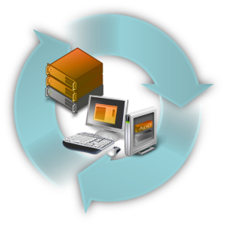

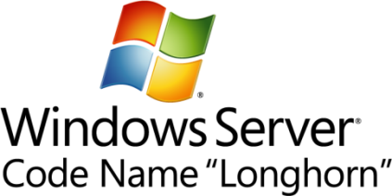



Microsoft Virtualization Strategy
Best TCO/ROI
It’s the Platform you know
Data center to desktop
End-to-End Management
1/3 the price up front
Key feature
of platform
Full range of products & solutions
Physical and Virtual & Cross-hypervisor
Significant Savings
Tools
you know
Large partner eco-system
Interoperability
Lower ongoing costs

Slide 3
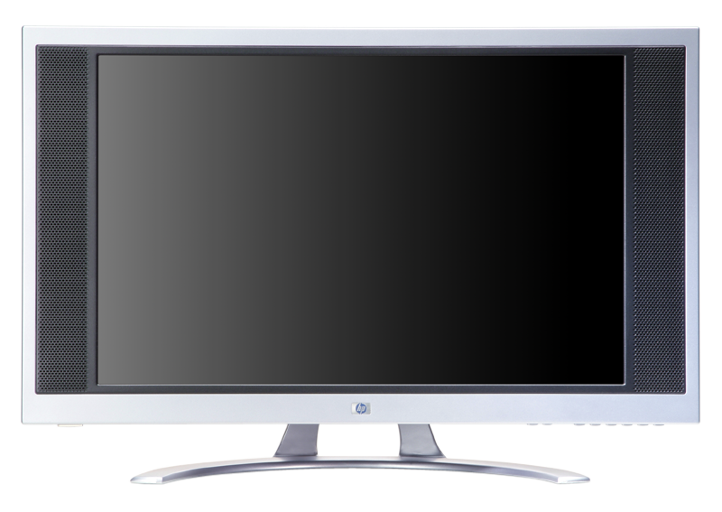

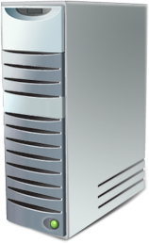
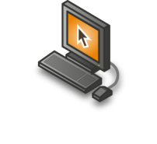


Virtualization
Improves IT Flexibility and Agility…
Machine Virtualization
OS can be assigned to any desktop or server
Operating System
installed to hardware
Presentation and process on same computer
Applications
installed to OS
Data resides
on local computer
Presentation Virtualization
Presentation layer separate from process
VS.
Application Virtualization
Any application on any computer on-demand
User-State Virtualization
Data resides on the network

Slide 4

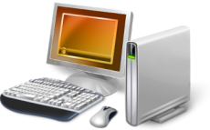
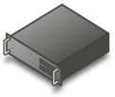









Microsoft Virtualization Products
From the Datacenter to the Desktop
Server
Virtualization
Application
Virtualization
Presentation
Virtualization
“Having one vendor for the hypervisor, operating system, and much of our application software was very appealing to us from a support and cost perspective.”
Bert Van Pottelberghe,
Sales Director, Hostbasket
Desktop
Virtualization
User State
Virtualization
Document redirection
Offline files
Notes:
Key points
Everyone thinks about server virt when they think about virt – we have history here w/ Virtual Server, and a big strength w/ Hyper-V
But, there’s more to virt than server virt…
As virtualization becomes more pervasive, management is much more critical to enable dynamic scenarios – System Center can sit at the heart of all of this
“When we think about virtualization, most of the hype in the industry today is focused on machine virtualization or server virtualization, and certainly server virtualization is a critical enabling technology where I'm able to encapsulate an operating system and application and my data all together.
Microsoft's solution there is that we have a solution, Virtual Server, in market, and now with Windows Server 2008, a key feature of Windows Server 2008 is Hyper-V, our hypervisor-based virtualization solution. That is in the process of coming to market and will be released to market within the next three to four weeks or so; which is great but that's just one kind of virtualization. Depending on the problem that you're trying to solve, there are a number of different virtualization technologies that are important to take advantage of.
So Application Virtualization: On clients the ability to do application isolation and to stream application on-demand is critical; if we think about the adaptive application delivery, which I'll talk to in a minute, and we have the leading virtualization capability here with Microsoft Application Virtualization.
Desktop virtualization: Virtual PC has been in market for awhile, and then we announced an acquisition of a company called Kidaro to really enable enterprise-class desktop virtualization solutions and scenarios.
Then presentation virtualization, which you may know of as Terminal Services, but the ability to centrally manage and host an application and the data, and just serve out the interaction with that, so present it up to a user remotely.
All of these different pieces can play a role in the solution that you're trying to solve for, but what's critical is at the heart of this is management. In a virtualized world, management becomes much, much more critical in enabling some of these dynamic scenarios that we talk about. So, take a broad view and think about desktop to datacenter.”

Slide 5
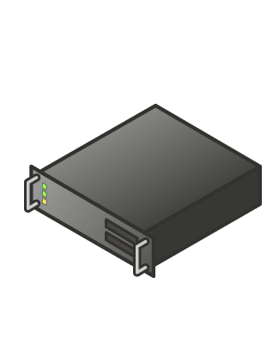
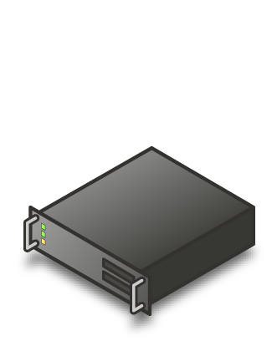
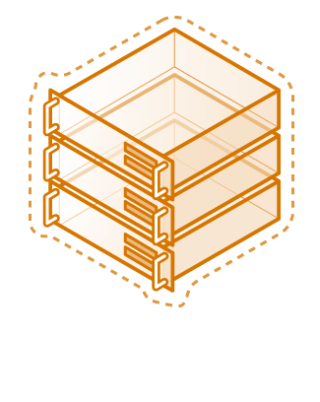
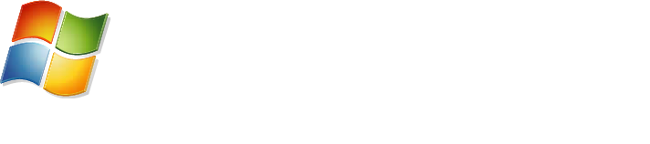
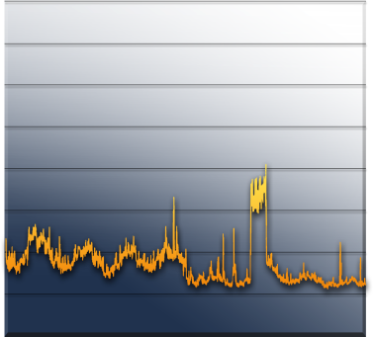
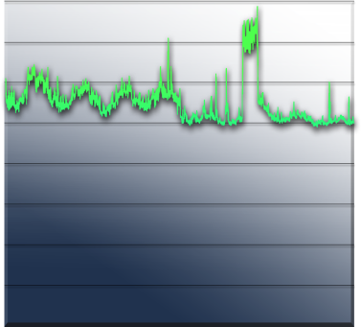
Server Consolidation:
The Fastest Way to Reduce Costs
Challenges:
Underutilized hardware
Excessive power consumption
Expensive space across datacenter and branch offices
“We expect to consolidate an additional 75 servers using Hyper-V, which will lead to a cost savings of more than $325,000 annually. By the time we hit our fifth virtual machine, we’ve usually paid for the host.
Long term, we will be able to reduce our total data center holdings by 75 percent—from nearly 400 servers to fewer than 100 servers.”
Robert McShinsky Senior Systems Administrator, Dartmouth-Hitchcock Medical Center
Server Utilization

Slide 6




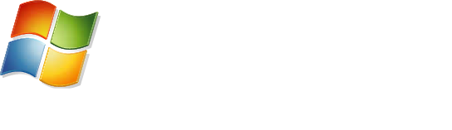

Virtualized Workloads
Microsoft fully supports our key server applications in a virtualized environment
Microsoft has updated server workload licensing to enable virtualization mobility
Management of the workloads is key, not just the virtual machine
“Maxol runs Exchange Server 2007, SQL Server 2005, Terminal Services, and file and print servers as key workloads in its virtual environment. Going forward, nearly every business application at Maxol will be a candidate for virtualization.”
Maxol Case Study
“We’ve seen first-hand that we can virtualize everything from file, print, and web servers to database servers running SQL Server and Oracle, and actually have the virtual machine run *faster* than what it ran on our original physical box.”
Janssen Jones, Indiana University

Slide 7
Windows Server 2008 R2 Hyper-V

Slide 8




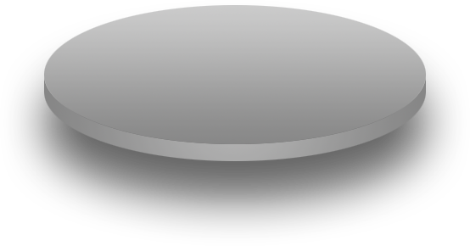




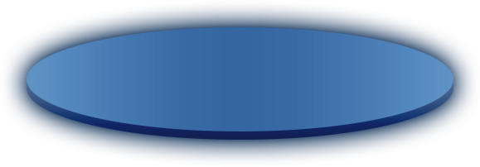
Hyper-V: Building and Expanding
Building on the rock-solid architecture of Windows Server 2008 Hyper-V
Integration with new technologies
Enabling new dynamic scenarios:
  Increased Server Consolidation
  Dynamic Data Center
  Virtualized Centralized Desktop

Slide 9
Hyper-V Architecture
Provided by:
OS
ISV / IHV / OEM
Microsoft Hyper-V
Parent Partition
Child Partitions
Microsoft / XenSource
Applications
Applications
Applications
VM Worker Processes
Applications
User Mode
WMI Provider
VM Service
Windows Server 2008
Windows Server 2003, 2008
Non-Hypervisor Aware OS
Xen-Enabled Linux Kernel
Windows Kernel
VSP
Windows Kernel
Linux VSC
VSC
IHV Drivers
VMBus
Kernel Mode
VMBus
VMBus
Emulation
Hypercall Adapter
Windows hypervisor
Ring -1
“Designed for Windows” Server Hardware

Slide 10
Windows Server 2008 R2 - Hyper-V
Delivers high levels of availability for production workloads via flexible and dynamic management while reducing overall costs through efficient server consolidation via:
Better flexibility
  Live Migration
  Cluster Shared Volumes
  Hot Add/remove of Storage
  Processor compatibility mode for live migration
Improved performance
  Improved memory management
  TCP Offload support
  Virtual Machine Queue (VMQ) Support
  Improved Networking
Greater Scalability
  At 64 logical processor support
  Enhance Green IT with Core Parking

Slide 11
Better flexibility
Live Migration
Cluster Shared Volumes
Hot Add/remove of Storage
Processor Compatabiltiy Mode

Slide 12
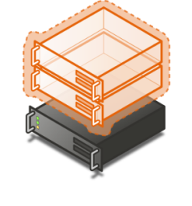


Live Migration
Overview
  Moving a virtual machine from one server to another without loss of service
Benefits
  Enables new scenarios
  Load balancing VMs for power
  Load balancing VMs for CPU
  Upgrade of host hardware and maintenance

Slide 13
Live Migration
Live Migration via Cluster Manager
  In box UI
Live Migration via Virtual Machine Manager
  Orchestrate migrations via policy
Moving from Quick to Live Migration:
  Guest OS limitations?: No
  Changes to VMs needed?: No
  Changes to Storage infrastructure: No
  Changes to Network Infrastructure: No
  Update to WS 2008 R2 Hyper-V: Yes

Slide 14

Quick Migration vs. Live Migration
Quick Migration
(Windows Server 2008 Hyper-V)
Save state
  Create VM on the target
  Write VM memory to shared storage
Move virtual machine
  Move storage connectivity from source host to target host via Ethernet
Restore state & Run
  Take VM memory from shared storage and restore on Target
  Run
Live Migration
(Windows Server 2008 R2 Server Hyper-V)
VM State/Memory Transfer
  Create VM on the target
  Move memory pages from the source to the target via Ethernet
Final state transfer and virtual machine restore
  Pause virtual machine
  Move storage connectivity from source host to target host via Ethernet
Un-pause & Run
Host 1
Host 2
Host 1
Host 2

Slide 15
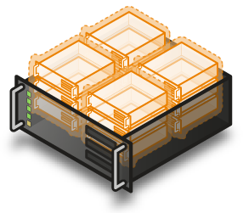

Cluster Share Volumes:
Migration & Storage
NEW Cluster Shared Volumes (CSV) in Windows Server 2008 R2
Overview
  CSV provides a single consistent file name space; All Windows Server 2008 R2 Server servers see the same storage
Benefits
  Easy setup; Uses NTFS
  No reformatting SANs
  Create one big data store
  No more drive letter problems
  Existing tools just work
  Highly recommended for live migration scenarios

Slide 16
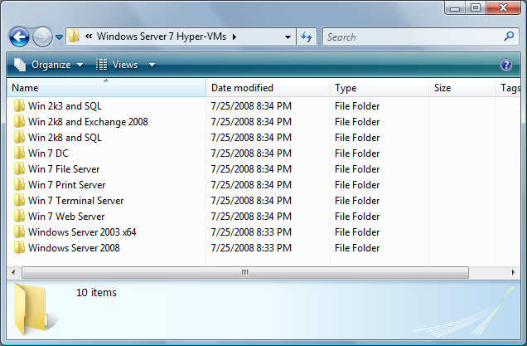
Cluster Shared Volumes
All servers “see” the same storage

Slide 17
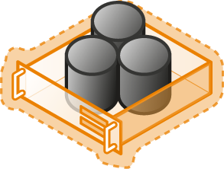
Hot Add/Remove Storage
Overview
  Add and remove VHD and pass-through disks to a running VM without requiring a reboot.
    Hot-add/remove disk applies to VHDs and pass-through disks attached to the virtual SCSI controller
Benefits
  Enables storage growth in VMs without downtime
  Enables additional datacenter backup scenarios
  Enables new SQL/Exchange scenarios

Slide 18
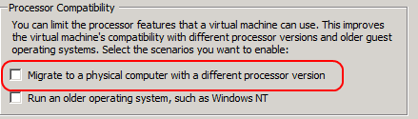
Processor Compatibility Mode
Overview
  Allows live migration across different CPU versions within the same processor family (i.e. Intel-to-Intel and AMD-to-AMD).
    Does NOT enable cross platform from Intel to AMD or vice versa.
  Configure compatibility on a per-VM basis.
  Abstracts the VM down to the lowest common denominator in terms of instruction sets available to the VM.
Benefits
  Provides a great deal of migration flexibility within clusters.
  Enables migration across a broader range of Hyper-V host hardware.
  No specific hardware requirements needed.

Slide 19

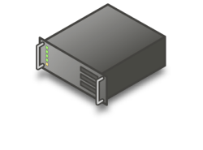
Processor Compatibility Mode
How it works?
  If a host A’s processor features are superset of host B’s processor features, migrating a running VM from host A to host B will fail; if the same VM is put in processor compatibility mode migration will succeed (see below image)
  Hypervisor exposes only those features to VM that are available between all Hyper-V supported processors
VM NOT in Processor compatibility mode
VM in Processor compatibility mode
VM sees
processor features: X,Y,Z
VM sees
processor features: X,Y
Migration fails
Migration succeeds
Physical Processor
features: X,Y,Z
Physical Processor
features: X,Y
Physical Processor
features: X,Y,Z
Physical Processor
features: X,Y
Host A
Host B
Host A
Host B

Slide 20
Processor compatibility mode
When to use it?
  If you have servers with different processors and you want flexibility in freely moving running VMs between servers
What to consider before using it?
  Moving a VM to a host with a superset of processor features does not require processor compatibility mode
  Due to some processor features are hidden from VM test multimedia, high-performance computing applications before deploying in VM with processor compatibility mode
Which Hyper-V features utilize this capability?
  Live Migration, Quick Migration and Save/Restore VM
How to use it?
  By default, processor compatibility mode is OFF
  To turn it ON, from Hyper-V Manager, select a CPU setting wizard of a VM. Check a check-box labeled “Migrate to physical computer with a different processor version”, see below image for details

Slide 21
Improved performance
Second Level Address Translation (SLAT)
TCP Offload support
Virtual Machine Queue (VMQ)
Jumbo Frame Support

Slide 22
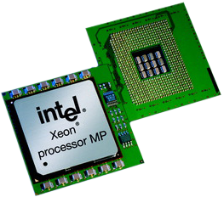
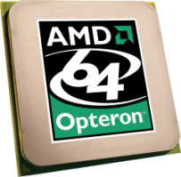
Second Level Address Translation (SLAT)
New Processor Feature Support
Overview
  Uses new processor features to improve performance and reduce load on Windows Hypervisor
    AMD: Nested Page Tables (NPT)
    Intel: Extended Page Tables (EPT)
Benefits
  Improve memory management performance
  Reduce in memory copies
  Memory usage will decrease from ~5% to 1% of total physical memory
  Most improvement with large working sets (TS/SQL)

Slide 23
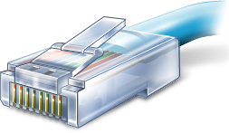
VM Chimney (TCP Offload Support)
Overview
  TCP/IP traffic in a VM can be offloaded to a physical NIC on the host computer.
  Disabled by default
Benefits
  Reduce CPU burden
  Networking offload to improve performance
  Live Migration is fully supported with Full TCP Offload
Cautions:
  Not all applications benefit from Chimney
    Works best for long-lived connections with large data transfers
    Applications with pre-posted buffers
  Chimney capable hardware supports a fixed number of offloaded connections – shared between all VMs

Slide 24
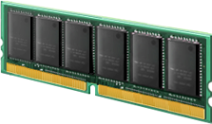
Virtual Machine Queue (VMQ)
Overview – disabled by default
  NIC can DMA packets directly into VM memory
    VM Device buffer gets assigned to one of the queues
    Avoids packet copies in the VSP
    Avoids route lookup in the virtual switch (VMQ Queue ID)
  Allows the NIC to essentially appear as multiple NICs on the physical host (queues)
    Best performance gains seen on 10G NICs (highly recommended)
Benefits
  Host no longer has device DMA data in its own buffer resulting in a shorter path length for I/O (performance gain)

Slide 25
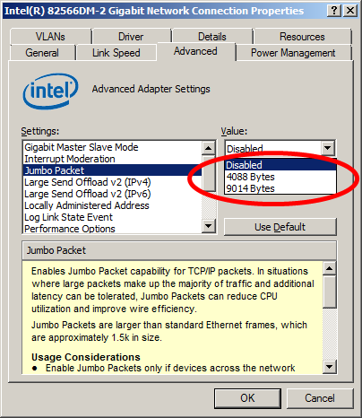
Jumbo Frame Support
Overview
  Enables 6x larger payload per packet
  Ethernet frames >1,500 bytes
  Ad hoc standard is ~9k
Benefits
  Improves throughput
  Reduce CPU utilization of large file transfers

Slide 26
Greater Scalability
64 logical processor support
Core Parking

Slide 27
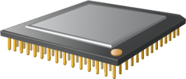
64 Logical Processor Support
Overview
  Provides Hyper-V the ability to utilizes up to 64 of the logical processor pool presented to Windows Server 2008 R2
Benefits
  Significantly increases host server density
  Easily provide multiple processers per virtual machine

Slide 28

Windows Server 2008 R2 Server Core Parking
Overview
  Scheduling virtual machines on a single server for density as opposed to dispersion
  This allows “park/sleep” cores by putting them in deep C states
Benefits
  Significantly enhances Green IT by being able to reduce power required for CPUs

Slide 29
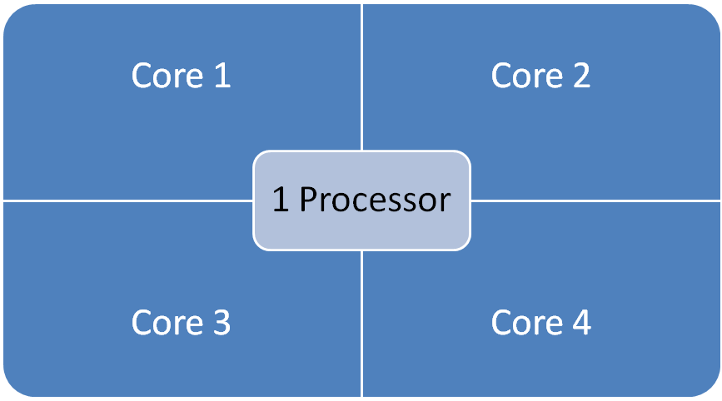
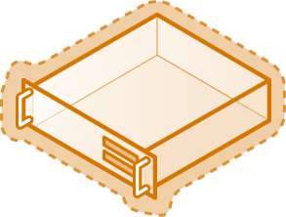
Windows Server 2008 (w/o core parking)
16 LP Server

Slide 30
Server Core Parking
16 LP Server
Processor is “parked”
Processor is “parked”

Slide 31

© 2007 Microsoft Corporation. All rights reserved. Microsoft, Windows, Windows Vista and other product names are or may be registered trademarks and/or trademarks in the U.S. and/or other countries.
The information herein is for informational purposes only and represents the current view of Microsoft Corporation as of the date of this presentation. Because Microsoft must respond to changing market conditions, it should not be interpreted to be a commitment on the part of Microsoft, and Microsoft cannot guarantee the accuracy of any information provided after the date of this presentation.
MICROSOFT MAKES NO WARRANTIES, EXPRESS, IMPLIED OR STATUTORY, AS TO THE INFORMATION IN THIS PRESENTATION.

