Slide 1
Windows Server 2008 R2 Hyper-V
Feature Overview Deck

Slide 2
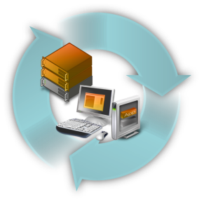
Microsoft Virtualization Strategy
Best TCO/ROI
It’s the Platform you know
Data center to desktop
End-to-End Management
1/3 the price up front
Key feature of platform
Full range of products & solutions
Physical and Virtual & Cross-hypervisor
Significant Savings
Tools you know
Large partner eco-system
Interoperability
Lower ongoing costs

Slide 3
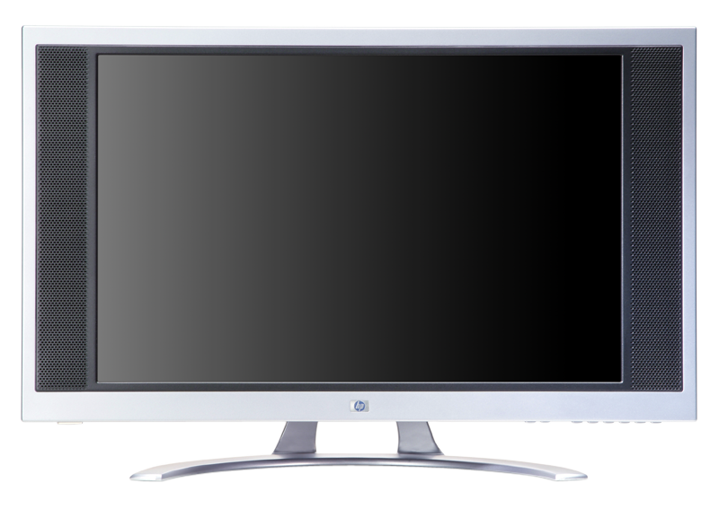
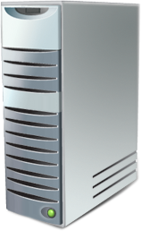
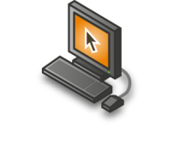
Virtualization Improves IT Flexibility and Agility…
Machine Virtualization
OS can be assigned to any desktop or server
Operating System installed to hardware
Presentation and process on same computer
Applications installed to OS
Data resides on local computer
Presentation Virtualization
Presentation layer separate from process
VS.
Application Virtualization
Any application on any computer on-demand
User-State Virtualization
Data resides on the network

Slide 4
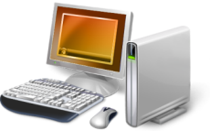
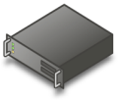
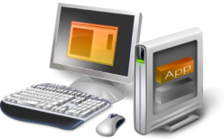
Microsoft Virtualization Products From the Datacenter to the Desktop
Server
Virtualization
Application
Virtualization
Presentation
Virtualization
“Having one vendor for the hypervisor, operating system, and much of our application software was very appealing to us from a support and cost perspective.”
Bert Van Pottelberghe,
Sales Director, Hostbasket
Desktop
Virtualization
User State
Virtualization
Document redirection
Offline files
Notes:
Note: all customer quotes are from Windows Server 2008 Case studies.
Key points
Everyone thinks about server virt when they think about virt – we have history here w/ Virtual Server, and a big strength w/ Hyper-V
But, there’s more to virt than server virt…
As virtualization becomes more pervasive, management is much more critical to enable dynamic scenarios – System Center can sit at the heart of all of this
“When we think about virtualization, most of the hype in the industry today is focused on machine virtualization or server virtualization, and certainly server virtualization is a critical enabling technology where I'm able to encapsulate an operating system and application and my data all together.
Microsoft's solution there is that we have a solution, Virtual Server, in market, and now with Windows Server 2008, a key feature of Windows Server 2008 is Hyper-V, our hypervisor-based virtualization solution. That is in the process of coming to market and will be released to market within the next three to four weeks or so; which is great but that's just one kind of virtualization. Depending on the problem that you're trying to solve, there are a number of different virtualization technologies that are important to take advantage of.
So Application Virtualization: On clients the ability to do application isolation and to stream application on-demand is critical; if we think about the adaptive application delivery, which I'll talk to in a minute, and we have the leading virtualization capability here with Microsoft Application Virtualization.
Desktop virtualization: Virtual PC has been in market for awhile, and then we announced an acquisition of a company called Kidaro to really enable enterprise-class desktop virtualization solutions and scenarios.
Then presentation virtualization, which you may know of as Terminal Services, but the ability to centrally manage and host an application and the data, and just serve out the interaction with that, so present it up to a user remotely.
All of these different pieces can play a role in the solution that you're trying to solve for, but what's critical is at the heart of this is management. In a virtualized world, management becomes much, much more critical in enabling some of these dynamic scenarios that we talk about. So, take a broad view and think about desktop to datacenter.”

Slide 5
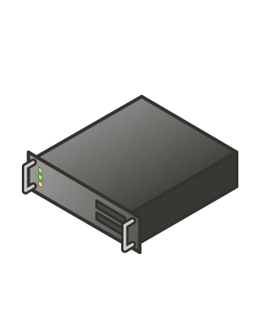
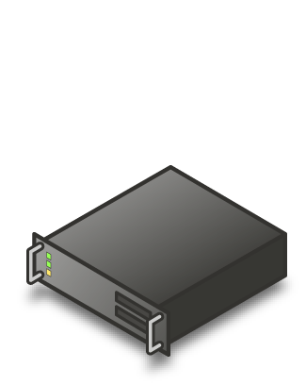
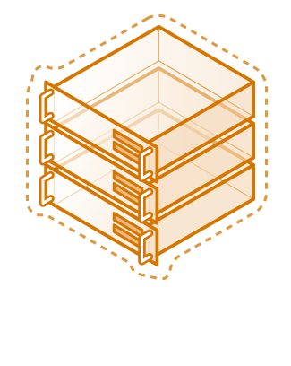
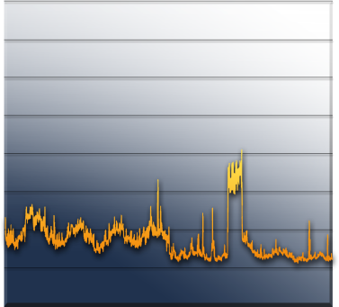
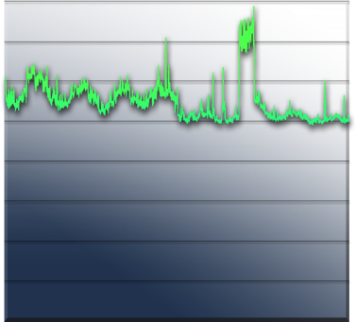
Server Consolidation: The Fastest Way to Reduce Costs
Challenges:
Underutilized hardware
Excessive power consumption
Expensive space across datacenter and branch offices
“We expect to consolidate an additional 75 servers using Hyper-V, which will lead to a cost savings of more than $325,000 annually. By the time we hit our fifth virtual machine, we’ve usually paid for the host.
Long term, we will be able to reduce our total data center holdings by 75 percent—from nearly 400 servers to fewer than 100 servers.”
Robert McShinsky Senior Systems Administrator, Dartmouth-Hitchcock Medical Center
Server Utilization
Notes:
Note: all customer quotes are from Windows Server 2008 Case studies.

Slide 6
Virtualized Workloads
Microsoft fully supports our key server applications in a virtualized environment
Microsoft has updated server workload licensing to enable virtualization mobility
Management of the workloads is key, not just the virtual machine
“Maxol runs Exchange Server 2007, SQL Server 2005, Terminal Services, and file and print servers as key workloads in its virtual environment. Going forward, nearly every business application at Maxol will be a candidate for virtualization.”
Maxol Case Study
“We’ve seen first-hand that we can virtualize everything from file, print, and web servers to database servers running SQL Server and Oracle, and actually have the virtual machine run *faster* than what it ran on our original physical box.”
Janssen Jones, Indiana University
Notes:
Note: all customer quotes are from Windows Server 2008 Case studies.

Slide 7
Windows Server 2008 R2 Hyper-V

Slide 8
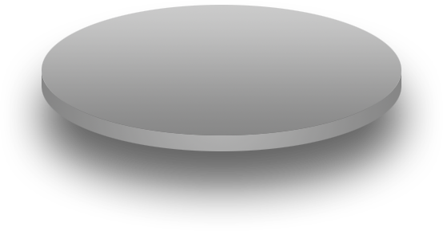
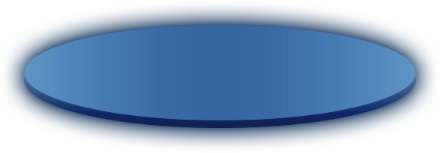
Hyper-V: Building and Expanding
Building on the rock-solid architecture of Windows Server 2008 Hyper-V
Integration with new technologies
Enabling new dynamic scenarios:
Increased Server Consolidation
Dynamic Data Center
Virtualized Centralized Desktop

Slide 9
Hyper-V Architecture
Provided by:
OS
ISV / IHV / OEM
Microsoft Hyper-V
Parent Partition
Child Partitions
Microsoft / XenSource
Applications
Applications
Applications
VM Worker Processes
Applications
User Mode
WMI Provider
VM Service
Windows Server 2008
Windows Server 2003, 2008
Non-Hypervisor Aware OS
Xen-Enabled Linux Kernel
Windows Kernel
VSP
Windows Kernel
Linux VSC
VSC
IHV Drivers
VMBus
Kernel Mode
VMBus
VMBus
Emulation
Hypercall Adapter
Windows hypervisor
Ring -1
“Designed for Windows” Server Hardware

Slide 10
Windows Server 2008 R2 - Hyper-V
Delivers high levels of availability for production workloads via flexible and dynamic management while reducing overall costs through efficient server consolidation via:
Better flexibility
Live Migration
Cluster Shared Volumes
Hot Add/remove of Storage
Processor compatibility mode for live migration
Improved performance
Improved memory management
TCP Offload support
Virtual Machine Queue (VMQ) Support
Improved Networking
Greater Scalability
At 64 logical processor support
Enhance Green IT with Core Parking

Slide 11
Better flexibility Live Migration Cluster Shared Volumes Hot Add/remove of Storage Processor Compatabiltiy Mode

Slide 12
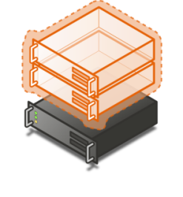
Live Migration
Overview
Provides the ability to move a virtual machine from one Hyper-V host server to another without loss of service
Benefits
Creates a dynamic IT infrastructure within your business
Provides the highest uptime for virtual machines
Load balancing VMs for power
Load balancing VMs for CPU
Upgrade of host hardware and maintenance

Slide 13
Live Migration
No change or limitations to existing IT infrastructure need:
Guest OS limitations?: No
Changes to VMs needed?: No
Changes to Storage infrastructure: No
Changes to Network Infrastructure: No
Update to WS 2008 R2 Hyper-V: Yes

Slide 14
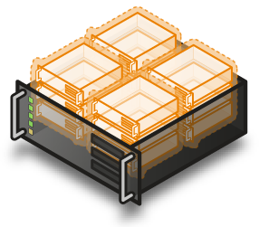
Cluster Share Volumes: Migration & Storage
Overview
Cluster Shared Volumes (CSV) in Windows Server 2008 R2 provides a single consistent file name space; All Windows Server 2008 R2 Server servers see the same storage
Benefits
Easy setup; uses existing Windows Server file system
No reformatting SANs
Eliminates drive letter limitation problems
Eases management burden & existing tools work
Highly recommended for live migration scenarios

Slide 15
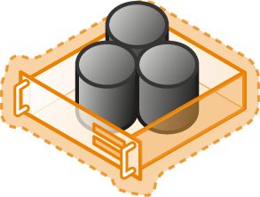
Hot Add/Remove Storage
Overview
Add and remove storage to virtual machines on the fly without requiring a reboot.
Hot-add/remove disk applies to VHDs and pass-through disks attached to the virtual SCSI controller
Benefits
Adds to the dynamic IT infrastructure
Enables storage growth in VMs without downtime
Enables additional datacenter backup scenarios

Slide 16
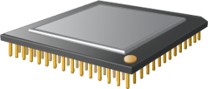
Processor Compatibility Mode
Overview
Allows live migration across different CPU versions within the same processor family (i.e. Intel-to-Intel and AMD-to-AMD).
Does NOT enable cross platform from Intel to AMD or vice versa.
Benefits
Enables migration across a broader range of Hyper-V host hardware.
Provides a great deal of migration flexibility within clusters.
No specific hardware requirements needed.

Slide 17
Improved performance Processor Management Enhancements Networking Performance Improvements: TCP Offload support Virtual Machine Queue (VMQ) Jumbo Frame Support

Slide 18
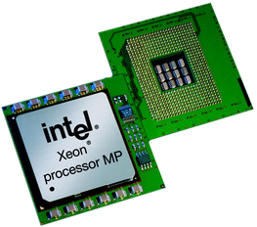
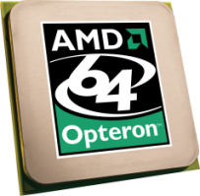
New Processor Feature Support: Processor Management Enhancements
Overview
Uses new processor features to improve performance and reduce load on Windows Hypervisor
AMD: Nested Page Tables (NPT)
Intel: Extended Page Tables (EPT)
Benefits
Improve memory management performance
Most improvement for high performance workloads such as SQL

Slide 19
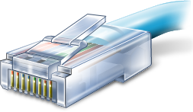
Networking Performance Improvements
Overview
Performance gains by offloading network traffic directly to network hardware
Allows network hardware to essentially appear as multiple network adaptors on the physical host
Increased data transfer sizes
Benefits
Reduce CPU burden
Networking offload to improve performance
Improves network efficiencies
Reduce CPU utilization of large file transfers

Slide 20
Greater Scalability 64 logical processor support Core Parking

Slide 21
64 Logical Processor Support
Overview
Provides Hyper-V the ability to utilizes up to 64 of the logical processor pool presented to Windows Server 2008 R2
Benefits
Significantly increases host server density
Easily provide multiple processers per virtual machine

Slide 22
Windows Server 2008 R2 Server Core Parking
Overview
This allows processor cores into a “park/sleep” mode when not in use.
Scheduling virtual machines on a single server for density as opposed to dispersion
Benefits
Significantly enhances Green IT by being able to reduce power required for CPUs

Slide 23
© 2007 Microsoft Corporation. All rights reserved. Microsoft, Windows, Windows Vista and other product names are or may be registered trademarks and/or trademarks in the U.S. and/or other countries.
The information herein is for informational purposes only and represents the current view of Microsoft Corporation as of the date of this presentation. Because Microsoft must respond to changing market conditions, it should not be interpreted to be a commitment on the part of Microsoft, and Microsoft cannot guarantee the accuracy of any information provided after the date of this presentation. MICROSOFT MAKES NO WARRANTIES, EXPRESS, IMPLIED OR STATUTORY, AS TO THE INFORMATION IN THIS PRESENTATION.

