Slide 2
Mobile Broadband Driver Development In Windows 7
Malayala Srinivasan
Sr. Program Manager Lead
Microsoft Corporation

Slide 3
Agenda
Windows 7: Mobile Broadband
Debug and Test Tools
Design for Deployment
Roadmap
Call To Action
Demo

Slide 4
Terminologies
Mobile Broadband (MB) is also referred as
Wireless WAN
WWAN
MB
Mobile Broadband Driver is also referred as
IHV Miniport Driver
MB Driver
Miniport Driver

Slide 5
MB Devices In Windows Vista
Network Adapter
Modem
Connection Manager #1
Connection Manager #n
Connection Manager #1
. . .
NDIS Driver
Modem
Integration challenges with OS and Connection Managers

Slide 6
What Is New?
Simple out-of-box connection experience for Mobile Broadband
Similar to WLAN, VPN and Dial-up
Driver Model for Mobile Broadband Devices
Mobile Broadband APIs
Logo Program for MB Devices

Slide 7
Driver Model
Supports packet-switched data connectivity over the Wireless WAN (3GPP/3GPP2) devices
Interconnect agnostic – Works on USB, PCMCIA/PC Card and any other interconnect technology
Introduces new NDIS Medium – NdisMediumWirelessWAN
Framework designed for slow response AT command based devices
Based on NDIS6.20 miniport driver model

Slide 8
Architecture
View Available
Network UI
Connection Flow
Experience UI
Properties UI
3rd Party
Connection Manager
Command
Line Interface
User Mode
Mobile Broadband API
Session 0
WWAN Service
Profiles
NDISUIO
Provided by:
Kernel Mode
Microsoft
Mobile Broadband Driver Model
ISV
WWAN Miniport Driver
WWAN Miniport Driver
IHV
MB Miniport Driver
OEM

Slide 9
Mobile Broadband Service
Also called as “WWAN Service”
User mode, Session 0 Windows Service
Implements Auto-connect, Auto-configuration and Diagnostics features
State machine implementation to
Manage Mobile Broadband devices, network and connectivity
Provide SMS, PIN and scanning functionalities

Slide 10
NDIS6.20 – Data Path
Windows Vista
Windows 7
TCP/IP Stack
TCP/IP Stack
NDIS 6.0
NDIS 6.20
Send / Receive
Send / Receive
802.3 Frames
IP Frames
IHV Miniport Driver
IHV Miniport Driver
DHCP Emulation
ARP Emulation
Windows 7 IHV Miniport Drivers for Mobile Broadband can
Take advantage of raw IP support in send/receive path
Eliminate DHCP and ARP spoofing in miniport drivers
Write less code and focus more on Quality

Slide 11
Control Path Functionalities
MB Driver Model defines the following control path functionalities
Device State Management
Connectivity Management
Radio Control
SMS (Short Message Services)
PIN
Provisioned Contexts
Service Activation
Vendor Specific

Slide 12
Control Path DDIs
WWAN Service uses NDIS OIDs for control requests (SET or QUERY) to miniport drivers
Asynchronous semantics for slow control devices
Designed for AT command-response based modems

Slide 13
Asynchronous Model
WWAN Service
Miniport Driver
NdisOidRequest
Oid = OID_WWAN_CONNECT
RequestHandle = 0x12345678
RequestId = 0x0000F00D
…
Asynchronous Response
Initiated by WWAN Service
2 Types : SET or QUERY
RequestId is Non-NULL
Return
NDIS_STATUS_INDICATION_REQUIRED
AT Cmd(s) to Device
NdisMIndicateStatusEx
Device Responds
StatusCode = NDIS_STATUS_WWAN_CONTEXT_STATE
DestinationHandle = 0x12345678
RequestId = 0x0000F00D
ActivationState = WwanActivationStateActivated
…
Event Notification
Used for device or network state changes
Initiated by driver
Request Id = NULL
Device/Network
state change
NdisMIndicateStatusEx
StatusCode = NDIS_STATUS_WWAN_CONTEXT_STATE
RequestId = 0x0
ActivationState = WwanActivationStateDeactivated
…

Slide 14
Debug And Test Tools

Slide 15
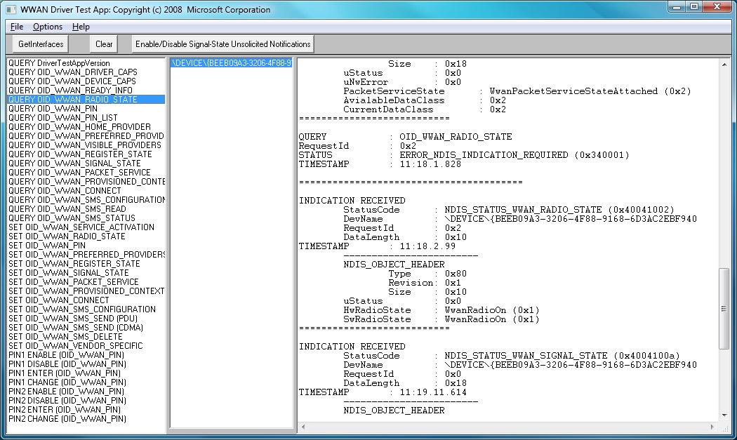
Control Path Testing
WwanDriverTestApp – Available in WDK
Helps testing OIDs individually one at a time
Not useful for testing multiple OIDs at same time

Slide 16
Control Path Testing – II
Mobile Broadband Device tests in WLK
Helps verifying OID functionalities and behavior
Full pass will qualify for Device Logo!

Slide 17
Packet Capture
Use Windows 7 feature: Packet Capture
Disconnect all interfaces other than WWAN
Launch command prompt in administrator mode and follow instructions below
The above produces dumpfile.xml
Make sure that you see PacketFragment events from the Microsoft-Windows-NDIS-PacketCapture provider
Supported in upcoming Beta builds
C:\netsh trace start capture=yes tracefile=foo.etl
<generate traffic – e.g, visit a website>
C:\netsh trace stop
C:\tracerpt –y -of XML foo.etl

Slide 18
Packet Analysis: Netmon
Use Netmon 3.2 for analyzing packets captured using Packet Capture feature
Netmon ETL Parser for Mobile Broadband is available for download from http://go.microsoft.com/fwlink/?LinkId=125105

Slide 19
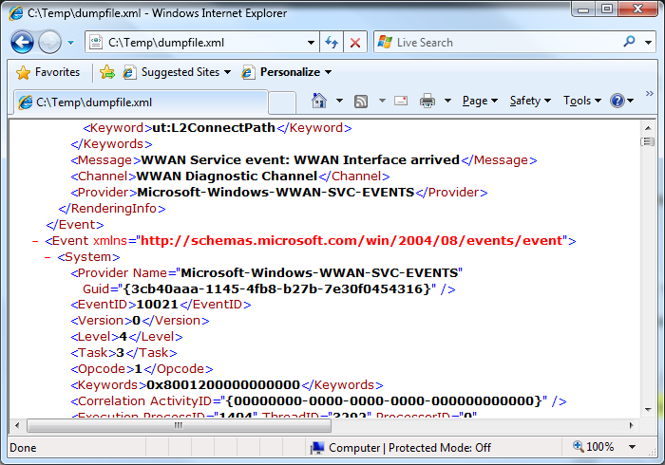
Debugging : Trace Log
Uses Windows 7 features Unified Tracing
Example – starting and stopping
The above produces dumpfile.xml
C:\netsh trace start scenario=wwan tracefile=foo.etl
<Use test application to generate control path traffic>
C:\netsh trace stop
C:\tracerpt –y -of XML foo.etl

Slide 20
Design For Deployment

Slide 21
Design For Deployment
Consider the following deployment scenarios while developing Win7 Drivers
Upgrade of Windows Vista to Windows 7
Ensure Windows 7 drivers can handle the Vista based Connection Managers
Devices can be used in Windows 7 as well as down-level Windows
Develop single firmware supporting all Windows

Slide 22
Design For Deployment
Driver distribution through Windows Update
Must be INF based installation
Firmware upgrades must be handled through Device Co-Installers

Slide 23
Future Investments

Slide 24
Windows 7
Future Windows Investments
Build MB Platform
Enable Ubiquitous Networking
Driver Model and Logo
API
Diagnostics
Connection Management
Rich enterprise policy management
Service Activation and Provisioning

Slide 25
Call To Action
Develop NDIS6.20 drivers compliant with Mobile Broadband Driver Model
MB devices must be NDIS6.20-based to get logo.
Refer to Mobile Broadband Whitepaper for multi-stage development model
Design drivers taking deployment scenarios into consideration
Test commercially deployed Mobile Broadband device solutions in Windows 7
Review Mobile Broadband device logo requirements and send us feedback
Contact us at win7mb@microsoft.com

Slide 26
Resources
Mobile Broadband Logo Requirements on https://winqual.microsoft.com/
Log in, click on the Logopoint link on the left side menu, and search for “MBN” requirements
WDK Documentation on MSDN
Porting NDIS 5.x Drivers to NDIS 6.0 - http://msdn.microsoft.com/hi-in/library/ms795567(en-us).aspx
IP Helper - http://msdn.microsoft.com/hi-in/library/bb742902(en-us).aspx
WDK documentation
Mobile Broadband Driver Model Specification
Mobile Broadband Driver Test App (WwanDriverTestApp)
NDIS 6.20
Windows Logo Kit (WLK)
Mobile Broadband Logo Tests
WHDC Web site at http://www.microsoft.com/whdc/default.mspx
Mobile Broadband Driver Development White Paper

Slide 27
Resources
WinHEC 2008 Session Resources
NDIS 6.20: Overview of Changes and Enhancements in Windows 7
NDIS 6.20: Core Network Power Management Fundamentals
Unified Tracing and Network Diagnostics Framework for Windows 7
Distributing Drivers on Windows Update
Extending Device Installation with Co-Installers

Slide 28
Related Sessions
Session | Day/Time
Windows 7: Mobile Broadband APIs | 7th Nov: 9.45AM – 10.45AM
New Windows Logo Program for Mobile Broadband Devices | 7th Nov: 11AM – 12 Noon
Discussion: Making Drivers Available on Windows | 7th Nov: 3.30PM – 4.30PM

Slide 29
Windows 7 Mobile Broadband demo using Sierra Wireless HSPA modems
Graeme Harfman Director of Software Marketing Sierra Wireless Inc.

Slide 30
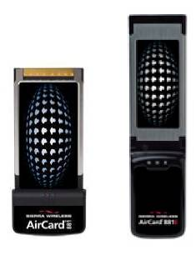
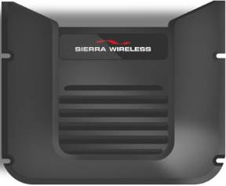
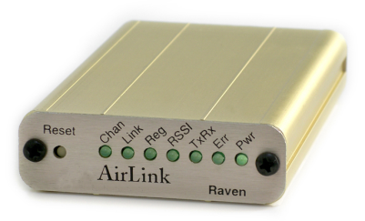
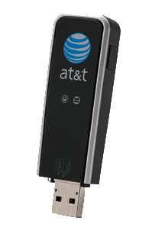
Sierra Wireless Product Lines
Wide breadth of devices tested for compatibility with Windows 7
Latest generation devices supports native Windows 7 Mobile Broadband driver model
Adapter Products
Embedded
Modules
Rugged
Mobiles
Rugged
Mobiles
M2M Modems
& Gateways
30
Notes:
Sierra Wireless Software
30
30
30

Slide 31
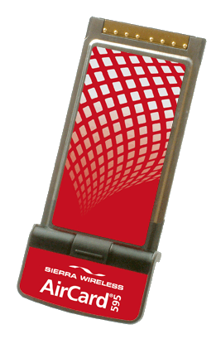
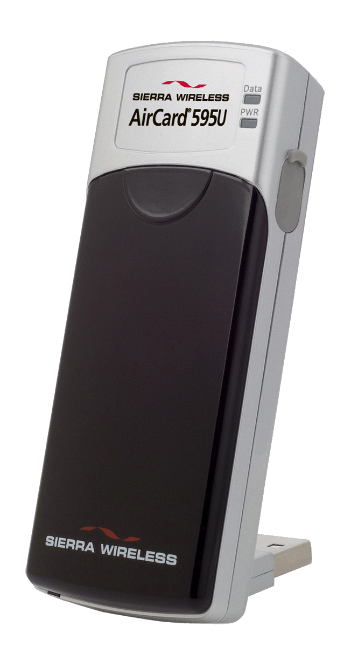
Windows 7 Mobile Broadband Driver Model Support
HSPA & EV-DO Support
Broad range of AirCard® & USB Solutions
AT&T Mercury USB modem
595 PC card and USB Modem
31
Notes:
31

Slide 32
Please Complete A Session Evaluation Form Your input is important!
Visit the WinHEC CommNet and complete a Session Evaluation for this session and be entered to win one of 150 Maxtor® BlackArmor™ 160GB External Hard Drives 50 drives will be given away daily!
http://www.winhec2008.com
BlackArmor Hard Drives provided by:

Slide 33
© 2008 Microsoft Corporation. All rights reserved. Microsoft, Windows, Windows Vista and other product names are or may be registered trademarks and/or trademarks in the U.S. and/or other countries.
The information herein is for informational purposes only and represents the current view of Microsoft Corporation as of the date of this presentation. Because Microsoft must respond to changing market conditions, it should not be interpreted to be a commitment on the part of Microsoft, and Microsoft cannot guarantee the accuracy of any information provided after the date of this presentation. MICROSOFT MAKES NO WARRANTIES, EXPRESS, IMPLIED OR STATUTORY, AS TO THE INFORMATION IN THIS PRESENTATION.

