Slide 2
Connecting Projectors And Using Docking Stations With Windows 7
Akshay Agrawal
Program Manager
Microsoft Corporation

Slide 3
Agenda
Improved multi-monitor support in Windows 7
What is “Connecting and Configuring Displays” ?
What does the + ‘P’ key do?
New display control panel
Improvements to the graphics stack
Microsoft recommendations and guidelines for the PC eco-system
System OEMs, graphics vendors, display manufacturers, cable/KVM manufacturers

Slide 4
Connecting And Configuring Displays

Slide 5
Introduction
“… is the new Windows 7 feature for end-to-end multi-monitor support.”
Scenarios
Laptops
Connecting a projector or TV
Docking stations with multiple monitors
Desktop
Connecting multiple monitors
Connecting a TV

Slide 6
Why Is This Important
Need to provide a simple user experience
Has been historically challenging
Increase in transient display scenarios
Laptops more popular than desktops
Increased multi-monitor popularity
LCD panels are now very affordable
Gain in productivity

Slide 7
Display Eco-System

Slide 8
The Eco-System
PC software
Windows operating system
Graphics driver
PC hardware
Laptops
Display devices
Monitors
Cables/KVM
OEM and IHV value add applications
Desktops
Graphics adapters
Projectors
TV
Display cable
KVM switchbox
Extender box

Slide 9
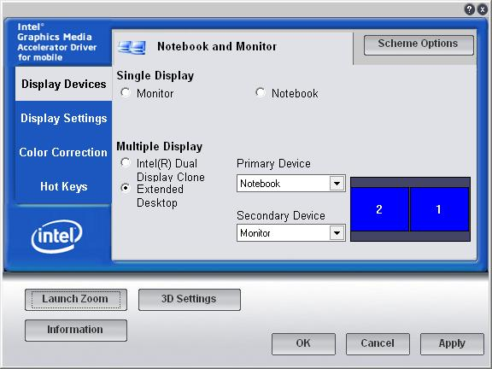
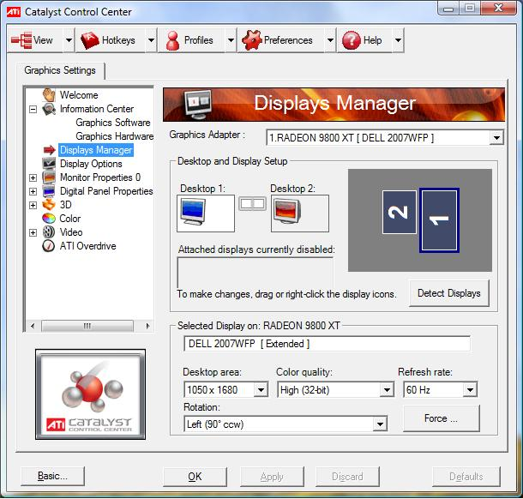
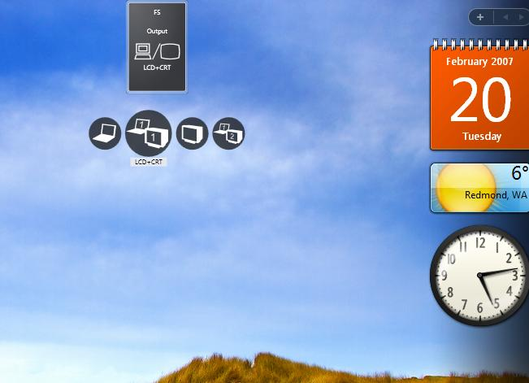
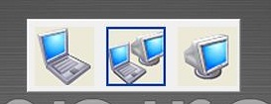
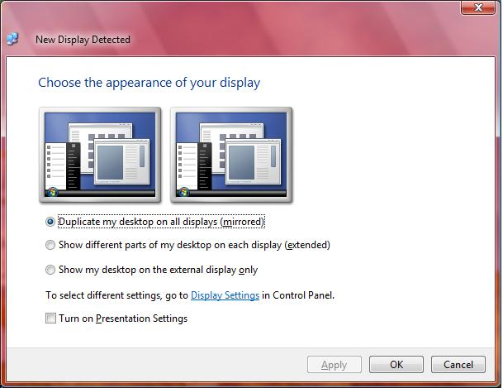
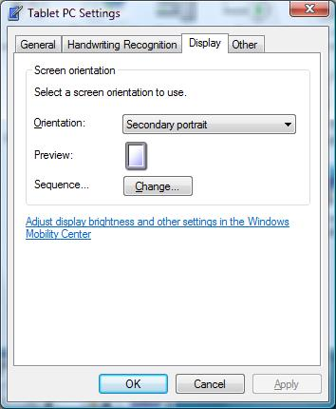
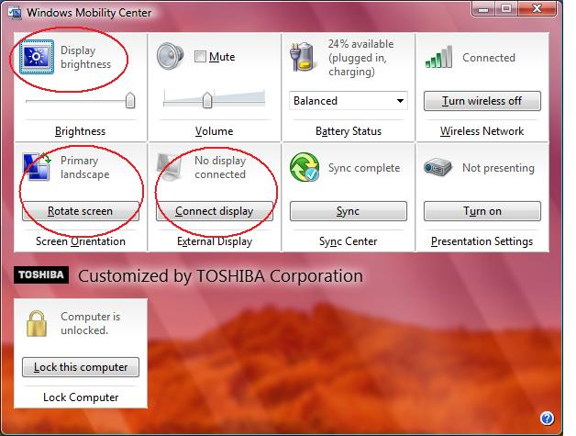
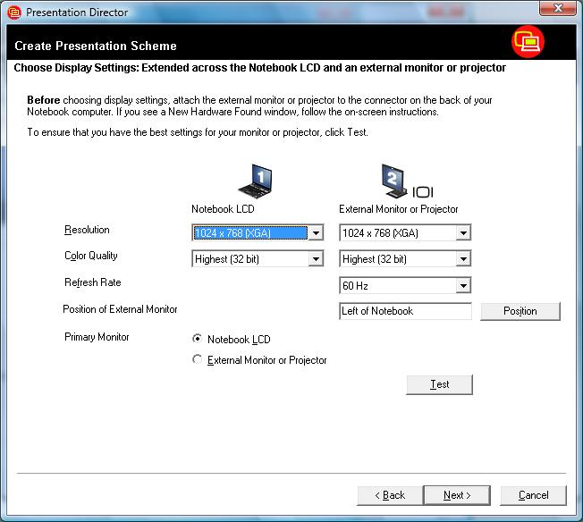
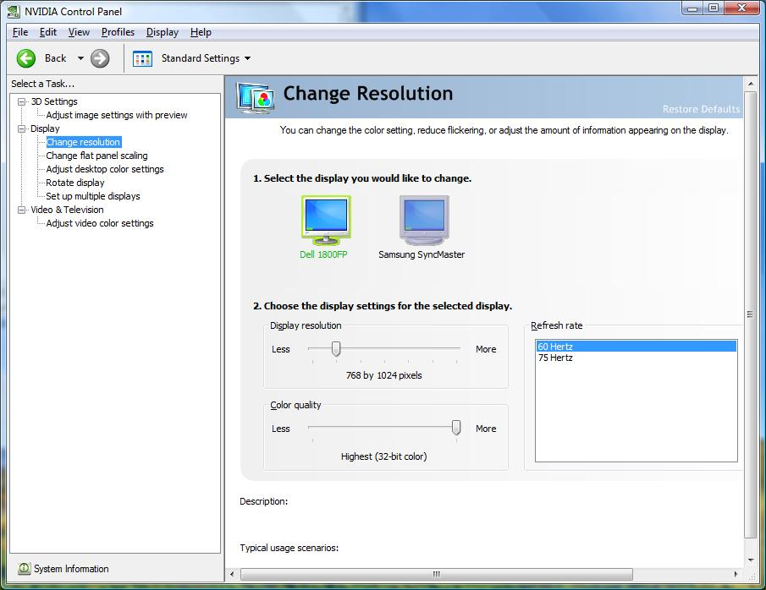
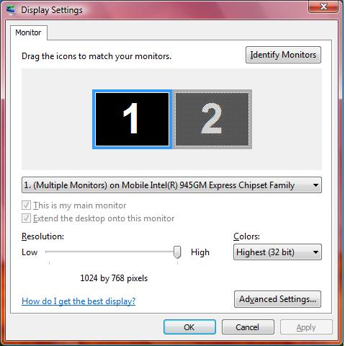
Confusing User Experience

Slide 10
Too Many Solutions
Provided by:
Windows -
user mode components
OEM value add
Microsoft
Gfx IHV
IHV value add
Hardware
PC OEM
User mode graphics driver
User Mode
Kernel Mode
Windows – Kernel mode components
Kernel mode graphics driver
OEM ACPI hot key
Graphics hardware

Slide 11
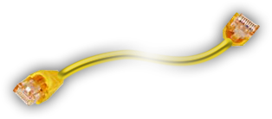
Display Devices With An EDID
Display Devices Without An EDID
Hello,
I am a PC
Hello, I am a Monitor

Slide 12
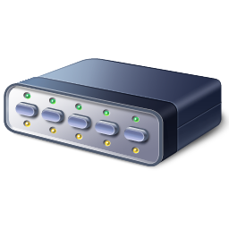
Cable/KVM Don’t Pass EDID
Hello, I am a Projector
Hello,
I am a PC
Hello, I am a KVM or Cable Extender

Slide 13
What Is Success?
Display scenarios should “just work”
Easy to understand behavior and UI
Streamlined user experience
Hardware agnostic user experience
Reliable and robust solution

Slide 14
Windows 7 Improvements

Slide 15
What's Done In Windows7
Improve end user experience
Provide consistent and predictable UX
Automatically configure the display device
Improve reliability
Address areas of potential failures
Provide infrastructure for the partners
New APIs, DDIs, persistence database

Slide 16
Consistent And Predictable UX
Same user experience on desktops and laptops
Hardware agnostic user experience
Address all scenarios end to end
Eliminate duplicate UI

Slide 17
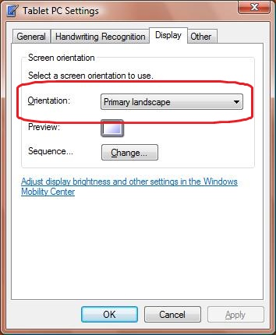
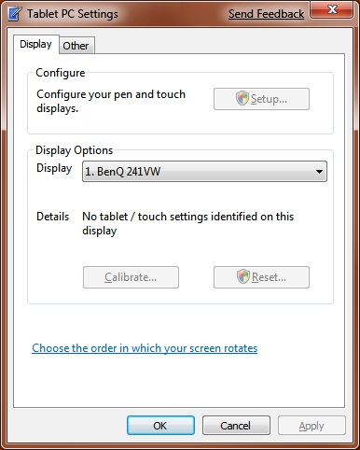
Tablet PC Settings
Vista
Windows 7

Slide 18
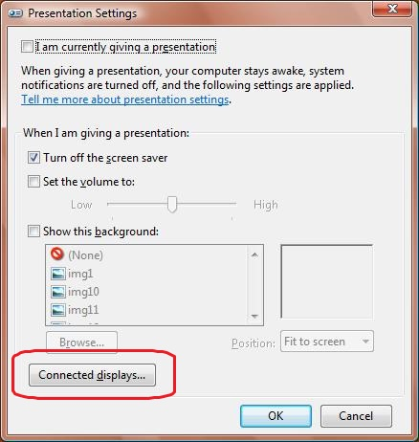
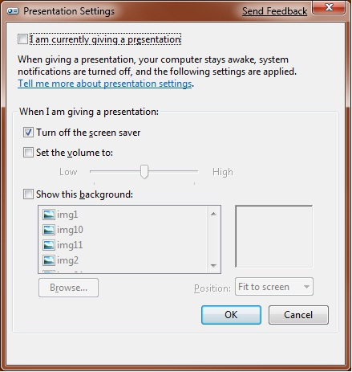
Presentation Settings
Vista
Windows 7

Slide 19
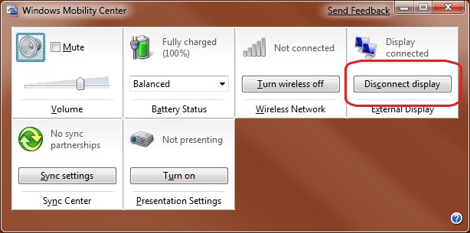
Mobility Center
Vista
Windows 7

Slide 20
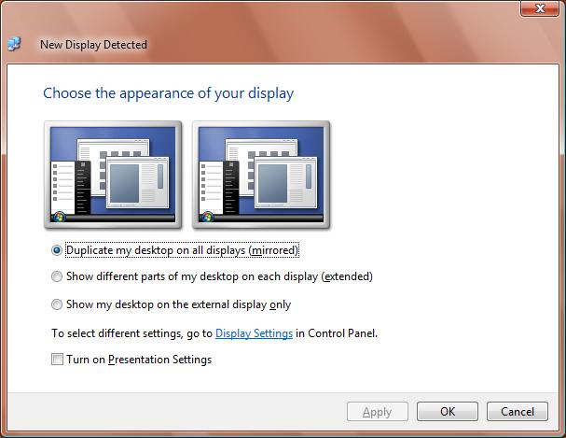
Transient MultiMonitor Manager
Vista
Windows 7

Slide 21
Projection Hot Key Introduction
Windows 7 provides a new projection hot key
Press and hold the key and tap the ‘P’ key

Slide 22
Projection Hot Key Features
Simple keyboard combination Windows key + (P)rojection key
Works the same on ALL laptops and desktops
Always provides the same options
Available even before user logs in
Works for more than 2 displays
Works with the new persistence database

Slide 23
Display Control Panel All displays are shown

Slide 24
Display Control Panel Monitor name

Slide 25
Display Control Panel Native resolution

Slide 26
Display Control Panel Monitor rotation

Slide 27
Display Control Panel Multi-monitor support

Slide 28
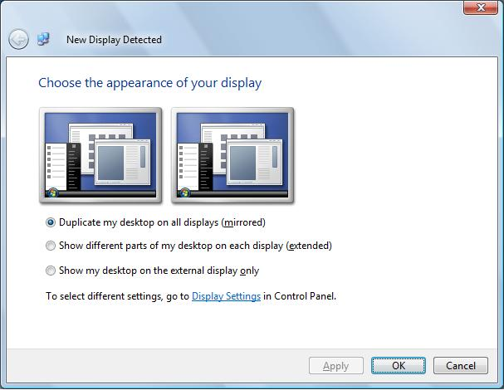
Automatic Configuration
Automatically enables a display device on connection
Optimum display settings applied based on EDID

Slide 29
New Persistence Database
Remembers display settings and re-applies
Settings based on EDID data
Changes made via Display Control Panel are persisted
Projection hot key uses same data
Settings applied even before logon screen is displayed
Any application that uses the new APIs can take advantage of this

Slide 30
Reliability And Robustness
Integrated solution into the Windows kernel
More reliable detection of display devices
Improved the infrastructure to eliminate
Black screens
Wrong display settings
Screen swaps

Slide 31
Docking Station Support
Docking station scenarios are part of design – not special case
Takes advantage of new persistence database and optimum setting algorithm
Call to action
System BIOS must implement ACPI-based docking notification
Graphics driver must report accurate state of display connectivity

Slide 32
New Aspect Ratio Scaling
Common scenarios
Widescreen laptop with standard projector
Standard laptop with widescreen TV
New “aspect ratio preserving” scaling mode is used as default on WDDM 1.1 drivers
Also accessible via new APIs

Slide 33
Graphics Driver Support
Windows 7 drivers
Driver model optimized for Windows 7
Additional support for aspect ratio scaling
Better support for TV resolutions
Vista drivers
+ ‘P’ and other features are designed to work on Windows Vista signed drivers
User who upgrade from Vista, will get the benefits of Windows 7 features
XP drivers
No new capabilities exposed

Slide 34
Working With The Ecosystem

Slide 35
Graphics Hardware Vendors
New WHQL requirements
Must not override operating system defaults
Report accurate display connectivity
Support new aspect ratio scaling
Set ITC bit for HDMI TV
Provide unified driver package that align with the Windows 7 design goals
Implement automatic detection for analog connectors

Slide 36
PC System Manufacturers
Provide Windows 7 optimized graphics drivers
Well formed EDID for laptop panel
Docking support
System BIOS must implement ACPI based docking notification
Graphics driver must report accurate state of display connectivity
Highly recommend
… modifying ACPI hot key to display Windows 7 projection hot key
… avoid stand alone UI for display scenarios – extend the display control panel UI

Slide 37
Display Manufacturers
New WHQL requirements
Well formed and accurate EDID
Native panel resolution = “Preferred timing”
User friendly name
Unique manufacturer ID and serial number
Accurate physical dimensions
All devices must support a “PC mode”
No overscan
No video processing
No edge enhancement

Slide 38
Cable And KVM Manufacturers
Cables
Always transmit the EDID
Pin used is 12 and 15 for VGA
Cable length and noise shielding based on VESA and HDMI standards
KVM switchbox
Accurate EDID from display device
Awareness of display device presence
No hot plug on console switch
I2C commands supported

Slide 39
Additional Resources
Web resources
White papers http://www.microsoft.com/whdc/display
Other resources http://msdn.microsoft.com/directx
Related sessions
GRA-C666: Connecting and Configuring Displays in Windows 7
Contact information
directx@microsoft.com

Slide 40
Please Complete A Session Evaluation Form Your input is important!
Visit the WinHEC CommNet and complete a Session Evaluation for this session and be entered to win one of 150 Maxtor® BlackArmor™ 160GB External Hard Drives 50 drives will be given away daily!
http://www.winhec2008.com
BlackArmor Hard Drives provided by:

Slide 41
© 2008 Microsoft Corporation. All rights reserved. Microsoft, Windows, Windows Vista and other product names are or may be registered trademarks and/or trademarks in the U.S. and/or other countries.
The information herein is for informational purposes only and represents the current view of Microsoft Corporation as of the date of this presentation. Because Microsoft must respond to changing market conditions, it should not be interpreted to be a commitment on the part of Microsoft, and Microsoft cannot guarantee the accuracy of any information provided after the date of this presentation. MICROSOFT MAKES NO WARRANTIES, EXPRESS, IMPLIED OR STATUTORY, AS TO THE INFORMATION IN THIS PRESENTATION.

