Slide 2
Multi-touch Driver Development
Reed Townsend
Program Manager
Microsoft Corporation

Slide 3
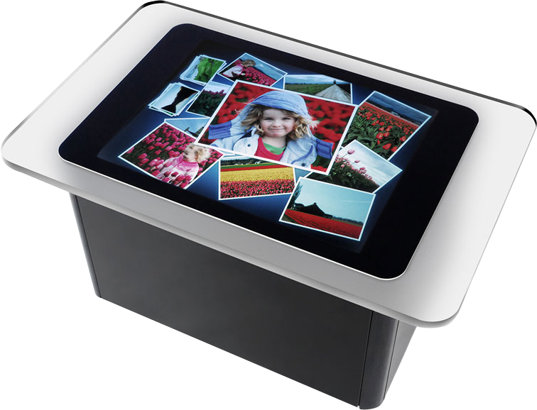
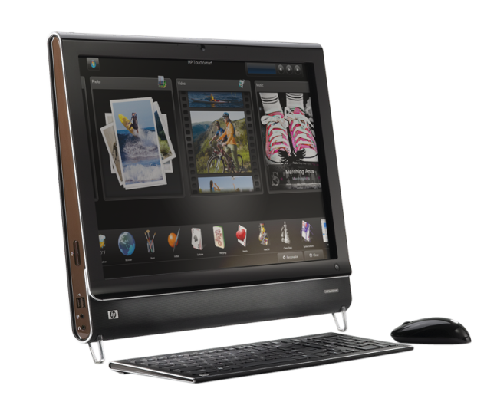
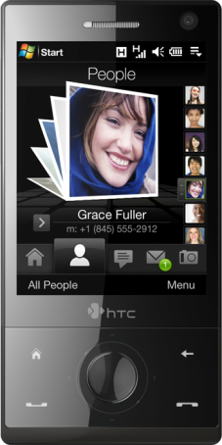
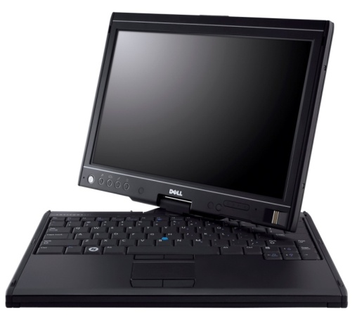
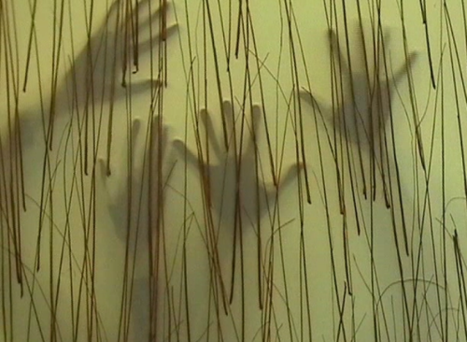
Multi-touch Is Here!
Devices
Surface to mobile phones to homebrewed multi-touch devices
PC Hardware
Multi-touch machines in market today – More coming with Windows 7 launch
Software
Windows 7, PDC partner demonstrations and Touch Platform announcement

Slide 4
Multi-touch
demo

Slide 5
Agenda
Introduction and demo
Which driver framework?
HID multi-touch usages
Logo and distribution
Wrap up

Slide 6
Driver Framework
KMDF
Shim will ship in-box in Win7 (mshidkmdf.sys), also shipped as a sample with Vista SP1 WDK
WDK Samples using the shim: WacomKMDF, EloMT, raw USB
Removes power management and PnP handling code
IRP cancelation logic goes away (see WacomPen samples)
UMDF
Can’t write a HID miniport driver in UMDF
WDM
Not recommended for new drivers

Slide 7
Example – Driver Entry
NTSTATUS EXTERNAL
DriverEntry(
IN PDRIVER_OBJECT DrvObj,
IN PUNICODE_STRING RegPath
)
{
NTSTATUS status = STATUS_SUCCESS;
HID_MINIDRIVER_REGISTRATION hidMinidriverRegistration;
//@@BEGIN_DDKSPLIT
WPP_INIT_TRACING(DrvObj, RegPath);
//@@END_DDKSPLIT
TEnter(API, ("(DrvObj=%p,RegPath=%p)", DrvObj, RegPath));
gDriverObj = DrvObj;
DrvObj->MajorFunction[IRP_MJ_CREATE] =
DrvObj->MajorFunction[IRP_MJ_CLOSE] = HpenCreateClose;
DrvObj->MajorFunction[IRP_MJ_SYSTEM_CONTROL] = HpenSystemControl;
DrvObj->MajorFunction[IRP_MJ_INTERNAL_DEVICE_CONTROL] = HpenInternalIoctl;
DrvObj->MajorFunction[IRP_MJ_PNP] = HpenPnp;
DrvObj->MajorFunction[IRP_MJ_POWER] = HpenPower;
DrvObj->DriverUnload = HpenUnload;
DrvObj->DriverExtension->AddDevice = HpenAddDevice;
//
// Register with HIDCLASS.SYS module
//
RtlZeroMemory(&hidMinidriverRegistration,
sizeof(hidMinidriverRegistration));
hidMinidriverRegistration.Revision = HID_REVISION;
hidMinidriverRegistration.DriverObject = DrvObj;
hidMinidriverRegistration.RegistryPath = RegPath;
hidMinidriverRegistration.DeviceExtensionSize = sizeof(DEVICE_EXTENSION);
hidMinidriverRegistration.DevicesArePolled = FALSE;
status = HidRegisterMinidriver(&hidMinidriverRegistration);
if (!NT_SUCCESS(status))
{
LogError(ERRLOG_MINIDRV_REG_FAILED,
status,
UNIQUE_ERRID(0x10),
NULL,
NULL);
TErr(("Failed to register mini driver (status=%x).", status));
}
TExit(API, ("=%x", status));
return status;
} //DriverEntry
NTSTATUS
DriverEntry (
__in PDRIVER_OBJECT DriverObject,
__in PUNICODE_STRING RegistryPath
)
{
NTSTATUS status = STATUS_SUCCESS;
WDF_DRIVER_CONFIG config;
WDF_OBJECT_ATTRIBUTES attributes;
WPP_INIT_TRACING( DriverObject, RegistryPath );
KdPrint((“Driver Entry \n"));
WDF_DRIVER_CONFIG_INIT(&config, WacomDFDeviceAdd);
WDF_OBJECT_ATTRIBUTES_INIT(&attributes);
attributes.EvtCleanupCallback = WacomDFDriverContextCleanup;
status = WdfDriverCreate(DriverObject,
RegistryPath,
WDF_NO_OBJECT_ATTRIBUTES, // Driver Attributes
&config, // Driver Config Info
WDF_NO_HANDLE
);
if (!NT_SUCCESS(status)) {
KdPrint(("WdfDriverCreate failed with status 0x%x\n", status));
}
return status;
}

Slide 8
Example – PnP Handling
NTSTATUS EXTERNAL
HpenPnp(
IN PDEVICE_OBJECT DevObj,
IN PIRP Irp
)
{
NTSTATUS status;
PDEVICE_EXTENSION devext = GET_MINIDRIVER_DEVICE_EXTENSION(DevObj);
PIO_STACK_LOCATION irpsp = IoGetCurrentIrpStackLocation(Irp);
//@@BEGIN_DDKSPLIT
#ifdef BUS_QUERY
PIO_STACK_LOCATION previousSp;
PWCHAR buffer;
#endif
//@@END_DDKSPLIT
PAGED_CODE();
TEnter(API, ("(DevObj=%p,Irp=%p,IrpSp=%p,Minor=%!PNPMN!)",
DevObj, Irp, irpsp, irpsp->MinorFunction));
status = IoAcquireRemoveLock(&devext->RemoveLock, Irp);
if (!NT_SUCCESS(status))
{
//
// Someone sent us another plug and play IRP after removed
//
LogError(ERRLOG_DEVICE_REMOVED,
status,
UNIQUE_ERRID(0x10),
NULL,
NULL);
TWarn(("Received IRP after device was removed (status=%x).", status));
Irp->IoStatus.Information = 0;
Irp->IoStatus.Status = status;
IoCompleteRequest(Irp, IO_NO_INCREMENT);
}
else
{
BOOLEAN fRemove = FALSE;
BOOLEAN fForward = FALSE;
switch (irpsp->MinorFunction)
{
case IRP_MN_START_DEVICE:
case IRP_MN_CANCEL_REMOVE_DEVICE:
TAssert(!(devext->dwfHPen & HPENF_DEVICE_STARTED));
…
NTSTATUS EXTERNAL
HpenPower(
IN PDEVICE_OBJECT DevObj,
IN PIRP Irp
)
{ … }
NTSTATUS INTERNAL
SendSyncIrp(
IN PDEVICE_OBJECT DevObj,
IN PIRP Irp,
IN BOOLEAN fCopyToNext
)
{ … }
…
PnP IRP handling procedures are no longer required
Just supply callbacks for:
EvtDeviceQueryStop
EvtDeviceQueryRemove
EvtDeviceSurpriseRemoval
Etc…

Slide 9
Exposing Your Multi-touch Device To Windows
Multi-touch devices are a superset of HID touch devices
Use existing HID touch usages, but additionally report HID contact id and max number of supported contacts
Configuration collection allows easier device configuration for down-level or other scenarios

Slide 10
Proposed Multi-touch Additions To HID Specification

Slide 11
Reporting Modes
Serial
Each packet contains a single update, multiple contacts are streamed serially
Can reduce per contact sample rate
Parallel
Each packet is capable of reporting the total number of contacts the device can detect
Large packets, often not fully utilized
Hybrid (Recommended)
Packets are large enough to report some number of contacts
Multiple packets can be reported serially in one logical frame
Avoids issues with serial and parallel

Slide 12
HID Multi-touch
Required usages
Touch collection (page 0x0D, usage 0x04)
X (0x01, 0x30), Y (0x01, 0x31), Tip switch (0x0D, 0x42), In-range (0x0D, 0x32)
Contact id (0x0D, 0x51)
Max count (0x0D, 0x55)
Recommended optional usages
Confidence (0x0D, 0x47)
Width and height (0x0D, 0x48 and 0x49)
Pressure (0x0D, 0x30)

Slide 13
Tips And Tricks
For null values, set the null bit on all main items in the report descriptor
Use the physical dimensions property for X and Y usages
If you cannot report accurate units, report 0 units
Report a top-level collection for each function your device supports (touch, multi-touch, pen)
If the device does not have a mouse, add a mouse collection that does not send data
More in Digitizer Drivers for Touch, Multi-touch, and Pen Devices whitepaper!

Slide 14
Capability Discovery And Configuration
If the configuration collection exists, Windows 7 will open it exclusively
Windows 7 will attempt to set it to multiple input
On Vista or XP Tablet Edition, 3rd party applications can set the configuration as necessary
The device index usage specifies the collection to configure
Multi-touch collections are identified via the contact id usage
If set to mouse, route data through the mouse collection

Slide 15
General Guidance
Do as much in firmware as possible
For USB devices, consider selective suspend
Helpful WDK tools
DriverVerifier, StaticDriverVerifier, PreFastForDrivers, CheckINF, and others

Slide 16
Windows Logo Requirements
Series of requirements designed to ensure hardware
Sample rate: At least 50hz per finger
Resolution: At least 100ppi and at least display resolution
Accuracy: No offsets greater than 2mm
See MBL-T529 for more details!

Slide 17
Driver Distribution
Millions of users worldwide automatically update their systems at http://windowsupdate.microsoft.com
Highly recommended: Distribute your logoed drivers through Windows Update
Manage settings for distributing your driver via Driver Distribution Center (DDC) on Winqual
View download statistics and WER data
For details, see Distributing Drivers on Windows Update

Slide 18
Digitizer Calibration And Mapping
Calibration
Changes in tabcal.exe to improve linearity calibration
Better support for dual-mode digitizers
Multidigimon
UI to map digitizers to displays

Slide 19
UX Considerations
General guidelines
Big targets
Whitespace
Avoid hover
See UX guidelines
Be aware of hardware limitations
Avoid on-hover UI
Edges, jitter, etc
Form factor
Gesture guidelines
Use common gestures
Gestures need to be intuitive and natural
Moving away from flicks-like gestures to manipulations

Slide 20
Call To Action
Build KMDF drivers that appear to Windows per the guidance here and in the whitepaper
Take full advantage of the samples and tools in the WDK
Do as much in firmware as possible

Slide 21
Additional Resources
Whitepapers
Digitizer Drivers for Touch, Multi-touch, and Pen Devices
Enabling USB Selective Suspend for Human Interface Devices
Websites
Pen and Touch Driver Guidance http://www.microsoft.com/whdc/device/input/PEN_touch.mspx
HID Extensions for Multi-touch Contact your TAM or email us
Getting started with the Windows Logo program http://www.microsoft.com/whdc/winlogo/getstart/default.mspx
Related WinHEC Sessions
MBL-T527 Multi-Touch in Windows 7 Overview
MBL-T529 Multi-Touch: Designing and Testing for Logo Compliance
COR-T520 Windows Logo Program Tools: Overview and Directions
COR-T609 Making Drivers Available on Windows
Logofest, coming soon, Redmond
Meet the team!
Contact us:
tab-ext@microsoft.com

Slide 22
Questions?

Slide 23
Please Complete A Session Evaluation Form Your input is important!
Visit the WinHEC CommNet and complete a Session Evaluation for this session and be entered to win one of 150 Maxtor® BlackArmor™ 160GB External Hard Drives 50 drives will be given away daily!
http://www.winhec2008.com
BlackArmor Hard Drives provided by:

Slide 24
© 2008 Microsoft Corporation. All rights reserved. Microsoft, Windows, Windows Vista and other product names are or may be registered trademarks and/or trademarks in the U.S. and/or other countries.
The information herein is for informational purposes only and represents the current view of Microsoft Corporation as of the date of this presentation. Because Microsoft must respond to changing market conditions, it should not be interpreted to be a commitment on the part of Microsoft, and Microsoft cannot guarantee the accuracy of any information provided after the date of this presentation. MICROSOFT MAKES NO WARRANTIES, EXPRESS, IMPLIED OR STATUTORY, AS TO THE INFORMATION IN THIS PRESENTATION.

Slide 25
Backup Slides

Slide 26
Now Is The Time!
Multi-touch offers clear differentiation with a high “WOW” factor for consumers
Multi-touch enhances on-the-go use and opens up new scenarios for business
90% of people in focus groups claimed they would pay a 20-30% premium for a PC with multi-touch
Seeing is believing: Consumer purchase intent doubles after hands-on experience

Slide 27
Multi-touch and Windows 7
Multi-touch is a major investment area and strong reason for customers to upgrade to a Windows 7 PC
MT scored very favorably in Concept Value testing
Consumer awareness and interest in touch is high
Customers perceive touch as the next stage of computing
Touch offers a sense of personal connection and freedom
Touch would help users be more efficient and be fun to use
Media response to MT disclosure has been very positive
>130 unique articles, 1M video views in 72hrs, continued monthly coverage

Slide 28
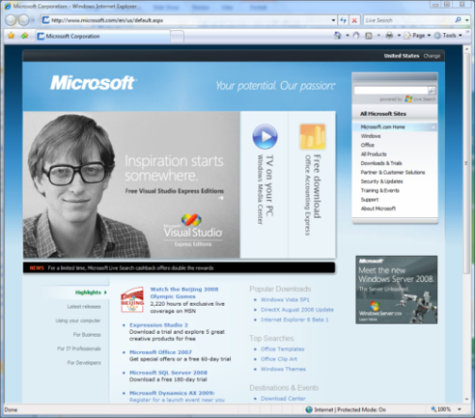
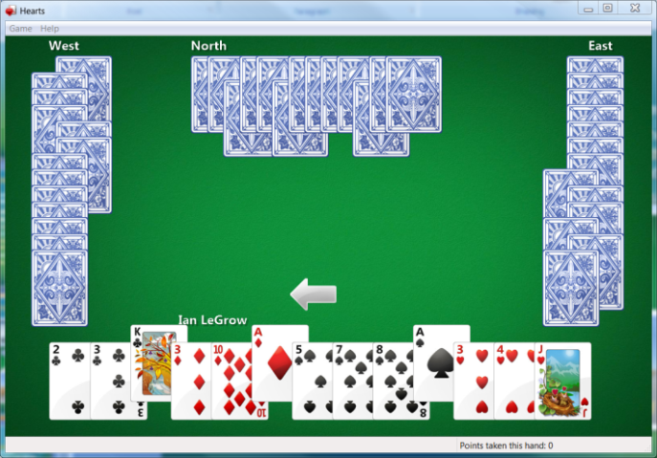
Multi-touch And Windows 7
We’ve identified several key scenarios for multi-touch:
Navigating and consuming the web
Reading and sorting email
Viewing photos
Playing casual games
Consuming music and video
Navigating files and arranging windows
Using Office applications
That led to four areas of investment:
Developer Platform: At the root is the touch developer platform that exposes touch APIs for any application
UI Enhancements: Focusing on the core scenarios, many parts of the core UI have been optimized for touch experiences
Gestures: Multi-touch gestures have been added to enable consistent panning and zooming in most applications
Applications: A set of multi-touch focused applications that demonstrate the power of touch. These will ship separate from Win7

Slide 29
Tell me more!
What is multi-touch?
Multi-touch is two or more independently trackable contacts
It is not gesture support grafted on top of a touch or pointing device nor pen and touch together

