Slide 2
Multi-Touch In Windows 7
Ian LeGrow
Group Program Manager
Microsoft Corporation

Slide 3
Agenda
Now is the time!
Demo
Multi-touch Tenets
  Augmenting Windows
  Delivering consistency
Hardware and Software

Slide 4
Now Is The Time!
Customers are ready for touch
Multi-touch offers clear differentiation with
a high “Wow” factor for consumers
Multi-touch enhances on-the-go use and
opens up new scenarios for business
90% of people in focus groups claimed they would pay a 20-30% premium for a PC with Multi-touch
Seeing is believing: Consumer purchase intent doubles after hands-on experience

Slide 5
Now Is The Time!
Mainstream digitizers are available
Multi-touch sensors are available today
for a range of form-factors from laptops
up to large all-in-ones
Windows 7 will work with any Multi-touch digitizer meeting the logo requirements
We are working closely with several digitizer partners, including
  Elo, N-Trig, NextWindow, and Wacom
  Contact us to be added to this list

Slide 6
Now Is The Time!
ISVs are investing in Multi-touch
ISVs are enthusiastic about Multi-touch!
We are working with several ISVs today
on Multi-touch applications, including
  AutoDesk
  Corel
  Sonic
  Cyberlink
  Avoco Secure
  Identity Mine

Slide 7
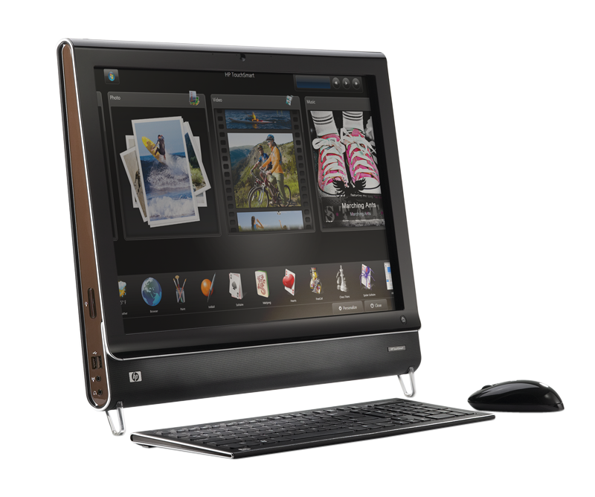
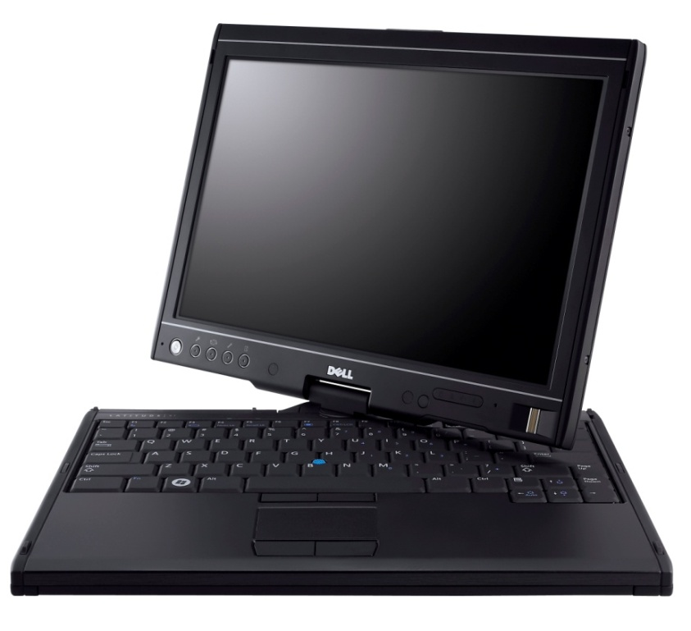
Multi-Touch Capable PCs
Are Available Today
HP TouchSmart
All-in-one PC with 2-touch digitizer from NextWindow
Dell Latitude XT
Laptop with Multi-touch and
pen digitizer from N-Trig

Slide 8
Multi-Touch
In Windows 7
demo

Slide 9
Windows 7 Multi-Touch Goals
Augment the Windows experience
  Make routine activities easier with touch
  Delight customers with direct manipulation
Deliver consistency
  Consistent user experience
  Consistent developer, IHV, OEM platform

Slide 10
Augmenting The Experience
Simple gestures for everyday use
Single finger panning for touch
Consistent Multi-touch gestures
  Gestures for double click, right click, panning, zoom, and rotate
  Designed for 2+ touch systems
Gestures are available across the operating system and available
“for free” to most applications

Slide 11
Augmenting The Experience
Optimize for consumption scenarios
Customers are most likely to use touch
for consumption activities
  Navigating and consuming the Web
  Consuming photos, music, and video
  Reading and sorting e-mail
  Playing casual games
  Using Office applications
We’ve optimized these areas for touch

Slide 12
A Short List Of Investments…
Core Windows
Applications
Touch-optimized top-level UI
  Start menu, taskbar, window arranging, Explorer etc
  Ripple feedback, cursor updates
  Touch optimized flicks
Panning UX and feedback
  Boundary feedback, bounce, inertia
  Visually appealing and “fun”
Photo viewer
  MT zoom and rotation
Touch-optimized Media Player
  Touchable playback controls
Touch-friendly keyboard
  New visuals, improved look, launching and feedback
  Prediction and improved correction experience
Internet Explorer
  Pan and zoom and navigation gestures
  “Open link in new tab” gesture
  Address bar drag menu
Media Center
  Live gallery panning
  On-screen keyboard
  Larger transport controls and seek
  New Now Playing and details pages
Multi-touch pack
  Separate delivery of multi-touch games and
  surface style mapping – not part of Windows
Also
  Windows Live Photo Gallery
  XPS viewer
  MS Paint

Slide 13
Deliver Consistency
Consistent for partners
  IHVs and OEMs: Digitizers interface through HID
  Developers: Standard APIs regardless of the digitizer technology used
Consistent for customers
  Gestures that work the same in every application
  on any Windows Touch PC
Consistency through Windows Logo
  Logo ensures a minimum level of functionality
  New touch features are only enabled with
  Logo certified Multi-touch digitizers

Slide 14
Consistent Touch APIs
A consistent set of APIs regardless of
the underlying hardware
Multi-touch platform
  Delivered first for Win32 and COM
  Integrated into next version of WPF
Feature support
  Gesture notifications: WM_GESTURECOMMAND
  Inertia and feedback algorithms
  Raw data support: WM_TOUCH or RTS
  “Surface-style” API providing 2D manipulation and inertia support

Slide 15
Multi-Touch Software
Good-Better-Best
Multi-touch offers a tangible way to differentiate, a Windows application can target one of 3 levels of touch integration
  Good: No specific touch APIs are used but the application UI is appropriately sized and
  works well with the built-in gestures
  Better: The gesture APIs are supported to give
  smooth natural interactions
  Best: Deep touch focused experiences designed
  to take advantage of Multi-touch

Slide 16
Multi-Touch Hardware
Laptop and AIO form-factors are great for Multi-touch
Target form-factors: Laptops and all-in-ones
  Laptops: Users are closer to the screen and
  touch has high benefits in mobile situations
  AIOs: Often in high traffic areas of the home
  where walk-up use is common
Hinges and pen are optional
  Not all touch laptops need to be tablet PCs
Attend Multi-touch logo session (529)
for hardware design guidelines

Slide 17
Tablet PC Hardware
A Multi-touch and pen enabled tablet PC is the ultimate mobile PC
Windows 7 continues our investment pen and tablet PC
  Predictive text on soft keyboard
  Recognition for 13 new languages (25 total)
  Dramatically improved Asian recognition
  Handwriting personalization in all languages
  New math recognition
A tablet PC can have multi-touch but does not need to
  Touch is focused on mainstream users
  Tablet PC is best for verticals and education

Slide 18
Working With Partners
Succeeding with Multi-touch is a team effort, we are working with many hardware and software partners
Please visit our Touch Community partners in the Expo hall

Slide 19
partners

Slide 20
Elo TouchSystems
partners
Steven Abramovich
Tim Masters

Slide 21
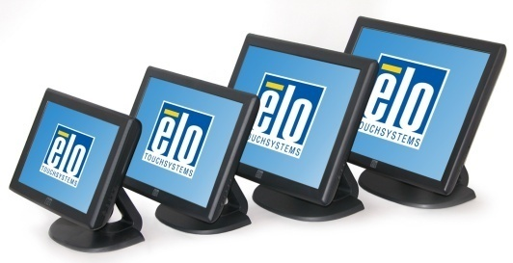
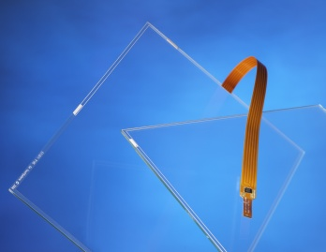
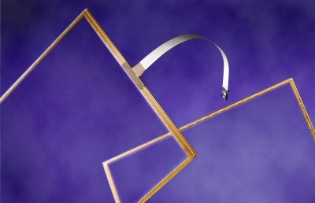
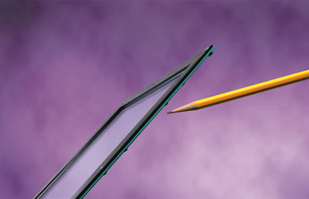
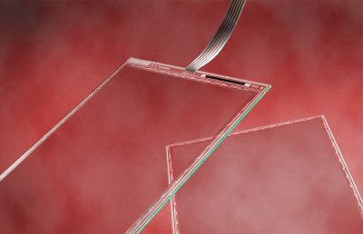
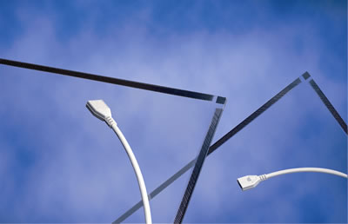
Elo TouchSystems
Overview
  Elo TouchSystems, the global leader in touch technology, develops, manufactures and markets a complete line of touch screen, touch monitor products and All-in-One touchscreen computers to OEM and Channel customers. Elo founders invented the touchscreen nearly 40 years ago. Since then, customers have used Elo touchscreens with one common, powerful result—advanced computer technology simplified for all users.
APR
Capacitive
Infrared
Resistive
Surface Acoustic Wave

Slide 22
Elo TouchSystems
Windows 7 Development
  Initial Protocol based on Elo TouchSystems Smart-Set Multi-Touch
- Microsoft and Elo TouchSystems partnered on HID Parallel Multi-Touch
Hardware Solutions – Current
  Infrared XYU
    Visit Elo in exhibition area
Hardware Solutions – Planned
  APR Zero Bezel
  Investigation of alternative touch technologies

Slide 23
Wacom
partners
Dan Doyle

Slide 24
Our Mission
We provide dependable technology solutions for advanced user interface experience with pen, touch and display integration.
Wacom is committed to provide high performance, low cost UI solutions for industry partners.
Wacom is committed to supports Microsoft Windows 7, and all future generation platforms to come
Wacom provides “Configurable Modular Solutions” to meet varying needs of customers.

Slide 25
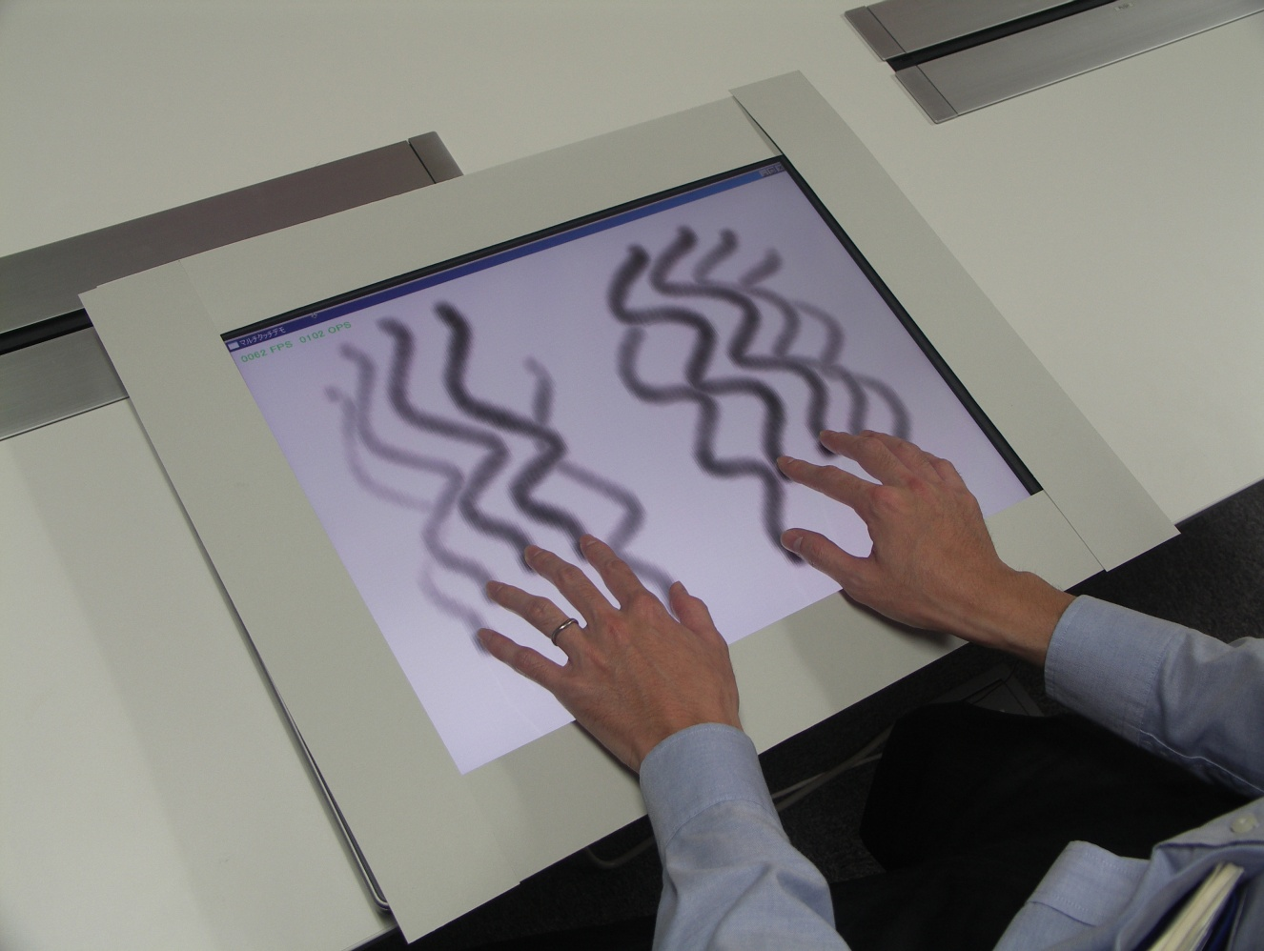
Capacitive Multi Touch Sensor
・ High speed, high precision multi-touch detection
  Unlimited fingers detection
  Size: 10～40 inch or more
  Speed: 100fps or more
  Resolution: 200ppi or more
  Accuracy: within 0.5mm
  Offset: within 2mm
  Low -power comsunption
  with ASIC
・ Target applications
  UMPC, TabeltPC, Note PC,
  Desktop PC, LCD monitor
  Interactive sign board
  Smart phone, PDA
  Game devices

Slide 26
Configurable Modular Solution
・ Modular solutions
  Touch sensor
  Pen digitizer sensor
  Touch and Pen sensors
  LCD module
  Optical bonding
Touch panel
Wacom
ASIC
Driver
System
Platform
Bonding
LCD
Display
Controller
Driver
INV
BL
Digitizer
LCD module integration

Slide 27
N-trig
partners
Lenny Engelhardt

Slide 28
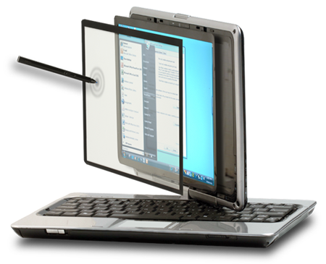
DuoSense™
A dual mode pen and multi touch digitizer which combines both forms of input into a single device for direct interactions and manipulations with computers.
Enabling OEMs and ODMs to introduce computer products that offer the end user a direct personalized, intuitive and Hands-on™ experience with their products.
28

Slide 29

Looking forward
Full MTM: Concept system design
  In sync. with Windows 7
New sensor structures
  Glass on top - no bezel design (ITO on Glass)
  Glass only sensor
Large range of form factors 7”-24”
29

Slide 30
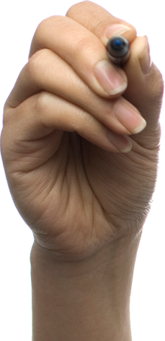

Persons contact details
Name: Lenny Engelhardt
Email: lenny@n-trig.com
www.n-trig.com
30

Slide 31
NextWindow
partners
Rusty Stapp

Slide 32
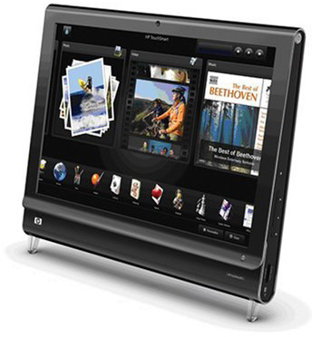
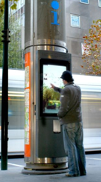
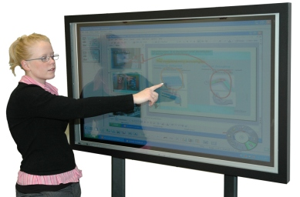
NextWindow
Leading provider of Optical Touch Solutions
Targeted for applications 18” – 100”
Proven high volume / low cost manufacturing - 2 Generations of HP TouchSmart
Notes:
32

Slide 33
NextWindow Optical Touch Technology Benefits
Fast and accurate touch
  +/- 2mm accuracy
  <20ms response
Stylus independent
Screen clarity
Multi-touch capability
One time calibration with no drift
Simple hardware integration
  CMOS sensors
  DSP w/ USB interface
  Reflective border
Cost competitive from small to large screens
Win7 Beta Driver available

Slide 34
Call To Action
Put Multi-touch on your roadmap –
now is the time
Engage with us, we want to help
Build drivers following the guidance
and samples in the Windows Driver Kit
Run the tests in Windows
Logo Kit frequently
Contact us if you have any questions

Slide 35
Additional Resources
WinHEC white paper: Digitizer drivers for touch, Multi-touch, and pen devices
Specserver
  HID extensions for Multi-touch
Web sites
  Pen and touch driver guidance
  http://www.microsoft.com/whdc/device/input/PEN_touch.mspx
  Getting started with the Windows Logo program
  http://www.microsoft.com/whdc/winlogo/getstart/default.mspx
  Pen and touch digitizer drivers
  http://www.microsoft.com/whdc/device/input/PEN_touch.mspx
Related WinHEC sessions
  2pm today → MBL-T528 Multi-Touch Driver Development
  3pm today → MBL-T529 Multi-Touch: Designing and Testing for Logo Compliance
Contact us: tab-ext@microsoft.com

Slide 36
Q&A

Slide 37


© 2008 Microsoft Corporation. All rights reserved. Microsoft, Windows, Windows Vista and other product names are or may be registered trademarks and/or trademarks in the U.S. and/or other countries.
The information herein is for informational purposes only and represents the current view of Microsoft Corporation as of the date of this presentation. Because Microsoft must respond to changing market conditions, it should not be interpreted to be a commitment on the part of Microsoft, and Microsoft cannot guarantee the accuracy of any information provided after the date of this presentation.
MICROSOFT MAKES NO WARRANTIES, EXPRESS, IMPLIED OR STATUTORY, AS TO THE INFORMATION IN THIS PRESENTATION.

