Slide 2
Protected Broadcast Driver Architecture (PBDA) in Windows 7
Jeremiah Spradlin
Technical Lead
Microsoft Corporation
Gabe Gottlieb
Dev Lead
Microsoft Corporation

Slide 3
PBDA What is it?
PBDA is Microsoft’s worldwide platform to integrate broadcast TV services into Windows Media Center on a Windows PC
Supersedes BDA
Will not affect existing BDA solutions

Slide 4
Agenda
PBDA Architecture
Tuner Messaging and Error Handling
Extensible Setup
Guide Data Delivery
XML Tuning
WMDRM Content Protection

Slide 5
PBDA Architectural Overview
PBDA Services
Eventing
Tuner
CAS
Name Value (GPNVS)
DRM
Mandatory
Mux
Scanning
Guide Data Delivery
Debug
Optional
Internet Gateway
Aux
Encoder
User Activity
WMDRMSession
WMDRMTuner

Slide 6
PBDA Bindings
Windows Media Center
PBDA Services
Required Services
Optional Services
PBDA-IP Binding
(PBDA Classdriver)
PBDA-KS Binding
(Utilizes a 3rd party driver)
PBDA-IP Tuner
PBDA-KS Tuner

Slide 7
PBDA Spec
CAS
Part 3 WMDRM
Part 1
Core Services
Microsoft Profile
Profile
A
Profile
B
Part 2 Bindings
IP
KS
Available at
http://www.microsoft.com/whdc/device/broadcast/bda/default.mspx

Slide 8
Tuner Data Flow
Tuner / Demodulator
Windows Media Center
Stream Processing
Transport Stream
Tag Table Generation
PBDA Services
Command & Control

Slide 9
PBDA Primitives
Eventing
TAG Table
Built from MPEG-2 Adaptation Fields
Generic method for inband signaling
Transport Packet Header
Table_section 1
Transport Packet Header
Table_section 2
Transport Packet Header
Table_section 3
TAG Table
Table_section 1
Table_section 2
Table_section 3

Slide 10
Tuner Messaging
Many tuners and operators require specific messaging to the Windows Media Center user
Signal issues
Tune failures
Unsubscribed channels
PBDA provides a robust architecture to deliver this localized information via MMIs

Slide 11
Man Machine Interface (MMI)
Session between the tuner and a user
A single MMI event can result in multiple sessions due to extenders
Authored in
Media Center Markup Language (MCML)
Rich UX capabilities
Simple HTML
Buttons
Links
Text formatting

Slide 12
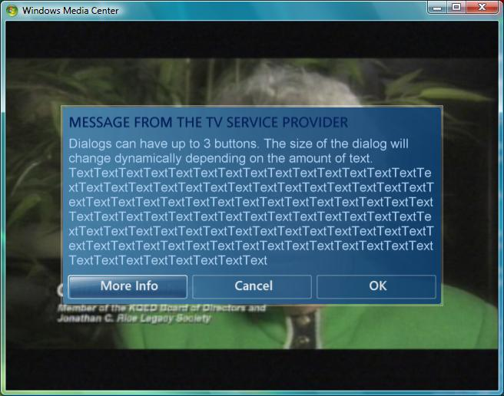
MMIs
Man Machine Interface (MMI)

Slide 13
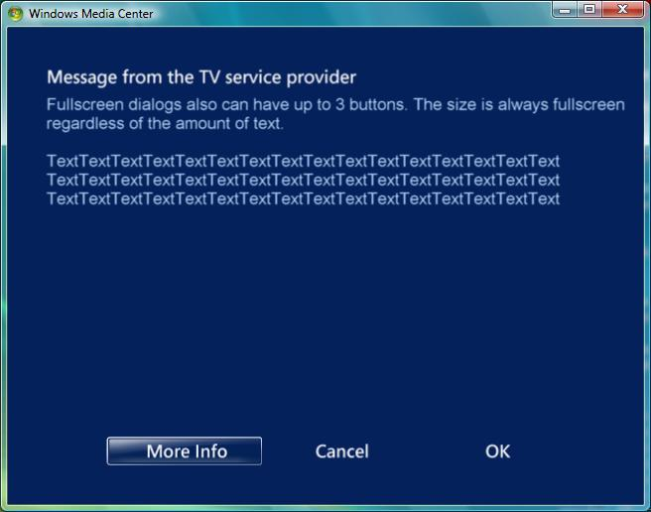
MMIs

Slide 14
Simplified MMI Flow
[Action] (Dialog Request Number)
Tuner
Windows 7 PC
SUCCESS_MMI_PENDING
OpenMMI (DR, URI)
GetValue (URI)
MMI Data
CloseMmi
CloseMmiDialog

Slide 15
Stream Errors In PBDA
Descramble Failure Notifications (DFNs)
PBDA TAG table
Associates a failure to the stream
Windows Media Center provides an internationalized UX based on the error code
Optionally the tuner may provide custom UX via an Entitlement Token in the DFN
WMC calls CheckEntitlementToken()
Live playback
Recorded playback

Slide 16
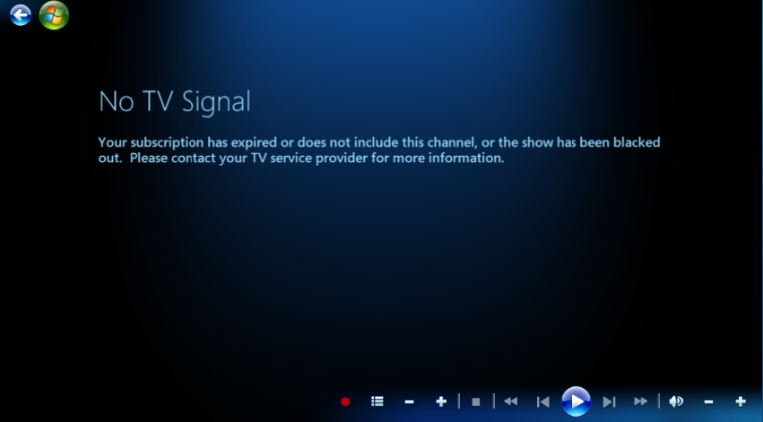
DFN

Slide 17
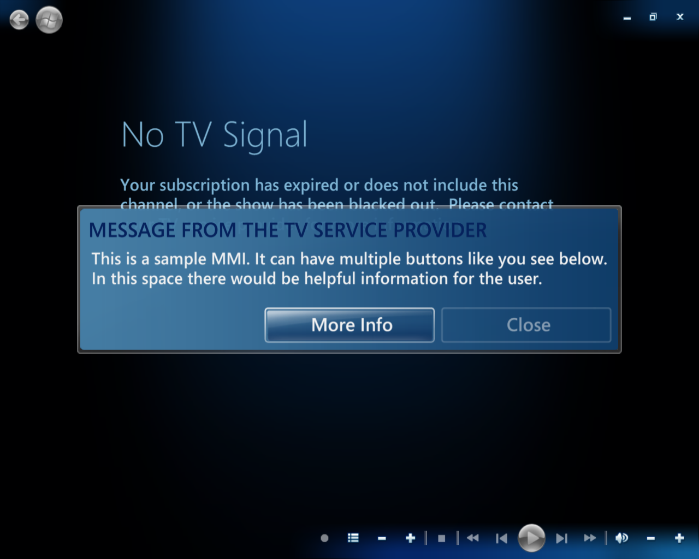
DFN With MMI

Slide 18
DFN Handling
Tuner
Transport Stream with DFN (Entitlement Token, Error Code)
Windows 7 PC
(some time later)
CheckEntitlementToken (ET, new Dialog Request Number)
SUCCESS_MMI_PENDING
OpenMmi
(regular MMI sequence)

Slide 19
Extensible Setup
Tuners may require additional setup above what Windows Media Center provides
Proprietary Satellite Setup
Subscription Verification
Codeless MCML setup provided from the device through GPNVS
PBDA:/NV/Method/System Setup
PBDA:/NV/Method/System Diagnostics

Slide 20
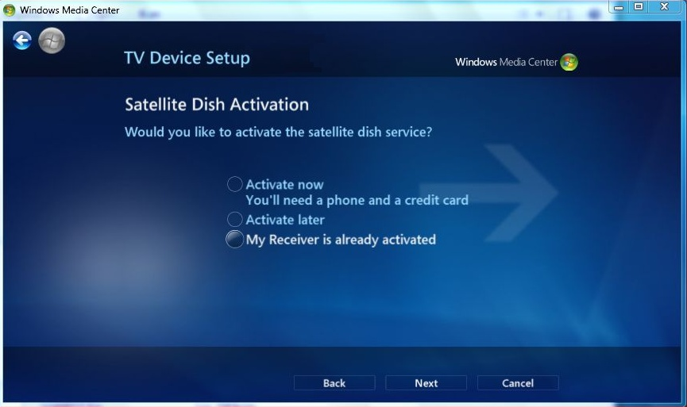
Example Extensible Setup

Slide 21
Extensible Setup
For more information on codeless MCML see
Windows Media Center SDK
http://msdn.microsoft.com/en-us/library/bb895967.aspx
Media Center Sandbox
http://blog.mediacentersandbox.com

Slide 22
PBDA Guide Data
If the Windows Media Center provided guide isn’t sufficient for your scenario
In-band guide delivery
DVB and ISDB in-band formats supported
Guide Data Delivery Service (GDDS)
Guide data sent via the command and control channel (not in the transport stream)

Slide 23
Guide Data Delivery Service
PBDA Service List
XML format
May provide a TuneXml for each service
PBDA-EIT format
Supports PBDA or DVB legacy descriptors
Regular schedule data
Present following (p/f) data

Slide 24
XML Tuning
XML tuning provides an extensible tuning mechanism with diverse devices
Simplified tuning flow
Tuner
SetTuner(TuneXml)
Windows 7 PC
SUCCESS
GetTunerState()
TunedXML

Slide 25
XML Tuning
Example Channel Tune Request
<tune:Channel xmlns:tune="http://schemas.microsoft.com/2006/eHome/MediaCenter/Tuning.xsd" Channel="4">
<tune:TuningSpace xsi:type="tune:ChannelIDTuningSpaceType" Name=" e8859e2c-c1ee-4b77-bea3-c64d8f25e99b" NetworkType="{E8859E2C-C1EE-4b77-BEA3-C64D8F25E99B} "/>
<tune:Locator xsi:type="tune:ATSCLocatorType" Frequency="-1" ModulationType="Uninitialized" InnerFECMethod="Uninitialized" InnerFECRate="Uninitialized" OuterFECMethod="Uninitialized" OuterFECRate="Uninitialized" SymbolRate="-1" PhysicalChannel="-1" TransportStreamID="-1" ProgramNumber="-1"/>
<tune:Components xsi:type="tune:ComponentsType"/>
</tune:Channel>

Slide 26
XML Tuning
Example ChannelID Tune Request
<tune:ChannelID xmlns:tune="http://schemas.microsoft.com/2006/eHome/MediaCenter/Tuning.xsd" ChannelID=“TunerPrivateTuningString24">
<tune:TuningSpace xsi:type="tune:ChannelIDTuningSpaceType" Name=" e8859e2c-c1ee-4b77-bea3-c64d8f25e99b " NetworkType="{E8859E2C-C1EE-4b77-BEA3-C64D8F25E99B} "/>
<tune:Locator xsi:type="tune:ATSCLocatorType" Frequency="-1" ModulationType="Uninitialized" InnerFECMethod="Uninitialized" InnerFECRate="Uninitialized" OuterFECMethod="Uninitialized" OuterFECRate="Uninitialized" SymbolRate="-1" PhysicalChannel="-1" TransportStreamID="-1" ProgramNumber="-1"/>
<tune:Components xsi:type="tune:ComponentsType"/>
</tune:ChannelID>

Slide 27
Protected Content Overview
PBDA provides robust transmission of premium content to Windows Media Center
Uses PBDA in-band Tag Tables
Uses WMDRM for license management
Provides for mapping of proprietary and standards based CA policies to WMDRM policies

Slide 28
Protected Tuner Data Flow
WMDRM Indiv
WMDRM Revocation Data
Tuner / Demod
Windows Media Center
CA Decrypt
WMDRM Encrypt
Transport Stream
WMDRM License Generation
PBDA Services
Command & Control
WMDRM Session

Slide 29
Cryptography Requirements
RSA-1024
Windows Media Center certificate containing an RSA public key
Root licenses encrypted to Windows Media Center RSA key
AES-128
Leaf licenses are encrypted with AES ECB
Content is encrypted with AES CTR
OMAC1
License signature to prevent tampering

Slide 30
Robustness Requirements
The tuner must implement the following
All WMDRM related functionality must be implemented in physical tuner
Anti-tamper, anti-rollback clock
Robust CA -> WMDRM conversion
Certificate validation using the Microsoft root
http://wmlicense.smdisp.net/wmdrmcompliance/default.asp

Slide 31
WMDRM Session Overview
All protected content is sent using a WMDRM Session
Provides a means for the tuner to validate the credentials of Windows Media Center
Allows for communication between tuner and Windows Media Center through Authenticated Commands
Time limited and expire after 48 hours

Slide 32
WMDRM Session Requirements
Windows Media Center Provided Certificate
XrML Certificates with 1024b RSA keys
Chains through WMDRM version, to Root Microsoft WMDRM Authority
WMDRM Revocation Data
Signed by Root Microsoft WMDRM Authority
Time and version to check freshness
Proximity Validation
<7ms ping to validate physical proximity

Slide 33
WMDRM Session Startup
Revocation Data
Tuner
Windows 7 PC
Registration Challenge
Certificate
Registration Response
Proximity Challenge
Proximity Response
Event: UpdateDrmStatus

Slide 34
Stream Formatting
WMDRM Tag Table types
License Packages
Contains a WMDRM License
Must be sent prior to being used
Optionally, contains renewal data
Stream Info
Contains AES Counters and Key IDs being used for the stream
Supplies Start Code detection state for the PID

Slide 35
Types Of Protection
Streaming Counter Mode
Protect audio/video content
Requires a unique counter per PID
Bulk Counter Mode
Protects non-A/V content, such as BML
One global counter across all PIDs
Incurs more overhead at record time

Slide 36
Streaming Counter Mode
A/V streams require additional processing during streaming
Specific MPEG start codes and some of the payload need to be left in the clear
Configuration is set via SetStartCodeProfile
Transport Packet Header
Stream Info
Transport Packet Header
Start Code
Transport Packet Header
Clear Payload
Transport Packet Header
Encrypted Payload
Clear Data
Encrypted Data
Start Code Info
Start Code
Clear Payload
Crypto Info
Encrypted Payload

Slide 37
Types Of WMDRM Licenses
Two types of licenses
Root
Leaf
Licenses contain policy and content keys
Policies consist of rights and restrictions
Copy Rights (i.e., copy to another PC)
Export Rights (i.e., CPRM)
Playback Restrictions (HDCP, CGMS, and MV)

Slide 38
Types Of Content
Non-encrypted content
e.g., Free to consumer
Non-expiring content
e.g., Regulated content (sporting events)
Subscription based renewable content
e.g., Pay TV
Non-renewable, expiring content
e.g., PPV

Slide 39
Call To Action
Adopt Digital TV formats
Embrace PBDA for your Windows Media Center Digital TV solutions
Get the PBDA specification
License the WMDRM porting kit
Develop your PBDA capable tuners
Engage now to be ready for Windows 7

Slide 40
Additional Resources
Today’s Related Sessions
GRA-T601 (9:45 AM) Perspectives on the Windows TV Tuners Ecosystem
GRA-T598 (11:00 AM) Protected Broadcast Driver Architecture in Windows 7
GRA-C665 (1:00 PM) Windows Media Center Chalk Talk with the Experts
GRA-T600 (2:30 PM) Overview of TV Tuners and Remotes Logo Program
Web Resources
Specifications, White Papers, Developer Toolkits, and other information http://www.microsoft.com/whdc/device/broadcast/bda/default.mspx
Windows Media for Professionals http://www.microsoft.com/windows/windowsmedia/forpros/default.mspx
Windows Media DRM Porting Kits http://www.microsoft.com/windows/windowsmedia/licensing/deviceportkit.aspx
Email us your questions to tvpbda@microsoft.com

Slide 41
Please Complete A Session Evaluation Form Your input is important!
Visit the WinHEC CommNet and complete a Session Evaluation for this session and be entered to win one of 150 Maxtor® BlackArmor™ 160GB External Hard Drives 50 drives will be given away daily!
http://www.winhec2008.com
BlackArmor Hard Drives provided by:

Slide 42
© 2008 Microsoft Corporation. All rights reserved. Microsoft, Windows, Windows Vista and other product names are or may be registered trademarks and/or trademarks in the U.S. and/or other countries.
The information herein is for informational purposes only and represents the current view of Microsoft Corporation as of the date of this presentation. Because Microsoft must respond to changing market conditions, it should not be interpreted to be a commitment on the part of Microsoft, and Microsoft cannot guarantee the accuracy of any information provided after the date of this presentation. MICROSOFT MAKES NO WARRANTIES, EXPRESS, IMPLIED OR STATUTORY, AS TO THE INFORMATION IN THIS PRESENTATION.

