Slide 2
Video Improvements In Windows 7
Dave Marsh
Principal Program Manager Lead for Media in Windows
Microsoft Corporation
Rudolph Balaz
Senior Program Manager Lead, DirectX team
Microsoft Corporation

Slide 3
This Session: GRA-T585
Windows 7 provides a rich platform for video. This session highlights the video improvement in Windows 7 and discusses how components plug into the Windows 7 video architecture
Topics covered will include playback and transcoding of different video formats, DirectX Video Acceleration-High Definition (DXVA-HD), and overlays

Slide 4
Agenda
Video playback and transcode functionality
Meeting ISV video rendering needs

Slide 5
Windows 7 Investments
Optimized Playback
Play all the common media formats
Fast transcode
Make the PC the center of an ecosystem of portable video player devices
New camera support
Webcams, Point and shoot, and AVCHD
Developer Support
Ways to access Media Foundation technology

Slide 6
Optimized Playback

Slide 7
Media Formats
Containers and Codecs
Tenuous relationship between
Popular format name
MP4, DivX, MJPEG
File extension mappings
.mp4, .m4a, .mp4v, .mov, .avi, .divx, …
Characteristics of container used
Streaming support, markers, …
Video and audio codecs
Proprietary DRM
Makes the realization of “format X just plays” rather complex

Slide 8
Simplified Statement
Many new popular media formats have emerged over the years, but the average computer user couldn’t care less
We've made mainstream media playback just work in Windows 7
Win7 can play these Containers
MP4, AVI, MOV, 3GP, AVCHD, ADTS, M4A, DVR-MS, WTV
Win7 can play these Codecs
H.264, MPEG4-SP, ASP/Divx/Xvid, MJPEG, DV, AAC-LC, AAC-HE
Efficient on power usage
Efficient on low cost PCs
Consistent metadata

Slide 9
New Inbox MF Decode Detail Additions relative to Vista Inbox Decoders
Generic Format Name | File Extensions | Container | Video Codecs | Audio Codecs
MPEG-4 | .mp4 (A, V, A+V) .m4a (A) | ISO MPEG-4 | H.264, MPEG-4 ASP and SP | AAC, MP3
3GPP/3GPP2 | .3gp, .3g2 (A, V, A+V) | 3GP | H.264, MPEG-4 SP | AAC
AAC | .aac (A) | ADTS |  | AAC
ASP in AVI (compatible with DivX ® 4-6 video codec, Xvid, 3ivx | .avi (V, A+V) | AVI | MPEG-4 ASP | MP3, MS ADPCM
AVCHD | .m2t, .m2ts, .mts (A, V, A+V) | MPEG-2 TS | H.264 | Dolby Digital, LPCM
HDV | .m2t, .m2ts, .mts (A, V, A+V) | MPEG-2 TS | MPEG-2 | MPEG-1 L2
H.264: Baseline, Main, and High Profiles @ all levels
IDCT, MoComp, and VLD DXVA
AAC: LC multichannel, HE v1 (SBR), HE v2 (PS)
MJPEG and DV native MFT decoders added for AVI

Slide 10
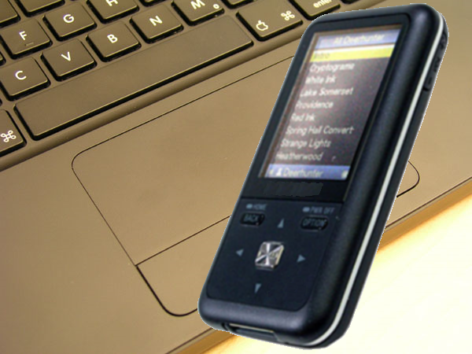
Fast Transcode

Slide 11
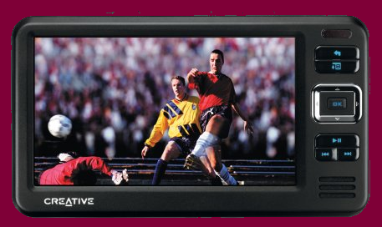
PC Is Center Of The Devices Ecosystem
PC is central media store
Often you want to be able to watch the content when you're out and about
Great examples of a Portable Media Players are Sony Walkman and Creative Zen W
People want simple ways of transferring content to devices without having to be bothered with the underlying complexities
We have integrated great transcode technology into the Windows 7 shell
When you do a drag and drop on your device, the necessary conversions happen automatically

Slide 12
Different Formats
Different portable video players need different video formats
Format needed will not be format in which video is stored on PC
Format on your PC will be whatever format content was delivered in
Typically TV is MPEG2
More and more in the future it'll be HD resolution
Typically, portable video devices need a lower resolution format to match their screens
More and more in the future they'll use H.264 video and AAC audio
Change format of video and audio content as part of the process of transferring content from PC store to device

Slide 13
Simple For User, Complex Underneath
User doesn't even have to think about transcode
The whole process just looks like a drag and drop file copy
Topology of Media Foundation building blocks underneath that…
Reads the source such as a recorded HDTV file
Decodes using eg an MPEG2 decoder
Processes it to get it into the resolution that the portable player needs
Encodes it using the codec that the portable player supports, eg H.264/AAC in MP4 container
Only problem is that it takes a while to do all this processing if doing it on the CPU
But we have hardware encode support to solve this

Slide 14
New Inbox MF Encode Detail Additions relative to Vista Inbox Encoders
Generic Format Name | File Extensions | Container | Video Codecs | Audio Codecs
MPEG-4 | .mp4 (A, V, A+V) .m4a (A) | ISO MPEG-4 | H.264 Baseline | AAC-LC
3GPP/3GPP2 | .3gp, .3g2 (A, V, A+V) | 3GP | H.264 Baseline | AAC-LC
H.264
Baseline profile level 3 with 1-pass CBR
Bit rate up to 1.5Mbps
Maximum size: 640 x 480, maximum frame rate: 30fps
AAC
LC stereo with 44.1 or 48KHz sample rate
96, 128, 160, or 192KHz bit rate

Slide 15
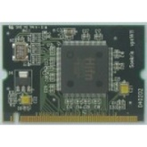
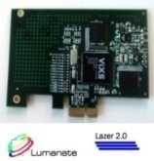
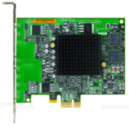
Hardware Transcode
Lots of processing needed to transcode a file
Transcoding a whole movie using software based processing can take a couple of hours, even on a very fast processor
Taking a long time to process is incompatible with the desire to hide all the transcode rigmarole from the user
New class of chips coming along that provide hardware codecs
These chips provide high speed transcoding, ie hardware decoding of the input format, and hardware scaling, and hardware encoding to a different output format
Also additional features to allow ISVs to provide better Blu-ray player apps
Various companies will be launching Hardware Codec chips
These chips will be packaged as plugin modules
Chips will also go onto motherboards
Even better is to make it a standard motherboard chipset feature

Slide 16
IHV Supplied MFTs
AV-Stream is the preferred way
It’s the easiest way, but not the only way
Or third parties can produce their own MFT and use a private interface to communicate with their hardware
Conform to the MFT input/output interfaces so that it looks like a software decoder or encoder
Expose decode and encode as separate MFTs
Codec certification for hardware accelerated MFTs will provide mechanism for topology builder to choose them
Provides robust way to know supplier and know it really is hardware
Tied to new robust merit scheme
Uses PVP-OPM-like embedded challenge certificate
Best to store certificate in hardware, but can be obfuscated in driver
8

Slide 17
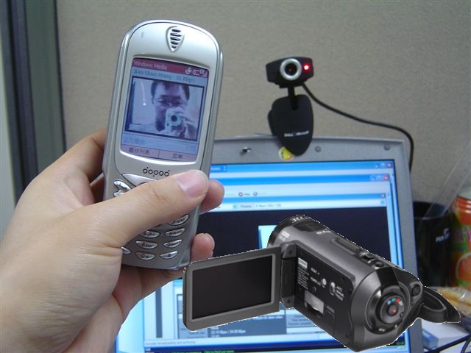
New Camera Support

Slide 18
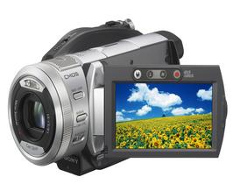
Wide Variety Of Support
Play and transcode whole range of formats that come from cameras
Camcorders using AVCHD container
H.264 in MP4 from next year’s ‘still’ cameras
FlipVideo using Xvid
In the past you would have had to install a special separate app
Media Foundation video streaming capture
Will open up a whole host of webcam capture app scenarios
For webcams
UVC1.1 class driver with driver extensibility
Made it nice and simple for the user

Slide 19
Developer Support

Slide 20
Media Foundation Technology
Ease of use enhancements
Performance enhancements
New components such as SourceReader and SinkWriter
Many more containers and codecs
Hardware pipeline support
Intelligent proxies
MF stream capture
Trusted merit
DirectShow and FSDK still supported, but all new investments are on Media Foundation

Slide 21
Pipeline Transcoding
Source Resolver
Topology & Loader
Encoding Profile Management
Media Session
Scheme Handler
Video Scaling/Conversion, Audio Processing, Other
Byte Stream Handler
File,
Network
Pipeline Topology
File,
Network
Byte Stream
Media Source
MFT Decoder
Proc
MFT Encoder
Media Sink
Byte Stream
Custom Input
or
or
Custom Output
or
Webcam
Hardware Acceleration

Slide 22
New MF Components Source Reader, Sink Writer
Specify URL, Byte Stream, or Media Source
Sync or Async Control and Status
Sync or Async Control and Status
Specify URL, Byte Stream, or Media Sink
Source Reader
Sink Writer
Direct access to consume, modify, and create media samples
Encoding Profile Mgmt.
File,
Network
File,
Network
Custom Input
Media Source
Media Sink
Custom Output
Webcam
MFT Decoder *
Specific Conversions *
Processing MFT *
MFT Encoder *
* Optional
Hardware Acceleration

Slide 23
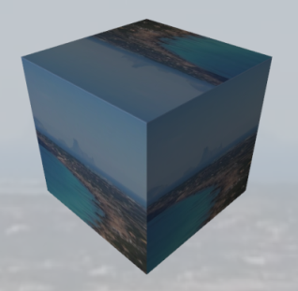
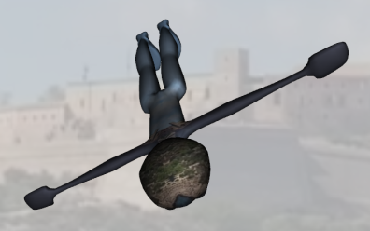
Developer Interface layers
Ways to access MF technology
Media Foundation interfaces
MF Play API and Transcode API
WMP.OCX
WPF
Silverlight
For specialized low level needs
Raw Video Rendering interfaces
Video is just a data type
Video is just a 3D texture
WPF XAML

Slide 24
H.264 In 3D WPF On Windows 7
demo

Slide 25
Play Almost Anything
demo

Slide 26
Drag And Drop Transcode
demo

Slide 27
Hardware Codecs
demo

Slide 28
Video Improvements In Windows7
Rudolph Balaz
Senior Program Manager Lead,
Windows Graphics/DirectX
Microsoft Corporation

Slide 29
Media Foundation+Infrastructure
Media Foundation
Source Reader
Sink Writer
File,
Network
File,
Network
Encoding Profile Mgmt.
Custom
Output
Custom Input
Media Source
Media Sink
Direct3D
Webcam
MFT Decoder *
Specific Conversions *
Processing MFT *
MFT Encoder *
Desktop Window Manager
COPP/OPM
WDDM
Video Memory
Hardware Acceleration
DirectX Video Acceleration (DXVA)
Direct3D
GPU
Windows Display Driver Model (WDDM)
Cable
* Optional
Display Driver / GPU Hardware
Display

Slide 30
Third Party ISV Needs
World class applications
Robust playback
Existing playback applications
Maybe not Media Foundation based
Performance expectations
Playback – low end hardware
Power – battery life
Contractual obligations

Slide 31
3rd Party ISV Pain points
Existing code bases/Legacy
Desktop composition turned disabled
Unexpected glitching/scalability
On low end hardware
Hard to meet content output rules
Private App to Driver side channels
Business requirements

Slide 32
Addressing 3rd Party Requirements In Windows 7

Slide 33
Publishing OPM
Addressing Legacy issues
OPM (Output Protection Management)
Specification and headers
Usable directly by applications
DirectShow or Media Foundation or other…
Updated base on new industry requirements
Supports for Display Clone, HDMI repeaters

Slide 34
Reducing Private Side Channels
Preventing Screen Scraping
D3D9Ex/DWM enhancements
Driver software protection
IHV Implementation using public interfaces
Hardware based protection
AES 128 for Encryption between CPU/GPU
Support for hardware crypto engines
SHED scenarios

Slide 35
Use Of Overlays In playback
The bad
Desktop Composition disabled
Video Memory Pinned
Available only via Legacy API’s
Hardware issues
Hardware (Availability/features)
Only one overlay
The good
Proven code in existing apps
Assumed to be faster/more secure?

Slide 36
Embracing - Overlay Support
Supported with Desktop Composition
Improved user experience
No flashes
No per frame composition costs
Available via D3D9 APIs
Simplifies code paths in application
Simplifies use with existing applications

Slide 37
Optimizations Playback
Memory pressure reporting
Many processes compete for Video Memory
Video application typically use many buffers
Enable applications to optimize playback by reducing buffering
Can result in smoother playback

Slide 38
Optimizations Playback
D3D9 Flip model
Improves Composition Performance (similar to overlay)
Reduces memory bandwidth needs
Full screen exclusive with DWM
Eliminates flash
MCE can be full screen with composition

Slide 39
Optimizing Playback
DXVA-HD - Extends DXVA
HD video processing and composition models
Examples BD, ISDB-T
Standardized application Interfaces
Drivers provide different private implementations
Available via Windows 7 optimized drivers
WDDM 1.1 optional driver features

Slide 40
Call To Action
Use the new video format support
Use the shell drag and drop
Make use of the new camera support
Make use of Media Foundation technology in your own apps
Make use of playback optimizations
DXVA-HD, D3D9 Flip, Overlays
OPM, AES128, etc…

Slide 41
Additional Resources
Media Foundation
http://msdn.microsoft.com/en-us/library/ms694197(VS.85).aspx
DirectShow
http://msdn.microsoft.com/en-us/library/ms783323(VS.85).aspx
DirectX
http://msdn.microsoft.com/directx
Whitepapers
http://www.microsoft.com/whdc/device/display/
Related Sessions
GRA-T515: DirectX – Core Graphics for Windows 7
GRA-T518: WDDM v1.1
GRA-T634: GPU Performance and GPU/CPU Interactions in Windows 7
MBL-T579: Connecting Projectors and Using Docking Stations with Windows 7

Slide 42
Please Complete A Session Evaluation Form Your input is important!
Visit the WinHEC CommNet and complete a Session Evaluation for this session and be entered to win one of 150 Maxtor® BlackArmor™ 160GB External Hard Drives 50 drives will be given away daily!
http://www.winhec2008.com
BlackArmor Hard Drives provided by:

Slide 43
© 2008 Microsoft Corporation. All rights reserved. Microsoft, Windows, Windows Vista and other product names are or may be registered trademarks and/or trademarks in the U.S. and/or other countries.
The information herein is for informational purposes only and represents the current view of Microsoft Corporation as of the date of this presentation. Because Microsoft must respond to changing market conditions, it should not be interpreted to be a commitment on the part of Microsoft, and Microsoft cannot guarantee the accuracy of any information provided after the date of this presentation. MICROSOFT MAKES NO WARRANTIES, EXPRESS, IMPLIED OR STATUTORY, AS TO THE INFORMATION IN THIS PRESENTATION.

