Slide 2
High DPI And
Windows 7
Ryan Haveson
Principal Program Manager Lead
Microsoft Corporation

Slide 3
Overview
Why we should care about High DPI
High DPI Infrastructure and New Features
Common High DPI App Compat Issues
Making high DPI hardware work with Windows
  Work required by ISVs to make applications DPI Aware
  Automatic DPI configuration via EDID
  Configuring the DPI via OEM XML Override

Slide 4
High DPI Displays Are Common
Description | Horizontal | Vertical | Width (in) | Panel DPI
17" WXGA+ | 1440 | 900 | 17 | 100
15.4" WXGA+ | 1440 | 900 | 15.4 | 110
15.4" WXGA | 1280 | 768 | 15.4 | 97
14.1" WXGA | 1280 | 768 | 14.1 | 106
13.3" WXGA | 1280 | 768 | 13.3 | 112
17" WUXGA | 1920 | 1200 | 17 | 133
17" WSXGA+ | 1680 | 1050 | 17 | 117
15.4" WSXGA+ | 1680 | 1050 | 15.4 | 129
14.1" WXGA+ | 1440 | 900 | 14.1 | 120
13.3" WXGA+ | 1440 | 900 | 13.3 | 127
12.1" WXGA | 1280 | 768 | 12.1 | 123
15.4" WUXGA | 1920 | 1200 | 15.4 | 147

Slide 5
This Was Very Surprising To Us…
Monitor Max Resolution | % Set to Maximum
1280X1024 | 56%
1400X1050 | 79%
1600X1200 | 32%
1680X1050 | 66%
1920X1050 | 39%
1920X1200 | 78%
Avg. set to default | 55%
Details
Users with Max Resolution of 1600X1200
User's Chosen Resolution | % using that resolution
640X480 | 1%
800X600 | 7%
1024X768 | 57%
1280X1024 | 3%
1600X1200 | 32%
Total | 100.00%
Almost half of all of users are not configuring their display to maximum resolution (!)
Users are lowering their screen resolution to get larger text…

Slide 6

Why Do We Care?
Non-native resolution negates the value of high fidelity displays
Text looks blurry because ClearType requires native resolution
Can’t display native high def content
  720p high definition video requires 1280x720 resolution
  1080p requires 1920x1080
  1.9 megapixel photos requires 1600x1200 native
Many people accidentally select a non-native aspect ratio
Pixilated Content does not take advantage of the display
Non-native aspect Ratio Settings “Squishes” Content

Slide 7
High DPI Goals
OEMs ship machines pre-configured to native resolution and High DPI
Users keep their display set to native resolution
Customers use DPI as the way to change the “bigness” of Text and UI
Improve overall end to end experience for applications
Examples:
Native Resolution of Display | Current User Setting | Optimal Setting | Increased Pixel Fidelity Gain
1200x1000 | 1024x768 | 1200x1000 @ 120 DPI | 52%
1600x1200 | 1024x768 | 1600x1200 @ 144 DPI | 140%
1600x1200 | 1200x1000 | 1600x1200 @ 120 DPI | 60%
Success metrics are: significantly increase the percentage of users running at native resolution and using high DPI, and increase the percentage of applications which are declared DPI aware.

Slide 8
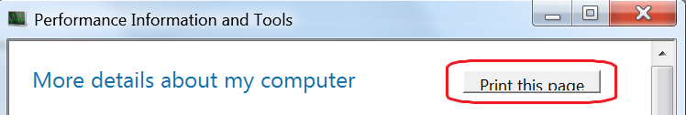
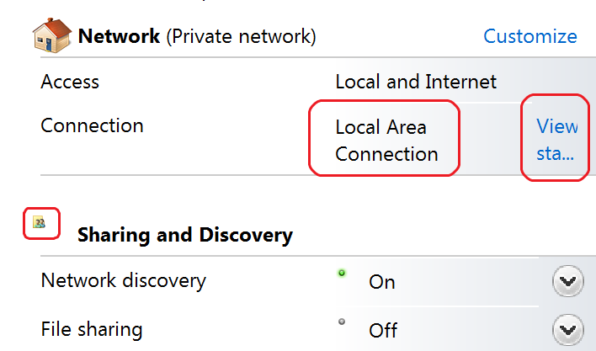
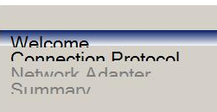
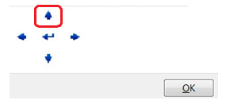
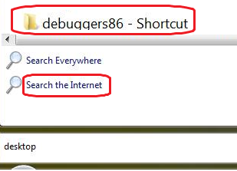
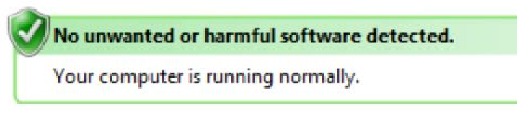
High DPI Issues
Clipped Text
Layout Issues & Image Size Issues
WinForms Issues
Pixilated Bitmaps
Blurry UI
Mismatched Font Sizes

Slide 9
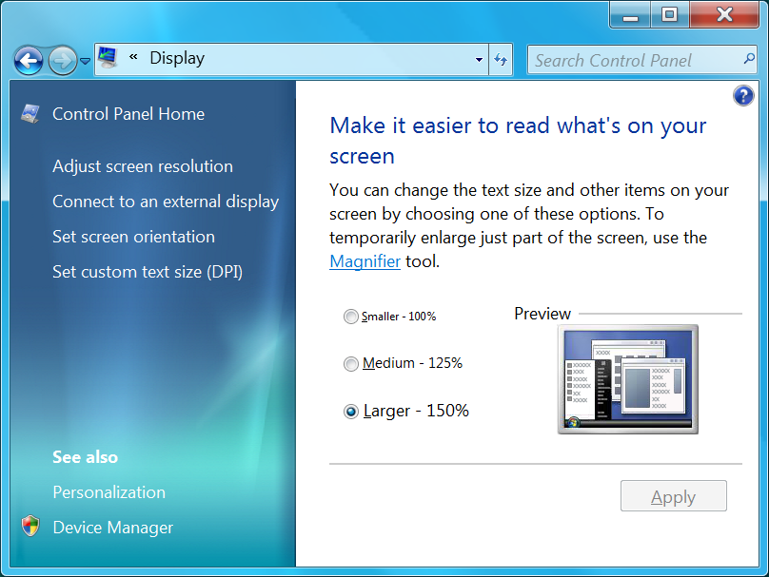

Configure DPI via Display CPL
Windows 7 uses Scaling percentage instead of a raw DPI value
  This is because most users don’t understand DPI
  100% = 96 DPI, 125% = 120 DPI, 150% = 144 DPI

Slide 10
DPI Settings Change System Metrics
System Metric | 96 DPI | 120 DPI | 144 DPI
GetDeviceCaps(hDC, LOGPIXELSX) | 96 | 120 | 144
DEFAULT_GUI_FONT height | 13 | 16 | 20
SM_CXHTHUMB (scroll bar control) | 17 | 21 | 26
SM_XICON (icon width) | 32 | 40 | 48
Font and Text
When the DPI increases the UI uses more pixels to draw icons, UI controls (e.g. scrollbars), and Text.

Slide 11



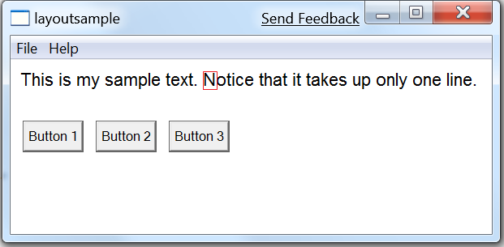
System Text Size Increases with DPI
This is the letter “N” blown at 1300% using a magnifier.
Notice the number of pixels used increases with DPI.
Also notice the sub-pixel coloration from ClearType, which is why native resolution is important.
96 DPI
(11 pixels)
120 DPI
(13 pixels)
144 DPI
(16 pixels)

Slide 12
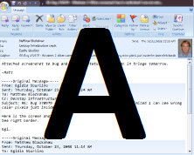

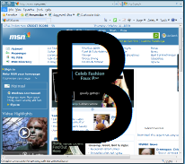
Desktop Composition Primer (DWM)
DWM Composes the Desktop
With DWM, all apps render off-screen and are composed by DWM at the screen refresh rate.
These off-screen surfaces are also used for Thumbnails and for Flip 3D
Off-screen Memory Surface

Slide 13
DPI Virtualization (Automatic Scaling)
DWM Scales A at composition time
A is not DPI Aware, and renders in a 96-DPI virtualized context
System metrics for A are in a 96-DPI virtualized space.
A is given a 96-DPI surface to render into (smaller).
B is DPI-Aware

Slide 14
Automatic Scaling is a stopgap, not a solution
Automatic scaling introduces blurriness in the app window
Some cross-app input operations fail due to mis-matched coordinate spaces
Some APIs are not virtualized and result in visual artifacts.
Only applies to apps which do not declared as DPI aware
By default, only enabled for DPI settings of >= 144
Automatic scaling is an app compat feature to ease the transition while the ISV ecosystem catches up to the hardware display capabilities.

Slide 15
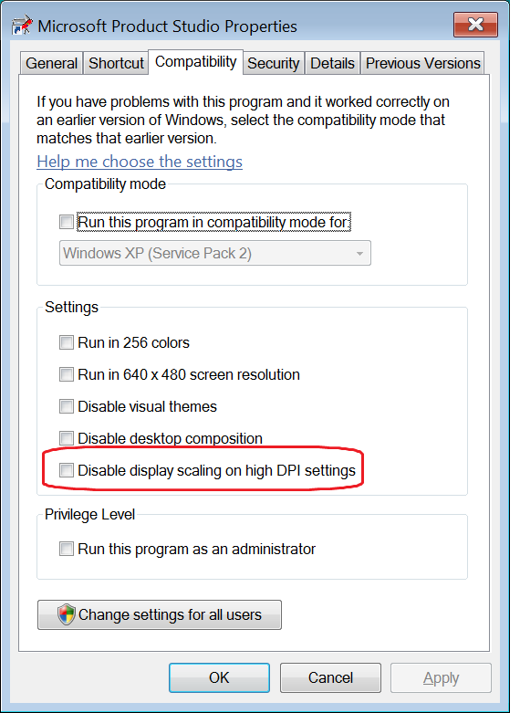
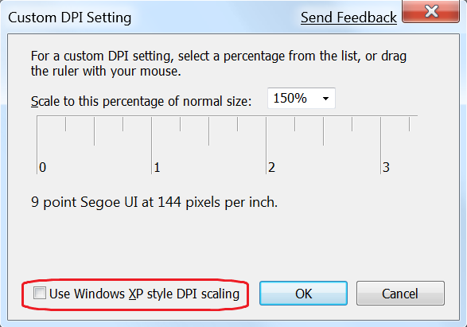
DPI Virtualization Compatibility
Can be disabled per-application by right-clicking the app and selecting Properties -> compatibility.
Note that DPI virtualization is only on by default if the DPI is set to 144 or greater.
This can also be disabled globally via the “custom DPI” dialog (below).

Slide 16
High DPI Features By OS
Feature | OS | Comment
UI for Users to Configure DPI | Windows 2000 Windows XP Windows Vista Windows 7 | UI has consistently become more “promoted” and in Windows 7 it is on the default display CPL hub page.
DPI Aware Win32 APIs (GetDeviceCaps, DEFAULT_GUI_FONT, GetSystemMetrics), etc. | Windows 2000 Windows XP Windows Vista Windows 7 | These APIs have been available since Windows 2000 & Windows 95 (used to be accessed through large fonts setting)
DPI Virtualization for non-DPI aware applications | Windows Vista Windows 7 | Apps which are not DPI aware get virtualized Win32 APIs and DWM scales the application up.
API & Manifest so app can declare DPI Awareness | Windows Vista Windows 7 | Windows Vista introduced DPI Virtualization to ease app compat issues. Apps which declare themselves DPI aware opt out of this.
Global setting to disable DPI Virtualization | Windows Vista Windows 7 | Some apps have compatibility problems with the DPI virtualization because they assume logical coordinates are the same as physical coordinates, or because they use a combination of virtualized & non-virtualized system metrics. Examples of this are drag-n-drop, full screen DX applications
Per-application compatibility mode setting to opt out of DPI Virtualization | Windows Vista Windows 7
IE8 has Native Support for High DPI | Windows XP Windows Vista Windows 7 | Ships on Windows 7, and will be available down level to Windows XP
Automatic configuration of DPI | Windows7 | During Setup, we detect the EDID and set the DPI accordingly
Per User DPI setting | Windows 7 | Previously this was a per-machine setting
Change DPI Without reboot | Windows 7 | Logoff/logon still required

Slide 17
How Are We Encouraging Adoption?
Improvements in Shell and IE
Automatic configuration in OOBE
Promotion the Control Panel UI for DPI
Raising ecosystem awareness

Slide 18
Improvements In Shell And IE
All 25 plus engineering teams test high DPI
> 800 bugs were fixed in Windows 7 UI
> 150 windows developers fixed high DPI bugs (!)
IE8 now has very good high DPI scaling
Discoverability: DPI is now on the main Display CPL page
DPI is now a per-user setting
DPI can be changed w/o rebooting (logoff & logon)
DPI is now auto-configured in OOBE based on EDID

Slide 19
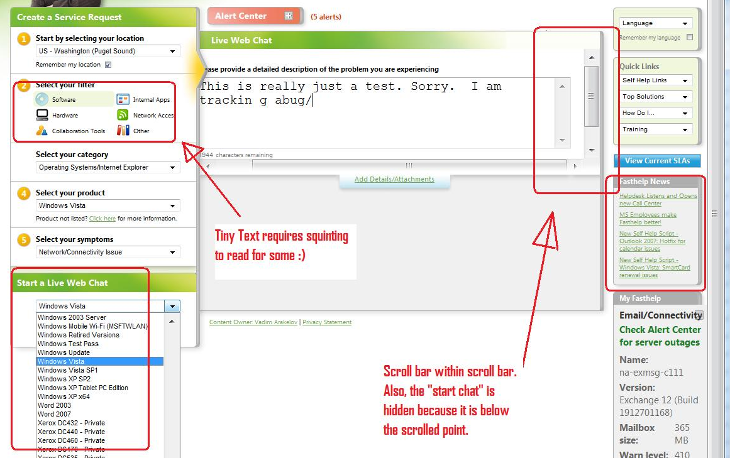
Layout, Clipping, And Font Issues With Websites
Prior to IE8, there were many issues with High DPI in IE. These are almost all fixed in IE8, so migrate your users to IE8 if possible.

Slide 20
Automatic Configuations Of High DPI Settings
Description | Horizontal | Vertical | Width (in) | Panel DPI | OS DPI | Scale level
17" WXGA+ | 1440 | 900 | 17 | 100 | 96 | 100%
15.4" WXGA+ | 1440 | 900 | 15.4 | 110 | 96 | 100%
15.4" WXGA | 1280 | 768 | 15.4 | 97 | 96 | 100%
14.1" WXGA | 1280 | 768 | 14.1 | 106 | 96 | 100%
13.3" WXGA | 1280 | 768 | 13.3 | 112 | 96 | 100%
17" WUXGA | 1920 | 1200 | 17 | 133 | 120 | 125%
17" WSXGA+ | 1680 | 1050 | 17 | 117 | 120 | 125%
15.4" WSXGA+ | 1680 | 1050 | 15.4 | 129 | 120 | 125%
14.1" WXGA+ | 1440 | 900 | 14.1 | 120 | 96* | 125%
13.3" WXGA+ | 1440 | 900 | 13.3 | 127 | 96* | 125%
12.1" WXGA | 1280 | 768 | 12.1 | 123 | 96* | 125%
15.4" WUXGA | 1920 | 1200 | 15.4 | 147 | 144 | 150%
The “Scale Level” column represents the default configuration based on the Max Horizontal / Vertical Image Size parameters from the EDID. Note that this requires that the EDID contains valid data for (see VESA EDID Spec for more details).
*Note: we never configure DPI producing an effective resolution of < 1024x768

Slide 21
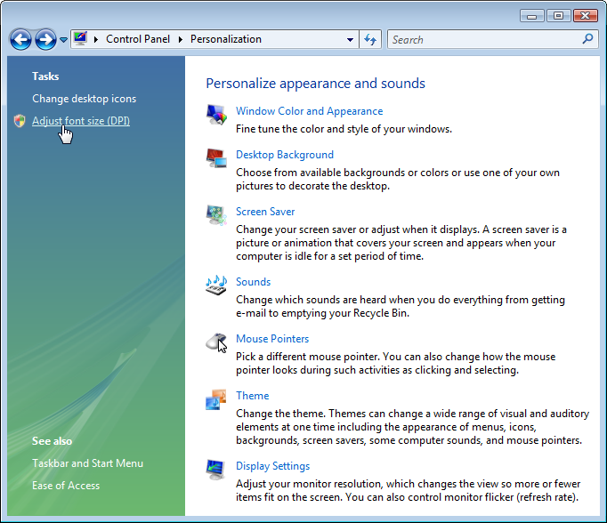
New High DPI Control Panel
Windows Vista Personalization CPL
Windows 7 Display CPL
DPI settings are now on the main DPI CPL Hub. Also we have made the terminology more user friendly.

Slide 22
Raising Ecosystem Awareness
Engaged OEMs from the beginning of Windows 7
Delivered testing guidance to TAP participants
High DPI was part of PDC Graphics Messaging
New 30 Page Whitepaper for Win32 Developers
High DPI Topics in Windows 7 Engineering Blog
Talking about High DPI at major events like this

Slide 23
What can you do?
Help Validate and Improve Software Quality at High DPI
  Test using the DPI configuration matrix
  Fix High DPI issues which are found
  Add the DPI Aware manifest to the application
Ensure your Hardware works with Windows 7
  Ensure that the EDID data is valid
  Test bundled software for DPI Compliance
Validate End-to-End PC System Quality at High DPI
  Ensure the DPI is configured correctly out of the box
  Test bundled software for DPI compatibility

Slide 24
High DPI Test Matrix
High level functional test pass, including install and uninstall, at the following settings:
Setting | What to look for
1024x768 @ 120 DPI* | This is an effective resolution of ~800x600, so look for UI clipped off the screen or layout issues. Also look for pixilated bitmaps and icons. *NOTE: if your app requires 1024x768, then do this test at 1280x960.
1600x1200 @ 144 DPI | Blurry UI. Verify that all mouse operations work, especially drag and drop operations. Also verify full-screen modes work properly
1600x1200 @ 144 DPI with DPI Virtualization Disabled from DPI UI -> Custom -> use XP Style Scaling | Often buttons and UI won’t scale in relation to larger text and there will be significant text clipping. Look for layout issues in general and pixilated bitmaps and icons.
Recommendation: Write a list of the issues identified, best is to add them to your bug DB with a High DPI tag for later validation. Integrate a variety of configurations into all future test passes. Also see references for link to whitepaper on how to remedy issue you find.

Slide 25
DPI Aware Manifest
Compile this in with your application manifest, and re-run the high DPI assessment:
<application xmlns="urn:schemas-microsoft-com:asm.v3">
<windowsSettings>
<dpiAware xmlns="http://schemas.microsoft.com/SMI/2005/WindowsSettings">true</dpiAware>
</windowsSettings>
</application>
More Info on using manifests can be found here:
http://msdn2.microsoft.com/en-us/library/ms633543.aspx

Slide 26
Ensure That The EDID Is Valid
Ensure that the values are valid for:
  Max Horizontal size and Max Vertical size
  The sizes are in cm
  Should measure the panel sizes not including the frame
Test with Windows 7 to ensure auto-config is working
  See the table earlier in this presentation for expected results
Don’t forget: If your hardware also ships with inbox software, please test at high DPI, fix DPI related bugs, and declare the applications DPI aware. This applies to your inbox manual, configuration CPL, etc.

Slide 27
Configuring The Unattend.XML
NOTE: We strongly recommend that you use the auto-configuration feature in Windows 7, which means that configuring this unattend.xml file is not necessary, however we are providing this information for cases where it is required such as a display with a non-working EDID configuration.
The following Display settings child elements are relevant
  DPI: Specifies the dots per inch setting for the display device
  HorizontalResolution: Valid Horizontal resolution for the device
  VerticalResolution: Valid Vertical resolution for the display device
  RefreshRate: Specifies a valid refresh rate for the display device
  ColorDepth: Specifies a valid color depth for the display device

Slide 28
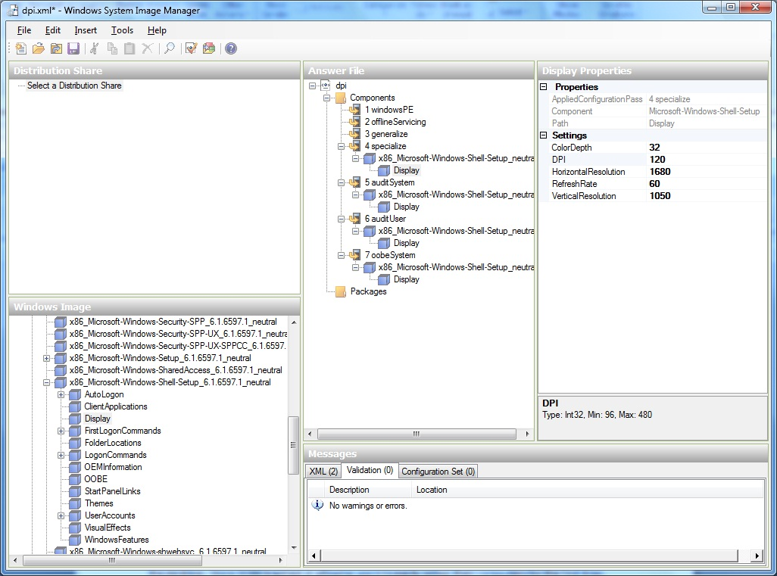
Using System Image Manager
DPI and Screen resolution settings can be configured here.
The customization can go in any of the following sections:
specialize
auditSystem
auditUser
oobeSystem
Windows System Image Manager can be used to override default configuration settings. See http://technet.microsoft.com/en-us/library/cc722301.aspx for details.
The unattend.xml file is referred to as the “Answer File” in this documentation.

Slide 29
Directly Configuring Unattend.xml
<Display>
<ColorDepth>32</ColorDepth>
<DPI>120</DPI>
<HorizontalResolution>1600</HorizontalResolution>
<RefreshRate>60</RefreshRate>
<VerticalResolution>1050</VerticalResolution>
</Display>
Change the DPI value to the desired default
  (!) This should be 96, 120 or 144
  Some applications have rendering issues at non-standard DPIs
The example above will set the display as follows
  1600x1050, at 120 DPI with 60 hz refresh
  32-bit color depth

Slide 30
Call To Action
Try the High DPI feature yourself
Test your hardware and software for
DPI compatibility
Raise awareness in your team about high DPI
  Use the materials in the “additional resources” slide
Explain to your customers the benefits of high DPI
Let us know if you have questions/concerns
  disup@microsoft.com

Slide 31
Additional Resources
Whitepaper for Writing DPI Aware Win32 Applications
  http://go.microsoft.com/fwlink/?LinkID=129586
EDID Specification
  http://www.vesa.org/Public/EEDIDguideV1.pdf
Information for OEMs configuring OOBE via XML Override
  http://technet.microsoft.com/en-us/library/cc722301.aspx
  http://technet.microsoft.com/en-us/library/cc721929.aspx
Windows 7 Engineering Blog High DPI Post
  http://blogs.msdn.com/e7/archive/2008/09/13/follow-up-on-high-dpi-resolution.aspx
  http://blogs.msdn.com/e7/archive/2008/09/16/more-follow-up-to-discussion-about-high-dpi.aspx
For more information or questions, send e-mail to
  disup@microsoft.com

Slide 32
Additional Resources
Web Resources
  Whitepapers: http://www.microsoft.com/whdc/display
  Other Resources: http://msdn.microsoft.com/directx
Related Sessions
  GRA-T515: DirectX – Core Graphics for Windows 7
  GRA-T516: DirectX11
  GRA-T517: GPU Compute
  GRA-T518: WDDM v1.1
  GRA-T584: Working with the Windows 7 Graphics Architecture
  GRA-T585: Video Improvements in Windows 7
  GRA-T634: GPU Performance and GPU/CPU Interactions in Windows 7
  GRA-P581: Panel: Application of General Purpose Compute
  GRA-C640: Validating Graphics Scenarios in Windows 7
  MBL-T579: Connecting Projectors and Using Docking Stations with Windows 7
  GRA-C666: Connecting and Configuring Displays in Windows 7
Contact information
  Directx@Microsoft.com

Slide 33
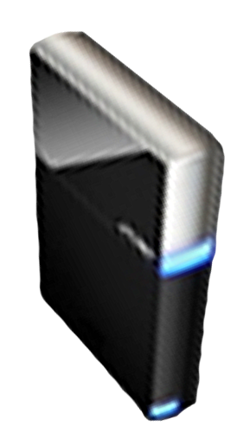


Please Complete A Session Evaluation Form
Your input is important!
Visit the WinHEC CommNet and complete a Session Evaluation for this session and be entered to win one
of 150 Maxtor® BlackArmor™ 160GB External Hard Drives
50 drives will be given away daily!
http://www.winhec2008.com
BlackArmor
Hard Drives provided by:

Slide 34

© 2008 Microsoft Corporation. All rights reserved. Microsoft, Windows, Windows Vista and other product names are or may be registered trademarks and/or trademarks in the U.S. and/or other countries.
The information herein is for informational purposes only and represents the current view of Microsoft Corporation as of the date of this presentation. Because Microsoft must respond to changing market conditions, it should not be interpreted to be a commitment on the part of Microsoft, and Microsoft cannot guarantee the accuracy of any information provided after the date of this presentation.
MICROSOFT MAKES NO WARRANTIES, EXPRESS, IMPLIED OR STATUTORY, AS TO THE INFORMATION IN THIS PRESENTATION.

