Slide 2
DirectX11
New Hardware And APIs
Chas. Boyd
Architect
Desktop and Graphics Technologies
Microsoft

Slide 3
GRA-T516 Session Description
In this session you will learn how Direct3D11 extends and enhances Direct3D10 with new hardware features and API calls. We’ll discuss
the features in Direct3D11 that enable you to create content that scales from small screens
to high res displays and across different CPU
and GPU configurations
Nov 5th 2008 2-3pm

Slide 4
Executive Summary: Direct3D11
Direct3D11 focuses on scalability and performance, a creating a better development experience, and extending the reach of the GPU
Direct3D11 is a strict superset of Direct3D10/10.1
  Direct3D11 adds support for new features to Direct3D10.1
  The fastest way to move to Direct3D11 is to start developing on Direct3D10/10.1 today
Direct3D11 will be available on Windows Vista and Windows 7
Direct3D11 will run on and add features to DirectX9 – and
DirectX10-class hardware

Slide 5
Outline
Direct3D10/10.1 status
Direct3D10 broader reach
Direct3D11L
  Tessellation
  Compute Shader
  Multi-Threading
  Dynamic Shader Linkage
  Texture Compression
  Misc Features

Slide 6
Direct3D10
Cleaner API → Easier coding than Direct3D9
More efficient DDI → Driver Optimization
A more consistent experience across hardware!
  Tighter specification
  Elimination of caps

Slide 7
Direct3D10.1
Improved multisampling
  MSAA depth access in shader
  Expose sample positions
  Explicit coverage control
  4-sample MSAA required
Improved fixed-function blending
  Per-MRT blend mode
  16-bit integer blending
Arrays of cube maps

Slide 8
Direct3D10.1
Improved performance over Direct3D10
  6-10% for common cases
  20-30% for applications relying on MSAA such as deferred shading engines
Algorithms closer to Direct3D11 and future APIs

Slide 9
Direct3D10 On DirectX9 Hardware
What if I want to run on a DirectX9 chip?
Introducing Direct310 on 9
DirectX10 API set is now supported on
DirectX9-class hardware
How do we handle capability flags?

Slide 10
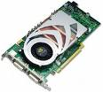


Feature Level 9_3:
Shader model 3.0
16 bit float blending
More Featues
NV 6800 +
ATI 1x00 series +
Super set
Feature Level 9_2:
Shader model 2.0
More Features
ATI 9800
ATI X200
Super set
Feature Level 9_1:
Shader model 2.0
965,
Geforce FX
Older S3 Parts
SIS Mirage

Slide 11
Key Decisions
Map to D3D9 DDI, skip runtime
No expensive emulation
  Geometry shader
  Texture array
  Exception: RGBA Textures are emulated!
BGRA Support added to D3D10
Can’t exceed a feature level
Require: Shader model 2.0, LDDM driver
D3D9 and D3D10 byte code stored in same blob

Slide 12
Direct3D10 WARP
What if there is no hardware/driver at all?
Direct3D10 WARP
A software rasterizer for Direct3D
Optimized for multi-core and SSE
Selectable at device create time
  Simulates a display driver

Slide 13
Further Direct3D Opportunities
Scalability
Performance
Cross-Platform Content and Techniques
General-Purpose Data-Parallel Computing

Slide 14
Outline
Overview
Drilldown
  Tessellation
  Compute Shader
  Multithreading
  Dynamic Shader Linkage
  Improved Texture Compression
  Quick Glance at Other Features
Summary

Slide 15
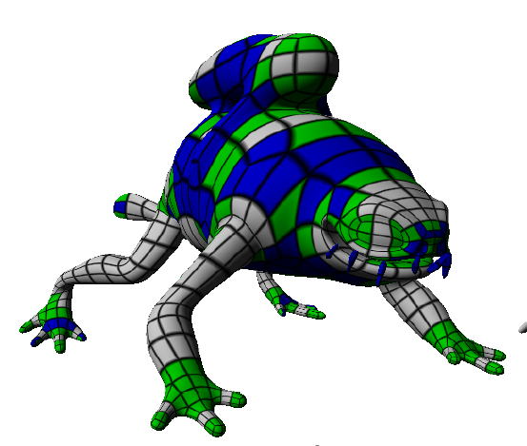
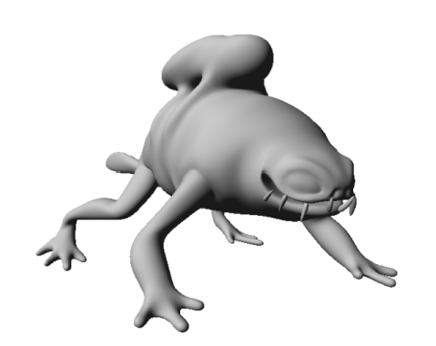
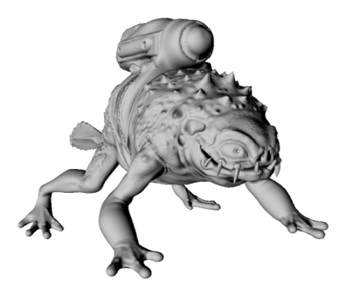
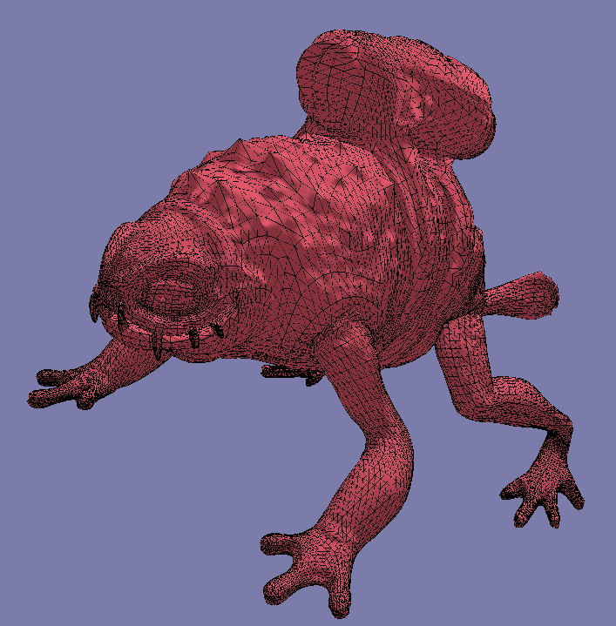
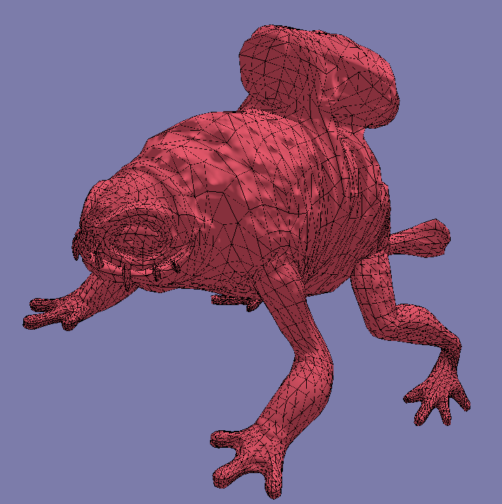
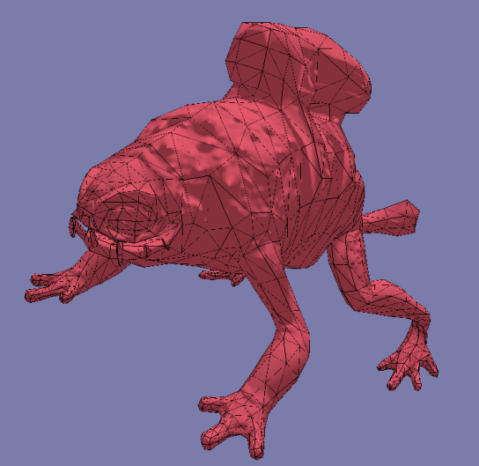
Current Authoring Pipeline
(Rocket Frog Taken From Loop &Schaefer, "Approximating Catmull-Clark Subdivision Surfaces with Bicubic Patches“)
Sub-D Modeling
Animation
Displacement Map
Polygon Mesh
Generate LODs

Slide 16
Character Authoring
Trends
  Denser meshes, more detailed characters
    ~5K triangles -> 30-100K triangles
  More complex animations
    Animations on polygon mesh vertices more costly
Result
  Indirection in authoring pipeline more painful
  Painful I/O issues
Solution
  Use higher-level surface representation longer
    Animate control cage (~5K vertices)
    Generate displacement and normal maps

Slide 17
Direct3D11 Pipeline
Input Assembler
Direct3D10 pipeline
Plus
Three new stages for Tessellation
Vertex Shader
Hull Shader
Tessellator
Domain Shader
Stream Output
Geometry Shader
Rasterizer
Pixel Shader
Output Merger

Slide 18

Hull Shader (HS)
HS input:
patch control pts
One Hull Shader invocation per patch
Hull Shader
HS output:
Patch control pts after
Basis conversion
HS output:
TessFactors (how much to tessellate)
Fixed tessellator mode declarations
Tessellator
Domain
Shader

Slide 19
Fixed-Function Tessellator (TS)
Hull Shader
Note: Tessellator does not see control points
TS input:
TessFactors (how much to tessellate)
Fixed tessellator mode declarations
Tessellator
TS output:
U V {W} domain points
TS output:
Topology
(to primitive assembly)
Domain Shader
Tessellator operates per patch

Slide 20
Domain Shader (DS)
Hull Shader
DS input:
Control points
TessFactors
Tessellator
DS input:
U V {W} domain points
Domain Shader
One Domain Shader invocation per point from Tessellator
DS output:
One vertex

Slide 21
Tesselation Pseudocode
Foreach Patch iPatch
{
HullShader( iPatch );
Foreach Vertex in Patch iPatch
{
float3 iParams = Tessellator();
DomainShader( iParams, iVertex );
}
}

Slide 22
Direct3D11 Tessellation Notes
Input Assembler
Vertex Shader
Direct3D11 Hardware Feature
Direct3D11 chip is required
Fundamental primitive is patch (not triangle)
Superset of Xbox 360 tessellation
Hull Shader
Tessellator
Domain Shader
Geometry Shader
Rasterizer
Pixel Shader
Output Merger

Slide 23
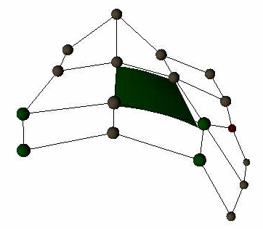
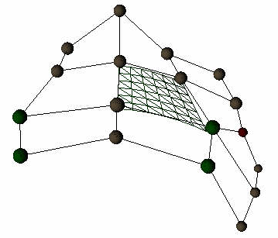
Example Surface Processing Pipeline
Single-pass process!
Vertex shader
Hull shader
Tessellator
Domain shader
Animate/skin
Control
Points
Transform basis,
Determine how
much to tessellate
Tess
Factors
Tessellate!
Evaluate
surface
including
displacement
Patch
control points
Transformed
control points
Control points
in Bezier patch
U V {W}
domain points
Displacement
map
Sub-D Patch
Bezier Patch

Slide 24
New Authoring Pipeline
(Rocket Frog Taken From Loop &Schaefer, "Approximating Catmull-Clark Subdivision Surfaces with Bicubic Patches“)
Sub-D Modeling
Animation
Displacement Map
Optimally Tessellated Mesh
GPU

Slide 25
Tessellation: Summary
Helps us get closer to eliminating “pointy heads”
Scales visual quality across PC hardware configurations
Supports performance increases
  Coarse model equals compression, faster I/0 to GPU
  Rendering tailored to each end user’s hardware
Better cross-platform (Windows + Xbox 360)
development experience
  Xbox 360 has a subset of Direct3D11’s tessellation
  Parity equals ease of cross-platform development
  Extra features equals innovation for Windows gaming
Render content as the artist created it!

Slide 26
Want To Know More?
Check out these presentations on
http://www.xnagamefest.com/presentations08.htm
“Direct3D11 Tessellation”
-Microsoft
“Advanced Topics in GPU Tessellation”
-AMD
“Water-Tight, Textured, Displaced Subdivision Surface Tessellation Using Direct3D11”
-nVidia

Slide 27
Outline
Overview
Drilldown
  Tessellation
  Compute Shader
  Multithreading
  Dynamic Shader Linkage
  Improved Texture Compression
  Quick Glance at Other Features
Summary

Slide 28
GPGPU Equals Data Parallel Computing
GPU performance continues to grow
Data Parallel programming model lets many applications scale to massive parallelism without tricky code changes
Direct3D is the API for talking to GPU
Some algorithms are difficult to support
How can we expand Direct3D to enable more algorithms to run?

Slide 29
Introducing: Compute Shader
A new processing model for GPUs
  Data–parallel programming for mass markets
Supports more general constructs
  Cross-thread data sharing
  Un-ordered access I/O operations
Enables more general data structures
  Irregular arrays, trees, etc.
Enables more general algorithms
  Far beyond shading

Slide 30
Optimized For Client Scenarios
More general programming features
  Random-access I/O, cross-thread comm.
Simpler setup syntax than graphics API
  Balance between power and simplicity
Better integration with media data types
  Pixels, samples, text, vs only floats
Consistent implementations
  Across vendors and across generations
Real-time rendering of results
  Very efficient interop with Direct3D

Slide 31
Integration With Direct3D
Fully supports all Direct3D resources
  Both texture sampling and random i/o
Efficient compute<->render transitions
Evolution of DirectX HLSL
Graphics pipeline updated to emit general data structures…
  …which can then be manipulated by compute shader…
  And then rendered by Direct3D again

Slide 32
Example Scenario
Input Assembler
Render scene
Write out scene image
Use Compute for image post-processing
Output final image
Vertex Shader
Hull Shader
Tessellator
Domain Shader
Stream Output
Geometry Shader
Rasterizer
Data Structure
Compute Shader
Pixel Shader
Output Merger

Slide 33
Target Applications
Image/Post processing
  Histogram, FFT, convolution
Video processing
  Transcode, noise removal, etc.
Games
  Advanced rendering techniques
    Ray-tracing, radiosity, A-Buffer, etc.
  Effects physics
Technical/Scientific

Slide 34
Compute Shader: Summary
Enables much more general algorithms
  Based on more general data structure support
Transparent parallel processing model for huge scaling capability
Full cross-vendor support in DirectX11 chips
  Broadest possible installed base
Backward compatible
  DirectX10 version provided for DirectX10-class hardware

Slide 35
Want To Know More?
“Direct3D11 New GPU Compute Shader”
  Next talk in this room
  GRA-T517

Slide 36
Outline
Overview
Drilldown
  Tessellation
  Compute Shader
  Multithreading
  Dynamic Shader Linkage
  Improved Texture Compression
  Quick Glance at Other Features
Summary

Slide 37
Multithreading Today
Physics
Graphics
AI
GPU

Slide 38
Multithreading Today
CPU-Bound Graphics
Physics
AI
GPU

Slide 39
Direct3D11 Multithreading
Enables distribution across threads of
  Application code, Runtime, and Driver
Device: Free threaded resource creation
Immediate Context: Your single primary device for state and draws
Deferred Contexts: Your per-thread devices for state and draws
Display Lists: Recorded sequence of
graphics commands

Slide 40
Direct3D11 Multithreading
Now, the following can be distributed across threads
  Application
  Direct3D11 Runtime
  Direct3D11 Drivers
  Updated Direct3D10 and 10.1 Drivers

Slide 41
Direct3D11 Multithreading
Application
Direct3D11 Runtime
Existing 10/10.1 Drivers
Direct3D11 Driver
Direct3D10/10.1 HW
Direct3D11 HW

Slide 42
Direct3D11 Multithreading
Application
Direct3D11 Runtime
New 10/10.1 Drivers
Direct3D11 Driver
Direct3D10/10.1 HW
Direct3D11 HW

Slide 43
Multithreading: Summary
Improves performance
Scalable across hardware configurations
in two ways
  # of CPUs
  Graphics cards/drivers
Better cross-platform (Windows+Xbox 360) development experience

Slide 44
Outline
Overview
Drilldown
  Tessellation
  Compute Shader
  Multithreading
  Dynamic Shader Linkage
  Improved Texture Compression
  Quick Glance at Other Features
Summary

Slide 45
Shader Issues Today
Shaders growing larger, more complex
Large number of materials, light types, etc.
Shaders must target wide range of hardware
Code must be efficient on SIMD processors
  Divergent flow control
  Register counts
Optimization of different shader configurations drives shader specialization

Slide 46
Options: Über-shader
Über-shader
foo (…) {
if (m == 1) {
// do material 1
} else if (m == 2) {
// do material 2
}
if (l == 1) {
// do light model 1
} else if (l == 2) {
// do light model 2
}
}

Slide 47
Option 1: Über-shader
“One shader to rule them all”
Good
  All functionality in one place
  Reduces state changes at runtime
  One compile step
  Seems to be most obvious coding method
Bad
  Complex, unorganized shaders
  Register usage is always worst case path

Slide 48
Option 2: Specialization
Multiple specialized shaders for each
combination of settings
Good
  Always optimal register usage
  Flow control precompiled out
  Easier to target optimizations
Bad
  Huge number of resulting shaders (GB!)
  Pain to manage at runtime

Slide 49
Solution
Dynamic Shader Linkage and OOP
Introducing new OOP features to HLSL
  Interfaces
  Classes
Can be used for static code
Also used as the mechanism for linking specific functionality at runtime

Slide 50
Dynamic Shader Linkage
Über-shader
Dynamic Subroutine
foo (…) {
if (m == 1) {
// do material 1
} else if (m == 2) {
// do material 2
}
if (l == 1) {
// do light model 1
} else if (l == 2) {
// do light model 2
}
}
Material1(…) { … }
Material2(…) { … }
Light1(…) { … }
Light2(…) { … }
foo(…)
{
myMaterial.Evaluate(…);
myLight.Evaluate(…);
}

Slide 51
In the Runtime
Select specific class instances you want
Runtime will inline class methods
  Equivalent register usage to a
  specialized shader
Inlining is done in the native assembly
  Fast operation
Applies to all subsequent Draw(…) calls

Slide 52
Outline
Overview
Drilldown
  Tessellation
  Compute Shader
  Multithreading
  Dynamic Shader Linkage
  Improved Texture Compression
  Quick Glance at Other Features
Summary

Slide 53
Why New Texture Formats?
Existing block palette interpolations too simple
Results often rife with blocking artifacts
No high dynamic range (HDR) support
NB: All are issues we heard from developers

Slide 54
Two New BC’s For Direct3D11
BC6 (aka BC6H)
  High dynamic range
  6:1 compression (16 bpc RGB)
  Targeting high (not lossless) visual quality
BC7
  LDR with alpha
  3:1 compression for RGB or 4:1 for RGBA
  High visual quality

Slide 55
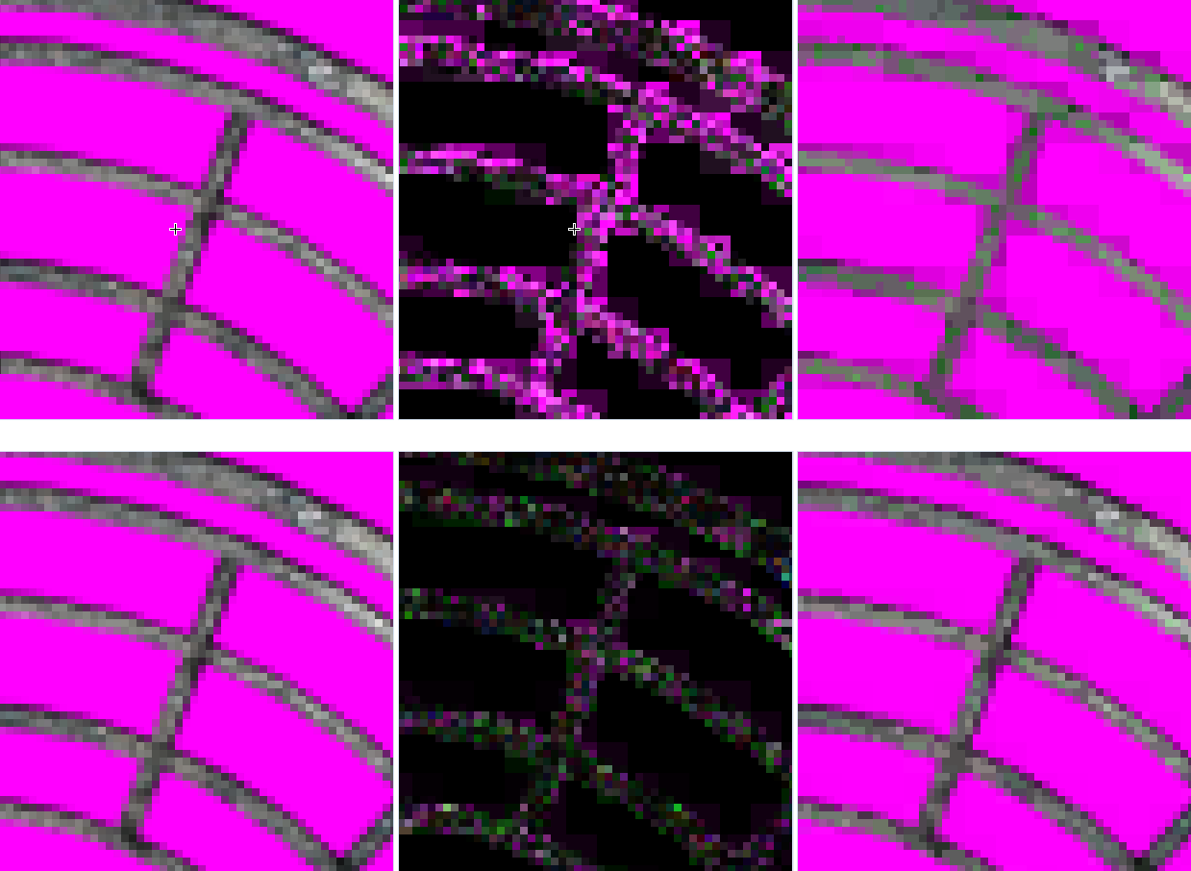
Comparisons
Orig
BC3
Orig
BC7
Abs Error

Slide 56
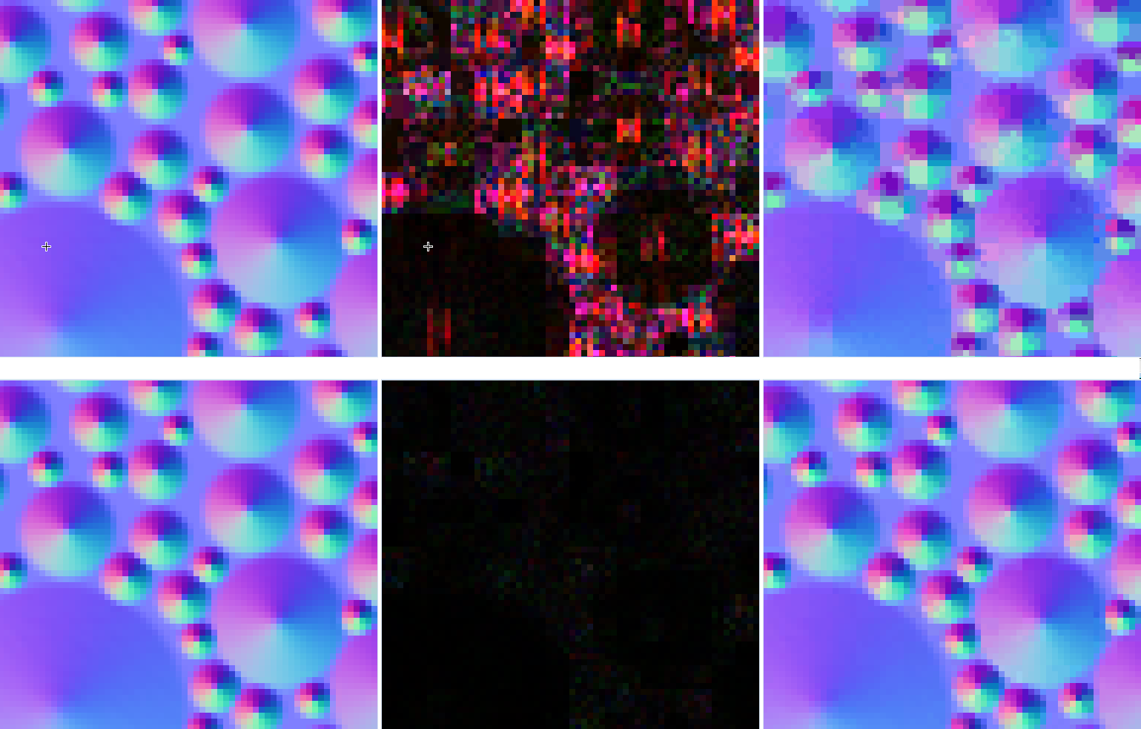
Comparisons
Orig
BC3
Orig
BC7
Abs Error

Slide 57
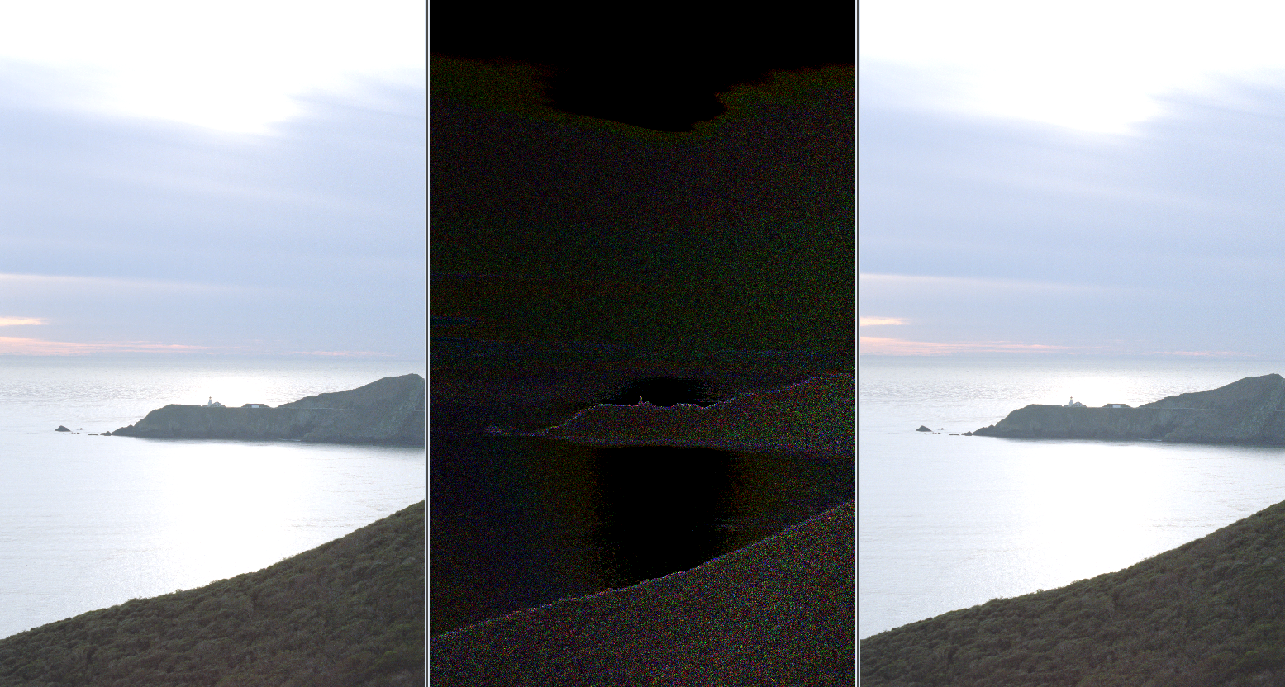
Comparisons
HDR Original at
given exposure
Abs Error
BC6 at
given exposure

Slide 58
Outline
Overview
Drilldown
  Tessellation
  Compute Shader
  Multithreading
  Dynamic Shader Linkage
  Improved Texture Compression
  Quick Glance at Other Features
Summary

Slide 59
A Plethora Of Other Features
Addressable Stream Out
DrawIndirect()
Pull-model attribute eval
Improved Gather4
Min-LOD texture clamps
16K texture sizes
Required 8-bit subtexel, submip filtering precision
Conservative oDepth
2 GB Resources
Geometry shader instance programming model
Optional double support
Read-only depth or stencil views

Slide 60
Outline
Overview
Drilldown
  Tessellation
  Compute Shader
  Multithreading
  Dynamic Shader Linkage
  Improved Texture Compression
  Quick Glance at Other Features
Summary

Slide 61
Direct3D11
Direct3D11 is strict superset of Direct3D10 and 10.1
  Direct3D11 adds support for features like compute shader, multithreading, and tessellation to Direct3D10.1
  The fastest way to move to Direct3D11 is to start developing on Direct3D10/10.1 today
Direct3D11 will be available on Windows Vista and future Windows operating systems
Direct3D11 will run on down-level hardware
  Multithreading!, Compute Shader
  Direct3D10.1, 10, and 9 hardware/drivers
  Full functionality (for example, tessellation) will require Direct3D11 hardware

Slide 62
When Can I Get It?
Preview bits will be in November 2008 SDK
  These bits will work on Windows Vista
  Will run on Direct3D10/10.1 hardware
  Full documentation, samples, etc.

Slide 63
Call To Action
OEMs: Plan for DirectX11 PCs
IHVs: Keep up the driver work
ISVs
  Get ready for the DirectX11
  Start porting code to DirectX10 asap
  Scan the DirectX11 PPTs and whitepapers
  Download the DirectX11 SDK next week
    Check out the samples
  Update art pipeline to support tessellation

Slide 64
Questions?

Slide 65
Related Sessions
GRA-T515 DirectX – Core Graphics for Windows 7
GRA-T516 DirectX 11
GRA-T517 GPU Compute
GRA-T518 Graphics Performance with WDDM v1.1
GRA-C640 Validating Windows 7 Graphics Scenarios
GRA-T579 Connecting Projectors and Docking Stations with Windows 7
GRA-T634 GPU Performance and CPU/GPU Interactions
GRA-P581 Application of GPGPU: Hype or Reality
GRA-T582 Hi DPI – Key to Readability
GRA-T583 Display and Monitor Technologies
GRA-T585 Video Improvements in Windows 7
GRA-C666 Connecting and Configuring Displays

Slide 66
Additional Resources
Microsoft DirectX SDK site
  http://msdn.microsoft.com/directx
  DirectX10 SDK and DirectX11 CTP should be up shortly
Windows 7 Whitepaper
  http://www.microsoft.com/whdc/display
Other Presentations
  GRA-T517
  DirectX11 Compute Shader – Next talk
  GRA-P581
  Panel on Many-Core applications – Thurs 4:30
  GRA-T584
  Working with the Windows 7 Graphics Architecture – Friday 11:00-12:00

Slide 67
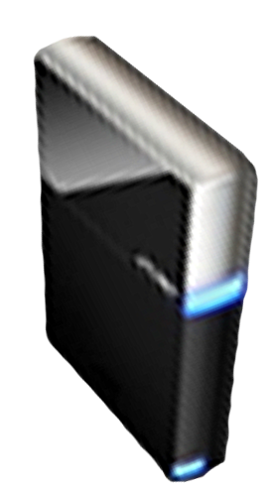


Please Complete A Session Evaluation Form
Your input is important!
Visit the WinHEC CommNet and complete a Session Evaluation for this session and be entered to win one
of 150 Maxtor® BlackArmor™ 160GB External Hard Drives
50 drives will be given away daily!
http://www.winhec2008.com
BlackArmor
Hard Drives provided by:

Slide 68

© 2008 Microsoft Corporation. All rights reserved. Microsoft, Windows, Windows Vista and other product names are or may be registered trademarks and/or trademarks in the U.S. and/or other countries.
The information herein is for informational purposes only and represents the current view of Microsoft Corporation as of the date of this presentation. Because Microsoft must respond to changing market conditions, it should not be interpreted to be a commitment on the part of Microsoft, and Microsoft cannot guarantee the accuracy of any information provided after the date of this presentation.
MICROSOFT MAKES NO WARRANTIES, EXPRESS, IMPLIED OR STATUTORY, AS TO THE INFORMATION IN THIS PRESENTATION.

