Slide 2
DirectX
Core Graphics For Windows 7
Anantha Kancherla
Group Program Manager
Microsoft Corporation

Slide 3
Talk Overview
Goal: Understand how DirectX is evolving to meet the needs of all Graphics scenarios, not just Gaming
New requirements for DirectX APIs
Overview of DirectX APIs
Changes to existing APIs
New APIs: Direct2D, DirectWrite

Slide 4

DirectX Evolution
Originally designed for Games and to abstract HW
DX9 introduced Floating point shaders
  HLSL to program shaders
  Windows Vista adopted it for many features:
    UI: Aero and MCE
    Image Processing: Windows Photo Gallery
DX10 was designed for more than games
  Clean API to minimize API overhead
  Consistent implementation across HW – No Caps
  Refactored Infrastructure API: DXGI

Slide 5
DirectX == High Performance Graphics

Slide 6
Broad Usage of Direct3D Today
Typical user is someone who needs great performance and very custom/rich rendering
Mapping applications:
  Eg. VirtualEarth and Google Earth
UI and Application Frameworks:
  WPF, XNA
User Interfaces:
  MCE, Zune, DWM
Workstation Applications:
  Eg. Dassault Systèmes-3DLive, AutoDesk Applications, Bentley Microstation, SoftImage XSI

Slide 7

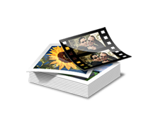






Elements of Graphics
3D
Video and Images
Segoe UI
2D
Text

Slide 8
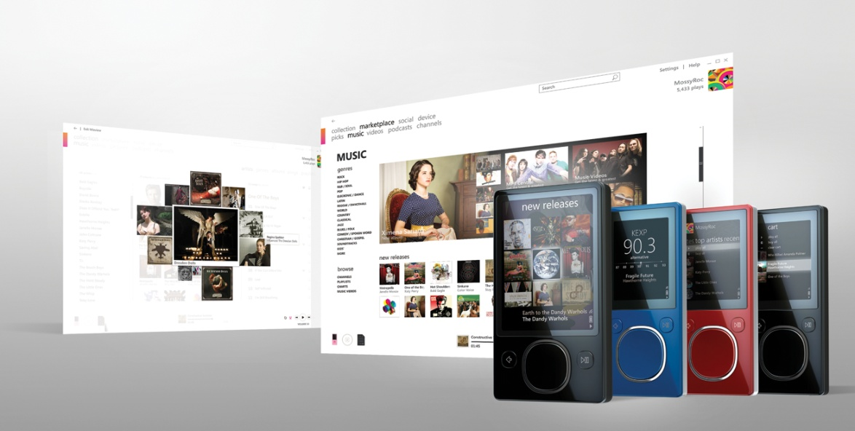

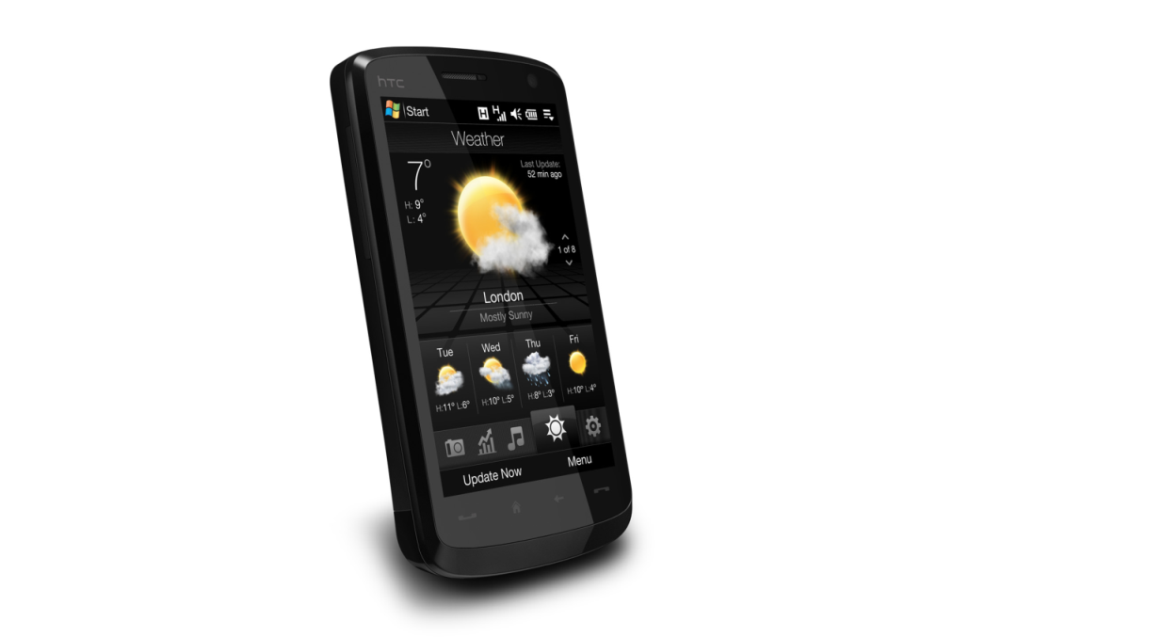
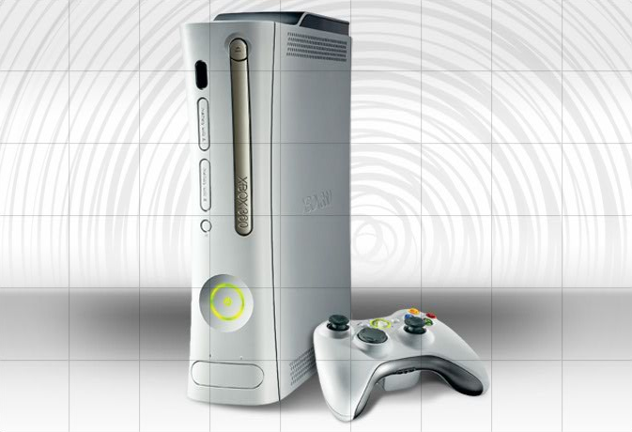
Evolving User Experiences

Slide 9
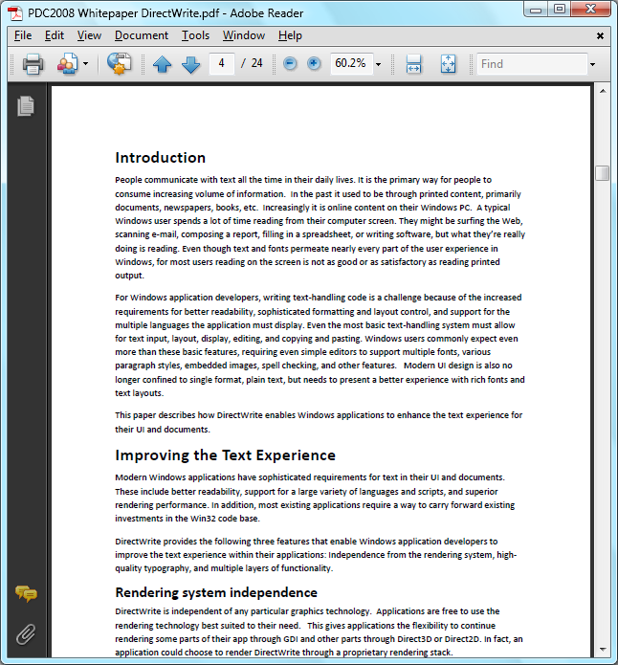
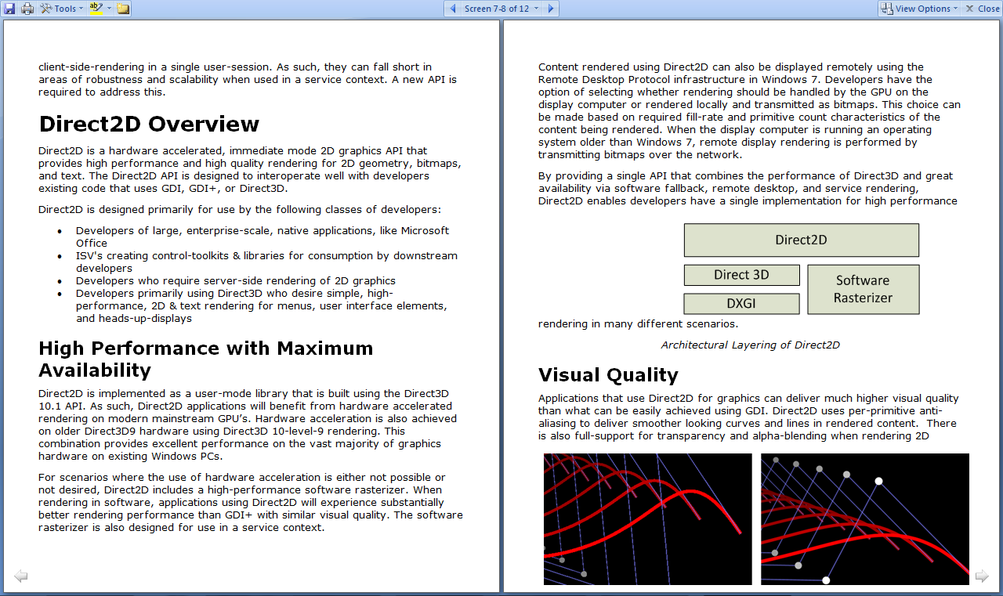
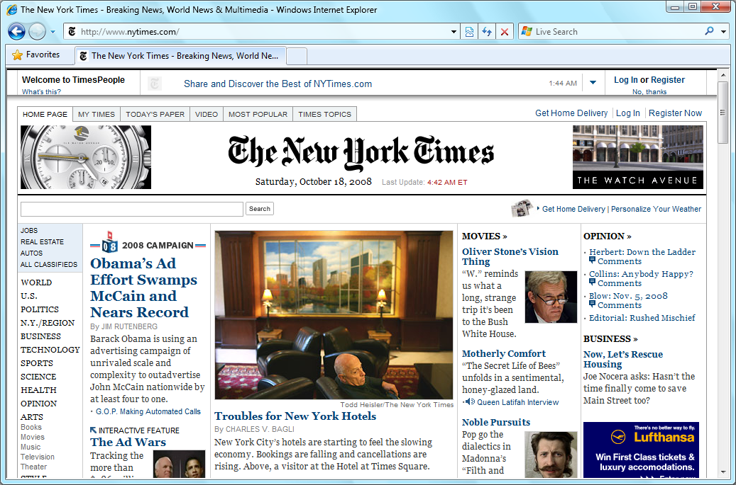
Reading And Text

Slide 10
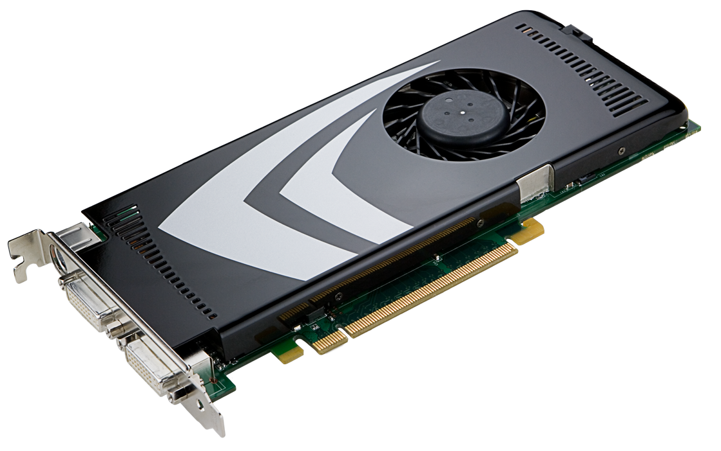
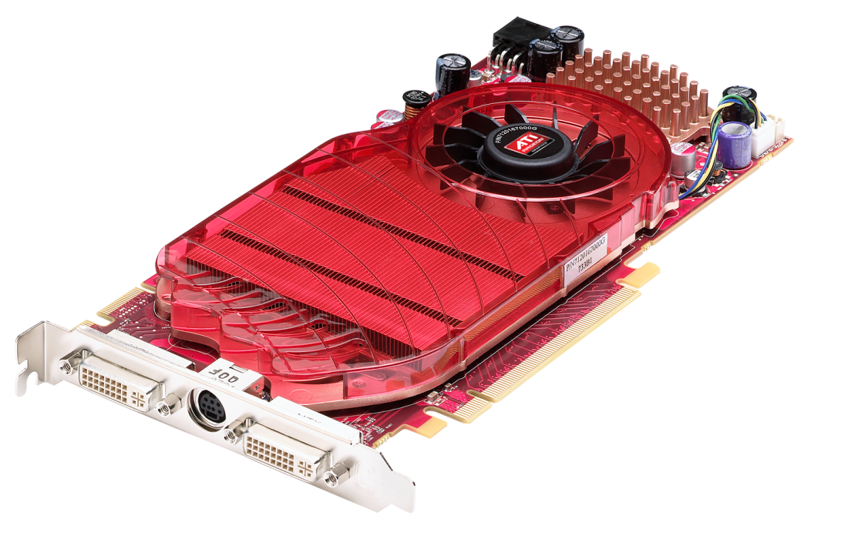
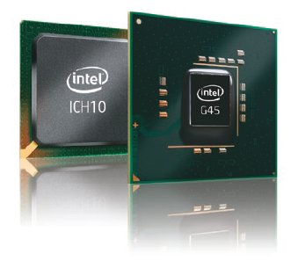
GPU Evolution

Slide 11
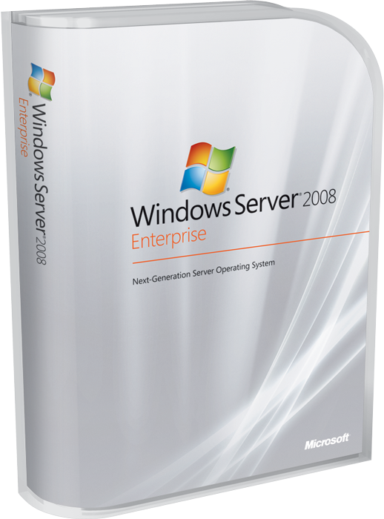
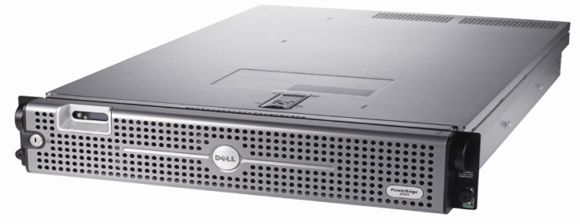
Server Rendering

Slide 12
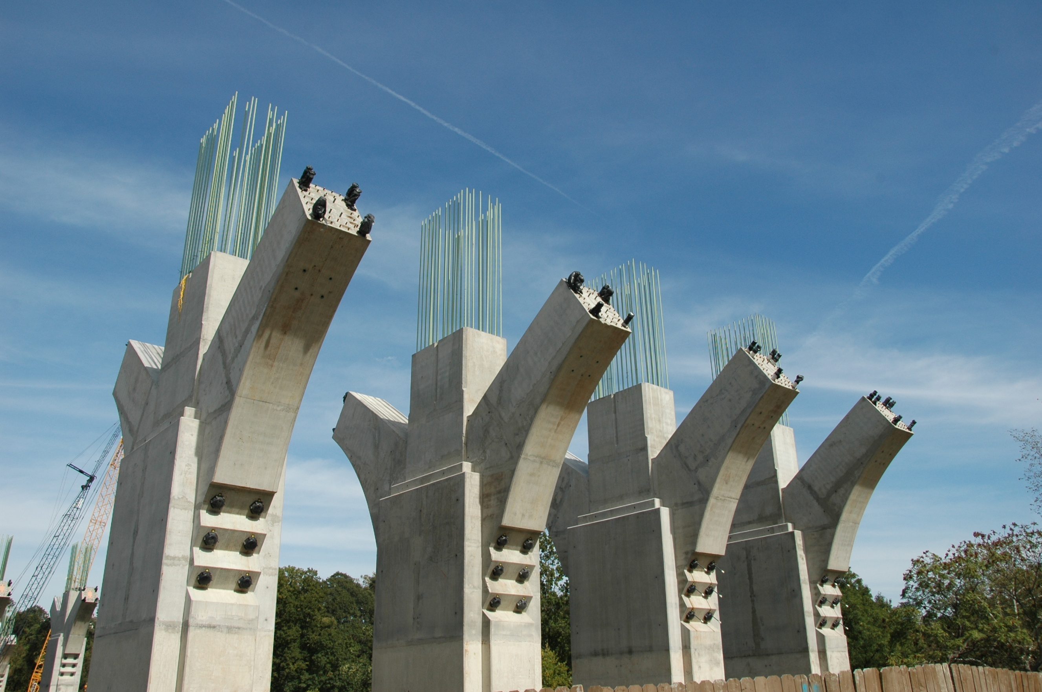
Foundational API's

Slide 13
Mainstream Developer Needs
Performance
  Frame rate
  Startup time and working set
Interoperability
  Plug-ins
  Partial migration
Software fallback
  Server-side rendering
  More consistent results
Remote display

Slide 14

Current Platform Challenges
Area | Existing API(s) | Challenges
3D | D3D3…D3D10 | Not always available: No HW Server Remoted
2D | GDI, GDI+ | Quality, Performance
Text | GDI | Quality, Not up to date
Imaging | GDI, GDI+, WIC | Extensive format support, Security
Device Control | GDI | Outdated notion of HW config

Slide 15
Advancing the platform
Area | Existing API(s) | Challenges
3D | D3D3…D3D10 | Not always available: No HW Server Remoted | Direct3D 10.1
2D | GDI, GDI+ | Quality, Performance
Text | GDI | Quality, Not up to date
Imaging | GDI, GDI+, WIC | Extensive format support, Security | Updated WIC
Device Control | GDI | Outdated notion of HW config | DXGI 1.1

Slide 16
Advancing the platform
Area | Existing API(s) | Challenges
3D | D3D3…D3D10 | Not always available: No HW Server Remoted | Direct3D 10.1
2D | GDI, GDI+ | Quality, Performance | Direct2D
Text | GDI | Quality, Not up to date | DirectWrite
Imaging | GDI, GDI+, WIC | Extensive format support, Security | Updated WIC
Device Control | GDI | Outdated notion of HW config | DXGI 1.1

Slide 17
Advancing the platform
Introducing…
Direct2D
DirectWrite

Slide 18
DWrite
WIC
D2D
DWM
DXVA
D3D10
D3D11
D3D9
GDI+
DXGI
USER
GDI
DXGKernel
Win32K
Hardware

Slide 19
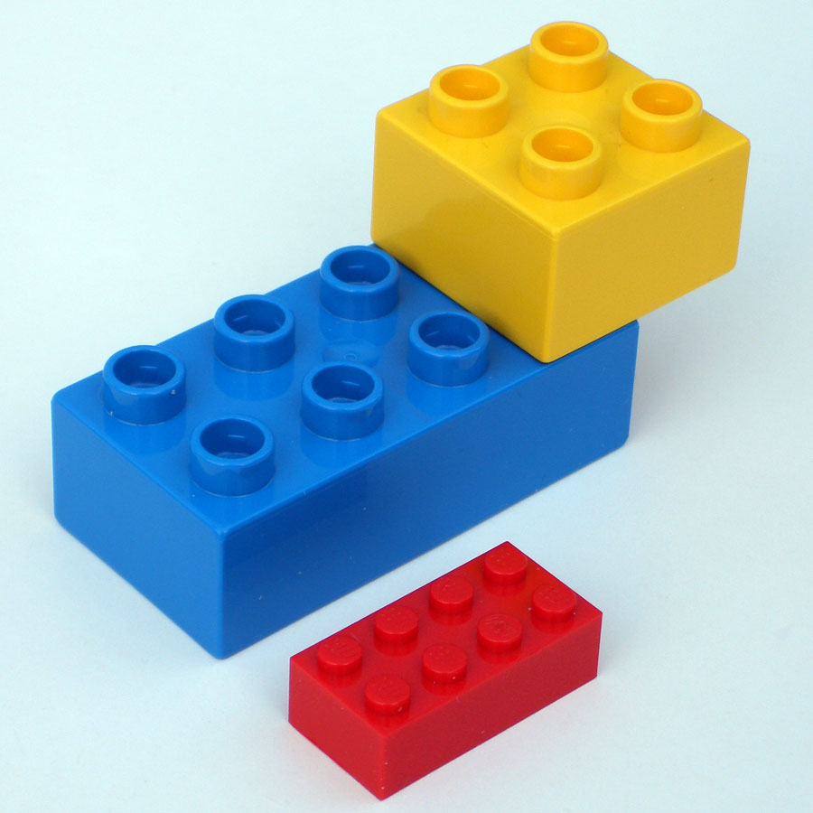
Properties of DirectX APIs
Primary focus:
  Large scale Win32 application developers with existing codebases
  Designed around needs of Windows UI, Internet Explorer, Microsoft Office
Side-by-side components
  Can mix-n-match
Interface based APIs w/ C/C++
Hardware accelerated
Immediate mode rendering
Interops with older Win32 APIs
Available on Windows Vista

Slide 20
GDI Future
GDI
2D
Text
Device Control
Imaging
DirectX
D3D
D2D
DWrite
DXGI
WIC

Slide 21
Changes To Direct3D 10
Microsoft Confidential

Slide 22
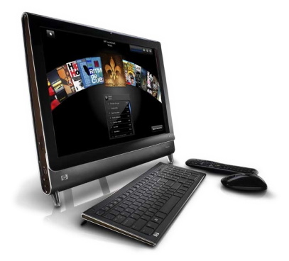

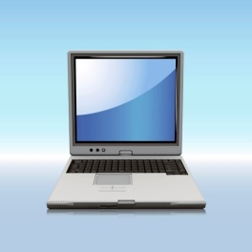
A Potential Scenario: Fabrikam
How can Fabrikam write a
graphics application that works
across all these configurations?
Desktop with
D3D10 Hardware
D3D9
No WDDM
D3D10 laptop

Slide 23
Direct3D
Application
Direct3D 10 Runtime
Direct3D 10 Driver
Direct3D 10 Hardware

Slide 24
A Potential Scenario: Fabrikam
Desktop with
D3D10 Hardware
D3D9
No WDDM
D3D10 laptop

Slide 25
Direct3D 10Level9
Application
Direct3D 10 Runtime
Direct3D 10Level9 Driver
Direct3D 10 Driver
Direct3D 9 Hardware
Direct3D 10 Hardware

Slide 26
A Potential Scenario: Fabrikam
Desktop with
D3D10 Hardware
D3D9
No WDDM
D3D10 laptop

Slide 27
Direct3D WARP 10
Application
Direct3D 10 Runtime
Direct3D WARP 10
Software Rasterizer
Direct3D 10Level9 Driver
Direct3D 10 Driver
Direct3D 9 Hardware
Direct3D 10 Hardware

Slide 28
Our Criteria for WARP Development
100% conformant with Direct3D10 Spec
Performance
  Hundreds of times faster than RefRast
  Fast enough for real-time use

Slide 29
Capabilities In Direct3D 10.1 API
DX10 Hardware is strictly defined
However the API itself supports more than DX10 HW…
Tiered capabilities, unlike previous DX
  D3D10_FEATURE_LEVEL_9_1
  D3D10_FEATURE_LEVEL_9_2
  D3D10_FEATURE_LEVEL_9_3
  D3D10_FEATURE_LEVEL_10_0
  D3D10_FEATURE_LEVEL_10_1
Going from hundreds of CAPS
(ultra fine grained control) to 5 levels (coarse but manageable control)

Slide 30
10Level9 Feature Levels (More Detail)
Value | Level9_1 | Level9_2 | Level9_3
MaxTextureDimension | 4096 | 4096 | 4096
MaxVolumeExtent | 256 | 512 | 512
MaxTextureRepeat | 128 | 2048 | 8192
MaxAnisotropy | 2 | 16 | 16
MaxPrimitiveCount | 65535 | 1048575 | 1048575
MaxVertexIndex | 65534 | 1048575 | 1048575
NumRenderTargets | 1 | 4 | 4
TwoSidedStencil | TRUE | TRUE | TRUE
Shader Model | 2.0 | 2.0 | 3.0

Slide 31
Remoting On Direct3D 10.1 API
Remote Adapter
Application opts into primitive remoting
  Bitmap remoting otherwise
  More details in: Presentation Virtualization: Graphics Remoting (RDP) Today and Tomorrow

Slide 32

Direct3D 10.1 is the Foundation
DWM in Windows 7 is built on it
Supports GDI compatible color channel ordering
Always available:
  D3D10L9 for DX9 HW
  Full SW emulation when there is no HW
  Fully remoted via primitives and bitmaps
Direct3D 10 HW is a Premium Logo requirement in Vista

Slide 33
Introducing Direct3D 11
Microsoft Confidential

Slide 34
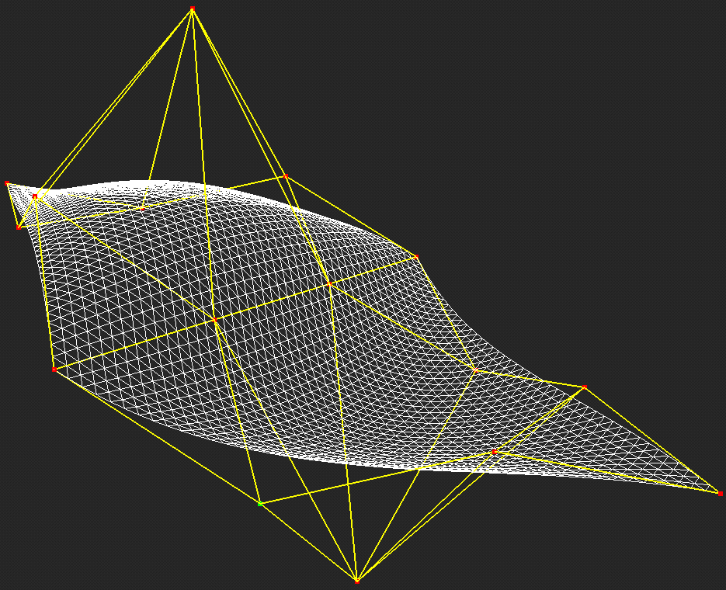
Direct3D 11: Increasing GPU Utility
Strict superset of Direct3D10
Runs on Direct3D 9, 10 and 11 HW
New Graphics features
  Improved multi-threading support
  (Need new HW) Tessellation
  (Need new HW) Subroutine support in shaders
Compute Shader Enables non-Graphics usages (GPGPU)
  Integrated with graphics for imaging usage
  Program with familiar HLSL and D3D resource model

Slide 35
DX11 Details
GRA-T516: DirectX 11 New Hardware and APIs
GRA-T517: Direct3D 11 New GPU Compute Shader

Slide 36
Introducing Direct2D

Slide 37
Features: Direct2D
Rendering focused
  2D vector graphics, bitmaps, and text
  Hardware or Software
Other Services
  Display/Device handling → DXGI
  Printing → XPS
  Image Encoding/Decoding → WIC
  Text Formatting → DirectWrite

Slide 38
Features: Direct2D
Interoperability
  GDI
  Direct3D
Performance
  Built on Direct3D 10.1
  Lower CPU usage than GDI/GDI+
Visual Quality
  Alpha Blending
  Per-primitive anti-aliasing
  MSAA via Direct3D interoperability

Slide 39
Direct2D
demo

Slide 40
Introducing
DirectWrite

Slide 41
Features: DirectWrite
Modern Typography
Enables world-wide applications
ClearType
Works with any rendering technology
Hardware accelerated with Direct2D

Slide 42
DirectWrite OpenType™ Features
Every font feature can be accessed via 4-byte name tag
Capitals to Small Caps Superscript Scientific Inferiors Subscript Ordinals Titling Alternates Swash Contextual Swash Contextual Alternates Proportional Oldstyle Tabular Lining Proportional Lining Tabular Oldstyle Standard Ligatures Discretionary Ligatures Historical Ligatures Case Sensitive Forms | Small Caps Contextual Ligatures Fractions Alternative Fractions Stylistic Alternates Stylistic Sets Historical Forms Slashed Zero Alternate Annotation Mathematical Greek Localized Forms Petite Caps Capitals to Petite Caps Unicase Glyph de/composition Required Ligatures Mark Positioning | Mark-to-mark Positioning Ruby Notation Forms Expert Forms Proportional Widths Full Widths Half Widths Third Widths Quarter Widths Simplified Forms Traditional Forms Traditional Name Forms NLC Kanji Forms Hojo Kanji Forms JIS 78 Forms JIS 83 Forms JIS 90 Forms JIS 04 Forms

Slide 43








Gabriola

Slide 44
DirectWrite Script Support
Arabic Armenian Bengali Bopomofo Canadian aboriginal syllabics Cherokee Chinese Simplified Chinese Traditional Cyrillic Deseret Devanāgarī Ethiopic Georgian Greek | Gujarati Gurmukhi Hebrew Japanese Kannada Khmer Korean Lao Latin Malayalam Mongolian Myanmar New Tai Lue N’Ko | Osmanya Oriya ’Phags-pa Sinhala Syriac Tai Le Tamil Telugu Thaana Tifnagh Thai Tibetan Vai Yi

Slide 45
DirectWrite Script Support
الْعَرَبِيَّة
Հայերէն
বাংলা
ㄓㄨˋ ㄧㄣ ㄈㄨˊ ㄏㄠˋ
ᐃᓄᒃᑎᑐᑦ
ᏣᎳᎩ
简体汉字
繁体漢字
Кириллица
𐐔𐐯𐑅𐐨𐑉𐐯𐐻
देवनागरी
ግዕዝ
მხედრული
Ελληνικό
ગુજરાતી
ਗੁਰਮੁਖੀ
עִבְרִית
ひらがな、
カタカナ、
漢字
ಕನ್ನಡ
អក្ខរក្រមខេមរភាសា
ශුද්ධ සිංහල
ܠܫܢܐ ܣܘܪܝܝܐ
ᥖᥭᥰᥖᥬᥳᥑᥨᥒᥰ
தமிழ்
తెలుగు
ތާނަ
ⵜⵉⴼⵉⵏⴰⵖ
อักษรไทย
དབུ་ཅན་
ꕙꔤ
ꆈꌠꁱꂷ
한글
ພາສາລາວ
Latin
മലയാളം
ᠮᠣᠩᠭᠣᠯ ᠪᠢᠴᠢᠻ
ᦟᦹᧅ ᦎᦷ ᦑᦺ
ߒߞߏ
𐒋𐒘𐒈𐒑𐒛𐒒𐒕𐒀
ଓଡ଼ିଆ
ꡍꡂꡛꡌ

Slide 46
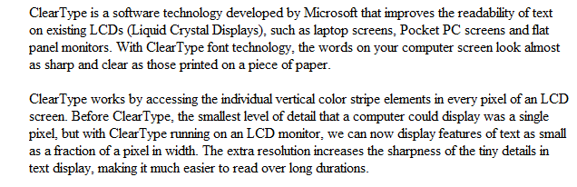
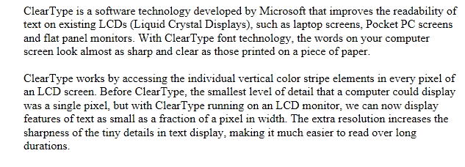
DirectWrite Rendering
Positioning using ClearType
GDI Text
Times New Roman 12 Point
ClearType Compatible Widths
DirectWrite
Times New Roman 12 Point
ClearType Sub-Pixel Positioning

Slide 47
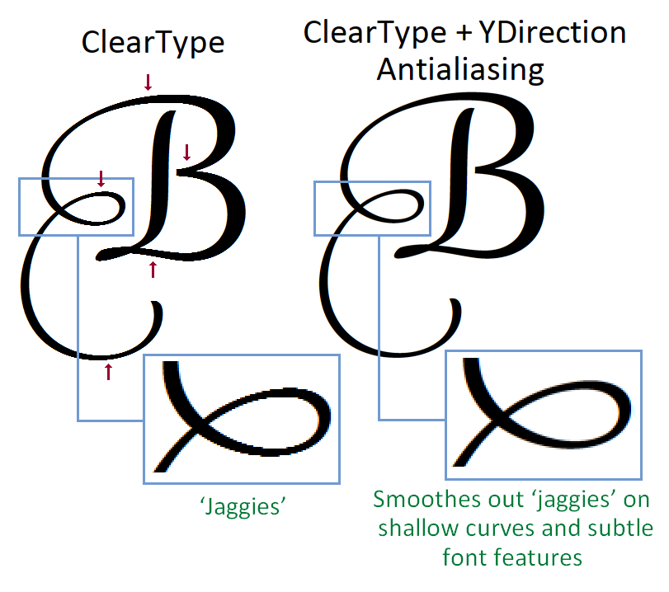
DirectWrite Rendering
Precise Glyph shapes

Slide 48
DirectWrite Rendering
Flexibility and performance
Rendering can be performed using
DirectX, GDI, or other technologies
Up to 2X faster layout
performance than GDI
Hardware accelerated text with Direct2D
  ClearType filter and blend performed
  in hardware
  Enables app-level hardware
  caching optimizations
  Reduced CPU usage in Windows OS components when drawing glyphs

Slide 49
Features: DirectWrite
Modern Typography
Enables world-wide applications
ClearType
Works with any rendering technology
Hardware accelerated with Direct2D
Best reading experience on the PC

Slide 50
WIC
Microsoft Confidential

Slide 51




Imaging
Windows Imaging Component (WIC)
  COM based API for image processing
  Optimized for performance and security
Windows 7 features
  Additional TIFF image format support
  High Color support
  Progressive Decoding

Slide 52
DXGI
Microsoft Confidential

Slide 53

DXGI Changes
Primitive Level Remoting support
  Detecting connection status
High Color Support
Synchronized shared surfaces

Slide 54
API Interop
All DirectX APIs interoperate with each other.
IDXGISurface is the common interchange between these APIs
Direct3D 11 and Direct3D 10 interoperate via synchronized shared surfaces
Direct2D and Direct3D 10/11 interoperate at the Device as well as at Surface Level
WIC and DirectWrite can be used with any API
GDI interoperates with D2D and D3D

Slide 55
Summary
Originally DirectX was designed for Gaming
Over time DirectX has become synonymous
with Graphics
Windows UI and many other applications
use DirectX
DirectX 10 has become the baseline
API for Windows
Two new DirectX APIs are introduced
Call to Action
  Design your HW with DirectX roadmap in mind
  Attend related talks to learn more

Slide 56
Additional Resources
Web Resources
  Whitepapers: http://www.microsoft.com/whdc/display
  Other Resources: http://msdn.microsoft.com/directx
Related Sessions
  GRA-T515: DirectX – Core Graphics for Windows 7
  GRA-T516: DirectX11
  GRA-T517: GPU Compute
  GRA-T584: Working with the Windows 7 Graphics Architecture
  GRA-T585: Video Improvements in Windows 7
  GRA-T634: GPU Performance and GPU/CPU Interactions in Windows 7
  GRA-P581: Panel: Application of General Purpose Compute
  GRA-C640: Validating Graphics Scenarios in Windows 7
  MBL-T579: Connecting Projectors and Using Docking Stations with Windows 7
  GRA-C666: Connecting and Configuring Displays in Windows 7
Contact information
  Directx @ Microsoft.com

Slide 57
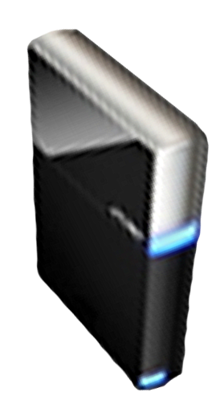


Please Complete A Session Evaluation Form
Your input is important!
Visit the WinHEC CommNet and complete a Session Evaluation for this session and be entered to win one
of 150 Maxtor® BlackArmor™ 160GB External Hard Drives
50 drives will be given away daily!
http://www.winhec2008.com
BlackArmor
Hard Drives provided by:

Slide 58

© 2008 Microsoft Corporation. All rights reserved. Microsoft, Windows, Windows Vista and other product names are or may be registered trademarks and/or trademarks in the U.S. and/or other countries.
The information herein is for informational purposes only and represents the current view of Microsoft Corporation as of the date of this presentation. Because Microsoft must respond to changing market conditions, it should not be interpreted to be a commitment on the part of Microsoft, and Microsoft cannot guarantee the accuracy of any information provided after the date of this presentation.
MICROSOFT MAKES NO WARRANTIES, EXPRESS, IMPLIED OR STATUTORY, AS TO THE INFORMATION IN THIS PRESENTATION.

