Slide 2
IPv6
Deploying The Foundation For Tomorrow
Sean Siler
Senior Program Manager
Microsoft Corporation

Slide 3
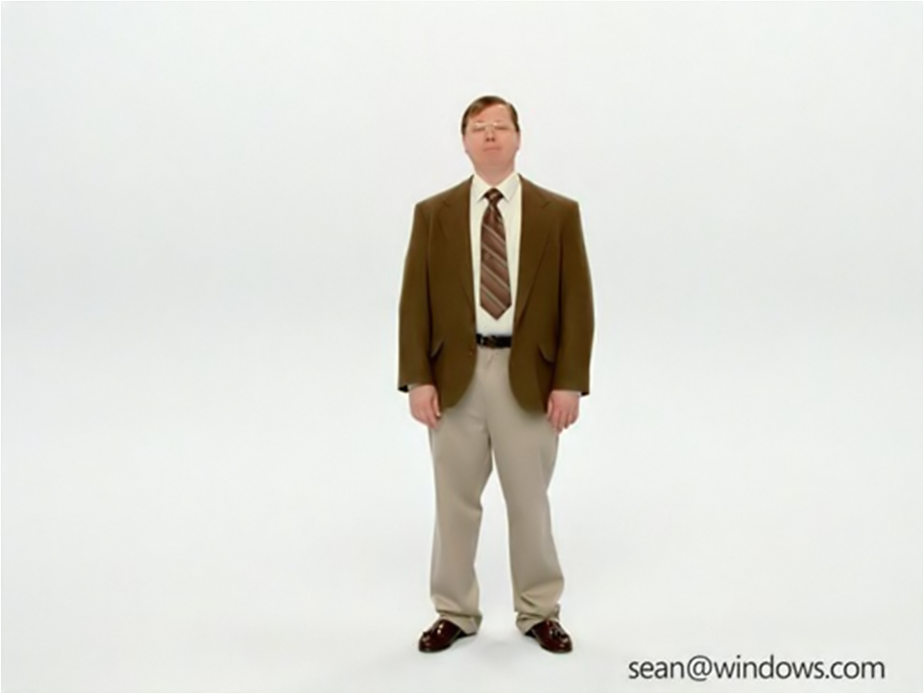
I’m a PC, and I'm Your Presenter

Slide 4
Who has been to an IPv6 presentation before?
How many of you were awake at the end of the presentation?

Slide 5
Agenda
Convince you to support IPv6
That’s it

Slide 6
Why aren't you supporting IPv6 now?
No pressing need
No business value
No customer demand

Slide 7

Case Study: Electric Light
1870-1900
Houses in the US built with or retrofitted for gas lamps
1879
Edison perfects light bulb
1816
Gas Light Company of Baltimore formed
1875
Six gas companies serving NYC
No pressing need
No business value
No customer demand
Challenges:
No electric tools/devices – just his bulbs
Bulbs cost more than $1 each, about $22 today
Gas companies had 50 years of infrastructure
Customers had just spent money to install gas pipes to their homes

Slide 8
Case Study
Electric Light
Lessons Learned from Edison
Providing content is the easiest way to increase demand
Change takes time
Existing companies don't like change
The end won't look like the design
Even your friends will fight with you

Slide 9
Pressing Need

Slide 10
IANA/8 Allocations By Year
NAT (RFC 1631, May 1994) and
CIDR (RFC 1517, Sep 1993) introduced
Average 12 allocations per year since 2003

Slide 11
Government Mandates
U.S. Department of Defense
  IPv6 Standards Profiles for IPv6 Capable Products
  http://jitc.fhu.disa.mil/apl/ipv6/pdf/disr_ipv6_product_profile_v3.pdf
U.S. Federal Government
  US Government IPv6 Profile
  http://www.antd.nist.gov/usgv6/usgv6-v1.pdf

Slide 12
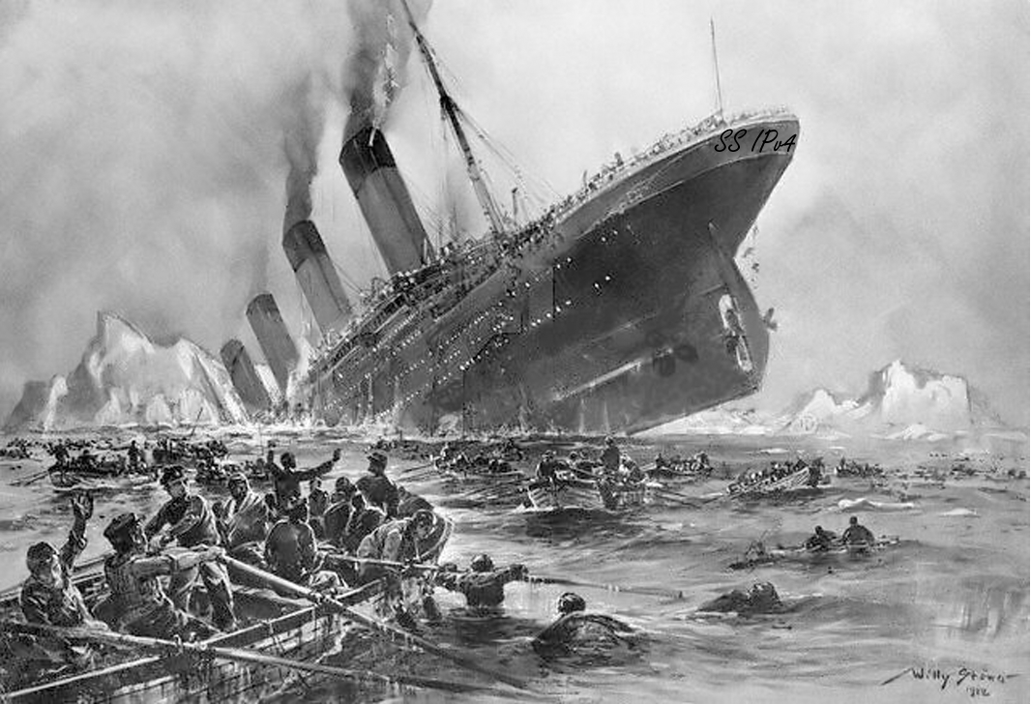
No I won't leave my Private Network! My NATted door will protect me!
SS IPv4

Slide 13

Business Value

Slide 14




IPv4
IPv6

Slide 15





DirectAccess

Slide 16

DirectAccess
Providing seamless, secure access to enterprise resources from anywhere

Slide 17




DirectAccess Requires IPv6
Internet
Enterprise Network
IPv6
DA Server
IPv6
Application
Server
Come to my DirectAccess session
to find out how this works…

Slide 18

More Business Value

Slide 19

Flipping The Paradigm: IPv4
Applications
Middleware
hardware
Network
Security
Mobility
P2P
NAT Traversal

Slide 20
Flipping The Paradigm:
IPv6
Applications
Infrastructure
Network
Security
Mobility
P2P
NAT Traversal

Slide 21
Current Data Flow
Single Point of failure
Bandwidth Chokepoint
Clients need connectivity
Saturates slow links
Long transfer times
Scheduling can miss machines

Slide 22
Peer To Peer Data Flow
Highly available
Distributed distribution
Disconnected networks
Authentication
Distributed Security
Managed Applications

Slide 23
Customer Demand

Slide 24

Customer Demand
Carrot and Stick
Hard to predict
Customer demand for DirectAccess
has exceeded expectations

Slide 25

How Will DirectAccess Impact Our Customers?
Internal traffic running over
ISATAP/v6 will increase
External traffic into corpnet running
over Teredo, 6to4 and IP-HTTPS
will increase significantly
Customers will begin requiring
management applications
that support IPv6

Slide 26
Why Is IPv6 Important To Microsoft?
Windows 7 lifespan
IPv4 address depletion
New connectivity scenarios

Slide 27

Business Opportunities
Monitoring
Firewalls
IDS/IPS
Load Balancing
Customers need IPv6 devices that have features in parity with existing IPv4 devices

Slide 28
Summary
Dwindling supply of IPv4 addresses
Mandates to move to IPv6
Terrific application that requires IPv6

Slide 29
Call To Action
We need your help
We want customers to be unblocked on IPv6 deployments
Support IPv6 in your devices

Slide 30
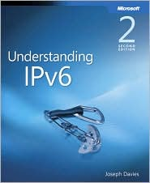
Additional Resources
Web Resources
  Microsoft IPv6 Website - www.microsoft.com/ipv6
  Microsoft IPv6 Blog blogs.technet.com/ipv6
Books
  Understanding IPv6, Second Edition,
  by Joseph Davies

Slide 31
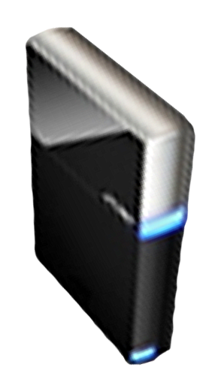


Please Complete A Session Evaluation Form
Your input is important!
Visit the WinHEC CommNet and complete a Session Evaluation for this session and be entered to win one
of 150 Maxtor® BlackArmor™ 160GB External Hard Drives
50 drives will be given away daily!
http://www.winhec2008.com
BlackArmor
Hard Drives provided by:

Slide 32

© 2008 Microsoft Corporation. All rights reserved. Microsoft, Windows, Windows Vista and other product names are or may be registered trademarks and/or trademarks in the U.S. and/or other countries.
The information herein is for informational purposes only and represents the current view of Microsoft Corporation as of the date of this presentation. Because Microsoft must respond to changing market conditions, it should not be interpreted to be a commitment on the part of Microsoft, and Microsoft cannot guarantee the accuracy of any information provided after the date of this presentation.
MICROSOFT MAKES NO WARRANTIES, EXPRESS, IMPLIED OR STATUTORY, AS TO THE INFORMATION IN THIS PRESENTATION.

