Slide 2
Server And Domain
Isolation (SDI)
Pascal Menezes
Senior Program Manager Network Security
Microsoft Corporation

Slide 3
Agenda
What are the business drivers
that SDI solves
What is the SDI and how does it work
SDI scenarios
SDI emerging ecosystem
Call to action

Slide 4
Enterprise Security Business Drivers
Regulatory Compliance Violations
  US and other governments have placed tight controls on the protection of customer data with corporate governance and compliance regulations
    HIPAA, European Union Directive on Data Protection, Gramm-Leach-Bliley Act (GLBA) and the California Security Breach Information Act (SB 1386)
Changes in the IT Work Environment
  Major swing in how and where employees connect to corporate networks
    More than 70% of IT executives said that more than half of their employees today access their networks remotely with a laptop or mobile device. Source - Yankee Group 2007 Anywhere Access Survey
  Enterprise networks are opening up not just to employees, but to outside parties too
    87% of the enterprises surveyed said that partners, customers and other users outside the company access internal network resources either frequently or every day. Source - Yankee Group 2007 Anywhere
    Access Survey

Slide 5
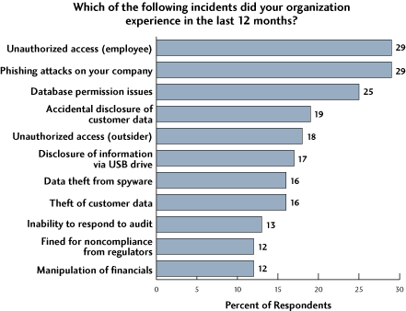
Enterprise Security Challenges
Unauthorized access
of employees is the
number one issue
20% of electronic crime
was committed by insiders
Source : CERT/CC, US Secret Service
& CSO Magazine
Source: Yankee Group 2006 Security Leaders and Laggards Compliance Survey

Slide 6
Insufficient “Internal” Network Security Real Life Example
Financial Transaction Processor and Check Verification firm
8.5M customers personal identity and bank account information were stolen by an “employee on the internal network”
RESULT: Legal suit – loss of millions of dollars
  2 years free credit and account monitoring
  $20K reimbursement to each customer
  Legal counsel for settlement – up to $4.3M

Slide 7
SDI
The Next Generation Network Security

Slide 8













Server And Domain Isolation
Dynamically segment your Windows environment into more secure and isolated logical networks
based on
integrated
“access policy”
Labs
Unmanaged guests
Based on IPsec
and Firewall
Server Isolation
Protect specific high-value servers and data
Domain Isolation
Protect managed computers from unmanaged
or rogue computers and users

Slide 9
SDI Policy Based Access Control
Policy-based security is foundational…
  Provides capability to enforce compliance and identity
  Integrated with NAP and AD
  Allows for server/application/services control regardless of location
Policy-based security is economical…
  Provides a low cost solution for logical segmentation, authentication,
  authorization and optional encryption
  Operates generically for all applications
  Supported by centralized policy management
Policy-based security is strategic…
  It creates the foundation for virtualization security and control
  Represents the evolution of security controls from the network to the host…
  Supports Bill Gates vision “Secure Anywhere Access’” vision
      “Security should be based on policy not topology”

Slide 10




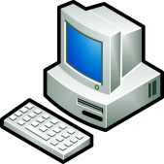
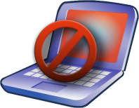


SDI Combinations
Active Directory Domain Controller
Corporate Network
Trusted Resource Server
X
Finance Computer
Servers with Sensitive Data
Unmanaged/Rogue Computer
X
Server Isolation
Managed Computer
Untrusted
Managed Computer
Domain Isolation

Slide 11

How SDI Solves Unauthorized Access – Server Isolation
AD
Identity
Mgmt
Machine and User
Authentication
Authentication Approved
Credential Given
Machine and User
Authenticated
for Access
User
Authorized for Access to Application 1
Server
Audit
Trail
Audit
Trail
Authentication
Polices
Authorization
Policy
Application 2
Client
IPsec Negotiation – Machine and user credential given
IPsec
Host
Firewall
IPsec Negotiation – Machine and user credential approved
Application 1
IPsec Data Traffic – Integrity with optional encryption

Slide 12

Business Value Of SDI
SDI
Managed
Assurance
Trusted Accessibility
Regulatory Compliance
Reduces network attacks on isolated machines
Improved levels of protection against
malware attacks
Drives domain membership and easier manageability
Protect data while in transit
Restrict access to the servers that users only need access to
Allow secure access through authenticated bypass
Confine access to
authorized users
Improved asset management
Isolate servers with
sensitive data

Slide 13
SDI Deployments
Of MORGs and LORGs that have IPSec partially or fully deployed, which access methods utilize IPsec?
Source: Microsoft Market Research and Insights July 2008

Slide 14
Host Protection With NAP And SDI
No Policy
Authentication
Optional
Authentication
Required
SDI allows
access to
this resource
May I have a health certificate? Here’s my SoH
Client ok?
Yes. Issue
health certificate
SDI does NOT allow access to this resource
You don’t get a health certificate.Go fix up
No. Needs
fix-up
Here’s your health certificate
✓
HRA
X
NPS
Client
I need updates
Accessing the network
Here you go
Remediation Server

Slide 15




Direct Access Solution And SDI
Internet
IPsec/IPv6
Compliant Client
Compliant Client
NAP / NPS Servers
IPsec/IPv6
Tunnel over IPv4 UDP, TLS, etc.
IPsec/IPv6
Thin Edge IPsec DOS Prevention Server
Assume the underlying network is always insecure
CORPNET User
Data Center and Business Critical Resources
Redefine CORPNET edge to cocoon the datacenter and business critical resources
CORPNET User
CORPNET
Compliant Network
Users are remote at all times and secured using SDI (IPsec)

Slide 16
SDI Business Opportunities
SDI
Sollution
Direct
Access
NAP
Future
Future
SDI Framework
Partner
Opportunities
End System
Hardware Offloading
Network
Devices
Mgmt
Tools

Slide 17
Areas Of Collaboration
SDI NIC Offloading
NIC
Offloading
L3 Switch,
Router, IDS
Data Center
Switch
SDI Switches
Server Blades
SDI
Inspecting
SDI
Terminating
Virtual
Switch
SDI Load Balancers
Load
Balancer
SDI
Modifying or
Terminating
WAN
Optimizer
SDI WOC
WAN
Optimizer
SDI
Modifying
SDI
Modifying

Slide 18





SDI Emerging Ecosystem
Network Partners
NIC Partners

Slide 19
Intel
Partner
Shefali Chinni
Product Marketing Manager
LAD

Slide 20
IPsec Performance On Microsoft Windows Server 2008*
Receive traffic
Intel® Server platform with 2.66Hz Quad-Core Intel® Xeon® processors, Windows Server 2008*, IxChariot*application, Intel® 82576 Gigabit Ethernet adapter

Slide 21
IPsec Offload Performance On Microsoft Windows Server 2008*
Receive traffic
Intel® Server platform with 2.66Hz Quad-Core Intel® Xeon® processors, Windows Server 2008*, IxChariot*application, Intel® 82576 Gigabit Ethernet adapter

Slide 22
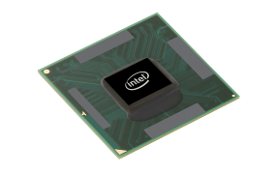
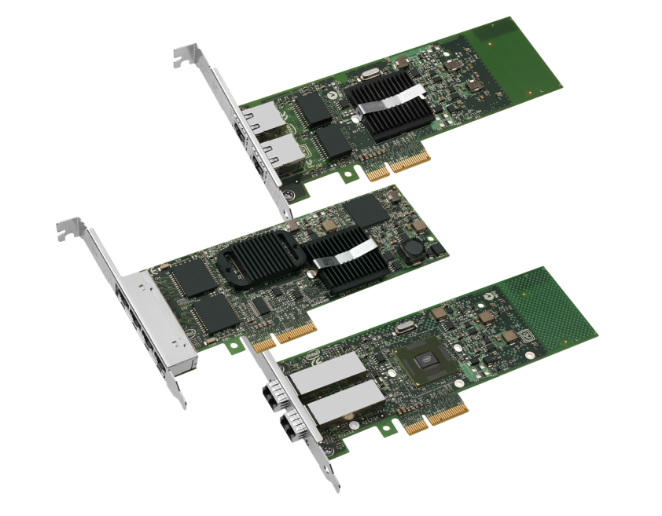
Intel® 82576 Gigabit Ethernet Controller
Next Gen 1 Gigabit Ethernet Controller
PCIe v2.0 (2.5GT/s) Dual port I/O Controller
  Total number of queues: 16 queues/port
  Power: 2.6W
  RoHS and Halogen free
Intel® VT for Connectivity
  Intel® I/O Acceleration Technology (I/OAT)
    Intel® QuickData with Microsoft’s NetDMA technology, TSO, checksum offloads, MSI-X, low latency interrupts, Receive Side Scaling
  Virtual Machine Device Queues (VMDq): data sorting offload with 8 queues/port
  PCI-SIG SR-IOV implementation: 8 Virtual Functions/port
Security
  IPsec offload – improve throughput, low CPU utilization
Manageability
  SMBus, NC-SI, IEEE 1588 (time synch capability)

Slide 23
SDI - Why Now!
Solves emerging IT and regulatory requirements
  Government compliance
  Mobile workforce
Tied to Windows 7 client and server
More business opportunities for partners
  A maturing partner ecosystem to enable montization
Technology provider to other upcoming Microsoft products and scenarios

Slide 24
Call To Action
Support SDI in your product lines
  SDI for Network Devices
    Inspecting
    Terminating
    Modifying
  SDI for Management Tools
  SDI for Hardware Offloading
SDI Collaboration with Microsoft
  Joint marketing collateral
  (White papers, web site, conferences, etc.)
  Collaborate in our IETF work on IPsec for the enterprise

Slide 25
Additional Resources
Web Resources
  SDI Resources
  http://technet.microsoft.com/en-us/network/bb545651.aspx
  IPSec
  http://technet.microsoft.com/en-us/network/bb531150.aspx
  NAP
  http://technet.microsoft.com/en-us/network/bb545879.aspx
  IETF IPSecme WG
  http://trac.tools.ietf.org/wg/ipsecme/trac/wiki
  Anywhere Access
  http://www.microsoft.com/mscorp/twc/anywhereaccess/default.mspx
Related WinHEC Sessions
  Microsoft Direct Access: Anywhere Access with Windows
Email addresses: SDIIHV@microsoft.com

Slide 26



Please Complete A Session Evaluation Form
Your input is important!
Visit the WinHEC CommNet and complete a Session Evaluation for this session and be entered to win one
of 150 Maxtor® BlackArmor™ 160GB External Hard Drives
50 drives will be given away daily!
http://www.winhec2008.com
BlackArmor
Hard Drives provided by:

Slide 27


© 2008 Microsoft Corporation. All rights reserved. Microsoft, Windows, Windows Vista and other product names are or may be registered trademarks and/or trademarks in the U.S. and/or other countries.
The information herein is for informational purposes only and represents the current view of Microsoft Corporation as of the date of this presentation. Because Microsoft must respond to changing market conditions, it should not be interpreted to be a commitment on the part of Microsoft, and Microsoft cannot guarantee the accuracy of any information provided after the date of this presentation.
MICROSOFT MAKES NO WARRANTIES, EXPRESS, IMPLIED OR STATUTORY, AS TO THE INFORMATION IN THIS PRESENTATION.

