Slide 1
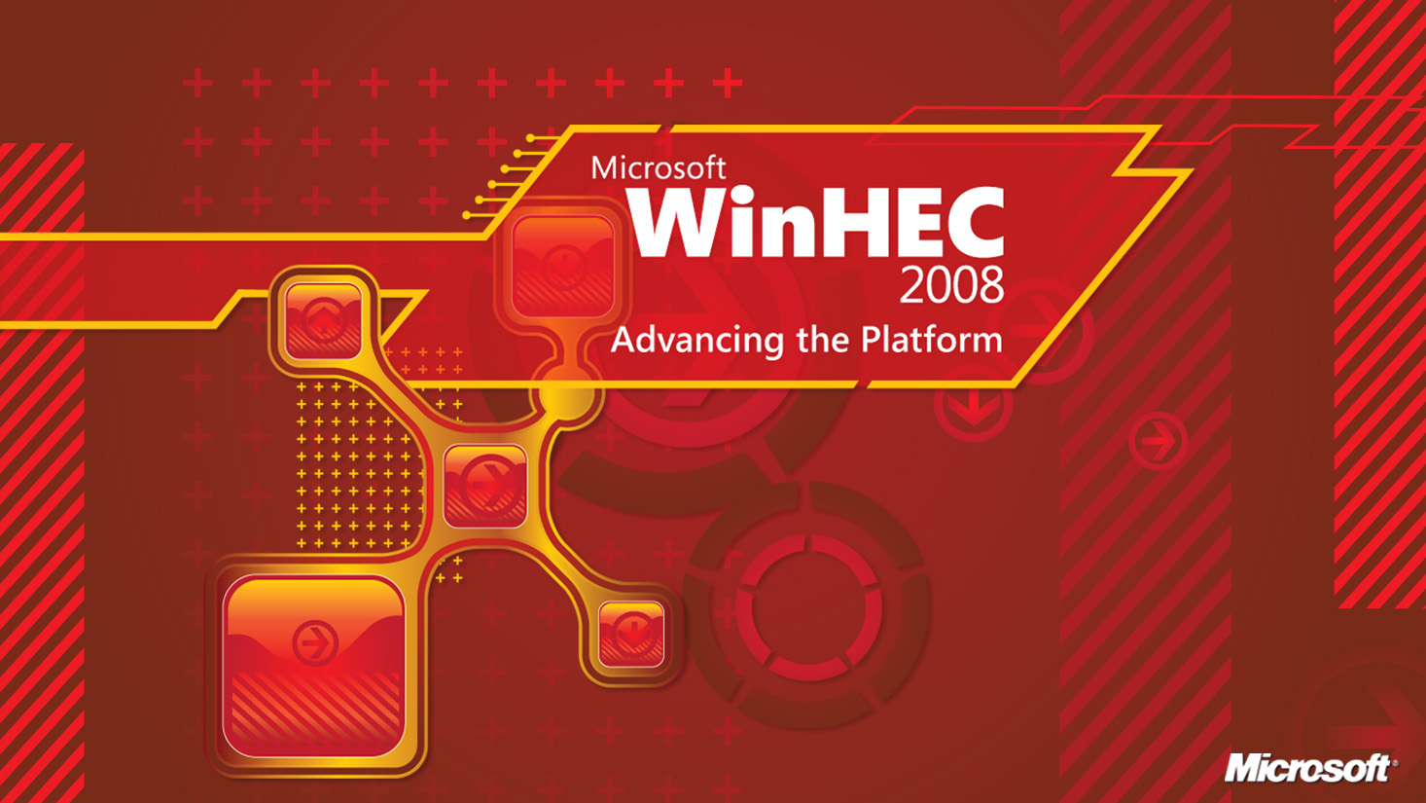

Slide 2
Microsoft Data Center Transformation
Daniel Costello
Director
Data Center Research
and Engineering
Christian Belady
Principal
Power and Cooling Architect
Microsoft Corporation

Slide 3
The Buzz…
Microsoft Embraces Data Center Containers
  Data Center Knowledge 4/01/08
Walking the talk: Microsoft builds first major container-based data center
  Computer World 4/07/08
Microsoft sees portable data centers everywhere
  InfoWorld 8/06/08
Microsoft’s Data Centers Growing by the Truckload
  CNET 8/20/08
Microsoft Data Centers: From Shipping Containers to Tents
  PC World 9/22/08

Slide 4
Agenda Today
What are CBlox?
Motivation - Change or Become Obsolete
Data Center Economics
Microsoft Goals
Standardization and Commoditization
Chicago Data Center/Chicago Tour
Microsoft’s container Story
  What we like about CBlox
  Proof of Concept
  CBlox Solutions
  Thermal boundaries
Summary

Slide 5
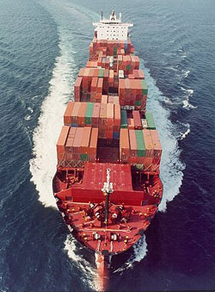
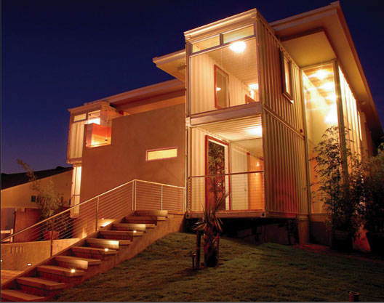
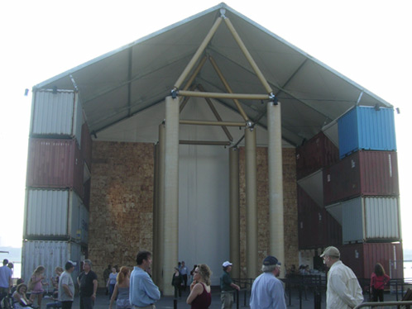
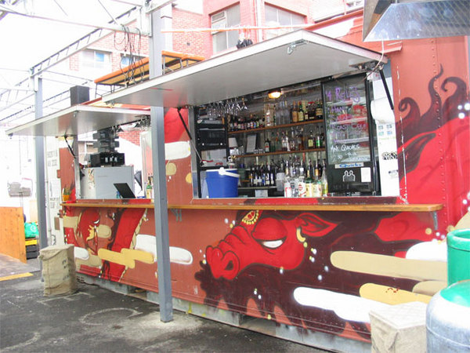
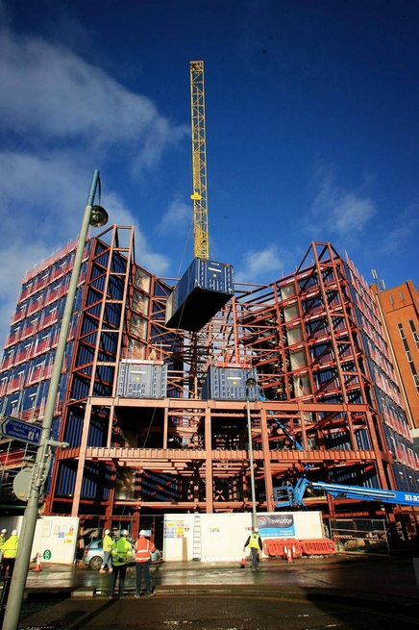
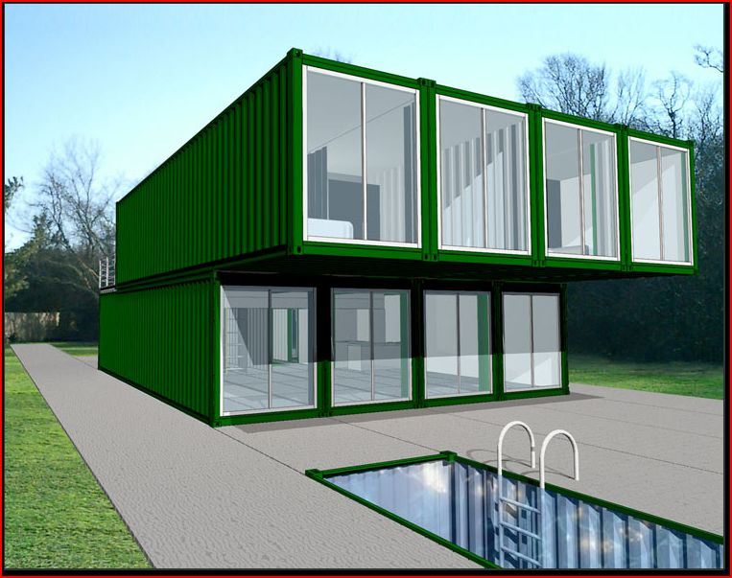
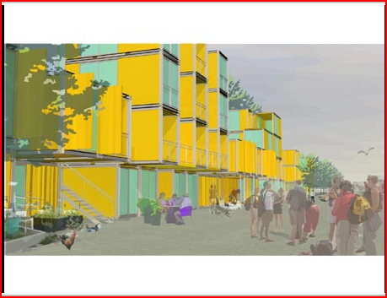
What Are Containers?
Use either standard ISO shipping container
or similar size
  40’,20’,10’ x 8 x 8’6”
Many New Applications emerging…
Homes
Hotels
Museums
Bars
Cities
Pools

Slide 6
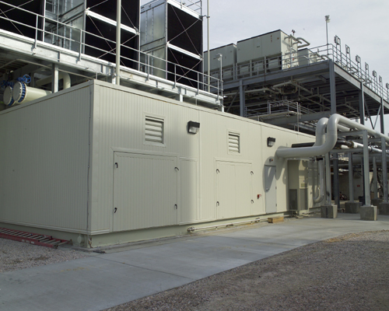
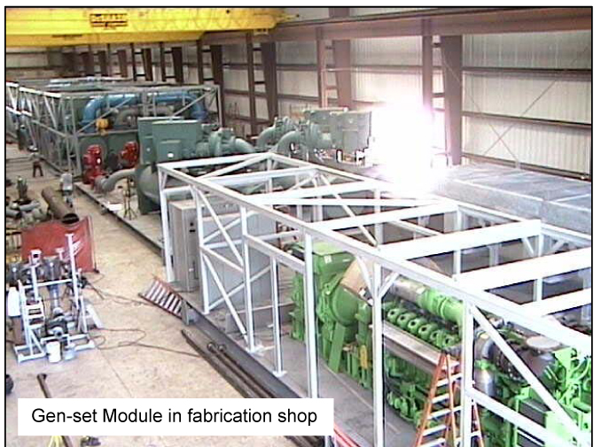
Containerized Equipment
Chiller Plant
Think containment not necessarily containers (modular form factor)
Generator

Slide 7
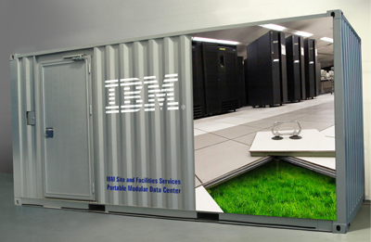
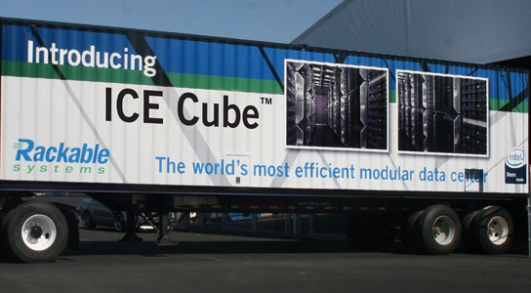
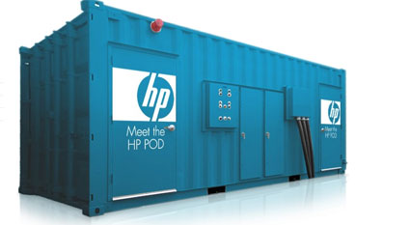
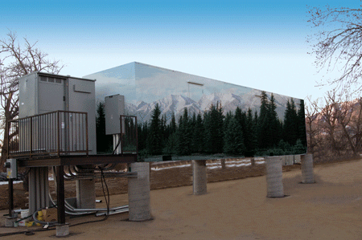
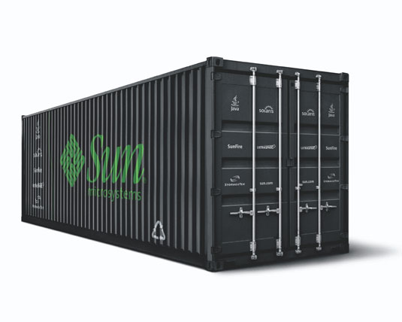
CBlox Computing
Verari

Slide 8
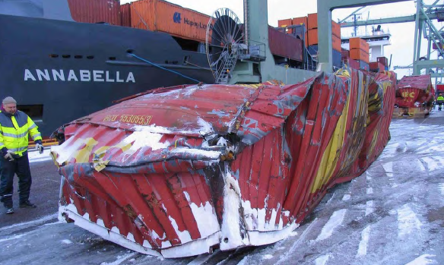
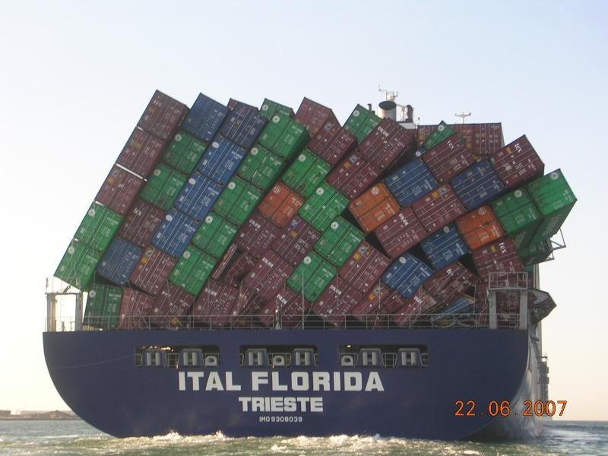
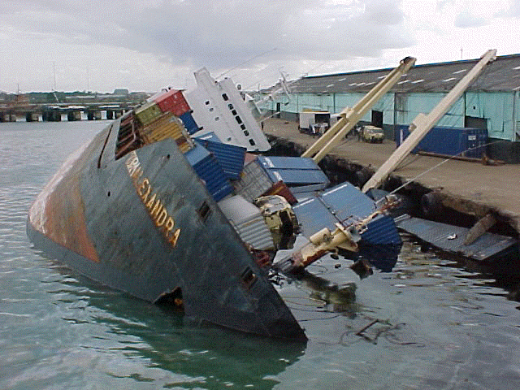
However, There Are Risks!

Slide 9
Change Or Become Obsolete
Bad News
  The Data Center industry has been negligent around efficiency and cost
    Organizations have been driving IT resiliency through Hardware Redundancy
      Example: The Uptime Institute Tier Rating System
      Creating a culture for no tolerance to failures and high cost
      We have been letting equipment suppliers drive the industry
    The data centers cooling designs have been treated like office buildings as opposed to engineered solutions
Good News
  The Opportunities are huge
    Virtualization and Cloud Computing will enable resiliency through the software stack
    New and Old technologies are emerging that are forcing well engineered solutions
      Examples: CBlox, Air Side economization, removal of raised floors, higher density systems, design of the entire system to remove
      components(fans), DC, Higher Voltage AC, Higher ambient temp, etc.

Slide 10
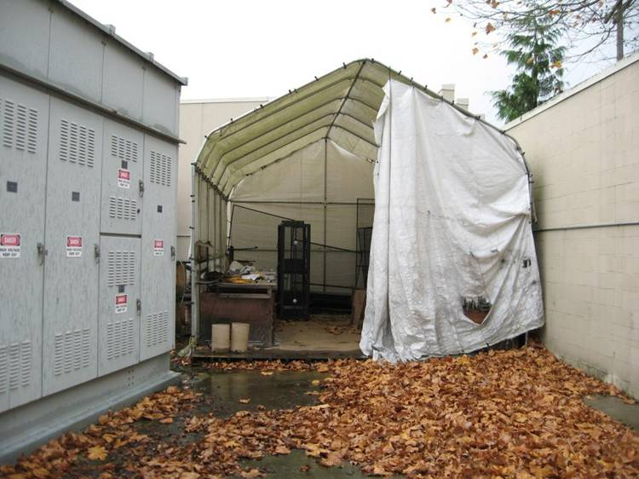
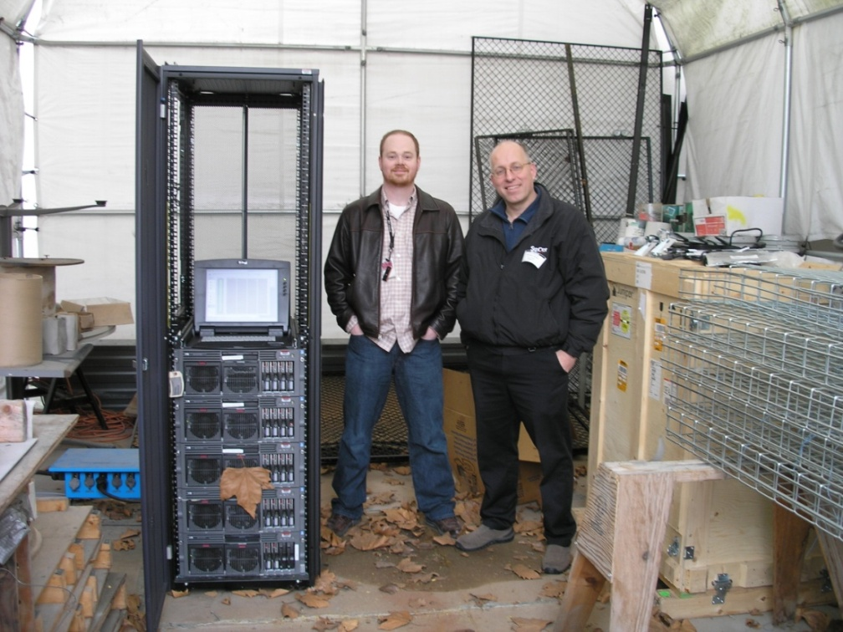
Change Or Become Obsolete
Bad News
  Your Jobs and Products will all change
    Companies will reward those who engineer their jobs away
      Example: Why do we need to replace failed hardware? Why do we need UPS and Generators
    The products vendors sell today will be different or obsolete
      Example: Chiller-less data centers
Good News
  The Opportunities are Huge
    Continual learning
      New Jobs will emerge
    Commoditization/Standardization
      Industry must work together
    Modularization
      Could be any size
      Example: Microsoft’s containers

Slide 11
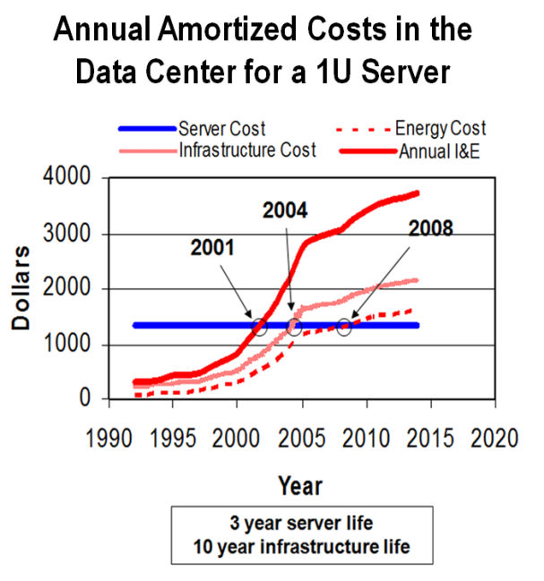
Data Center Economics Have Changed!
Cost of physical space was a primary consideration in data center design
Cost of power and cooling has risen to prominence
Data center managers now must prioritize investment in efficient power and cooling systems to lower the total cost of operating (TCO) of their facilities
Belady, C., “In the Data Center, Power and Cooling Costs More than IT Equipment it Supports”, Electronics Cooling Magazine (Feb 2007)

Slide 12
Data Center Economics Have Changed!
Belady, C., “In the Data Center, Power and Cooling Costs More than IT Equipment it Supports”, Electronics Cooling Magazine (Feb 2007)

Slide 13
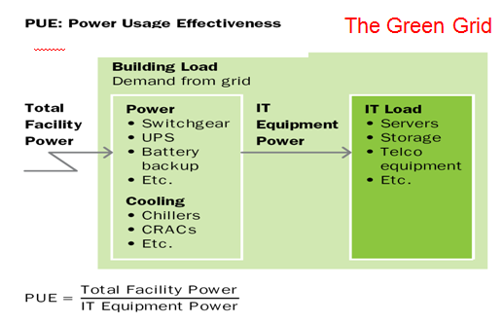
A Metric To Measure Data Center Efficiency
The Green Grid’s
Data Center Efficienct
Metric: PUE
Source: EYP Mission Critical Facilities Inc, New York

Slide 14
Microsoft's Data Center Efficiency Goals
Extreme Efficiency is our Goal!
X
Follows
Less’ Law
Source: EYP Mission Critical Facilities Inc, New York

Slide 15

Microsoft's Data Center Efficiency Goals
Today’s DC
Microsoft’s Future
Large step function in data center costs
Data center costs becomes variable
$
$
Facility
Server
Scale
Scale
Facility cost rising faster than server cost
Break the trend for facility cost
Drive a lowering trend in server cost
$
$
Scale
Scale
Microsoft Confidential

Slide 16
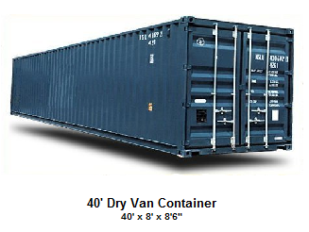
Standardization And Commoditization Helps
Key for driving cost down and efficiency up!
ASHRAE
Guidelines
End User
Manufacturer
Today’s
Data Center
Chilled
Water
Chilled
Water
Conditioned
Air
Conditioned
Air
Server
or Rack
Server
or Rack
End User
Manufacturer
Tomorrow’s
Data Center
Conditioned
Liquid
Server
or Rack
New Interface
Guidelines

Slide 17
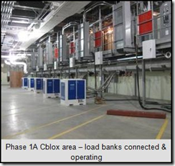
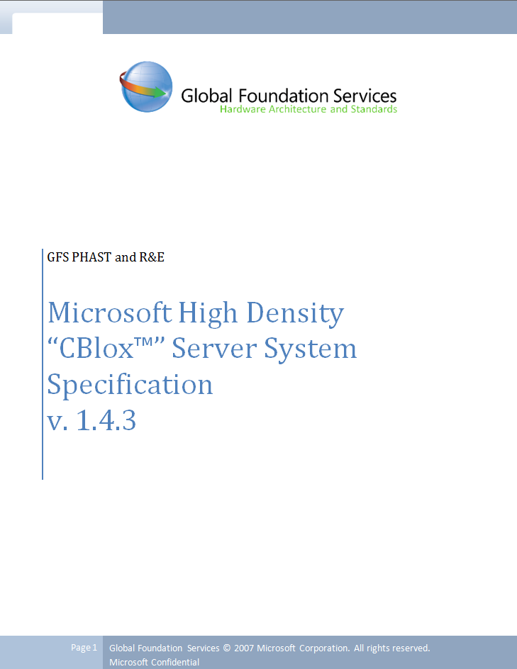
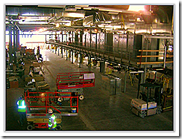
How Did We SPEC The CBlox?
We developed the “CBlox” Specification for our container
Specification defined all of the interface requirements to the Data Center such as
  Chilled Water
  Power
  Data Connection
Selection based on many criteria
but primarily on the following
  $/Server
  # of Servers/kW

Slide 18
video
Chicago CBlox Data Center
Sean James
Project Manager
Data Center Development

Slide 19
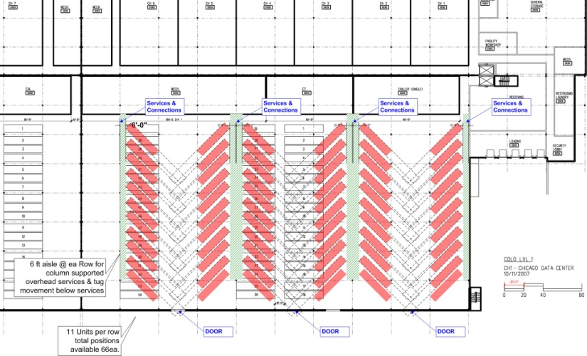
Chicago Container Layout

Slide 20
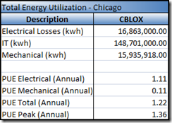
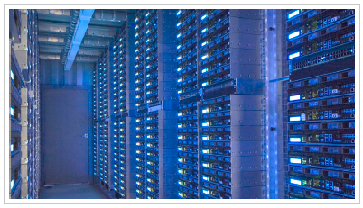

Why We Like CBlox
Can deploy at scale
Plug and Play
Drives Innovation
Abstracts away religious wars in competitive bid
  AC versus DC
  Air versus Liquid
Cost can include maintenance
Allows for easy cost and
performance measurement
Creates an environment to drive competition around efficiency
Accountability is with one prime vendor
Question:
Is this water cooling or air cooling?

Slide 21
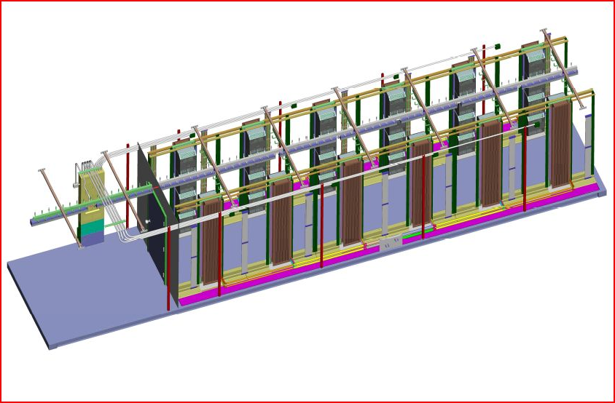
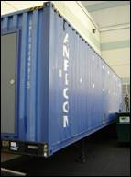
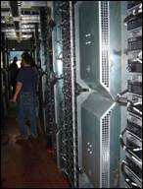
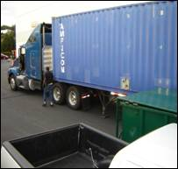
"CBlox" POC
Microsoft Ran a Proof of Concept on a Rackable system at Canyon Park in Seattle
PUE came in between 1.2 and 1.3 é
Ran unit up to full load measured at 107kW equals 178 watts per server é
Dropped power to unit and came back online no issues é
Fans and servers ran at full speed for 7mins on batteries é
“CBlox” spec completed and vendor RFP underway é
Batteries temp remained at 75F using probe and IR camera. Back is exposed to 85F. Need to place a temp probe at rear of battery è
Ambient air temp had a large effect on temp inside the trailer due to no insulation è
Permit and UL inspection took 90 days to obtain è
Harmonics above 15%: Varies across all 3 phases ê

Slide 22
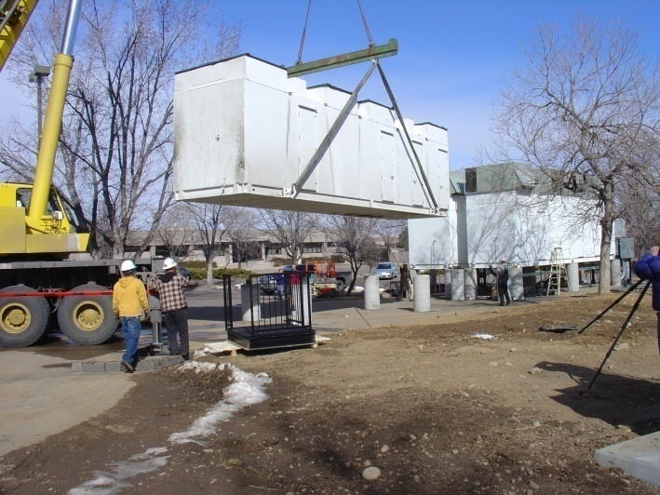
CBlox Solutions
CBlox units in production at Microsoft
  Portability allows the Delivery and operation of servers in self contained units
    Move costs from long lead to short lead equipment, > ROIC
    Optimize server delivery at 1000U+ as a unit versus 40+U in a rack and
    a Single SKU and Warranty
Containers seen as a solution to burst demand and temporary by the industry
Microsoft’s approach is different –use them
as a primary packaging unit
5 months from Engineering to Live
Cost/Sustainability: It costs less and has a reduced impact on the shipping products to ship 2,000 servers in one container than it does to ship and then install individual racks. Additional savings come from not needing raised floors or fans for each server, and requiring a lot less wiring, packaging and shipping.

Slide 23
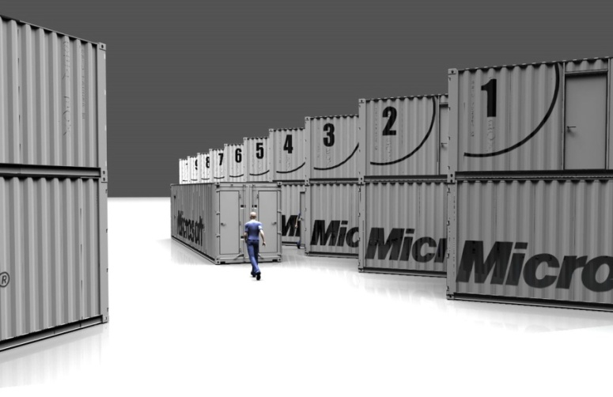
CBlox Solutions
The CBlox gives us the opportunity to test new technology such as increased supply air temperature, removal of fans from servers, managed airflow with hot aisle containment, significantly increased WPSF and more efficient electrical distributions
Microsoft have stand alone units running in production today and are running proof of concepts on newer technology
Parallel construction and manufacturing
Energy efficiency: At more than 1,000 Watts per square foot, containers allow us to power a lot more servers in a given area. This is the key reason containers have become economically viable. PUE numbers tested in a POC measured at peak ~1.3

Slide 24
CBlox Solutions
 | Pros | Cons
Economy of Scale | A Larger unit of compute allows 10x scale to deploy. “CBlox” manufacturing can occur in parallel with Datacenter | Risk with Large unit of compute of stranding power. Large scale material handling system for movement
Flexibility | Self contained small remote deployment. Can go anywhere with power and network connections | Today Homogeneous solutions to a single vendor – no vendors supporting multiple HW manufacturers yet
Expandability | Essentially unlimited expansion up to power capability, with sufficient land available | Cost for expansion is stretched over time, compared to fixed facility
Energy Efficiency | More energy efficient design than our data centers today at a higher power density which allows more servers in the same footprint | Same technology can be applied to a data center

Slide 25
CBlox Solutions
 | Pros | Cons
Refresh | Opportunity to refresh data center technology if there is a positive ROI with HW refresh cycle | Replacement of containers may be costly per container if not refurbished
Risk | Secondary protection of assets in containers from a physical disaster such as smoke or water – destruction testing in progress | New technology risks for code, compliance, engineering and operations
Reliability | Design allows for smaller failure mode – 1 container at a time versus 1 Colo | Today “CBlox” are lower reliability and require application to have geo redundancy and ability to take downtime for maintenance

Slide 26
Summary
Containers are not for everyone - yet
For Microsoft containers are just a small step in a much larger transformation
Containers are a primary packaging unit
Containerization enables modularization
There are a lot of opportunities for us as an industry

Slide 27
Call To Action
Develop resiliency at the application layer to enable failover between data centers

Slide 28
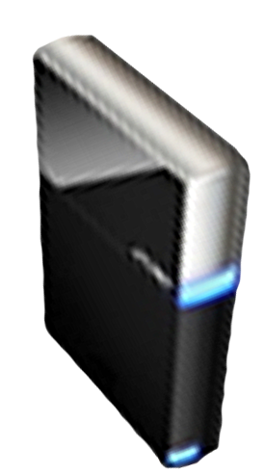


Please Complete A Session Evaluation Form
Your input is important!
Visit the WinHEC CommNet and complete a Session Evaluation for this session and be entered to win one
of 150 Maxtor® BlackArmor™ 160GB External Hard Drives
50 drives will be given away daily!
http://www.winhec2008.com
BlackArmor
Hard Drives provided by:

Slide 29


© 2008 Microsoft Corporation. All rights reserved. Microsoft, Windows, Windows Vista and other product names are or may be registered trademarks and/or trademarks in the U.S. and/or other countries.
The information herein is for informational purposes only and represents the current view of Microsoft Corporation as of the date of this presentation. Because Microsoft must respond to changing market conditions, it should not be interpreted to be a commitment on the part of Microsoft, and Microsoft cannot guarantee the accuracy of any information provided after the date of this presentation.
MICROSOFT MAKES NO WARRANTIES, EXPRESS, IMPLIED OR STATUTORY, AS TO THE INFORMATION IN THIS PRESENTATION.

