Slide 2
Devices Profile for Web Services in Windows 7
Rob Williams
Program Manager
Microsoft Corporation

Slide 3
Agenda
Web Services (WS) in business
Microsoft Platform Advances with WS
Enterprise and Vertical Scenarios
Logo Testing for your Implementation

Slide 4
Device Protocol Requirements
Robust and standards based
Secure
Flexible
Scalable
Interoperable
Web Services!

Slide 5
Web Services is Software Talking to Software

Slide 6
Who Is Solving These Challenges?
WS-SEC. CONV.
SOAP/WSDL
WS-SECURITY
MTOM
WS-TRUST
Service Orientation
Support for Enterprise Scenarios
Support for Consumer Scenarios
Interoperable
Messaging
Security
Microsoft Corporation | ü | ü
Oracle | ü | ü
IBM | ü | A
BEA Systems, Inc. | ü | A
Sun Microsystems, Inc. | ü | ü
Google | ü
Amazon.com | ü
eBay, Inc | ü
Apache | ü | ü
White Mesa Software | ü | ü
gSOAP | ü | ü
Ricoh | ü | 
Epson Corporation | ü | 
HP | ü | 
Xerox | ü | 
Intel Corporation | ü | 
Canon Inc. | ü | 
Microsoft Corporation | ü | ü | ü
Oracle | ü |  | 
IBM | ü |  | ü
BEA Systems, Inc. | ü | A | 
RSA Security Inc. | ü |  | 
Systinet Corporation | ü |  | 
Apache | ü |  | 
Layer7 Technologies | ü | A | ü
Computer Associates International, Inc. | ü | A | A
Sun Microsystems, Inc. | ü
SAP AG | ü
Tibco Software, Inc. | ü
IONA Technologies | ü
WebMethods, Inc. | ü
Nokia | ü
Cape Clear | ü
gSOAP | ü
Netegrity |  | A | A
Verisign, Inc. |  | A | A
WS-RM
WS-Policy
Assurances
WS-AT
Metadata
MEX
Microsoft Corporation | ü | ü
Oracle | 
IBM | ü | ü
BEA Systems, Inc. | ü | A
Sun Microsystems, Inc. | ü
Cape Clear | ü
Systinet Corporation | ü
Blue Titan Software, Inc | ü
IONA Technologies |  | ü
Arjuna Technologies |  | ü
Choreology Ltd |  | ü
Apache | ü | ü
Microsoft Corporation | ü | ü
Oracle |  | 
IBM |  | 
BEA Systems, Inc. | A | ü
SAP AG | A | 
Sun Microsystems, Inc. | ü | ü
Verisign Inc. |  | A
Sonic Software |  | A
Computer Associates International, Inc. | A
WebMethods, Inc. | A
gSOAP |  | ü
ü | Released product
 | Public interop
A | Co-Author only

Slide 7
Standards Based Approach
a<?xml version="1.0" encoding="UTF-8" ?>
- <wsdl:definitions targetNamespace="http://www.example.org/discoveryproxy" xmlns:tns="http://www.example.org/discoveryproxy" xmlns:wsd="http://schemas.xmlsoap.org/ws/2005/04/discovery" xmlns:wsa="http://schemas.xmlsoap.org/ws/2004/08/addressing" xmlns:wsdl="http://schemas.xmlsoap.org/wsdl/" xmlns:xs="http://www.w3.org/2001/XMLSchema">
<wsdl:import namespace="http://schemas.xmlsoap.org/ws/2005/04/discovery" location="http://schemas.xmlsoap.org/ws/2005/04/discovery/ws-discovery.wsdl" />
- <wsdl:types>
- <xs:schema>
<xs:import namespace="http://schemas.xmlsoap.org/ws/2005/04/discovery" schemaLocation="http://schemas.xmlsoap.org/ws/2005/04/discovery/ws-discovery.xsd" />
</xs:schema>
- <xs:schema targetNamespace="http://www.example.org/discoveryproxy" xmlns:tns="http://www.example.org/discoveryproxy">
- <xs:complexType name="PassThroughType">
- <xs:sequence>
<xs:any minOccurs="0" maxOccurs="unbounded" />
</xs:sequence>
</xs:complexType>
<xs:element name="PassThrough" type="tns:PassThroughType" />
</xs:schema>
</wsdl:types>
- <wsdl:portType name="DiscoveryProxy">
- <wsdl:operation name="Hello">
<wsdl:input message="wsd:HelloMsg" wsa:Action="http://schemas.xmlsoap.org/ws/2005/04/discovery/Hello" />
</wsdl:operation>
- <wsdl:operation name="Bye">
<wsdl:input message="wsd:ByeMsg" wsa:Action="http://schemas.xmlsoap.org/ws/2005/04/discovery/Bye" />
</wsdl:operation>
- <wsdl:operation name="Probe">
<wsdl:input message="wsd:ProbeMsg" wsa:Action="http://schemas.xmlsoap.org/ws/2005/04/discovery/Probe" />
<wsdl:output message="wsd:ProbeMatchMsg" wsa:Action="http://schemas.xmlsoap.org/ws/2005/04/discovery/ProbeMatches" />
</wsdl:operation>
- <wsdl:operation name="Resolve">
<wsdl:input message="wsd:ResolveMsg" wsa:Action="http://schemas.xmlsoap.org/ws/2005/04/discovery/Resolve" />
<wsdl:output message="wsd:ResolveMatchMsg" wsa:Action="http://schemas.xmlsoap.org/ws/2005/04/discovery/ResolveMatches" />
</wsdl:operation>
</wsdl:portType>
</wsdl:definitions>

Slide 8
Standards Based Approach
IT managers
No single vendor lock-in
Application developers and intigrators
Engineering community designed
Device manufactures
Royalty free licensing
Everyone
Interoperability

Slide 9
Secure
Enterprise grade cryptography
Protects high value services
Transport layer security
Signed discovery messages
TLS transport security
x.509 client and service authentication
Cryptographically secured discovery

Slide 10
Flexible and Reusable
Services oriented world demands flexibility in use and reuse
Web services are composable to meet changing business needs
Services able to meet needs for wide range of different applications

Slide 11
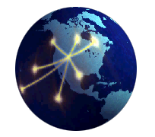
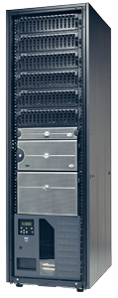
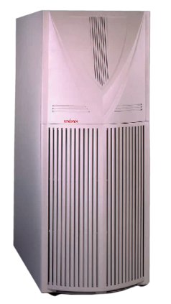
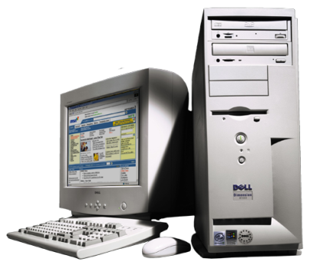
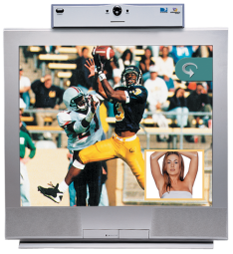
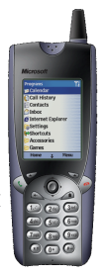
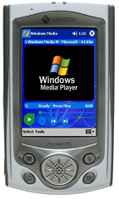
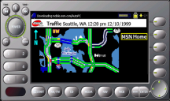
Scalable
“Scales in the Cloud” spans organizations and geographies
“Scales Out”
In clusters
“Scales Up” on large systems
“Scales In” on a machine
“Scales Down”
to devices

Slide 12
Scalable
“Scales in the Cloud” spans organizations and geographies
“Scales Out”
In clusters
“Scales Up” on large systems
“Scales In” on a machine
“Scales Down”
to devices
“Scales Micro”
to sensors

Slide 13
Scalable
Distributed cloud services
Enterprise business applications
Device input and output
Sensor data networks

Slide 14
Devices as Part of Business Flow
Devices are becoming deeply integrated into business process
Devices are computers that offer a specialty service
Devices are computers that should be lower in cost to manage and integrate

Slide 15
Windows 7 Server 2008 R2 Platform Enhancements

Slide 16
Enhancements to the Platform
Windows 7 and Windows Server 2008 R2
Discovery remote extensions
Security enhancements
Windows Embedded CE6R2
Windows CE
Windows Network Projector
Full DPWS support
.NET Micro Framework
Full DPWS support
New code generation tool

Slide 17
Cross Subnet Discovery
Directed discovery
Install Web Services device by name
Discovery remote extensions
Browse for PCs, people, and Web Services across entire organization
Publish anything with Publication Services
Faster response than NETBios

Slide 18
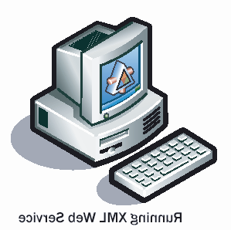
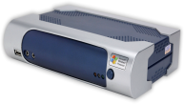
Cross Subnet Discovery
ProbeMatches
Unicast Probe
Print
Discovery Proxy

Slide 19
Discovery Remote Extensions
Benefits
Cross subnet discovery
Multicast traffic suppression
WS-Discovery proxy based design
Proxy can publish other resources
Type and scope matching increasing in importance!

Slide 20
Enhancements to the Platform
Windows 7 and Windows Server 2008 R2
Discovery remote extensions
Security enhancements
Windows Embedded CE6R2
Windows CE
Windows Network Projector
Full DPWS support
.NET Micro Framework
Full DPWS support
New code generation tool

Slide 21
Security Enhancements
Compact Signature Signed Discovery
Prohibits discovery denial of service attacks
Flexibility in certificate model
UUID based Common Name (CN) validation
No longer tied to DNS Cname or IP Address

Slide 22
Enhancements to the Platform
Windows 7 and Windows Server 2008 R2
Discovery remote extensions
Security enhancements
Windows Embedded CE6R2
Windows CE
Windows Network Projector
Full DPWS support
.NET Micro Framework
Full DPWS support
New code generation tool

Slide 23
Enabled Scenarios

Slide 24
Inbox Applications of WS
WS Hosts, Publishing Resources
WS Print, Secure Print, Scan
WS Enterprise Scan Manager
WS Network Projection

Slide 25
Distributed Scan Management
Office imaging systems are WS client
Windows Server 2008 R2 Scan Manager Web Service
Integration into complex workflow

Slide 26
Distributed Scan Management
Health management organization
Medical record retention requirements
Local collection (scan)
Central storage
Secure authentication and transport
Privacy is the law!

Slide 27
Windows Network Projection
Web Services moving into projector and display systems
Meeting room presentations
Digital signage
Operations center display walls

Slide 28
Windows Network Projection Scenario
Network operations center displays
Organization’s critical state to be monitored
Virtual Machine Desktop remoted
Local or cross-WAN systems displayed

Slide 29
WS in Vertical Markets
IP camera
Industry moving toward a single protocol
RFID
Biztalk Server 2008
Point of sale
ARTS working on WSPOS
Industrial control
SOCRADES

Slide 30
DPWS Platform Advances in Windows Summary
Windows 7 infrastructure investments
Discovery proxy support
Security enhancements
Application investments
Enterprise Scan Server Role
RFID readers in BizTalk
Platforms
Micro Framework code generation tools

Slide 31
Building Devices
DPWS Stack options
All of Microsoft Embedded OS’s
Reference stacks
gSOAP, SOA4D, eSOL, Levitate
Full in-house implementation
Device description and methods
Microsoft
Industry standards

Slide 32
New Logo Requirements
New tests required in June 2009
Device Fundamental category
Discovery Robustness is focus
Devices are good Network Citizens
Run tests early
Work with Microsoft to resolve issues
Incorporate tests into regression suites

Slide 33
Call To Action
Test devices with new Web Services logo requirements
Build Web Services into your devices to increase security, flexibility, and utility
Work with your industry to define device methods and WSDLs

Slide 34
Additional Resources
Web Resources
http://www.microsoft.com/Rally
OASIS WS-DD
http://www.oasis-open.org/committees/ws-dd/
Developer’s Blog
http://blogs.msdn.com/dandris/default.aspx
MSDN Forum
http://www.microsoft.com/communities/newsgroups/enus/default.aspx?dg=microsoft.public.windows.devices.wsdapi

Slide 35
Please Complete A Session Evaluation Form Your input is important!
Visit the WinHEC CommNet and complete a Session Evaluation for this session and be entered to win one of 150 Maxtor® BlackArmor™ 160GB External Hard Drives 50 drives will be given away daily!
http://www.winhec2008.com
BlackArmor Hard Drives provided by:

Slide 36
© 2008 Microsoft Corporation. All rights reserved. Microsoft, Windows, Windows Vista and other product names are or may be registered trademarks and/or trademarks in the U.S. and/or other countries.
The information herein is for informational purposes only and represents the current view of Microsoft Corporation as of the date of this presentation. Because Microsoft must respond to changing market conditions, it should not be interpreted to be a commitment on the part of Microsoft, and Microsoft cannot guarantee the accuracy of any information provided after the date of this presentation. MICROSOFT MAKES NO WARRANTIES, EXPRESS, IMPLIED OR STATUTORY, AS TO THE INFORMATION IN THIS PRESENTATION.

