Slide 2
Debunking the “Mainframe is Greener” Myth
Kelly Hollis
Staff Software Engineer
Fujitsu Computer Systems

Slide 3
Overview
The Myth: What you may have heard
Debunking the Myth: Our findings
How we obtained our results
Why Windows servers are green
What you can expect in the future

Slide 4
The Myth
What you may have heard
“Mainframe computers are proving to be dramatically efficient in cooling and power consumption.” 1
“As additional power benchmarking analysis is performed, the IBM System z9 will continue to be viewed as an outstanding platform for power efficiency.” 1
“IBM claims an 80% efficiency gain over x86” (Gartner analyst casual comment)
OUR CONTENTION:
Mainframes are good – just not the best
¹A Power Benchmarking Study… (see Additional Resources)

Slide 5
Debunking The Myth
Our findings

Slide 6
Debunking The Myth
Our findings
We work with traditional mainframe applications: CICS/COBOL online,
COBOL batch
Areas in which mainframes should shine
Used IBM papers for statistics and guidelines on suitable applications
Included some web enablement techniques as they’ve been offered for several years

Slide 7
Debunking The Myth
Our findings
Web Enablement Technique | Computer | Transactions per Second | Rate of Energy Consumption (Watts) | Transactions per Kilowatt Hour (kWh)
3270 Green Screen (no Web enablement) | Mainframe | 984 | 5,221 | 678,455
 | PRIMERGY | 354 | 551 | 2,314,939
3270 Web Bridge | Mainframe | 341 | 5,221 | 234,810
 | PRIMERGY | 354 | 551 | 2,314,939
CICS Web Support (CWS) Direct Connect | Mainframe | 1155 | 5,221 | 796,524
 | PRIMERGY | 850 | 551 | 5,555,593
CICS Transaction Gateway (CTG) Applet | Mainframe | 717 | 5,221 | 494,616
 | PRIMERGY | 1177 | 551 | 7,696,852
CICS Transaction Gateway (CTG) Servlet | Mainframe | 327 | 5,221 | 225,487
 | PRIMERGY | 850 | 551 | 5,555,593

Slide 8
Debunking The Myth
Our findings

Slide 9
Debunking The Myth
Our findings

Slide 10
How We Obtained Our Results

Slide 11
How We Obtained Our Results
Used results published by IBM for their Trader application (upgraded to later platform by using IBM’s LSPR tables)
Migrated Trader using our NetCOBOL, NeoKicks and NeoData software
Executed Trader on a PRIMERGY server (loaded between 84% and 97%)
Used published energy figures
Calculated total transaction rates

Slide 12



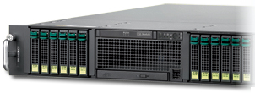


How We Obtained Our Results
Redbook
A Performance
Study of Web
Access to CICS
PROGRAM-ID. TRADER.
ENVIRONMENT DIVISION.
…
Fujitsu
Power
Configuration
Tool
RB
PRIMERGY
RX300-S4
9672-R55
LSPR Tables
A Power
Benchmarking
Study on the
IBM System z9
x 8.89
Microsoft/Fujitsu
Comparing Mainframe
and Windows Server
Transactions per kWh
2094-704

Slide 13
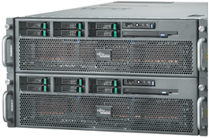
How We Obtained Our Results
Driving PRIMERGY transactions
Transaction Processing
Transaction Driving
PRIMERGY RX300-S4
PRIMERGY RX800-S2
Gigabit Ethernet
2 x Xeon X5460 3.16 GHz
8 x 2GB FBD 667 PC2-5300 ECC
2 x 73GB SAS (hot-plug)
Integrated remote management controller
Windows Server 2008 (32-bit)
NeoKicks V2.0.13
NeoData V1.0.10
SQL Server 2008 (32-bit)
4 x Xeon 7020 2.16 GHz
Windows Server 2003 (32-bit)
Visual Studio 2005 Web Test

Slide 14
How We Obtained Our Results
Checking PRIMERGY power usage
Server Management Controller
  On board controller, accessed through
  web browser
  Real time power consumption information
  Historical data available as a graph

Slide 15
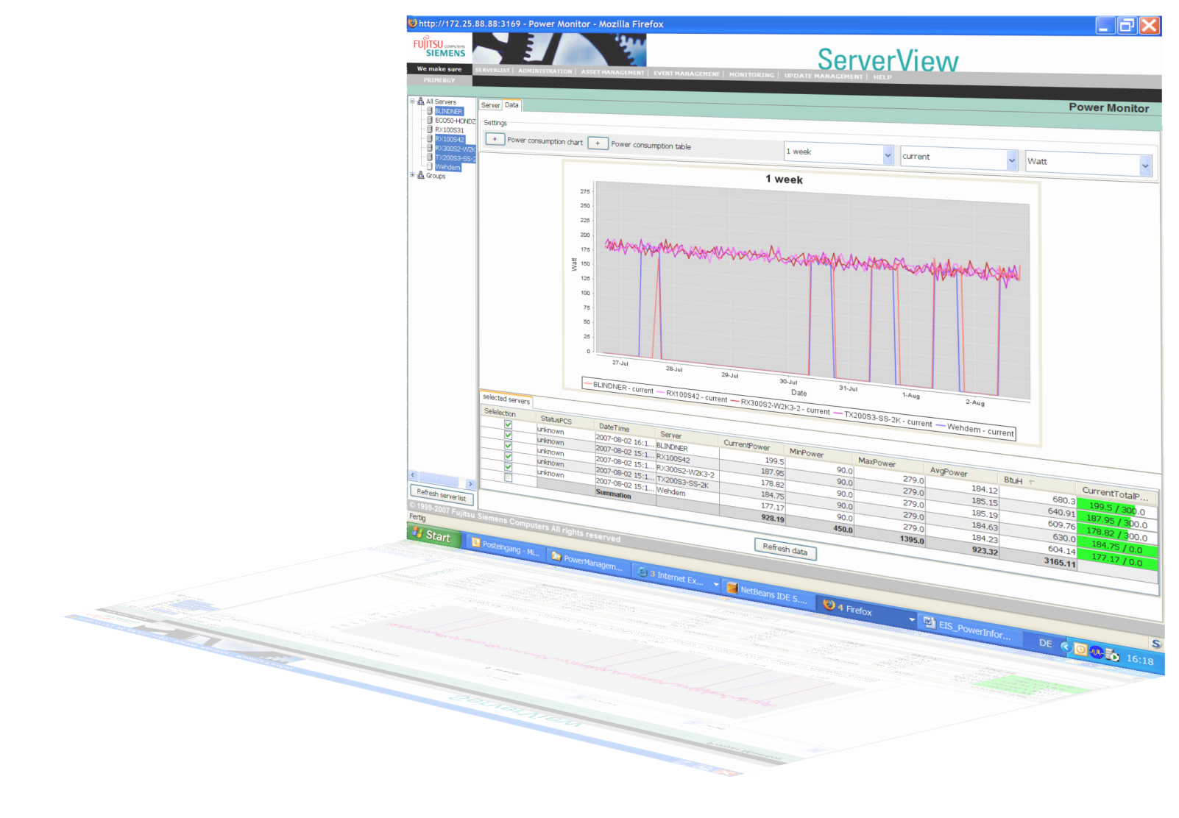
How We Obtained Our Results
With ServerView
you can
  Monitor one or more PRIMERGY server’s power management settings
  Check the power consumption of your data center or
  selected servers
  Select between
  BTU and watts

Slide 16
Why Windows
Servers Are Green

Slide 17
Why Windows Servers Are Green
Windows Server performance is much closer to
mainframe performance than generally assumed but consume much less power

Slide 18

Why Windows Servers Are Green
Windows Server performance is much closer to mainframe performance than generally assumed but consume much less power
Mainframes are designed with a bigger mission in mind – often overkill for many
Servers like PRIMERGY have many power-saving features built-in: selectable power modes; choice of chips; smaller HD drives; more efficient power supplies; …
IBM comparisons have been based on low-utilization, older PC servers vs. the latest mainframes

Slide 19
Why Windows Servers Are Green
Optimizations on the Windows platform
IIS and ASP.NET are highly tuned
for performance
NeoKicks converted CICS applications
run as native ASP.NET applications
Built to handle thousands of users
and high throughput
Able to take advantage of the
latest hardware

Slide 20
What You Can Expect
In The Future

Slide 21
What You Can Expect In The Future
Improvements to PC harware
Faster processors with lower power
and ability to choose performance/power consumption combination e.g.,
X5470 – 3.33GHz, 120W
L5430 – 2.66GHz, 50W
More cores per socket
Larger memory modules, more
power-efficient models

Slide 22
What You Can Expect In The Future
Benefits of power optimized server
“Standard” PY RX300 S3
E5335 CPU, 8x 1GB RAM, 6x HDD 3.5“ 15K
“Power optimized” PY RX300 S3
L5335 CPU, 4x 2GB RAM, 6x HDD 2.5“ 10K
14%
Fan
12%
PSU
22%
PSU
Saving:
33%
11%
MoBo
14% CPU
8%
Memory
18%
HDD
23%
CPU
14% Fan
7%
HDD
11%
Memory
11%
MoBo
SPECint_rate_base 148
SPECint_rate_base 148
  33% saving by using less redundancy, different memory and LV processors

Slide 23
What You Can Expect In The Future
From Dec 2007 to May 2008 we saw from 22% to 39% improvement in our test results
Web Enablement Technique | Transactions per Second (Dec 07) | Transactions per Second (May 08) | Increase
3270 Green Screen (no Web enablement) | 290 | 354 | 22%
3270 Web Bridge | 290 | 354 | 22%
CICS Web Support (CWS) Direct Connect | 610 | 850 | 39%
CICS Transaction Gateway (CTG) Applet | 800 | 1177 | 47%
CICS Transaction Gateway (CTG) Servlet | 610 | 850 | 39%

Slide 24
What You Can Expect In The Future
22% to 39% increase attributed to:
Processor upgraded from X5355
(2.66GHz, 120W) to X5460
(3.16GHz, 120W)
Upgrading to Windows Server 2008
(from 2003)
Upgrading to SQL Server 2008 (from 2005)
NeoKicks enhancements (the CICS transaction supporting software)

Slide 25
What You Can Expect In The Future
Move additional workloads
Your workloads will likely include
batch jobs
  With SORT statements

Slide 26
What You Can Expect In The Future
World-record-related tests
GB
per
min
1200
$K
1000
800
600
400
200
0

Slide 27
What You Can Expect In The Future
Some customer experiences with batch jobs

Slide 28
Summary
Well-managed Windows-Server-based systems look very green compared
to mainframes
Windows servers continue to improve in both performance and performance-per-kWh at a pace that means things are greener today than when I created
this presentation
Including batch jobs will give you an
even greener picture

Slide 29
Call To Action
Read the white paper:
“Comparing Mainframe and Windows Server
Transactions per kWh”
www.microsoft.com/windowsserver/mainframe/papers.mspx
Review mainframe to Windows information at: www.microsoft.com/windowsserver/mainframe/default.mspx
netcobol.com
Contact us to discuss if modernizing to
Windows is for you:
Email -
cobol@netcobol.com

Slide 30
Additional Resources
Web Resources
  Whitepapers:
  http://www.netcobol.com/info/white_papers.html
  http://www.microsoft.com/windowsserver/mainframe/papers.mspx
  Mainframe migration:
  http://www.netcobol.com
  http://mainframemigration.org
  IBM LSPR tables:
  http://www-03.ibm.com/servers/eserver/zseries/lspr/index.html
Contact
  cobol@netcobol.com
Papers referenced:
Stahl, Elizabeth, Michael Buechele, and John P. Rankin, “A Power Benchmarking Study on the IBM System z9: Applying Energy Efficiency Metrics to Performance,” IBM, October 4, 2007.
www-03.ibm.com/support/techdocs/atsmastr.nsf/WebIndex/WP101110
Wakelin, Phil, Graham Rawson, Per Fremstad, Dave Scott, and Andy Abbey, A Performance Study of Web Access to CICS, IBM Redbooks, February, 2000.

Slide 31
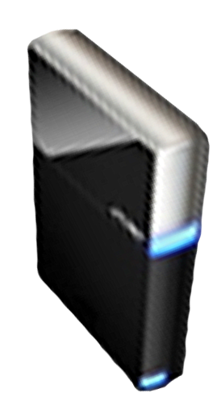


Please Complete A Session Evaluation Form
Your input is important!
Visit the WinHEC CommNet and complete a Session Evaluation for this session and be entered to win one
of 150 Maxtor® BlackArmor™ 160GB External Hard Drives
50 drives will be given away daily!
http://www.winhec2008.com
BlackArmor
Hard Drives provided by:

Slide 32


© 2008 Microsoft Corporation. All rights reserved. Microsoft, Windows, Windows Vista and other product names are or may be registered trademarks and/or trademarks in the U.S. and/or other countries.
The information herein is for informational purposes only and represents the current view of Microsoft Corporation as of the date of this presentation. Because Microsoft must respond to changing market conditions, it should not be interpreted to be a commitment on the part of Microsoft, and Microsoft cannot guarantee the accuracy of any information provided after the date of this presentation.
MICROSOFT MAKES NO WARRANTIES, EXPRESS, IMPLIED OR STATUTORY, AS TO THE INFORMATION IN THIS PRESENTATION.

