Slide 2
Making Drivers Available On Windows
Chris Matichuk
Senior Program Manager Lead
Microsoft Corporation

Slide 3
Windows Vista SP1 Systems Will Upgrade To Window 7 Without Device Issues

Slide 4
Windows Vista SP1 Systems Will Upgrade To Window 7 Without Device Issues
No manual searching to find a driver
Incompatible drivers are seamlessly replaced with working drivers
Pre-upgrade warnings on unsupported devices

Slide 5
Device Ecosystem Health
Improving Driver Availability
The best possible driver is available to end users in the best possible way
End users are informed on whether their device is supported or should be replaced
Distribute Solution
Identify Solution
Identify Partner
Improving Driver Quality
Monitor Availability Gaps
Monitor Quality Gaps
Identify Partner
Identify Solution
Distribute Solution

Slide 6
Availability Goals
99%+ inbox availability of relevant market share for Network Ethernet and Storage Controller devices found in Vista SP1 systems
No driver availability regressions from Windows Vista SP1
Inbox drivers removed from Windows Vista SP1 will be supported either on WU (Windows Update) or a DNF (Driver Not Found) Response
90%+ of Windows 7 systems will have 0 DNFs or drivers available via WU or DNF Response

Slide 7
Monitoring Driver Availability
How was this done in the past?
OEM surveys
IHV surveys
Market research reports
Retail reports
How are we doing this today?

Slide 8
Driver Availability Metrics
Availability gaps by systems
CEIP (Microsoft Customer Experience Improvement Program)
Availability gaps by DNF
Systems report a DNF when a driver is not found for an installed device
Availability gaps by market share
Kernel mode drivers: OCA
User mode drivers: CEIP

Slide 9
Availability Gaps: Systems
In Aug 2008, 92% of the Vista SP1 32bit systems had either all drivers installed, or a driver available on Windows Update or a Windows Error Response pointing to a driver on a vendor site
Vista SP1 64bit is at 83%
Windows 7 will build off of Windows Vista SP1 driver availability
We need your help to improve driver availability for 64bit
Sources = Microsoft CEIP, WU, Responses, and others

Slide 10
Availability Gaps: DNF
Metrics are tracked by month
Objective is to reduce monthly DNF hits by targeting the best solution in the best way
Step 1: Create DNF Responses pointing to a solution on a vendor site
Step 2: Work with partners to move high market share drivers to Windows Update
Use WinQual to monitor DNF hits for logo’d drivers

Slide 11
Availability Gaps: Market Share
Device Category | Windows Vista SP1 Driver Availability | Windows 7 Inbox | Windows 7 Inbox + WU | Windows 7 Inbox + WU + Response | Windows Vista SP1 to Windows 7 Gap
Audio | 99.38 | 93.55 | 98.16 | 98.16 | 1.22
Bus | 96.71 | 95.7 | 95.81 | 95.92 | 0.79
Display | 98.33 | 67 | 97.73 | 97.73 | 0.60
Network | 95.54 | 71.86 | 90.58 | 90.61 | 4.93
Storage | 96.73 | 80.9 | 95.29 | 95.31 | 1.42
Streaming | 88.97 | 36.89 | 83.01 | 83.01 | 5.96
Data is an approximation of market share
This is an example of the data we are tracking for Windows 7, it is not the goal

Slide 12
Driver Quality Goals
No core functionality device regressions for Windows Vista logo’d or high volume devices from Vista SP1 and WS08
Drivers made available for Windows 7 are offered and installed
Primary device functions work as expected (Printer prints, audio makes sound, etc.)
Device functions fine after suspend/resume and driver doesn’t interfere with normal suspend/resume behavior
Driver crash/install ratio for high market share devices is less than 2ce the average of the categories crash/install ratio
Inbox kernel mode drivers are PFD (PREfast for Drivers) clean, and annotated as needed
WDM and KMDF drivers are SDV (Static Driver Verifier) clean
Drivers pass Windows 7 WLK DevFund and Feature tests, where not limited by legacy hardware

Slide 13
Monitoring driver quality
How was this done in the past?
OCA
Watson
User mode crashes
Device related software issues
WU install failure
How are we doing this today?

Slide 14
Driver Quality Metrics
OCA Crash Ratios
DQR available on https://winqual.microsoft.com
WU install failure reports
https://winqual.microsoft.com
DNF Response surveys
Microsoft managed
Windows Vista Compatibility Center (WVCC)
http://microsoft.com/compatibility

Slide 15
Monitoring OCA Crash Ratios
A Crash Ratio measures a drivers crash to install ratio against the average crash to install ratio of the category
OCA Analysis
Issues tracked for drivers that we see 100+ crashes per day on Windows Vista systems
Crash Ratio Analysis
Issues for drivers that have more than 2x the average crash ratio for the category are prioritized higher
Market Share Analysis
Issues for drivers with a high market share within their category are prioritized at the highest level
Category | Average Crash Ratio
Audio | 0.003
Bluetooth | 0.003
Input | 0.005
Networking | 0.028
Storage | 0.004
Streaming Media | 0.030
Rating | Description
5 (best) | <= .25x average
4 | <= .75x average
3 | <= 2x average
2 | <= 9x average
1 (worst) | >9x average
Use WinQual to identify OCA crash data for your drivers
Post updated drivers to Windows Update
* Average Crash Ratio = (# times caused) / (# times seen) for all devices within a category

Slide 16
Monitoring WU install failures
Windows Vista SP1 September 2008 | Install Successes | Install Failures %
Other Hardware | 8,296,200 | 4.40
Networking | 689,900 | 1.98
Storage | 376,080 | 6.89
Sound | 283,560 | 5.74
Video | 170,880 | 4.00
Printers | 153,340 | 11.24
Modems | 23,680 | 8.64
* Windows Vista SP1 accounts for 1/3rd of the successful download and installs

Slide 17
Monitoring Response Surveys
NO DATA AVAILABLE FOR MAY
DNF response to vendor homepage (lower CSAT)
DNF response to driver on vendor site (higher CSAT)
DNF “not supported” response to URL on WVCC
Yes + (Somewhat/2)
CSAT =
Yes + No + Somewhat
Quality = Avg(CSAT of responses >30 surveys)

Slide 18
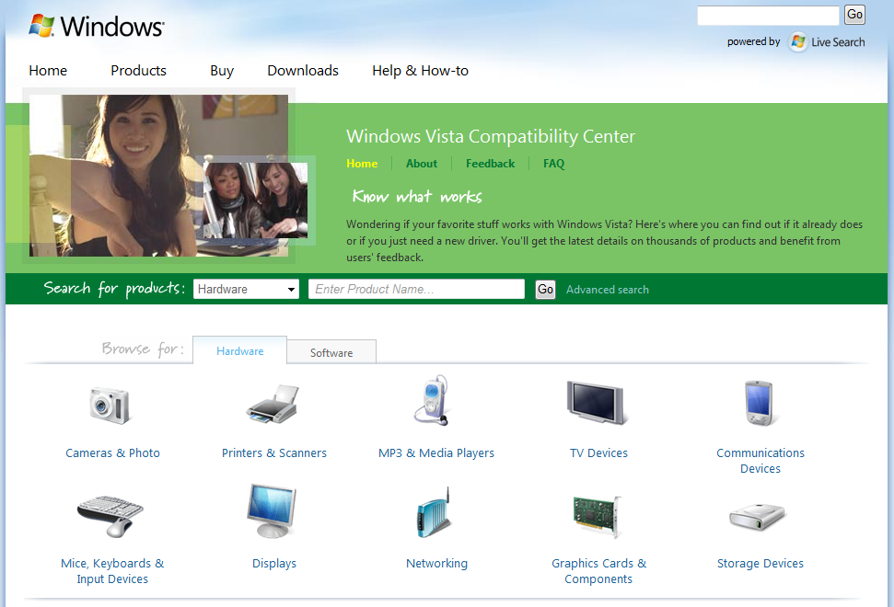
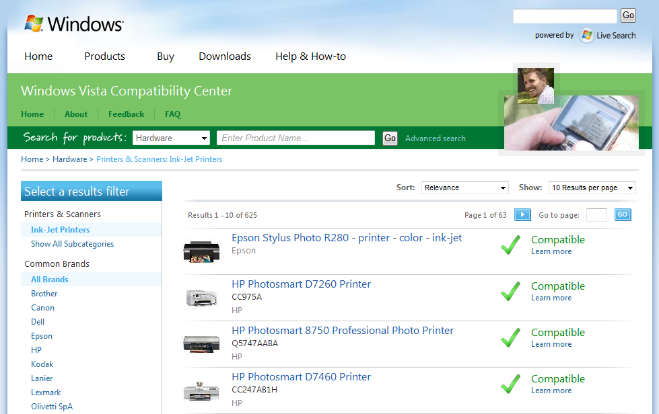
WVCC - Compatibility Center
http://www.microsoft.com/compatibility
Helps consumers, businesses and retail partners know what works with Windows Vista
Launched July 11, 2008
Lists over 12,800 products (7,100 devices and 5,600 software programs)
Awareness and usage high
1.1 million visits (15K/day or 100K/week)
1.0 million unique visitors
4.5 million page views
Users engaging with site extensively
10K pieces of feedback
Come learn more at the kiosk in the expo hall

Slide 19
What's next?
Now that we’ve identified the gaps, what’s the next step?
Identify Availability Gaps
Identify Partner
Identify Solution
Distribute Solution
Identify Quality Gaps

Slide 20
Identifying The Partner
Identifying the right partner(s) to enable a solution depends on several factors
Which partner developed the driver
Which partner developed the hardware
Which partner(s) own distributing the driver
IHV
CM
Software
Hardware
Build Product
Retail
Channels
IHV
SM
Hardware
CM
Chips and Interfaces Reference Designs
Driver Maintenance
Build Product
PC OEMs
ODM
Build and Sell
Products
SM = Semiconductor Manufacturer
ODM = Original Development Manufacturer
CM = Contract Manufacturer

Slide 21
Identify The Solution
What is the best possible driver?
Which driver? Which version? OEM specific?
Update to an Inbox Driver?
Is the driver PFD/SDV clean?
How will the end user access/install the solution?
Will the solution be available for both upgrade and clean install scenarios?
What about legacy devices?
Managing obsolesance with the end user in mind
Blocking drivers from migrating
Not supported messaging

Slide 22
Compatibility Scenarios
Scenario | Description
PC Purchase | New PC purchased from the store Working peripheral devices from previous PC continue to work
Device Purchase | Device purchased from the store and installed on a working PC
Software Upgrade | Upgrade for driver, firmware, or application is discovered and installed on a working PC
Service Update | Updating OS components (Service Pack) that devices depend on Drivers supports uninstall/reinstall
OS Upgrade | Upgrade for OS is installed on a working PC Working drivers for peripherals are migrated Working drivers for internal devices are migrated Non working drivers are blocked from migration
OS Clean Install | OS is installed on a PC Drivers for peripherals and internal devices are available

Slide 23
What About Legacy Devices?
A device becomes legacy when there is no financial incentive for the partner to continue to support the device
Device lifespan varies by category, platform/peripheral, and whether the device creates ongoing revenue
Options for solutions
Driver migration block (feeds to Upgrade Advisor)
DNF “not supported” response, pointing user to WVCC
WER response for OCA
BIOS block for non supported systems
Stage | Description
New | Small install base with increasing adoption
Mainstream | High adoption within device category
Maintenance | Decreasing new sales or supported in prior OS
Legacy | Device has not been sold for several years
End of Life | Relatively low install base

Slide 24
Distribute The Solution
Inbox
New OS release
Required inbox
Optional inbox
Windows Update
Important update
Driver targeting
Windows Server Update Services
Response
OCA response
DNF response
Windows Vista Compatibility Center

Slide 25
Why Pursue An Inbox Driver?
Required for basic functionality
Basic functionality supported inbox to install the system, get to network connectivity, and update the system
End user benefits
Best possible OOBE without requiring the user to search for a driver
Best possible compatible driver is used on upgrade
It just works, and it works well
IHVs benefits
PC OEMs request it from the IHVs (improved ROI, reduced test overhead)
Demonstrates to PC OEMs a long term commitment to quality
Decreased time to market for new devices supported by the inbox driver
Best OOBE with instant availability to known working driver
Microsoft invests in ensuring inbox drivers are high quality

Slide 26
Inbox Driver Process
Setup
Submission
Verification
Distribution
Pre-Qualify for Inbox
Contact Microsoft device team
Pass WLK Logo, PFD, SDV, and INF tests
Driver passes device team pre-qualification tests
Legal and Policy
NDA, IDDA, amendments
MSCA, Grant
ECA
Onboard
Partner
SSD/AutoSecure setup
Security group setup
Bug DB setup
Individuals
Cardkey, RAS
SSD enlist
Build access (Connect)
Extranet access
Security group add
Partner training
Partner Build
Submit to SSD
Source uses MS structure
Builds in MS Razzel environment
Partner Verify
Pass INF tests
Pass signability
Pass PFD tests
Pass SDV tests
Pass WLK Logo
Pass Inbox Driver tests with Driver Verifier
Submit to Microsoft
Driver
PDBs
Logs
Baseline PnP IDs
Stakeholder list
Microsoft Verifies
Verify INF, signability, PFD, SDV, and WLK logs
Build, test sign, and, and verify driver bits
Device team verifies Inbox Driver tests with Driver Verifier
External Stakeholders
Provided driver to stakeholders
Incorporate feedback
Report Feedback
Pass
Fail
Fail with bugs
Grant exceptions
Notify stakeholders
Windows Update
Codesign
Post to WU
Device team verifies driver downloads from WU and installs
Windows 7 Inbox
New Driver
FCIB War approval
Manifest changes
Timebuild
Device team verifies timebuild
Driver check-in
Monitor for build breaks
Device team verifies driver installs with new build
Device team verifies zero regressions on upgrade from prior OS

Slide 27
Windows Update
Step 1: Pass the logo tests
Step 2: Submit to WinQual for logo
http://winqual.microsoft.com/
Step 3: Use the DDC on WinQual to submit the driver for distribution
Step 4: If there are special driver distribution needs, contact DDCHELP
http://www.microsoft.com/whdc/maintain/drvupdate.mspx

Slide 28
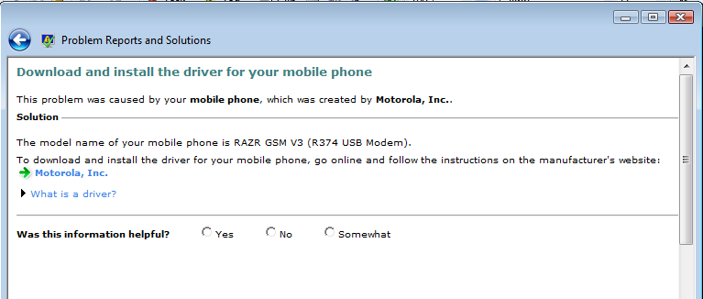
Response
For OCA crash responses, use WinQual
http://www.microsoft.com/whdc/maintain/wer/WERWorks.mspx
For drivers packages that can not be distributed on Windows Update, contact DDCHELP to request help creating a DNF Response
http://www.microsoft.com/whdc/maintain/drvupdate.mspx
DNF response to vendor homepage (not recommended)
DNF response to driver on vendor site (direct download)
DNF “not supported” response

Slide 29
Summary
Identify Gaps
Identify Partner
Identify Solution
Distribute Solution
Driver Availability
System view
DNF Response view
Market Share view
SM
Reference driver
Reference hardware
Inbox driver
Best Driver
Driver
Version
PFD/SDV clean
Target system
Target distribution
Inbox
Required inbox
Optional inbox
Driver Quality
OCA and crash ratio reports
WU install failures
DNF Response surveys
WVCC ratings
IHV/ISV
Driver modifications
Inbox driver
Driver distribution
Legacy
Migration block
Not supported response
WER
BIOS block
Windows Update
WinQual logo
WinQual DDC
ODM/CM
Hardware modifications
Response
OCA
DNF homepage
DNF direct download
DNF not supported
WVCC
OEM
Driver modifications
Inbox driver
Driver distribution

Slide 30
Call To Action
Use WinQual and DDCHELP to ensure your devices have driver support either on WU or a DNF response pointing to a solution
Use WinQual to monitor the quality metrics for your drivers and address issues with updated drivers on WU
Provide feedback on WVCC for your devices, and review feedback from others posted to WVCC
Test Windows Vista to Windows 7 upgrade scenarios for your drivers, and address regressions identified
Continue support for legacy devices with updated drivers on WU, or driver migration blocks and DNF “not supported” responses

Slide 31
Additional Resources
Driver Distribution Help
Web Resources
Driver Distribution: http://www.microsoft.com/whdc/maintain/drvupdate.mspx
Tools: http://msdn.microsoft.com/en-us/library/ms798418.aspx
Compatibility Center: http://www.microsoft.com/compatibility
Catalog: http://catalog.update.microsoft.com/v7/site/Home.aspx
Upgrade Advisor: http://www.microsoft.com/windows/windows-vista/get/upgrade-advisor.aspx
Related Sessions
COR-T526: Creating High-Quality Drivers for Windows
COR-T592: Using the Windows Feedback Loop to Deliver High-Quality Drivers
CON-T612: Creating Deployable Driver Packages for Windows
CON-T613: Common Driver Installation Errors and How to Diagnose Them
COR-C645: The Driver Quality Rating Tool
COR-C646: Distributing Drivers on Windows Update
COR-C661: (Discussion) Making Drivers Available on Windows
DDCHelp@microsoft.com

Slide 32
Please Complete A Session Evaluation Form Your input is important!
Visit the WinHEC CommNet and complete a Session Evaluation for this session and be entered to win one of 150 Maxtor® BlackArmor™ 160GB External Hard Drives 50 drives will be given away daily!
http://www.winhec2008.com
BlackArmor Hard Drives provided by:

Slide 33
© 2008 Microsoft Corporation. All rights reserved. Microsoft, Windows, Windows Vista and other product names are or may be registered trademarks and/or trademarks in the U.S. and/or other countries.
The information herein is for informational purposes only and represents the current view of Microsoft Corporation as of the date of this presentation. Because Microsoft must respond to changing market conditions, it should not be interpreted to be a commitment on the part of Microsoft, and Microsoft cannot guarantee the accuracy of any information provided after the date of this presentation. MICROSOFT MAKES NO WARRANTIES, EXPRESS, IMPLIED OR STATUTORY, AS TO THE INFORMATION IN THIS PRESENTATION.

