Slide 2
Using the Windows Feedback Loop to Deliver High-Quality Drivers
Gretchen Loihle
Principal Development Lead
Microsoft Corporation

Slide 3
Agenda
Introduction to Windows Error Reporting (WER) Online Crash Analysis (OCA)
WER OCA Process
Data collection
Using WER Data
WinQual website
Questions

Slide 4



Introduction
History
7

Slide 5




WER OCA Process
Crash occurs on the client
WER client collect crash data
Microsoft shares data with software developers
Software developers troubleshoot
Software developers respond to Microsoft and Customer
Opt-in rates for Windows XP is ~20%
Opt-in rates for Windows Vista is ~80%
Crash
5
1
Respond
Collect
4
2
Troubleshoot
Share
3

Slide 6
Collect Crash
Bucket
“Buckets” organize similar crashes
The bucket names come from the debugger and !analyze extension
  0x7E_NETIO+1638a ← bucket name without symbols
  0x7E_NETIO!NsipReadBootFirmwareTableData+77 ← with symbols
BugCheck Code (Stop Code) Reference - http://msdn2.microsoft.com/en-us/library/ms789516.aspx
Stop Code:
0x7E
DriverName:
NETIO.sys
Function Offset:
Becomes a unique identifier

Slide 7
Collect Crash
Data collected
Crashes on Windows XP, Windows 2003,
Windows Vista, Windows 2008, and Windows 7
WERfault.exe client does the collection after system reboot
Creates guid.cab file containing
  Minimmddyy-##.dmp
  sysdata.xml (Loaded drivers and devices with PnPID’s)
  Version.txt (SKU and Build info)
Example:
  \\ocadump1\OCAArchive9\2007-01-16\05\6abc1048-3f10-47ff-b482-963c4c8048aa.cab
    Mini011507-03.dmp 138,192
    sysdata.xml 261,410
    Version.txt 428

Slide 8
Collect Crash sysdata.XML
<DEVICE>
<DESCRIPTION>Texas Instruments OHCI Compliant IEEE 1394 Host</DESCRIPTION>
<HARDWAREID>PCI\VEN_104C&DEV_8032&SUBSYS_309B103C&REV_</HARDWAREID>
<SERVICE>ohci1394</SERVICE>
<DRIVER>ohci1394.sys</DRIVER>
</DEVICE>
<DEVICE>
<DESCRIPTION>ATI I/O Communications Processor PCI Bus Controller</DESCRIPTION>
<HARDWAREID>PCI\VEN_1002&DEV_4371&SUBSYS_00000000&REV_0</HARDWAREID>
<SERVICE>pci</SERVICE>
<DRIVER>pci.sys</DRIVER>
</DEVICE>
<DRIVER>
<FILENAME>usbscan.sys</FILENAME>
<FILESIZE>35328</FILESIZE>
<CREATIONDATE>11-02-2006 10:25:24</CREATIONDATE>
<VERSION>6.0.6000.16386</VERSION>
<MANUFACTURER>Microsoft Corporation</MANUFACTURER>
<PRODUCTNAME>Microsoft® Windows® Operating System</PRODUCTNAME>
<HASH>19319bb94215a845a53b35aa63dc5c56</HASH>
</DRIVER>

Slide 9
Collect Crash
Additional data
The WER client has several methods to collect
additional custom data it stores in a secondary cab
Secondary data can be
  Full dumps – Kernel or system
  Driver Verifier – Results of Driver Verifier dynamically enabled
  registry.txt – Any RegKey or tree
  xyzdrv.sys – File and or FileVersion info
  wql.txt – Results of any WQL WMI query
    Commonly used to collect Eventlog entries or setup/install logs
    (Event 1001 bugcheck history is nice!)

Slide 10
Automate Driver Verifier
When Vista crashes in a specific bucket, we can use the OCA protocol to request that the user “Help Microsoft improve the product.”
  The desired Driver Verifier settings are associated with the crash bucket on the OCA processing servers
  These driver verifier settings are dynamically delivered to customers’ machines and enabled for one boot cycle
Volatile prevents boot crash loops
We can enable for a particular driver or for all drivers if necessary
See “Driver Verifier” on MSDN for details:
http://msdn.microsoft.com/en-us/library/ms792872.aspx

Slide 11
OCA Database
Every dump file submitted is processed
For each dump submitted, the processing server populates hundreds of database fields
  All bugcheck parameters
  RAM size
  ALL loaded modules in the loaded module list of the crash dump
  Crashing Device PnP ID where applicable
  CPU speed, count, manufacturer, model, overclocking
  BIOS data from smbios.sys
  Stack module, function, and offset data
  Crashing process
  And so on…

Slide 12
Heuristics Examples
Crashes for specific areas/subareas (Networking/WLAN, or Streaming Media/TV Tuner)
Crashes for a given vendor (Intel, Realtek, Broadcom)
Crashes on specific driver versions, CPUs, or locales (etc.)
All crashes on a given device (PnP ID)
Driver Frequency—show drivers loaded in a bucket more often than typically present
Show all buckets that have a specific driver (or driver version) loaded, blamed or not

Slide 13
More Heuristics Examples
Crashes with a specific function on the stack
(stack sampling)
Show all PnP IDs (of crashing driver) for device buckets
OEMs for a bucket or buckets for an OEM
Buckets with specific bugcheck parameters
  Example: USB buckets with stopcode 0xFE and
  param4 = 0xfffffff0
Crash-to-Install ratio of a given driver (for example, driver quality rating info on the WinQual Web site)
Crash buckets that are suddenly spiking in hit count
Patch monitoring

Slide 14
How does Microsoft use the data?
Work with internal product groups
Monitor crashes during product development (Vista Beta and SP1,
Server 2008, Windows 7)
Contact third party vendors, deliver crash data
  Data delivered to top 40 companies every month
  Ad hoc vendor contact for high-hitting and spiking issues and vendor requests
  Meet filter driver ISVs twice-yearly at plugfest events

Slide 15
How does Microsoft use the data?
(cont'd)
Provide OEMs and vendors with both high-level and focused views of their crashes, for fix leverage and machine image improvement
  All crashes for a given vendor
  Crashes on specific releases or versions
Create OCA responses directing customers to fixes, upgrades, other messaging
Track crash trends through data mining and heuristics
Improve debugger !analyze
Participate in Developer and Platform Evangelism (DPE) efforts
And so on…

Slide 16
WinQual Site
Walk-through
http://winqual.microsoft.com

Slide 17
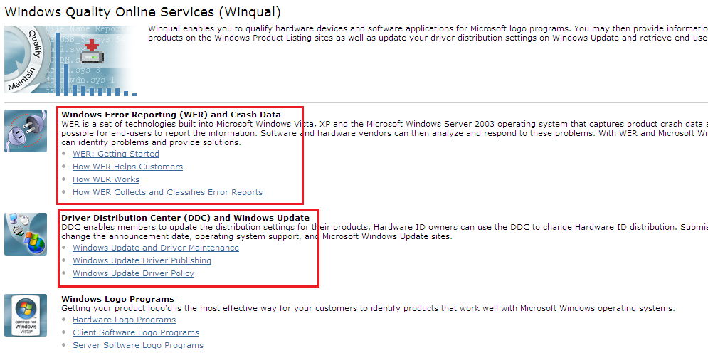
WinQual
Home Page

Slide 18
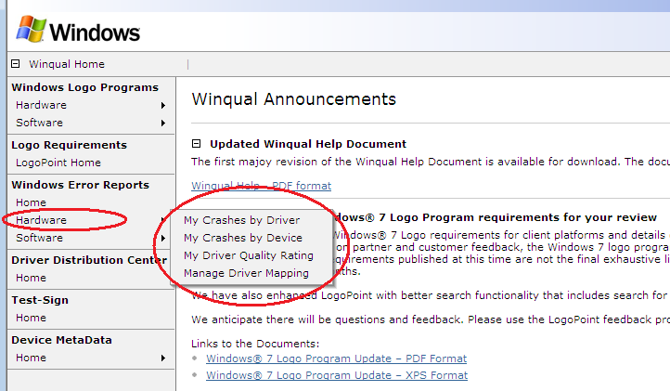
WinQual
Hardware Home

Slide 19
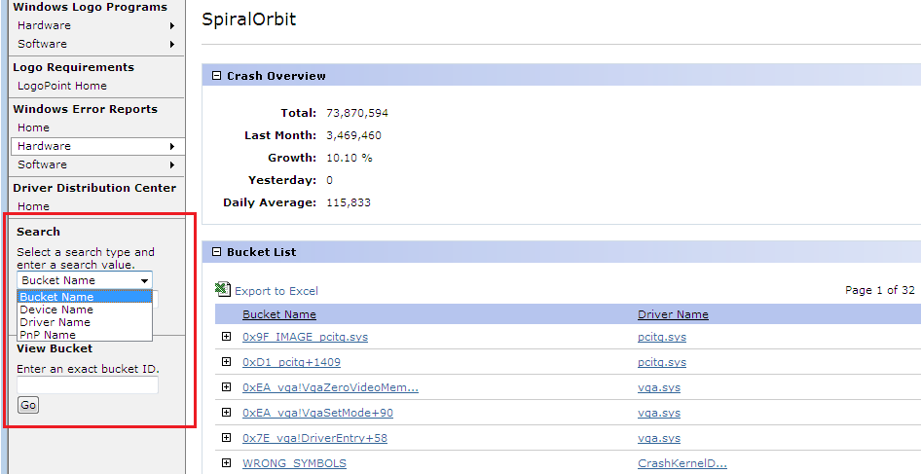
WinQual
Search

Slide 20
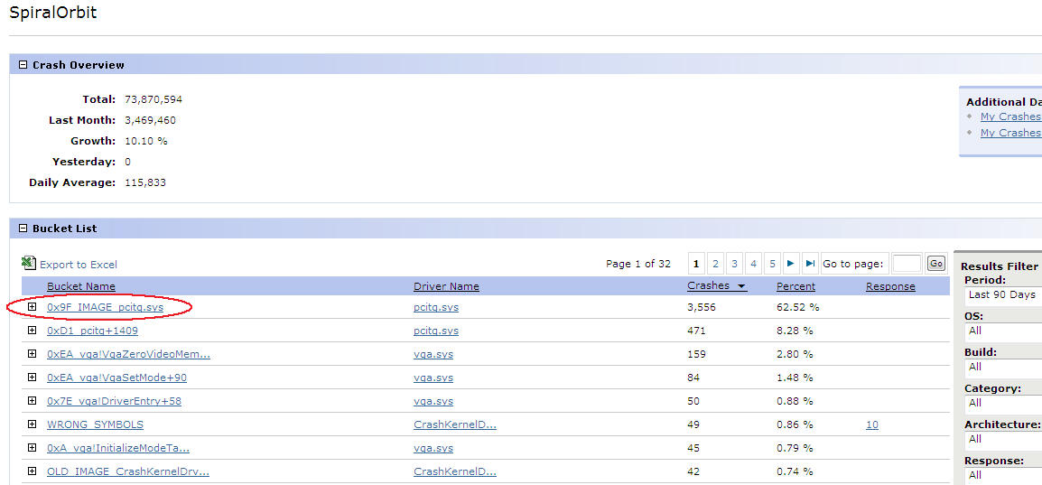
WinQual
Buckets
Driver crashes and versions
Cab downloads

Slide 21
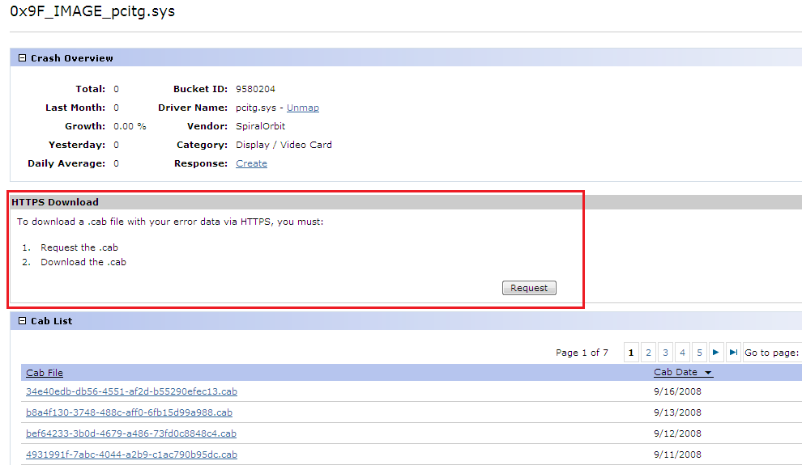
WinQual
Cab Downloads

Slide 22
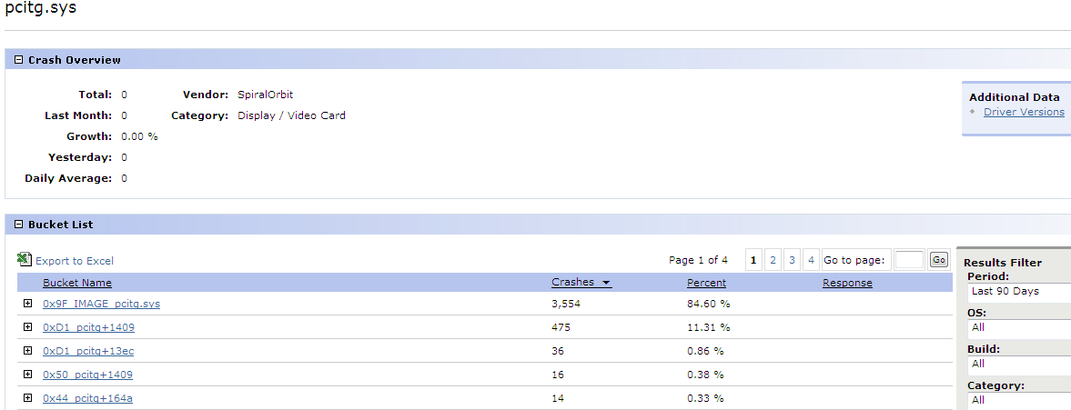
WinQual
Driver Versions

Slide 23
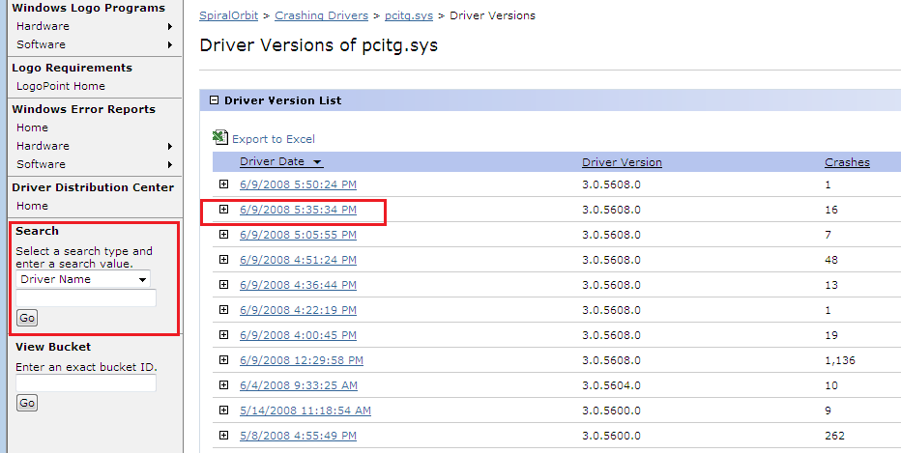
WinQual
Driver Versions

Slide 24
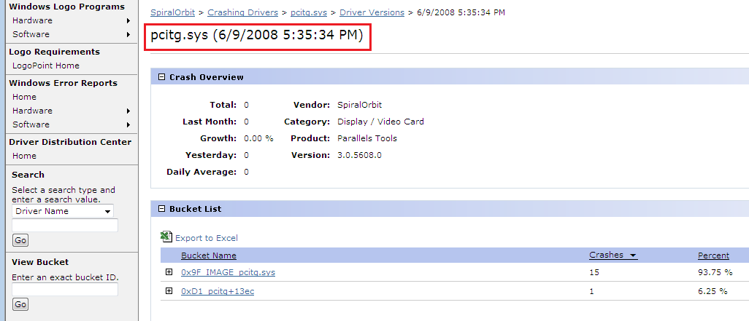
WinQual
Driver Versions

Slide 25
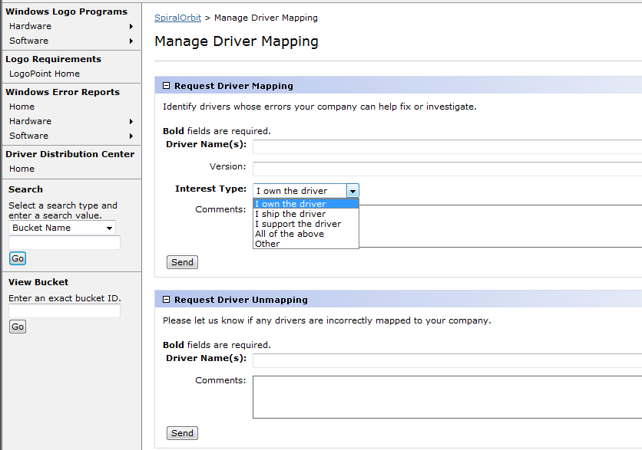
WinQual
Mapping Drivers

Slide 26
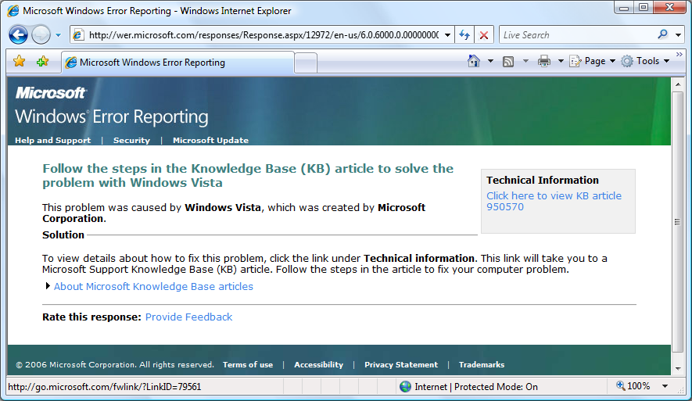
Responding to Customers

Slide 27
Call To Action
Sign up at http://winqual.microsoft.com
Map your drivers
Provide public symbols to Microsoft
Enable Driver Verifier during product development
Use OCA to research and leverage crash data
Use OCA-generated data to raise important issues with Microsoft or OEMs
Post fixed drivers to Windows Update
Help distribute information to customers about fixes or solutions, create or improve OCA responses

Slide 28
Additional Resources
Winqual site: http://winqual.microsoft.com
Driver Verifier: http://msdn.microsoft.com/en-us/library/ms792872.aspx
Bugcheck Stop Codes: http://msdn2.microsoft.com/en-us/library/ms789516.aspx
Windows Hardware Developer Central http://www.microsoft.com/whdc/default.mspx
Contact: pfat@microsoft.com

Slide 29
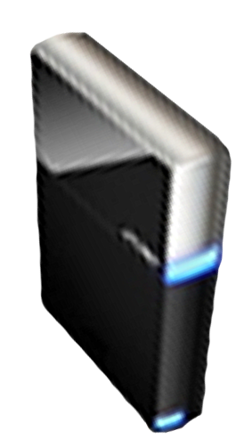


Please Complete A Session Evaluation Form
Your input is important!
Visit the WinHEC CommNet and complete a Session Evaluation for this session and be entered to win one
of 150 Maxtor® BlackArmor™ 160GB External Hard Drives
50 drives will be given away daily!
http://www.winhec2008.com
BlackArmor
Hard Drives provided by:

Slide 30


© 2008 Microsoft Corporation. All rights reserved. Microsoft, Windows, Windows Vista and other product names are or may be registered trademarks and/or trademarks in the U.S. and/or other countries.
The information herein is for informational purposes only and represents the current view of Microsoft Corporation as of the date of this presentation. Because Microsoft must respond to changing market conditions, it should not be interpreted to be a commitment on the part of Microsoft, and Microsoft cannot guarantee the accuracy of any information provided after the date of this presentation.
MICROSOFT MAKES NO WARRANTIES, EXPRESS, IMPLIED OR STATUTORY, AS TO THE INFORMATION IN THIS PRESENTATION.

