Slide 2
Storage Networking Platform Features in Windows 7/Server 2008 R2
Suzanne Morgan
Senior Program Manager
Microsoft Corporation

Slide 3
Agenda
Trends influencing feature set in Windows 7/Windows Server 2008 R2
Storport Enhancements
Storage Driver Compatibility
Performance for Fibre Channel and
iSCSI on Windows Server 2008
iSCSI Performance Enhancements
iSCSI Initiator in Hyper-V
MPIO enhancements
The “Real World” –
Windows 2008 SAN deployments

Slide 4
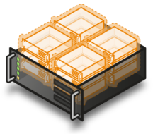
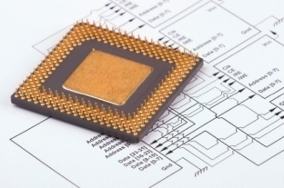
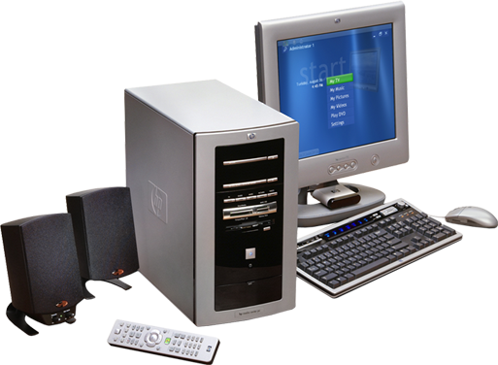
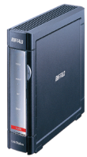
Trends Influencing Feature
Set for Platform Storage
Green IT
Increasing Hyper-V adoption
with SANs (FC and iSCSI)
10GB adoption
Multicore proliferation/scale out
Use of Server Core installation
with SAN attached storage
Prosumer iSCSI

Slide 5
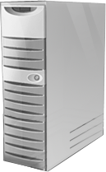

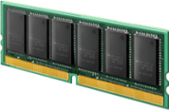




Storport Enhancements
New bus types to support virtual miniports and Hyper-V VHD
BusTypeVirtual – used for volatile drivers i.e., ramdisks
BusTypeFileBackedVirtual – for virtual devices
which persist its “contents” to a data file
Improving Scalability and Performance
>64 processor core support!
New Interfaces to dynamically allocate
and free contiguous memory blocks
Interfaces to optimize memory allocation
Enhanced event logging for Storport miniports
New interface enabling miniport to extend error log details
Greater log detail improves diagnosability and root cause analysis
* Note: Please see appendix for interface details

Slide 6
Storage Platform Driver Compatability for Windows Server 2008 R2
No interface changes required for Server 2008 miniports or MPIO DSMs to work on Windows Server 2008 R2
  Assumes that existing drivers are not hardcoded to # of processors
  MPIO and Storport new interfaces are optional to implement
Legacy SCSIport miniports are removed from Windows 7
  SCSIport (port driver) still inbox but will be removed in next Windows full release (release after Win7)
  SCSIport miniports can be F6’d in for boot support (add driver)
    Scripted through standard methods including unattend.xml
  SCSIport miniports can be F6’d in for boot support (add driver)
  For Logo, Storport miniports required for SAS, iSCSI, Fibre Channel.
  SCSIport miniports can be used to Logo with legacy SCSI or SATA devices

Slide 7
Storage Platform Driver Compatability for Windows Server 2008 R2
RSM (Removable Storage Manager) removed from Windows 7
Driver migration
  Storage settings are migrated on in place upgrade including registry settings under
  MPIO, miniport, iSCSI

Slide 8



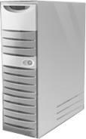





Fibre Channel Multipathing SAN Support
Clients
In Hyper-V Fibre Channel
LUNs Supported as
  Passthrough Raw Disk
    Connect from parent,
    map to VM
    VM formats with NTFS
  VHD
    Connect from Hyper-V host
    Format from host
    Create VHDs for each guest
Windows
Server Hosts
Fabric/Fibre Channel Network
Switches
VHDs
LUNs

Slide 9
Boosting iSCSI Performance
Filesystem
Provided by:
Volume Manager
Microsoft
Class/Disk
Firmware/
Driver
Hardware
Port Driver (Storport)
IHV
MSISCSI.SYS
OS
MSISCSI.SYS
iSCSI HBA miniport
OS
TCPIP.SYS
TCP Chimney
HW
HW
NDIS MINIPORT
HW
NDIS MINIPORT
LRO
LSO
LRO
LSO
iSCSI HBA
RSS
RSS

Slide 10



10GB iSCSI Performance
# of Connections/sessions | 1 | 2 | 3 | 4 | 5 | 6 | 7 | 8
Iometer raw MCS MB/s | 499 | 968 | 1043 | 1174 | 1170 | 1137 | 1174 | 1165
Iometer raw MCS CPU Util % | 17.8 | 41 | 46 | 55 | 52 | 53 | 54 | 54
Iometer raw MPIO MB/s | 499 | 790 | 955 | 1108 | 1090 | 1107 | 1171 | 1162
Iometer raw MCS CPU Util % | 22 | 36 | 40 | 50 | 51 | 56 | 60 | 55
Microsoft iSCSI Software Initiator
4 MCS connections/per session
Intel® 82598 10 Gigabit Ethernet Controller
NetApp FAS 3070 10 Gigabit iSCSI Target
RSS, NetDMA, LRO, LSO, Jumbo Frames
IBM x3550 with 1995 MHz dual CPUs and 4GB RAM
iSCSI 10GB Wire Speed = 1174 Mbytes/sec
Windows Server® 2008 physical Iometer raw tests throughput

Slide 11
iSCSI Direct Performance from Hyper-V Child
 | Average Throughput | Peak Throughput
Server 2008 Child MCS | 289 MB/sec | 310 MB/sec
Server 2008 ChildMPIO | 287 MB/sec | 309 MB/sec
Server 2003 Child MCS | 158 MB/sec | 160 MB/sec
Server 2003 Child MPIO | 161 MB/sec | 165 MB/sec
Summarizes peak and average throughput in a Windows Server® 2008
child partition and a Windows Server 2003 child partition.

Slide 12
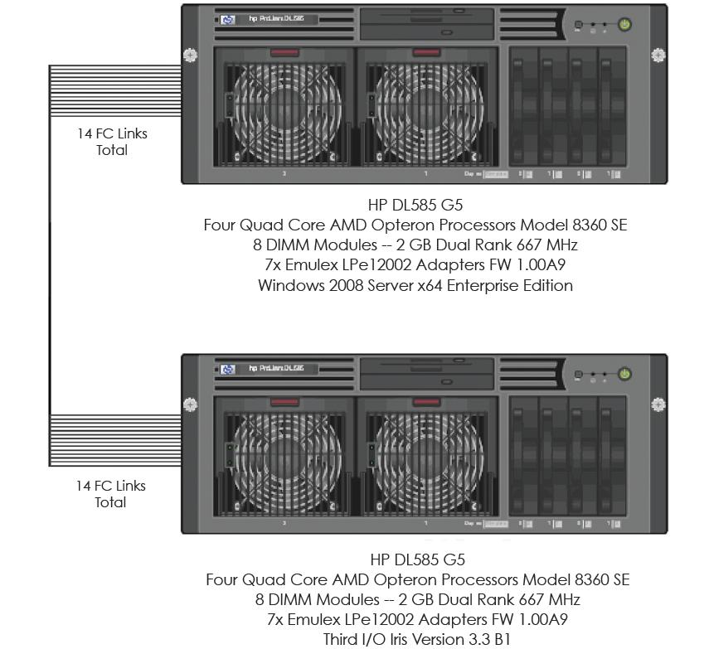
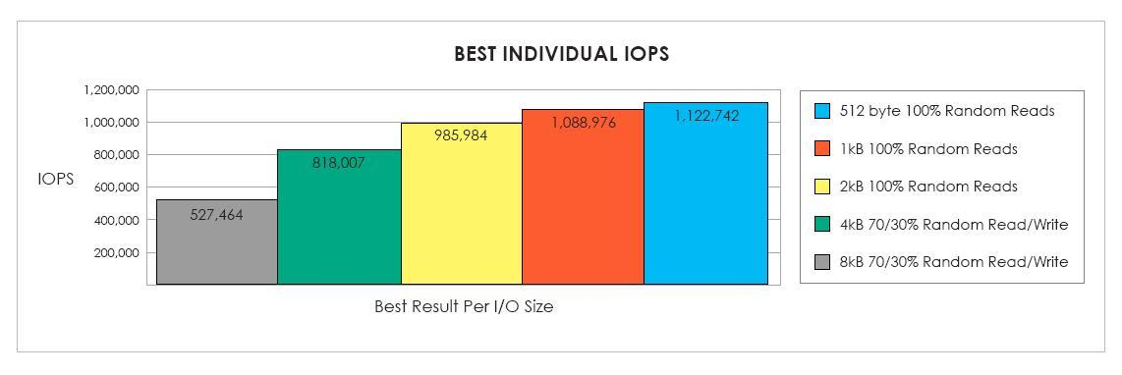
Emulex Fibre Channel HBAs
Surpasses 1 million I/O’s per second from a single server platform
*Third I/O benchmark tested I/O transaction performance potential
of a single server platform
  At a glance: 1,222,742 IOPS on 512 byte and 1,088,976 IOPS on 1KB 100% random reads
Key technology enabler – Message Signaled Interrupts eXtended (MSI-X)
  New industry standard replacing less efficient line-based interrupt technology
  Emulex 8Gb/s Fibre Channel HBAs optimized for MSI-X on Windows Server 2008
  for exceptional performance on non-uniform memory access (NUMA) systems
Configuration included
  Microsoft Windows Server 2008 x64 Enterprise Edition
  Emulex LightPulse ® LPe12002 8GB/s Fibre Channel HBAs
  HP DL585 G5 servers with AMD Opteron processors
  Third I/O Iris Storage Solution
* Benchmark by Third I/O Inc. July 16, 2008

Slide 13
Intel 10 GB Iometer iSCSI Read/Write Test
Windows Server 2008 – Tuned
Test
  Iometer 2004.07.30
  Test Duration=1 minute
  12 Targets
  Variable Buffer Size (512B – 64KB)
  Tuned Configuration – 110 Outstanding I/O Per Target
Servers
  Green City CRB (Tylersburg)
  2X 3.00GHz Quad-Core Intel Xeon processors (Nehalem)
  8GB 1066MHz RAM
  Windows Server 2008
Network Configuration
  Cisco Catalyst 6509 Connected to
  Clients Connected @ 1000 Mbs
Source: Intel labs: This is reference data only to illustrate the potential
performance using a combination of product and pre-released equipment – May, 2008

Slide 14
Alacritech 10GB 64K Read and Write
Windows Server 2008 Performance Numbers

Slide 15
Alacritech 10GB Efficiency Numbers
Windows Server 2008 Performance Numbers

Slide 16



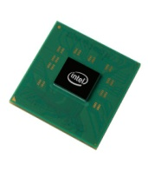
iSCSI Digest Offload
iSCSI Initiator CRC (Header and Data Digests)
offloaded using new CPU instruction set
Benefits
  Transparent Interoperability
  NIC independent
  20% reduction in CPU utilization
  Uses Industry standard CPU Intrinsic
  Auto detection/no configuration needed
  Important for routed networks
20%
Lower CPU
Supports Intel
Nehalem/I7 Processors
Disclaimer: Preliminary results indicate more than 20% improvement , however pre-Beta
and Beta builds may or may not represent expected performance for RTM

Slide 17
iSCSI Additional
Performance Improvements
MSISCSI uses Storport APIs (NUMA I/O)
for DPC redirection
  Completes processing of IO on the processor
  on which it initialized
Reduction of lock contention in core IO path
TCP Waitall
Support for Disabling Nagle
  Registry option for disabling Nagle for
  iSCSI traffic in a given system

Slide 18

Hyper-V Performance Improvements
For virtual network interface and iSCSI in Windows 7
Hyper-V Parent
Server 2008
Hyper-V Child
Server 2008 R2
RSS
TCP Chimney
TCP Chimney
LSO V1
LSO V1
LSO V2
LSO V2
Jumbo Frames
Jumbo Frames
Performance Benefits
For iSCSI
Direct Connections
MPIO & MCS
MPIO & MCS

Slide 19
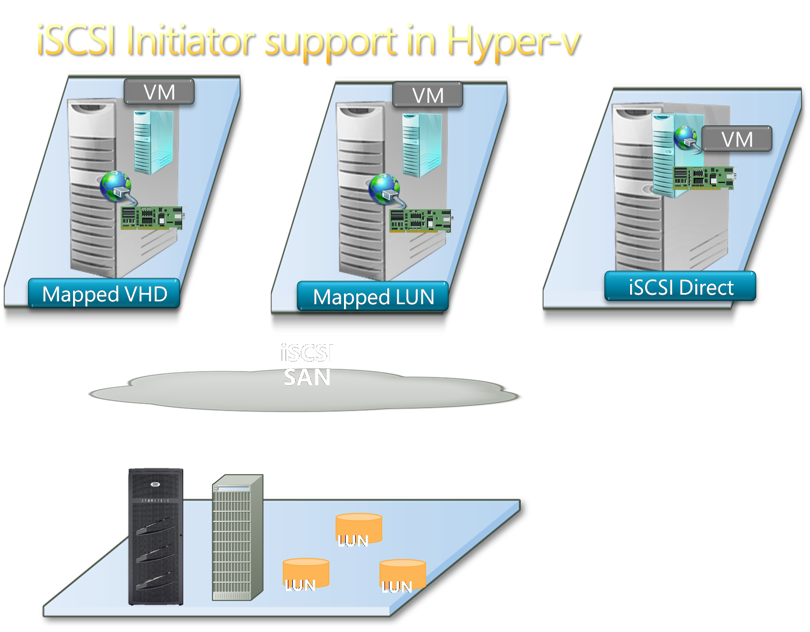
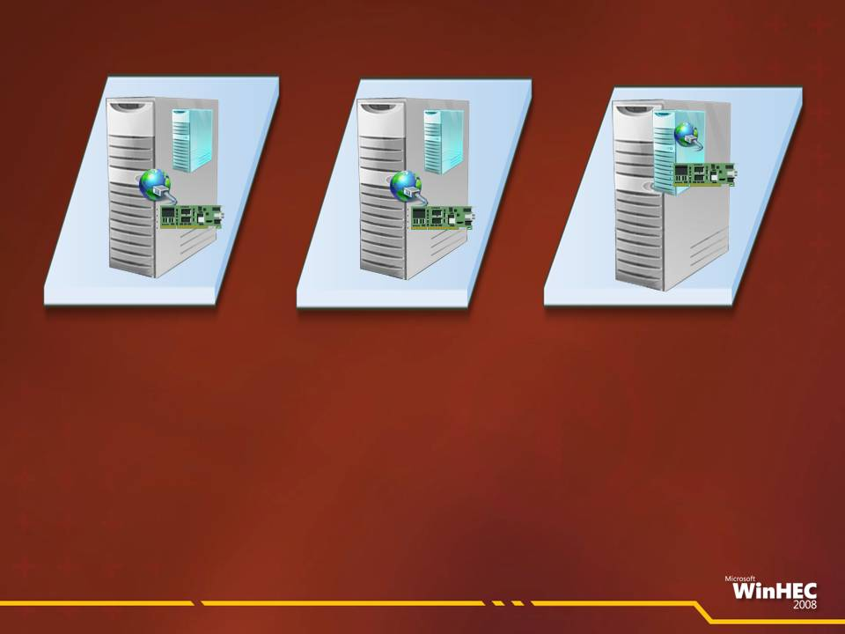
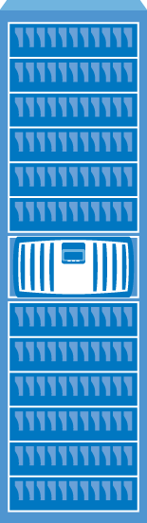
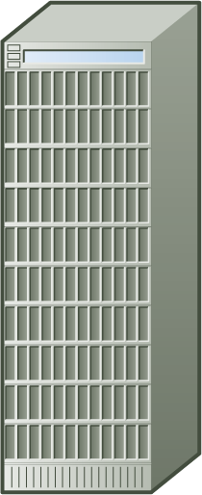


iSCSI Initiator Support with Hyper-V
VHD
Passthrough LUN
iSCSI Direct
Multipathing
Microsoft MPIO
MCS
Storage arrays

Slide 20
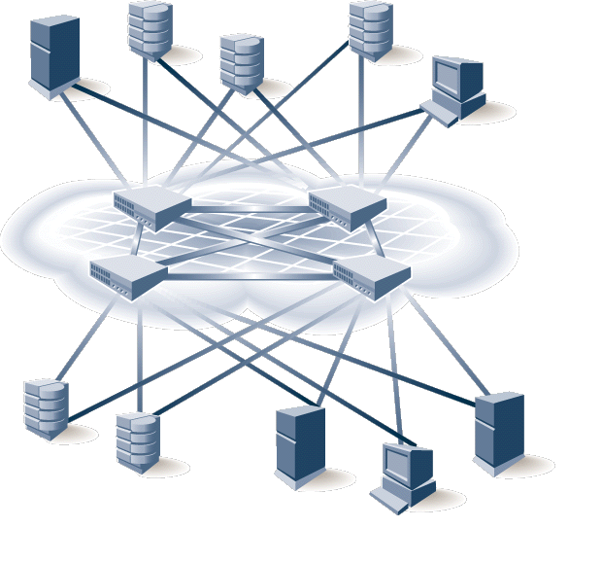
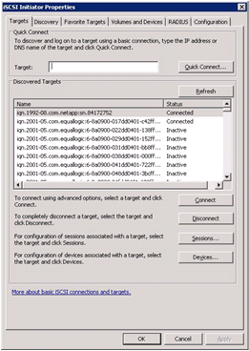
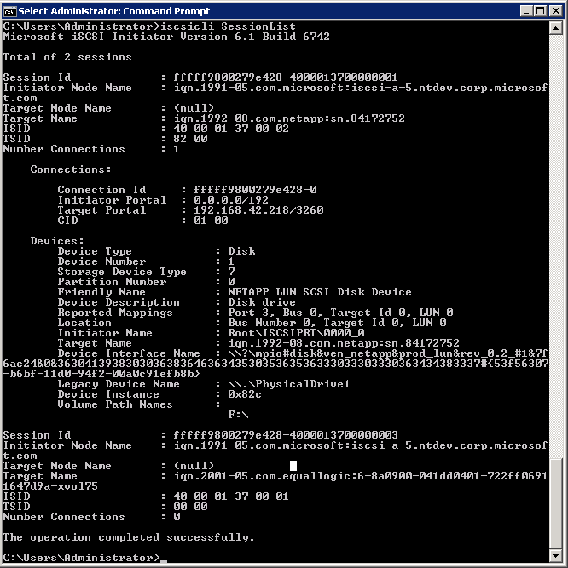
iSCSI Management Overview
WMI Interfaces to enable Enterprise SAN Management Applications
iSCSI CLI
iSCSI GUI

Slide 21
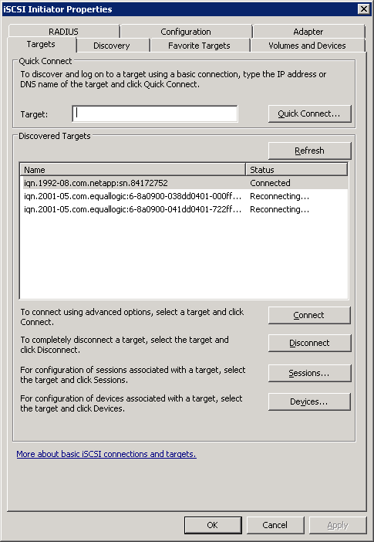
iSCSI Quick Connect
New in Windows 7/Windows Server 2008 R2

Slide 22
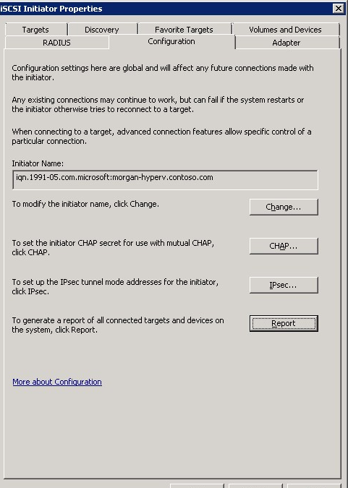
iSCSI UI Enhancements
Configuration tab
Configuration report
Context sensitive help
Alt shortcuts
for each function

Slide 23
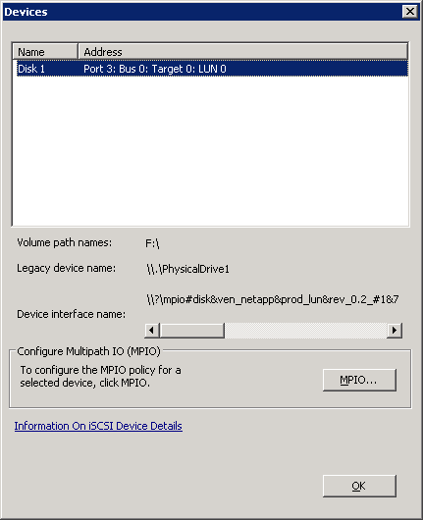
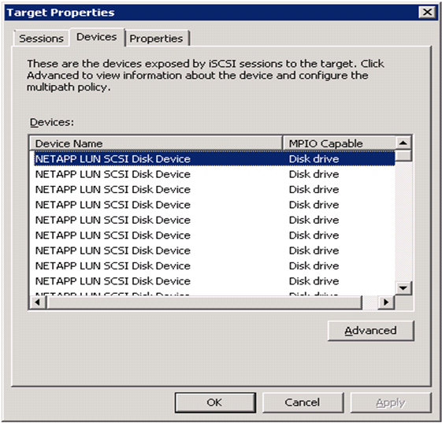
Device Mapping
New device list
Previous device list

Slide 24
iSCSI UI Extensibility
Vendor provided tab goes here
Enables iSCSI SAN array specific functionality

Slide 25
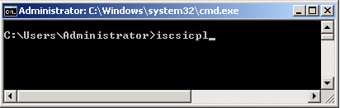
iSCSI CPL on Server Core
From Server Core command line type
iscsicpl

Slide 26
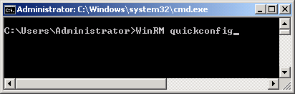
Managing iSCSI Remotely
Windows Remote Shell
  Server to be managed
    winrm quickconfig
  Remote management server
    winrs r:<server name> iscsicli –help
  Reference:
  http://msdn.microsoft.com/en-us/library/aa384426(VS.85).aspx
Psexec
  psexec.exe <Server name> iscsicli –help
  Reference:
  http://technet.microsoft.com/en-us/sysinternals/bb897553.aspx

Slide 27
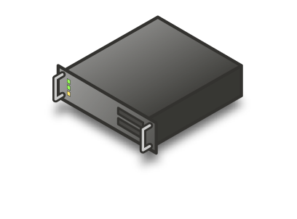


Support for >2 Paths at Boottime iSCSI Boot Enhancement
Windows Server 2008 R2
Boot Parameters transferred via Network
. . . .
Ethernet
Switch
DHCP Server
PXE Server
Pre-Boot
Windows
Boot Disks
iSCSI Software Initiator
Int13
iBF
Table
Boot Manager
UNDI
TCP/IP
Storage Array
NIC
NDIS
Microsoft iSCSI
NDIS Miniport
Microsoft Windows
NIC
Vendor

Slide 28
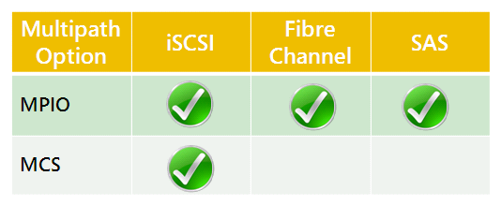

Building on Server 2008 Multipath Scalability
Load balancing and fail over between Server and Storage array
IO performance scales out with the number of NICs/HBAs
using iSCSI or HBAs using Fibre Channel or SAS
Multipathing provides redundancy and optimize performance
for SAN environments
MPCLAIM Command line utility extended in W
  Added option to set load balance policy
  Added configuration snapshot
  Also available in MPIO Configuration UI

Slide 29
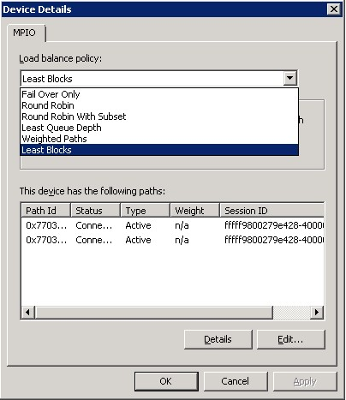
MPIO Performance Optimizations
Least Blocks Load Balance Policy
Core MPIO Stack and
DSM Improvements
  Reduce spinlocks
  Eliminate unnecessary use of processor-intensive operations
  Minimizing unnecessary memory write operations
15% Total Improvement in MPIO Performance
Disclaimer: Preliminary results indicate 15% improvement, however pre-Beta and Beta builds may or
may not represent expected performance for RTM. Results for sequential workloads.

Slide 30

MPIO Health Reporting
Gathers MPIO statistics for diagnosability
Surfaced through WMI
Enables path monitoring by Multipath/SAN Management Applications
Includes
  Number of reads/writes
  Characters read/written
  Retries
  Path failures
  IO errors
Statistics are persistent through removal and arrival of paths

Slide 31
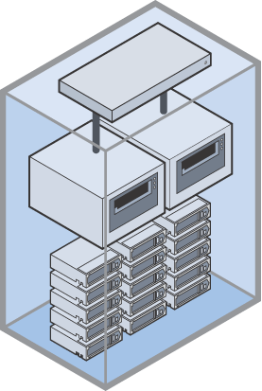
MPIO: Datacenter Automation
FC-SAN
iSCSI Storage Arrays
Fibre Channel Storage Arrays
Storage
Area
Network
Step 2: Connect Storage
Later
Pre-configuration of MPIO settings in absence of storage including
  MPIO DSM install
  Timer Settings
Enabled by DSM
  New interface for 3rd party
  MPIO DSMs
  Implemented in inbox DSM
Automate through scripting ex: unattend.xml
Step 1: Deploy and Configure Servers

Slide 32
Customer Case Studies
The Real World: Windows Server 2008 SAN deployments

Slide 33


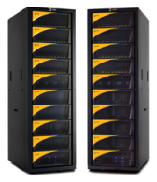

Hilton Grand Vacations
Fibre Channel SAN
Pain Points
  Low Storage Utilization
  Storage challenges scaling performance and capacity
Solution
  Windows Server 2008 iSCSI hosts
    Microsoft MPIO
  3PAR MPIO DSM
  SQL Server
  Exchange Server
  Fibre Channel SAN consolidation
Benefits
  Huge gains in business agility
  Cost reduction
  3x performance improvement using load balancing with MPIO
Departmental IT and
New Database Project
Exchange
Mail Servers
SQL Server
File Shares
Development
Database
Fibre Channel SAN
Fibre Channel Disk Arrays
“With 3PAR, we have achieved remarkable gains in business agility as well as a cost reduction for a broad range of applications.”
— Rich Jackson, VP of Operations

Slide 34


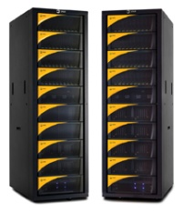
CareerBuilder Fibre Channel SAN
Applications and platforms used
  Windows Server 2008
    Microsoft MPIO
  Microsoft SQL Server
Pain Points
  Scaling performance
  Growing capacity on demand
Solution
  3PAR SAN Storage (Fibre Channel)
  10GB Ethernet with
  Windows Server 2008
Benefits
  High, predictable performance
  Simplicity and ease of use
  High performance TCP/IP stack in Windows Server 2008
Microsoft SQL Server
Windows Server 2008
Microsoft MPIO
SAN
Fibre Channel Disk Arrays
“With more than 1.6 million jobs and 23 million unique visitors to our site each month, performance
is critical to our business, but so is simplicity and ease of use.”
— Ali Shahzad, Storage Architect at CareerBuilder.com
Notes:
11/11/2008 10:05 PM
© 2003-2005 Microsoft Corporation. All rights reserved.
This presentation is for informational purposes only. Microsoft makes no warranties, express or implied, in this summary.
34

Slide 35


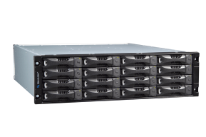

Construction Services:
Stanley Elevator iSCSI SAN
Applications
  Current: SQL Server, SharePoint Server, Essential Business Server BETA, WennSoft Project Managers Portal
  Planned: Exchange Server 2007, Microsoft Dynamics
Pain Points
  DAS storage difficult to scale and manage
  with growing need to keep more data online
  Insufficient backup window and
  restores from tape takes too long
  FC SAN too complex and costly
Solution
  Windows Server 2008 hosts
  Updated to Dell server infrastructure
  Consolidated storage onto a 12-TB Dell EqualLogic iSCSI SAN with Auto-Snapshot Manager/Microsoft Edition
Benefits
  Simplified server and storage management with
  boot from SAN and transparent SAN expansion
  Fast backup and restore using SAN-based snapshots
www.stanleyelevator.com
SharePoint Server on Windows Server 2008
Essential Business Servers on Windows Server 2008
SQL Server on
Windows Server 2008
Dell PowerConnect 5424
Gigabit Ethernet Switches
PS5000E
12 TB
7,200 RPM SATA

Slide 36





Avanade
Platform
  Windows® Server 2008 Hyper-V™
  Microsoft MPIO
  Microsoft iSCSI Software Initiator
  Failover Cluster
Applications Virtualized
  Team Foundation Server
  System Center Operations Manager 2007
  Windows® Server 2008 Terminal Services
Impetus for Change
  Flexibility for Disaster Recovery
  Time savings – needed ability to add servers
  quickly, rather than over weeks
  Space is expensive – needed scalable solution
  without using as much space
  Going green – computing power per watt
    Much more efficient use of physical resources
Benefits
  51% space savings with de-duplication
  250GB capacity saved without code update
  Auto-provisioning
  Highly available virtual machines
  Great performance with Hyper-V and NetApp
1 Gbit/s LAN
Production VMs
4-Node Hyper-V Cluster
iSCSI SAN
NetApp® Fabric-Attached Storage
(FAS) System
“Hyper-V allows us to provision new servers quickly and more efficiently utilize hardware resources. Using Hyper-V with our existing NetApp infrastructure provided a cost-effective and flexible solution without sacrificing performance.”
— Andy Schneider, infrastructure architect, Avanade

Slide 37



Lionbridge Technologies iSCSI Fibre Channel
Applications Used
  Microsoft SQL Server/ Microsoft Exchange Server
  Microsoft File Shares
Windows Server 2008 Components
  Microsoft iSCSI Software Initiator
  Failover Clustering
  Hyper-V
  Microsoft MPIO
  FalconStor MPIO DSM
Pain Points
  Single Protocol / Single SAN Vendor Lock-In
  Lack of Mirroring, Snapshot, Replication
  across any SAN regardless of protocol
Solution
  Microsoft Windows 2008 iSCSI hosts with Hyper-V with Failover Clustering and Microsoft MPIO
  SAN Gateway with Snapshot, Mirroring and
  Sub-block Replication
Benefits
  Ability to deploy Multi-Site Clustering
  Multiple SAN Vendors
Global IT – Windows Server 2008 Hyper-V ISCSI SAN
File Shares
MS Exchange 2007
on Windows Server
SQL Server Windows Server 2008 Failover Cluster
300+
Hyper-V Virtual Machines
iSCSI
iSCSI
“Hyper-V has allowed us to consolidate 300+ servers to virtual machines. This configuration when combined with Microsoft’s iSCSI, Fibre Channel and multipathing support provides great flexibility in storage options. We chose FalconStor’s SAN Gateway which enables advanced storage features to be used with any SAN storage and our iSCSI based virtual machines”
— Frank Smith, Sr. Systems Engineer
SAN Gateway
Fibre Channel SAN

Slide 38



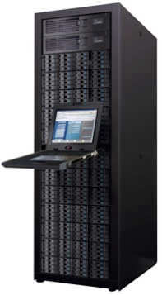

Indiana University: Fibre Channel SAN
Auxiliary Information Technology
Applications
  Internet Information Server 6.0/7.0 (IIS)
  SQL Server 2005/2008
  File and Print Services
  Team Foundation Server
Pain Points
  Cost of managing DAS storage
  Time to provision new servers
  Insufficient restore times with
  bare metal recovery
  Server Utilization and Legacy Hardware
Solution
  90% virtualized DC with Hyper-V
  Microsoft MPIO
  Microsoft Failover Clustering
  Consolidated on Compellent Storage Center
Benefits
  Fully virtualized Server and Storage
  Ease and speed of deployment
  Energy savings with server and storage
  Shared Storage and reduced footprint
Hyper-V Hosts
Windows 2008 File Servers
SQL Server on
Windows Server 2008
Fibre Channel Switch
With 4GB Dual Path HBAs

Slide 39




Jackson Energy Authority iSCSI SAN
Applications Used
  Exchange, SharePoint, Dynamics
  Windows Server 2003 / 2008 / Hyper-V
  Terminal Services
Windows Server 2008 components
  Microsoft iSCSI Software Initiator
  Microsoft MPIO
Pain Points
  High growth and change
  No disaster protection
  Poor storage utilization
  Complex storage management
Solution
  Windows Server 2008 iSCSI hosts
  30TB iSCSI SAN with MPIO load balancing
  Lefthand MPIO DSM
  Two storage pools: SAS and SATA
  Multi-site SAN between two sites
Benefits
  High availability across sites
  Reduced storage management costs
  Increased flexibility in dealing
  with change and growth
Highly Available Terminal Server Infrastructure
SharePoint Server Farm
Terminal Server – SITE A
Terminal Server – SITE B
Exchange
Mail Servers
iSCSI SAN
Switched Gb-Ethernet
Dynamics
Multi-Site iSCSI SAN
“When combining Hyper-V, and native Server 2008 technologies such as Microsoft MPIO and the Microsoft iSCSI software initiator, our administration was greatly simplified.”
— Michael Johnston, VP of Information Technology
SITE A
SITE B

Slide 40



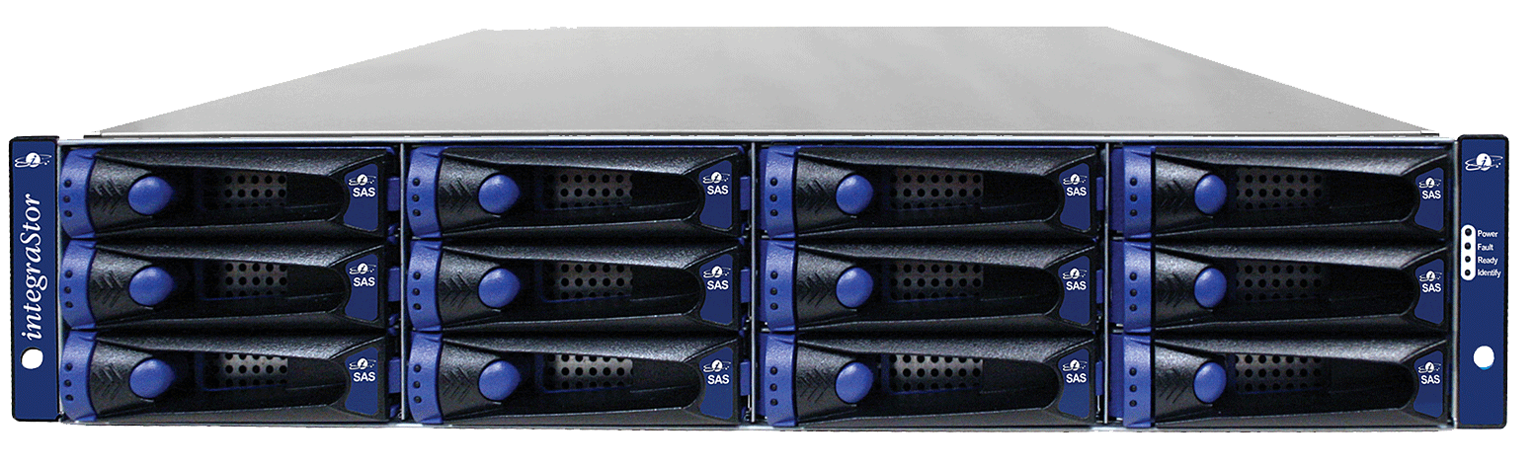

Virtualization Performance iSCSI SAN
www.virtualizationperformance.com
Pain Points
  Capital Expenditures
  Rising Datacenter Costs
  Power, Cooling, and floor space
  Backup and Disaster Recovery
  Disk Utilization
Solution
  iSCSI SAN consolidation
  Microsoft iSCSI Software Initiator
  Microsoft MPIO
  Windows Server 2008 Hyper-V
Benefits
  Reduced Capital Expenditures
  Controlled Datacenter costs
  Increased Storage capacity to 15TB
  Can failover to DR site quickly
Sales SQL
Database VM
File Server VM
Exchange
Mail Server VM
Windows Server 2008
+ Hyper-V
iSCSI SAN
Switched Gb-Ethernet
iStor iSCSI Disk Arrays
“An iSCSI SAN allowed us to control costs and deliver better services to our clients.”
— Stephen Ames, Virtualization Performance

Slide 41




Munder
Fibre Channel SAN, iSCSI Boot From SAN
Applications:
  Exchange Server (FC)
  Sybase AsaServer (iSCSI)
  PostgreSQL (iSCSI)
  Web Services (iSCSI)
Pain Points:
  Cost of managing DAS storage
  Insufficient backup window and
  restores from tape takes too long
Solution:
  Windows Server 2008 hosts
  Microsoft MPIO
  Microsoft iSCSI Software Initiator
  Fibre Channel SAN
  Compellent Fibre Channel iSCSI SAN storage
  Microsoft Cluster Server
  Consolidated storage Compellent Storage
Benefits:
  Remote Boot
  Ease of deployment
Exchange Server on Windows Server 2008 Hyper-V
Windows Server 2008
Windows 2008 File Servers
Ethernet Switches
“The native remote -boot capabilities in Server 2008, combined with Double-Take Software's winBoot/I enables seamless moves between physical hardware and Windows Server 2008 Hyper-V virtual machines”
— Wolfgang Goerlich, Munder Network Operations and Security Manager

Slide 42
iSCSI Quick Connect
demo

Slide 43
Related Sessions
ENT-T587: Microsoft Hyper-V
ENT-T588: Windows Virtualization And Cluster Shared Volumes
ENT-T590: Directions In Virtualized I/O
COR-T521: New Developments in the Storage Platform
ENT-T554: Windows Support For Greater Than 64 Logical Processors
COR-T559: System Integrated Flash Storage

Slide 44
Call to Action
Windows 7/Server 2008 R2 Beta Participants
  Try out the new iSCSI Initiator UI and give us feedback
  Test SAN Management applications and utilities with Windows 7/Server 2008 R2
Storage mini-port developers
  Update miniports to take advantage of MSI-X and Numa IO
  enabled in Storport in Windows Server 2008
  Update miniports to take advantage of new error log
  extensions in Windows 7/Server 2008 R2
  Test your utilities include RAID configuration
  Evaluate new Storport interfaces in Windows 7/Server 2008 R2 to improve
  performance of your drivers in >64 core environments
MPIO developers
  Implement new DSM interface for MPIO datacenter automation

Slide 45
Additional Resources
Microsoft MPIO: http://www.microsoft.com/mpio
  mpiopm@microsoft.com
  MPIO DDK
  MPIO DSM sample, interfaces and libraries
  will be included in Windows 7 DDK/SDK
Microsoft iSCSI: http://www.microsoft.com/iSCSI
  SCSI@microsoft.com
  iSCSI WMI Interfaces: http://msdn.microsoft.com/en-us/library/ms807120.aspx
Storport Website: http://www.microsoft.com/Storport
  Storport Documentation
    Windows Driver Kit
    MSDN: http://msdn.microsoft.com/en-us/library/bb870491.aspx
Microsoft Virtualization: http://www.microsoft.com/virtualization/default.mspx

Slide 46
Additional Resources
Case Study partners and Performance Data References
Intel: http://www.intel.com
Emulex: http://www.emulex.com
Alacritech: http://www.alacritech.com
NetApp: http://www.netapp.com
3Par: http://3par.com
iStor: http://istor.com
Lefthand Networks http://www.lefthandnetworks.com
Doubletake: http://www.doubletake.com
Compellent: http://www.compellent.com
Dell/Equallogic: http://www.dell.com
Falconstor: http://www.falconstor.com

Slide 47
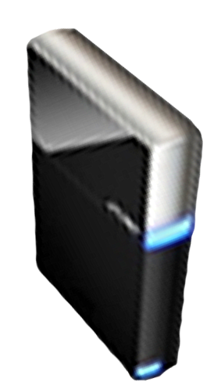


Please Complete A Session Evaluation Form
Your input is important!
Visit the WinHEC CommNet and complete a Session Evaluation for this session and be entered to win one
of 150 Maxtor® BlackArmor™ 160GB External Hard Drives
50 drives will be given away daily!
http://www.winhec2008.com
BlackArmor
Hard Drives provided by:

Slide 48


© 2008 Microsoft Corporation. All rights reserved. Microsoft, Windows, Windows Vista and other product names are or may be registered trademarks and/or trademarks in the U.S. and/or other countries.
The information herein is for informational purposes only and represents the current view of Microsoft Corporation as of the date of this presentation. Because Microsoft must respond to changing market conditions, it should not be interpreted to be a commitment on the part of Microsoft, and Microsoft cannot guarantee the accuracy of any information provided after the date of this presentation.
MICROSOFT MAKES NO WARRANTIES, EXPRESS, IMPLIED OR STATUTORY, AS TO THE INFORMATION IN THIS PRESENTATION.

Slide 49
Appendix
Additional Performance Data
MPIO Health Reporting examples
Storport New Interfaces
MPIO New Interfaces

Slide 50
Intel 10 GB Iometer iSCSI Read/Write Test
Windows Server 2008 – Tuned for Throughput
Test
  Iometer 2004.07.30
  Test Duration=1 minute
  12 Targets
  Variable Buffer Size (512B – 64KB)
  Tuned Configuration – 110 Outstanding I/O Per Target
  8 HW Queues enabled on NIC
Servers
  Green City CRB (Tylersburg)
  2X 3.00GHz Quad-Core Intel Xeon processors (Nehalem)
  8GB 1066MHz RAM
  Windows Server 2008
  Processor
Network Configuration
  Cisco Catalyst 6509 Connected to
  Clients Connected @ 1000 Mbs
Source: Intel labs: This is reference data only to illustrate the potential
performance using a combination of product and pre-released equipment – May, 2008

Slide 51
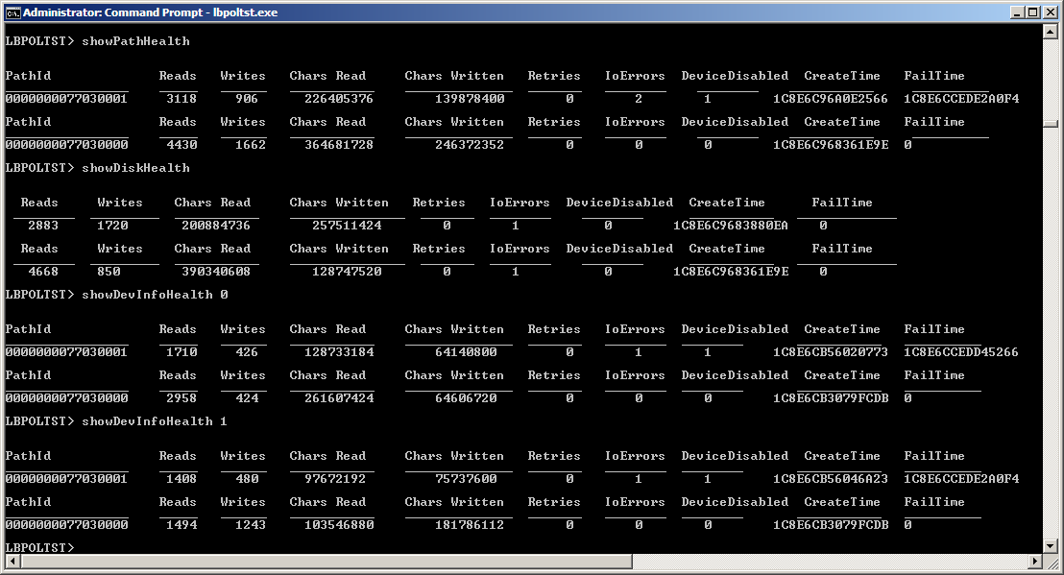
MPIO Health Reporting – Example 1
Path Health, Disk (pseudo-LUN) Health and DeviceInstance Health Statistics.

Slide 52
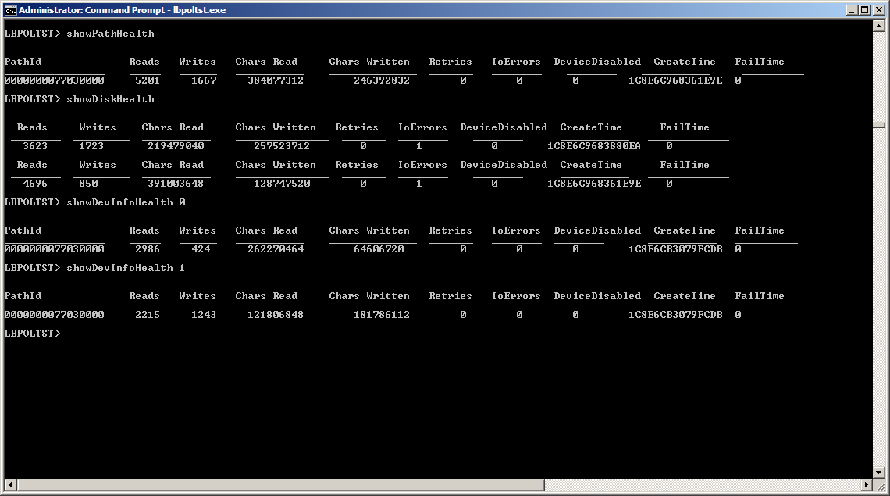
MPIO Health Reporting – Example 2
Health Statistics output after the user-specified “Health Flush” period has expired and the “orphan” Health packets (associated with failed path 000000077030001 have been discarded.

Slide 53
MPIO Health Monitoring WMI Class For LUN
// Embedded Disk Health Class
[WMI, guid("{6453c476-0499-42ab-9825-5133282b0b56}")]
class MPIO_DISK_HEALTH_CLASS
{
[WmiDataId(1), read, Description("Number of read requests sent to this device.") : amended] uint64 NumberReads;
[WmiDataId(2), read, Description("Number of write requests sent to this device.") : amended] uint64 NumberWrites;
[WmiDataId(3), read, Description("Cumulative number of bytes read by requests sent to this device.") : amended] uint64 NumberCharsRead;
[WmiDataId(4), read, Description("Cumulative number of bytes written by requests sent to this device.") : amended] uint64 NumberCharsWritten;
[WmiDataId(5), read, Description("Number of requests sent to this device that were retried.") : amended] uint64 NumberRetries;
[WmiDataId(6), read, Description("Number of requests sent to this device that failed.") : amended] uint64 NumberIoErrors;
[WmiDataId(7), read, Description("System time at which this health packet was created for this device.") : amended] uint64 CreateTime;
[WmiDataId(8), read, Description("Number of path failures experienced by this device.") : amended] uint64 PathFailures;
[WmiDataId(9), read, Description("System time at which this device went offline/failed.") : amended] uint64 FailTime;
[WmiDataId(10), read, Description("Flag that indicates if the device is offline/failed.") : amended] boolean DeviceDisabled;
[WmiDataId(11), read, Description("Count of the number of times that the NumberReads field wrapped.") : amended] uint8 NumberReadsWrap;

Slide 54
MPIO Health Monitoring WMI Class For LUN – Contd.
[WmiDataId(12), read, Description("Count of the number of times that the NumberWrites field wrapped.") : amended] uint8 NumberWritesWrap;
[WmiDataId(13), read, Description("Count of the number of times that the NumberCharsRead field wrapped.") : amended] uint8 NumberCharsReadWrap;
[WmiDataId(14), read, Description("Count of the number of times that the NumberCharsWritten field wrapped.") : amended] uint8 NumberCharsWrittenWrap;
[WmiDataId(15), read] uint8 Pad1[3];
};
// Provider Health Information Class
[WMI, Dynamic, Provider("WmiProv"), Description("MPIO Psuedo-LUN Health Information.") : amended,
Locale("MS\\0x409"), guid("{ef04568a-782b-443c-a3db-966ab43775f9}")]
class MPIO_DISK_HEALTH_INFO
{
[key, read] string InstanceName;
[read] boolean Active;
[WmiDataId(1), read, Description("Number of Psuedo-LUN Health Packets.") : amended] uint32 NumberPlPackets;
[WmiDataId(2), read, Description("Reserved for future use.") : amended] uint32 Reserved;
[WmiDataId(3), read, Description("MPIO Pseudo-LUN Health Info Array.") : amended,
WmiSizeIs("NumberPlPackets“)] MPIO_DISK_HEALTH_CLASS PlHealthPackets[];
};

Slide 55
MPIO Health Monitoring WMI Classes – Path & Device Instance
Path Health Information
  Embedded class: MPIO_PATH_HEALTH_CLASS
  Provider class: MPIO_PATH_HEALTH_INFO
Device Instance Health Information
  Embedded class: MPIO_DEVINSTANCE_HEALTH_CLASS
  Provider class: MPIO_DEVINSTANCE_HEALTH_INFO
Health Packet cleanup
  Registry value: FlushHealthInterval
    Default: 24 hours
Turning OFF health monitoring
  Registry value: GatherHealthStats
    Default: TRUE (i.e. ON)

Slide 56
Summary of Storport New Interfaces
New Multiprocessor Interfaces
StorPortGetCurrentProcessorNumber
StorPortGetGroupAffinity
StorPortGetActiveGroupCount
New NUMA Interfaces
StorPortGetNodeAffinity
StorPortGetActiveNodeCount
StorPortGetHighestNodeNumber
StorPortGetLogicalProcessorRelationship
Related Interfaces for Memory Allocation
  StorPortAllocateContiguousMemorySpecifyCacheNode
  StorPortFreeContiguousMemorySpecifyCache

Slide 57
New Storport Multiprocessor Interfaces
Use these functions if your miniport can optimize its performance based on knowledge of the underlying processor topology.
ULONG StorPortGetCurrentProcessorNumber( PVOID HardwareExtension,
PPROCESSOR_NUMBER ProcNumber )
Description
Returns the system-assigned number of the current processor on which the caller is running.
ULONG StorPortGetGroupAffinity( PVOID HardwareExtension,
USHORT GroupNumber,
PKAFFINITY GroupAffinityMask )
Description
Constructs a mask of the active processors in the requested group.
ULONG StorPortGetActiveGroupCount( PVOID HardwareExtension,
PUSHORT NumberOfGroups )
Description
Returns the number of groups present in the system.
Continued…

Slide 58
New Storport Multiprocessor Interfaces
…continued
ULONG StorPortGetLogicalProcessorRelationship( PVOID HardwareExtension,
PPROCESSOR_NUMBER ProcessorNumber,
LOGICAL_PROCESSOR_RELATIONSHIP_TYPE RelType,
PSYSTEM_LOGICAL_PROCESSOR_INFORMATION_EX Info,
PULONG Length )
Description
Returns a specified type of relationship information about groups, physical processors, and nodes in the host system.

Slide 59
New Storport NUMA Interfaces
Use these functions if your miniport can optimize its performance based on knowledge of the underlying NUMA/memory topology.
ULONG StorPortGetNodeAffinity( PVOID HardwareExtension,
ULONG NodeNumber,
PGROUP_AFFINTY NodeAffinityMask )
Description
Constructs a mask of the active processors in the requested NUMA node.
ULONG StorPortGetActiveNodeCount( PVOID HardwareExtension,
PULONG NumberOfNodes )
Description
Returns the number of nodes present in the system.
ULONG StorPortGetHighestNodeNumber( PVOID HardwareExtension,
PULONG HighestNode )
Description
Returns the largest possible node number on the system.

Slide 60
New Storport Memory Interfaces
Use these function to dynamically allocate and free contiguous memory blocks. A preferred NUMA node can be specified.
ULONG StorPortAllocateContiguousMemorySpecifyCacheNode(
PVOID HardwareExtension,
SIZE_T NumberOfBytes,
PHYSICAL_ADDRESS LowestAcceptableAddress,
PHYSICAL_ADDRESS HighestAcceptableAddress,
PHYSICAL_ADDRESS BoundaryAddressMultiple,
MEMORY_CACHING_TYPE CacheType,
NODE_REQUIREMENT PreferredNode,
PVOID * BufferPointer )
Description
Allocates a range of physically contiguous, cache-aligned memory.
ULONG StorPortFreeContiguousMemorySpecifyCache( PVOID HardwareExtension,
PVOID BaseAddress,
SIZE_T NumberOfBytes,
MEMORY_CACHING_TYPE CacheType )
Description
Frees a buffer allocated by StorPortAllocateContiguousMemorySpecifyCacheNode.

