Slide 1
The Windows 7 Windows Driver Kit
Jennifer Stepler
Program Manager, WDK
Microsoft Corporation
Keith Boyd
WDK Documentation Manager
Microsoft Corporation
Craig Ziegler
Test Lead, WDK
Microsoft Corporation

Slide 2
The Windows 7 Windows Driver Kit Updates
Jennifer Stepler
Program Manager, WDK
Microsoft Corporation

Slide 3
Agenda
Installation
Introducing Kit Servicing
Build Environment
Tools and Samples
Quality Improvements
Documentation
Q&A

Slide 4
WDK Installation Using Kitsetup
Supports servicing
Single UI for all kit components
Single EULA for all kit components
Documentation installation is part of complete kit installation

Slide 5
KitSetup

Slide 6
Introducing WDK Servicing
For Windows 7
Individual “Hot Fixes” available on Microsoft Connect, as needed
Scheduled Service Pack releases – feedback?
Beyond Windows 7 (feedback?)
Combine Windows Software Development Kit with WDK
Kit “in the clouds” – download/install/servicing

Slide 7
New Device Technologies
Biometrics
XPS Print
Hypervisor
Sensor/PC3
Windows Vista Display Driver Model (WDDM) updates
Wave Real-Time (WaveRT)
Wireless Wide Area Network (WWAN) updates
Windows Driver Foundation (WDF) 1.9
And more…

Slide 8
Build Environment Changes
No Windows 2000 build environment
New build macros
Use Binplace to target obj/bin directories
Microsoft Automatic Code Review (OACR)
Runs by default in the WDK BE
Runs PREfast for Drivers (PFD) in the background automatically
Provides a Taskbar monitor

Slide 9
Build Environment Macros
ISSUE: During build, objects and binaries go under source.
Binplace used with TARGET_DESTINATION and PASS2_BINPLACE macros in the sources file allows objects and binaries to be redirected.
Benefits
All objects and binaries that are built are stored separately
Source code could be in read only location (stored on an external disk)
Easy to cleanup the results of the build on object and binaries folders and start fresh
Binaries folder designate a uniform target destination to binplace binaries in a common folder

Slide 10
Capabilities to Binplace Files
Binplace conveniently places all these in one directory: The driver file, inf, co-installer, cat file.
The benefits
Binplace creates a binplace.log and with the source and destination of the file
Binplace can be used to organize a great number of files into the proper project directories or packages
Binplace can be executed automatically by using macros in a sources file
No need to execute a binplace from the command line each time you build your project
How it works?
The binplace.exe utility is run on Pass2 of the build after all of the targets are built.
Files can be binplaced by using TARGET_DESTINATION and PASS2_BINPLACE macros in the sources file.

Slide 11
Introducing OACR
demo

Slide 12
New Tools in the WDK
ComputerModelID (added)
OACR (added)
IRP Concurrency Coverage (proposed)
Service Discovery Profile (SDP) Verifier (proposed)
CTRPP (proposed)

Slide 13
Sample Changes in the WDK
New Samples | Technology
WiFi, WLAN WiFi, Neterion 10G NDIS Miniport | Networking
miniSpy, nullFilter, passThrough, scanner, Metadata Manager, ctx, cdo, Encryption, Name Provider, Reparse Points, CancelSafe, swapBuffers | FileSystems
WpdBasicHardwareDriver, WpdServiceSampleDriver, WpdMultiTransportDriver (UMDF) | WPD
Consumer IR Receiver Sample Driver (smscir) (KMDF) | IR

Slide 14
The Windows 7 Windows Driver Kit Quality
Craig Ziegler
Test Lead, WDK
Microsoft Corporation

Slide 15
WDK Content Quality Efforts
QA efforts to improve the overall quality of the samples and tools in the WDK
Add header annotations to many WDK headers
Run PREfast for Drivers (PFD) against sample sources
Run Static Driver Verifier (SDV) against sample sources
Check for /W4 warnings
Compile with MSC_WARNING_LEVEL=/W4 /WX in sources
Run Application Verifier against UMDF samples and driver tools
Run Driver Verifier against samples
Conduct code reviews of samples
Remove obsolete and poor samples

Slide 16
Static Analysis Tools Run Against WDK Samples
PREfast for Drivers
112 bug fixes
3110 PFD defects removed from samples
Header annotations added to reduce false positives
Static Driver Verifier
14 bug fixes
Role type annotations added to samples

Slide 17
W4 Compiler Warnings
Found by setting MSC_WARNING_LEVEL=/W4 /WX in sources files
159 bug fixes
3934 warnings removed from samples
Typical errors include uninitialized variables, unreferenced parameters
MS08-014 – Security vulnerability could have been prevented by /W4 compilation
Many Windows 7 samples will default to /W4 in the sample sources file

Slide 18
Build Environment Validation Testing
Internal testing tool developed to validate the WDK build environment
Extracts API/Struct/Union/Enum information from headers
Validates that headers are versioned properly
Finds discrepancies between headers in WDK and documentation on MSDN

Slide 19
The Windows 7 Windows Driver Kit Documentation
Keith Boyd
Documentation Manager, WDK
Microsoft Corporation

Slide 20
WDK Documentation
Windows 7 docs coming at Beta
Over two thousand new topics
Biometrics, XPS, Hypervisor, WDDM, WaveRT, WWAN, WDF
Complete technical review of all 802 topics in the Kernel-Mode Driver Architecture Reference
Expanded requirements block for new DDIs
OS version
IRQL requirements
Header/lib
“Roadmaps” with basic steps to create drivers
WDK documentation monthly update on MSDN and WHDC
~1,000,000 million page views per month on MSDN
~10,000 downloads per month on WHDC
Increased visibility
WDK Doc Blog (http://blogs.msdn.com/wdkdocs)
Notes:
20

Slide 21
We Take Your Feedback Seriously!
Online and offline doc feedback triaged weekly
All Community Content (“MSDN Wiki”) is reviewed and turned into a doc bug if merited, removed if deemed unhelpful or inaccurate
We review metric data based on page views and user ratings to identify areas for reinvestment and improvement
All verbatim feedback is triaged and fixed at appropriate intervals
We survey the community annually and drive responses back into the documentation

Slide 22
2007 Feedback Initiatives
Results based on your feedback in annual surveys
Roadmaps
Audio and WFP in WinHEC release, target completion by Dec. 2008
New doc viewer being built based on your feedback
Standalone CHM version of WDK content for Beta.
Requirements block implemented for new topics
Monthly refresh of WDK docs on WHDC
Better quality driver test descriptions in WLK docs
Better quality sample readmes in WDK docs
Side-by-side machine translation pilot for WDK on MSDN

Slide 23
2008 WDK Doc Survey Results
357 responses! Thank you
50.6% indicated docs are getting better, 17.7% said worse
Kernel Mode Architecture documentation and improved index were top user priorities
Multifunction devices, imaging, display, infrared, modem and storage all identified as areas for reinvestment
More production quality samples!

Slide 24
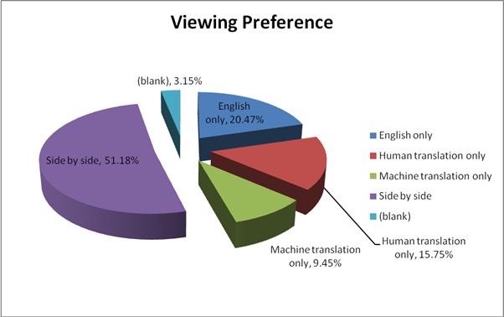
How Do You Like Your Translation?

Slide 25
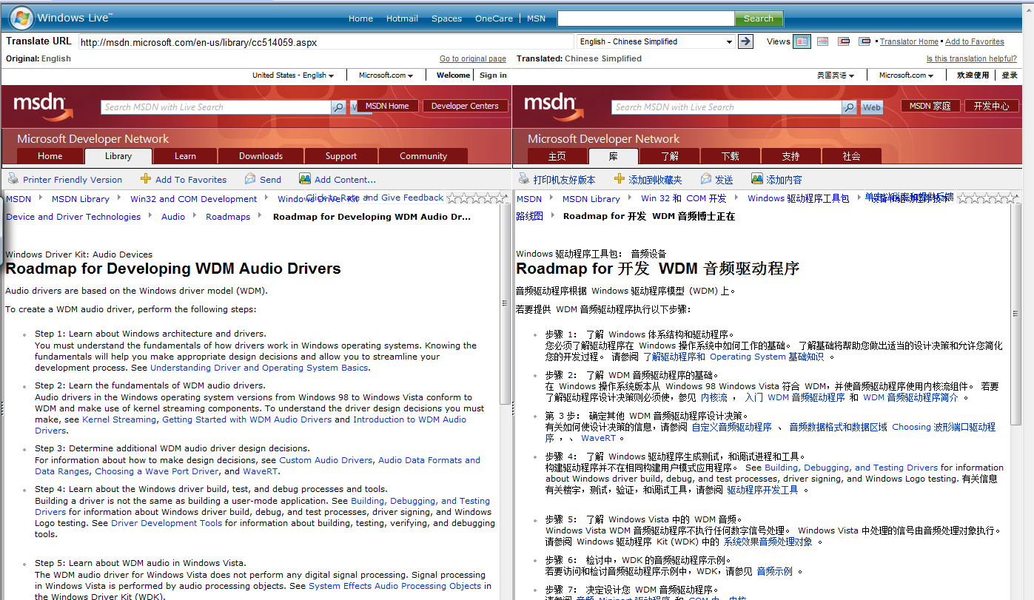
Side-by-Side Translation
English to Simplified Chinese on http://translator.live.com

Slide 26
Translation Results and Plans
Machine Translation Beta participation totaled 502,730 visits
Pilot ran Oct. 1st, 2007 through Feb. 28th, 2008
Windows Driver Kit 3rd most viewed of 10 in pilot
Majority of our customers non-native English speakers
Used survey data to prioritize target languages for side-by-side translation
Content in some top languages targeted by end of FY09
Japanese, Chinese (Simplified), Chinese (Traditional), Russian, Korean, Portuguese, French, Spanish
Notes:
26

Slide 27
Call To Action
Send feedback on Servicing Plan, Docs, Build Environment, etc.
Try Microsoft Automated Code Review – tell us what you think
Try the new Macros

Slide 28
Additional Resources
Contact the WDK Team:
WDKPMFT@microsoft.com (WDK PM team)
WDKQA@microsoft.com (WDK Test team)
DDKSurv1@microsoft.com (WDK Docs team)
Available online:
WHDC website: http://www.microsoft.com/wdk
Read the WDK Doc blog at http://blogs.msdn.com/wdkdocs/default.aspx
Download monthly WDK doc refresh from http://www.microsoft.com/whdc/DevTools/WDK/WDKdocs.mspx
Driver Development Newsgroup: http://msdn.microsoft.com/newsgroups/default.aspx?dg=microsoft.public.development.device.drivers&lang=en&cr=US

Slide 29
Questions?

Slide 30
Please Complete A Session Evaluation Form Your input is important!
Visit the WinHEC CommNet and complete a Session Evaluation for this session and be entered to win one of 150 Maxtor® BlackArmor™ 160GB External Hard Drives 50 drives will be given away daily!
http://www.winhec2008.com
BlackArmor Hard Drives provided by:

Slide 31
© 2008 Microsoft Corporation. All rights reserved. Microsoft, Windows, Windows Vista and other product names are or may be registered trademarks and/or trademarks in the U.S. and/or other countries.
The information herein is for informational purposes only and represents the current view of Microsoft Corporation as of the date of this presentation. Because Microsoft must respond to changing market conditions, it should not be interpreted to be a commitment on the part of Microsoft, and Microsoft cannot guarantee the accuracy of any information provided after the date of this presentation. MICROSOFT MAKES NO WARRANTIES, EXPRESS, IMPLIED OR STATUTORY, AS TO THE INFORMATION IN THIS PRESENTATION.

