Slide 1
System Integrated Flash Storage
David Walp
Program Manager
Microsoft Corporation

Slide 2

Windows Storage Device Investments
Non-Volatile Memory (NVM)
Security
Smart Storage Devices
Green Technologies
Virtualization
Optical Platform
Personal Storage
Core Storage
Storage Networking

Slide 3
Photographic Film and Floppy Replacements
yesterday

Slide 4
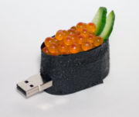
Consumer Ecosystem
Ubiquitous flash card
  Camera
  Mobile devices
Convenient personal storage
  USB flash drive
  Fashion statement

Slide 5
Non-Volatile Memory as PC Storage
today

Slide 6
Today’s Usage
Transient storage
Primary storage
  Bootable LBA device
Caching
  Layered on existing storage
    e.g. ReadyBoost
  Integrated device
    e.g. ReadyDrive
  Separated device

Slide 7
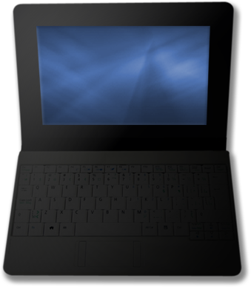
New Form Factors and Use Cases
Non-volatile memory is different
  Small form factor
  Lower power consumption
  Lower cost for low-end devices
  Shock resiliency
  Dust
  Temperature
  Humidity
E.g.: Netbook; harsh, rugged environments
MBL-T549 Designing Flash-based Netbooks

Slide 8

Flash as a Catalyst
Recognition
Data Set management
  Trim
Power management
Cache integration
COR-T558 Windows 7 Enhancements for SSDs
CON-S535 Is your Disk Drive Going Away?

Slide 9
Standards Related Work Survey
Industry
IDEMA
FCIA
STA
SNIA
HSA
UFDA
Formats
OSTA (MPV)
Multimedia file formats:
CIPA (JPG,DCF), MP3, VC1
Transport-Independent Abstractions
TCG SWG
IEEE 1667
IEEE 1619 .1/.3
GSM
ISO 7816.X
Transports
T11
T13
T10
CAP
USB-IF
CCID/ICCD
USB-IF
DWG
SDA
CFA
T10
SAS
Hardware Interface
SATA-IO
AHCI WG
NVMHCI WG
Hardware Design
ONFI
JEDEC

Slide 10
Groundwork for New Paradigms
tomorrow

Slide 11
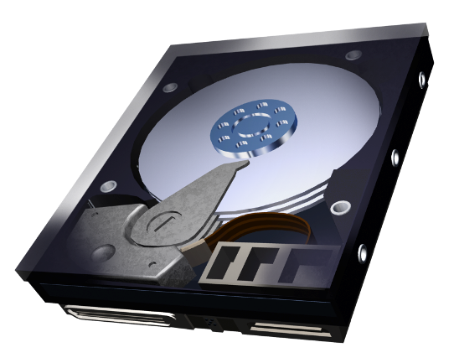
Different Roles for Different Technology
Hard disk drive
  Lower price per GB
  Higher performance (usage dependent)
Solid state storage
  Higher performance (usage dependent)
  Lower power
  Lower floor price
  Broader acceptable environment range
Combination solutions
Both hard disk drives and flash have complementary roles!

Slide 12
Beyond Consumer - Enterprise
Diskless blades – remote boot cache
Hypervisor
Storing dumps and diagnostics
Caching in the SAN
Application specific usage
ENT-C628 Solid State Storage in the
Server and Data Center Environments
CON-S530 MLC NAND in PC Environment

Slide 13
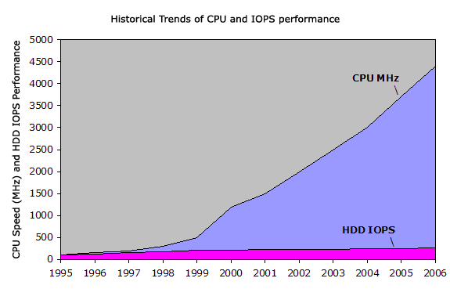
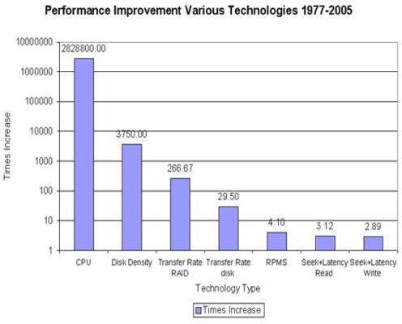
Growing Gap
Power consumption and communication technologies trends are similar

Slide 14


Storage Technologies
PCM
Growing gap between
HDD and DRAM
FLASH is here today –
“solid state storage”
No mechanics like HDD
Persistent unlike DRAM
Flash performance is
complementary to HDD and DRAM
PCM is potentially a new layer
  30x faster than today’s FLASH
  No write limit
  Being developed –
  future is not yet clear
?
DRAM
Flash
HDD
$/GB
IOPS
70s EEPROM
($10K/GB)
1997 Digital photo – killer application
($1K/GB)
2005 Mobile applications
($20/GB)
1987 FLASH invented
($5K/GB)
2003 Digital music
($100/GB)
2006 Computing UFDs
($5/GB)

Slide 15
How Good is Your Crystal Ball?
Filling the gap between DRAM
and Storage in new ways
ENT-T539 – Design Tradeoffs for Solid-State Disk Performance
COR-P777 – How Windows and SSDs Can Provide the Best User Experience

Slide 16
Flash Interface for the Future
Enable technology innovation
without interface design overhead
  Evolving technology requires an
  abstraction free of assumptions of
  current underlying technologies
  Define cache access methods
  but avoid specifying algorithms
NVMHCI!

Slide 17
NVMHCI Overview
New Development
Flash has become cost effective
in PC relevant sizes
Opportunity
Mainstream Flash into PC architecture in a standardized form with acceptable performance
Solution
Standardize a flash interface to promote adoption and enable innovation

Slide 18
NVMHCI Committee and Standard
Formed May 2007
NVMHCI 1.0 was published
on April 14, 2008
Leveraged AHCI semantics,
concepts, and experience
Currently consists of 35+ members

Slide 19
Storage Bus Architecture
Processor
HCI
Processor
PORT
PORT
NVMC
CI
DC
Legend
CI = Command Interface
DC = Disk Controller
HCI = Host Controller Interface

Slide 20
SSD Storage Bus Architecture
CI
CI
Processor
Processor
CI
NC
NC
NC
NC
DC
NVM
NVM
NVM
NVM
Legend
NC = NVM Controller
NVMC = NVM Channel
NVMC
NVMC
NVMC
NVMC

Slide 21
NVMHCI Architecture
Processor
NVMHCI
Processor
NC
NC
NVMC
NVMC
NVMC
NVMC
CI
CI
Processor
Processor
NC
NC
NC
NC
NVM
NVM
NVM
NVM
Legend
NC = NVM Controller
NVMC = NVM Channel
NVMC
NVMC
NVMC
NVMC

Slide 22
AHCI with NVMHCI
Processor
AHCI/NVMHCI
Processor
NC
PORT
PORT
NVM
CI
DC
Legend
CI = Command Interface
DC = Disk Controller
HCI = Host Controller Interface

Slide 23
NVMHCI Key Benefits
NVMHCI standardizes a flash host
controller interface that…
Moves beyond today’s buses and devices
Minimizes controller complexity
Enables features only available
on flash controllers
Enables caching solutions

Slide 24
…Moves Beyond Today’s
Buses and Devices
Asynchronous notification to the host
  Enables a controller to request an action by the host
  Multiple simultaneous commands
  Leverages parallelism of
  flash controller designs
Out of order data transfers
  Improves throughput efficiency
  by using data when is ready
Processor
NVMHCI
Processor
NC
NC
NVM
NVM
NVM
NVM

Slide 25
…Minimizes Controller Complexity
Host controller and flash
controller are one
  Controller can manage storage
  in a consistent manner over the
  entire life of the media
Focused operation set…
Enumeration | Identify
Configuration | Get Features, Set Features
Health Monitoring | Get Status
IO | Read, Write, Flush
Management | Data Set Management

Slide 26
…Enables Features Only Available on Flash Controllers
Operations defined in a large,
extensible, segmented structure
  Timeout
  Workload Management
  Prioritization
Metadata transfers
  Provides metadata read/write access to the host
  Metadata access can even
  be done during IO operations
Command
Address Low
Address High
Transfer Count
Parameters
Attributes
Reserved
Reserved

Slide 27
…Enables Caching Solutions
BIOS support
  Leverages an NVMHCI boot cache
  Prevents boot failures using safe mode
  Cache usage control for OEMs
Device Layout Types
  Prevents cache segments from
  being used as permanent storage
  and vice versa
NVMHCI ports under an
AHCI controller
  Used as cache for a SATA HDD
Processor
AHCI/NVMHCI
Processor
NC
Port
NVM
Port
NVMC

Slide 28
And More!
Multiple ports
Enumeration efficiency
Index data/pair
Data set management
Logical, physical, page alignment
Configuration persistence
Metadata size
Linear processing
Power management
Cache map table formats
Allocation and optimum transfer size

Slide 29
NVMHCI
Providing a Solid Standardized Foundation for Future Work

Slide 30
Microsoft and NVMHCI
Active committee member
We are closely monitoring hardware availability
The technology readiness did not align with Win 7 development milestones
  Ongoing investigation of
  potential ship vehicle
Related logo requirements in review
Hardware validation tests available

Slide 31
Call To Action
Take advantage of the emerging features
Participate with the industry committees and standard organizations
Get the NVMHCI specification and
see what it can do for you
  http://www.intel.com/standards/nvmhci/index.htm
Review the other WinHEC flash presentations

Slide 32
Additional Resources
Windows Driver Kit – NV Cache Manager Structures
http://msdn2.microsoft.com/en-us/library/aa907462.aspx
Microsoft Research Papers - Design Trade-offs for SSD Performance
http://research.microsoft.com/users/vijayanp/papers/ssd-usenix08.pdf
Design Guidelines – Guidelines for Designing Flash-based
Ultra Low Cost PCs for Windows XP
http://download.microsoft.com/download/2/0/a/20ac945c-34d0-4a60-8245-f80e80fe954f/GuidelinesForDesigningULCPCForWindowsXP-MSFT%20.pdf
Specifications – Data Set Management Commands Proposal
for ATA8-ACS2, Rev. 3
http://www.t13.org/Documents/UploadedDocuments/docs2007/e07154r3-Data_Set_Management_Proposal_for_ATA-ACS2.pdf
NVMHCI
http://www.intel.com/standards/nvmhci/index.htm

Slide 33
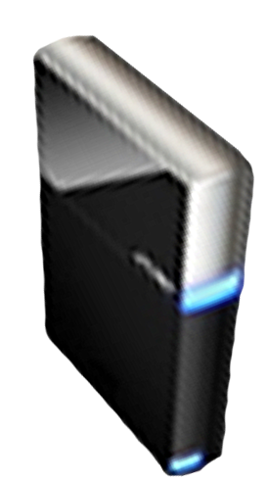


Please Complete A Session Evaluation Form
Your input is important!
Visit the WinHEC CommNet and complete a Session Evaluation for this session and be entered to win one
of 150 Maxtor® BlackArmor™ 160GB External Hard Drives
50 drives will be given away daily!
http://www.winhec2008.com
BlackArmor
Hard Drives provided by:

Slide 34


© 2008 Microsoft Corporation. All rights reserved. Microsoft, Windows, Windows Vista and other product names are or may be registered trademarks and/or trademarks in the U.S. and/or other countries.
The information herein is for informational purposes only and represents the current view of Microsoft Corporation as of the date of this presentation. Because Microsoft must respond to changing market conditions, it should not be interpreted to be a commitment on the part of Microsoft, and Microsoft cannot guarantee the accuracy of any information provided after the date of this presentation.
MICROSOFT MAKES NO WARRANTIES, EXPRESS, IMPLIED OR STATUTORY, AS TO THE INFORMATION IN THIS PRESENTATION.

