Slide 1
Windows 7 Enhancements for Solid-State Drives
Frank Shu
Sr. Program Manager
Microsoft Corporation

Slide 2
The Agenda
Review of SSD technology trends
Windows 7 SSD enabling technology
Learning the new features of Windows 7 for SSD identify and Trim
The importance of NTFS partition alignment to SSD geometry, and the implementation
Proposed Windows 7 logo requirements related to SSD
Remaining challenges
Ongoing effort and progress

Slide 3
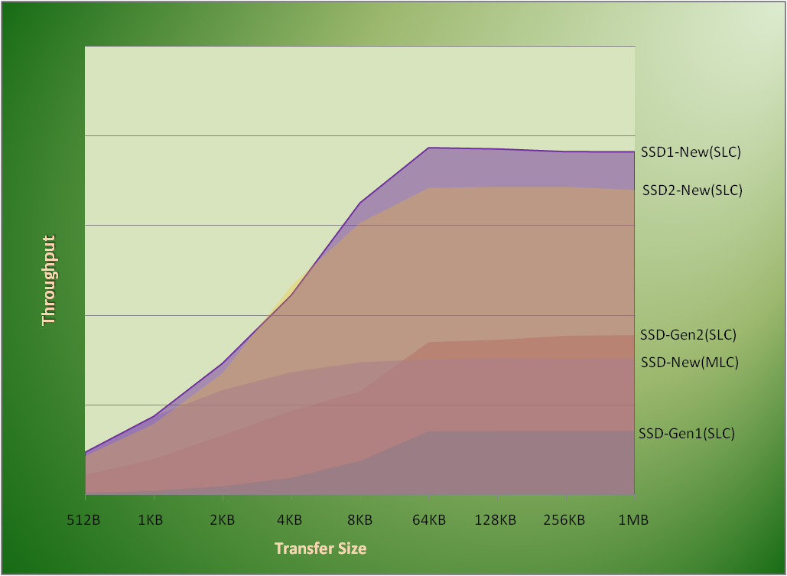
SSD Performance Trends (Sequential write)
Sequential performance
continues to improve
MLC drive’s Performance is increasing
Sequential performance
advantage is big and real
Source: a subset of sample data from internal lab

Slide 4
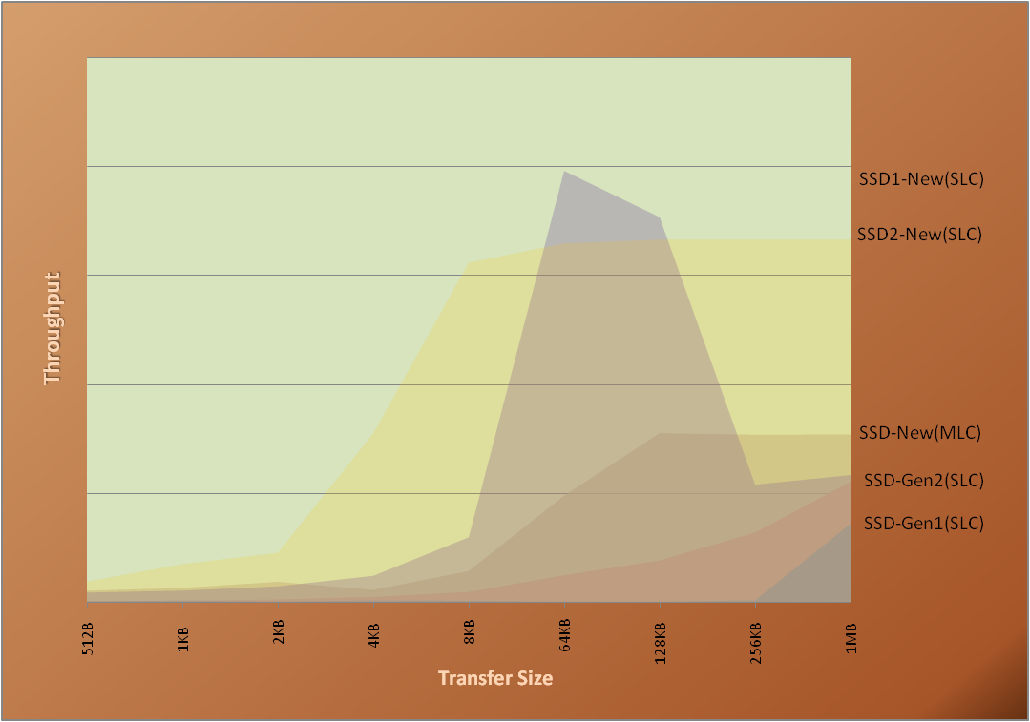
SSD Performance Trends (Random write)
Random write speed is increasing
MLC drive’s random write is also improving
Random performance issues are being solved
Source: a subset of sample data from internal lab

Slide 5
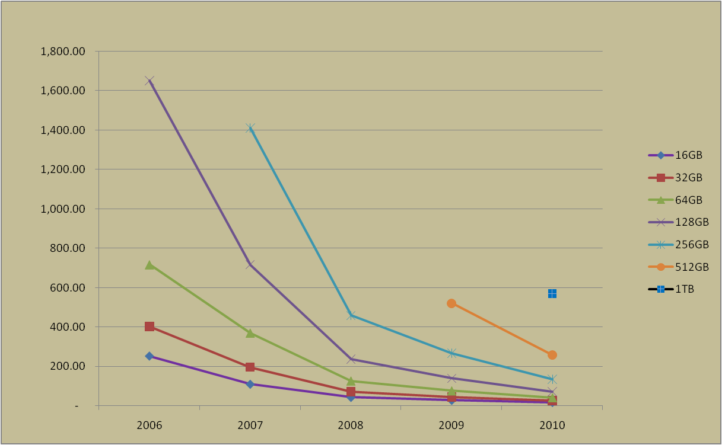
SSD Cost Trends
The mark shows where the cost is today
$
And it continues down
The device cost will be in affordable range by 2010
1TB SSD is on the radar
Source: Semiconductor Forecast Worldwide--Forecast Database [SEQS-WW-DB-DATA], Gartner August 2008, by Joe Unsworth, et al.

Slide 6
SSD Is On The Path To Its Full Potential

Slide 7
Windows 7 SSD Enabling Technology

Slide 8
Windows 7 Enables Improved Endurance for SSD Technology
SSD can identify itself differently from HDD in ATA as defined by ATA8-ACS Identify Word 217: Nominal media rotation rate
Reporting non-rotating media will allow Windows 7 to set Defrag off as default; improving device endurance by reducing writes

Slide 9
Windows 7 Enables Optimization for SSD Technology
Microsoft implementation of “Trim” feature is supported in Windows 7
NTFS will send down delete notification to the device supporting “trim”
File system operations: Format, Delete, Truncate, Compression
OS internal processes: e.g., Snapshot, Volume Manager
Three optimization opportunities for the device
Enhancing device wear leveling by eliminating merge operation for all deleted data blocks
Making early garbage collection possible for fast write
Keeping device’s unused storage area as much as possible; more room for device wear leveling.

Slide 10
NTFS Partition Alignment is Important for SSD Performance
The alignment of NTFS partition to SSD geometry is important for SSD performance in case of Windows XP and Windows XP upgrade to Windows Vista and Windows 7
The first Windows XP partition starts at sector #63; the middle of a SSD page
Misaligned partition can degrade device’s performance down to 50% caused by read-modify-write
The example with 4k page size
Implementing correct alignment according to the latest ATA and SCSI spec.

Slide 11
Proposed Windows 7 Logo Requirements For SSD

Slide 12
Windows 7 Storage Logo Proposal (1-3)
Proposed Windows 7 logo requirements related to SSD
Storage devices complying with ATA8-ACS specification shall report their rotation speeds according to ATA8-ACS Identify Word 217: Nominal Media Rotation Rate
The performance of the storage device shall not degrade with any amount of data stored to the maximum capacity of the device

Slide 13
Windows 7 Storage Logo Proposal (2-3)
If “Trim” algorithm is applied, the “Trim” implementation must comply with ATA8-ACS2 proposal e07154r6 (Data Set Management Commands Proposal for ATA8-ACS2) section 5.3 and section 6.2. The completion time of Trim command should be less or equal to 20ms
SATA-IO certification is required for Solid State Drive (SSD) connected through SATA interface. More information on SATA-IO testing will be available on the SATA-IO Web site at: http://www.sata-io.org/testing.asp

Slide 14
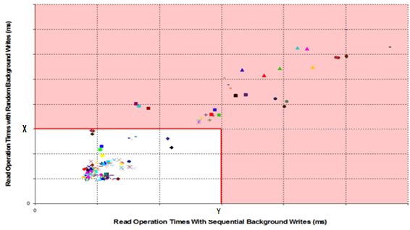
Windows 7 Storage Logo Proposal (3-3)
The read response time of storage device shall be less than or equal to the maximum response time required.
Giving read a priority can be important when there is a long queue of writes
The result is better user experience of system responsiveness

Slide 15
Challenges Ahead
SSD performance and quality are scattered widely with product on the market
Maintaining a consistent good user experience
SSD endurance is equal to the safety of user’s data
Data retention becomes more important
The answer to questions
Does SSD has its own defrag issue?
How useful is Optimum Write Size?

Slide 16
The Effort and Progress are Ongoing
Continue enabling SSD technology in Windows platform; Boot, Index, …
Working with IHVs and OEMs to enrich Windows hardware logo program for better quality
Define SSD endurance specification together with industry

Slide 17
Call To Action
Test your SSD with Windows 7 beta and optimize your device with new Windows 7 features
Run Windows 7 logo evaluation kit (available soon) to ensure your device compliance
Provide us with your feedback on future device optimization need
Participate in industry standard work (T13, T10, JEDEC, SSDA, …) and support SSD endurance, data retention, and device statistic standardizations

Slide 18
Additional Resources
Web Resources
Trim command specifications: http://t13.org/Documents/UploadedDocuments/docs2008/e07154r6-Data_Set_Management_Proposal_for_ATA-ACS2.doc
ATA8-ACS: http://t13.org/Standards/Default.aspx?DocumentType= 3&DocumentStage=2
Microsoft Research Papers: Design Trade-offs for SSD Performance http://research.microsoft.com/users/vijayanp/papers/ssd-usenix08.pdf
Guidelines for Designing Flash-Based Ultra Low Cost PCs for Windows XP: http://download.microsoft.com/download/2/0/a/20ac945c-34d0-4a60-8245-f80e80fe954f/GuidelinesForDesigningULCPCForWindowsXP-MSFT%20.pdf
Related Sessions
“New Developments in the Storage Platform” – COR-T521
“System Integrated Flash Storage” – COR-T559
“Solid State Storage in the Server and Data Center Environments” – ENT-C628
“Designing Flash-based Netbooks for Windows” – MBL-T549
Contact info
Forum: Storage Platform –ATA http://forums.microsoft.com/MSDN/ShowForum.aspx?ForumID=1837&SiteID=1
Email: ssddiscu@microsoft.com

Slide 19
Please Complete A Session Evaluation Form Your input is important!
Visit the WinHEC CommNet and complete a Session Evaluation for this session and be entered to win one of 150 Maxtor® BlackArmor™ 160GB External Hard Drives 50 drives will be given away daily!
http://www.winhec2008.com
BlackArmor Hard Drives provided by:

Slide 20
© 2008 Microsoft Corporation. All rights reserved. Microsoft, Windows, Windows Vista and other product names are or may be registered trademarks and/or trademarks in the U.S. and/or other countries.
The information herein is for informational purposes only and represents the current view of Microsoft Corporation as of the date of this presentation. Because Microsoft must respond to changing market conditions, it should not be interpreted to be a commitment on the part of Microsoft, and Microsoft cannot guarantee the accuracy of any information provided after the date of this presentation. MICROSOFT MAKES NO WARRANTIES, EXPRESS, IMPLIED OR STATUTORY, AS TO THE INFORMATION IN THIS PRESENTATION.

