Slide 2
The Manycore Shift Microsoft Makes Parallel Computing Personal
Jan Gray Software Architect Parallel Computing Platform Microsoft Corporation

Slide 3
The Manycore Paradigm Shift
Microsoft’s Parallel Computing Initiative
Why look to parallel computing now?
What’s coming next for developers
An overview of a new stack of Microsoft technologies for parallel programming

Slide 4
Towards The Next 100×
Since 1975, performance ↑100×/decade
3,000× clock frequency, 300,000× transistors
10⁻¹× voltage, 100× power
Rich instructions, caches, instruction level parallelism (ILP)
Spent it all on compelling experiences
“The free lunch” and upgrade cycles
Can we look forward to another 100×?

Slide 5
Technology Scaling 2008-2016
Power: P = nCV²f + leakage
Scaling: 45→32→22→16→11 nm
↑↑n: 2⁴ = 16× transistors
↓C/transistor; ↓V: 1.0→0.7 volts; 0.7² ≈ ½
Power wall: P₂₀₁₆ ≤ P₂₀₀₈: can’t crank up f!
Complexity wall: ILP diminishing returns
Memory wall: slow latency improvement
Meager single thread performance scaling = no 100× and no return of the free lunch

Slide 6
Towards Manycore Processors
Moore’s Law gives us billions of transistors
100× throughput in same power?
Return to simpler cores (lots of them)?
↓ILP ↓out-of-order ↓speculation ↓perf/core → same answers in ↓power ↓area ↓complexity
Wide vector SIMD + scalable memory systems = TFLOPS and TB/s
Amdahl’s Law, other system bottlenecks
Manycore ::= modular heterogeneous multiprocessor system-on-a-chip
Primary
Processor
D
D
D
D
SP
SP
C
C
C
C
SP
SP
C
C
C
C
SP
SP
C
C
C
C
SP
SP
IO
N
N
N
N
N
N
IO
Primary Processor
C
C
C
C
SP
SP
C
C
C
C
SP
SP
C
C
C
C
SP
SP
D
D
D
D
SP
SP

Slide 7
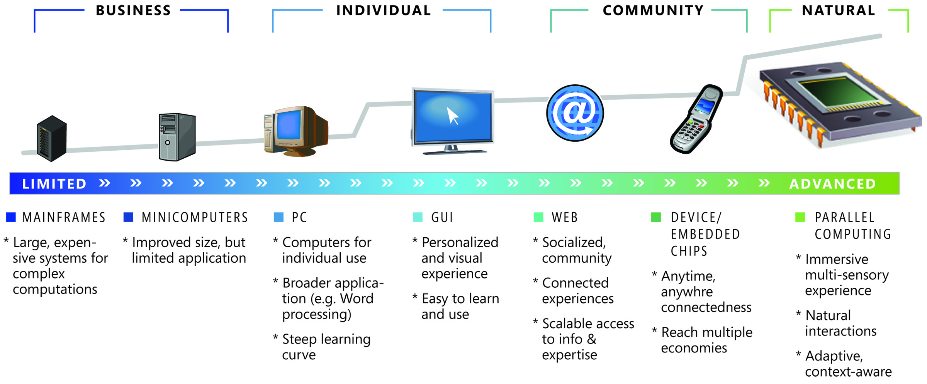
Parallel Computing Initiative
Microsoft’s Parallel Computing Initiative encompasses the vision, strategy, and innovative technologies for delivering transformative, natural, and immersive personal computing experiences, harnessing the compute power of manycore architectures

Slide 8
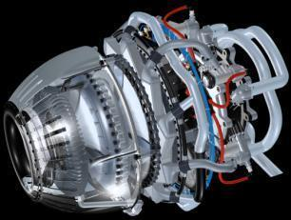
Opportunities for the Future
Immersive Experience
Improved Productivity
Breakthrough Innovation

Slide 9
Taking Parallelism Mainstream (Over Several Product Cycles)
Enable broad spectrum of developers
Experts: explicit unsafe parallelism
Everyone else: invisible or safe parallelism
Via encapsulation, new abstractions
Address complexity of client software
Anticipate diversity of hardware targets

Slide 10
Parallelism and the Software Stack
Applications
Constructing Parallel
Applications
Libraries
Languages, Compilers and Tools
Efficiently Executing
Parallel Applications
Concurrency Runtime
Coordinating System Resources and Services
OS/Hypervisor
Hardware

Slide 11
Parallel Programming Support in Visual Studio 2010
.NET 4.0
Task Parallel Library
Task, Task<T>
Parallel.For, Parallel.ForEach
Parallel.Invoke
Coordination data structures
Parallel LINQ
Native C++
Parallel Pattern Library
task, task_group
parallel_for, parallel_for_each
parallel_invoke
Concurrent data structures
Primitives for message passing
Concurrency runtime
Parallel debugging windows – tasks, stacks, locals
Parallel profiling – core utilization, thread behavior and contention blocking, thread execution patterns

Slide 12
Scalable Parallel Programs Return of the Free Lunch
Invite parallel execution at key sites
Over-decompose for future scaling
Relax sequential order to gain parallelism
Consider data as well as control flow
Result: new code with abundant latent parallelism
Then the Concurrency Runtime efficiently maps the work to the available processors

Slide 13
Task Parallel Abstractions System.Threading.Parallel
Compound Parallel Statements
void QuickSort<T>(T[] arr, int low, int hi)
where T : IComparable<T> {
if (…/* reached sequential threshold */)
Array.Sort(arr, low, hi - low);
else {
int pivot = Partition(domain, low, hi);
Parallel.Invoke(
delegate { ParQuickSort(domain, low, pivot - 1); },
delegate { ParQuickSort(domain, pivot + 1, hi); }
);
}
}

Slide 14
Task Parallel Abstractions System.Threading.Parallel
Compound Parallel Statements
Parallel Loops
void RenderParallel(Scene scene, Int32[] rgb) {
Parallel.For(0, screenHeight, y => {
int stride = y * screenWidth;
Camera camera = scene.Camera;
for (int x = 0; x < screenWidth; x++) {
Color color = TraceRay(
new Ray(camera.Pos, GetPoint(x, y, camera)),
scene, 0);
rgb[x + stride] = color.ToInt32();
}
});
}

Slide 15
Task Parallel Abstractions System.Threading.Parallel
Compound Parallel Statements
Parallel Loops
Unstructured Tasks
private void UpdateImageAsync() {
if (_lastTask != null) _lastTask.Cancel();
_lastTask = Task.StartNew(delegate {
Bitmap bmp = MandelbrotGenerator.Create(...);
... // draw to UI
});
}

Slide 16
Task Parallel Abstractions System.Threading.Parallel
Compound Parallel Statements
Parallel Loops
Unstructured Tasks
Task Manager
Scheduling/resource policies
Aggregate wait/cancel
Same basic concepts available in C++ as Parallel Pattern Library

Slide 17
New Abstraction: Parallel LINQ Automatic Data Parallel Queries
LINQ ::= .NET Language INtegrated Query
“SQL” over in-memory data structures
No explicit sequencing enables domain specific “automatic” parallelization
// Query babies born in given state and year range, sorted
List<BabyInfo> babies = new List<BabyInfo>();
...
var q = from b in babies.AsParallel()
where b.Name.Equals(name) &&
b.State == state &&
b.Year >= yearStart && b.Year <= yearEnd
orderby b.Year
select b;

Slide 18
Some New Parallel Programming Models
demo

Slide 19
Efficient Execution
Minimize costs per task
Load balance across available cores
Dynamic resource assignment
Respect the memory hierarchy
Allow multiple strategies
Multiple paradigms, specialized schedulers

Slide 20
Work As A Dynamic Tree
Recursive divide and conquer can quickly generate a lot of tasks
We do not want them all to run: wastes resources, esp. memory
Traditional time-shared OS notions of “threads” with “fairness” are inappropriate

Slide 21
Managing the Work Sequential
Sequential execution very efficient, O(lg n) storage
A like number “ready”
A ready node also represents much work yet to be elaborated

Slide 22
Managing the Work Parallel
Publish work to be stolen by idle workers
Steal big chunks of work
Depicted 4 workers

Slide 23
Visual Studio 2010 Tools / Programming Models / Runtimes
Tools
Programming Models
Parallel LINQ
Parallel
Debugger Tool Windows
Task Parallel
Library
Parallel Pattern Library
Agents
Library
Concurrency Runtime
Data Structures
Data Structures
Profiler Concurrency
Analysis
ThreadPool
Task Scheduler
Task Scheduler
Exposed APIs
Resource Manager
Resource Manager
Operating System
Threads
Key:
Managed Library
Native Library
Tools

Slide 24
Some Windows Kernel Advances
>64 logical processor support
Greater scalability, avoiding hot locks
Thread scheduling enhancements for more efficient concurrency runtimes
ENT-T554, Windows Server Support for More than 64 LPs, Thu, 11 am
ENT-T555, Scaling To More than 64 LPs: SQL, Thu 2 pm

Slide 25
Parallel Developer Tools Defining the developer experience for constructing parallel applications
Design
Debug
Optimize
Validate
Design and modeling tools to enable developers to start with zero parallelism debt
Debug across multiple programming models, with data and task-focused visualizations
Actionable performance guidance for understanding and optimizing parallel applications
Tools for developers and testers to validate correctness and cope with inherent non-deterministic execution

Slide 26
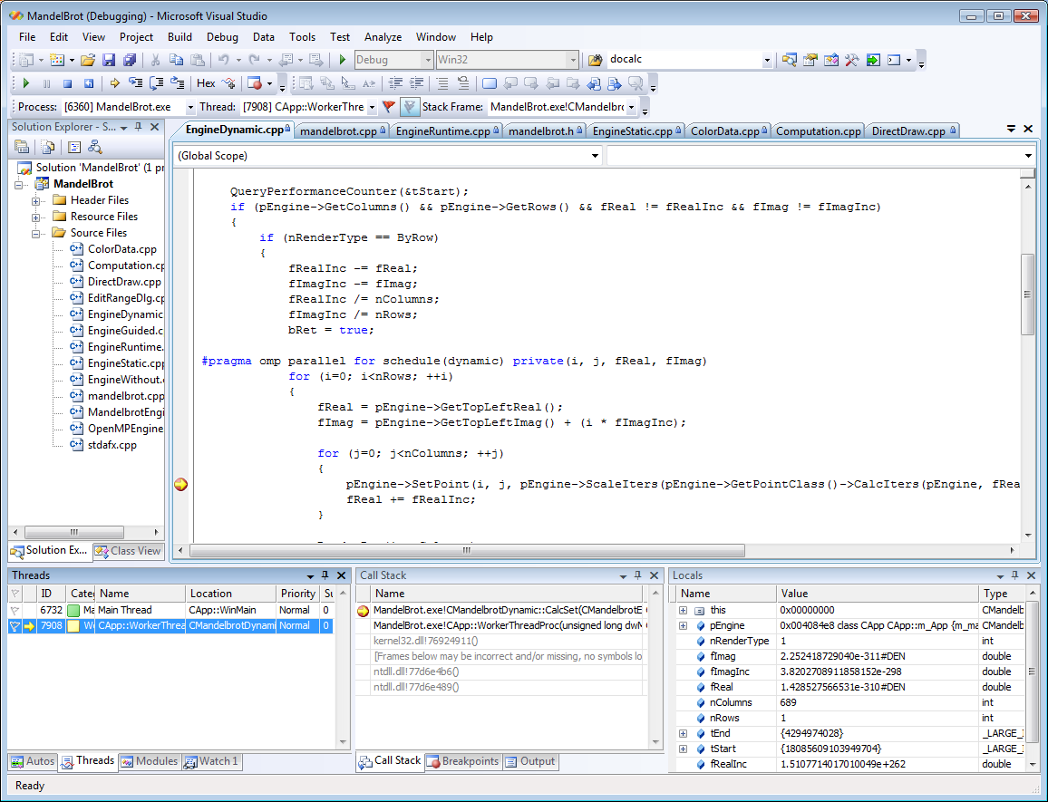
Parallel Debugging Challenges
Flat list of OS threads with limited data
Data views based on current stack frame
Visualization doesn’t scale well
Linear, per-thread call stacks
Lacks a “data pivot” for data parallelism
Hard to grasp overall execution flow

Slide 27
Visual Studio 2010 Debugger Parallel Tasks
Visualize and navigate tasks directly

Slide 28
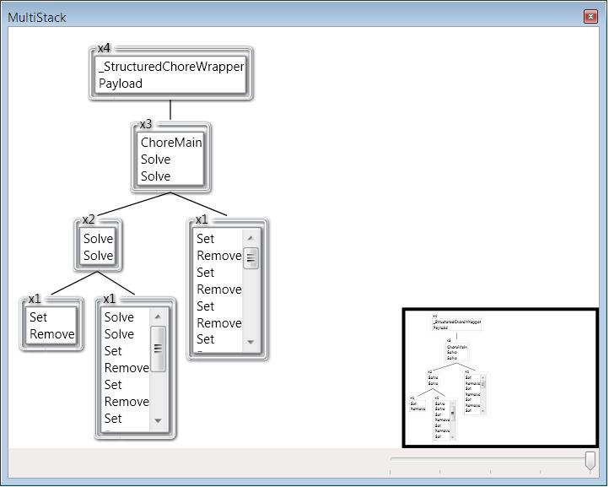
Visual Studio 2010 Debugger Parallel Stacks
Grasp execution flow at a glance
Easily move between contexts and stacks
More…

Slide 29
Visual Studio 2010 Profiling Concurrency Analysis Tools
Based upon Event Tracing for Windows (ETW) traces
Understand CPU utilization and causes of thread blocking
Correlate events to high level abstractions e.g. Parallel.For annotation

Slide 30
(Data Parallel Computing on GPUs)
TFLOPS and 100s GB/s bandwidth today
Increasingly general purpose data parallel computing applications
HD media, graphics, physics, games, HPC
Direct3D11 Compute Shader
GRA-T519, Direct3D11 Compute Shader (today)
GRA-P581, Panel: Application of General-Purpose GPU, Thu 4:30

Slide 31
Summary and Call to Action
The next 100× requires parallel computing
TFLOPS clients will bring new killer apps
Scalable parallel code, faster on new hardware
Comprehensive parallel computing developer platform coming in Visual Studio 2010
Dig into http://msdn.com/concurrency
Download and try the Visual Studio 2010 and .NET Framework 4.0 CTP, or the Parallel Extensions .NET June 08 CTP
Surf the parallel computing paradigm shift!

Slide 32
Questions?
Evals!

Slide 33
Related Sessions
ENT-T554 Windows Server Support for More than 64 Logical Processors
ENT-T555 Scaling To More than 64 LPs: SQL
GRA-T515 DirectX – Core Graphics for Windows 7
GRA-T516 DirectX 11
GRA-T517 Direct3D11 Compute Shader
GRA-T634 GPU Performance and CPU/GPU Interactions
GRA-P581 Application of GPGPU: Hype or Reality
COR-S544 Making Technology and Products Matter for Developers: The Intel Product Roadmap
Microsoft PDC 2008 online session videos tagged ‘Parallelism [9]’ at https://sessions.microsoftpdc.com/public/timeline.aspx

Slide 34
Please Complete A Session Evaluation Form Your input is important!
Visit the WinHEC CommNet and complete a Session Evaluation for this session and be entered to win one of 150 Maxtor® BlackArmor™ 160GB External Hard Drives 50 drives will be given away daily!
http://www.winhec2008.com
BlackArmor Hard Drives provided by:

Slide 35
© 2008 Microsoft Corporation. All rights reserved. Microsoft, Windows, Windows Vista and other product names are or may be registered trademarks and/or trademarks in the U.S. and/or other countries.
The information herein is for informational purposes only and represents the current view of Microsoft Corporation as of the date of this presentation. Because Microsoft must respond to changing market conditions, it should not be interpreted to be a commitment on the part of Microsoft, and Microsoft cannot guarantee the accuracy of any information provided after the date of this presentation. MICROSOFT MAKES NO WARRANTIES, EXPRESS, IMPLIED OR STATUTORY, AS TO THE INFORMATION IN THIS PRESENTATION.

Slide 36
Additional Materials
Evals!

Slide 37
Example: Tree Walk
Sequential
static void ProcessNode<T>(Tree<T> tree, Action<T> action) {
if (tree == null) return;
ProcessNode(tree.Left, action);
ProcessNode(tree.Right, action);
action(tree.Data);
}
ThreadPool (Naïve)
static void ProcessNode<T>(Tree<T> tree, Action<T> action) {
if (tree == null) return;
using (ManualResetEvent mre = new ManualResetEvent(false)) {
ThreadPool.QueueUserWorkItem(delegate {
ProcessNode(tree.Left, action);
mre.Set();
});
ProcessNode(tree.Right, action);
action(tree.Data);
mre.WaitOne();
}
}
Heavyweight Synchronization
Serial Interfaces
Block a thread
Lose locality

Slide 38
Example: Tree Walk, Cont'd
ThreadPool (better, but still not great)
static void ProcessNode<T>(Tree<T> tree, Action<T> action)
{
IEnumerator<T> enumerator = tree.GetEnumerator();
using (ManualResetEvent mre = new ManualResetEvent(false)) {
int waitCount = Environment.ProcessorCount;
WaitCallback wc = delegate {
while(true) {
T item;
lock (enumerator) {
if (!enumerator.MoveNext()) break;
item = enumerator.Current;
}
action(item);
}
if (Interlocked.Decrement(ref waitCount) == 0) mre.Set();
};
for (int i = 0; i < Environment.ProcessorCount - 1; i++) {
ThreadPool.QueueUserWorkItem(wc);
}
wc(null);
mre.WaitOne();
}
}
Oversubscription
Serialization
Loss of Locality
Explicit Synchronization
Boiler Plate
No Inter-element coordination

Slide 39
Example: Tree Walk with Tasks
Parallel Extensions (with Task)
static void ProcessNode<T>(Tree<T> tree, Action<T> action) {
if (tree == null) return;
Task t = Task.Create(delegate { ProcessNode(tree.Left, action); });
ProcessNode(tree.Right, action);
action(tree.Data);
t.Wait();
}
Parallel Pattern Library for C++
Parallel Extensions (with Parallel)
static void ProcessNode<T>(Tree<T> tree, Action<T> action) {
if (tree == null) return;
Parallel.Invoke(
() => ProcessNode(tree.Left, action),
() => ProcessNode(tree.Right, action),
() => action(tree.Data) );
}
template<class T>
static void ProcessNode(Tree<T>* tree, Action<T> action) {
if(tree == NULL) return;
task_group g;
g.run([&] { ProcessNode(tree->left, action); });
g.run([&] { ProcessNode(tree->right, action); });
action(tree.Data);
g.wait();
}

