Slide 1
Is Your Disk Drive
Going Away?
Mike Alexenko Steffen Hellmold
Executive Director, Vice President,
Strategic Marketing, Marketing & Business Dev.
Core Products, Memory Products Group
Seagate Technology Seagate Technology

Slide 2
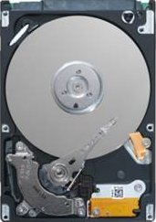
“…The reports of my death have been greatly exaggerated…”
Mark Twain

Slide 3
50+ Years And Counting
Bubble Memory
Challengers either co-exist or have gone away...
Technology barriers continuously removed
Lithography—Head Width Challenges
Optical Storage
Super Paramagnetic Limit Effect
Holographic Storage
Flash Memory
Nano\Probe Storage
Head Clearance \ Control
Optical Tape

Slide 4
What Drives Disk Drives?
Market Demands Storage Space
  Content coming from everywhere: internet,
  user generated, replicated, backed up
Economics & Scalability
  Continues to provide best $/GB value prop
  Manufacturing capability to fill demand
  Broad portfolio of devices & features
Extensible Platform
  Complete “system” with independent
  processing, memory, storage & I/O

Slide 5
Disk Drives And $/GB
Avg. $/GB
Megabyte Era
Gigabyte Era
Terabyte Era
  "Software is like a gas - it fills the space available" - Nathan Myhrvold
Source: Seagate Market & Competitive Intelligence, DiskTrend Historic

Slide 6
Solid State Price Reductions
SLC
vs
MLC
vs
HDD Average Selling Price Erosion, 2007
-
2011
$/GB
10
1
0.1
0.01
2007
2008
2009
2010
2011
3.5" HDD
2.5" HDD
1.8" HDD
MLC NAND
SLC NAND
Source: Gartner (December 2007)
Notes:
Seagate Confidential
6

Slide 7
Explosive Growth Of Data
2007 Snapshot
  Resized digital universe:
  281 billion gigabytes
  Faster than expected growth in cameras, digital TV sales
  and better understanding of replication
    315 billion images from 1 billion digital cameras = 150 Exabytes
  Home\Consumer storage
  needs outpacing Professional segment
2011 Forecast
  Digital universe expected
  to be 10x 2006 size
  Internet traffic will generate 342 Exabytes of storage
  Personal data protection devices expected to consume more Terabytes than all other segments except desktop PC
  Home\Consumer storage
  needs continue to outpace Professional segment
Source: IDC, Cisco

Slide 8
Fulfilling Demand
Manufacturing scalability
Millions of Terabytes Shipped
2011: HDD
514M TB
2011: Flash
50M TB
Flash industry would have to spend $50B - $85B
to bring online 10% of the HDD capacity in 2011
Source: Gartner

Slide 9
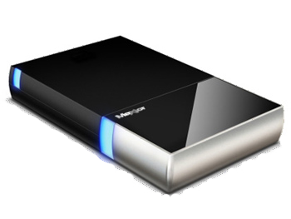
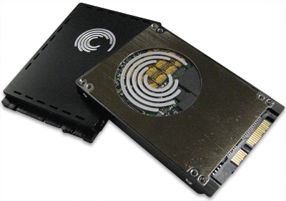
Extensible Platform
Continued evolution of disk drives and suppliers
New features & capabilities always
on being integrated
  Not just about capacity
Two topics today:
  Embedded Security
  Incorporation of flash

Slide 10
Embedding Security
Mike Alexenko

Slide 11
Why Security?
Number of lost & stolen laptops & disk drives continue to rise world-wide
Legislation: Safe harbor laws for loss of systems with personal records
Risk mitigation: Cost of disclosures for corporations
Privacy concerns

Slide 12
Why Security In The Disk Drive?
Zero performance impact
Not susceptible to exploits— Can’t be turned off
Encryption keys never leave
the drive hardware
  Self-generated, hidden from
  user space\access
  Key escrow supported for
  security applications
Low total cost of ownership
  Secure erase & ease of use

Slide 13
Secure Drive Components
Authentication
Access Control
(Lock \ Unlock)
Data Encryption
It’s not either-or
Secure Password Validation
Secure Messaging
Key, Password Management
Secure Erase (Key Erase)
Host \ User Interaction

Slide 14
Current Model
Pass-thru architecture
Security Commands (under review)
  ATA8-ACS: Trusted Send/Receive
  SCSI SPC-4: Security Protocol In/Out
  Not officially available yet
Transport requires “tunneling” via pass-thru
  Pass-thru has inherent limitations
  Future transport can be IEEE-1667

Slide 15
Pass-Thru
Pass-Thru supports any “non-standard” command. With it comes compatibility issues & restrictions: Admin rights required, transfer length limits, …
Applications & 3rd Party Libraries
Pass-Thru Commands
Standard Storage
Stack
Standard ATA & SCSI Commands
Storage Device
Security, SMART, Vendor Unique,….
Microsoft Enhanced Storage implementation of IEEE1667 provides a transport mechanism specific to security commands

Slide 16
IEEE-1667 Implementation
Microsoft TM Applications
(e.g. BitLockerTM)
3rd Party Applications
Microsoft Enhanced
Storage
Probe Silo
Certificate Silo
Password Silo
Future Silos
TCG Silo
3rd Party Silo
Other Silos
Standard Storage
Stack
IEEE-1667 Compliant Storage Device
Security Protocols
(e.g. TCG, Seagate SecureTM, other security standards)
Other (Future) Storage Features
Host will implement all Silos, Devices must implement probe silo, all others are optional

Slide 17

IEEE-1667 And Transient Storage
IEEE-1667 is both a security protocol and a transport mechanism
  As a security protocol, it can authorize and authenticate users
  As a transport mechanism,
  it enables additional security protocols via Windows
  Enhanced Storage™
Better user experience— Enables “Plug and Play”
data security
IEEE
1667

Slide 18
Unlock Sequence
IEEE-1667 Password Silo
Probe Command
Query Password Silo Function
Request Mutual Challenge Function
Mutual Authenticate Function
Media Accessible
Authenticate for ACT Access Function
Disc Encryption Key Loaded

Slide 19
Benefits Of IEEE-1667
Partnering with Microsoft & Enhanced Storage simplifies security
  Less driver work & support for IHVs, ISVs
  Standardizes security transport for Microsoft Windows
  Provides extensibility for future features and value-add

Slide 20
Today's 1667 Password Demo
Sequence
Take Ownership/Set Password
  Not Provisioned → Not Authorized
Authorize for ACT Access
  Not Authorized → Authorized
View contents
Perform Initialize to Manufacturer State
  Authorized → Not Provisioned
Show empty contents

Slide 21
DEMO
Seagate USB External Storage, IEEE 1667 & Microsoft Enhanced StorageTM

Slide 22
Security Summary
Data Security has become an imperative due to regulation and cost of a breach
Disk-based security provides security at the data source
Enhanced Storage & IEEE-1667 provides a transport mechanism specific to security commands
Together, Enhanced Storage, IEEE-1667 & Self-Encrypting disk drives will enable a larger market for security and provide value-add to IHVs & ISVs

Slide 23
Flash and the Disk Drive
Steffen Hellmold

Slide 24
A New Storage Growth Opportunity
Market Demands
  More performance
  Lower price points
Key Trends
  Rotating magnetic storage offers best $/GB
  Solid State Storage offers best performance as in $/IOPS
  Solid State Storage value proposition involves $/IOPS/W/m3 as well as $/Drive in Client and Enterprise compute apps
  Both will co-exist due to their respective value propositions
  Hybrid architectures involving solid state and rotating magnetic storage are evolving in enterprise and client
  SSD enables new tier in enterprise & new segment in client
New Form Factors, interfaces and protocols will emerge to fully exploit the benefits of Solid State Storage

Slide 25
Choosing Storage For The PC
WEIGHT
NOISE
Suppliers Differentiate
Around Attributes
ROBUST
In-Category Differentiators
POWER
Buying Criteria
PHYSICAL SIZE
Class of Storage Defined
by Pricing Categories
PERFORMANCE
PRICE
Category Class
CAPACITY
RELIABILITY
Entitlements
AVAILABILITY
“If your SSD loses my data we do not have to discuss the other features!”
Storage Attribute Model:
John Squires, Founder, Conner Peripherals, c1989

Slide 26
SSD Needs Innovation
At the drive-level
    Endurance
    Reliability
  Advancement in controller technology required in the face of degrading "media"
At the system level
    Performance
    Power
  Systems must be optimized to maximize the promise of flash in the platform
Industry standards required to foster market adoption

Slide 27
Challenges With SSD
What's keeping SSD from gaining traction in the market?
  Capacity at acceptable cost
What if there was a different way?
  Provide HDD's cost-effective
  capacity with SSD's speedy
  response and power efficiency
ASD – Advanced Storage Drive

Slide 28
ASD – Best Of Both Worlds
Single drive tiered storage for the PC
Small cache with different characteristics than Primary Store
  Flash has faster random performance than HDD
Caching benefit determined by
  Type & speed of cache
  Cache management method
I/F (SATA)
Buffer (DRAM)
Cache (Flash)
Performance & Power defined by Size & RPM
  Incremental improvements gen-to-gen
  Fast sequential performance
  Random performance limited by mechanical latency
Delivers Affordable Capacity
Primary Store (disc)
Reliability gains come with integrating the flash-cache into the drive

Slide 29
ASD Addresses PC Market Needs
Physical Size
  Standard 2.5in HDD for factor
  Fits in all NB chassis – no extra card needed
Performance
  Delivers performance most end-users will notice in everyday use
Price & Capacity
  Small premium above standard HDD prices
  All the affordable capacity the HDD industry has been delivering for years

Slide 30
ASD Video Demo

Slide 31
Flash Executive Summary
Performance SSD
Extreme premium to get capacity
SSDs offer a growth opportunity
in storage, expanding the overall storage market by creating a new tier of performance in enterprise and low capacity client solutions
Performance, reliability,
endurance and power are
essential for the success of Solid State Storage in Compute
ASD offers a blend of
performance and capacity to satisfy notebook market needs
Seagate is leading standards activities for SSD and HDD
ASD
High Cap or
High Performance
HDD
Increasing Price & Performance
Mainstream
HDD
Entry
HDD
Entry SSD
Low capacity for low Price

Slide 32
Call To Action
Industry stake holders are encouraged to join the effort! Participate in these standards bodies:
  IEEE-1667 & TCG (security)
  JEDEC JC64.8 (SSD)
Get ready for Enhanced Storage
  Ensure your applications and devices support
  IEEE 1667
Work with industry stakeholders to enable SSD growth
  Deliver Standards for Performance, Endurance,
  Reliability & Power
Secure your data with Full Disk Encryption

Slide 33
Additional Resources
Related Sessions
  Microsoft Enhanced Storage™ Workshop
Booths with demos and more information:
  Seagate
  Microsoft
Web resources:
  http://www.seagate.com/security
  http://www.ieee1667.com
  https://www.trustedcomputinggroup.org
  http://www.t10.org
  http://www.t13.org
  http://jedec.org/Home/press/press_release/JC-6487-17-08.pdf
For more information, contact
  Mike.Alexenko@seagate.com
  Steffen.Hellmold@seagate.com

Slide 34
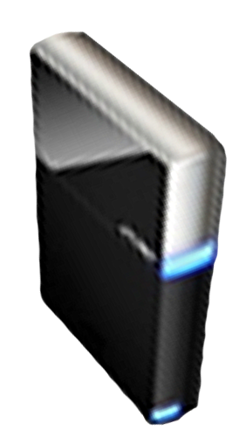


Please Complete A Session Evaluation Form
Your input is important!
Visit the WinHEC CommNet and complete a Session Evaluation for this session and be entered to win one
of 150 Maxtor® BlackArmor™ 160GB External Hard Drives
50 drives will be given away daily!
http://www.winhec2008.com
BlackArmor
Hard Drives provided by:

Slide 35

© 2008 Microsoft Corporation. All rights reserved. Microsoft, Windows, Windows Vista and other product names are or may be registered trademarks and/or trademarks in the U.S. and/or other countries.
The information herein is for informational purposes only and represents the current view of Microsoft Corporation as of the date of this presentation. Because Microsoft must respond to changing market conditions, it should not be interpreted to be a commitment on the part of Microsoft, and Microsoft cannot guarantee the accuracy of any information provided after the date of this presentation.
MICROSOFT MAKES NO WARRANTIES, EXPRESS, IMPLIED OR STATUTORY, AS TO THE INFORMATION IN THIS PRESENTATION.

