Slide 1
MLC NAND in the PC
Planning for Success
Rich Heye
Sr. VP and GM, SSD
SanDisk Corp.

Slide 2
Forward Looking Statements
During our meeting and presentation today we will be making forward-looking statements. Any statement that refers to expectations, projections or other characterizations of future events or circumstances is a forward-looking statement, including those relating to market share, market growth, industry trends, technology development, technology transitions and future products. Actual results may differ materially
from those expressed in these forward-looking statements. Risks that may cause these forward-looking statements to be inaccurate include the risks detailed under the caption “Risk Factors” and elsewhere in
the reports we file from time-to-time with the SEC, including our annual report on Form 10-K and our quarterly reports on Form 10-Q. We undertake no obligation to update the forward-looking statements that we make today and note that such forward-looking statements speak only as of the date hereof.

Slide 3
Agenda
Background on MLC NAND
  Use models in PCs & Digital Media
Introducing ExtremeFFSTM
  The next generation of file systems for SSDs
Two new metrics of SSD Performance
  Endurance: Longterm Data Endurance (LDE)
  Performance: virtualRPM (vRPM)
Conclusions and Call to Action

Slide 4
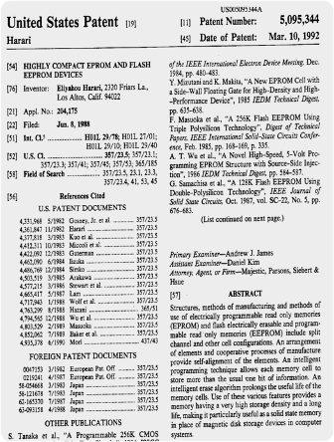
MLC NAND Flash
Driving the cost curve
SanDisk Invented MLC flash
MLC has been key to cost reductions
% Cells
SLC
1
0
V_{t}
% Cells
MLC
11
01
10
00
V_{t}

Slide 5
The SSD Challenge
Replicate and speed up HDD functionality
Page within a block
Minimum Read/Write Size ~8kB
Block within a NAND component Minimum Erase size ~512kB
Flash
Drive
Host
System
Read/Write to
512B Sectors
Controller
External Interface
Internal NAND Bus
NAND Component Containing up to 64k blocks

Slide 6

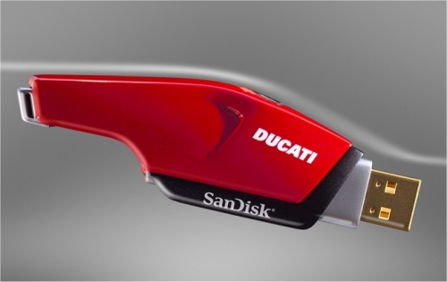



In Digital Media Applications
Usage pattern minimizes conflict
Garbage Collection
Flash
Drive
Digital Camera
Controller
External Interface
Internal NAND Bus

Slide 7

In Digital Media Applications
Block based mapping is extremely effective
Sector ranges are
tied together and
mapped to an
available block
Controller
Internal NAND Bus
External Interface
Internal NAND Bus
External Interface
Works very well
for streaming
(digital media)
traffic

Slide 8
TrueFFSTM
The optimal block based file system
Static & Dynamic
Wear Leveling
TrueFFSTM
Introduced by SanDisk (msystems) in 1994
The leading flash
management in
the industry
Used by Sony,
Nokia & Windows 95
Dynamic Bad Block
Management
ADVANCED FLASH MANAGEMENT
Write/Erase
Virtual Mapping
Basic
Endurance
Flash
Management

Slide 9
Full Featured Client OS
Usage pattern requires something new
Word
Powerpoint
Excel
Photoshop
Outlook
Random
Read ≤16kB
Random
Read ≥32kB
Random
Write ≤ 16kB
Random
Write ≥ 32kB
Sequential
Read
Sequential
Write
Vast majority of writes are random ≤16kB
  Over 50% of random writes are 4kB or less
Mismatch to block size is significant
Office 2007 & ADOBE Photoshop CS2 under Vista

Slide 10
In Computing Applications
Block based mapping hurts random write
NAND Flash does not support over-writing a page
Read – Modify - Write
Host
System
Controller
Internal NAND Bus
External Interface
Internal NAND Bus
External Interface

Slide 11
Introducing ExtremeFFSTM
The next generation SSD algorithm
Static & Dynamic
Wear Leveling
TrueFFSTM
Page based Data
Allocation
Dynamic Bad Block
Management
ADVANCED FLASH MANAGEMENT
Write/Erase
Virtual Mapping
PC CLASS FLASH MANAGEMENT
Basic
Endurance
Flash
Management

Slide 12

Introducing ExtremeFFSTM
The next generation SSD algorithm
Mark old page invalid and write new data to
an available location
NAND Flash does not support over-writing a page
No longer any tie between sectors, pages and blocks
Controller
Internal NAND Bus
External Interface
Internal NAND Bus
External Interface
ExtremeFFSTM simply writes data where it’s
most convenient

Slide 13
Introducing ExtremeFFSTM
The Next Generation SSD Algorithm
Static & Dynamic
Wear Leveling
TrueFFSTM
Page based Data
Allocation
Dynamic Bad Block
Management
Fully non-Blocking
Architecture
ADVANCED FLASH MANAGEMENT
Usage Based
Content
Localization
Write/Erase
Virtual Mapping
PC CLASS FLASH MANAGEMENT
Basic
Endurance
Flash
Management
ExtremeFFSTM

Slide 14
Solid State Drives
A new industry needs new benchmarks
Reliability
  1-4% of HDDs fail annually in a corporate notebook environment; SSDs reduce this failure rate by 80%
  Most HDDs fail due to mishandling (dropping); SSDs are relatively immune to shock and vibration
  But NAND Flash has finite endurance…
Performance
  HDD performance is measured in RPM
  SSDs need a simple performance measure

Slide 15
Reliability - Endurance
Longterm Data Endurance (LDE)
Definition: The total amount of writes allowed in an SSD’s lifespan = LDE
  Write Pattern – BAPCO – typical business user
  Retention – Data is retained for at least one year
  after LDE is consumed
LDE can be used to estimate an SSD’s lifespan
  SSD with an LDE of 80 TBW (terabytes written)
  A system that writes 20GB/day
  Lifespan is 80,000 / 20 = 4,000 days = >10 years

Slide 16
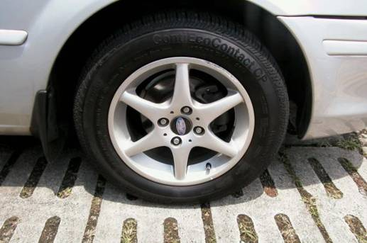
Reliability – Endurance
Longterm data endurance (LDE) update
Think of LDE like tire design life (e.g.,60k miles):
  For a typical user, usable life will exceed LDE
  Realtime endurance data is in discussion at T13

Slide 17
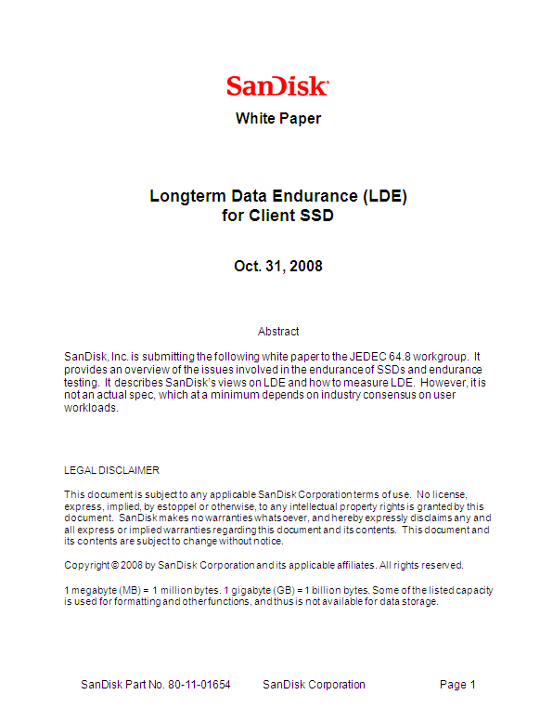

Reliability – Endurance
Longterm data endurance (LDE) update
SanDisk proposed the first industry measure of SSD endurance (LDE) in July/08
  All major PC OEMs and competitors have reviewed and commented on initial proposal
SanDisk submitted a whitepaper on to JEDEC in October
  Working with partners to drive LDE as an industry standard

Slide 18
Performance
In the client PC usage model
Word
Powerpoint
Excel
Photoshop
Outlook
Random
Read ≤16kB
Random
Read ≥32kB
Random
Write ≤ 16kB
Random
Write ≥ 32kB
Sequential
Read
Sequential
Write
How do HDDs support this usage model?
  System Performance is dependently
  almost solely upon random performance

Slide 19
Spin The HDD Faster And Faster
Random Performance α RPM
Application
Completion time for HDD random access command
Command overhead
Seek time
Rotational latency
Data transfer time
1
4
File System
3
2

Slide 20
Translating HDD Performance
Matching read/write ratios
SSDs read much faster than they write
  10-100x difference in random read & write
  performance at NAND level
  Windows XP and Vista R:W ratio in typical
  environments is 50:50 +/- 10%
 | Mobile SSD Performance*
 | IOPS_R | IOPS_W | PC_IOPS
2006/7 | 5,000 | 10 | 20
2008 | 10,000 | 100 | 200
2009 | 20,000 | 400 | 785
*Industry averages, not representative of a specific product

Slide 21

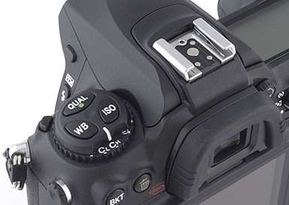

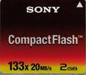
Digital Analogues
In Digital Photography
Even in Flash Memory
1x = 150kB/s

Slide 22
Introducing virtualRPM (vRPM)
How fast would you have to spin an HDD to achieve the net performance of an SSD?
 | 2.5” HDD* |  |  | Mobile SSD*
 | IOPS_R | IOPS_W | RPM | IOPS_R | IOPS_W | PC_IOPS | vRPM
2006/7 | 41 | 42 | 5,400 | 5,000 | 10 | 20 | ~1,000
2008 | 70 | 113 | 7,200 | 10,000 | 100 | 200 | ~10,000
2009 | 75 | 120 | 7,200 | 20,000 | 400 | 785 | ~40,000
…and we’re just getting started
*Industry averages, not representative of a specific product

Slide 23
Conclusions
Introduction of a fundamentally new flash management system ExtremeFFSTM
  Dramatic improvement in performance and
  reliability for Compute Applications
  Will ship in SanDisk products in 2009
SSD will revolutionize Client storage, but
requires new ways of thinking
  vRPM: Simple performance measure to compare
  SSD to HDD and SSDs to each other
  LDE: Simple endurance measure for end users
  Eventually – treating SSDs differently than HDDs

Slide 24
Call to Action
SSD adoption is not going to happen on its
own – to achieve it the industry needs
  Simple, useful and accurate metrics – vRPM, LDE
  Endurance as a marketing rather than QA feature
  SSD Price Points that make the choice easy
We encourage others to follow SanDisk’s lead
to take SSDs to the mass market

Slide 25



Please Complete A Session Evaluation Form
Your input is important!
Visit the WinHEC CommNet and complete a Session Evaluation for this session and be entered to win one
of 150 Maxtor® BlackArmor™ 160GB External Hard Drives
50 drives will be given away daily!
http://www.winhec2008.com
BlackArmor
Hard Drives provided by:

Slide 26


© 2008 Microsoft Corporation. All rights reserved. Microsoft, Windows, Windows Vista and other product names are or may be registered trademarks and/or trademarks in the U.S. and/or other countries.
The information herein is for informational purposes only and represents the current view of Microsoft Corporation as of the date of this presentation. Because Microsoft must respond to changing market conditions, it should not be interpreted to be a commitment on the part of Microsoft, and Microsoft cannot guarantee the accuracy of any information provided after the date of this presentation.
MICROSOFT MAKES NO WARRANTIES, EXPRESS, IMPLIED OR STATUTORY, AS TO THE INFORMATION IN THIS PRESENTATION.

