Slide 1
Distributed Scan Management
Erhan Soyer-Osman
Program Manager
Microsoft Corporation
Mike Fenelon
Senior Developer
Microsoft Corporation

Slide 2
Distributed Scan Management
Feature Overview
Brand new role service under ‘Print
and Document Services’ role in
Windows Server 2008 R2
Focus: Secure, Controlled,
Distributed Network Scanning
Bottom Line
  Devices can do more than print!
  Allows IT-Administrators to take full advantage of device capabilities using Windows Server

Slide 3


Distributed Scan Management
Solving Difficult Problems

Slide 4
Distributed Scan Management
Solving Difficult Problems
Difficult to centrally manage scanning
in an enterprise/organization
IT-Administrators have a difficult time controlling user scanning activities
Users want the ability to access their personal scan processes from anywhere

Slide 5

Distributed Scan Management
Features
Scan Management Console
  Easily track scanners and
  create Scan Processes for users
Distributed Scan Server
  Secure scanning to Email,
  Sharepoint and Fileshare
  Active Directory
  Control scanning in your organization

Slide 6
Windows Vista And Windows Server 2008 Web Services On Devices Scan Architecture
WIA App
Windows Vista/ Server 2008
WIA
WSDScan
Class Driver
WIA Driver
WS-SCAN
Scan Device
Scan Device
Provided by:
Microsoft
Software Vendor
Hardware Vendor

Slide 7
Windows 7 And Windows Server 2008 R2 Web Services On Devices Scan Architecture
SharePoint
Distributed Scan
Server
Scan Management
Console
WIA App
LDAP
LDAP
Windows 7/ Server 2008 R2
Fileshare
WIA
WS-DSP
Distributed Scan Processing
Windows Server 2008 R2
AD
WS-DSD
Distributed Scan Device
WSDScan
Class Driver
WIA Driver
Email
Email
LDAP
WS-SCAN
Scan Device
Scan Device
WS-DSD/WS-DSP
Scan Device
Provided by:
Microsoft
Software Vendor
Hardware Vendor

Slide 8
Scan Management Console
Designed for IT-Administrators
Manage scanners in your network
  Retrieve device configuration and current status
  Create ‘Scan Processes’ – scan
  settings created by IT-Administrator
  on a per-user basis
  Stored in Active Directory

Slide 9
Scan Management Console
Details: Device Interaction
Directed Discovery used to find scanners: WS-Discovery probe message
sent using HTTP unicast
Uses WS-DSD: Distributed Scan Device
  Retrieve scan device capabilities and current status
  Validates Scan Ticket settings during Post-Scan Process creation
  WS-DSD is a sub-set of WS-SCAN

Slide 10
Scan Management Console
Details: WS-DSD
Manage Scanners: ex. GetScannerElements
Create Post-Scan Process: ex. ValidateScanTicket
<dsd:GetScannerElementsRequest>
<dsd:RequestedElements>
<wscn:Name>dsd:ScannerDescription</wscn:Name>
</dsd:RequestedElements>
</dsd:GetScannerElementsRequest>
<dsd:ValidateScanTicketRequest>
<dsd:ScanTicket>
<wscn:DocumentParameters>...
<wscn:InputSource>Platen</wscn:InputSource>
...</wscn:DocumentParameters>
</dsd:ScanTicket>
</dsd:ValidateScanTicketRequest>

Slide 11
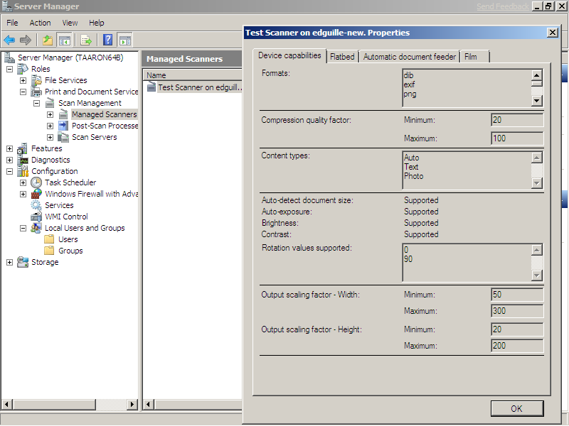

Slide 12
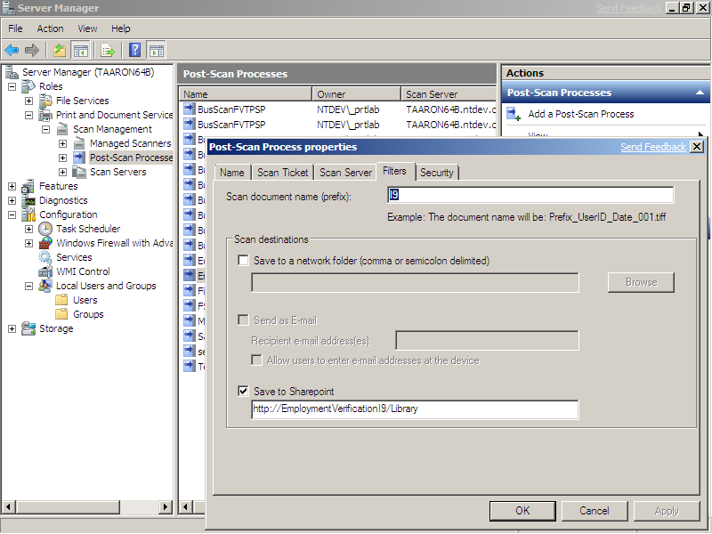

Slide 13
Active Directory
Management of Scan Functionality
Allows users to retrieve Scan Processes from any device in the network
Users no longer have to enter painful
URLs or E-mail addresses into the
front-panel of the device
Control scanning activity on
a per-User basis

Slide 14
Active Directory
Details: Device Interaction
Device queries for new Scan Process objects in Windows Server 2008 R2 schema from the forest
  Objects of class msImaging-PostScanProcess
Device displays Scan Processes to user
public DeviceDisplay<PSPData> GetPSPs()
{
SortedList<PSPData> Psps = new SortedList<PSPData>();
{
DisplayName;
}
DirectorySearcher searcher = new DirectorySearcher(_searchRoot, @"(objectClass=msImaging-PostScanProcess)");
return Psps;
}

Slide 15
Distributed Scan Server
Distributed Scanning, Centralized Management
Scan processing occurs from one central secure point
Centralized management of user scan logging across an enterprise
Easily integrate scan functionality into ECM solutions
Capabilities include: Scan to: SharePoint, Fileshare, E-mail

Slide 16
Distributed Scan Server
Logging
ETW event logs used to track all
user scan activity on the server
IT-Administrators are able to retrieve logging information using the Scan Management Console

Slide 17
Distributed Scan Server
Security
Certificate-based authentication:
HTTPS connections between device and server
  Certificate-based client authentication requires devices to provide X.509 certificate to create connection
  Service Account on server takes actions on behalf of user
class GetCert {
public X509CertificateCollection ClientCertificates { get; set; }
}
...
class CertManager {
X509Store store = new X509Store("My", StoreLocation.CurrentUser);
store.Open(OpenFlags.ReadOnly | OpenFlags.OpenExistingOnly);
...
httpWebRequest.ClientCertificates = fcollection;
store.Close();
}

Slide 18
Distributed Scan Server
Details: WS-DSP
Create Job: ex. CreatePostScanJob
<DSP:CreatePostScanJobRequest>
<DSP:PSP_Identifier>9293B5ED-1BFC-4BA8-9AC2-C41F3F881685</DSP:PSP_Identifier>
<DSP:PostScanInstructions>
.. <PSP:Dialect>http://schemas.microsoft.com/img/filter/sharepoint</PSP:Dialect>
<PSP:Instructions> <SHP:SaveToSharePointSiteURL>http://winhec/scans</SHP:SaveToSharePointSiteURL>
</PSP:Instructions>
..
</DSP:PostScanInstructions>
</DSP:CreatePostScanJobRequest>

Slide 19
Distributed Scan Management
demo

Slide 20
Protocol Stack
WS-DSD and WS-DSP Support
Distributed Scan Server
Scan Management Console
WSDDSP.dll Host
WSDDSD.dll Proxy
WSD API
Devices Profile for Web Services (DPWS)
IP Network
Device
Provided by:
Microsoft
Infrastructure
Hardware Vendor

Slide 21
Hardware Opportunities
Scanner supports DPWS
  WS-DSD: Distributed Scan Device
  WS-DSP: Distributed Scan Processing
  Scanner queries Active Directory
  Search for Scan Processes for users
  Scanner supports HTTPS
  Create secure connection using certificate-based client authentication

Slide 22
Hardware Opportunities
Benefits
Increased scanner usage
  Centralized management for
  scan activity simplifies deployment
Reduced implementation cost
  Scan processes add common
  features at the server
Ease of entry
  Distributed Scanning protocols are built
  upon DPWS (Devices Profile for Web Services)

Slide 23
Call To Action
Give Microsoft feedback on features, protocols, and hardware directions
Develop scanners/MFPs that support Distributed Scan Management
Start planning for Windows
Server 2008 R2 launch

Slide 24
Additional Resources
Feedback and questions
  prninfo@microsoft.com
WS-DSD and WS-DSP protocol specifications (v0.5)
  Request at prninfo@microsoft.com
Related Sessions
CON-C651: Discussions:
Distributed Scanning Architecture
ENT-T543: Windows Devices Profile for Web Services in Windows 7

Slide 25



Please Complete A Session Evaluation Form
Your input is important!
Visit the WinHEC CommNet and complete a Session Evaluation for this session and be entered to win one
of 150 Maxtor® BlackArmor™ 160GB External Hard Drives
50 drives will be given away daily!
http://www.winhec2008.com
BlackArmor
Hard Drives provided by:

Slide 26


© 2008 Microsoft Corporation. All rights reserved. Microsoft, Windows, Windows Vista and other product names are or may be registered trademarks and/or trademarks in the U.S. and/or other countries.
The information herein is for informational purposes only and represents the current view of Microsoft Corporation as of the date of this presentation. Because Microsoft must respond to changing market conditions, it should not be interpreted to be a commitment on the part of Microsoft, and Microsoft cannot guarantee the accuracy of any information provided after the date of this presentation.
MICROSOFT MAKES NO WARRANTIES, EXPRESS, IMPLIED OR STATUTORY, AS TO THE INFORMATION IN THIS PRESENTATION.

