Slide 1
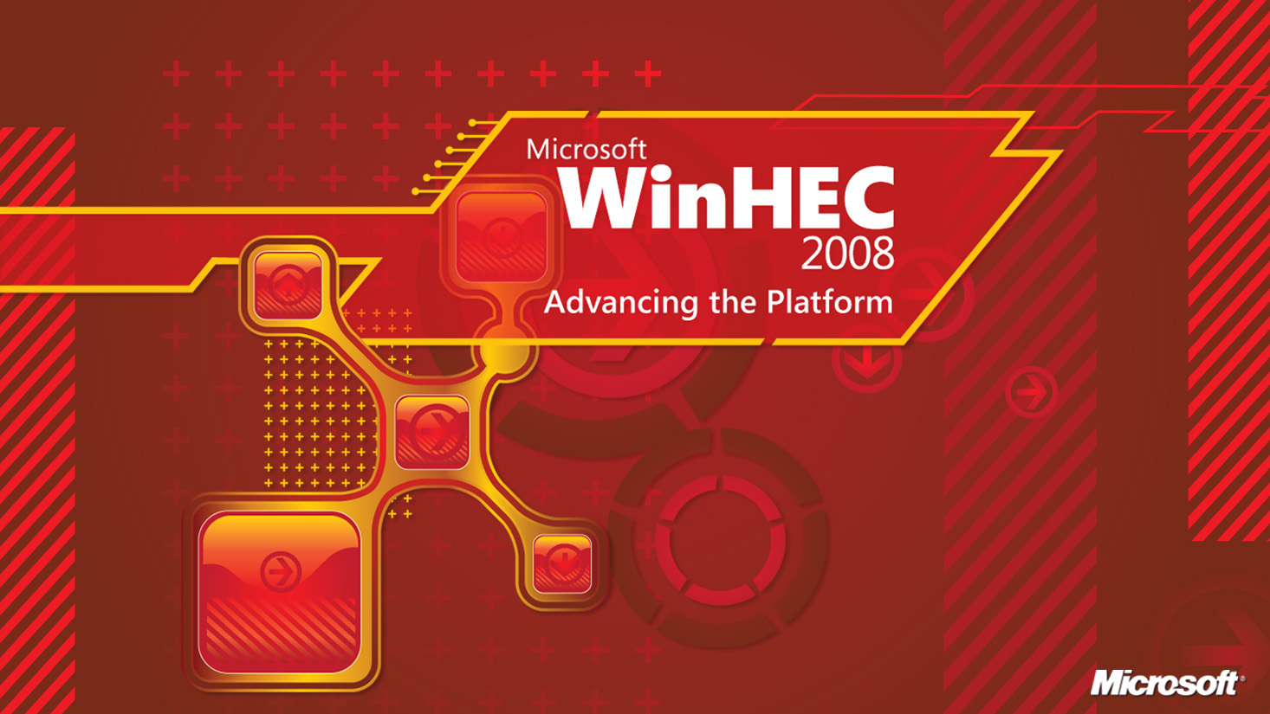

Slide 2
Plug And Play Key Concepts
George Roussos
Senior Program Manager
Jim Cavalaris
Lead Software Design Engineer
Device Foundation Platform Team
Windows Core OS Division
Microsoft Corporation

Slide 3
Agenda
Prepared Content
  Device Installation Fundamentals
  Device and Driver Installation Scenarios
  Hardware-First Installation Sequence
    Search
    Select
    Stage
    Install
  Software-First Installation
  OEM Preload (OS Offline)
  Extending Device Installation
Audience Q&A

Slide 4
Fundamentals
Device Instance
  A unique instance of a model of device detected by the system or other components
  Software and settings are configured for each device instance detected by the system
Device ID
  A fundamental characteristic describing the model of a device
Driver Package
  .INF File and all the files it copies
  Describes software and default settings for applicable devices
  Defines applicability to devices using Device IDs
  Driver Packages may apply to multiple models of devices
  Devices may be supported by multiple Driver Packages

Slide 5
Fundamentals
Driver Store
  Local store containing software and
  settings supported by the system
Driver Selection
  Process of selecting the “best” software
  and settings to configure for a device
Device Installation
  Process of configuring a device
  with selected software and settings

Slide 6
Device IDs
Identifies the model of hardware
  Format defined by bus driver
  Treated as opaque strings – are not parsed!
Discovered before drivers selected
Used to select matching drivers
Reported by drivers as two separate lists
  Hardware IDs
    Usually includes manufacturer and model information
  Compatible IDs
    Usually includes “generic” IDs
      Without specific manufacturer or model information
    Compatible IDs considered for match only after Hardware IDs
Each list is ordered from most to least specific
Hardware IDs:
USB\Vid_vvvv&Pid_pppp&Rev_rrrr
USB\Vid_vvvv&Pid_pppp
Compatible IDs:
USB\Class_cc&SubClass_ss&Prot_pp
USB\Class_cc&SubClass_ss
USB\Class_cc

Slide 7
Driver Packages
Consists of the INF file and any associated files
  Simple text file (INF file), required
  Driver files (.sys, .dll files), optional
  Digital signature (.cat), best practice
Describes supported devices
  Hardware IDs, Compatible IDs
  A package’s IDs are the “applicability rules”
Specifies associated files
  Where to find them relative to INF
  Where to copy them on system
Defines settings
  Instance-specific default registry settings
Driver Package
INF
ID1, ID2, ID3,…
File 1
File 2
File 3
File 4

Slide 8
Driver Store
Local copy of complete driver packages
  All files required for all devices supported by the INF are always present
  Drivers are available to the System to automatically install new devices without user intervention (“hardware-initiated”)
A driver package must be “staged” to the Driver Store before the driver can be used to install any devices
  “Driver staging“ and “Device installation”
  are logically separate operations
Driver Store
INF 1
File 1
File 2
File 3
File 4
INF 2
File 1
File 2
File 3
File 4
INF 3
File 1
File 2
File 3
File 4
. . .

Slide 9
Device And Driver Installation Scenarios
Most developers consider installation with an interactive user present.
How many of you have thought about or performed device installation in the following contexts?
  OS installation
  OS SKU upgrade (e.g., Home Basic to Ultimate)
  OS Service Pack install
  Settings transfer from old PC to new PC (same or different OS versions)
  Home Server machine recovery—boot client off CD & restore system from image on Home Server
  Hardware first install before user logs in
  OEM factory floor preloads where no user is logged in
  IT department mass deployment with no interactive user
  IT department remotely pushing a driver update to a machine where the user doesn’t have administrator credentials
  Windows Update, Auto Update
  Headless server, Terminal Server, etc.

Slide 10
Device And Driver Installation Scenarios
Encourage you as developers to concentrate on the general case of device installation when authoring your driver packages. Please avoid special-casing specific install scenarios when authoring your packages.
Attend “Creating Deployable Driver Packages for Windows” WinHEC 2008 presentation about authoring installs to work in these scenarios.

Slide 11
Hardware-First Installation Sequence
A Hardware-First Installation is triggered when
a user attaches a device to a system
Go through a sequence that illustrates what PnP does in
Windows 7 from the point at which a user attaches
a USB device up to when a user can use that device
Four phases of Hardware-First Installation Sequence:
Search
Select
Stage
Install

Slide 12
Search
Driver Search
  The Search phase defines where PnP searches for drivers that match a device, and in what sequence
  DevicePath: A registry location that may contain a list of UNC paths that PnP will search for driver packages
  HKEY_LOCAL_MACHINE\Software\Microsoft\Windows\CurrentVersion\DevicePath
Search
Select
Stage
Install

Slide 13
Search
Which Locations PnP searches in what order per Windows OS version
Sequence | Windows Vista | Windows 7
1 | Driver Store | Windows Update
2 | DevicePath | DevicePath
3 | Windows Update | Driver Store
4 | Prompt for Media

Slide 14
Select
Driver Selection
The Select phase is where Ranking occurs.
Ranking is the method PnP uses to determine the best driver match from more than one available driver package for a device.
Rank Factors – in a progressive tie-breaker fashion:
  Signature for driver package
  Feature score (primarily matters for Display choosing XP or Vista driver model)
  Rank of matching Device ID (Hardware ID or Compatible ID)
  DriverVer Date field
  DriverVer Version field
Given two packages, if both are equivalently signed, next PnP compares the feature score,
then Hardware ID, and so forth to determine which is the best driver match
New in Windows 7 – By default, Windows 7 will treat all
properly digitally signed driver packages as equals in the
PnP Ranking process.
For details, see How Setup Selects Drivers (Windows Vista)
http://msdn2.microsoft.com/en-us/library/aa477022.aspx
Select
Search
Stage
Install

Slide 15
Driver Selection
Find common IDs between
device and driver packages
  Exact ID match required
Best match determined by
“driver ranking” algorithm
  Position of matching ID in
  Device’s ID lists
  Position of matching
  ID in INF’s ID list
  Digital signature “score”
  Date, Version used for tiebreaker only!
If selected driver is not present in the
Driver Store, it must first be “staged”
INF
ID1, ID2, ID3,…
best match
File 1
File 2
File 3
File 4
Hardware IDs:
USB\Vid_vvvv&Pid_pppp&Rev_rrrr
USB\Vid_vvvv&Pid_pppp
Compatible IDs:
USB\Class_cc&SubClass_ss&Prot_pp
USB\Class_cc&SubClass_ss
USB\Class_cc
INF
ID1, ID2, ID3,…
File 1
File 2
other match
File 3
File 4
no match!!
INF
ID1, ID2, ID3,…
File 1
File 2
File 3
File 4

Slide 16
Stage
Driver Staging
The Stage phase is where driver packages are imported into
the Driver Store (unless already present) before installation.
Digital Signature evaluation occurs during the Stage phase.
De-couple staging from installation of drivers. Two distinct
operations in Windows Vista and onwards.
Different permissions required to stage vs. install drivers, which
enables additional Standard User device installation scenarios.
Stage
Search
Select
Install

Slide 17
Driver Staging
Driver Disk
May be Original Media, Windows Update, DevicePath, Local Directory or Network Share, etc.
INF
File 1
File 2
File 3
File 4
Allows flexible access rights requirements for user-initiated store importation
Digital signature validation and unsigned driver consent prompt performed only once
System actions
Drivers can be “staged” independently of device installation
Driver Store
INF
File 1
File 2
File 3
File 4

Slide 18
Install
Device Installation
The Install phase configures the device; it loads and starts executing the driver.
Installation is performed in a non-interactive system context
regardless of permission of any currently logged in user.
Loads the driver into memory and instantiates against a specific device instance.
A Finish-Install Action or Co-installer may be launched at the end of the Install phase.
Install
Search
Select
Stage

Slide 19

Device Installation
User privilege not required to directly manipulate files or settings
Allows flexible access rights requirements for user-initiated device installation
System actions
No additional signature or file prompts for installation of devices using staged drivers
Driver Store
Target Destination
INF
File 1
File 2
File 3
File 4
File 3
File 4

Slide 20
Hardware-First Installation
Driver Disk
INF
File 1
File 2
File 3
File 4
Software or user selection of “unstaged” driver
System actions
Driver Store
Target Destination
INF
File 1
File 2
File 1
File 2
Re-select “staged” driver
File 3
File 4

Slide 21
Hardware First Install Sequence: Windows 7
Search Driver Store and find best match
Basic Driver OK?
Yes
No
Better match on WU?
Yes
Search Windows Update
No
Download driver
Stage into Driver Store
Best match in
Device
Path?
Yes
Search Driver Store and DevicePath
Core Device Installation
No
User attaches device
Best match in Driver Store?
Yes
start
end
No

Slide 22
Software-First Installation
A Software-First install is a Hardware-First Install preceded by running a Setup.exe application.
The Software-First Install sequence of events is:
An interactive user with Administrative credentials launches Setup.exe application.
Setup.exe stages the driver install package by calling an API like SetupCopyOEMInf, DiInstallDriver, or DIFx DriverPackagePreinstall.
Setup.exe *may or may not* force the selection of the driver install package using the “force” flag.
Setup.exe triggers driver package install by calling UpdateDriverForPlugAndPlayDevices, DiInstallDevice, or DIFx DriverPackageInstall.
Setup.exe can perform other actions—such as installing applications—
before or after installing the device.
Stage
Select
Install

Slide 23
Software-First Installation
Driver Disk
INF
File 1
File 2
File 3
File 4
System actions
System selection of “staged” driver
Driver Store
Target Destination
INF
File 1
File 2
File 3
File 4
File 3
File 4

Slide 24
OEM Preload (OS Offline)
During an OEM Preload, staging occurs under a different “Host” OS like WinPE.
  There is no means for user input during staging beyond specifying file name.
Key Definitions
  Offline Windows image (OS Offline)
    A Windows image that is not currently running, either an image
    in a .wim file or a Windows installation on a separate partition.
  Package Manager
    A command line tool that ships in the OEM Preinstall Kit OPK) and the Windows
    Automated Install Kit (WAIK) for adding 3rd party driver packages to Offline Windows image(s).
  F6
    When booting from DVD media, Windows OS setup can prompt the user
    to insert additional driver packages that may be required to

Slide 25
OEM Preload (OS Offline)
The OEM Preload (OS Offline) Install Sequence of events is:
Host OS OS install on Target machine
During OS install on Target machine there is no means for user input during Search, Select, and Install phases
Stage
Search
Select
Install

Slide 26
Extending Device Installation
How do I install applications related to a device as part of a Hardware-first Installation?
  Co-installer
  Finish-install action
Each approach has pros and cons. We encourage interested parties to attend the following WinHEC 2008 sessions:
    Creating Deployable Driver Packages for Windows
    Extending Device Installation by Using Co-Installers

Slide 27
Call To Action
Consider the vast number of different installation
scenarios when authoring your driver packages.
  Assume that someone is going to use your driver package
  in other installation scenarios than you originally intended.
  Remember all the “non-interactive user” scenarios.
  Don’t hard-code your install for one scenario:
    Software-first, non-Administrator users,
    OS installation, Offline staging, etc.
  Recognize that the different phases of PnP installation
  occur in different sequences depending upon the installation scenario.
OS Offline is a new context introduced in Windows
Vista that matters to OEMs and IT departments.
  Get the Windows Automated Install Kit (WAIK) and stage packages to offline images
  Test your install package in OS Offline scenarios using the WAIK.

Slide 28
Related Sessions
Wednesday
11:00-12:00 154 Windows 7 Device Experience Overview
2:00-3:00 154 Windows 7 Device Installation Experience
3:15-4:15 154 Windows 7 Device Experience Part 1
4:30-5:30 154 Windows 7 Device Experience Part 2
Thursday
11:00-12:00 Hall K Plug and Play Key Concepts
3:15-4:15 404 A/B Unifying Wireless & Network Device Install Experience in Win 7
Friday
8:30-9:30 404 A/B Creating Deployable Driver Packages for Windows
8:30-9:30 409 B PC and Devices in Windows 7: What You Need to Know
9:45-10:45 404 A/B Common Driver Installation Errors and How to Diagnose Them
11:00-12:00 404 A/B Extending Device Installation with Co-Installers
11:00-12:00 409 A Discussion: Device Center, Bluewire, and Device Installation
1:15-2:15 404 A/B Device Interfaces Overview

Slide 29
Additional Resources
Web Resources:
  Windows Automated Installation Kit (WAIK)
    Nearly identical to OPK
    Go to http://www.microsoft.com/, search for “Windows Automated Installation Kit” or “WAIK” and download from there
  WDK documentation on MSDN
    How Setup Selects Drivers (Windows Vista)
    http://msdn2.microsoft.com/en-us/library/aa477022.aspx

Slide 30
Audience Q & A

Slide 31
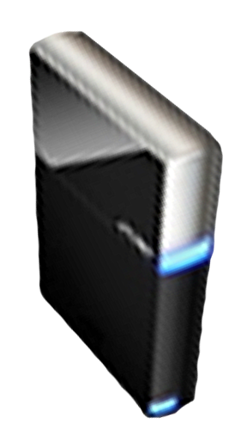


Please Complete A Session Evaluation Form
Your input is important!
Visit the WinHEC CommNet and complete a Session Evaluation for this session and be entered to win one
of 150 Maxtor® BlackArmor™ 160GB External Hard Drives
50 drives will be given away daily!
http://www.winhec2008.com
BlackArmor
Hard Drives provided by:

Slide 32

© 2008 Microsoft Corporation. All rights reserved. Microsoft, Windows, Windows Vista and other product names are or may be registered trademarks and/or trademarks in the U.S. and/or other countries.
The information herein is for informational purposes only and represents the current view of Microsoft Corporation as of the date of this presentation. Because Microsoft must respond to changing market conditions, it should not be interpreted to be a commitment on the part of Microsoft, and Microsoft cannot guarantee the accuracy of any information provided after the date of this presentation.
MICROSOFT MAKES NO WARRANTIES, EXPRESS, IMPLIED OR STATUTORY, AS TO THE INFORMATION IN THIS PRESENTATION.

