Slide 2
Windows 7 Device Installation Experience
Richie Fang
Program Manager
Microsoft Corporation

Slide 3
Agenda
Vista versus Windows 7 user experience
  Installing drivers
  Installing device-related application
  What you need to do
Takeaway: device installation just works!
  Easy for your user to get all your software
  Get logo‘d, put driver on Windows Update

Slide 4








Where Do We Find Drivers?
Windows Update
Software/driver distribution service for Windows
1
Driver Store
Local driver repository of installable drivers
Device Path
OEM or IT administrator specified folders where Windows should search for drivers
2

Slide 5
Three Major Improvements in '7'
Automatic
  Searches all driver locations
  Download driver if necessary
  Install
  No more prompts
  No more elevation
  No more wizard UI (now automatic)
  Works even when no user logged on

Slide 6
Three Major Improvements in '7'
Accurate
  Search Windows Update first
  Improved status information
Improved performance
  No longer capture System Restore point
  Concurrency built-in
  User can cancel a lengthy driver download
  Special-case certain devices to not search Windows Update
Better User
Experience!

Slide 7
User Experience – Scenarios
Driver in the Driver Store
Driver on Windows Update
Driver in the Driver Store but a better one on Windows Update
Driver in Device Path
No driver
Driver on a disc

Slide 8
Scenario 1
Driver is in the Driver Store

Slide 9
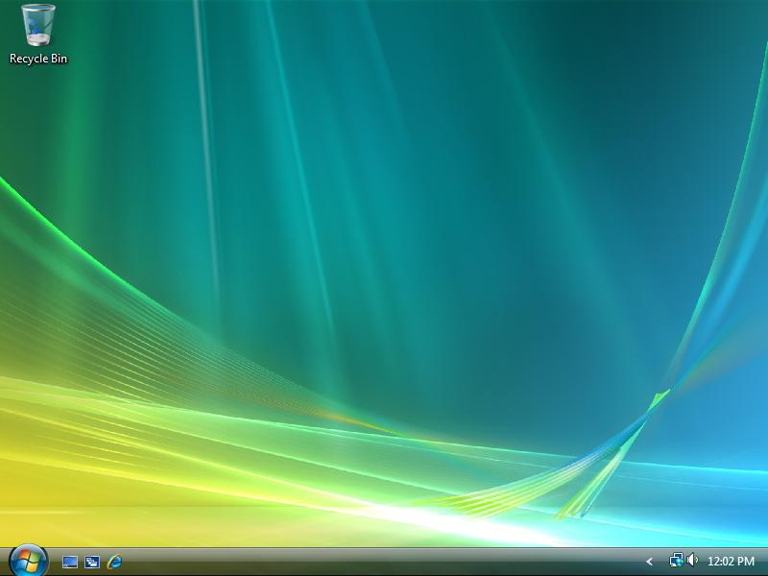
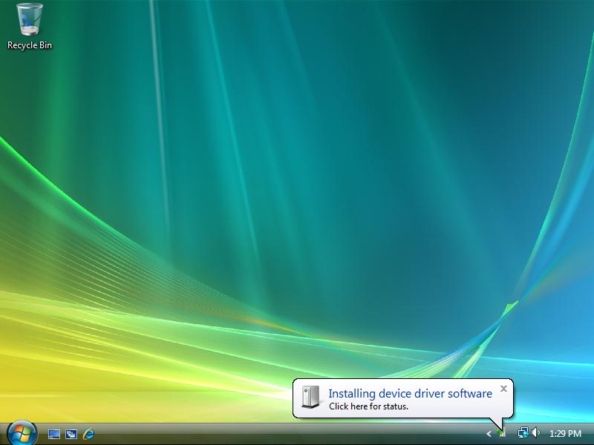
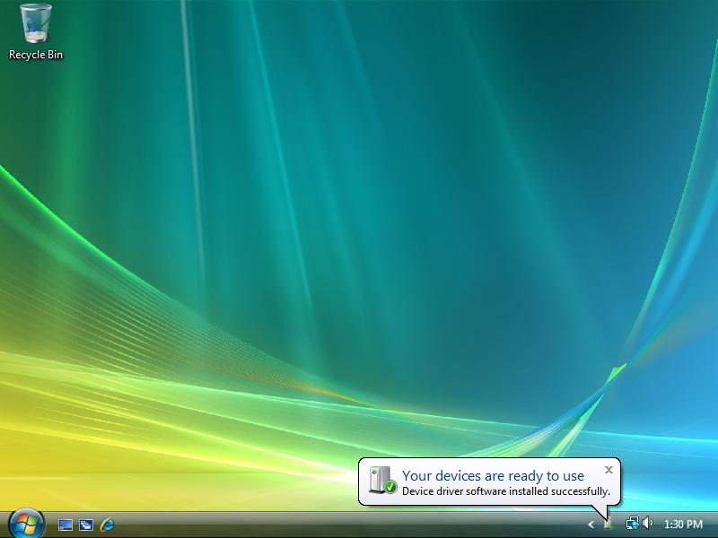
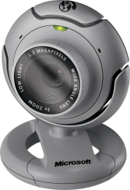

Scenario 1: Driver is in Driver Store
Vista
Windows 7

Slide 10
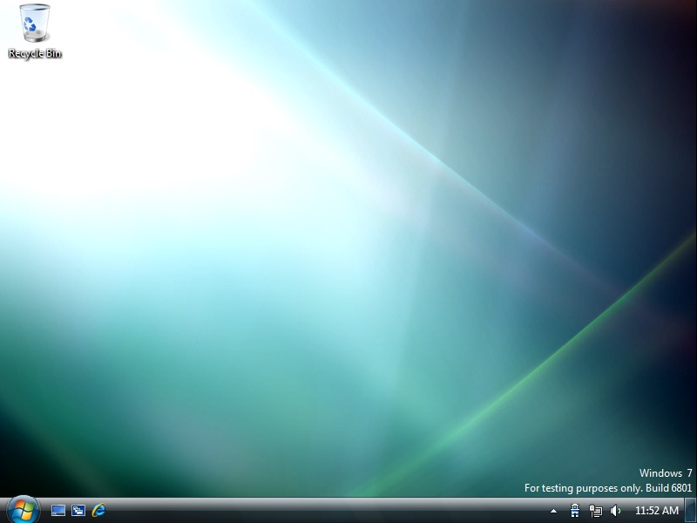
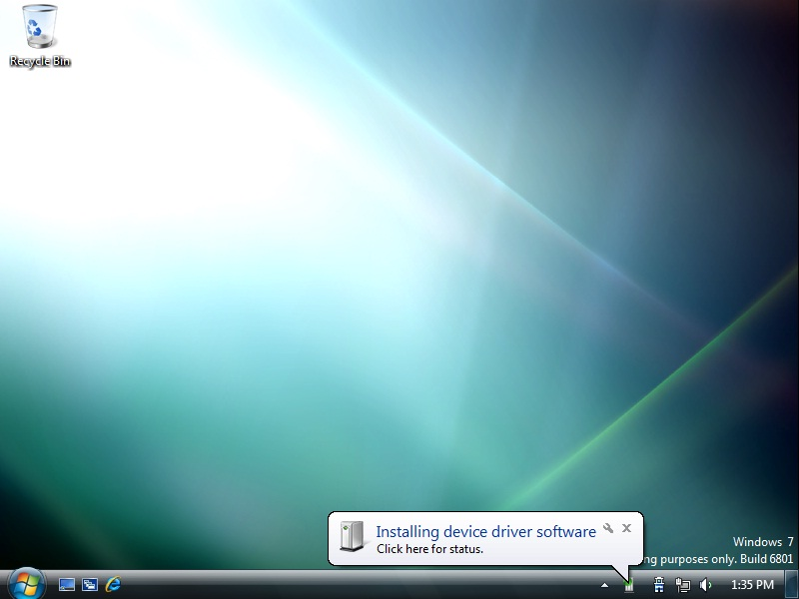
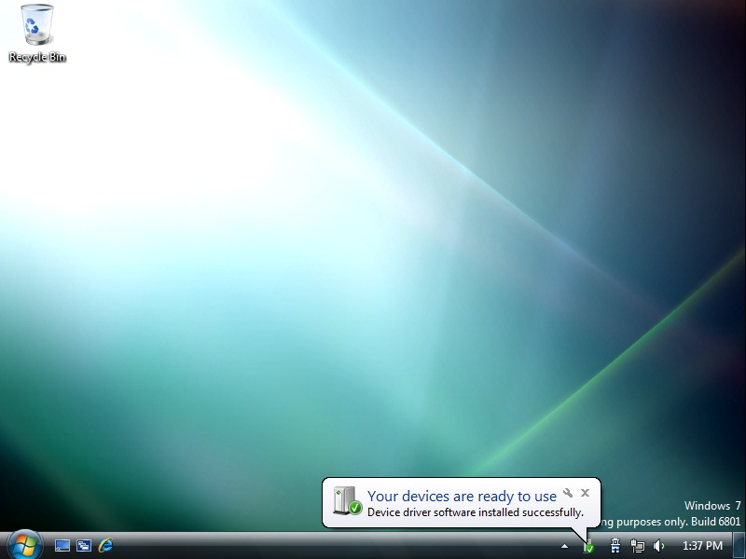
Scenario 1: Driver is in Driver Store
Vista
Windows 7

Slide 11
Scenario 1:
Driver is in the Driver Store
Vista
  0 click
  Driver Store driver installed
Windows 7
  0 click
  Driver Store driver installed

Slide 12
Scenario 2
Driver is on Windows Update

Slide 13
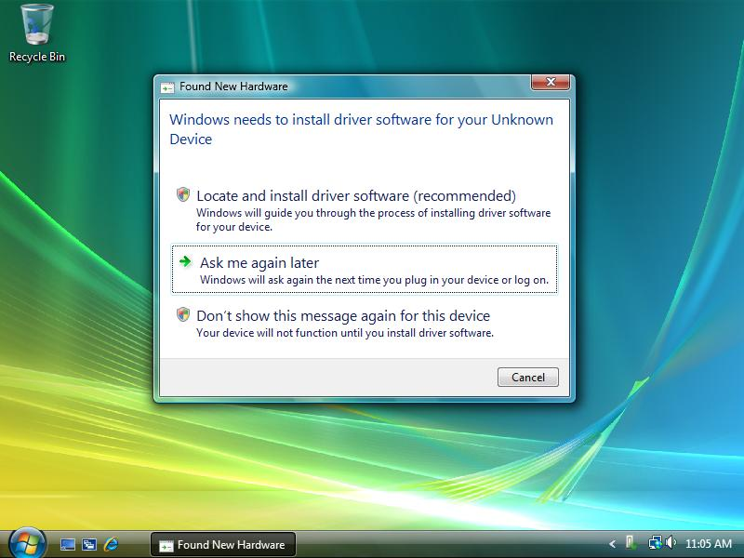
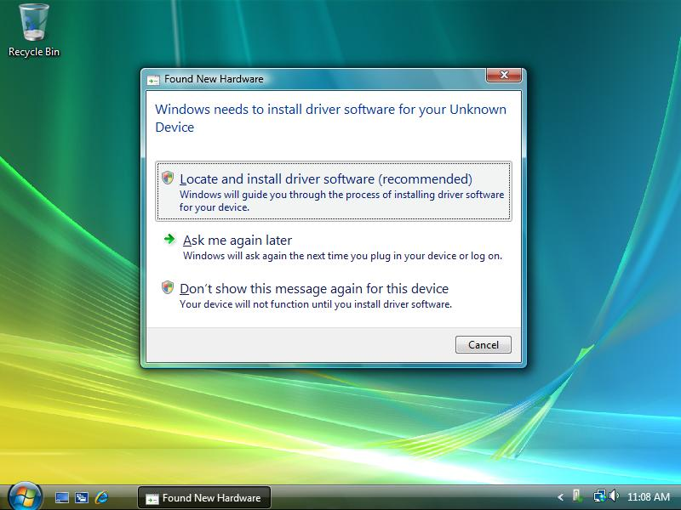
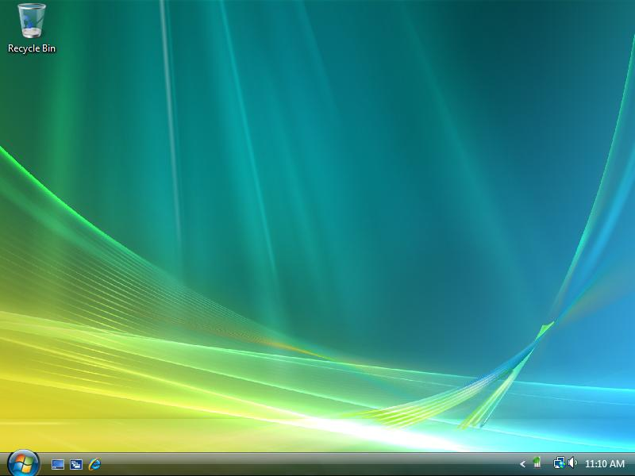
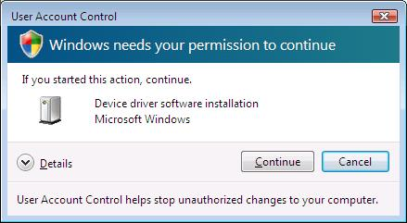

Scenario 2: Driver is on Windows Update
Vista
Windows 7
1
2
2 decision points where the wrong choice could be made!

Slide 14
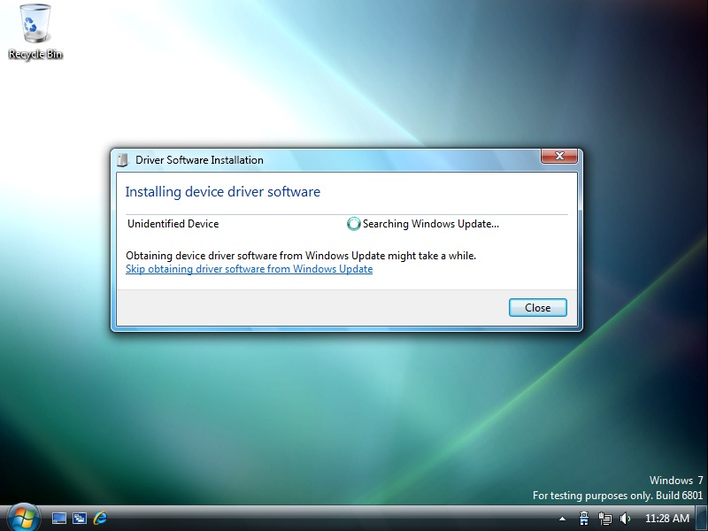
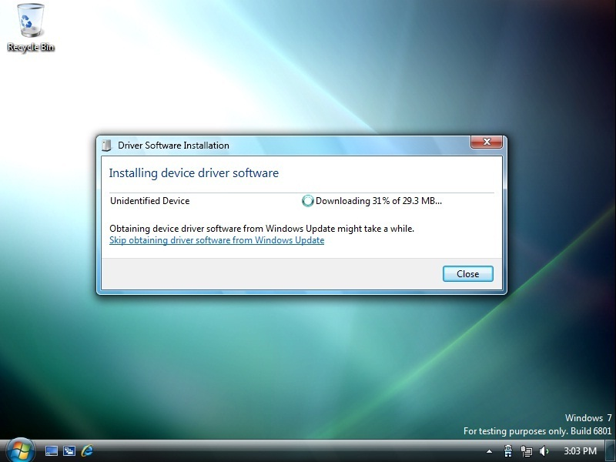
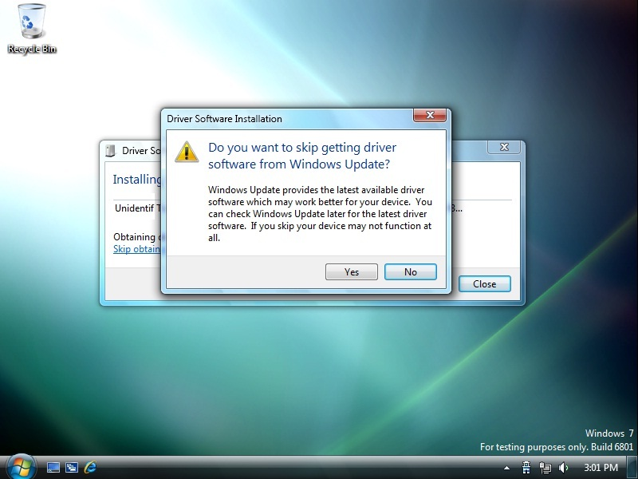

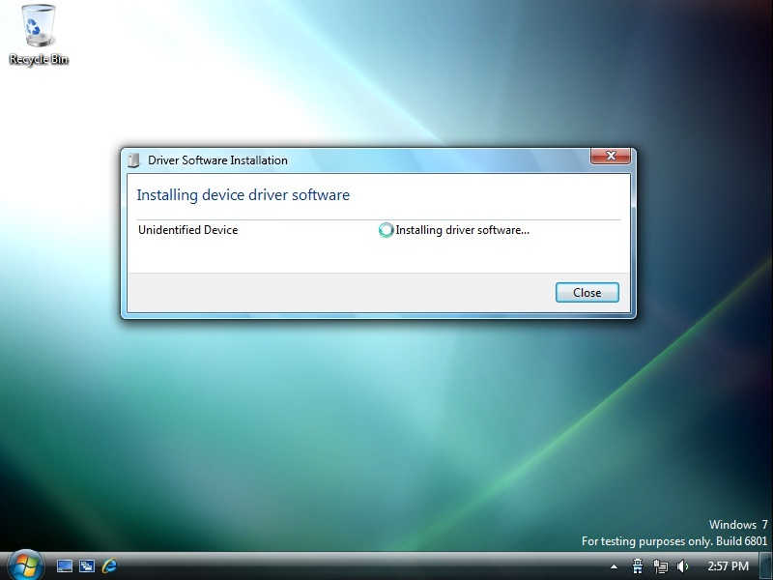
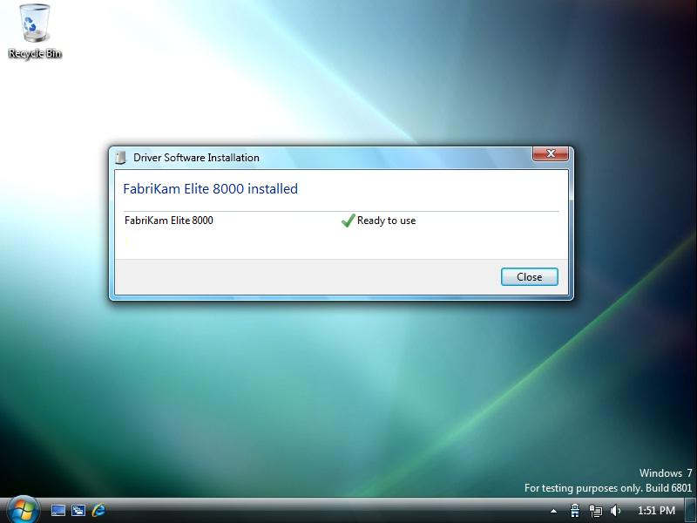

Scenario 2: Driver is on Windows Update
Vista
Windows 7
Replay

Slide 15
Scenario 2
Driver is on Windows Update
Vista
  2 clicks
  Windows Update driver installed
Windows 7
  0 click
  Windows Update driver installed

Slide 16
Scenario 3
Driver in the Driver Store,
Better one on Window Update

Slide 17

Scenario 3: Driver in the Driver Store, better one on Windows Update
Vista
Windows 7
Depends…
Did not install driver from Windows Update!

Slide 18
Scenario 3: Driver in the Driver Store, better one on Windows Update
Vista
Windows 7

Slide 19
Scenario 3
Driver in the Driver Store, better one on Windows Update
Vista
  0 click
  Driver Store driver installed – Wrong driver!
Windows 7
  0 click
  Windows Update driver installed – Right driver!

Slide 20
Scenario 4
Driver is in Device Path

Slide 21
Scenario 4: Driver is in Device Path
Vista
Windows 7

Slide 22
Scenario 4: Driver is in Device Path
Vista
Windows 7

Slide 23
Scenario 4
Driver is in Device Path
Vista
  2 clicks
  Device Path driver installed
Windows 7
  0 click
  Device Path driver installed

Slide 24
Scenario 5
No driver found

Slide 25
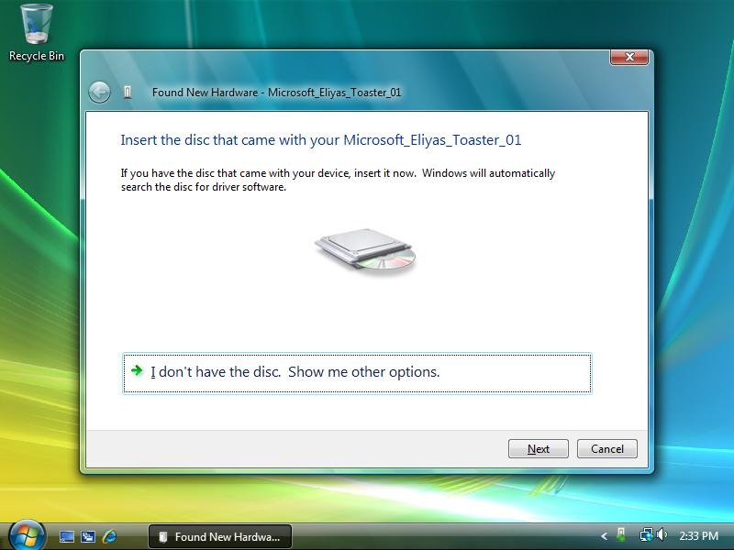
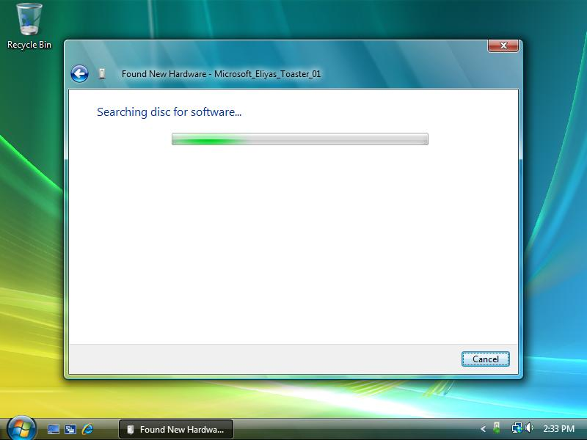
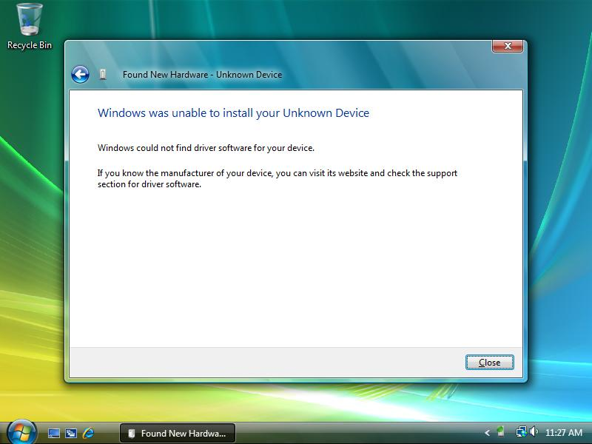
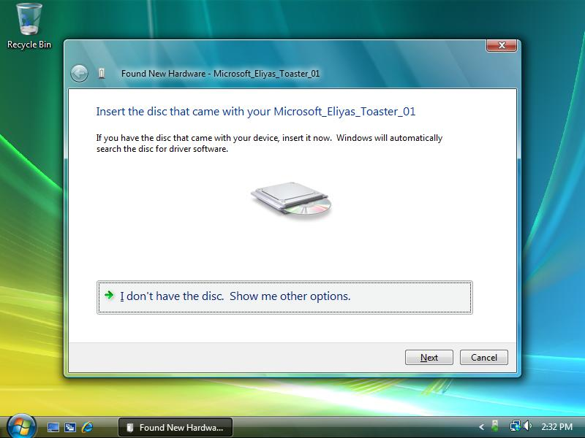
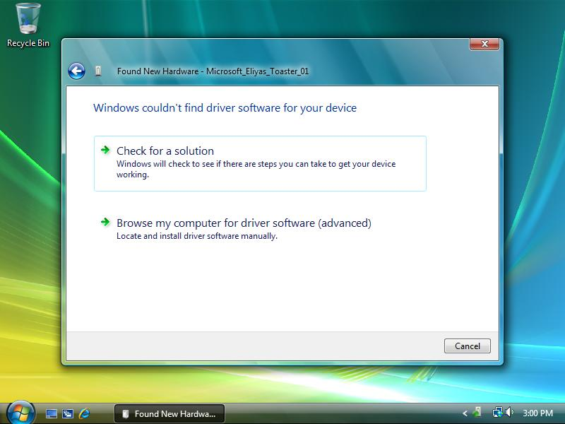
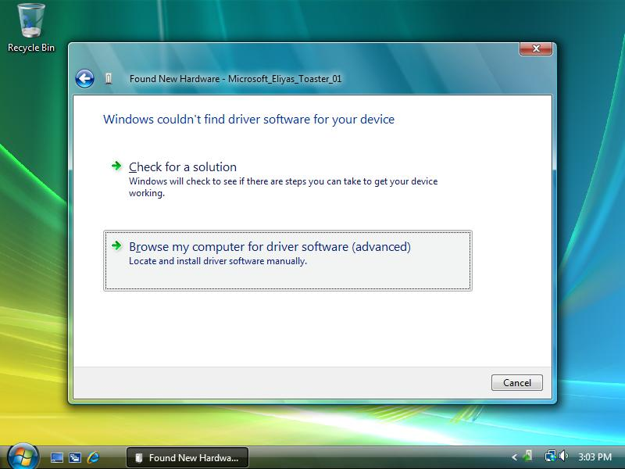
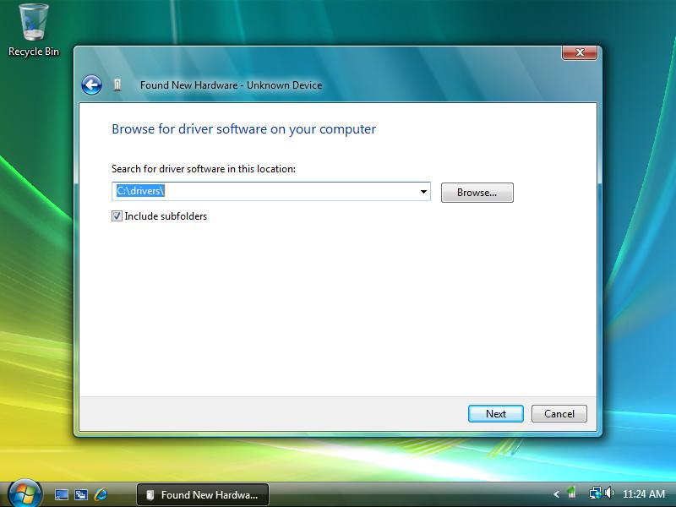
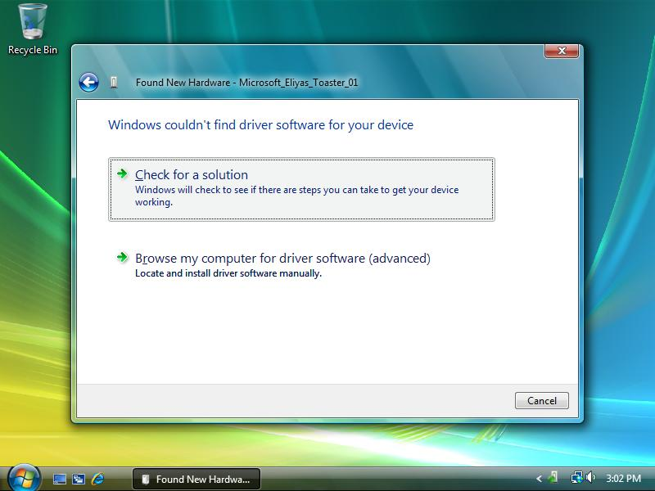

Scenario 5: No driver found
Vista
Windows 7
4
8
1
9
2
6
5
7
10
3
10 clicks! Only to find out there’s no driver

Slide 26
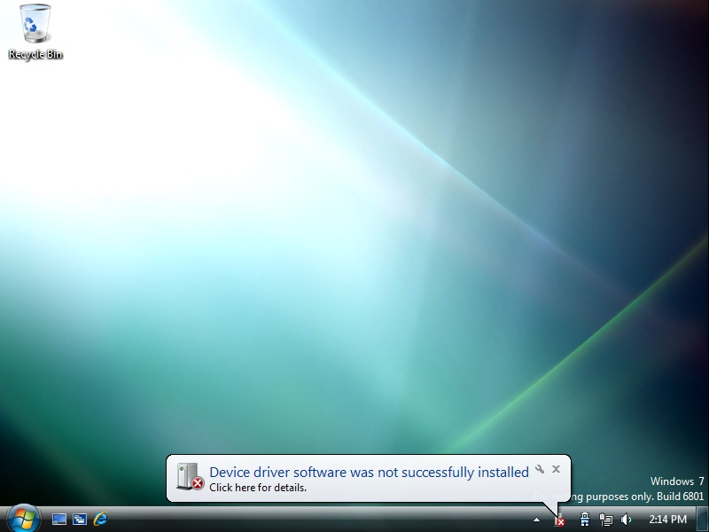
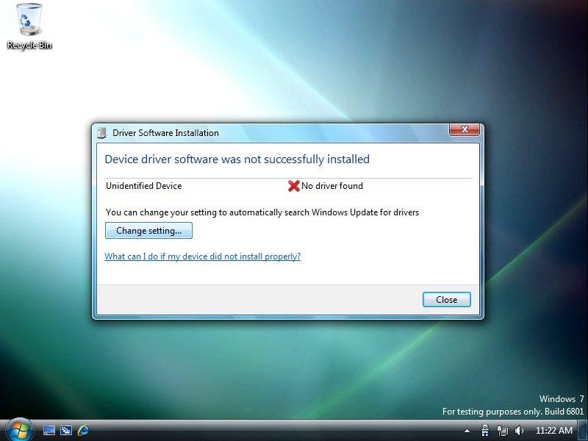
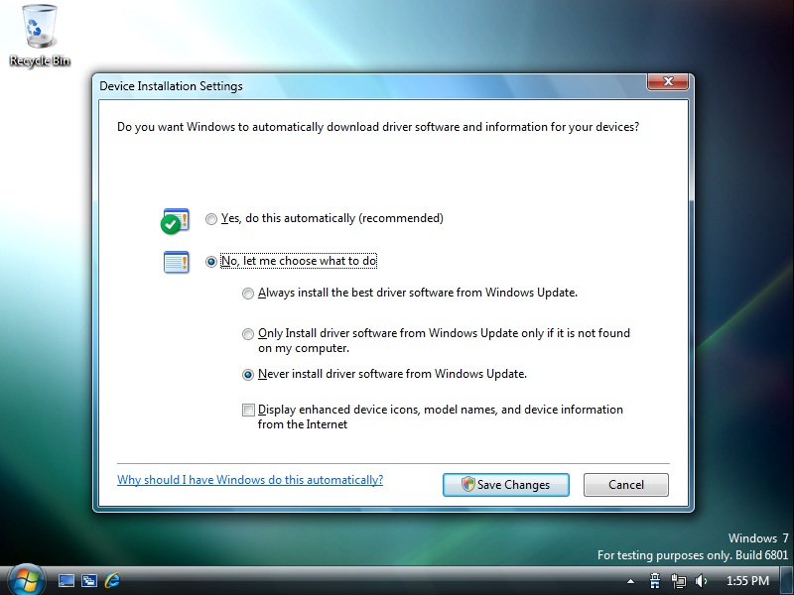
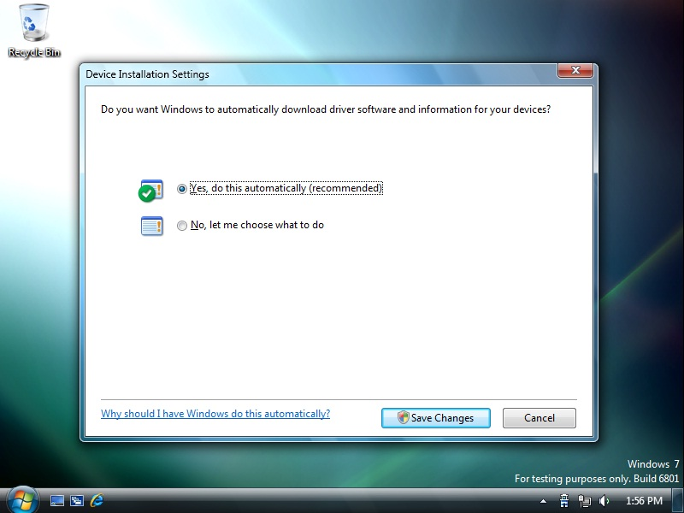

Scenario 5: No driver found
Vista
Windows 7

Slide 27
Scenario 5
No driver found
Vista
  Potentially 10 clicks
  No driver installed
Windows 7
  0 click
  No driver installed

Slide 28
Scenario 6
Driver is on a disc

Slide 29
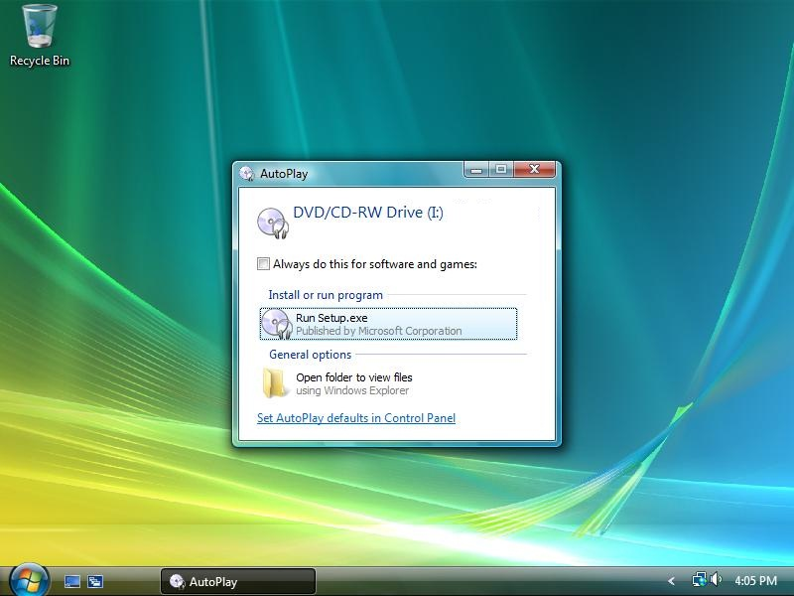

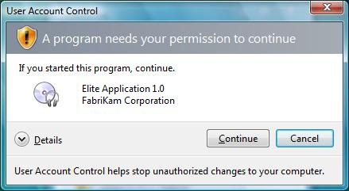
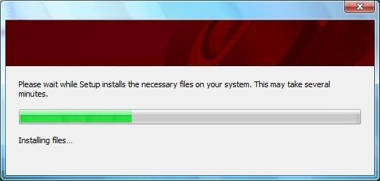

Scenario 6: Driver is on a disc
Vista
Windows 7
Software-first
Installing driver and software for your device…
FabriKam® Elite 8000

Slide 30
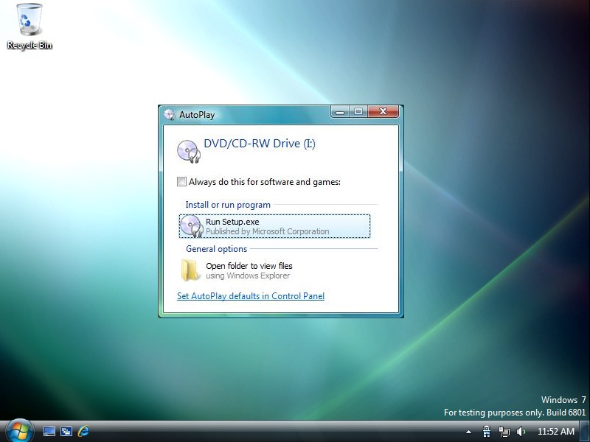
Scenario 6: Driver is on a disc
Vista
Windows 7
Software-first
Installing driver and software for your device…
FabriKam® Elite 8000

Slide 31
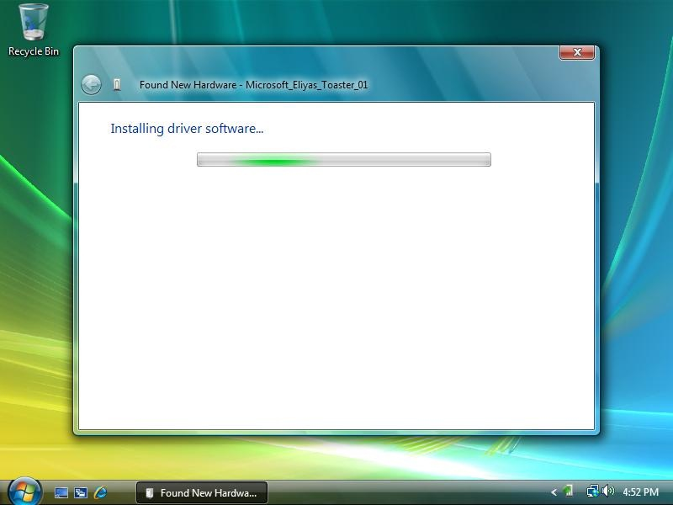
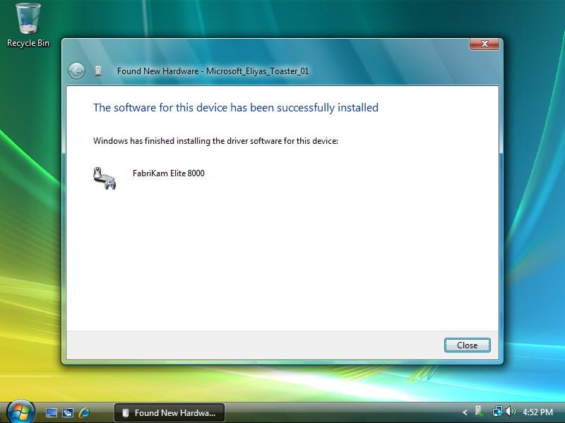
Scenario 6: Driver is on a disc
Vista
Windows 7
Hardware-first
Depends…
Did not run setup.exe!

Slide 32
Scenario 6: Driver is on a disc
Vista
Windows 7
Hardware-first
Installing driver and software for your device…
FabriKam® Elite 8000

Slide 33
Scenario 6
Driver is on a disc
Vista
  Software-first: You’re in control
  Hardware-first: Found New Hardware Wizard suppresses your setup program by default, can be overridden by including Autorun.inf in
  your disc
Windows 7
  Same experience whether it’s software-first or hardware-first: You’re in control

Slide 34
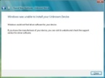
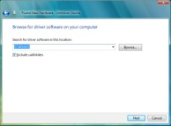
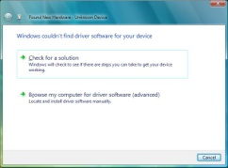
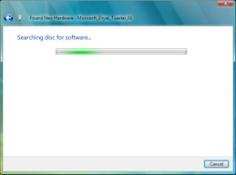
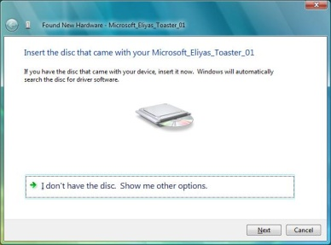
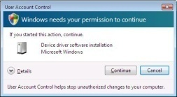
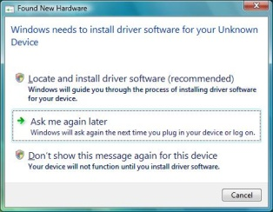
Vista User Experience
Scenario 2 and 4
Scenario 5 and 6

Slide 35
Better User Experience in '7'
Automatic
Accurate
Improved performance
Magic

Slide 36
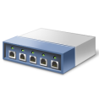

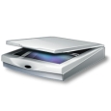



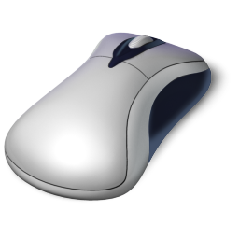
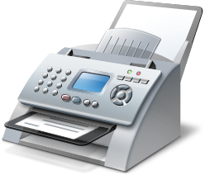
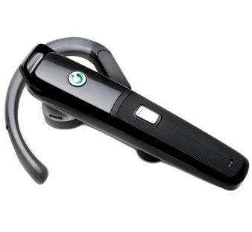
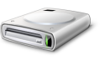
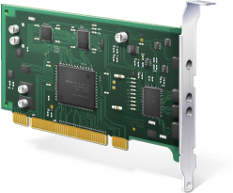
True for All PnP Devices
External or internal device
Single or multi-function device
  Many devices all at once
Wirelessly or IP connected device
USB composite
Scanner
Printer
Fax
CF reader
SD reader

Slide 37
Device-Related Applications

Slide 38
Device-Related Applications
Finish Install Action
    Implemented in a co-installer
Problems Reports and Solutions (PRS)
    PRS type: RequestAdditionalSoftware

Slide 39
Device-Related Applications
Finish Install Action

Slide 40
Finish Install Action
Vista
Windows 7
Installing driver and software for your device…
FabriKam® Elite 8000

Slide 41
Finish Install Action
Vista
Windows 7
Administrator
Installing driver and software for your device…
FabriKam® Elite 8000

Slide 42
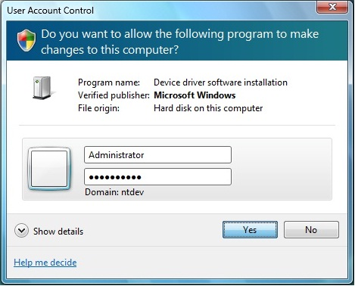
Finish Install Action
Vista
Windows 7
Standard User
Installing driver and software for your device…
FabriKam® Elite 8000

Slide 43
Device-Related Applications
Finish Install Action
Vista
  Prompt
  Elevation
Windows 7
  No prompt
  Elevation
    Protected administrators will be auto-elevated
    Standard users still need to elevate

Slide 44
Device-Related Applications
Problem Reports and Solutions

Slide 45

Problem Reports and Solutions
Vista
Windows 7
Not available in Vista

Slide 46
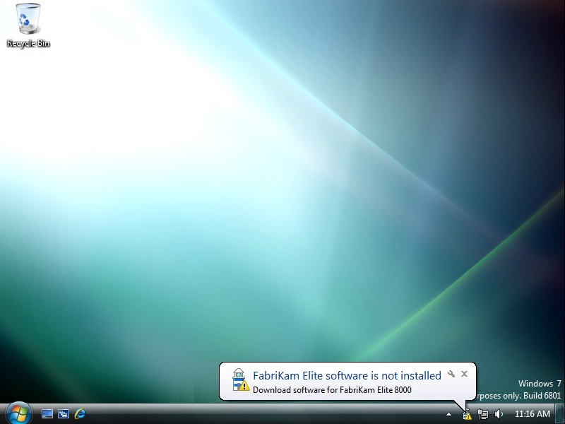




Problem Reports and Solutions
Vista
Windows 7
Installing driver and software for your device…
FabriKam® Elite 8000

Slide 47
Device-Related Applications
Problem Reports and Solutions
Vista
  This was not an option for Vista
Windows 7
  User gets notified if there is a solution
  Linked to your web site to
  acquire application
  Notification is suppressed once the application is installed on the system

Slide 48
Problem Reports and Solutions
What you need to know
Type: RequestAdditionalSoftware
Submit solution on WinQual in April 2009
Parameters that identify a unique report
  Most specific HWID
  CPU architecture
Fields you need to provide for the solution
  Title
  Description
  URL
  Add/Remove Program (ARP) registry keys

Slide 49
Which One Is For Me?
 | Finish Install Action | Request Additional Software
User Experience | Continuous: After driver installation completes Windows attempts to run the Finish Install Action | Asynchronous: After driver installation completes Windows will separately notify user through Problem Reports and Solutions there are additional software for the device
Development | Write your own co-installer | Provide a title, description, URL, and ARP keys via WinQual
Where does the app installer live? | In the driver package | Hosted on your website
OS supported | Vista, Server 2008, Win 7 | Win 7
Other consideration | Driver and app are tied – if you rev one you have to rev the other | You will be able to submit solutions on WinQual in April 2009

Slide 50
Call To Action
Goal: It just works!
Make it easy for your user to get all of your software
If your software includes applications
  Install them from your driver package via a Finish Install Action
Get logo’d
Post your driver package (including software) on Windows Update

Slide 51
Additional Resources
Devices that bypass searching Windows Update in Windows 7
  http://go.microsoft.com/fwlink/?LinkId=131077
Using Problem Reports and Solutions to redirect user to additional software
  http://go.microsoft.com/fwlink/?LinkId=131073
  To be online: April 2009
Attend related sessions on device installation
  Plug and Play key concepts
  Creating deployable driver packages for Windows

Slide 52
Related Sessions
Wednesday
11:00-12:00 154 Windows 7 Device Experience Overview Dennis
2:00-3:00 154 Windows 7 Device Installation Experience Richie
3:15-4:15 154 Windows 7 Device Experience Part 1 Roland/Max
4:30-5:30 154 Windows 7 Device Experience Part 2 Roland/Max
Thursday
11:00-12:00 Hall K Plug and Play Key Concepts George/Jim
3:15-4:15 404 A/B Unifying Wireless & Network Device Install Experience Dave
3:15-4:15 410 Distributing Drivers on Windows Update Tim
Friday
8:30-9:30 404 A/B Creating Deployable Driver Packages for Windows Eugene
9:45-10:45 404 A/B Common Driver Installation Errors and How to Diagnose Abed
11:00-12:00 404 A/B Extending Device Installation with Co-Installers Chad
11:00-12:00 409 A Discussion: Device Center, Bluewire, and Device Installation ~~~

Slide 53
Questions

Slide 54



Please Complete A Session Evaluation Form
Your input is important!
Visit the WinHEC CommNet and complete a Session Evaluation for this session and be entered to win one
of 150 Maxtor® BlackArmor™ 160GB External Hard Drives
50 drives will be given away daily!
http://www.winhec2008.com
BlackArmor
Hard Drives provided by:

Slide 55


© 2008 Microsoft Corporation. All rights reserved. Microsoft, Windows, Windows Vista and other product names are or may be registered trademarks and/or trademarks in the U.S. and/or other countries.
The information herein is for informational purposes only and represents the current view of Microsoft Corporation as of the date of this presentation. Because Microsoft must respond to changing market conditions, it should not be interpreted to be a commitment on the part of Microsoft, and Microsoft cannot guarantee the accuracy of any information provided after the date of this presentation.
MICROSOFT MAKES NO WARRANTIES, EXPRESS, IMPLIED OR STATUTORY, AS TO THE INFORMATION IN THIS PRESENTATION.

