Slide 2

Creating Content Centric
Publishing Sites with Microsoft Office SharePoint Server 2007
Session Code: OFC301
Zac Smith
MVP SharePoint Technologies
Trinkit
Mark Orange
MVP SharePoint Technologies
Intergen

Slide 3
Session Objectives
Provide an understanding of how web content management works within Microsoft Office
SharePoint Server
Provide developers with an understanding of a recommended approach for building deployable SharePoint publishing sites

Slide 4
Session Agenda
Demo - Content editing experience in our web site
Explain the SharePoint Publishing Feature and how
pages a managed
Demo - Creating a page layout
Illustrate the architecture of a publishing website
The brief theory of Site Definitions
Demo - Building core parts of our site
Query and Display Content
Tuning tips and tricks

Slide 5
Content Editing Experience
demo
Mark Orange
MVP SharePoint Technologies
Intergen

Slide 6
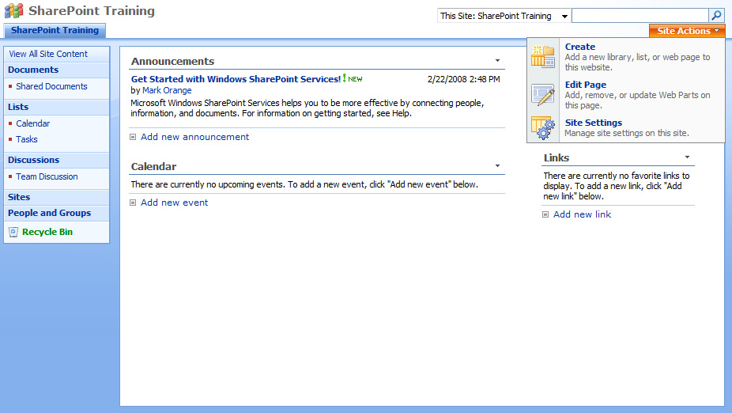
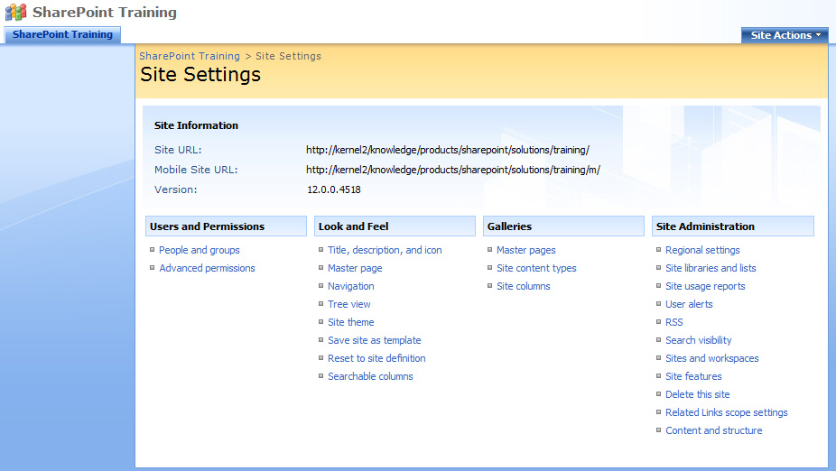
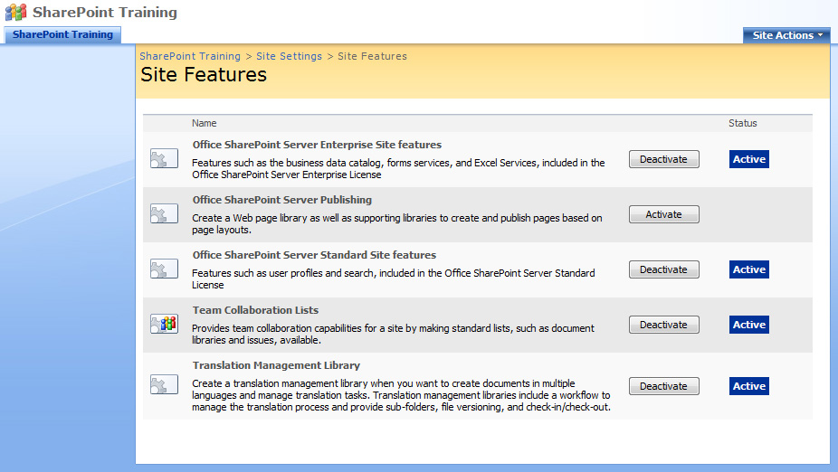
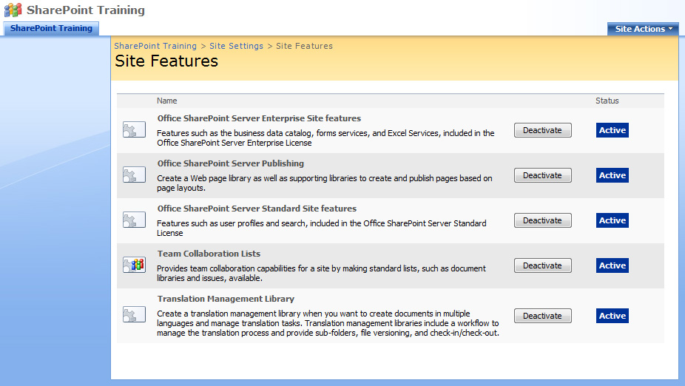
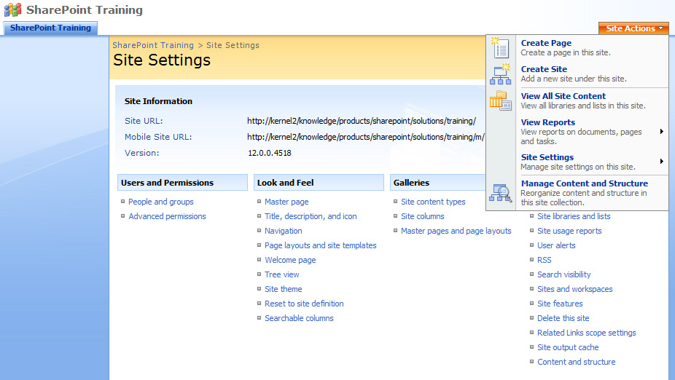
SharePoint Publishing Feature

Slide 7
Publishing Feature Elements
Out of the box Publishing Site Templates
Out of the box content types and page layouts
Out of the box Publishing master pages
Site Variations for multilingual publishing
Translation Workflow Template
Reusable Content Library
3 Publishing Web Parts
Manage output caching per site through UI
Convert Word documents to web pages

Slide 8
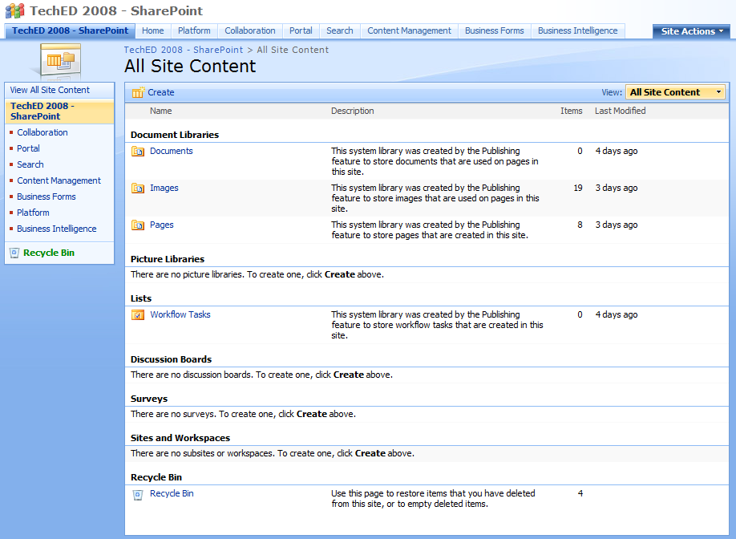
Publishing Lists and Libraries
http://www.mysite.co.nz/pages/default.aspx

Slide 9
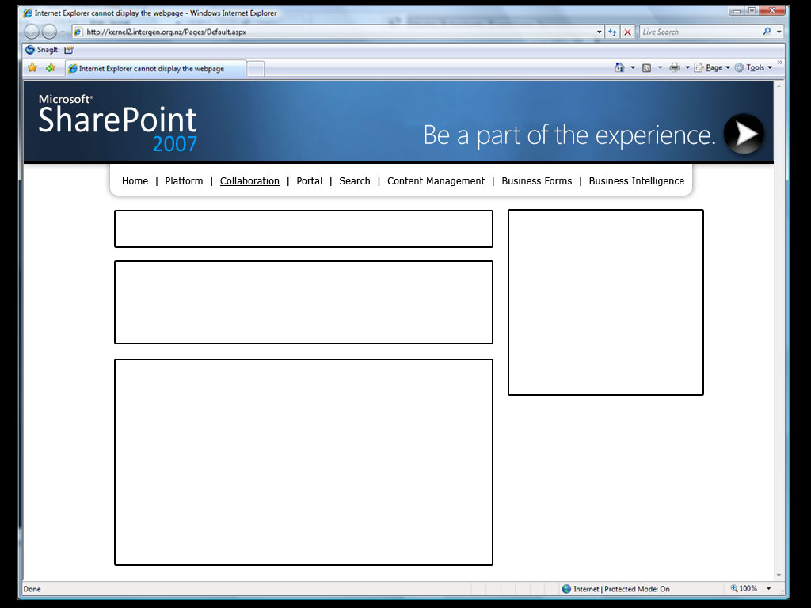
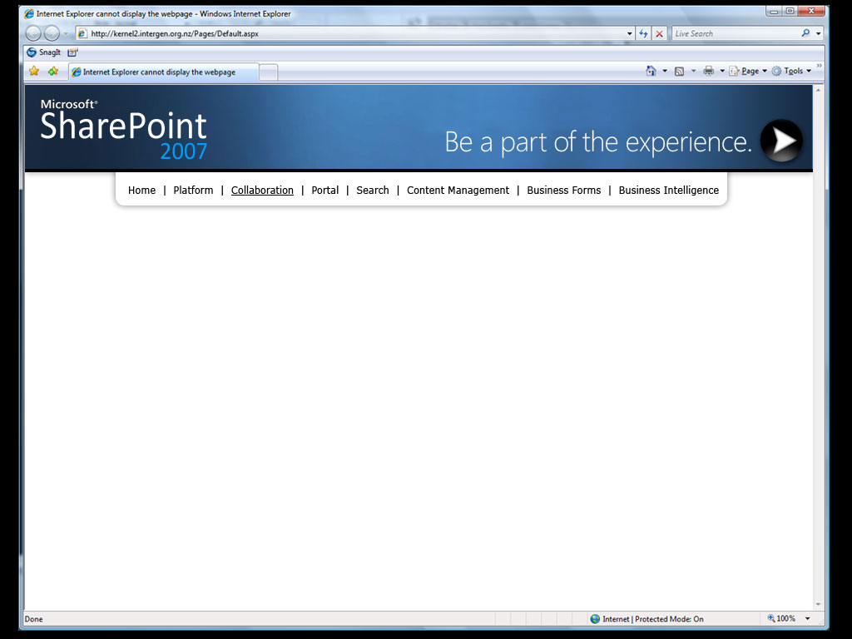
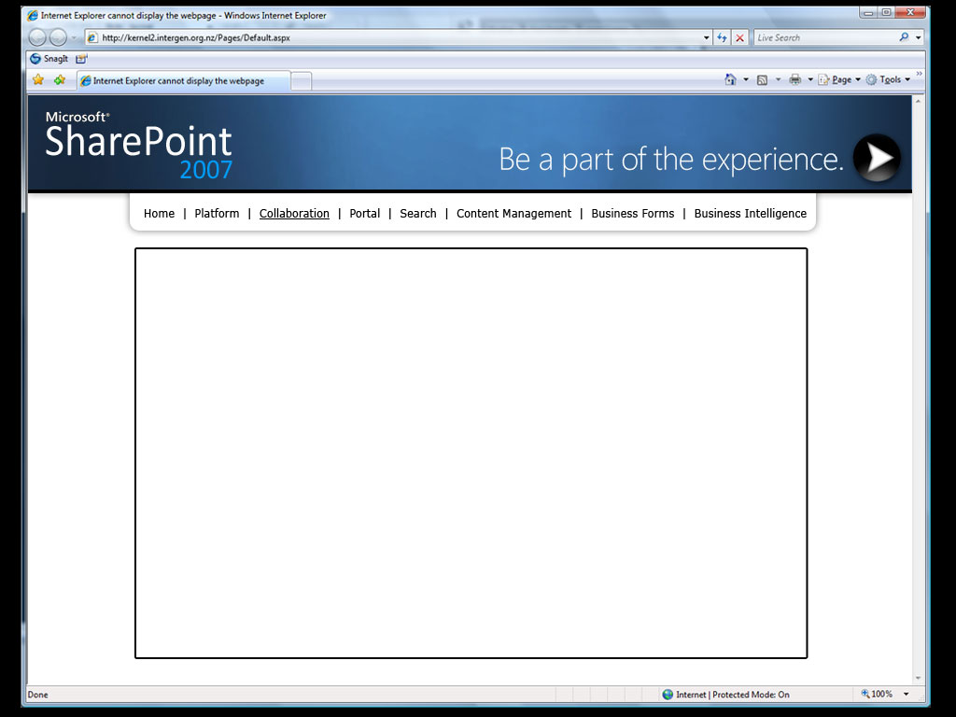
Page Layouts
Title | Description | Page Content | Page Image
Vincent van Gogh | Gogh was a Dutch Post-Impressionist artist who live in the 1800s. | Van Gogh spent his early adult life working for a firm of art dealers. After a brief spell as a teacher… | PortraitOne.jpg
GeneralPageLayout.aspx
HomePageLayout.aspx
Title
Description
Page Content
Vincent van Gogh
Gogh was a Dutch Post-Impressionist artist who live in the 1800s.
Van Gogh spent his early adult life working for a firm of art dealers. After a brief spell as a teacher, he became a missionary worker in a very poor mining region. He did not embark upon a career as an artist until 1880.
Page Image
Page Content
Van Gogh spent his early adult life working for a firm of art dealers. After a brief spell as a teacher, he became a missionary worker in a very poor mining region. He did not embark upon a career as an artist until 1880.

Slide 10
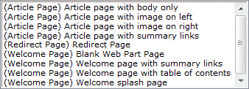
Page Layouts
Control how content is rendered on a webpage
Each Page Layout is bound to a Content Type
A Content Type can have many Page Layouts
3 out of the box publishing content types
with 9 page layouts

Slide 11

Standard Web Site
Homepage
Topic Page
General
News Article
Job Vacancy
Special 1 e.g. Project
Special 2 e.g. Profile

Slide 12
Creating a page layout
demo
Mark Orange
MVP SharePoint Technologies
Intergen

Slide 13
Basic Architecture of a page
MasterPage.master
GeneralPageLayout.aspx
Title
Description
Page Content
Page Image
Vincent van Gogh
Gogh was a Dutch Post-Impressionist artist who live in the 1800s.
Van Gogh spent his early adult life working for a firm of art dealers. After a brief spell as a teacher, he became a missionary worker in a very poor mining region. He did not embark upon a career as an artist until 1880.
Page Content
Title | Description | Page Content | Page Image
Vincent van Gogh | Gogh was a Dutch Post-Impressionist artist who live in the 1800s. | Van Gogh spent his early adult life working for a firm of art dealers. After a brief spell as a teacher… | PortraitOne.jpg

Slide 14
Masterpages
SharePoint uses ASP.NET 2.0 Master Pages
Start from scratch with a Minimal Master
Use SharePoint Designer to build master pages
Application pages have hardcoded master page
application.master
Normal SharePoint page uses static token
~masterurl/default.master
Publishing Page Layouts uses dynamic token
~masterurl/custom.master

Slide 15
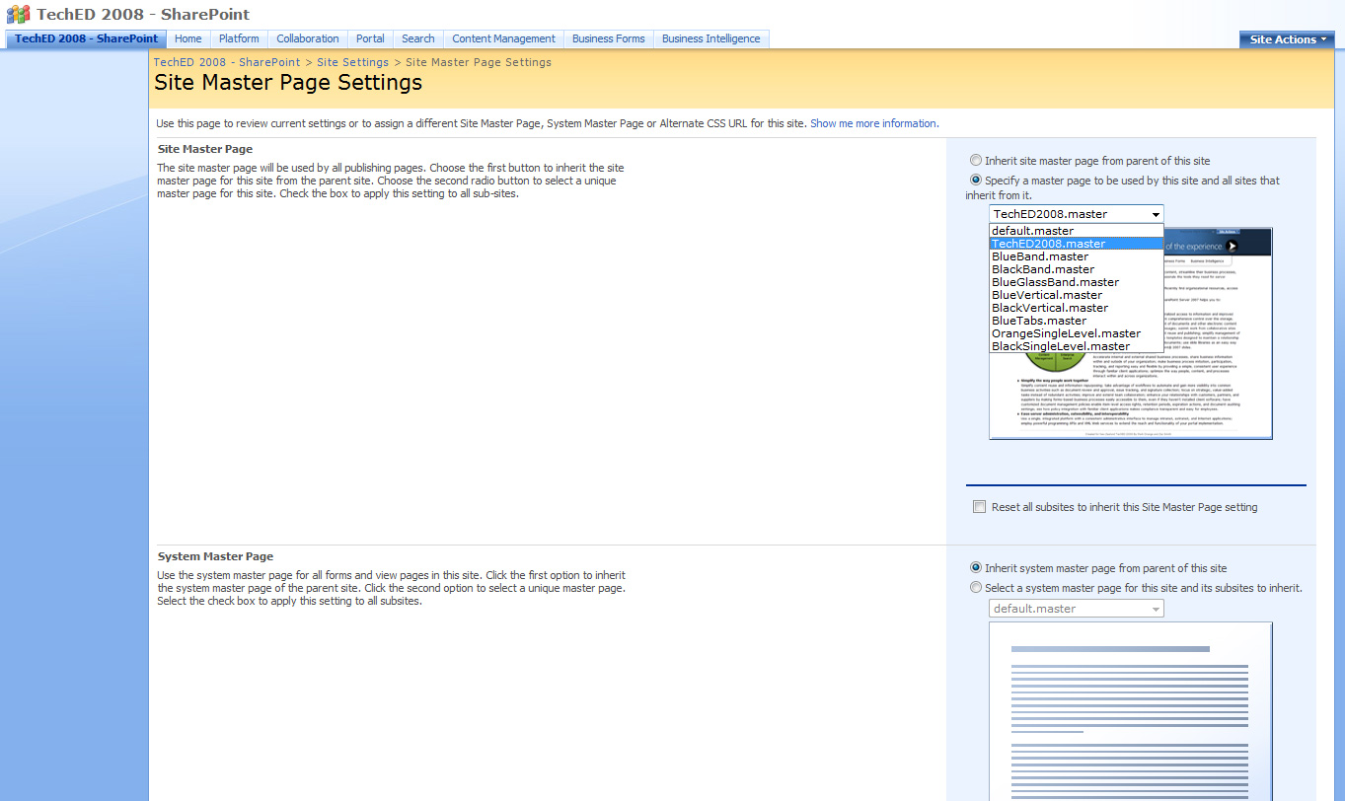
Setting Publishing Master Page

Slide 16
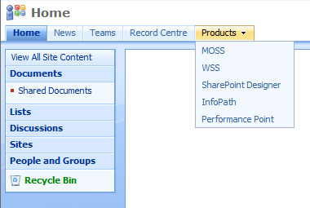
Navigation
Standard navigation uses
an implementation of the
ASP.NET 2.0 Menu control
  Microsoft.SharePoint.WebControls.AspMenu
  Directly inherits from
  System.Web.UI.WebControls.Menu
MOSS uses PortalSiteMapProvider
  Microsoft.SharePoint.Publishing.Navigation.
  PortalSiteMapProvider

Slide 17
Architecture of Publishing Website
SharePoint Enabled Web Application
SharePoint Site Collection
Root Site
Child Site
Descendent Site
Descendent Site
Child Site
Child Site
Descendent Site
Descendent Site
Descendent Site
Descendent Site
Descendent Site
Descendent Site
Descendent Site
Child Site
Reusable Content
Site Collection Images
Site Collection Documents
Pages Library
Publishing Images
Publishing Documents
Pages Library
Publishing Images
Publishing Documents
Pages Library
Publishing Images
Publishing Documents

Slide 18
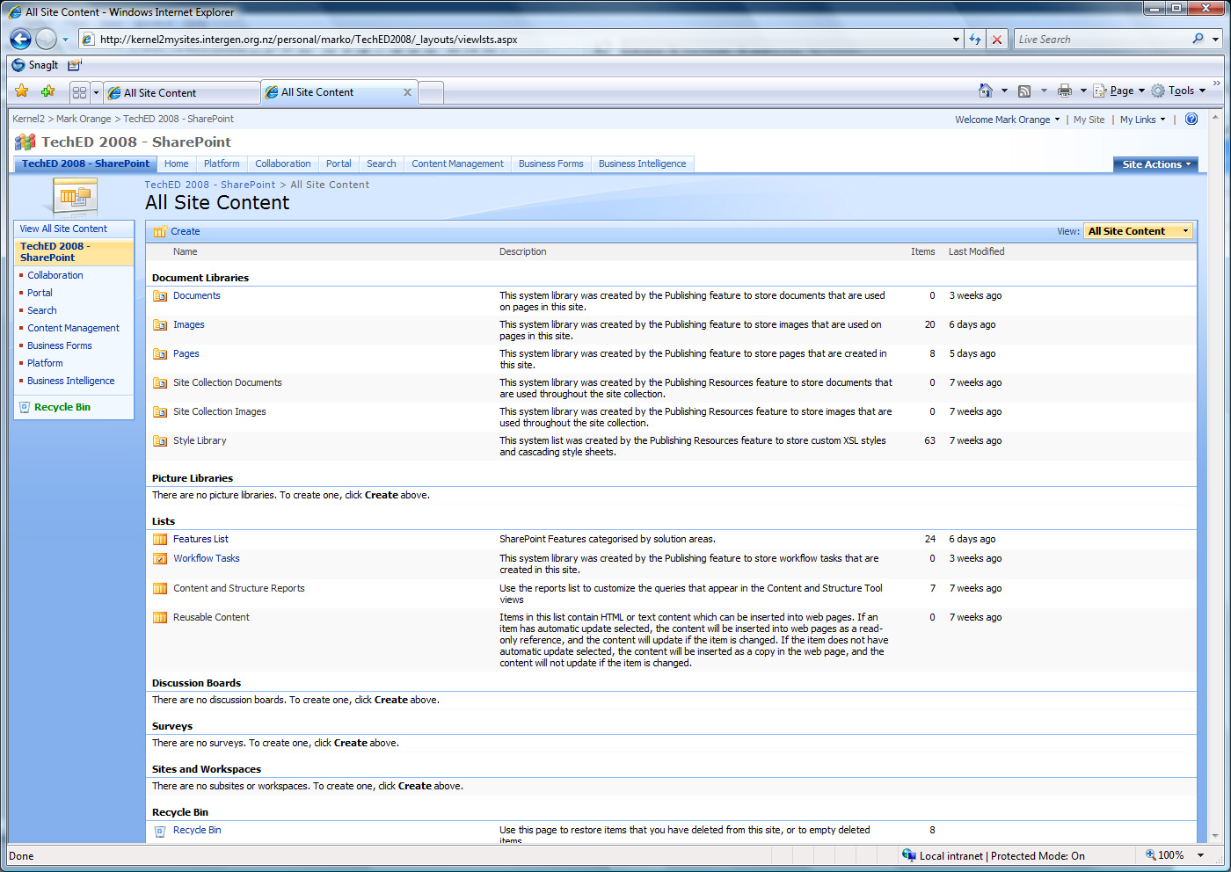
Publishing Root Site

Slide 19
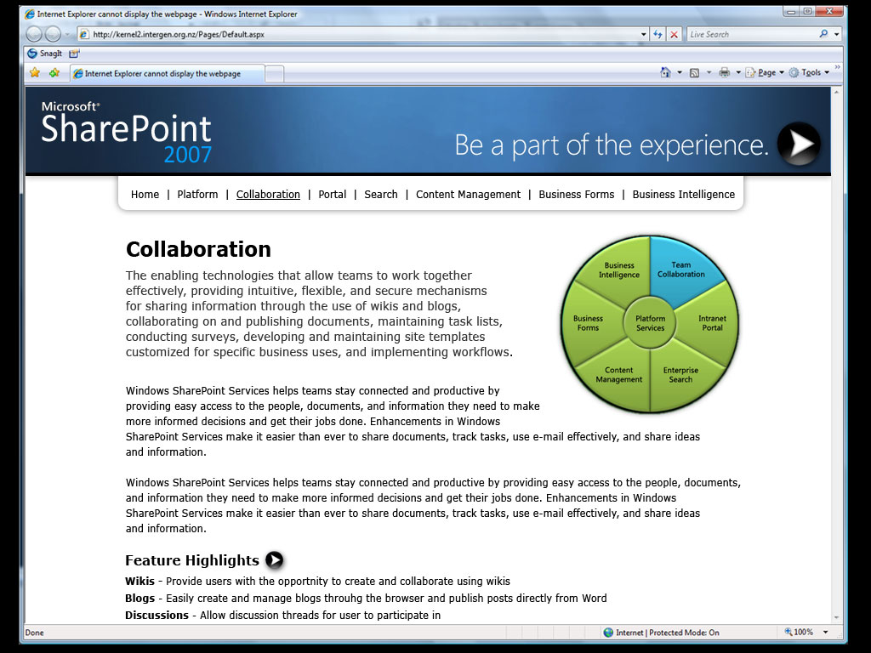
Architecture of Publishing Website

Slide 20
Architecture of Publishing Website
SharePoint Enabled Web Application
SharePoint Site Collection
Root Site
Pages Library
Publishing Images
Publishing Documents
Features List

Slide 21
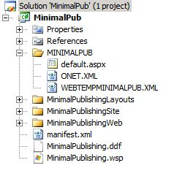
Understanding Site Definitions
The core of any SharePoint site
Anatomy of a site definition
Why use custom site defs?
  Reduce the bloat
  Easy deploy between environments
  Promotes reuse of assets
Site defs vs Site templates

Slide 22
Exploring the Site Definition
demo
Zac Smith
MVP SharePoint Technologies
Trinkit

Slide 23
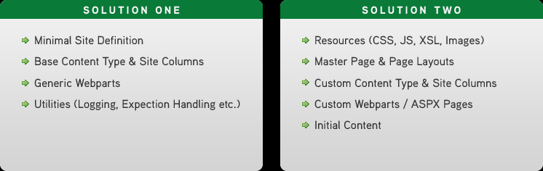
Using Site Definitions Effectively
Create a minimal site definition
Group site components into ‘Features’
Why not create everything in browser/SPD?
Consider using multiple solutions

Slide 24
Aggregating Content
Content Query web part (or DVWP)
  Quick build time
  Built-in caching
  Suits Intranets/Extranets
Custom CAML web part
  Longer build time
  Maximum flexibility
  Suits public facing web

Slide 25
Query and Display Content
demo
Zac Smith
MVP SharePoint Technologies
Trinkit

Slide 26
Tuning tips and Tricks
Use Forms Lockdown Feature
Remove name.dll ActiveX control
Don’t render unused resources – CORE.JS, CORE.CSS
Enable object/disk caching
Avoid customised pages
Avoid mixing collaboration with WCM
Know your development best practices

Slide 27
Conclusion
Demo - Content editing experience in our web site
Explain the SharePoint Publishing Feature and how
pages a managed
Demo - Creating a page layout
Illustrate the architecture of a publishing website
The brief theory of Site Definitions
Demo - Building core parts of our site
Query and Display Content
Tuning tips and tricks

Slide 28

Related Content
Breakout Sessions
OFC375 MOSS 2007 Governance: From Chaos to Success in Ten Steps
Wednesday 2:20 – 3:35
OFC303 Tools and techniques for productive and effective SharePoint development
Wednesday 3:45 – 5:00
Office Track Hands on Labs
Nothing specific to web content management and Publishing Feature
OFC58-HOL Microsoft Windows SharePoint Services 3.0 Site Templates
OFC66-HOL Microsoft Office SharePoint Server 2007 Advanced Authentication
OFC50-HOL Microsoft Office SharePoint Server 2007 People and Permissions
OFC51-HOL Microsoft Office SharePoint Server 2007 Advanced Administration

Slide 29
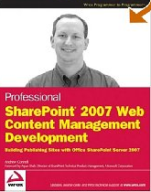
Publishing Site Resources
SharePoint Team Blog http://blogs.msdn.com/sharepoint
Microsoft ECM Team Blog http://blogs.msdn.com/ecm/default.aspx
SharePoint Community Portal http://sharepoint.microsoft.com/sharepoint
NZ SharePoint User Groups http://www.sharepointusergroup.net.nz
Zac’s Blog http://www.trinkit.co.nz/blog
Andrew Connell’s Blog http://andrewconnell.com/blog
SharePoint Server 2007 Web Content Management
Building Publishing Sites with Office SharePoint Server 2007
The first book and the only book on the market that focuses on
SharePoint Server as a robust platform for Web content
By Andrew Connell

Slide 30
Please complete an
evaluation

Slide 31
Q & A

Slide 32




Resources
www.microsoft.com/teched
  Tech·Talks Tech·Ed Bloggers
  Live Simulcasts Virtual Labs
http://microsoft.com/technet
  Evaluation licenses, pre-released products, and MORE!
http://microsoft.com/msdn
  Developer’s Kit, Licenses,
  and MORE!

Slide 33

© 2008 Microsoft Corporation. All rights reserved. Microsoft, Windows, Windows Vista and other product names are or may be registered trademarks and/or trademarks in the U.S. and/or other countries.
The information herein is for informational purposes only and represents the current view of Microsoft Corporation as of the date of this presentation. Because Microsoft must respond to changing market conditions, it should not be interpreted to be a commitment on the part of Microsoft, and Microsoft cannot guarantee the accuracy of any information provided after the date of this presentation. MICROSOFT MAKES NO WARRANTIES, EXPRESS, IMPLIED OR STATUTORY, AS TO THE INFORMATION IN THIS PRESENTATION.

