Slide 1

SQL Server 2008 R2
Analysis Services

Slide 2



The Microsoft BI Solution Stack
BUSINESS USER EXPERIENCE
BUSINESS COLLABORATION PLATFORM
Data Infrastructure & BI Platform
Analysis Services
Reporting Services
Master Data Services
Integration Services
Data Mining
Data Warehousing
DATA INFRASTRUCTURE & BI PLATFORM
Notes:
Key Points:
A trusted BI platform is critical for a business intelligence solution to work today. If we’re going to achieve the promise of BI, we need to have the confidence and trust in the data, we need to know where it came from, and that it is both timely and reliable for us to use to make a decision. That’s where the power of an integrated BI platform like SQL Server comes into play.
Once you have the data ready to use, the middle tier comes into play, where business users actually interact with the data and turn it into something that is useful to them to make the right decision. The numbers that we pull from other systems are just that—we need applications and content to turn them into actionable items—and that’s where the middle tier comes into play.
Finally, we need the right tools and applications to ensure that we can use that data in the way we want to in order to make our decisions. Applications and tools that range from personal, to team, to organizational and corporate tools, all with a familiar look and feel, all integrated and working with my Operating system, email, Internet search function. And this is what the power of integration through Microsoft Office brings you. From the Office productivity tools like Excel, through to the team and collaboration tools of SharePoint. By integrating BI seamlessly into a broader business productivity suite that includes search, collaboration, unified communications, and content management, we offer the end user a much richer experience.

Slide 3
The Microsoft BI Solution Stack
BUSINESS USER EXPERIENCE
Business Productivity Infrastructure
Dashboards & Scorecards
Excel Services
Web based forms & workflow
Collaboration
Search
Content Management
LOB data integration
PowerPivot for SharePoint
BUSINESS COLLABORATION PLATFORM
DATA INFRASTRUCTURE & BI PLATFORM
Notes:
Key Points:
A trusted BI platform is critical for a business intelligence solution to work today. If we’re going to achieve the promise of BI, we need to have the confidence and trust in the data, we need to know where it came from, and that it is both timely and reliable for us to use to make a decision. That’s where the power of an integrated BI platform like SQL Server comes into play.
Once you have the data ready to use, the middle tier comes into play, where business users actually interact with the data and turn it into something that is useful to them to make the right decision. The numbers that we pull from other systems are just that—we need applications and content to turn them into actionable items—and that’s where the middle tier comes into play.
Finally, we need the right tools and applications to ensure that we can use that data in the way we want to in order to make our decisions. Applications and tools that range from personal, to team, to organizational and corporate tools, all with a familiar look and feel, all integrated and working with my Operating system, email, Internet search function. And this is what the power of integration through Microsoft Office brings you. From the Office productivity tools like Excel, through to the team and collaboration tools of SharePoint. By integrating BI seamlessly into a broader business productivity suite that includes search, collaboration, unified communications, and content management, we offer the end user a much richer experience.

Slide 4
The Microsoft BI Solution Stack
Delivered through a Familiar Interface
Self-Service access & insight
Data exploration & analysis
Predictive analysis
Data visualization
Contextual visualization
PowerPivot for Excel 2010
BUSINESS USER EXPERIENCE
BUSINESS COLLABORATION PLATFORM
DATA INFRASTRUCTURE & BI PLATFORM
Notes:
Key Points:
A trusted BI platform is critical for a business intelligence solution to work today. If we’re going to achieve the promise of BI, we need to have the confidence and trust in the data, we need to know where it came from, and that it is both timely and reliable for us to use to make a decision. That’s where the power of an integrated BI platform like SQL Server comes into play.
Once you have the data ready to use, the middle tier comes into play, where business users actually interact with the data and turn it into something that is useful to them to make the right decision. The numbers that we pull from other systems are just that—we need applications and content to turn them into actionable items—and that’s where the middle tier comes into play.
Finally, we need the right tools and applications to ensure that we can use that data in the way we want to in order to make our decisions. Applications and tools that range from personal, to team, to organizational and corporate tools, all with a familiar look and feel, all integrated and working with my Operating system, email, Internet search function. And this is what the power of integration through Microsoft Office brings you. From the Office productivity tools like Excel, through to the team and collaboration tools of SharePoint. By integrating BI seamlessly into a broader business productivity suite that includes search, collaboration, unified communications, and content management, we offer the end user a much richer experience.

Slide 5






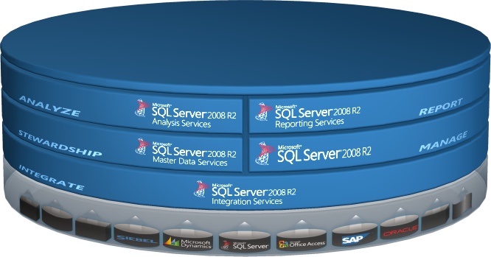
SQL Server 2008 R2 BI Technologies
IT PROFESSIONALS
BUSINESS DECISION
MAKERS
INFORMATION
WORKERS
POWER USERS
DEVELOPERS
MICROSOFT BI PLATFORM
Notes:
Key Points:
Integration Services (SSIS) provides a scalable enterprise data integration platform with exceptional Extract, Transform, Load (ETL) and integration capabilities, enabling organizations to more easily manage data from a wide array of data sources
Master Data Services (MDS) enables organizations to start with simple solutions for analytic or operational requirements, and then adapt the solutions to additional requirements incrementally
The latest version of SQL Server from Microsoft SQL Server 2008 offers hundreds of new DBMS features that boost the productivity of database administrators and developers, improve support for larger databases, and enhance security
Reporting Services (SSRS) provides a full range of ready-to-use tools and services to help you create, deploy, and manage reports for your organization, as well as programming features that enable you to extend and customize your reporting functionality
Analysis Services (SSAS) delivers online analytical processing (OLAP) and data mining functionality for business intelligence applications
Conclusion: With SQL Server 2008 R2 customers get all the technologies needed to build a reliable and secure BI platform. SQL Server 2008 R2 has the strongest combination of price/performance, manageability, security, and DBA productivity.

Slide 6
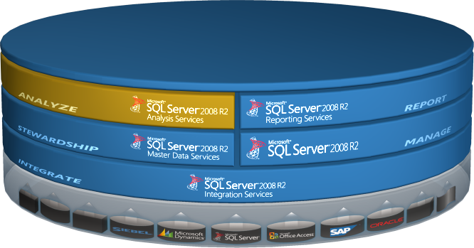
SQL Server 2008 R2 BI Technologies
IT PROFESSIONALS
BUSINESS DECISION
MAKERS
INFORMATION
WORKERS
POWER USERS
DEVELOPERS
MICROSOFT BI PLATFORM
Notes:
Key Points:
Store - The SQL Server 2008 R2 Database Engine provides a high-performance, scalable storage solution for enterprise-scale data warehouses.
Integrate – SQL Server Integration Services provides a comprehensive set of ETL capabilities that you can use to build and maintain a data warehouse that consolidates business data from across the enterprise.
Analyze – SQL Server Analysis Services provides powerful OLAP analysis and data mining functionality to help your users gain deep insights into your business data.
Report – SQL Server Reporting Services is an enterprise-scale reporting solution that you can use to create and deliver reports throughout the organization and to external partners and customers
Stewardship – SQL Server Master Data Services enables organizations to start with simple solutions for analytic or operational requirements, and then adapt the solutions to additional requirements incrementally.
Conclusion: SQL Server 2008 R2 provides a full, end-to-end platform for Business Intelligence solutions.

Slide 7






Intelligent Data Platform
Unlock Your Data
Deliver Relevant Information
Drive Actionable Insights
Scale for thousands of users
Rich connectivity
Intuitive design environment
Personalized data experience
Embedded insights
Predictive analysis
Wide-spread delivery through Office
Enterprise-class manageability
Robust data integration
Notes:
Key Points:
With SQL Server 2008 R2, customers can integrate and manage their enterprise data and deliver the information to thousands of users in order to drive actionable insights.
In order to make data accessible, the solution needs to support rich connectivity and data integration capabilities.
IT organizations require efficient data management tools in a centralized environment
BI developers need intuitive development tools to create organizational BI solutions
Business users want to access BI through Office-based applications and reports that support interactive data navigation and drilldown
Conclusion: SQL Server 2008 R2 provides all required technologies to unlock enterprise data, deliver the information to the users, and support rich applications and Microsoft office on the client side.

Slide 8

Analysis Challenges
How Do You Deal With:
Data stored in multiple data sources
The cost of developing analytical solutions
The costs of learning new tools
Build fast but build to last
Deploy for today’s problem but scale
over time
‘Real-Time’ data access
Inflexible architecture
Multiple Users, Multiple Tools
Diverse analytical needs
Inconsistent data
Notes:
Key Points:
How do you:
Build the analytics infrastructure to support diverse needs?
Provide a unified view across all business data?
Manage insight across the enterprise accommodating all BI stakeholders?
Enable all users across the organization to drive actionable decisions?
Conclusion: SQL Server 2008 R2 Analysis Services helps organizations to address a variety of typical challenges to bring down costs and accelerate solution delivery.

Slide 9





Analysis Services 2008 R2
Design Scalable Solutions
  Productivity enhancing designers
  Scalable Infrastructure
  Superior Performance
  Extend Beyond OLAP
    Unified meta data model
    Central KPI manageability
    Predictive Analysis
Deliver Pervasive Insight
  Optimized Office interoperability
  Rich partner extensibility
  Open, embeddable architecture
Notes:
Key Points:
Scalable solutions require a high-performance platform and development tools to promote better code quality
Delivering pervasive insights requires extended OLAP capabilities, including data mining, and support of additional tools, such as Reporting Services and PerformancePoint Services to deliver dashboards and KPIs to decision makers
Power users and information workers also have ad-hoc analytics needs. Analysis Services supports ad-hoc analysis specifically through optimized Office interoperability.
Conclusion: SQL Server Analysis Services is an Enterprise Scale Offering delivering Comprehensive Analytics, that enable Intelligence Where Users Want It!

Slide 10
Advanced Analysis Services Features
Designed to Perform
Design
Run
Monitor
Innovative Cube Designer
Enhanced Aggregation Design
Enhanced Dimension Design
Best Practice Design Alerts
Subspace Computations
Scalable Shared Databases
Enhanced Back-Up Scalability
MOLAP Enabled Write-Back
Dynamic Management Views
Execution Plan
Notes:
Key Points:
Greater infrastructure flexibility and more users per server than with SQL Server 2005
Optimized cube processing
Faster query execution in the vast majority of the MDX functions and better code quality
Subspace computation improvements open new tuning and optimization possibilities
Read-only databases
Enhanced monitoring capabilities
Improved Analysis Services database backups
Conclusion: SQL Server Analysis Services features cover all aspects of the Solution Development Live Cycle (SDLC)

Slide 11
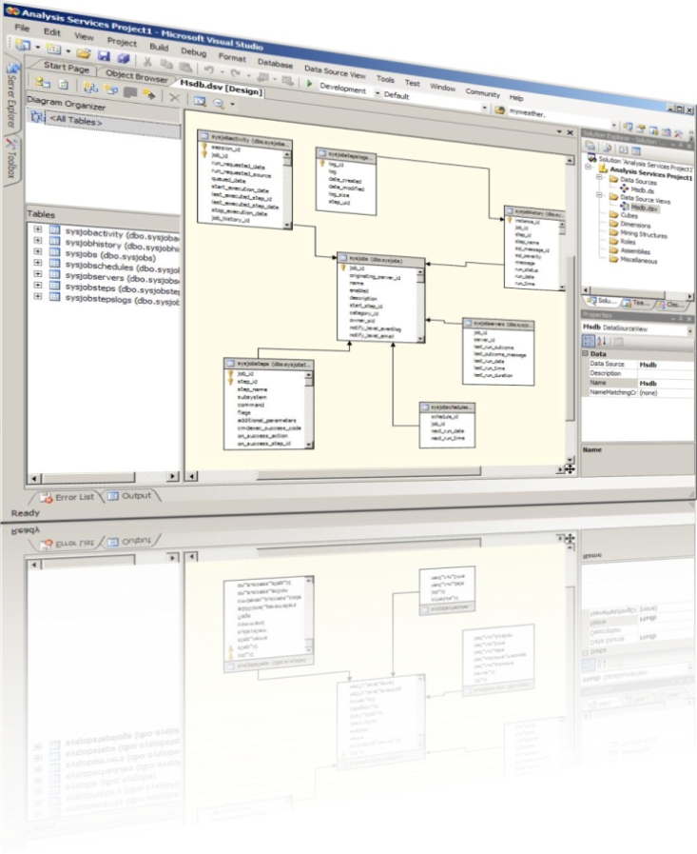
Design Scalable Solutions
  Productivity Enhancing Designers
  Optimized design experience
  Best Practice Design Alerts
  Project Lifecycle support
Scalable Infrastructure
  Heterogeneous data Integration
  Robust Scale-Out Configuration
  Advanced Resource Monitoring
  User-differentiated perspectives
  Superior Performance
    Market leading MOLAP Engine
    Near real-time data access
  Subspace computation optimization
  MOLAP enabled write-back
Notes:
Key Points:
Productivity also include:
Visual development environment
Single tool, multiple technologies
Infrastructure also include:
Backup performance
Global scalability (translations)
Parallel partition processing
Superior Performance:
Real-time data access
Centralized server calculations
Automatic synchronization
Conclusion: SQL Server Analysis Services includes a large number of features and tools to help developers create and deliver scalable high-quality BI solutions.

Slide 12
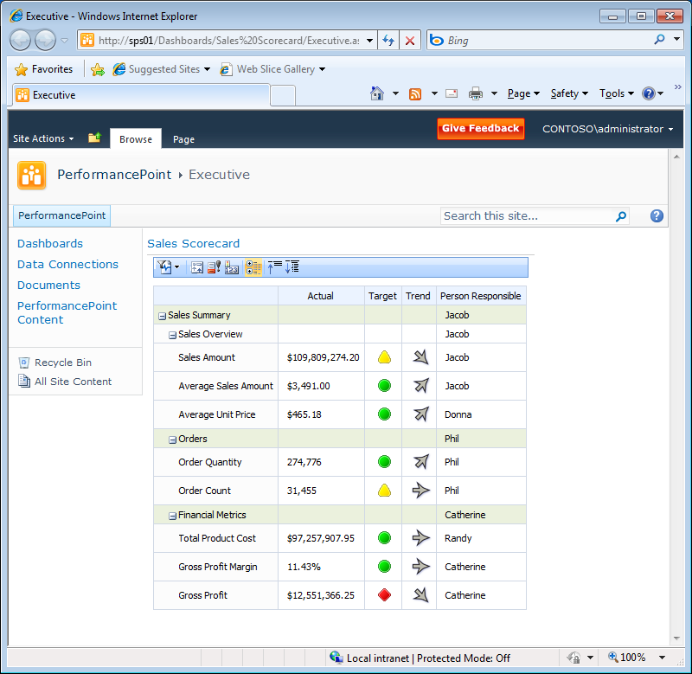
Extend Beyond OLAP
Unified Metadata Model
  One consolidated business view
  Integrated relational & OLAP analysis
  Business information modeling
  Time- and financial intelligence
Central KPI Manageability
  Server based KPI framework
  Centrally managed repository
  Pervasive end-user accessibility
Predictive Analytics
  Complete data mining framework
  Embeddable viewers
  Predictive capabilities available to everyone through Microsoft Office
Notes:
Key Points:
Multiple Analytical capabilities in one Unified Dimensional Model
Predictive Analysis:
Extensible .NET programming model + SQL language based API’s
Conclusion: SQL Server Analysis Services supports a unified data model, KPI manageability and data mining out of the box and provides the basis for a rich user experience in combination with additional analytics products, such as PerformancePoint Services in Microsoft SharePoint Server 2010.

Slide 13
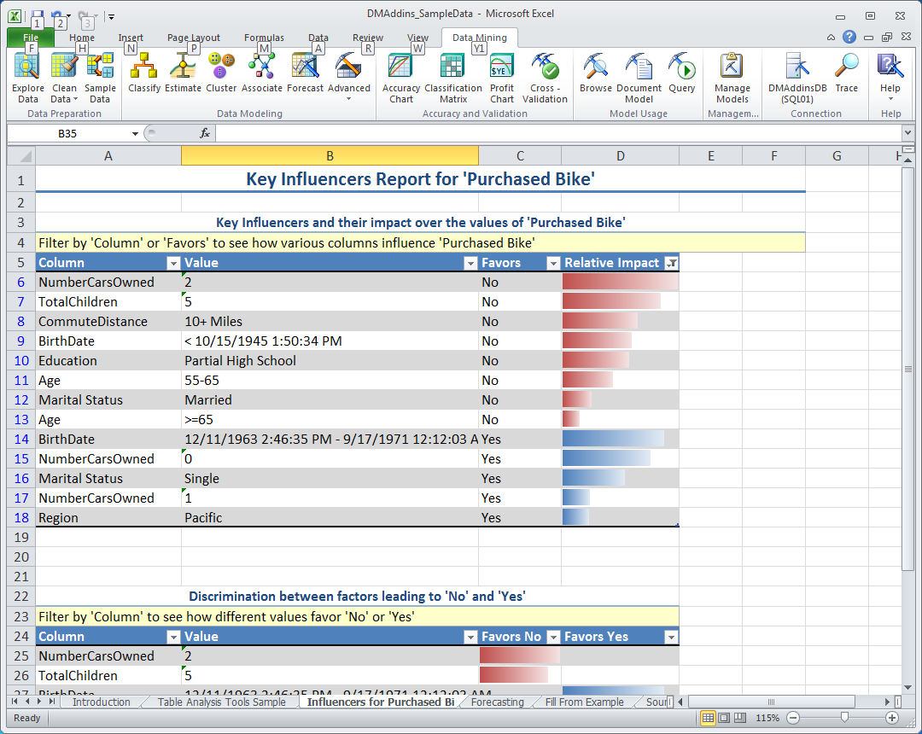

Predictive Analysis
Bring Data Mining to the Masses through Microsoft Office
Enable easy to use predictive analysis
  At every desktop
  For every information worker
  Through three powerful add-ins to Microsoft Office
  Predictive capabilities readily available for business users in Excel
  Data mining client for building data mining models in Excel
  Data mining templates for project visualization in Visio
“What Microsoft has done is to make data mining available on the desktop to everyone” (David Norris, Associate Analyst, Bloor Research).
Notes:
Key Points:
Table Analysis Tools for Excel: This add-in provides you with easy-to-use tasks that leverage SQL Server Data Mining under the covers to perform powerful analytics on your spreadsheet data.
Data Mining Client for Excel: This add-in allows you to go through the full data mining model development lifecycle within Excel using either your spreadsheet data or external data accessible through your SQL Server Analysis Services instance.
Data Mining Templates for Visio: This add-in allows you to render and share your mining models as annotatable Visio drawings.
Conclusion: Microsoft Office is familiar to users. Analysis Services takes advantage through standard features and add-ins. See separate deck on the Microsoft SQL Server Data Mining Add-Ins for Office.

Slide 14
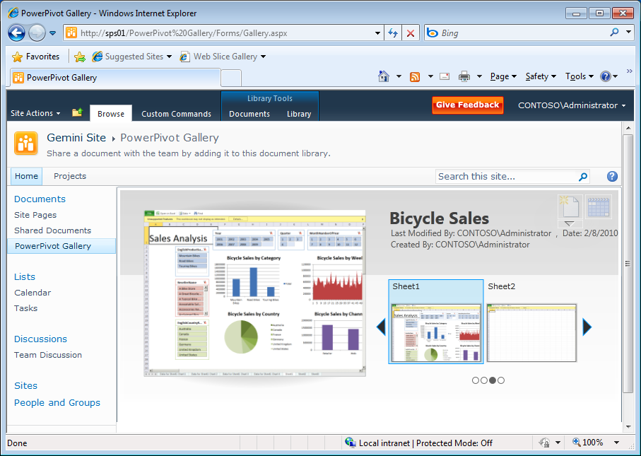
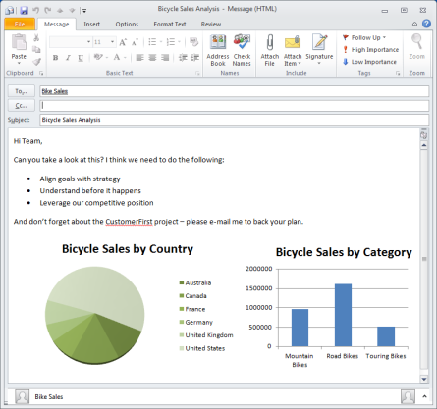
Deliver Pervasive Insight
Optimized Office Interoperability
  Massive data analysis for everyone with PowerPivot for Excel 2010
  Team Collaboration through PowerPivot for SharePoint 2010
  Corporate performance management through PerformancePoint Services 2010
Rich Partner Ecosystem Extensibility
  Vertically specialized solutions
  Packaged applications
  API support from all major BI vendors
Open, embeddable architecture
  Open API’s and XML/A based protocols
  Native web service functionality
  Close loop analysis
Notes:
Key Points:
Universal reach through Office, SQL Server technology, and additional products from Microsoft
Broad support from all major third-party BI vendors
Open architecture to accommodate custom solutions and line-of-business applications
Align analysis with business performance monitoring and planning
Access data for analysis directly from your Excel spreadsheets
Support seamless and secure collaboration
Conclusion: With Office interoperability users hit the ground running because they already know the Excel features, can use virtually unlimited data sources, and new capabilities in the form of SQL Server 2008 R2 innovations.

Slide 15
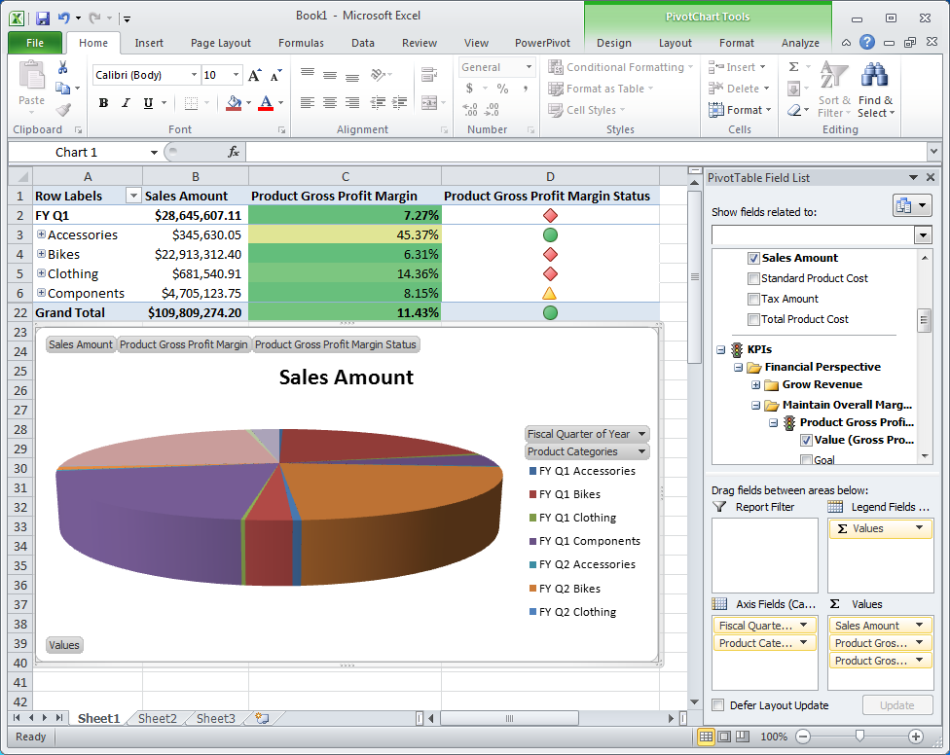
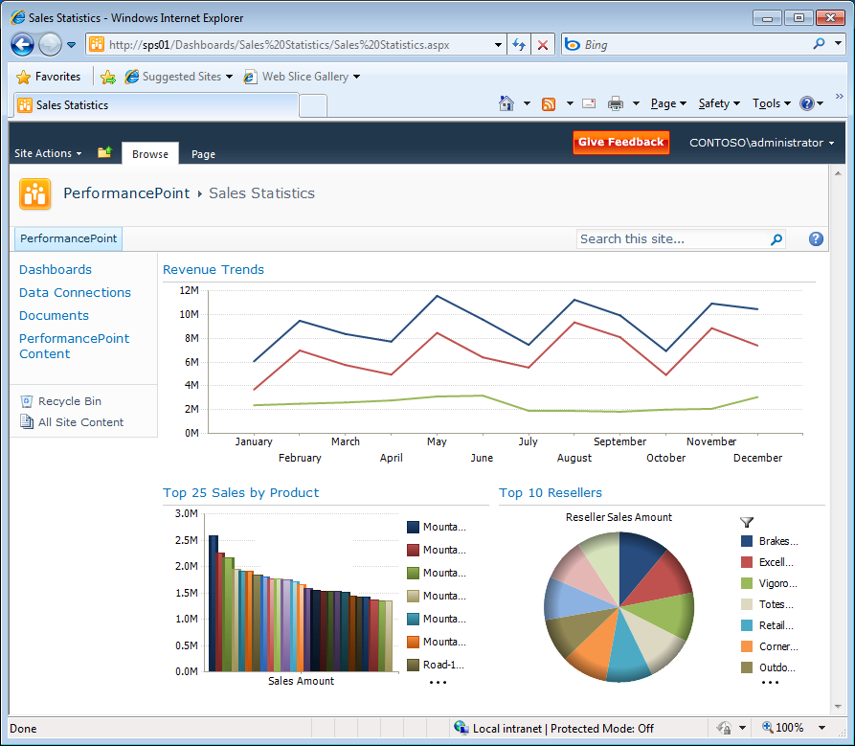
Office 2010 Integration
Excel 2010
  Great cross product investments optimizing Excel 2010 as analytical client for Analysis Services
  Enhancements around local cubes
  Significant performance and functionality investments
  Data Mining Add-Ins for predictive analysis
  PowerPivot for massive data analysis on the desktop
PerformancePoint Services 2010
Great cross product investments for thin analytic client for Analysis Services
Rich web capabilities for data exploration.
Guided and contextual analysis through integrated dashboards
Predictive analytics by integrating with SQL Server Data Mining
Notes:
Key Points:
Major improvements in Excel 2010 and PerformancePoint Services 2010
It is now possible to perform massive data analysis directly on the desktop
Other Non Office improvements:
General performance improvements
Increased stability
Key reported issues found by customers
Approximately 300 bug fixes planned
Conclusion: SQL Server 2008 R2 Analysis Services is the best OLAP platform in a Microsoft Office 2010 environment.

Slide 16

Samsung Electronics - Supply Chain Management
Challenge
Solution
Benefits
More than 90 offices in 52 countries
High logistics costs
Insecure supply and demand of raw materials
Avoid over-production
Enterprise-wide BI platform
Unified solution for analytics and data mining
Silverlight-based BI dashboard
Enhanced reliability of decision making
Decreased business risks
20% increased forecast accuracy for product demands
‘Calculating expected ROI before promoting this project showed 1000% more benefits. And we can safely assume the payback period to be one year after the application to enterprise-wide business division
has been completed.‘
- Jo, Dong-Geun, Deputy Manager, Samsung Electronics
Notes:
Samsung http://www.microsoft.com/casestudies/Case_Study_Detail.aspx?casestudyid=4000003889
Other Case Studies:
Premier BankCard http://www.microsoft.com/casestudies/Case_Study_Detail.aspx?casestudyid=4000000475
Raymond James http://www.microsoft.com/casestudies/Case_Study_Detail.aspx?casestudyid=4000004239
Lloyds TSB http://www.microsoft.com/casestudies/Case_Study_Detail.aspx?casestudyid=4000003453
Conclusion: The Microsoft BI vision is turned into reality at customers of all sizes. The Microsoft BI technologies are reliable and enterprise ready.

Slide 17


The Business Intelligence Continuum
Organizational BI
Team BI
Personal BI
Our Business
BI Solution created by IT. Established corporate solutions are reusable, scalable, and backed up.
Our Projects
BI Solution created by power user for a small team. Managed on a server.
My Questions
BI solution created by user for user-specific purpose. Exists as spreadsheet.
SQL Server PowerPivot does not replace Analysis Services.
The technologies complement each other to extend the reach of BI
from organizational to team and personal spaces.
Notes:
Key Points:
SQL Server 2008 R2 includes all the technologies and tools necessary to create and deliver BI solutions that are centrally developed and maintained by IT
For team BI solutions, SQL Server 2008 R2 integrates seamlessly with Microsoft SharePoint Server 2010, both through Reporting Services in integrated mode and PowerPivot/Analysis Services for SharePoint
SQL Server PowerPivot for Excel 2010 is the key enabler for personal BI and in conjunction with SQL Server 2008 R2 and SharePoint Server 2010, PowerPivot provides the foundation for managed self-service BI offerings
Conclusion: In order to cover the entire BI continuum, customers should use SQL Server 2008 R2 Analysis Services , SharePoint Server 2010, and SQL Server PowerPivot.

Slide 18







Traditional Enterprise Analytics Scenario
BI Developers:
  Business Intelligence Development Studio (BIDS)
  Dashboards (KPIs)
  Support ad-hoc analysis in Excel
  Benefits:
  Design scalable solutions
  Deliver a single version of the truth
  Extend beyond OLAP with unified data model and advanced data mining
  Deliver pervasive insight through an open architecture and Office interoperability
Dashboards
Ad-Hoc Analysis
BIDS
Corporate BI Environment
BI Developer
Analysis Services
Notes:
Key Points:
SQL Server Analysis Services provides the following features:
Single Version of the truth
Project management
Source control
AMO warnings
Role-based security
Unified Dimensional Model (UDM)
Cube partitioning
Localization
Advanced Data Mining

Slide 19







Managed Self-Service BI Scenario
  BI Users:
  Massive data analysis on the desktop
  Collaboration on user-generated BI solutions
  Access via Internet Explorer and PowerPivot for Excel
  Benefits:
  Familiarity of Excel features
  Fast calculations and analysis
  Virtually unlimited support of data sources
  Data Analysis Expressions
  Seamless SharePoint integration
  PowerPivot Management Dashboard for IT efficiency
Data Sources
Microsoft
SQL Azure
Text Files
Teradata
Reporting Services
Microsoft
SQL Server
Excel
Files
IBM DB2
Data
Feeds
Oracle
Others
(OLE DB/ODBC)
Executive
Analyst
Decision Maker
IT Professional
Managed BI Collaboration Environment
Information Worker
Notes:
Key Points:
SQL Server PowerPivot for Excel 2010 is a data analysis add-in that delivers unmatched computational power directly within Microsoft Excel
SQL Server PowerPivot for Excel 2010 is available for download free of charge at www.powerpivot.com.
SQL Server PowerPivot for SharePoint integrates with Excel Services on the SharePoint server to enable seamless and secure sharing and collaboration on user-generated BI solutions directly in the browser
SQL Server PowerPivot for SharePoint is included in SQL Server 2008 R2
Conclusion: SQL Server PowerPivot technology is the key to managed self-service BI, empowering users, enabling seamless and secure sharing and collaboration on user-generated BI solutions , and helping IT organizations increase efficiency through the PowerPivot Management Dashboard.

Slide 20

© 2009 Microsoft Corporation. All rights reserved.
This presentation is for informational purposes only. Microsoft makes no warranties, express or implied, in this summary.

