Slide 1
Scaling Your
Organization to the Cloud
David Remmer
Architect Advisor, Microsoft Canada

Slide 2


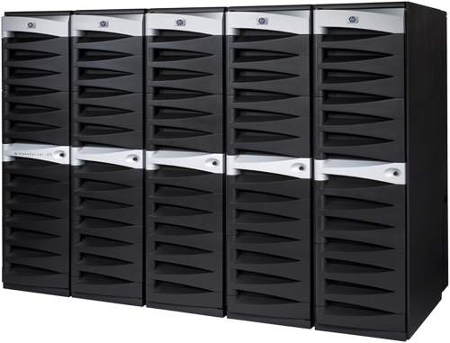
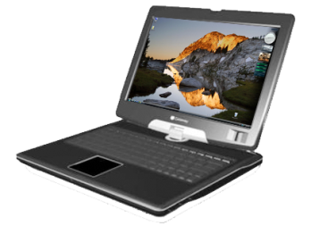




The Industry Debate
Security & Privacy
  Customizability
    Visibility & Control
      Data Accessibility
Global Reach
  Ease of Provisioning
    Business Agility
      Deploy-ability & Manageability

Slide 3
Software + Services
Best of both worlds
  User in control
    Deployment choices for IT
+
Extending tools and platform to cloud
  Experience across multiple devices
    Best-in-class SLAs and IT governance

Slide 4














The Move is On
Desktop Software
Apple iTunes, iPhone SDK
Adobe AIR
Quicken Online
SAP Business ByDesign
Lotus Notes Hosted Messaging
Siebel CRM OnDemand
Sun Hydrazine
Enterprise Software
Consumer Web
Google Chrome, Android, Gears
Yahoo! BrowserPlus, Zimbra Desktop
eBay Desktop, Skype
Salesforce Offline Edition 2.0, Mobile
NetSuite Office integration
Zoho CRM Outlook Edition
Pure-Play SaaS

Slide 5

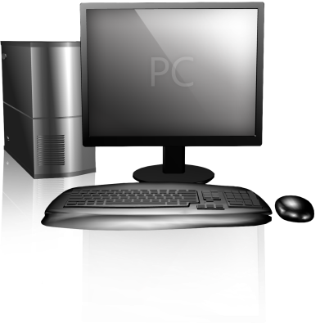

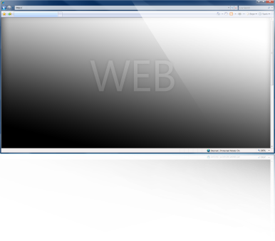
Integrated Experiences
Raising the level of the platform above individual devices
Making the combination of the PC, the Web and the phone greater than the sum of their parts
Provides platforms and tools that capitalize on each device’s unique characteristics

Slide 6






Microsoft Online Services
Enterprise class software delivered via subscription services hosted by Microsoft and sold with partners
New
Microsoft Online Services
: Business Productivity Online Suite

Slide 7

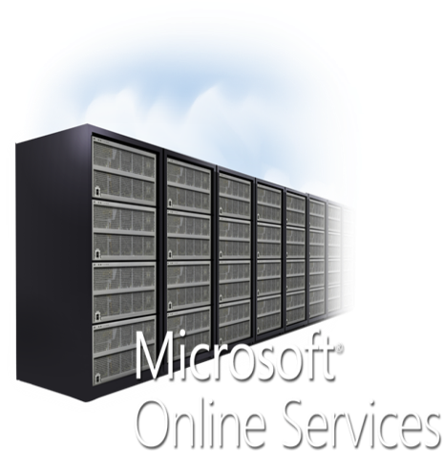




Software + Services
Power of choice
Evolve existing paradigms to work with hybrid architectures
Federated Identity
+
+
Extensibility

Slide 8


Slide 9











Azure™ Services Platform

Slide 10


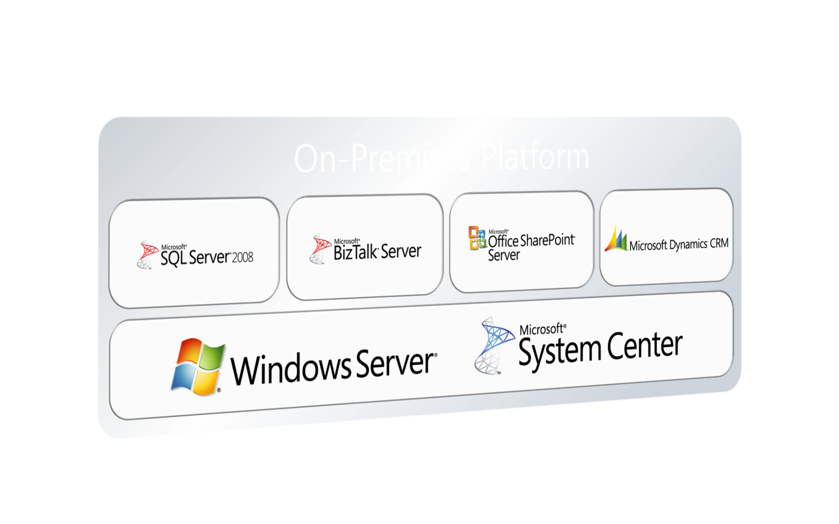
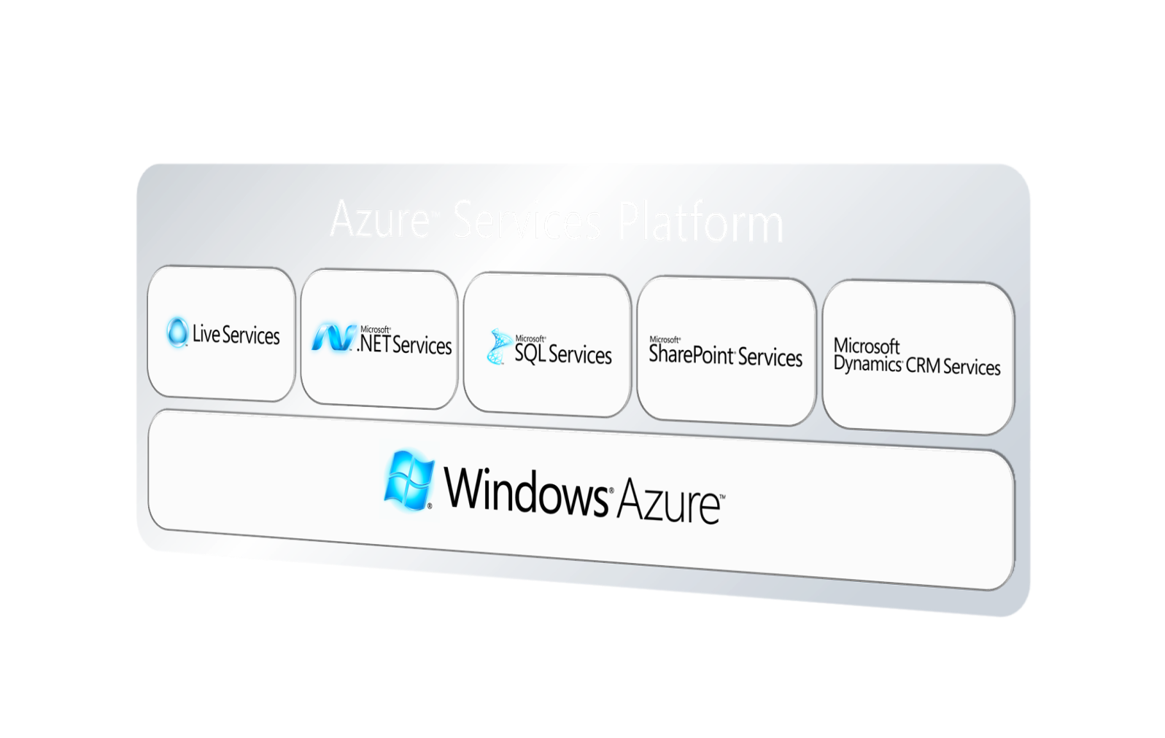
On-Premises
Cloud Services

Slide 11



Scalable, available hosting platform
Rich developer experience
Model-driven service lifecycle management
Enterprise-ready and hobbyist-friendly
Service
Mgmt
Virtualized
Compute
Blobs
Tables
Queues
Locks

Slide 12








Skills Reuse

Slide 13
Services Requirements
Interoperability, Business Processes
Identity & Security
Data Management & Compliance
Services Management

Slide 14

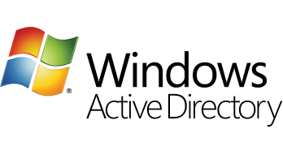


Open and Interoperable Identity
Users control their own identities
Single, federated identity platform
Open and interoperable
“Geneva”

Slide 15


Azure™ Services Platform

Slide 16
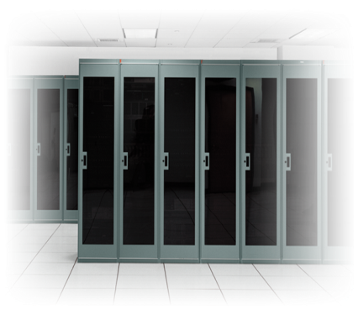





The Power of Choice
On-Premise
On-Premise
Partner
Hosted
Partner
Hosted
MS Hosted
MS Hosted
Outsourced IT
Industry / Vertical configuration
Packaged solutions
Control & ownership
Strategic capabilities
Advanced integration
Outsourced IT
Industry / Vertical configuration
Packaged solutions
Control & ownership
Strategic capabilities
Advanced integration
Rapid implementation
Anywhere-access
Rich customization
Rapid implementation
Anywhere-access
Rich customization

Slide 17









The Impact of Cloud Computing
Reduce Risk, Improve
Productivity
Reduce Costs
Manage Complexity,
Achieve Agility
Infrastructure Optimization
Basic
Standardized
Rationalized
Dynamic
IT is a
cost center
IT is an efficient
cost center
IT is a
business center
IT is a
strategic asset

Slide 18


Summary
Services Optimization
Extend new services
Work anywhere
Create agility

Slide 19
Call to Action
Use your 30 day trials of BPOS and CRM online
  www.microsoft.ca/online
Talk to your account rep about how Azure can extend your infrastructure or be your application development platform

Slide 20
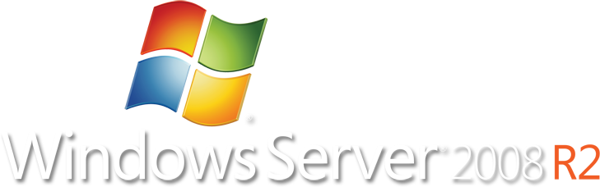


Overall Summary & Conclusion
Optimizing your infrastructure to do more with less

Slide 21
Thank You
Please don’t forget to fill out and hand in your evaluation for a chance to win a Dell Latitude Netbook loaded with Windows 7.

