Slide 2
Reducing Costs and
Increasing Efficiency
with Virtualization
Damir Bersinic
Senior IT Pro Advisor, Microsoft Canada

Slide 3
Reducing Costs and Increasing Agility Through
Consolidation Savings
Business Continuity Management
Reducing Deployment Costs
Integrated Management Solution

Slide 4





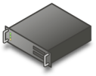









Profile
Virtualization
Document Redirection
Offline files
Server Virtualization
Presentation Virtualization
Management
Desktop Virtualization
Application Virtualization
Centralized Desktop

Slide 5
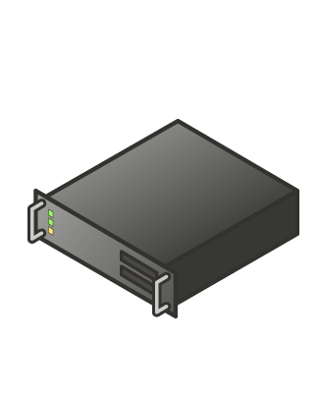
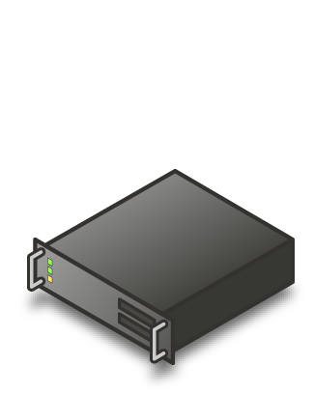
Physical Server Constraints
Underutilized hardware
Excessive power consumption
Expensive space across datacenter and branch offices

Slide 6
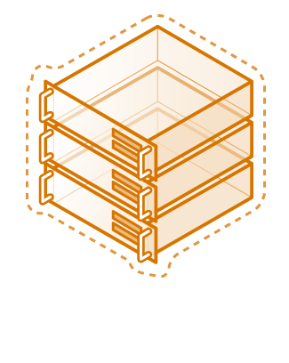
Server Consolidation
Minimize capital expenditures
Reduce Operating Costs
Improve Service Levels

Slide 7
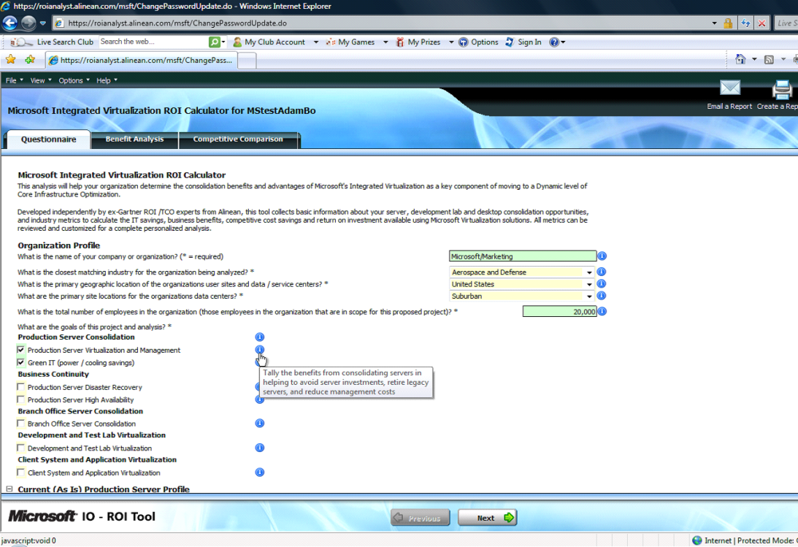
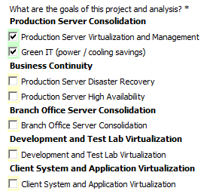
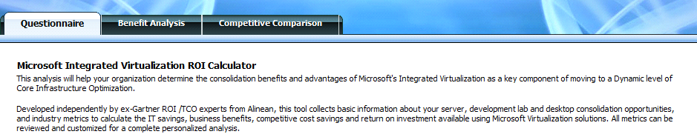
Microsoft Virtualization ROI Tool
http://www.microsoft.com/virtualization/resources

Slide 8
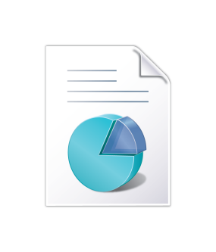
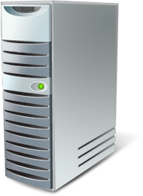

Microsoft Assessment and Planning Toolkit
http://www.microsoft.com/virtualization/resources
Secure and Agentless Inventory
Comprehensive Data Analysis
In Depth Readiness Reporting

Slide 9


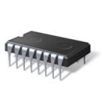
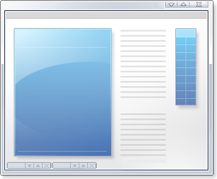





Increasing Availability
Live Migration
Virtual Machine
Virtual Machine
Memory Content
Memory Sync
Configuration Data
Cluster
Node 1
Cluster
Node 2
User
VHD
Network Storage

Slide 10
Demo
Live Migration

Slide 11
Increasing Availability
Live Migration
Virtual Machine
Virtual Machine
Memory Content
Memory Sync
Configuration Data
Cluster
Node 1
Cluster
Node 2
User
VHD
Network Storage

Slide 12
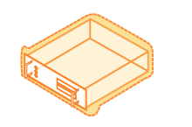

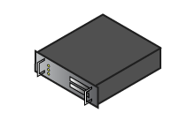

Hot Add/Remove of Storage and CPUs

Slide 13
“Virtualization without management
is more dangerous than not using virtualization in the first place.”
~ Tom Bittman
Gartner VP & Analyst

Slide 14
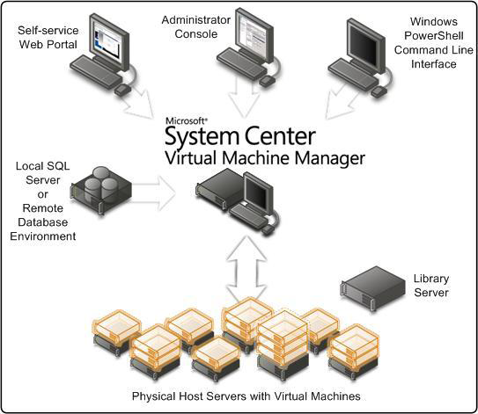

Slide 15
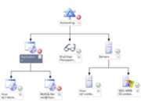
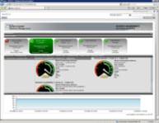
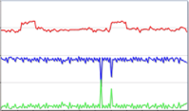
System Center Operations Manager 2007 R2
Cross Platform Monitoring
Service Level Monitoring
User Interface Improvements

Slide 16
DEMO
System Center Virtual Machine Manager

Slide 17
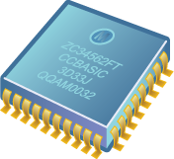
Power Management
2.8 GHz Dual
Core Processor
Core Parking
Processor
Core 1 Active
Processor
Core 2 Inactive
Processor
Core 3 Inactive
Processor
Core 4 Inactive

Slide 18
Power Management
Core Parking
Adjusting
P-states
P-State | Percent | Frequency
0 | 100 | 2.800 GHz
1 | 90 | 2.520 GHz
2 | 85 | 2.380 GHz
3 | 75 | 2.100 GHz
4 | 60 | 1.680 GHz
5 | 50 | 1.400 GHz
P-State=0
Processor
Core 1
P-State | Percent | Frequency
0 | 100 | 2.800 GHz
1 | 90 | 2.520 GHz
2 | 85 | 2.380 GHz
3 | 75 | 2.100 GHz
4 | 60 | 1.680 GHz
5 | 50 | 1.400 GHz
P-State=4
Processor
Core 2

Slide 19
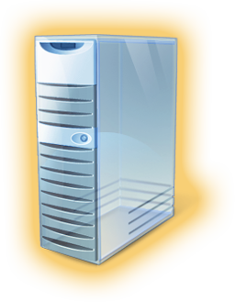



Power Management
Core Parking
Adjusting
P-states
Centralized
storage
Storage Area
Network

Slide 20









Impact of an Optimized Server Infrastructure
Reduce Risk, Improve
Productivity
Reduce Costs
Manage Complexity,
Achieve Agility
Infrastructure Optimization
Basic
Standardized
Rationalized
Dynamic
IT is a
cost center
IT is an efficient
cost center
IT is a
business center
IT is a
strategic asset

Slide 21
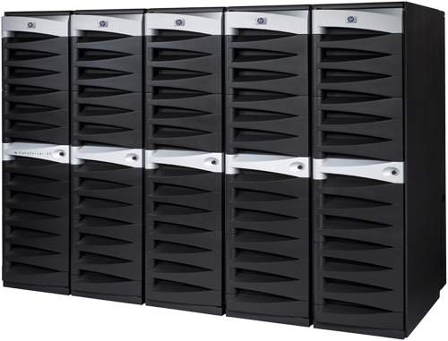

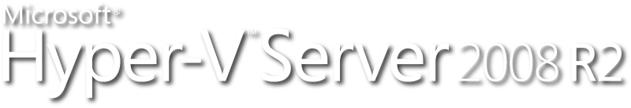
Summary
Server Optimization
Consolidate resources
Increase automation
Enable new services

Slide 22
Call to Action
Evaluate the benefits of virtualization for your organization using the ROI tool
  http://www.microsoft.com/virtualization/resources
Contact us if you’re interested in doing a proof of concept or pilot
  alignit@microsoft.com
Evaluate Windows Server 2008 R2 and Hyper-V
  http://www.microsoft.com/windowsserver2008/en/us/try-it.aspx
  http://www.microsoft.com/hyper-v-server/en/us/default.aspx

