Slide 2
Microsoft SQL Server 2008 Analysis Services enhancements
BIN 310
Pat Martin
ANZ SQL Premier Field Engineer
Microsoft New Zealand

Slide 3
What We Will Cover
Background to SSAS
“Design to perform”
Performance monitoring
Improved computation
Enhanced Backup and other improvements

Slide 4
A Quick Look Back at Analysis Services 2005
Integrated Management with SQL Server
centralised calculations engine
Multi-Instances
Data Source View
MDX Scripts
Multiple Fact tables
Auto referential integrity
MDX Debugger
Enhanced backup and restore
Proactive Caching
Server Synching
  Attribute-based Dimension
AMO
Dr Watson
Integration With Profiler
XML/A
Disk based dimension storage
Perspectives
Many to Many Dimensions
Meta Data Globalisation/Translation
Capture and Replay
Fine grain administration roles
Centralised KPI Frame Work
Role playing dimensions
Failover Clustering
XML-based DDL scripting

Slide 5
AS Enhancements in SQL 2008
“Designed to Perform”
Design
Monitor
Run
Block Computation
Backup scalability
Read-Only DB for
scale out
AMO Warnings
Dimension Design
Cube Design
Resource Monitoring

Slide 6
Peformance: "Design It Right"
“Designed to Perform”
Design
Monitor
Run
AMO Warnings
Dimension Design
Cube Design
Aggregation Designer + Improved algorithms

Slide 7
AS Tools in SQL 2008:
Design it Right the First Time!
Background
  OLAP models can be quite complex, with many interdependencies between objects
  Best practices and performance tuning trips are not generally well known and scattered
AS 2008 Focus
  Embed best practices and performance tuning tricks into the object model and user interface
  Modify design of key areas of the interface so that an optimal design is the natural outcome

Slide 8
Top Performance Tips
Attribute Relationships
Aggregation Design
Cube Design

Slide 9
Attribute Relationships
Dimension Design
1-n relationships between attributes
  Server simply “works better”
Country
Year
Quarter
State
Month
City
Date

Slide 10
Rigid versus Flexible Relationships
Dimension Design
Flexible relationships can change
Rigid relationships do not change
City
Customer
Customer
Phone Number
State
Quarter
City
Month

Slide 11
Relationships And The Key Attribute
Dimension Design
Country
All attributes have an implicit relationship to the key attribute
State
City
Gender
Marital
Age
Customer

Slide 12
Redundant Relationships
Dimension Design
No need for explicit relationships where
implicit relationships already exist
Year
Country
Quarter
State
Month
City
Date

Slide 13
Natural Hierarchies
Dimension Design
1-n relationships between every
pair of adjacent levels
Country
1-n
Customer
State
Country
1-1
1-n
1-n
Gender
City
City
1-n
1-n
Age
Customer

Slide 14
Hierarchies And Performance
Dimension Design
Only natural hierarchies are materialised
on disk during processing
Unnatural hierarchies are built on the
fly during queries
  Cached in memory
  Server internally decomposes
  into natural components

Slide 15
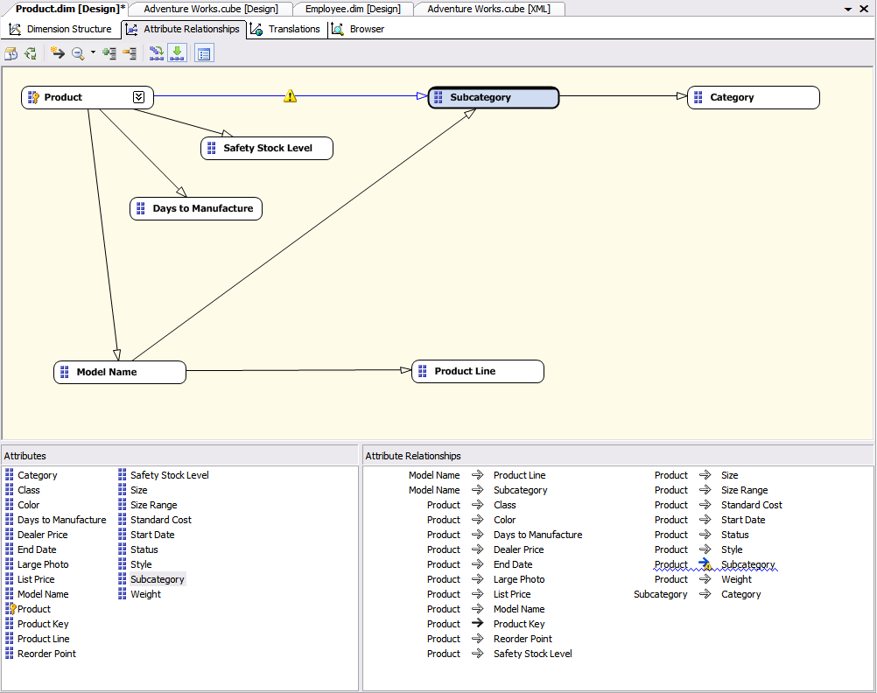
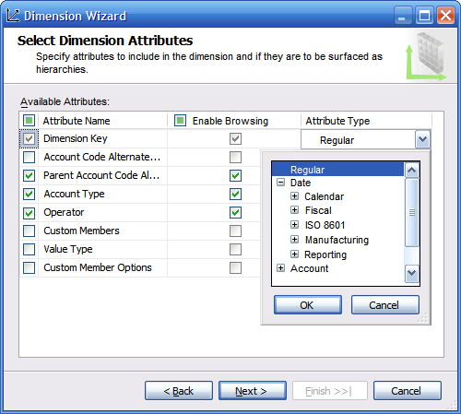
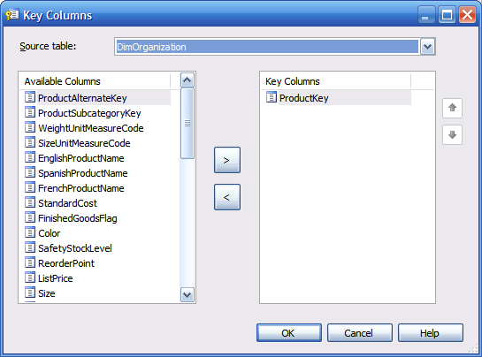
Attribute Relationship Designer
Dimension Design
New designer for viewing and editing attribute relationships
Many built-in validations help in optimal dimension design

Slide 16
Dimension Wizard
Dimension Design
Fewer paths and branches
More powerful
  Automatically create parent-child
  Classify member properties
  Safer error configuration settings

Slide 17
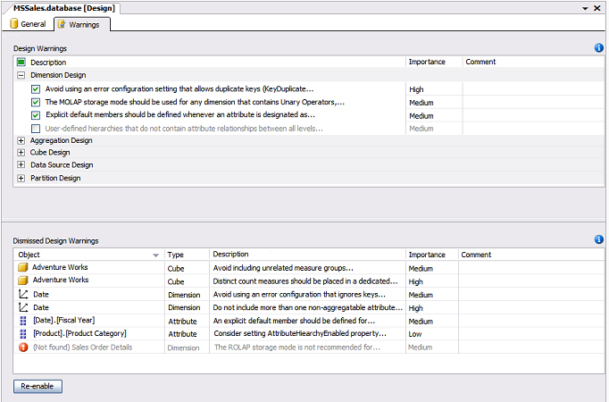
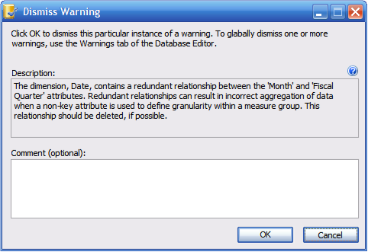
Development Experience
“Designed to Perform”
Design
Monitor
Run
AMO Warnings
  Over 40 best practices integrated into real-time designer checks
  Think of it as auto BPA while you develop
  Subtle
    Blue squiggly lines and build time warnings
    No pop-ups to get in your way
  Dismissible
    By instance or globally
    Can specify comment
    in each case

Slide 18
Analysis Services 2008 Design Tools
Dimension Design
demo
Pat Martin
ANZ SQL Premier Field Engineer
Microsoft N.Z.

Slide 19
Aggregation Design

Slide 20
What Is An Aggregation?
Aggregations
A subtotal of partition data
  based on a set of attributes from each dimension
Highest-Level Aggregation
Customer | Product | Units Sold | Sales
All | All | 347814123 | $345,212,301.30
Intermediate Aggregation
Customers
All Customers
Country
State
City
Name
Products
All Products
Category
Brand
Item
SKU
countryCode | productID | Units Sold | Sales
Can | sd452 | 9456 | $23,914.30
US | yu678 | 4623 | $57,931.45
…
Facts
custID | SKU | Units Sold | Sales
345-23 | 135123 | 2 | $45.67
563-01 | 451236 | 34 | $67.32
…

Slide 21

How Big Is An Aggregation?
Customers
All Customers (1)
Country (3)
State (80)
City (578)
Name (3811)
Product
All Products (1)
Category (60)
Brand (911)
Item (7621)
SKU (8211)
Time
All Time (1)
Year (3)
Quarter (12)
Month (36)
Day (1095)
Aggregations at lower levels have more possible rows…
  (All, All, All) 1 x 1 x 1 = 1
  (Country, Item, Quarter) 3 x 7621 x 12 = 274,356
  (Name, SKU, Day) 3811 x 8211 x 1095 = 34,264,872,495
Actual number of rows depends on the data sparsity
Size also depends on the number of measures

Slide 22
Aggregations And Performance
Aggregations
Customers
All Customers
Country
State
City
Name
Products
All Products
Category
Brand
Item
SKU
Time
All Time
Year
Quarter
Month
Day
Query levels Aggregation used Max Cells
(All, All, All) (All, All, All) 1
(Country, Item, Quarter) (Country, Item, Quarter) 274,356
(Country, Brand, Quarter) (Country, Item, Quarter) 274,356
(Country, Category, All) (Country, Item, Quarter) 274,356
(State, Item, Quarter) (Name, SKU, Day) 34,264,872,495
(City, Category, Year) (Name, SKU, Day) 34,264,872,495
Using a higher-level aggregation means fewer cells to consider

Slide 23
Some Hints For Aggregations
Aggregations
Define all possible attribute relationships
Set accurate attribute member counts
and fact table counts
Set AggregationUsage
  Set rarely queried attributes to None
  Commonly queried attributes to Unrestricted

Slide 24
7-steps In Aggregation Design
Aggregations
Use Storage Design Wizard for the initial aggregations (~20% perf gain)
Enable query log
Run pilot workload with limited users
Refine with Usage Based Optimisation Wizard
Use a larger perf gain (70+%)
Reprocess partitions for new aggregations
to take effect
Periodically use UBO to refine aggregations

Slide 25
New UBO Algorithm
Aggregations
Query # | Run #2 - Old UBO | Run #3 - New UBO
0 | 0:02:32 | 0:02:11
1 | 0:00:32 | 0:00:04
2 | 0:00:01 | 0:00:01
3 | 0:00:08 | 0:00:10
4 | 0:00:02 | 0:00:04
5 | 0:00:06 | 0:00:06
6 | 0:00:00 | 0:00:01
7 | 0:04:27 | 0:00:17
8 | 0:06:38 | 0:00:03
9 | 0:00:46 | 0:00:12
10 | 0:00:01 | 0:00:00
11 | 0:00:00 | 0:00:00
12 | 0:07:19 | 0:06:20
13 | 0:00:09 | 0:00:09
14 | 0:02:06 | 0:02:16
15 | 0:04:39 | 0:04:38
16 | 0:04:34 | 0:05:48
17 | 0:00:06 | 0:00:07
18 | 0:00:09 | 0:00:04
19 | 0:00:08 | 0:00:06
20 | 0:00:05 | 0:00:05
21 | 0:00:32 | 0:00:29
Total | 0:35:00 | 0:23:11

Slide 26
New UBO Algorithm
Aggregations
Query # | Run #2 - Old UBO | Run #3 - New UBO
0 | 0:02:32 | 0:02:11
1 | 0:00:32 | 0:00:04
2 | 0:00:01 | 0:00:01
3 | 0:00:08 | 0:00:10
4 | 0:00:02 | 0:00:04
5 | 0:00:06 | 0:00:06
6 | 0:00:00 | 0:00:01
7 | 0:04:27 | 0:00:17
8 | 0:06:38 | 0:00:03
9 | 0:00:46 | 0:00:12
10 | 0:00:01 | 0:00:00
11 | 0:00:00 | 0:00:00
12 | 0:07:19 | 0:06:20
13 | 0:00:09 | 0:00:09
14 | 0:02:06 | 0:02:16
15 | 0:04:39 | 0:04:38
16 | 0:04:34 | 0:05:48
17 | 0:00:06 | 0:00:07
18 | 0:00:09 | 0:00:04
19 | 0:00:08 | 0:00:06
20 | 0:00:05 | 0:00:05
21 | 0:00:32 | 0:00:29
Total | 0:35:00 | 0:23:11

Slide 27
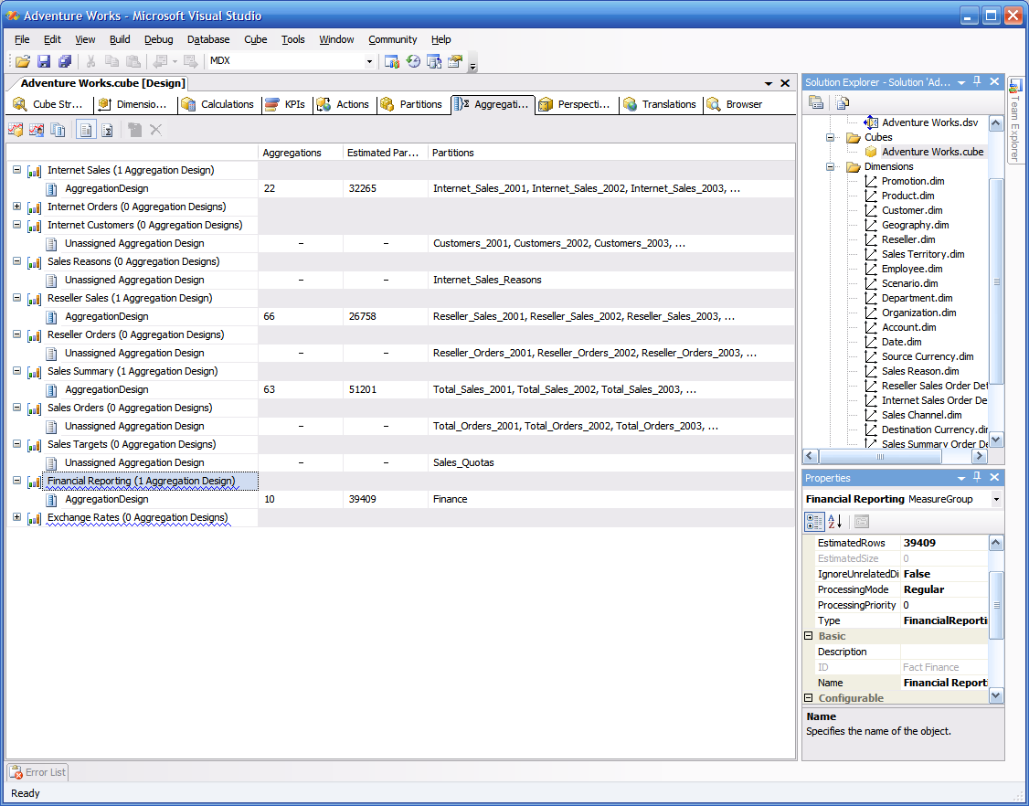
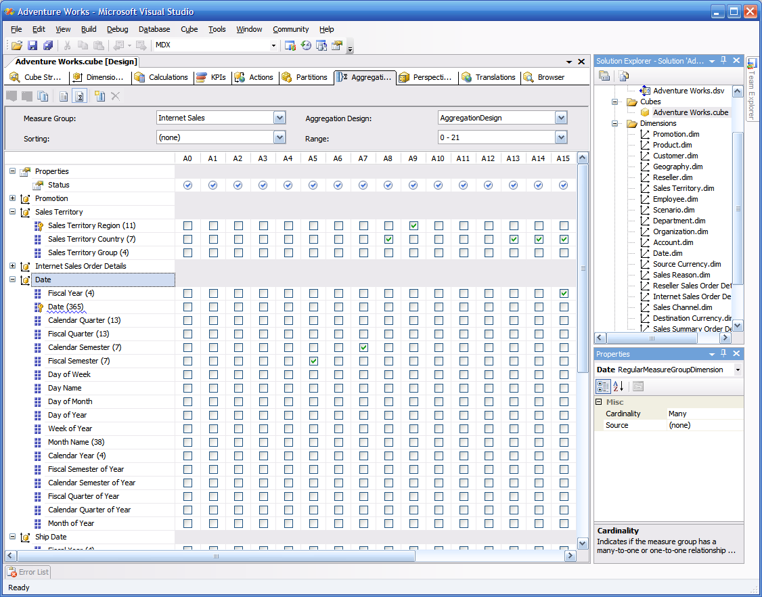
2008 Aggregation Design Tools
Aggregations
Wizard Enhancements
  Support for modifying aggregation usage property
  Ability to append results of UBO
  to an existing aggregation design
  Potentially new UBO algorithm
Dedicated Designer
  View aggregation designs and aggregations in both management and development environments
  Manually edit/create/delete aggregations
  Built-in validations to assist
  in creating optimal designs

Slide 28
Analysis Services 2008 Design Tools
Aggregation Design
demo
Pat Martin
ANZ SQL Premier Field Engineer
Microsoft N.Z.

Slide 29
Peformance: Monitoring
“Designed to Perform”
Design
Monitor
Run
Resource Monitoring

Slide 30
Resource Monitoring (DMV)
Ask/Need | “I need to know what and who is running large queries on my server” “I want to find and kill runaway query” Monitoring server health – Infrastructure to allow for collecting server health statistics
Today's Problem | AS 2005 stats are not rich enough provides basic information such as: User session/connection info Connection Time Last executed command (text)
AS 2008 Solution | New server infrastructure for resources monitoring collection and reporting

Slide 31
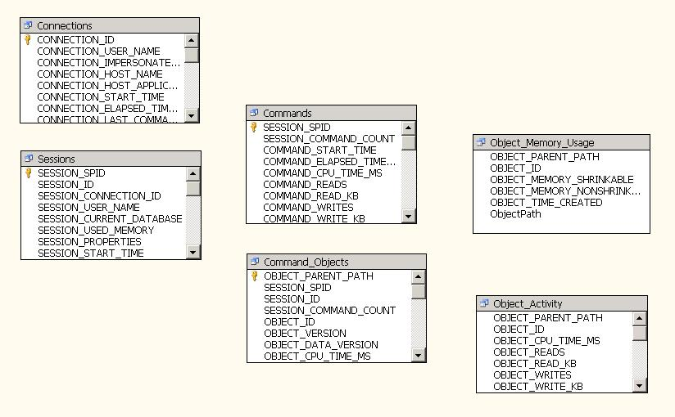
Analysis Services DMV Schema

Slide 32
Dynamic Management Views
demo
Pat Martin
ANZ SQL Premier Field Engineer
Microsoft N.Z.

Slide 33
Performance: "Run"
“Designed to Perform”
Design
Monitor
Run
Block Computation
Backup scalability
Read-Only DB for scale out

Slide 34
MDX Query Performance:
Subspace Computation
Cube space populated at fact table generally extremely “sparse”
  Values only exist for small minority of possible combinations of dimension keys
Goal is to compute expressions only where they need to be computed
  Most often, everything takes on a default value typically (but not always) null
Partially implemented in Analysis Services 2005
  See orders of magnitude performance improvement where implemented

Slide 35
An Example
Consider the expression:
WITH MEMBER Measures.ContributionToParent AS
‘measures.Sales/(measures.Sales, Product.Currentmember.parent)’
SELECT
Product.[Product Family].members ON COLUMNS,
Customer.Country.members ON ROWS
FROM
Sales
WHERE
measures.ContributionToParent
How is the expression computed in the query space?

Slide 36
Cell-by-cell Computation
Measures.ContributionToParent
 | Drink | Food | Non-Consumable
Canada
Mexico
USA
=
(null)
(null)
(null)
(null)
(null)
(null)
9.22%
71.95%
18.83%
measures.[Unit Sales]
(Measures.Sales, Product.Currentmember.Parent)’
 | Drink | Food | Non-Consumable
Canada | (null) | (null) | (null)
Mexico | (null) | (null) | (null)
USA | $ 24,597.00 | $ 191,940.00 | $ 50,236.00
/
 | All Products
Canada | (null)
Mexico | (null)
USA | $ 266,773.00
AS Calc Engine Rules: Null / Null = Null

Slide 37
Block Computing Goals
Only calculate non-null* values.
Perform the cell navigation (ie, .prevmember, .parent) just once instead of for every cell
  Navigate for the entire space
*An oversimplification. Actually, we want to avoid calculating non-default values.
For example: iif( measures.Sales>0, measures.profit/measures.sales, 0)

Slide 38
Block Computing
 | Drink | Food | Non-Consumable
Canada | (null) | (null) | (null)
Mexico | (null) | (null) | (null)
USA | 9.22% | 71.95% | 18.83%
3) …and everything else is null
Country | Product | Measure | Value
USA | Drink | Contribution to Parent | 9.22%
USA | Food | Contribution to Parent | 71.95%
USA | Non-Consumable | Contribution to Parent | 18.83%
2) Perform the computation for the non-null values - only 3 computations instead of 9…
Country | Product | Measure | Value
USA | Drink | Sales | $24,597.00
USA | Food | Sales | $191,940.00
USA | Non-Consumable | Sales | $50,236.00
Country | Product | Measure | Value
USA | All Products | Sales | $266,773.00
1. Retrieve non-null values from storage engine

Slide 39
Subspace Computation
demo
Pat Martin
ANZ SQL Premier Field Engineer
Microsoft N.Z.

Slide 40
Scalable Backup
Ask/Need | Estimated 20% of cubes are greater then 50GB BI is mission critical to many business Needs fast and reliable backup “ I need a fast mean of moving /shipping cubes from one server to another”
Today's Problem | Analysis Services 2005 backup scales well up to 20GB cubes Beyond 20GB seeing significant performance degradation on backup operation Note: 20GB of AS cubes represents ~ 80GB relational data Today's workaround: File copy of data folder
AS 2008 Solution | Out of the box performance that is comparable to the speed of file copy

Slide 41
Backup Performance - AS 2008

Slide 42
Scalable Shared Databases (Read-only)
Ask/Need | Easy way of scaling out AS data cross multiple machines
Today's Problem | While MOLAP cubes are Read-Only databases, no two servers are share same data directory. Cube Sync – works but have latency issues which are not acceptable in LB solutions.
AS 2008 Enterprise Edition Solution | Single read-only copy database is shared between several Analysis Servers.
Virtual IP
. . .
Analysis Server
Analysis Server
Analysis Server
SAN storage

Slide 43




Clients: Excel, Proclarity, Internet Explorer
Load Balancer – NLB, F5, Custom ASP.NET
Processing Server
Query Servers
Cube Processing
Read Only DB on
Shared SAN Drive
Detach & Attach

Slide 44
Session Summary
SSAS 2008 helps you “design to perform”
Performance monitoring enhances manageability
Engine improvements increase performance
Backup and shared scalable database support

Slide 45
Q & A

Slide 46




Resources
www.microsoft.com/teched
  Tech·Talks Tech·Ed Bloggers
  Live Simulcasts Virtual Labs
http://microsoft.com/technet
  Evaluation licenses, pre-released products, and MORE!
http://microsoft.com/msdn
  Developer’s Kit, Licenses,
  and MORE!

Slide 47
Related Content
DAT361 SQL Server 2008 Security Deep Dive
BIN309 SQL Server 2008 ETL drill down
BIN310 SQL Server 2008 Analysis Server (SSAS) enhancements
DAT362 SQL Server Spatial in the Spotlight
BIN352 Microsoft SQL Server 2008 Reporting Services: Architecture Overview
BIN311 Advanced Dashboard Creation with MOSS 2007
DAT364 End-to-End Troubleshooting for Microsoft SQL Server 2005/2008
BIN401 Optimising Query Performance in SQL Server 2008 Analysis Services
DAT355 Upgrading to Microsoft SQL Server 2008: Notes from Early Adopters
BIN402 Building and Deploying Advanced MOSS 2007 Planning Applications

Slide 48


Slide 49
Please complete an
evaluation

Slide 50

© 2008 Microsoft Corporation. All rights reserved. Microsoft, Windows, Windows Vista and other product names are or may be registered trademarks and/or trademarks in the U.S. and/or other countries.
The information herein is for informational purposes only and represents the current view of Microsoft Corporation as of the date of this presentation. Because Microsoft must respond to changing market conditions, it should not be interpreted to be a commitment on the part of Microsoft, and Microsoft cannot guarantee the accuracy of any information provided after the date of this presentation. MICROSOFT MAKES NO WARRANTIES, EXPRESS, IMPLIED OR STATUTORY, AS TO THE INFORMATION IN THIS PRESENTATION.

