Slide 1
Getting Started: Windows Logo Program
Amina Saify
Program Manager

Slide 2
Objectives
Understand end-to-end Windows Logo Program for hardware
How to access logo program requirements
How to run tests and troubleshoot
How to make a submission
How to manage your submission

Slide 3
Overview
Introduction
Logo qualification workflow
LogoPoint
Windows Logo Kit
Troubleshooting
Packaging and submitting test results

Slide 4
Introduction

Slide 5
The Windows Logo Qualification
Ensures that:
Systems and/or devices have gone through thorough testing
All devices and other components in the system are logo-qualified for Windows
Microsoft-signed drivers for Windows are available on Windows Update for all devices and other components in the system
The system is reliable, stable, secure and compatible with Windows

Slide 6
Partner Benefits: Reasons to Get the Windows Logo
Association with one of the strongest, most well-known brands in the world – Windows
Value add against competitors
Meeting corporate and retail purchasing criteria
Receiving a Windows Compatibility Center listing
Product listing in the Windows Hardware Compatibility list
Drivers published on Windows Update
Lower support costs and reduced product returns

Slide 7
Logo Qualification Workflow

Slide 8
Windows Logo System
Requirements System
Validation System
Validate your device and driver
Processing System
Winqual Submission Tool and Submission Center
Online and offline tools to prepare and upload test results and mange your products
Online tool for publishing requirements and managing feedback on new requirements
Windows Logo Kit
(WLK)
LogoPoint

Slide 9
Windows Logo Program Workflow
Prep Work
Validate your device and driver
Submit your results to Winqual
Manage your product on Winqual
Acquire VeriSign ID
Sign legal documents
Download the Windows Logo Kit (WLK)
Run the logo tests
Create CAB file using the Winqual Submission Tool (WST)
Upload CAB to Winqual
Download signed cat files and artwork
Manage distribution and marketing partnerships
Use driver quality tools
Review logo requirements

Slide 10
Prep Work Checklist
Prep Work
  Acquire VeriSign ID
  Sign legal documents
  Review logo requirements
Obtain your VeriSign ID
Establish Winqual accounts
Winqual billing
Sign legal agreements
Review logo program requirements on LogoPoint

Slide 11
Obtain VeriSign ID
Purpose: Establishes your company’s identity
Certificate types:
  Organizational certificate: Used for establishing identify of an organization
  Code-signing digital ID: Used for establishing ownership of code
Certificates must be renewed annually
Links to VeriSign via Winqual
Discounts on certificates available via Winqual

Slide 12
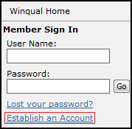
Establish Winqual Accounts
Accounts are organized by company
Initially establish a company account using your VeriSign ID
Establish the administrator account when creating the company account
Create additional user accounts
  User applies for new user account under your company account
  Administrator approves creation of new user account

Slide 13
Winqual Billing
Devices and systems: $250 per submission
Fee is per submission and per operating system family, for example
  Device for Windows 7
  Device for Windows Vista
  Device for Windows Vista and Windows XP
  Device for Windows Vista x86 and Windows Vista x64 submitted together
A few unique submissions have different prices
Your company will be billed quarterly
Fees must be paid in US dollars via check or wire transfer
Check Winqual site for current fee schedule

Slide 14
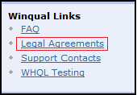
Sign Legal Agreements
Agreement types:
  Testing agreement: Required to participate
  Logo license agreement: Required to use the logo
  Technology-specific agreement: Required to display the logo on specific types of products
Signing
  Agreements are signed by you and countersigned by Microsoft
  Agreements are not effective until they are countersigned
  Agreements do expire regularly
  Winqual will help you manage all of your agreements and track their status

Slide 15
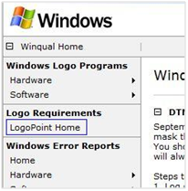
Review Logo Requirements
Logo requirements are managed and published in LogoPoint, an online application hosted on Winqual
Use LogoPoint to:
  View current requirements
  Communicate with Microsoft about requirements
  Download requirements documents for offline viewing

Slide 16
LogoPoint

Slide 17
Logo Program Terminology
Term | Definition
Logo policy | A policy of the Windows Logo Program
Logo requirement | A requirement for your product
If implemented | A logo requirement that applies if a specific technology is implemented
Additional qualification (AQ) | An “if implemented” that helps distinguish products with advanced capabilities For example, to showcase a specific user scenario

Slide 18
Requirements Development Cycle
A
Publish new draft requirements
Gather ecosystem feedback
Respond to feedback
Publish updated requirements based on feedback
Requirements become applicable
Time between steps D & E:
E
B
6 months for requirement changes that affect driver/firmware development
12 months for requirement changes that affect hardware design
18 months for requirement changes that affect silicon design
D
C

Slide 19
Windows LogoPoint System
Logo requirements management system
Repository of requirements
Official plan of record
Searchable
Downloadable reports available
A place to provide specific feedback
Accessible through https://winqual.microsoft.com

Slide 20
Requirements Common to All Categories
Logo policy (POLICY)
  Governs the spirit of the program
  Applies across the board
Device connectivity (CONNECT)
  Applies depending on the type of connectivity
Device fundamentals (DEVFUND)
  Applies to all devices (external and internal)
System fundamentals (SYSFUND)
  Applies to all PC systems

Slide 21


System- and Device-Specific Requirements
Systems Requirements
All-in-one PC Client Device Desktop PC Mobile PC Ultra-Mobile PC (UMPC) Rack System Server Device Standalone Server Windows Home Server
Device Groups
Audio Devices Bus Controllers and Ports Display Devices Graphics Device Imaging Devices Input Devices Modem Network Devices Networked Media Device Portable Devices Storage Devices Streaming Media

Slide 22
System Form Factors For Windows Vista
Desktop | A uniprocessor or multiprocessor system that requires AC power for continuous operation. A desktop system does not include attached peripherals such as mouse devices, monitors, keyboards, or printers.
All-in-One | A uniprocessor or multiprocessor system that has a permanently attached integrated display. This is a fixed form factor desktop system that typically includes integrated components based out of mobile hardware designs.
Mobile | A uniprocessor or multiprocessor system that can be physically carried, has integrated display and input devices, and has a battery that can provide continuous operation when not plugged in.
Ultra Mobile | A mobile system that weighs less than 2.5 pounds or 1.134 kg in the standard configuration and has a 7-inch or smaller screen size.

Slide 23
System Form Factors For Windows 7
Desktop | A uniprocessor or multiprocessor system that requires AC power for continuous operation. A desktop system does not include attached peripherals such as mouse devices, monitors, keyboards, or printers.
All-in-One | A uniprocessor or multiprocessor system that has a permanently attached integrated display. This is a fixed form factor desktop system that typically includes integrated components based out of mobile hardware designs.
Mobile | A uniprocessor or multiprocessor system that can be physically carried, has integrated display and input devices, and has a battery that can provide continuous operation when not plugged in.
Ultra Mobile | A mobile system that has a 10.2-inch or smaller screen size.

Slide 24
Windows Logo Program for Hardware: Requirement Lists
LogoPoint database:
http://winqual.microsoft.com -> Member Sign In -> LogoPoint Home -> Requirements
or
LogoPoint database snapshots: http://www.microsoft.com/whdc/winlogo/hwrequirements.mspx
Our test suite will validate everything that can be tested. There are requirements that cannot be tested with our infrastructure and we will need you to verify those requirements outside of WLK. You should look through all the relevant requirements to make sure that all the necessary requirements are met.
Note: The latest version of the logo requirements will always be in the LogoPoint database on http://winqual.microsoft.com

Slide 25
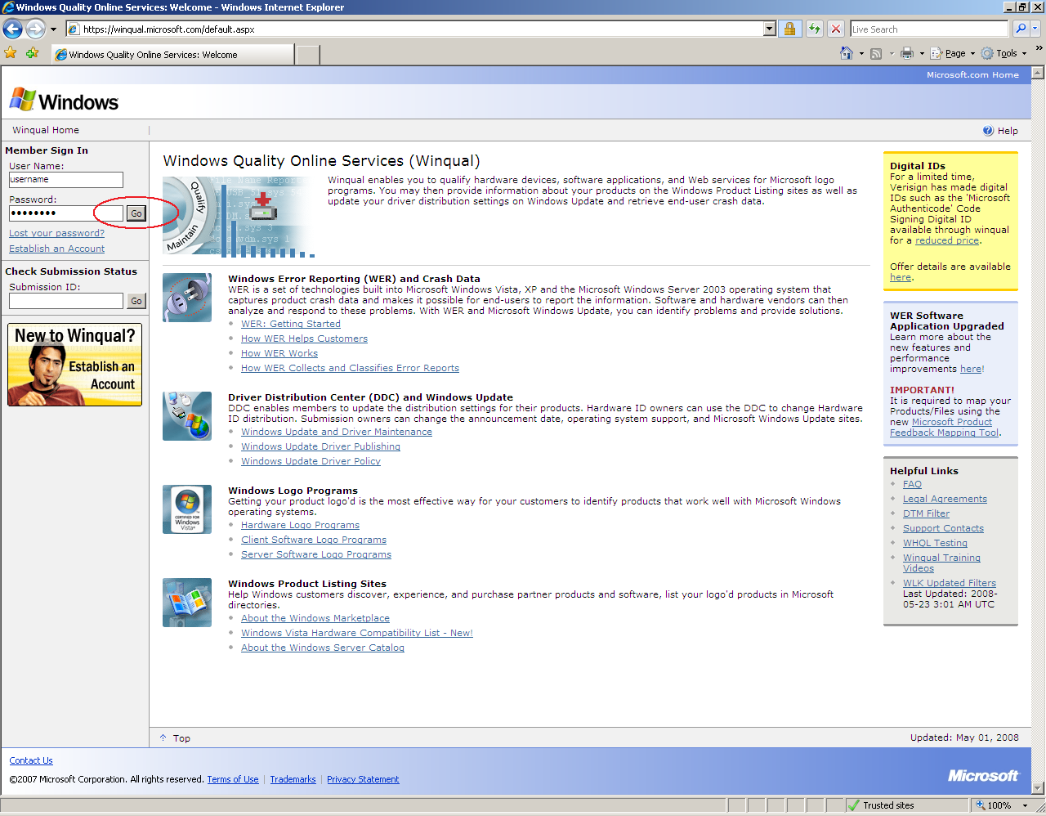

LogoPoint: Current Version of Requirements

Slide 26
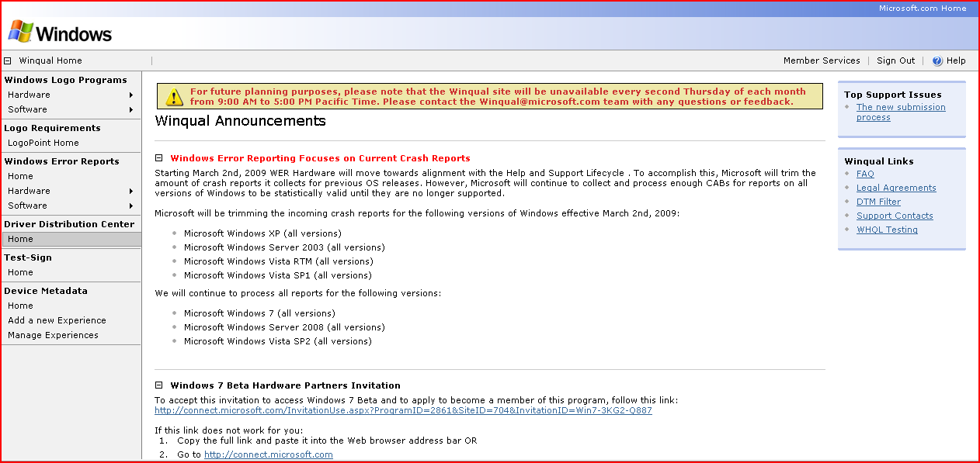
LogoPoint: Current Version of Requirements (2)

Slide 27
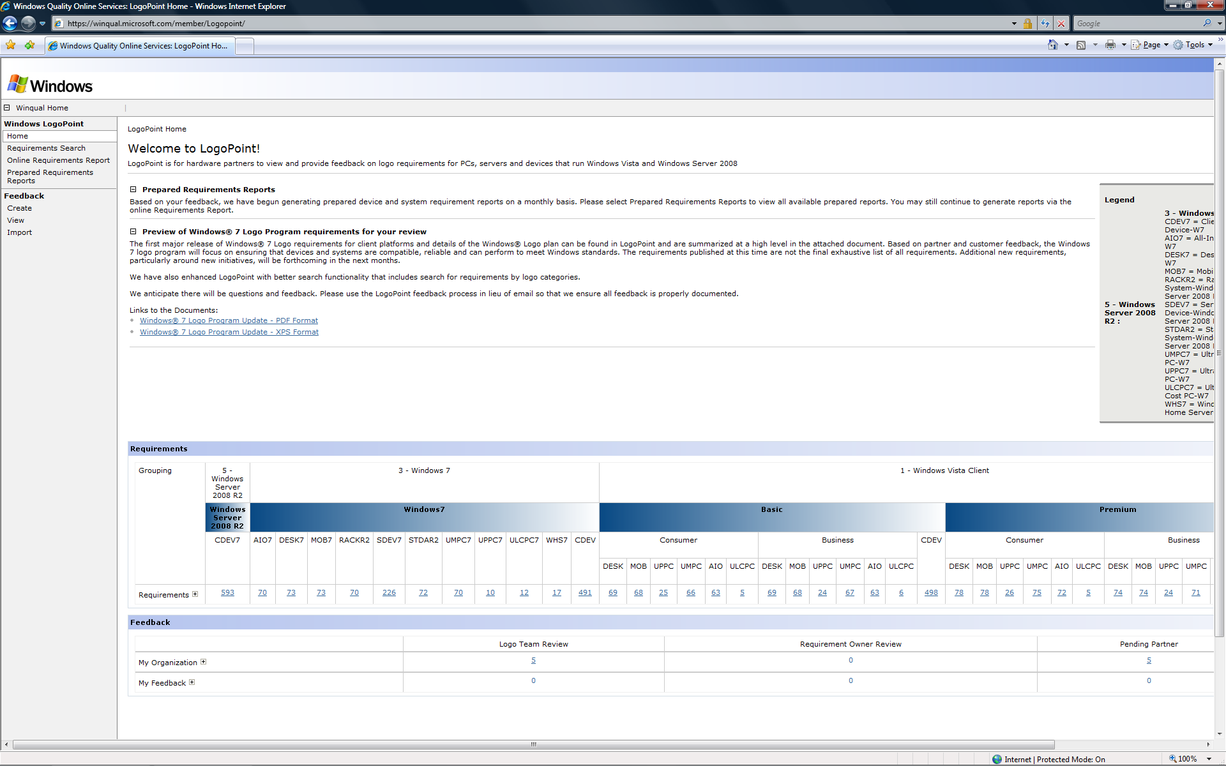
LogoPoint Home Page

Slide 28
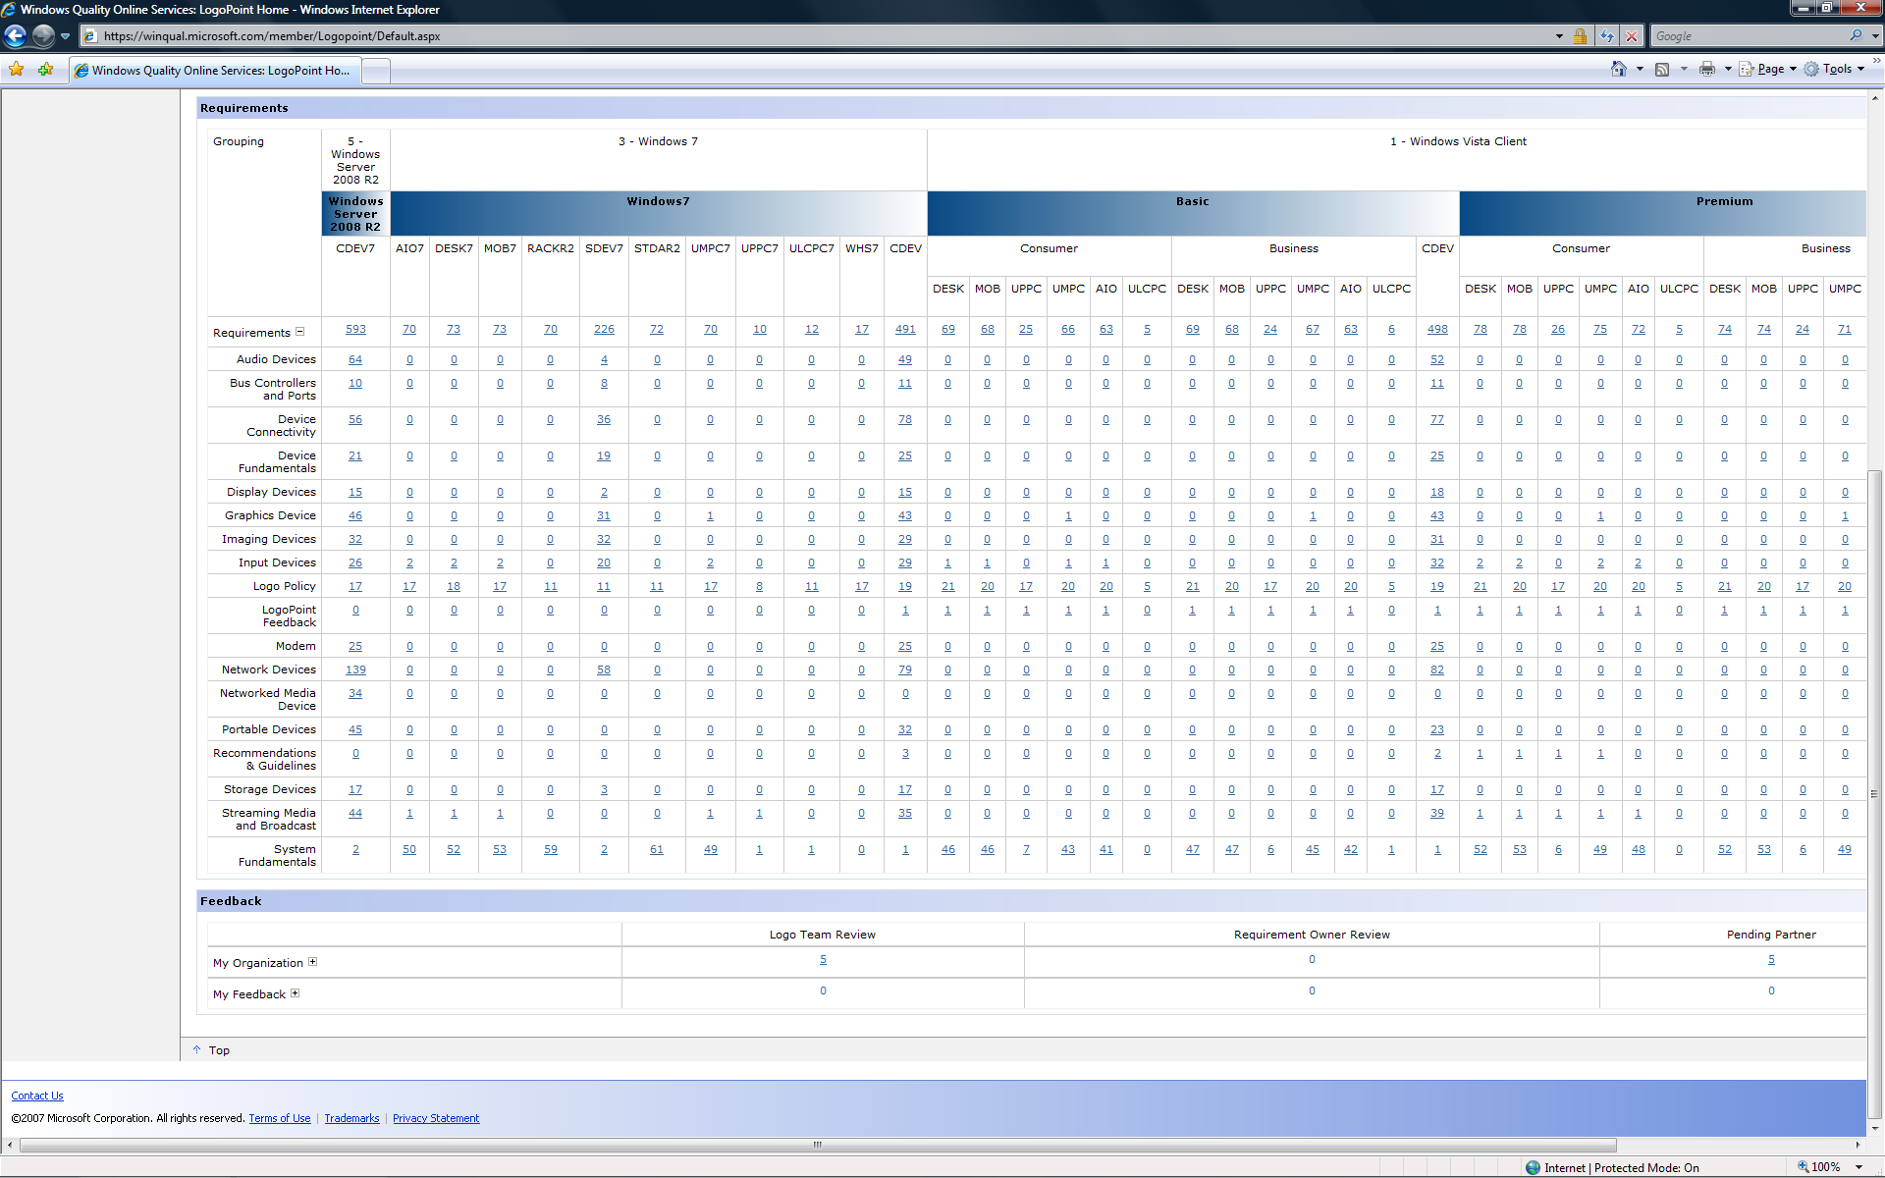
Requirements Overview

Slide 29
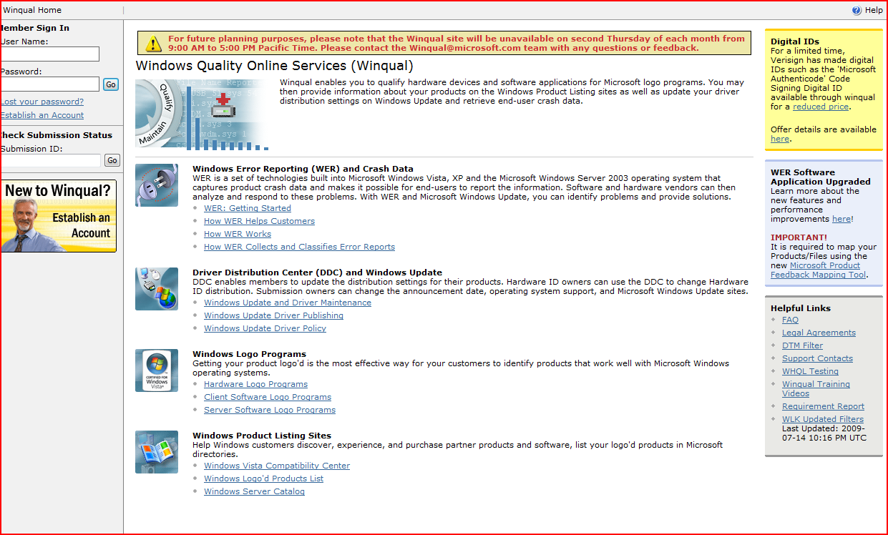
Prepared Requirement Reports

Slide 30
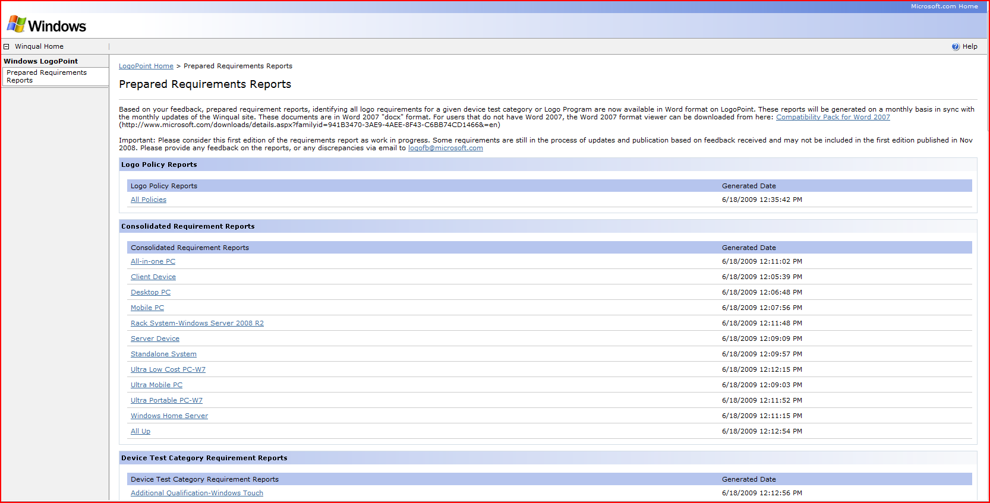
Prepared Requirement Reports (2)

Slide 31
Windows Logo Kit

Slide 32
Validation Process
Validate your device and driver
  Download the Windows Logo Kit (WLK)
  Run the logo tests
  Deploy the Driver Test Manager (DTM)
  Run the tests
Diagnose, resolve issues, retest
Apply filters
    View WLK filters information on Driver Test Manager (DTM) filter page
    Install the latest filters
    Using WLK filters to triage test logs
Export passing results to a CPK file

Slide 33
What is WLK?
Test suite to validate your devices and/or systems for Windows
Available free from WLK program on Microsoft Connect
Released in sync with Windows Logo Program updates and Windows operating systems releases

Slide 34
WLK Components
Windows Logo Kit
WLP: Windows Logo Program
WLK: Windows Logo Kit
DTM: Driver Test Manager
WTT: Windows Test Technologies
Test Kit
Test Kit
Test Kit
Test Kit
Logo/Device Features
WTT
Driver Test Manger

Slide 35
Driver Test Manager
A powerful automation infrastructure
The same test automation platform that Microsoft uses to test Windows every day
Components customized to the needs of partners testing devices and systems for logo
Key features
  Parallel execution
  Remote access
  Centralized results reporting
  Integration of logo requirements testing

Slide 36
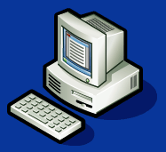

DTM Components
At least two systems
DTM Studio
  Streamlined for testing
  Planning and monitoring
Controller
  Services and daemons
  Configuration database
  Stored procedures
Test client
  System under test
  Contains a slim execution agent
∞
1
Automation
Datastore
1
DTM Controller
1-100

Slide 37
Requirements
At least two systems
  DTM Controller
    Windows Server 2003 SP2
    WLK 1.5 SQL Server 2005 or SQL Server Express
  DTM Studio
    Can be on the same system as DTM Controller
    All currently supported operating systems
  DTM Client
    Cannot be run on the same system as DTM Controller or DTM Studio

Slide 38

DTM Scenario
The scheduler matches the jobs to the test targets with the appropriate hardware
My Job
Job 0
Scheduler
Automation
Datastore
…and shared with customers, OEMs, or submitted to Windows Logo Program
My Job
Config
Device x
Job Management
DTM Controller
The jobs and test configuration are sent to the test targets
Device 0
Device 0
Device 0
Log 2
Log 1
The test targets are configured automatically
DTM Studio
Log 0
Test System
Pool
The tests execute in parallel or in sequence, collecting results in logs

Slide 39
Supported Deployment Scenarios
Domain-joined environment
  A domain‑joined environment is an environment in which a domain controller is present and all machines on which DTM components will be installed are joined to the domain controller
Workgroup environment
  A workgroup environment is one in which no domain controller is present and all machines belong to the same workgroup
NOTE: Undocumented deployment scenarios are not supported

Slide 40
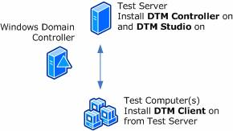
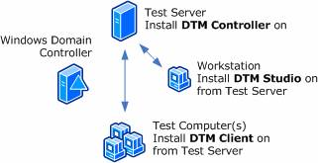
Domain-Joined Environment

Slide 41
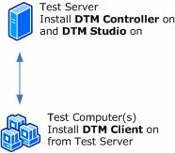
Workgroup Environment

Slide 42
System Requirements (Controller)
Minimum:
  Processor: Single x86‑based processor running in x86 mode
  System memory: 2 GB main memory
  Hard disk capacity: 300 GB
Optimum:
  Processor: Multi-core or multiple x64‑based processors running in x86 mode
  System memory: 4 GB main memory
  JBOD array
Network connection: 100 megabits per second (Mbps).
Operating system: x86‑based version of Windows Server 2003 with SP1 or SP2 installed (SP2 recommended)

Slide 43
System Requirements (Controller) (2)
Notes:
DTM Controller is not supported on Windows Vista, Windows XP, Windows 7, Windows Server 2008, or Windows Server 2008 R2.
DTM Controller is not supported on a Windows Server 2003 installation that has already been set up as a domain controller
DTM Controller is not supported in a virtual PC environment

Slide 44
System Requirements (Studio)
Processor: x86‑based, Itanium‑based, or x64‑based architectures
Operating system: All currently supported operating systems

Slide 45
System Requirements (Studio) (2)
Notes:
DTM Studio is not supported in a virtual PC environment

Slide 46
System Requirements (Client)
Processor: x86‑based, Itanium‑based, or x64‑based architectures
System Memory
  Shipping configuration
  Policy for minimum requirements
Operating System
  Windows 7 (Home Premium, Professional, and Ultimate) for x86‑based or x64‑based architectures
  Windows Server 2008 R2 (Datacenter) x64-based
  Windows Vista (SP2) (Home Premium, Professional, Enterprise and Ultimate) for x86‑based or x64‑based architectures
  Windows Server 2003 (SP2) for x86‑based, x64‑based Itanium‑based architectures
  Windows XP (SP2) (netbook only)

Slide 47
System Requirements (Client) (2)
Notes:
If the DTM client will run Windows Vista and Windows 7, you must select Private as the network category during the first boot; otherwise, the DTM client will be unable to process jobs from its DTM Controller
When selecting a machine name for the DTM Client, you must choose a unique name with 15 or fewer characters
DTM Client is not supported in a virtual PC environment

Slide 48
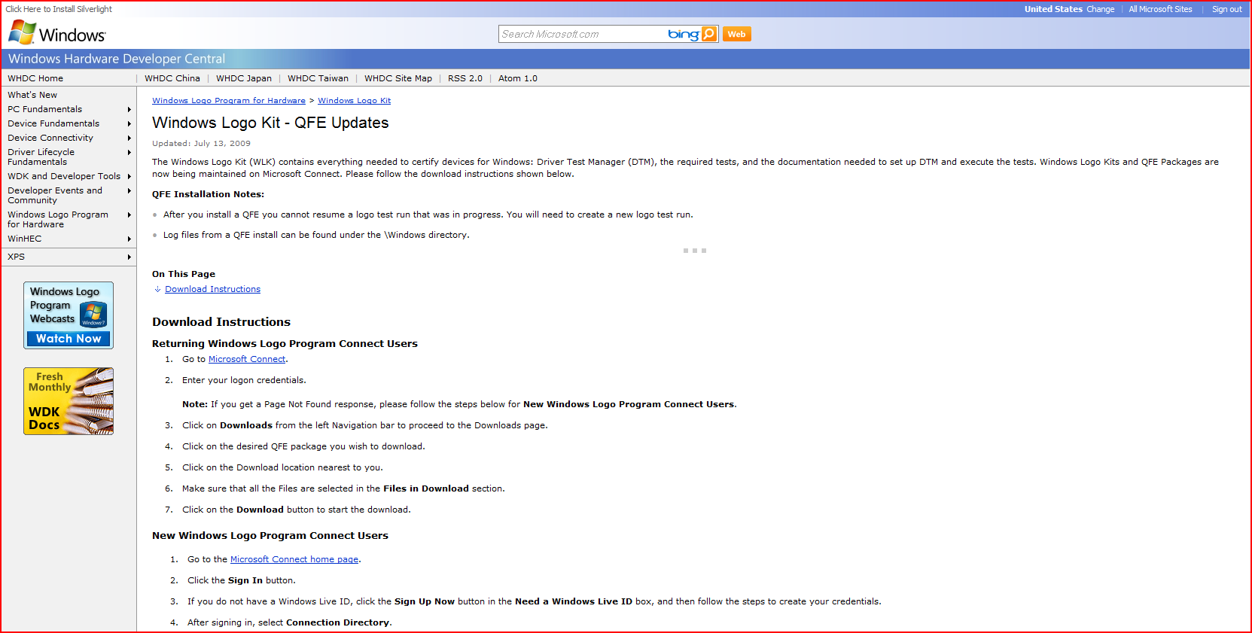
WLK QFE Updates http://www.microsoft.com/whdc/winlogo/WLK/WLKQFE.mspx

Slide 49
Testing Tools
DTM Studio Job Monitor
  Preparing for running tests
    Creating and configuring machine pools
    Managing systems under test
  Viewing test progress
  Examining test results
    Viewing test logs
DTM Studio Device Console
  Preparing for running tests
    Creating submissions
  Selecting and running necessary tests
  Applying filters to test results
  Examining test results
    Viewing test logs
  Creating *.cpk submission package files

Slide 50
Preparing To Run Tests
Create and configure a machine pool
Move the test client from the Default Pool into the created machine pool
Set the test client status to Ready state
Create a submission
  Select OS on the test client
  Select submission category
  Select qualification level

Slide 51
How Can I See Whether a Test Passes or Fails?
To indicate the status of the job that is associated with the test you will use:
DTM Studio Job Monitor
  Job Execution Status pane
– The job is executing
– The job has ended and passed
– The job has ended and failed
Note: If the job passes, you can ignore errors in the Task Execution Status pane

Slide 52
Valid Test Failures
“Errata”
  Unintentional errors within logo tests, Microsoft responsibility
  “Contingency”
    A legal exception negotiated with Windows Logo team, typically specific hardware IDs
  “AutoTriage”
    A known issue borne from WLK support incidents for which an acceptable workaround is available
“Errata” + “Contingencies” = “Filters”
Applying filters masks the valid errors in test result logs
Filters and AutoTriages have expiration dates

Slide 53
Preview Test Failures and Filters
What is a preview test?
  A new test and/or a point of failure
What is a preview filter?
  Helps you identify the issue with respect to the new points of failure
  Will not convert a failure to pass in the log
  Winqual backend will see preview filtered logs as pass

Slide 54
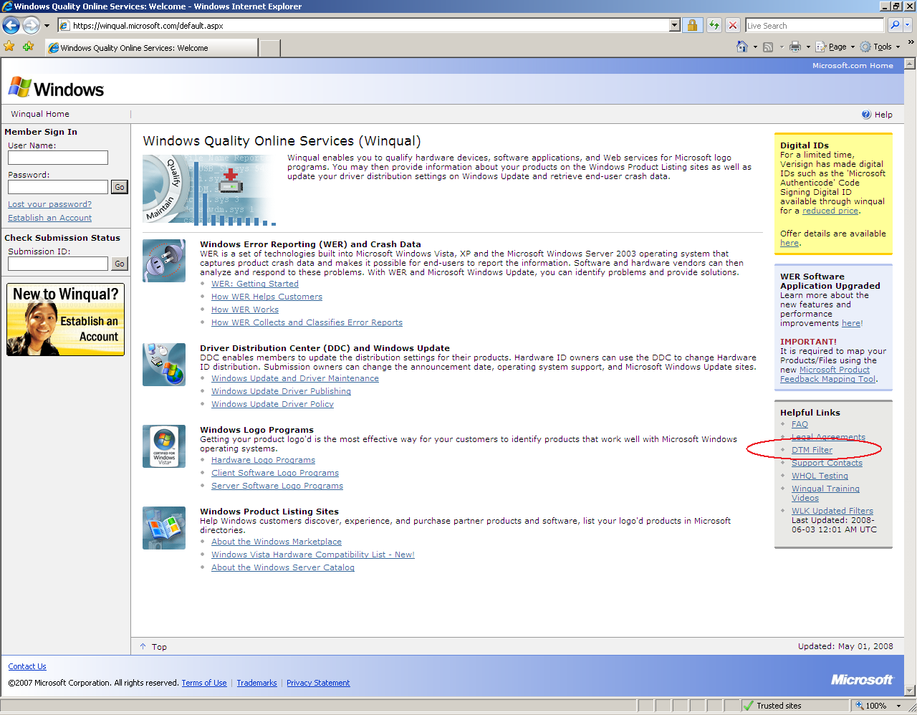

Filter and AutoTriage Descriptions on http://winqual.microsoft.com

Slide 55
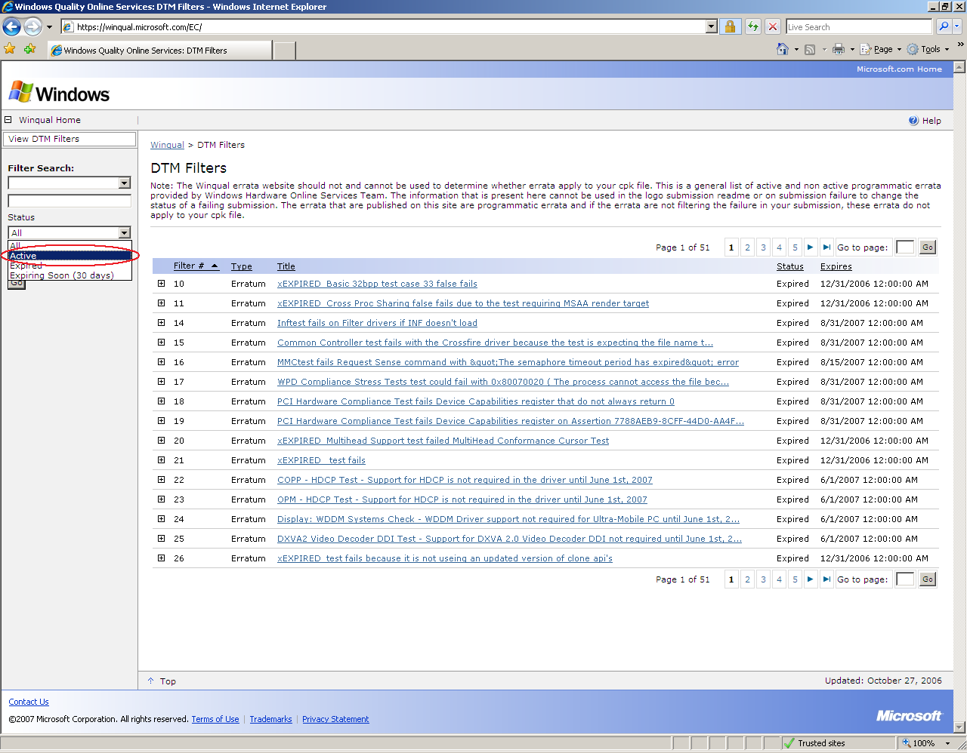
Filter and AutoTriage Descriptions (2)

Slide 56
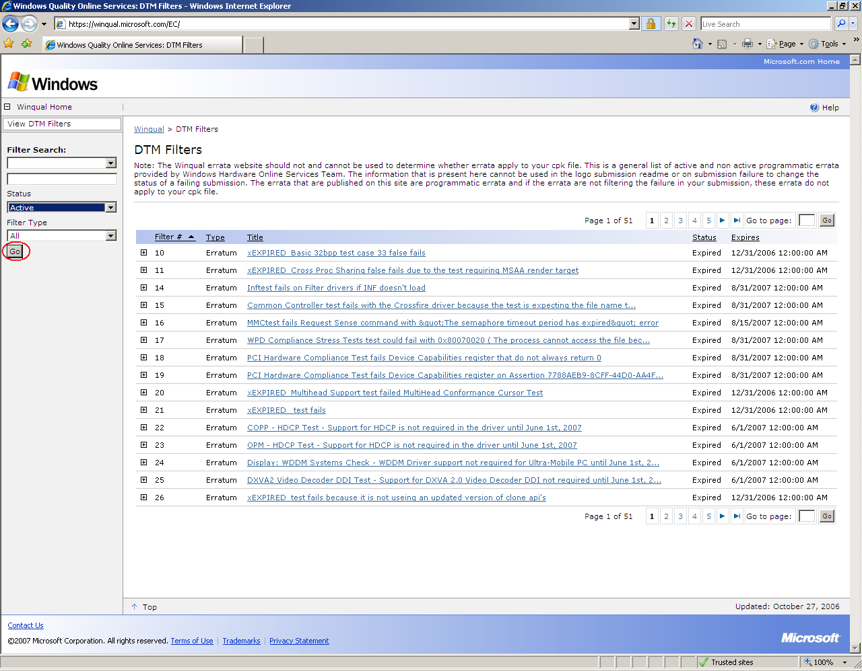
Filter and AutoTriage Descriptions (3)

Slide 57
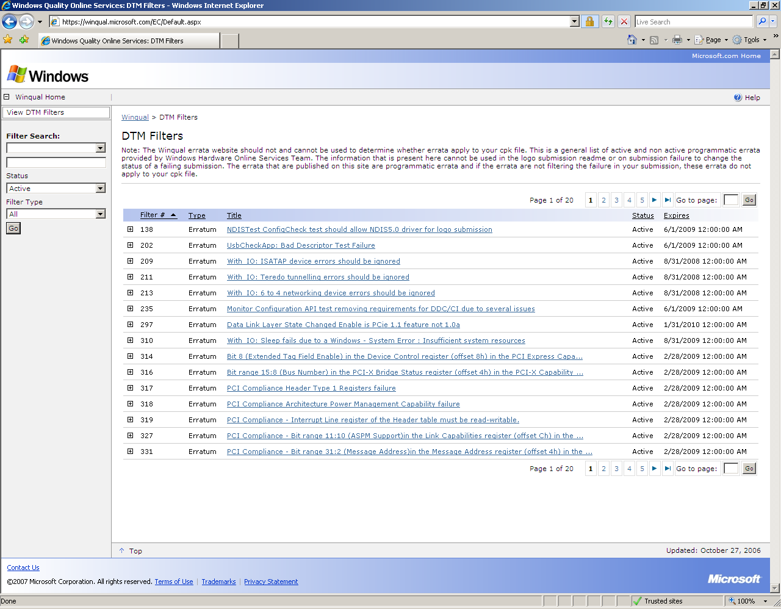
Filter and AutoTriage Descriptions (4)

Slide 58
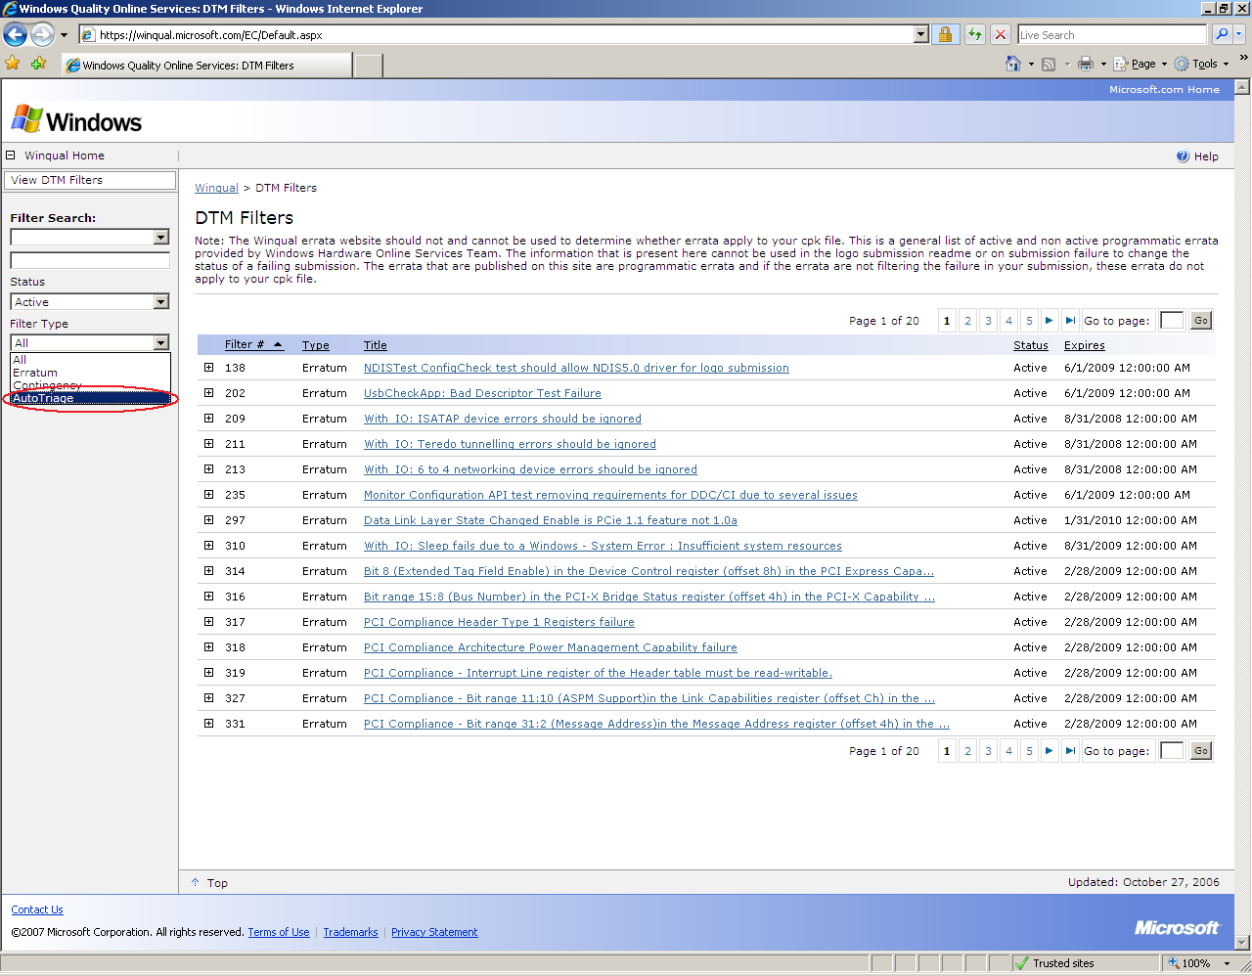
An AutoTriage Example

Slide 59
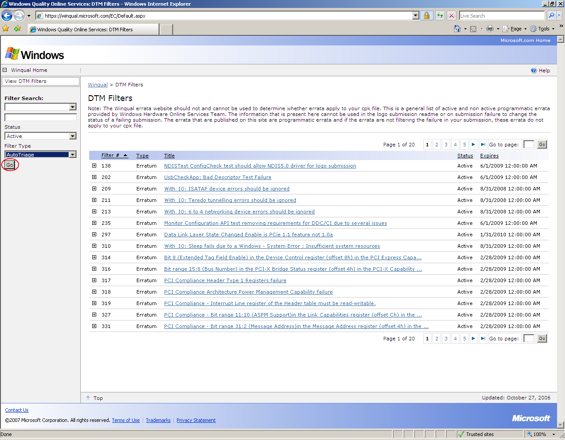
An AutoTriage Example (2)

Slide 60
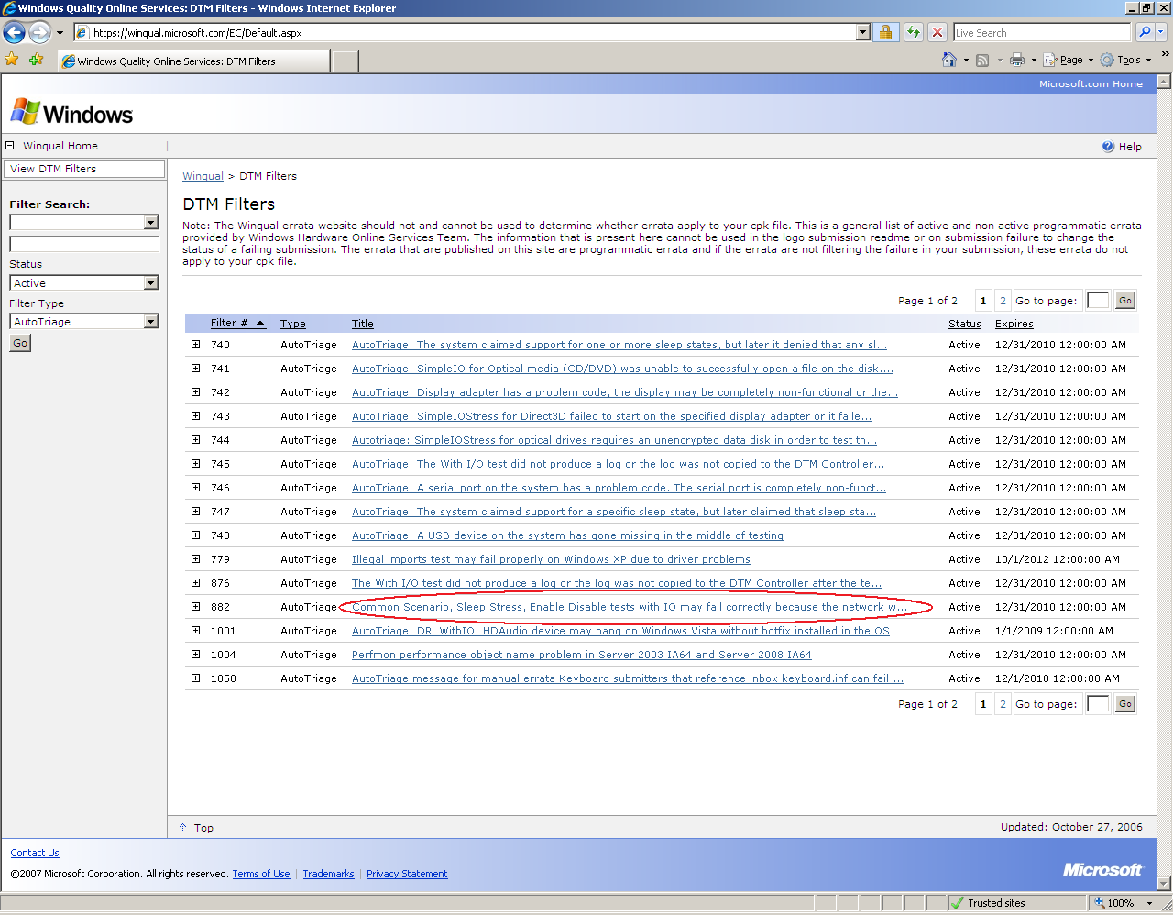
An AutoTriage Example (3)

Slide 61
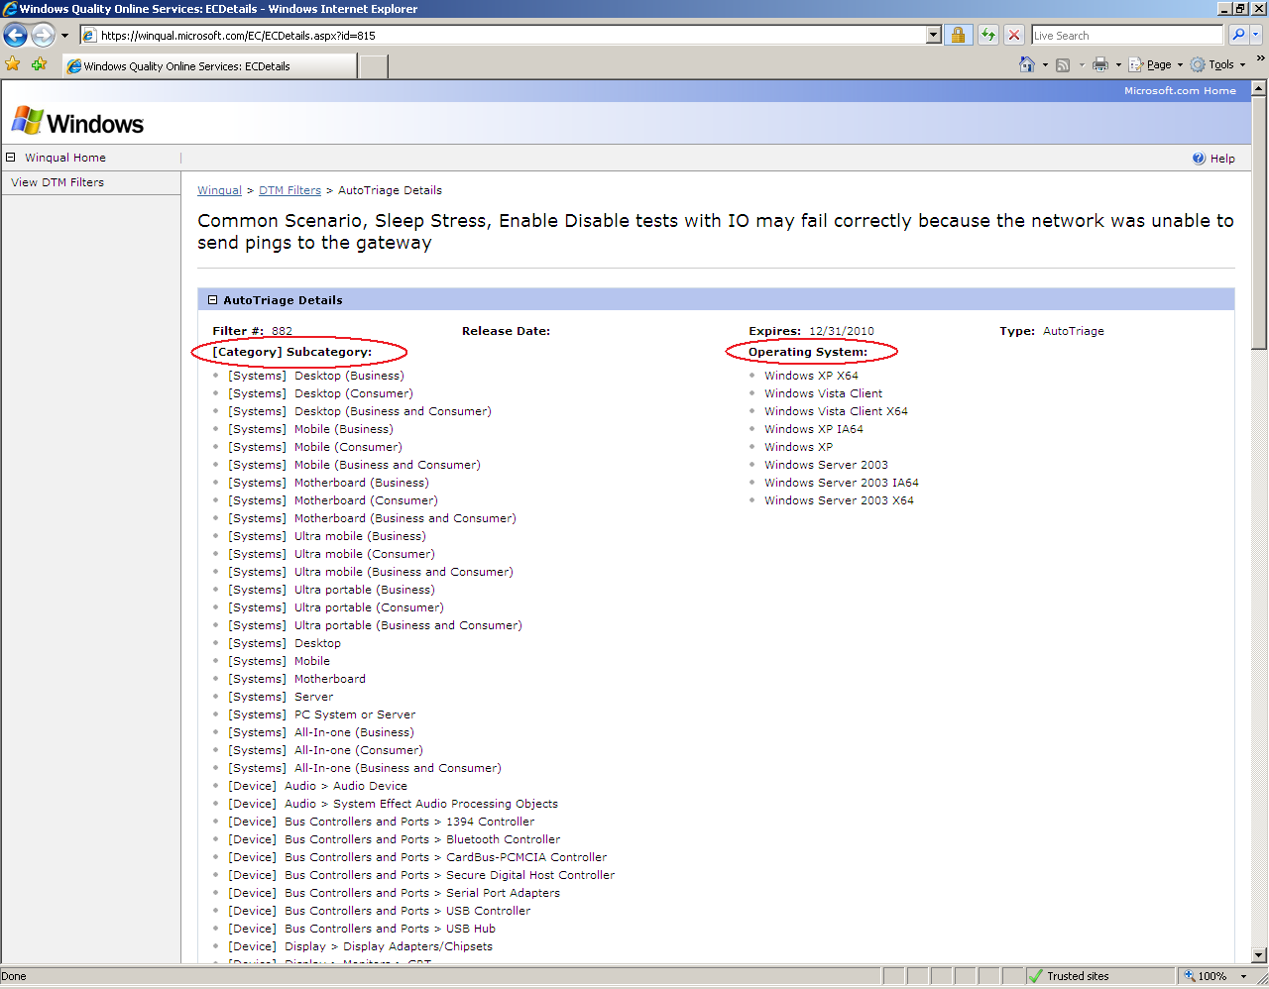
An AutoTriage Example (4)

Slide 62
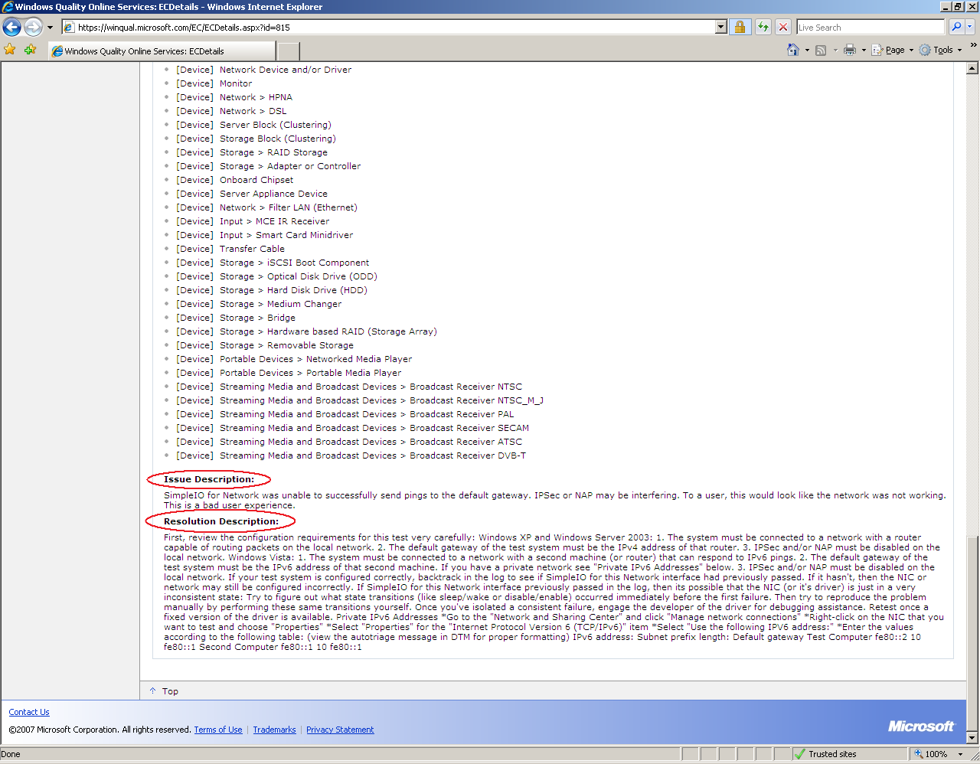
An AutoTriage Example (5)

Slide 63
Filter and AutoTriage Descriptions: Notes
The Winqual Web site should not and cannot be used to determine whether filters apply to your test results
The information that is present here cannot be used in the logo submission readme or on submission failure to change the status of a failing submission
To apply an AutoTriage to your submission you must follow the resolution description guidelines

Slide 64
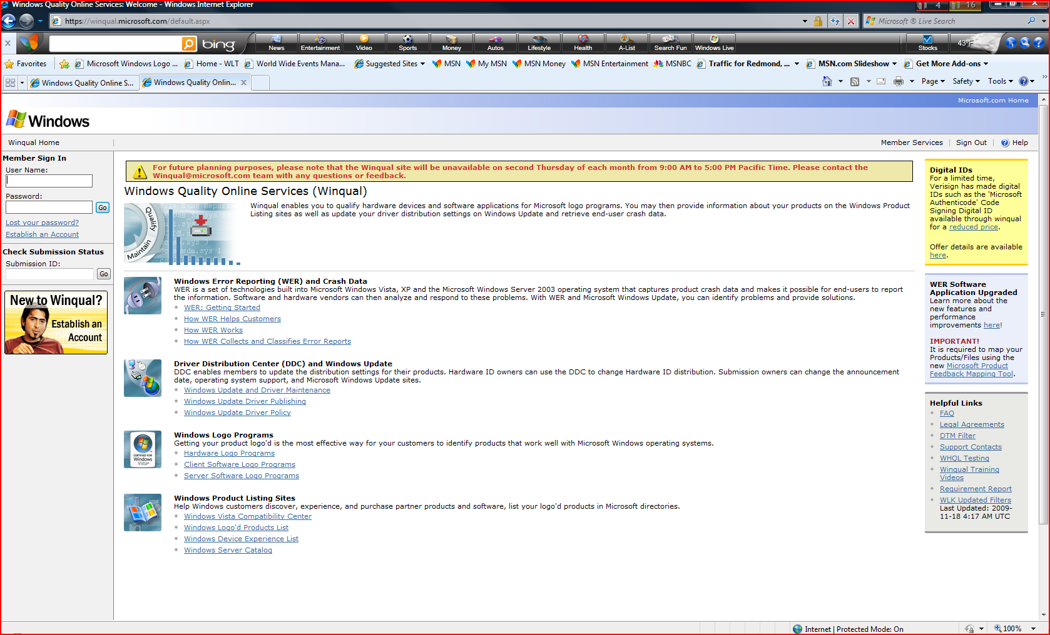
Filter Updates on http://winqual.microsoft.com

Slide 65
High Level Filtering Process
Log with failures
Problem is resolved automatically
Goes through filters

Slide 66
Applying Filters: Best Practices
Download and install filter updates frequently (for example, once a week)
  After a test ends, apply the latest filter updates before reviewing the test result
  Download, install, and apply the latest filter updates prior to submitting your test results to Winqual

Slide 67
Troubleshooting Test Failures:
Viewing and Understanding
Test Logs

Slide 68
Tools for Reviewing Test Logs
  DTM Studio
    Reviewing *.wtl log files
    Reviewing *.xml log files
  DTM Log Viewer
    Reviewing *.wtl log files
    Reviewing *.xml log files
    Reviewing *.cpk log files

Slide 69
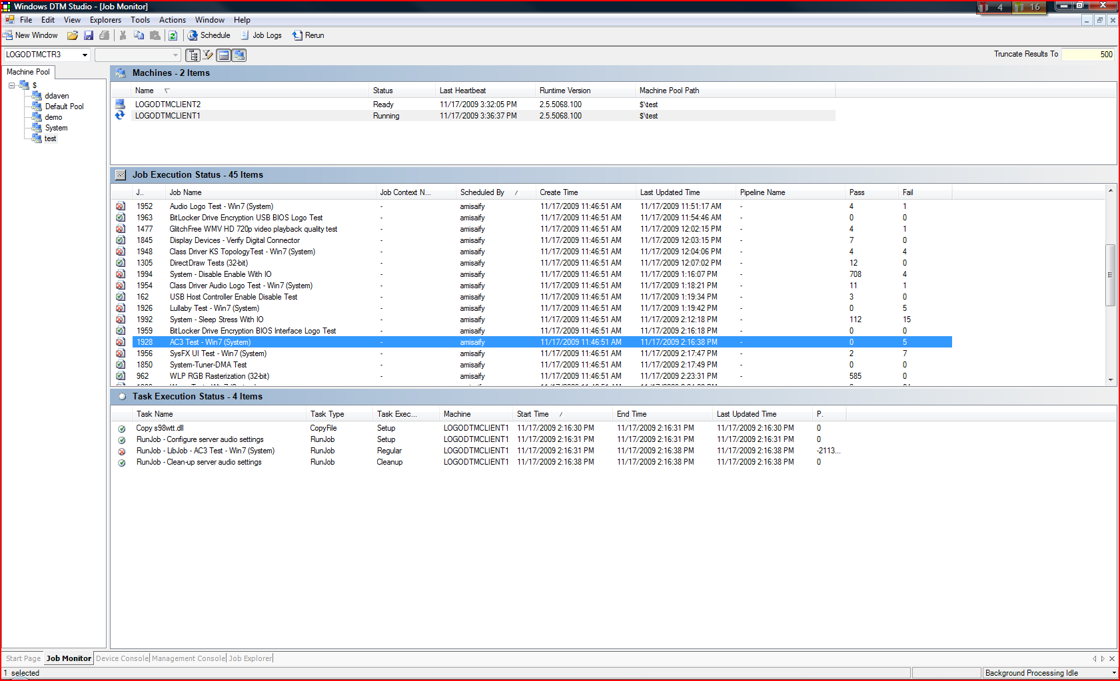
A Test Failure Example

Slide 70
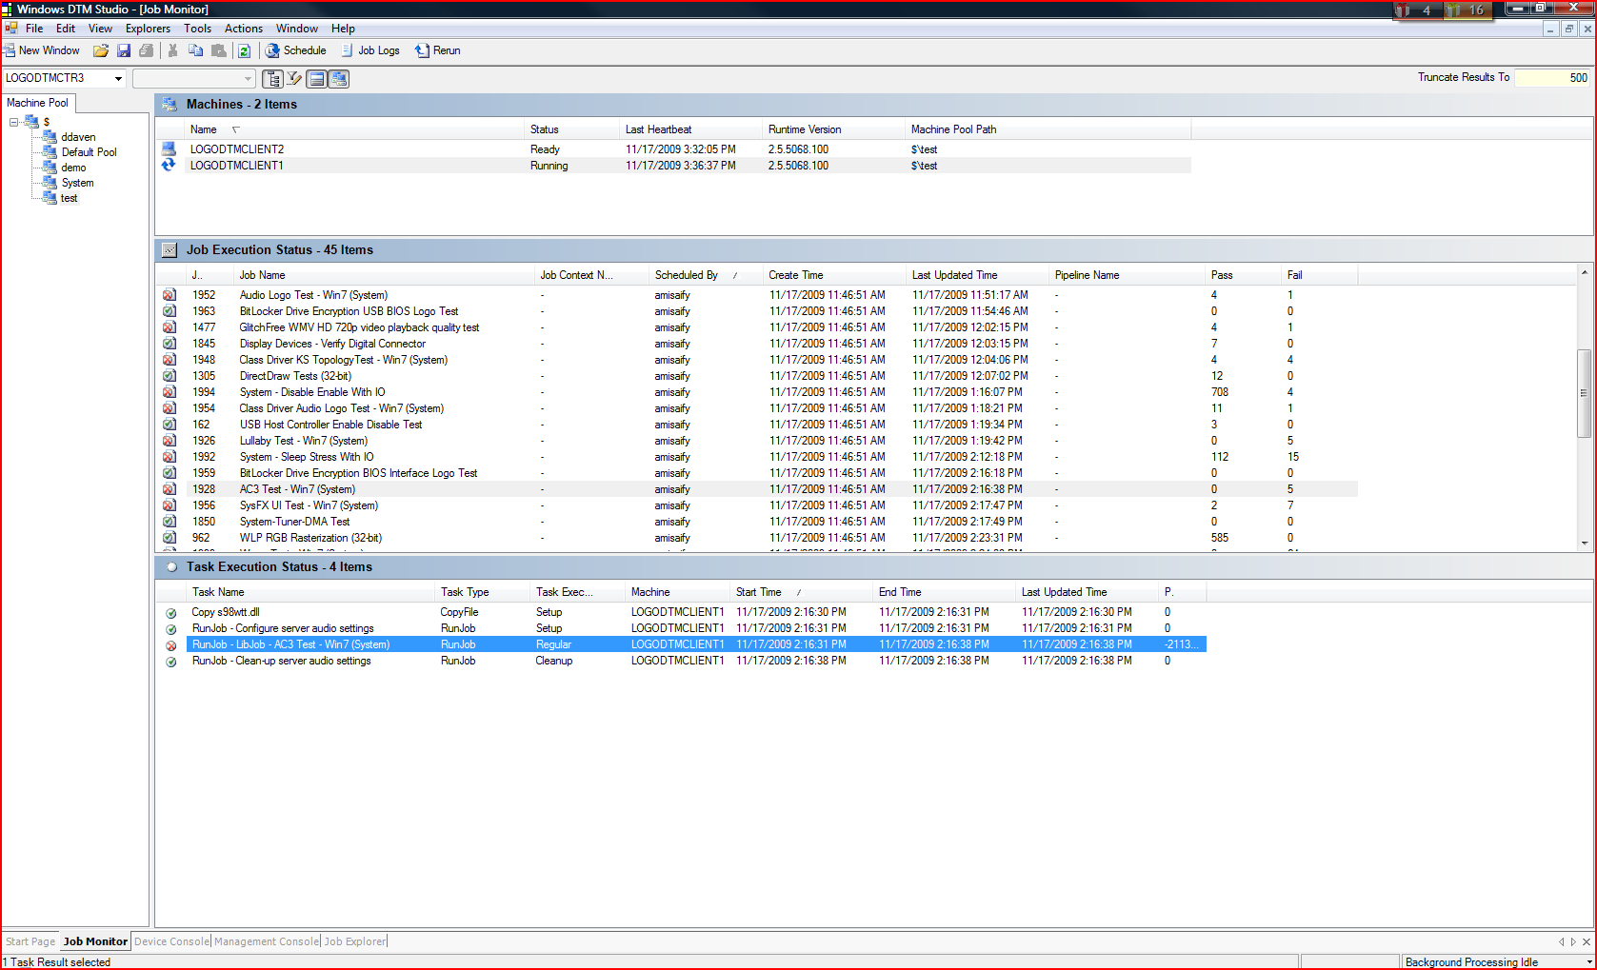
Viewing Test Logs Using DTM Studio: Job Monitor

Slide 71
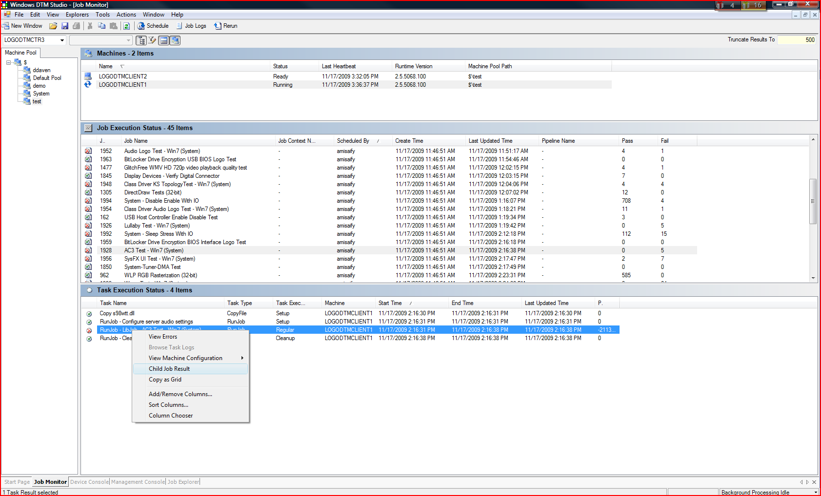
Viewing Test Logs Using DTM Studio: Job Monitor (2)

Slide 72
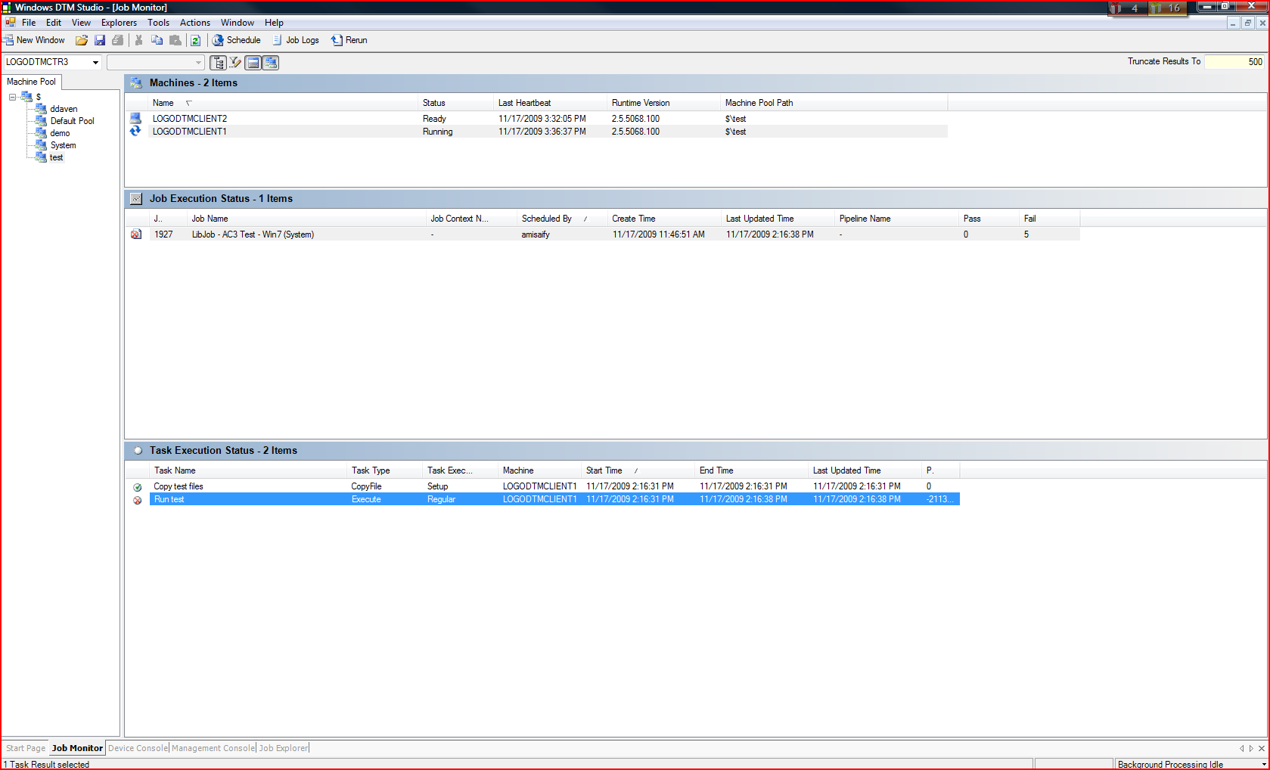
Viewing Test Logs Using DTM Studio: Job Monitor (3)

Slide 73
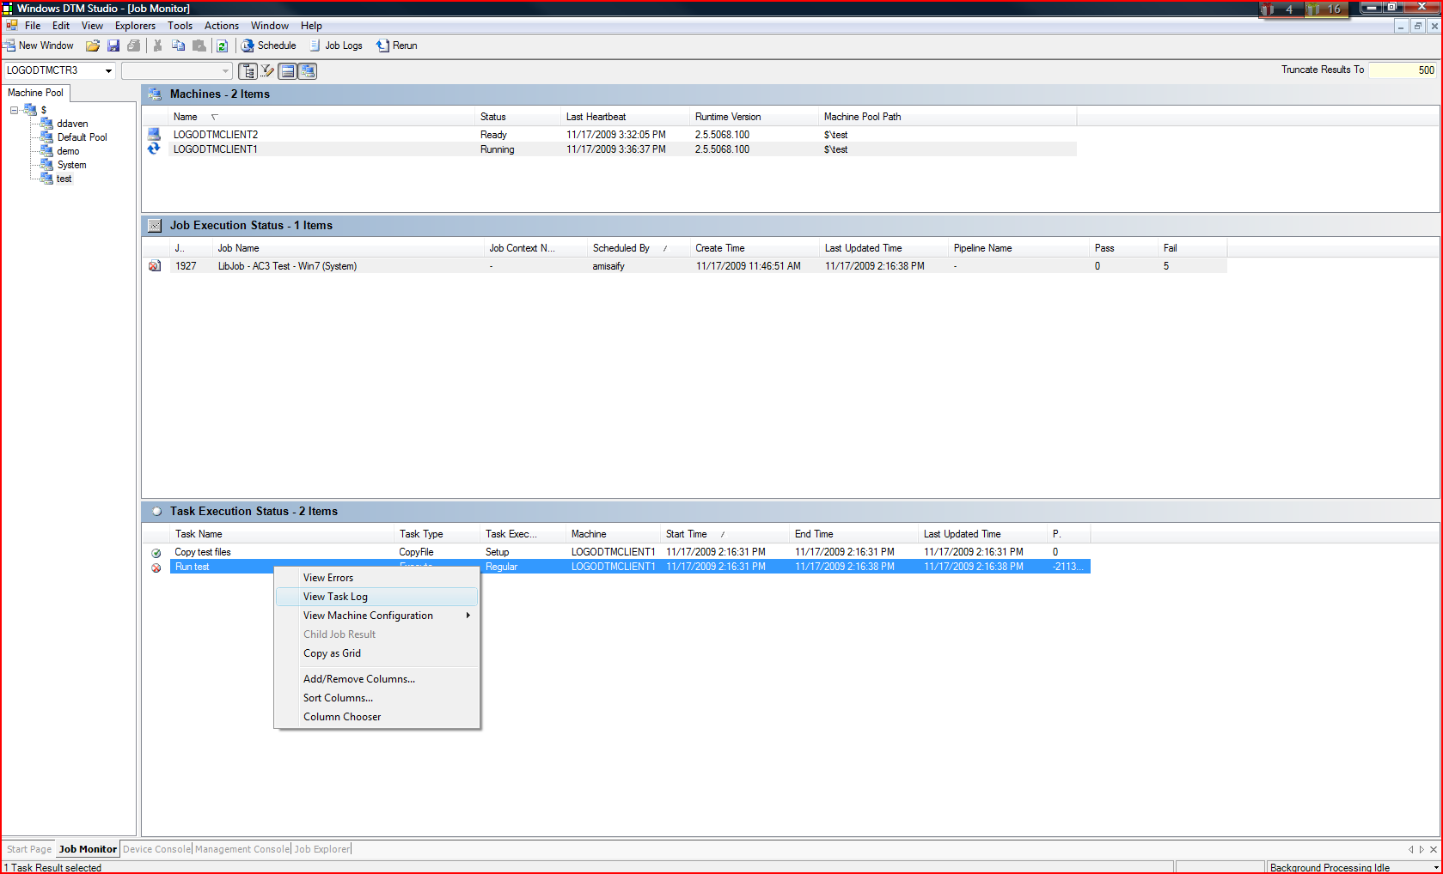
Viewing Test Logs Using DTM Studio: Job Monitor (4)

Slide 74
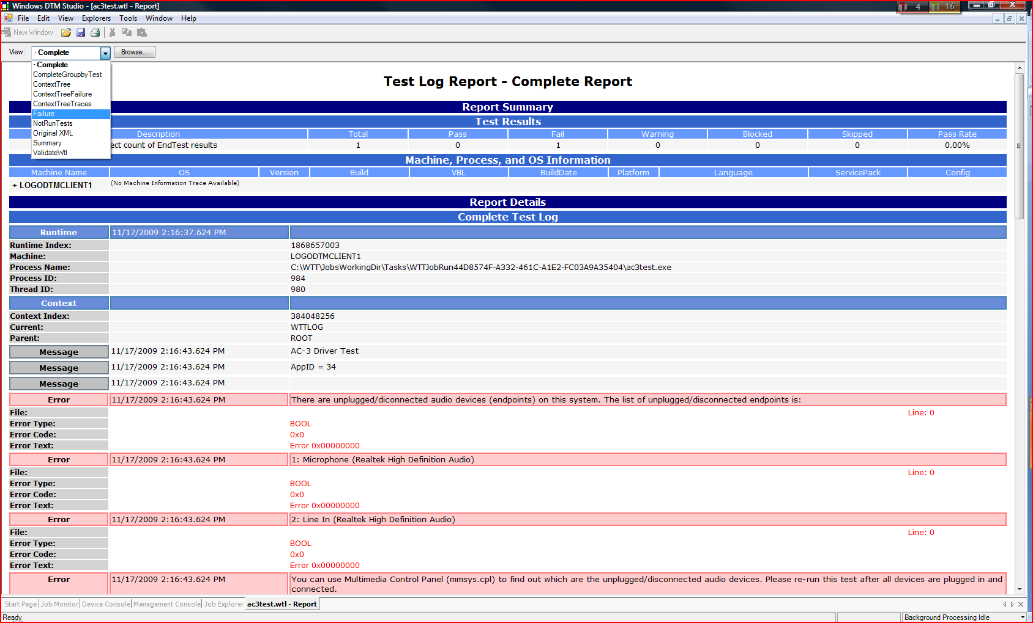
Viewing Test Logs Using DTM Studio: Job Monitor (5)

Slide 75
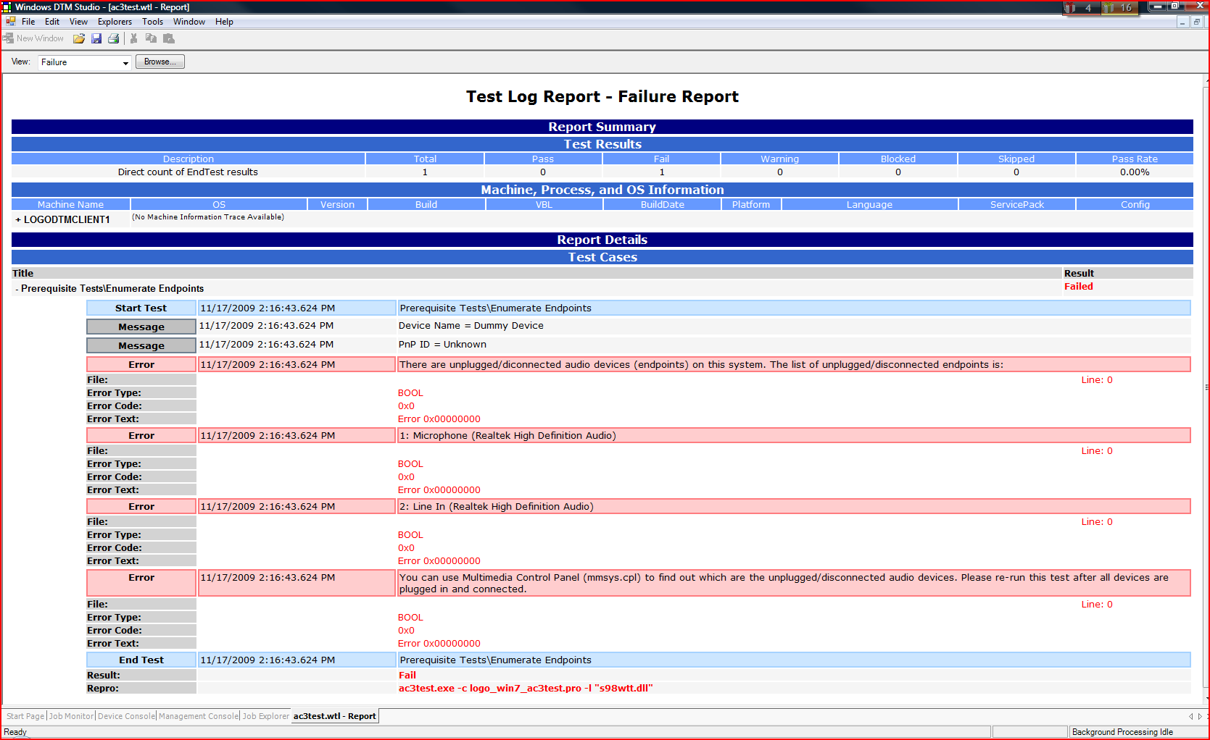
Viewing Test Logs Using DTM Studio: Job Monitor (6)

Slide 76
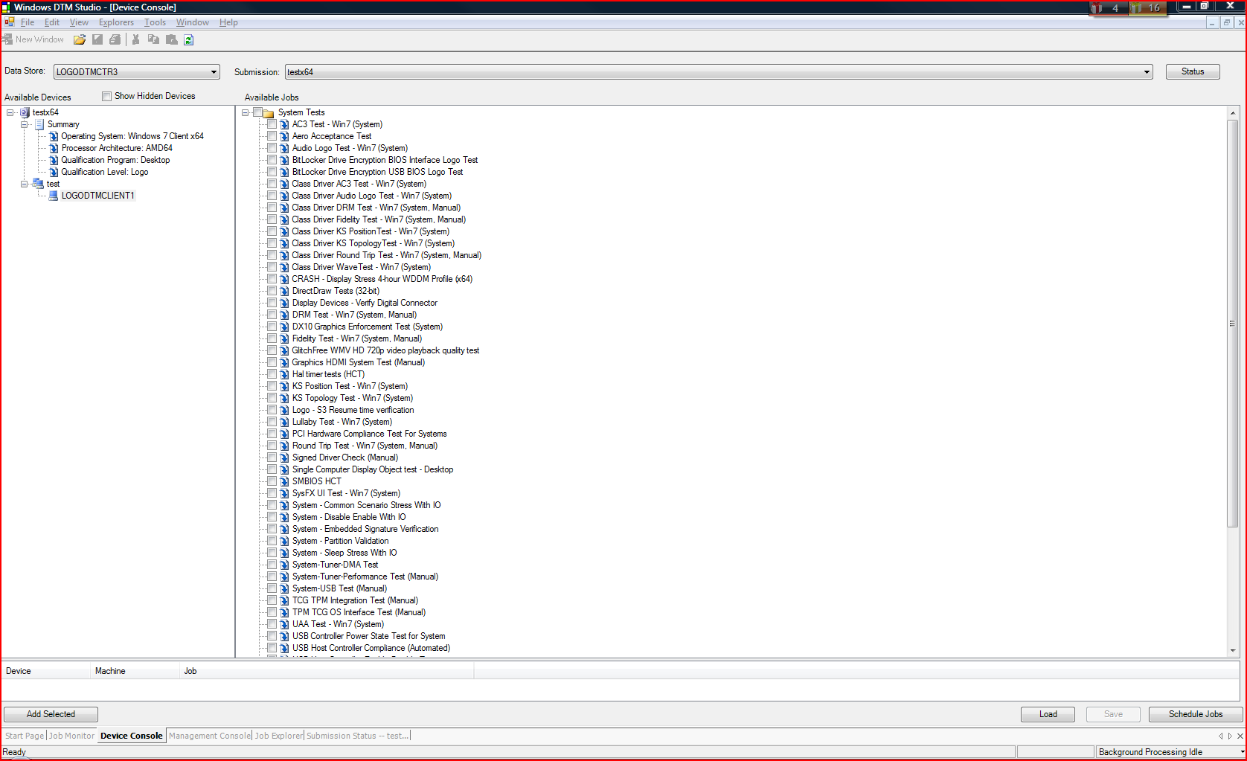
Viewing Test Logs Using DTM Studio: Device Console

Slide 77
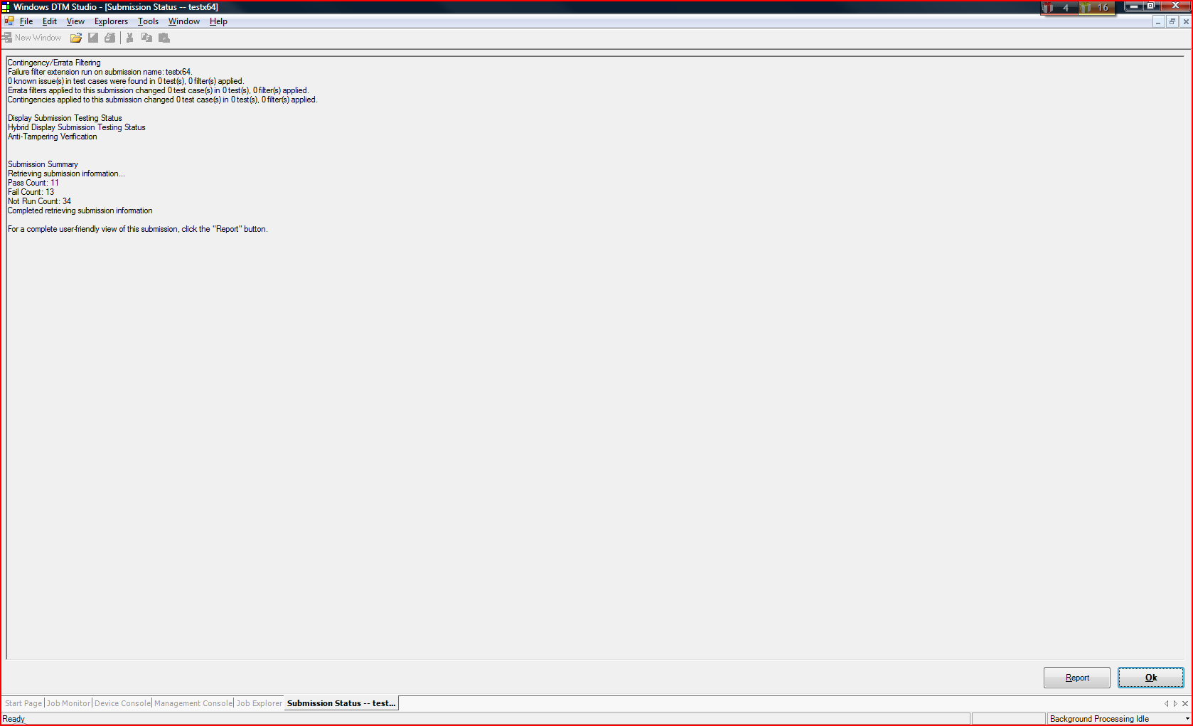
Viewing Test Logs Using DTM Studio: Device Console (2)

Slide 78
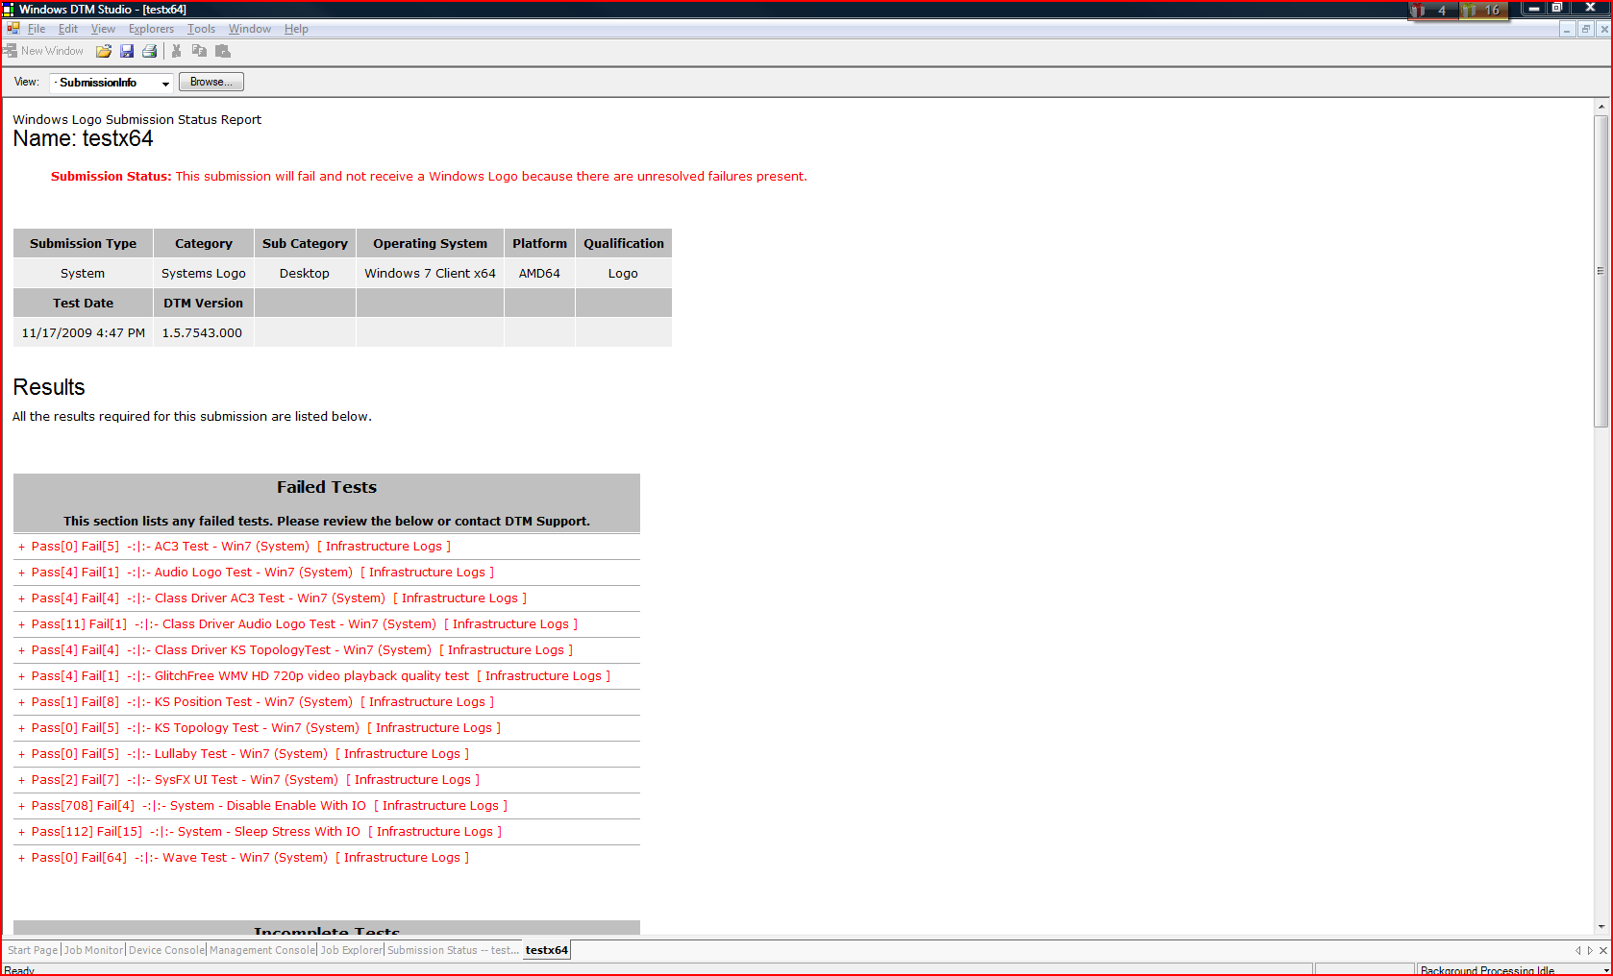
Viewing Test Logs Using DTM Studio: Device Console (3)

Slide 79
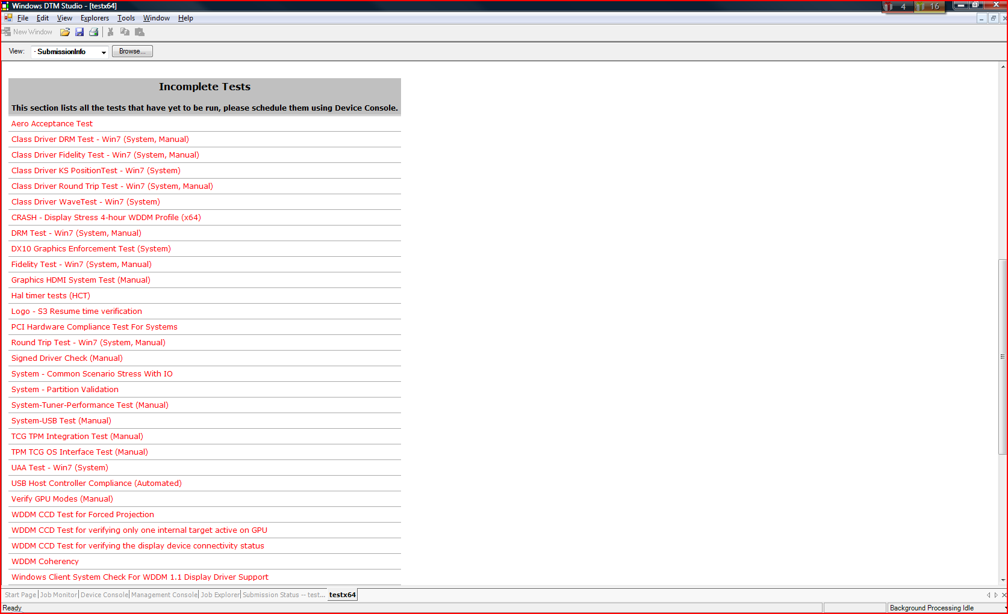
Viewing Test Logs Using DTM Studio: Device Console (4)

Slide 80
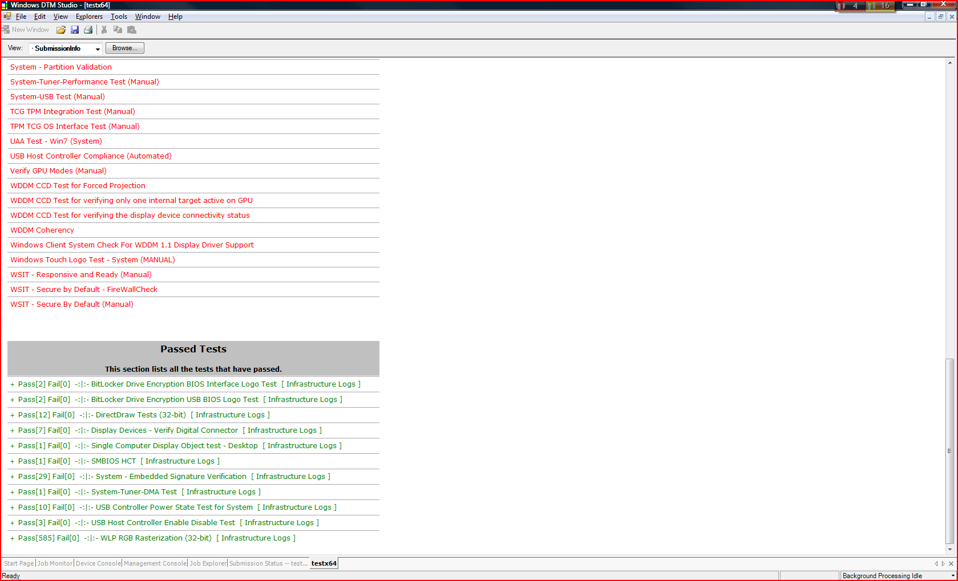
Viewing Test Logs Using DTM Studio: Device Console (5)

Slide 81
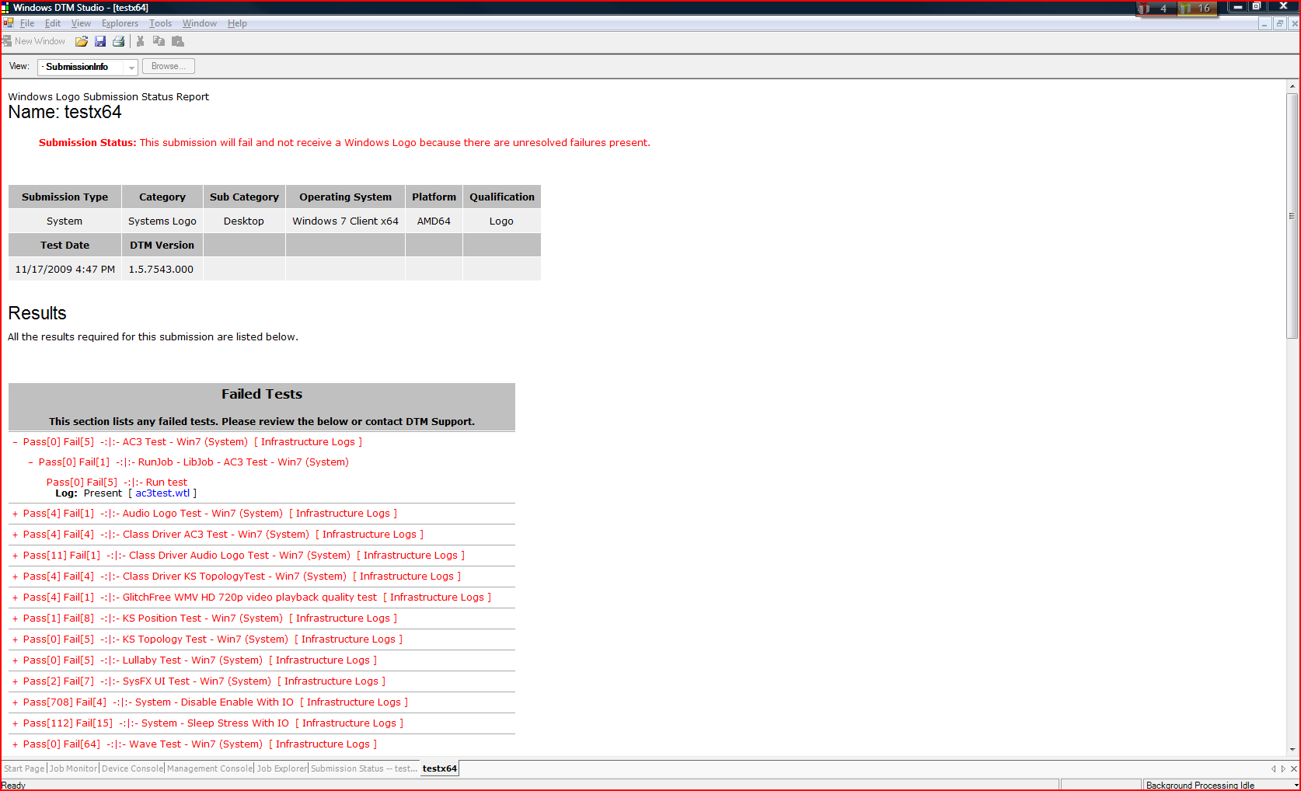
Viewing Test Logs Using DTM Studio: Device Console (6)

Slide 82
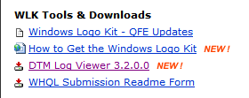
Viewing Test Logs Using DTM Log Viewer
Available to download for free from WHDC website:
  http://www.microsoft.com/whdc/winlogo/WLK/default.mspx

Slide 83
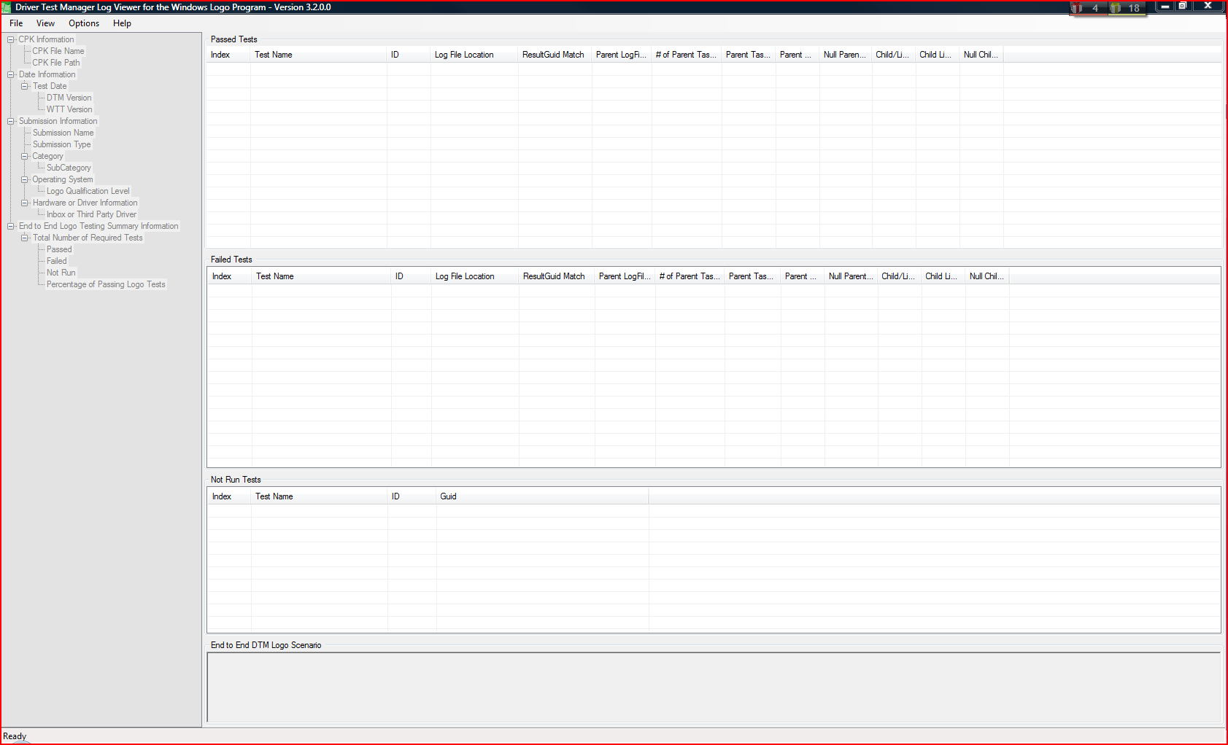
Viewing Test Logs Using DTM Log Viewer (2)

Slide 84
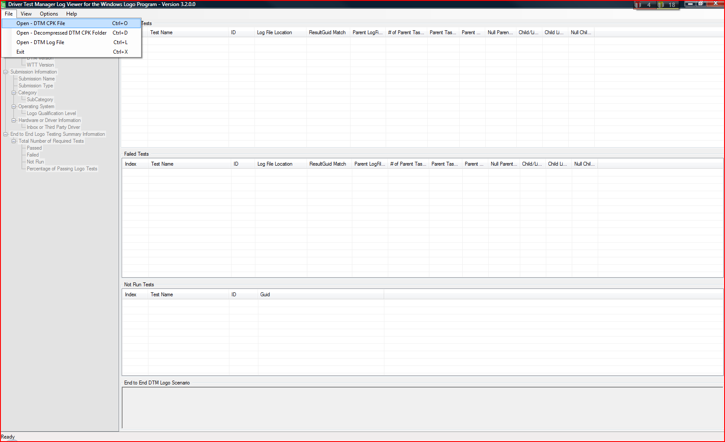
Viewing Test Logs Using DTM Log Viewer (3)

Slide 85
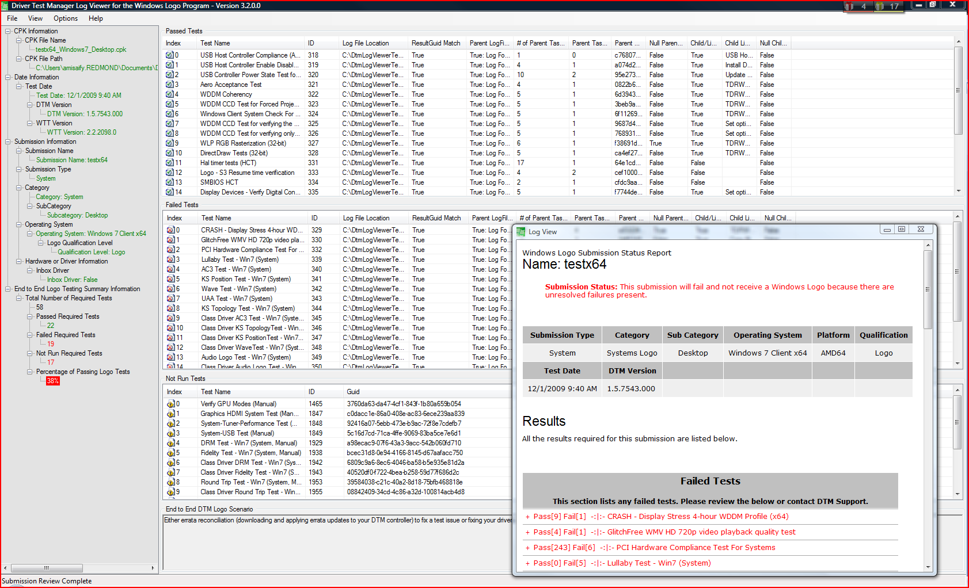
Viewing Test Logs Using DTM Log Viewer (4)

Slide 86
Test Failures – Potential causes
Industry Standards
PCI Spec
USB Spec
Windows Logo Program Requirements
System- and device-level requirements
SMBIOS Spec
By category, by qualification level, by processor architecture
Windows Requirements
Read/Write addresses
Allocated memory
Aero, BitLocker, DirectX, Media Transfer Protocol

Slide 87
Test Failures – Potential causes (2)
Test set up failures
Example: Copying test binaries to the test client fails
No active logged on user
Example: Someone logged off the test client
No heartbeat from DTM Client
Example: The test client is powered down or lost contact with DTM Controller

Slide 88
Root Cause Analysis: How Do I Know What Failed?
Understand the testing sequence
  Copying the test binary from the DTM Controller to the test client
  Executing the test binary on the test client
  Copying the test result logs from the test client back to the DTM Controller
Review logo tests documentation and description
  http://www.microsoft.com/whdc/winlogo/default.mspx
    PC Fundamentals
    Device Fundamentals
    Device Connectivity
    Driver Lifecycle Fundamentals
    DTM Studio -> Help -> Contents -> Logo Tests: Device and Driver Technologies-><TECHNOLOGY GROUP>

Slide 89
What Should I Do If Applying Filters Doesn’t Solve the Problems?
Schedule the failed tests several times; some tests might pass after being rescheduled
Download, install, and apply the latest filter updates
Review active AutoTriages
Review the test logs and investigate test failures (you might need to update the BIOS or/and device drivers, replace plug-in components, or connect additional devices)
Review logo tests documentation and description

Slide 90
What Should I Do If Applying Filters Doesn’t Solve the Problems? (2)
Verify that general Windows Logo Program requirements are met
Check for a QFE update
Download and install necessary WLK quick fix engineering (QFE) updates, if there are any, and reschedule the failed tests

Slide 91
What Should I Do If Applying Filters Doesn’t Solve the Problems? (3)
Use technical support
  Contact your Systems Engineer at your local Microsoft office
  Contact hardware manufacturer (Intel, Asus, Gigabyte, etc.)
  Contact Microsoft WLK support
    DOEM – free (OEM Communication Extranet https://oem.partners.extranet.microsoft.com/oem)
    SBC – handled via standard Microsoft product support channels
      Customers with a Premier Support contract should work with their TAM to open support incidents
      For non-Premier customers, Professional Support options are listed at http://support.microsoft.com/oas/default.aspx?&prid=11880 including phone numbers and pricing information

Slide 92
Packaging and Submitting Test Results to Windows Quality Online Services

Slide 93
Submission Process
Submit your results to Winqual
Create a CAB file using the Winqual Submission Tool (WST)
Upload the CAB to Winqual
Sign in to Winqual and download the Winqual Submission Tool (WST)
Install WST and make a submission
Receive notification

Slide 94
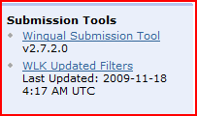
Winqual Submission Tool
Download and install the WST from Winqual
Add your CPK(s) and driver(s)
Submission packages
  Must be scanned for viruses
  Must have drivers packaged as they will be distributed to end users
  Must be signed using your code-signing certificate
Output
  WQReady.xml
  WQSubmission.cab

Slide 95
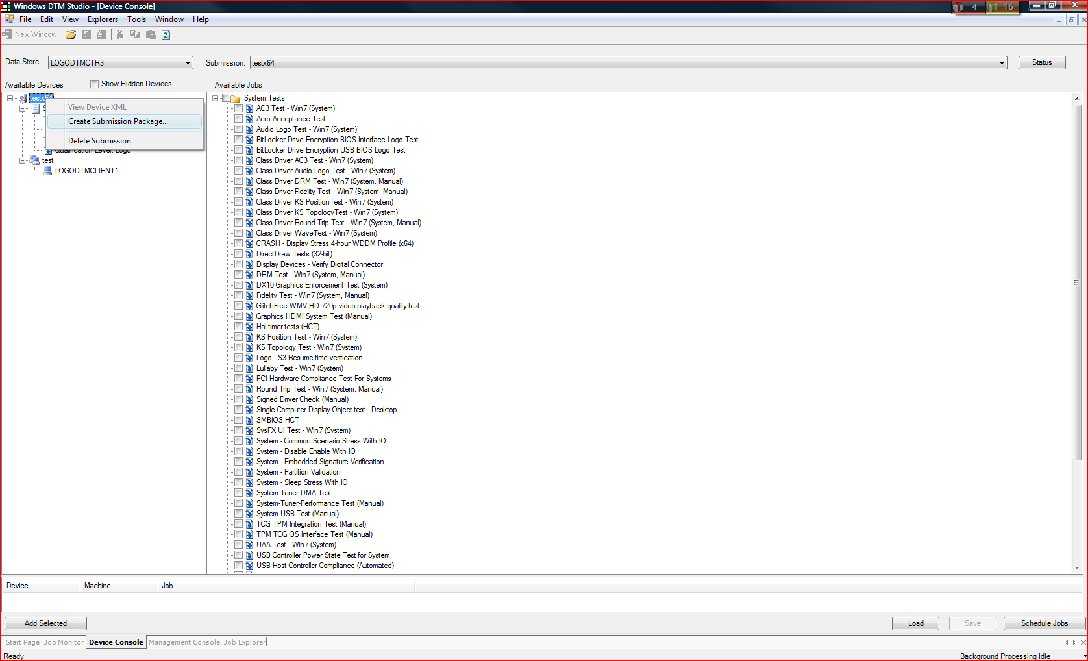
Creating a *.cpk File

Slide 96
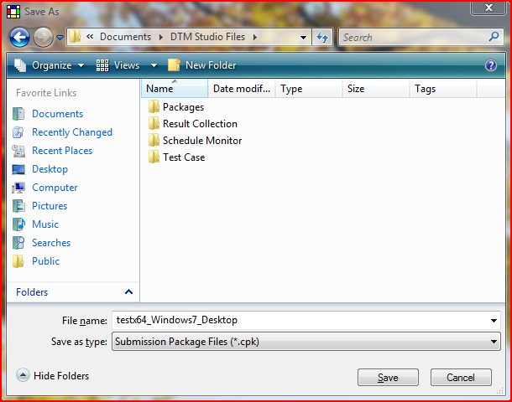
Creating a *.cpk File (2)

Slide 97
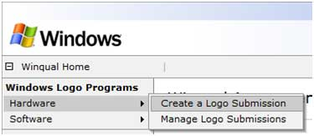
Winqual Submission Pages
Wizard-type interface
Browse to WQReady.xml
Provide additional product information
Browse to WQSubmission.cab
Wait for a notification
  Most submissions are processed within 24 hours
  Failed submissions will go into a queue for manual review

Slide 98
Managing Your Product
Manage your product on Winqual
  Download signed catalog files and artwork
  Manage distribution and marketing partnerships
  Take advantage of driver quality tools
Download artifacts from Winqual
Distribute drivers on Microsoft Update via Driver Distribution Center (DDC)
View Driver Quality Rating (DQR) and Windows Error Reporting (WER) data
Add data to your submission

Slide 99
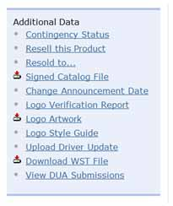
Download from Winqual
Logo artwork and style guide
Signed catalog files
Logo verification report

Slide 100
Use the Available Support Tools
Tool | Use to
Driver Distribution Center (DDC) | Manage how your drivers are distributed on Windows Update
Driver Quality Rating (DQR ) | Identify potential problem drivers
Online Crash Analysis (OCA) | Resolve problems and deliver solutions directly to your customers

Slide 101
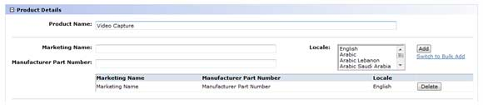
Add Data to Your Submission
You can add additional product data to your submission, including
  Marketing names
  Announcement date
  Model IDs
  Updated INF files

Slide 102
Summary
You should know
  How to access logo requirements
  How to install test kit
  How to test systems and/or devices
  How to troubleshoot failures
  How to make logo submissions and manage them

Slide 103
Call To Action
Review latest requirements on LogoPoint
Install latest available test kit
Run logo tests on your systems and/or devices
Make logo submissions

Slide 104
Additional Resources
References
  WLK installation documents: Install.htm, RelNote.htm
  DTM Studio Help file
Web resources
  Windows Logo’d product list
  http://winqual.microsoft.com/hcl/
  Windows Logo Program
  http://www.microsoft.com/whdc/winLogo/
  Windows Logo Program Webcasts
  http://www.microsoft.com/whdc/winlogo/logocast.mspx
  Windows Quality Online Services (Winqual)
  https://winqual.microsoft.com/
  Sign up for the Logo Program newsletter
  http://www.microsoft.com/whdc/newsreq.mspx#EEC
E-mail addressees
  Logo feedback and policy: logofb@microsoft.com
  Winqual Web site: winqual@microsoft.com
  Logo’d product List: winqual@microsoft.com
  Windows Server Catalog: wscat@microsoft.com
  Logo-related legal agreements: whqlegal@microsoft.com
  Windows Update: whqlwu@microsoft.com

Slide 105
Feedback
For feedback on the Windows Logo Program, contact the Windows Logo Program team at: logofb@microsoft.com

Slide 106
Appendix

Slide 107
Domain-Joined Environment Instructions
Setup procedure overview:
Install Windows Server 2003 (SP2) on the proposed DTM Controller machine.
Install clean operating systems on all DTM Studio and all DTM Client machines.
Join all machines to the appropriate domain.
On the DTM Controller, run Kitsetup.exe from the WLK installation media.
On each machine where you want to install DTM Studio, click Start, click Run, type \\ControllerName\DTMInstall\Studio\Setup.exe, and then click OK.
On each machine where you want to install DTM client, click Start, click Run, type \\ControllerName\DTMInstall\Client\Setup.exe, and then click OK.

Slide 108
Workgroup Environment Instructions
Install Windows Server 2003 (SP2) on the proposed DTM Controller machine.
Install clean operating systems on all DTM Studio and all DTM Client machines.
On each machine, log on as a user who is a member of the Administrators group and enable the Guest account.
On the DTM Controller use Kitsetup.exe to install WLK Driver Test Manager Controller Only or Complete Windows Driver Kit (as appropriate for your requirements).
On the DTM Controller machine, click Start, click Run, type \\ControllerName\DTMInstall\Studio\Setup.exe, and then click OK.
Add the ControllerName\Guest account to the DTM_DSUSERS group on the DTM Controller:
  Start DTM Studio, click Tools, then click Management Console.
  In the Management Console, expand Console Root, expand Datastore, right‑click Users, and then click New User.
  Type ControllerName\Guest and select dtm_DSusers in the Datastore Role.
  Click OK.
On each machine where you want to install DTM Client, click Start, click Run, type \\ControllerName\DTMInstall\Client\Setup.exe, and then click OK.

Slide 109
Installing Filter Updates Instructions
Download UpdateFilters.cab from http://winqual.microsoft.com to your DTM Controller
  http://winqual.microsoft.com -> WLK Updated Filters
  or
  Link directly to the file http://winqual.microsoft.com/member/SubmissionWizard/LegalExemptions/updatefilters.cab
Open the “%Program Files%\Microsoft Driver Test Manager\Controller” directory in Explorer
Open the downloaded UpdateFilters.cab file
Click and drag UpdateFilters.sql from the cab file to the Controller directory
Run UpdateFilters.exe from the Controller directory

Slide 110

© 2009 Microsoft Corporation. All rights reserved. Microsoft, Windows, Windows Vista and other product names are or may be registered trademarks and/or trademarks in the U.S. and/or other countries.
The information herein is for informational purposes only and represents the current view of Microsoft Corporation as of the date of this presentation. Because Microsoft must respond to changing market conditions, it should not be interpreted to be a commitment on the part of Microsoft, and Microsoft cannot guarantee the accuracy of any information provided after the date of this presentation.
MICROSOFT MAKES NO WARRANTIES, EXPRESS, IMPLIED OR STATUTORY, AS TO THE INFORMATION IN THIS PRESENTATION.

