Slide 1
Winqual Device Metadata Submissions
Niket Sanghvi
Program Manager

Slide 2
Overview
Prerequisites
Device metadata submission demo
Winqual device experience overview
Business rule deep dive
  Device metadata and Windows Logo Program
  Experiences and packages

Slide 3
Concept Prerequisites
Differences between Devices and Printers and Device Stage metadata
How to author Devices and Printers metadata
How to author Device Stage metadata
Rules and requirements of HWIDs and ModelIDs
How your device can utilize device metadata

Slide 4
What is an Experience?
Device Experience
Logo Sub IDs
Device
Metadata
Packages
HWIDs
ModelIDs

Slide 5
Create an Experience
Experience
HWID: 1, 2
EN-US
HWID: 1, 2
JA-JP
HWID: 1, 2
Preview
HWID: 1, 2
Preview
HWID: 1, 2
Release
HWID: 1, 2
Release
HWID: 1, 2

Slide 6
Device Metadata Submission
Demonstration

Slide 7
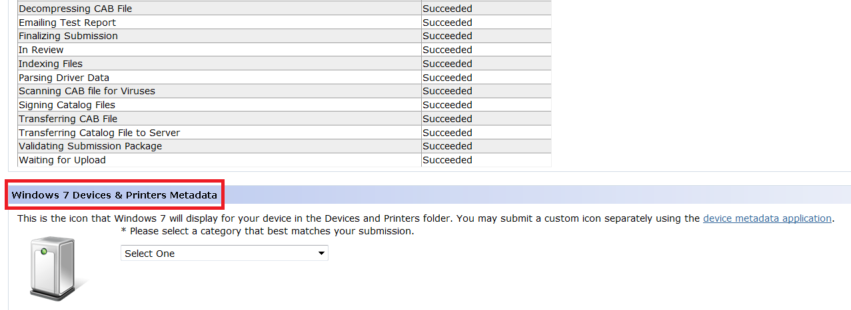
Submitting for a Logo
Set the device metadata category in the Logo Verification Report (Windows 7 logos)

Slide 8
Do I Need a Logo?
Device Stage metadata
  Logo is required
  Check device requirements in Help documents
  IDDA allowed for document publishing devices
  (Printers, faxes, scanners, MFPs, etc.)
Devices and Printers metadata
  Devices with a logo (Windows 7 or Windows Vista)
  Devices that use a driver that ships with Windows
  Devices with unclassified (signature only) submissions

Slide 9
Which Logos Should I Bind?
Logos bound to an experience must cover all the HWIDs and ModelIDs in that experience
Device Metadata Experience 1
HWID: 1, 2
Logo SID1
HWID: 1
Logo SID2
HWID: 2
Logo SID3
HWID: 3

Slide 10
Which Logos Should I Bind?
Logos without HWIDs cover any remaining HWIDs
  HWID “5” is covered by Logo Submission ID “A”
Device Metadata Experience 2
HWID: 4, 5
Logo SID4
HWID: 4
Logo SID6
HWID: 6
Logo SID A
No HWIDs

Slide 11
Experience Business Rules
Experience
HWID: 1, 2
EN-US
HWID: 1, 2
JA-JP
HWID: 1, 2
Preview
HWID: 1, 2
Preview
HWID: 1, 2
Release
HWID: 1, 2
Release
HWID: 1, 2

Slide 12
Experience Business Rules
Experiences contain packages
  Different locales
  Preview or Release state
Packages within an Experience have the same set of HWIDs and ModelIDs
Packages within an Experience apply to the same device category
Experience names must be unique within your company

Slide 13
Package Business Rules
Package friendly names must be unique within an experience
Packages must adhere to a single locale
  Locales must comply with RFC 4646
Package file names must be GUIDs
VIDs in HWIDs must be owned by your company according to the Standards Initiation Group (SIG) of the bus enumerator

Slide 14
Summary
Device metadata is a small investment with large gains
Submitting device metadata on Winqual is easy
Experiences organize metadata and enforce business rules
Winqual manages the device ecosystem to ensure devices work well

Slide 15
Call To Action
Obtain Windows 7 logos for your device
Review the device metadata business rules
Create device metadata for your device
Submit device metadata on Winqual

Slide 16
Additional Resources
Creating device metadata
  WHDC - Metadata Development Kit
  Device Experience Webcasts
Winqual Homepage
  Sign up for an account
  Windows Logo Program
Device Metadata Homepage
  Help documents and information
  Submit and manage Experiences

Slide 17
Feedback
Winqual and device metadata questions can be directed to: winqual@microsoft.com

Slide 18

© 2009 Microsoft Corporation. All rights reserved. Microsoft, Windows, Windows Vista and other product names are or may be registered trademarks and/or trademarks in the U.S. and/or other countries.
The information herein is for informational purposes only and represents the current view of Microsoft Corporation as of the date of this presentation. Because Microsoft must respond to changing market conditions, it should not be interpreted to be a commitment on the part of Microsoft, and Microsoft cannot guarantee the accuracy of any information provided after the date of this presentation.
MICROSOFT MAKES NO WARRANTIES, EXPRESS, IMPLIED OR STATUTORY, AS TO THE INFORMATION IN THIS PRESENTATION.

Slide 19
Appendix

Slide 20
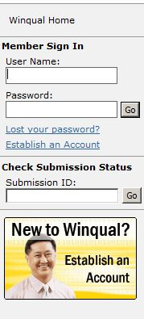


Device Metadata End-to-End
Author
Metadata Packages
Submit on Winqual
WMIS and Windows 7 Download Appropriate DM Packages

Slide 21
Device Metadata Processing
Accept a VeriSign Class 3 certificate–signed package
Virus scan the package
Check for any unnecessary files
Check for improper references within the package
Validate all XMLs against appropriate XSDs
Check for required icon sizes
Check for required image sizes
  Device Stage only
Validate Microsoft business rules

Slide 22
Device Metadata Status
Pending
Package has been submitted
To Be Published
Your package has passed validation
Live
Package has been submitted to WMIS – submissions run every morning
Winqual is validating (~1-2 hours average)
You can download the Winqual-signed package
You can download the Winqual-signed package
Note: Live is different than Preview or Release
Your package is waiting to be sent to Windows Metadata & Internet Services (WMIS)
Error!
  Package failed at least one step of validation!
  Expand details using the ‘+’

Slide 23
Inbox vs. Logo vs. Unclassified
Inbox Driver
Logo
Unclassified
Select first option
Select second option, attach Submission IDs
Select second option, attach Submission IDs
Submit Devices & Printers metadata only
Submit Devices & Printers or Device Stage
Submit Devices & Printers metadata only
Device uses Microsoft inbox class driver
Device has one or more Submission IDs
Device has one or more Submission IDs
If the logo submission has HWIDs, they must match the packages
If the logo submission has HWIDs, they must match the packages

Slide 24
Selecting the Right Logo Option
Option 1: “This device uses only inbox drivers and has no associated Logo submissions”
  Device must use a Microsoft inbox class driver
  Sign the Device Metadata Legal Agreement
  Submit only Devices and Printers metadata

Slide 25
Selecting the Right Logo Option
Option 2: “This device has associated Logo submissions or is a PC, printer/fax, or scanner device”
  Sign the latest WLP Testing Agreement
  Bind Logo or Unclassified Device submissions
  Submit Devices and Printers or Device Stage metadata
  Do not need to bind any submissions if your HWIDs are on the IDDA list
  PCs have a 90 day buffer before logo binding is required

Slide 26
Logo Requirements for Device Stage
Windows Vista
Digital Still Camera
Printer/Fax/Scanner
Keyboard/Mouse
Windows 7
Digital Still Camera
Portable Media Player
Printer/Fax/Scanner
Portable Media Player
Cell Phone
Cell Phone
Keyboard/Mouse
Smartcard
Mobile Broadband
PC

Slide 27
Details on Preview Packages
Preview packages are used to test a device metadata package using Winqual
Best used for packages that are not yet ready to be released
Testing using preview packages
  Submit regular device metadata packages
  Create a registry key to download and install on device metadata packages on computers running Windows 7
  The registry key is the PreviewKey
PreviewKey – Set on Winqual
  Required for preview packages
  One per company
  1-15 alphanumeric characters

Slide 28
Details on Preview Packages
Submit Preview Package to Winqual
PreviewKey
Package
Registry Key set with PreviewKey
Registry Key not set with PreviewKey

