Slide 1
MDA 2.0

Slide 2
funkce + vzhled + příbuznost + příběh =
UX¹
UX¹ = User experience (zkušenost uživatele)

Slide 3
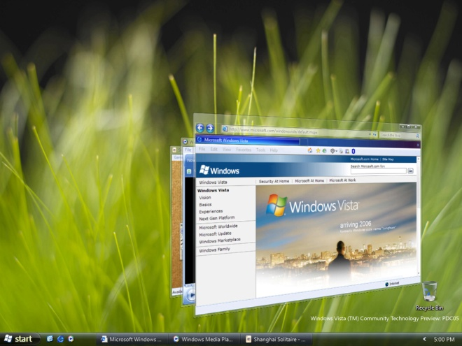
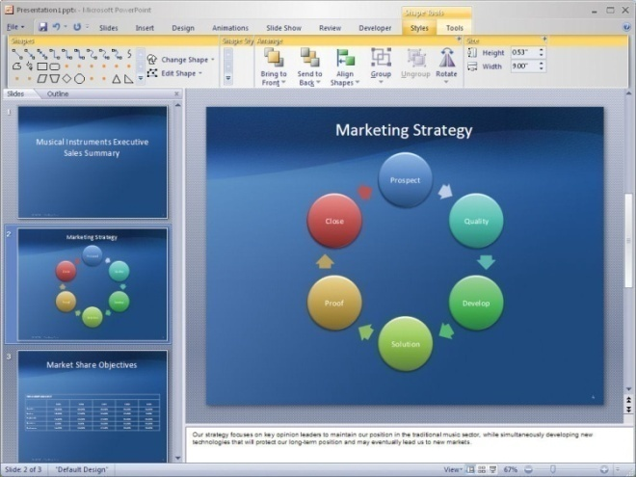
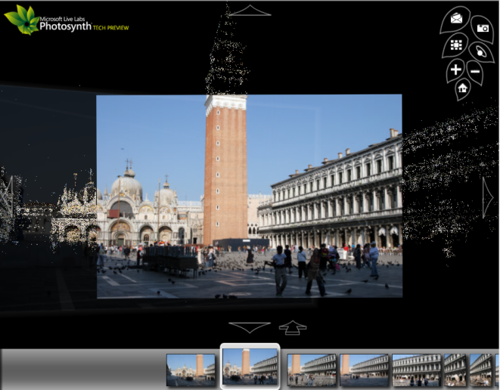
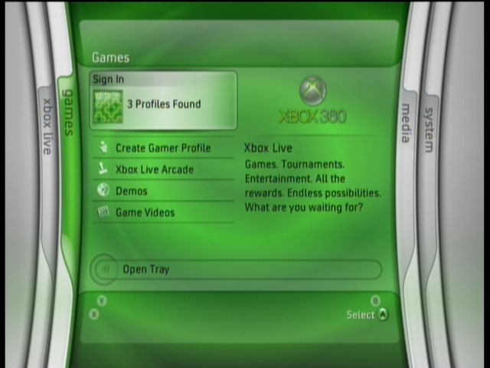
Microsoft
Notes:
Microsoft has made vast strides in our approach to user experience. The evolution of the operating system and productivity tools are not simply software advancements, they’re experience advancements, and the investment in other areas (photography, gaming) helps to further clarify our UX ideals. Each product certainly contains its’ own design goals, but the ultimate result is a more consistent and pleasant design.

Slide 4
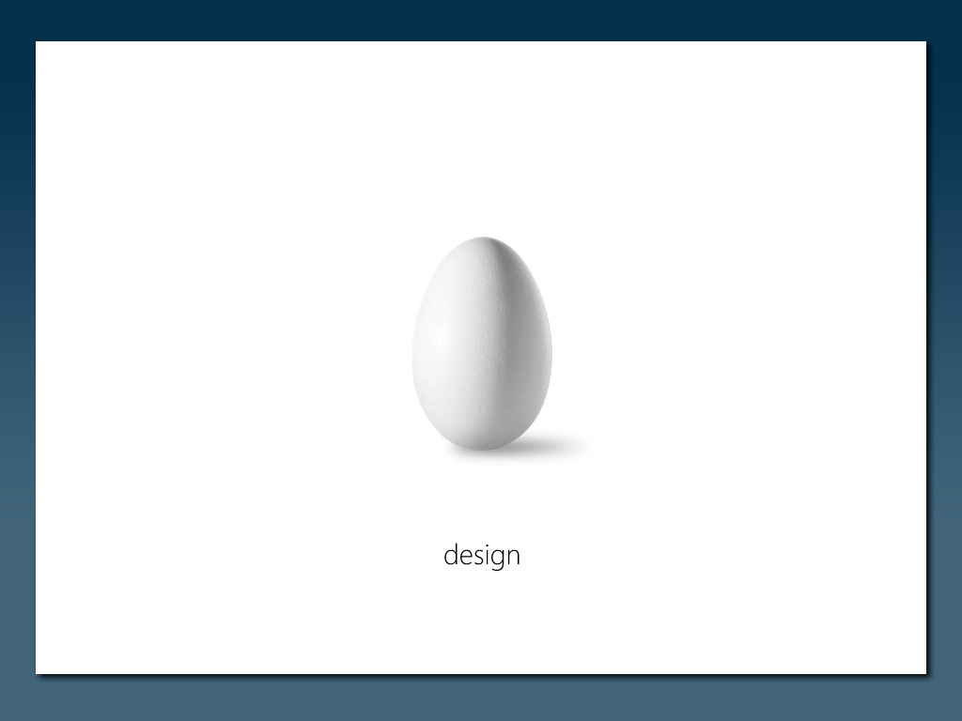
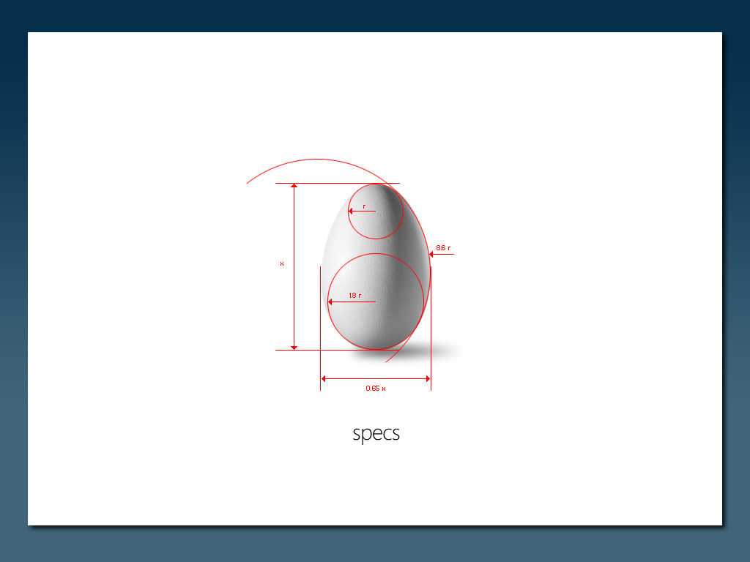
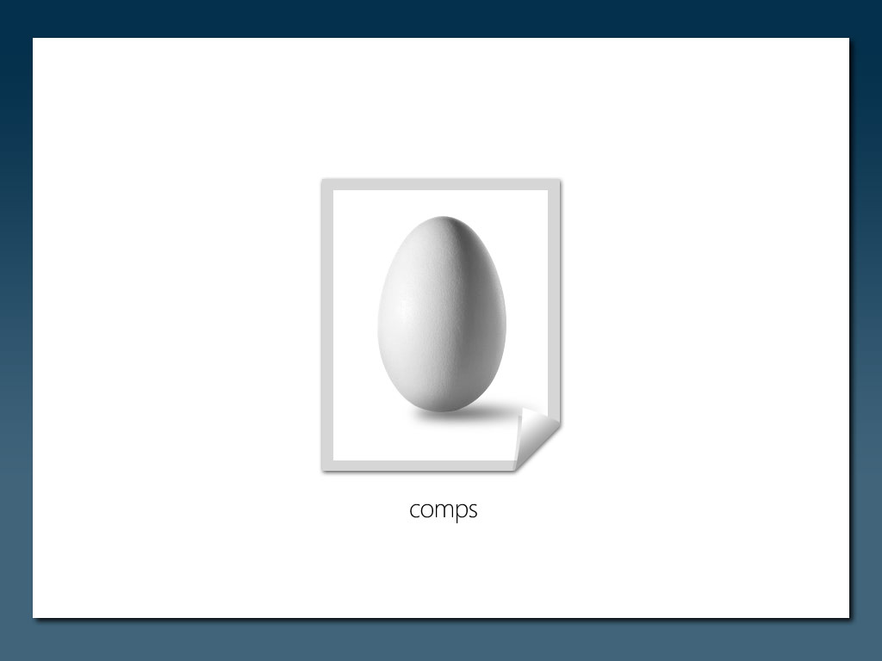

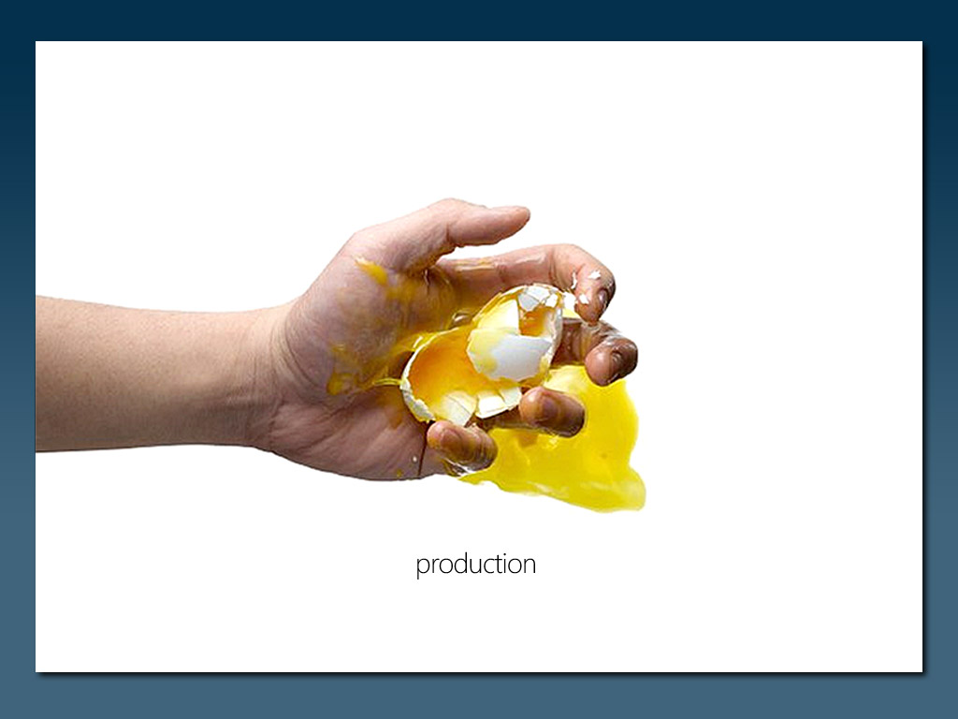
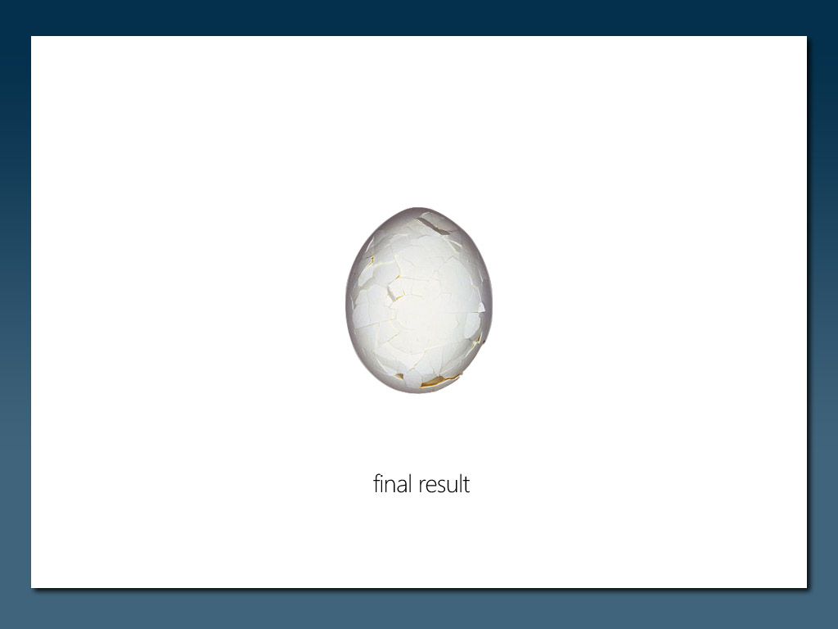
Designer vs Developer
=
Notes:
Optional slide

Slide 5


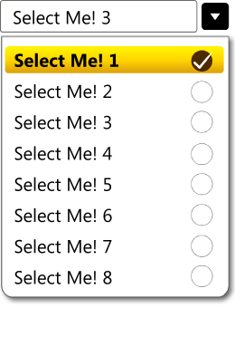
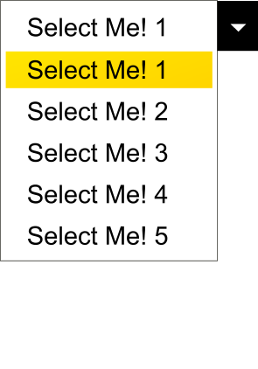



Propojení Designera & Developera
Designer
Expression
Developer
Visual Studio
Paper
JPG / TIFF
PSD
PPT
MOV / WMV
XAML
C++
C#
VB.NET
XHTML
CSS / XSLT
XML
ASP.NET
Javascript
AJAX
Non Standards
‘Dirty Code’
Mockups

Slide 6
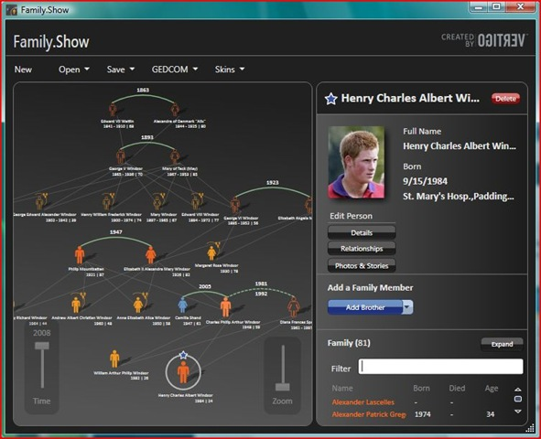
WPF

Slide 7
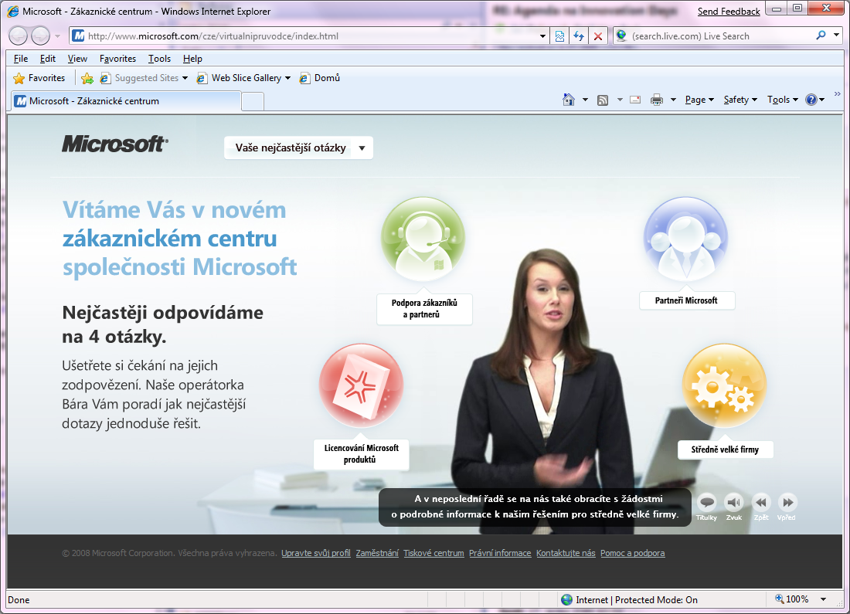
Silverlight

Slide 8
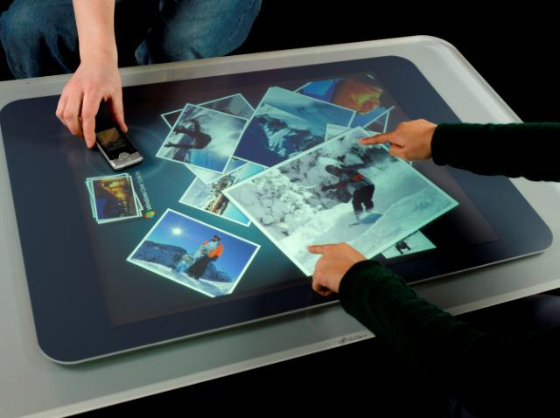
Surface

