Slide 1
Portals and Collaborative Workflow
Steve Read MCSE, MCSD, MCDBA, MCP BizTalk
sread@microsoft.com
Process Platform SSP
Microsoft State and Local Government

Slide 2
Key Takeaways
Overview of Microsoft’s Portal Workflow Strategy
What is BizTalk Server
How does MOSS, WWF and BizTalk work together to provide a end to end Workflow Platform

Slide 3
Agenda
The Workflow Spectrum
The Integration Problem
Integration Architectures
BizTalk 2006 Overview
Bringing it All Together
Demo
Discussion

Slide 4
What is Workflow?
Generally associated with human to human or human to application workflow
  This is actually part of a larger picture
Workflows are actually Business Processes that span people, applications and possibly businesses or agencies
They can be dynamic or static but usually have elements of both
They can be document centric or data centric
They usually are associated with larger Business Processes that span across platforms
Bottom Line is Workflow can mean different things to different people.

Slide 5





Why Does Process Matter?
How do I improve citizen relations?
How do I cut streamline procurement?
How do I comply with regulatory mandates?
How do I eliminate redundant processes across systems?
How do I create new automated processes from my existing legacy applications?
How do I reduce the time required for employee daily activities? (i.e. vacation request, expense reporting)

Slide 6
















Microsoft’s Business Process
Management System (BPMS)
SOA & Process Capability
Data & BI Capability
Windows Workflow Foundation
Development Capability

Slide 7
It’s the Platform not the Product
The Microsoft Workflow Strategy is based on the Microsoft Platform. No one product solves all workflow needs
Microsoft Workflow Solutions are based on:
  BizTalk server
  Microsoft .NET
    WWF (Windows Workflow Foundation)
    WCF (Windows Communication Framework)
  Microsoft Office SharePoint Server (MOSS)
  Microsoft Office
  Third Part Solutions that leverage the above

Slide 8
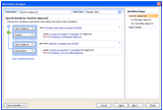
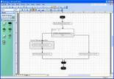



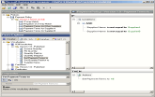






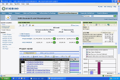

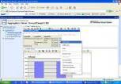
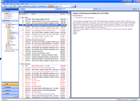
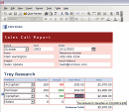
People-Ready Processes
Development of Business Processes
Develop new composite processes from reuse of existing systems
Deployment of Highly Distributed Processes
Business Process Modeling and Documentation
Visual Design of Electronic Forms
Visual Design of Collaborative Applications
Intuitive end-user task interaction thru Office
Interaction with Collaborative Processes
Effective Management and Control of Distributed Processes
Real-time Tracking of End-to-end Business Process Performance
Management Visibility into Business Process Performance
Real-time Process Optimization

Slide 9





Breadth of Processes
Collaborative Processes
Transactional Processes
Example: Email, instant messaging, personal task list
Example: Document approval, vacation approval
Example: Expense reporting, management dashboard
Example: Extending LOB applications, supply-chain
Individual
Ad hoc
Human Semi
Structured
System Highly
Structured
Fixed
Process
Activity Complexity/Rigidity
Individual
Team
Cross-Team
Enterprise App
Notes:
9/27/2007
9
9

Slide 10

Breadth of Processes
Collaborative Processes
Transactional Processes
Individual
Ad hoc
Human Semi
Structured
System Highly
Structured
Fixed
Process
Collaboration Server
Process Server
Common Design Tools
Common Monitoring Tools
Common Runtime

Slide 11
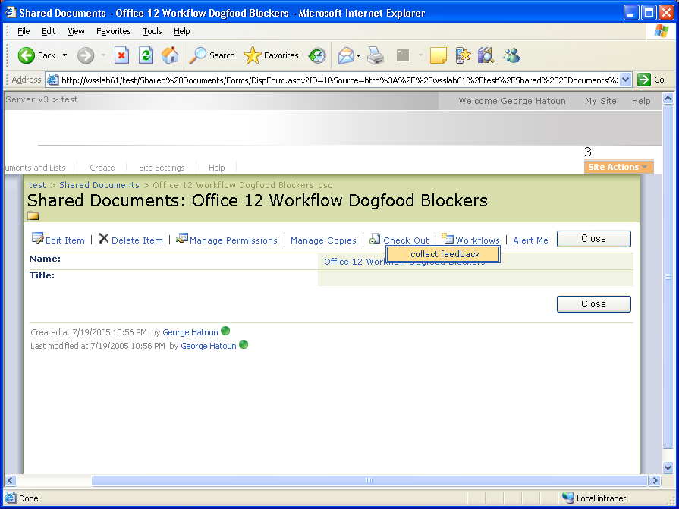
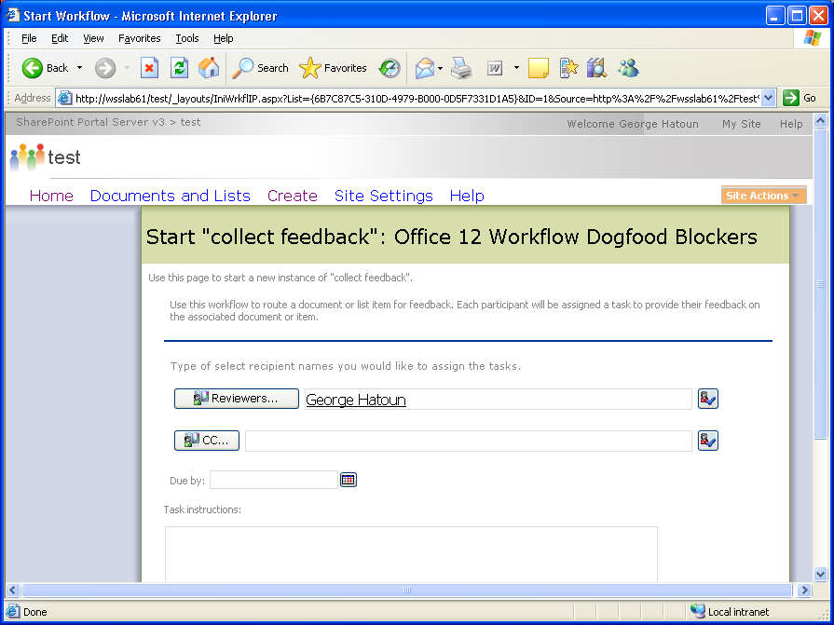
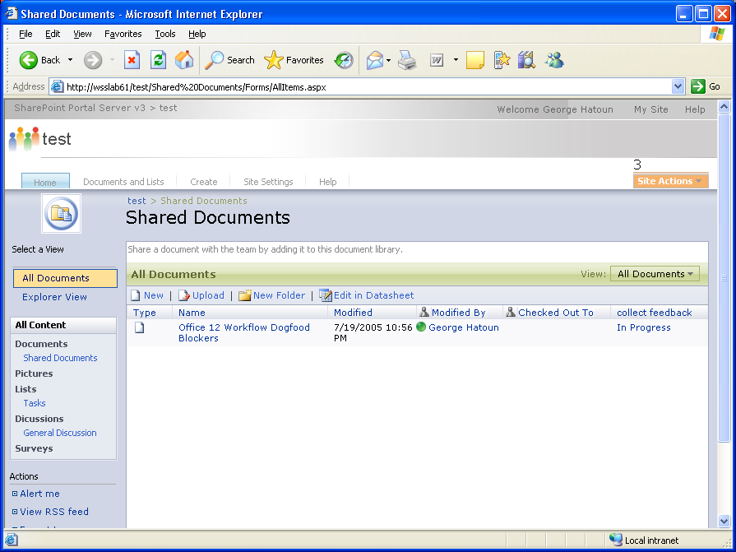
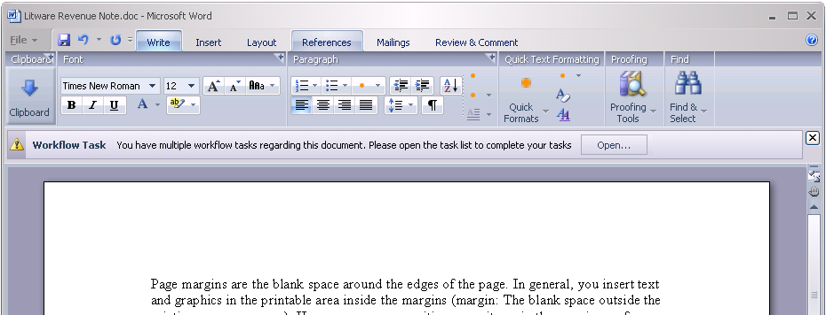
Easy Workflow…

Slide 12

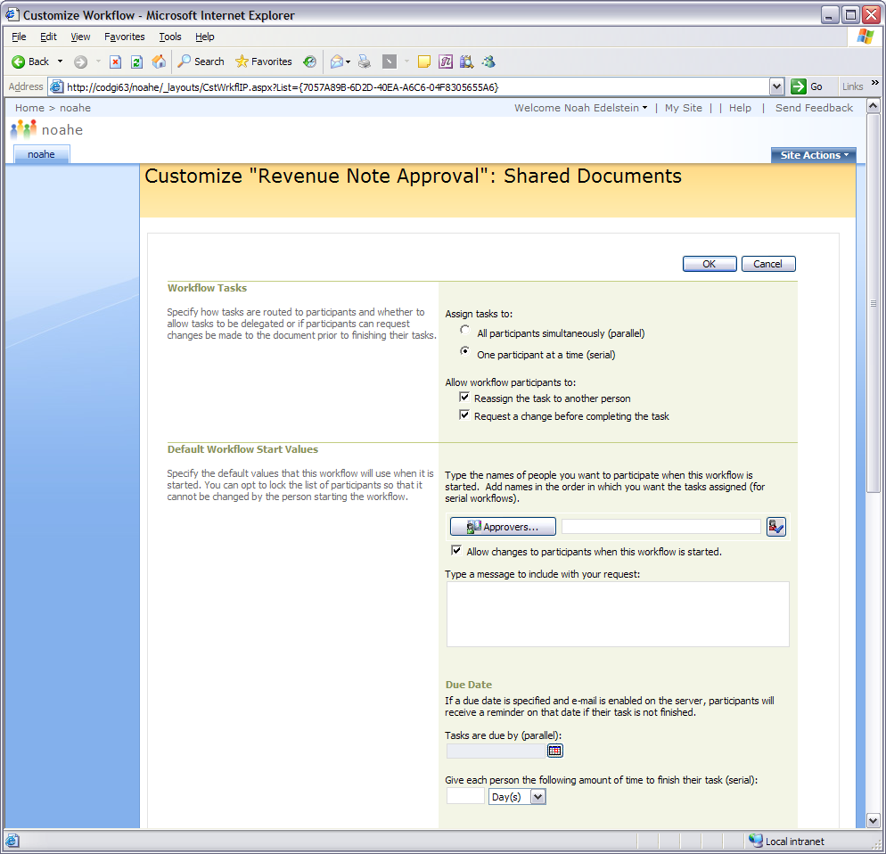
Workflow Options
Content
Management
Serial or parallel approval processes
Default approvers and due dates

Slide 13
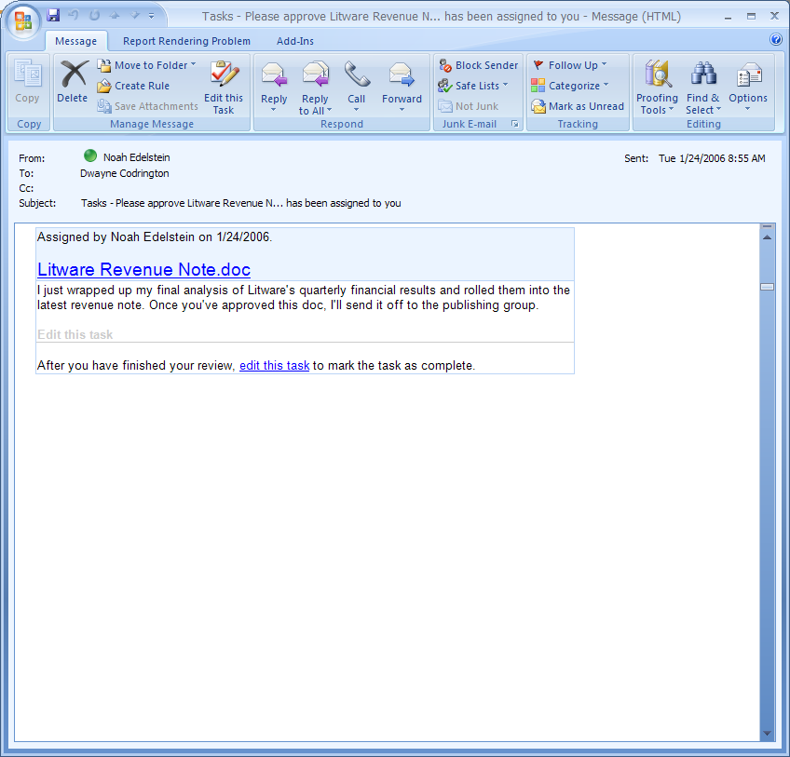
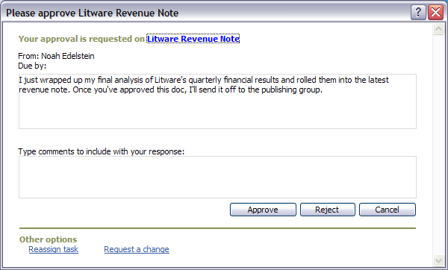
Workflow via Outlook
Content
Management
Notifications and task tracking via e-mail
Task Completion in mail and task items

Slide 14
Agenda
The Workflow Spectrum
The Integration Problem
Integration Architectures
BizTalk 2006 Overview
Bringing it All Together
Demo
Discussion

Slide 15
Government Agency Challenges
Integration & Interoperability
Connecting legacy applications on different platforms
Integrating LOB (Line of Business) applications on different platforms
Software Lifecycle
Service Oriented Architecture (SOA)
Enterprise Application Integration (EAI)
Business to Business integration (B2B) or (A2A)
Integrating EDI systems
Regulation and Compliance (ex. HIPAA, HL7, GJDXM)
Trend to XML

Slide 16
Integration Imperative
Common problem
  Historically an afterthought
  Too hard, too expensive, too slow, too brittle
  “Islands of technology in a sea of connectivity”
  Solutions evolving to constellations
  Virtual organizations built on integration
Examples
  Inside departments
  Between Business Partners
  Synchronous & Asynchronous communication

Slide 17
Agenda
The Workflow Spectrum
The Integration Problem
Integration Architectures
BizTalk 2006 Overview
Bringing it All Together
Demo
Discussion

Slide 18
Integration Architectures
Point-to-Point (Spaghetti)
No Central
Management
ERP Systems
Messaging
Client-Server
Systems
Component
Bridging
Resource
Intensive
In-house
LOB
Applications
Database
Replication
Fragile
Implementation
Legacy
Applications
Batch Data
Export/Import
E-Commerce
Applications
Limited
Business Process
Documentation

Slide 19
Integration Architectures
Hub Spoke
Application
Independent
ERP Systems
Business Process
Orchestration
BizTalk
Orchestration
Loosely
Coupled
Client-Server
Systems
BizTalk
Messaging
Centralized Message Routing and Processing Hub
Configurable
In-house
LOB
Applications
Business
Process
Oriented
Legacy
Applications
E-Commerce
Applications
Auditing and
Monitoring

Slide 20
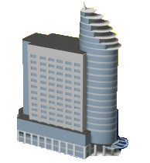
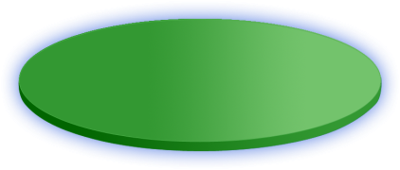
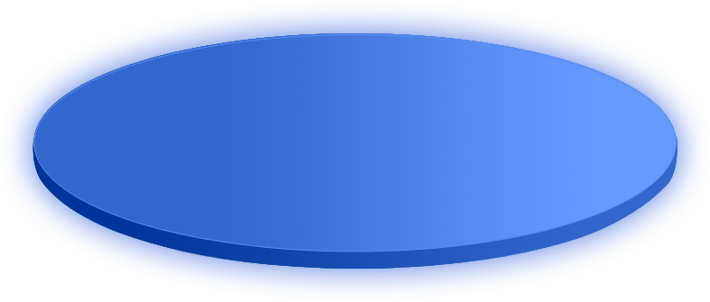



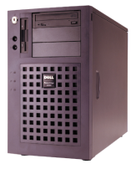

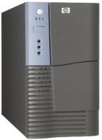



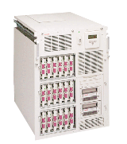

How Do Agencies Work Today?
Customer
Hospital
Agency
EDI
Internet
HIPAA
Logistics
Flat File
Core System
XML
Other Agency
System
Core System
Federal Agency
System

Slide 21





Comprehensive integration solution
EAI
BPA
B2B
Hospital
Agency
HIPAA/ HL7
EDI
Supplier
XML
Internet
Logistics
Core System
GJXDM
Agency
XML
System
Federal Agency)
System
Core System

Slide 22
The Composite Application
The application that is built on other applications
Base applications can be on different platforms (OS and Database)
Base applications do not need to support web services
  File drop, MQ, FTP, SMTP, POP3, MSMQ, MLLP
  COM via SOAP wrapper
Increases the value of existing applications
Leverages the software life cycle

Slide 23
Agenda
The Workflow Spectrum
The Integration Problem
Integration Architectures
BizTalk 2006 Overview
Bringing it All Together
Demo
Discussion

Slide 24
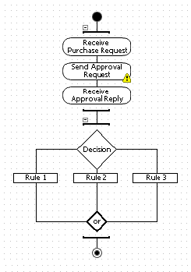
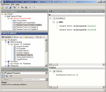
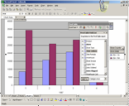
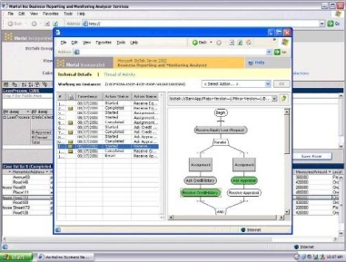
BizTalk Solution Flow
File
Web Service (SOAP)
FTP
SMTP
HTTP
SQL Server
Host Integration Server (Host)
WSS
Adapters…
File
Web Service (SOAP)
FTP
SMTP
HTTP
SQL Server
Host Integration Server (Host)
WSS
Adapters…
Orchestration
Business Rules
Transport
Transport
Decrypt
Parse
Resolve
Party
Serialize
Sign
Encrypt
Receive Pipeline
Send Pipeline
Message
Box
BAM (Business Activity Monitoring)
HAT (Health Activity Tracking)
Notes:
24
TechEd 2003

Slide 25
Scaling Out Architecture
No single point of failure
Network Load Balance
Machine
Machine
Machine
Machine
Host
Host
Host
Host
SQL Server Machine (Master)
SQL Server Machine
Message box
Message box
Stored procs
Stored procs
Data
Data

Slide 26
What About Security?
Encryption
  Protect the message contents
  SSL, IPSec, etc…
Authentication
  Who is using my service?
  Envelope issues - SOAP, local mechanisms
  Party Resolution
Digital Rights Management
  Included with Office 2003 and 2007
  Works with Windows Server 2003 Active Directory

Slide 27
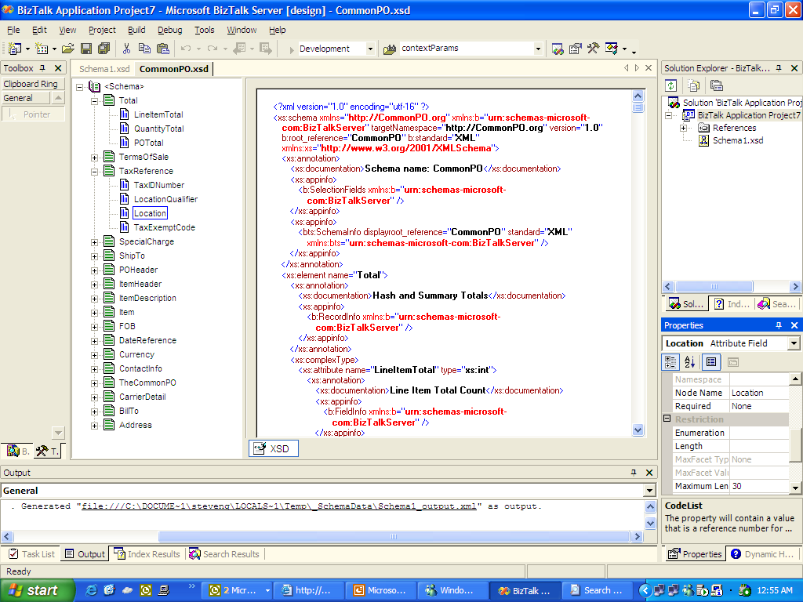
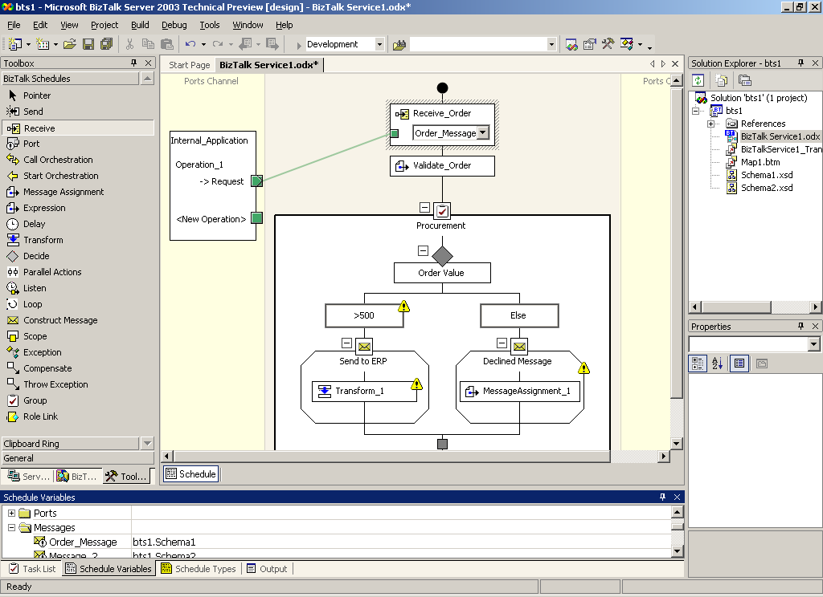
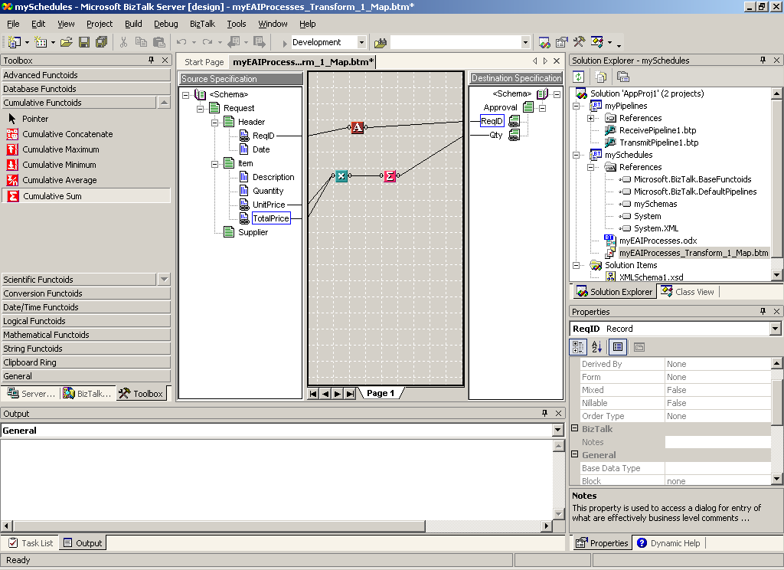
One Developer Experience
Leverage existing skills
Harness the Microsoft® .NET framework
Build with standards
Schemas
Proceses
Maps

Slide 28
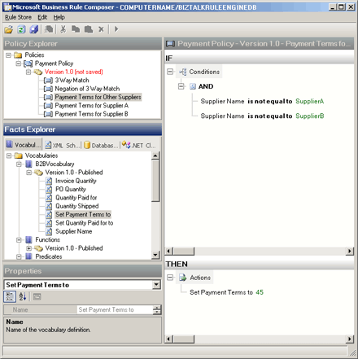
Business Rules/Policy
Rules change more often than processes
Business rules provide increased flexibility
Rules are abstracted from process and
user code
Complements orchestration
Rules engine is
high throughput,
low latency

Slide 29
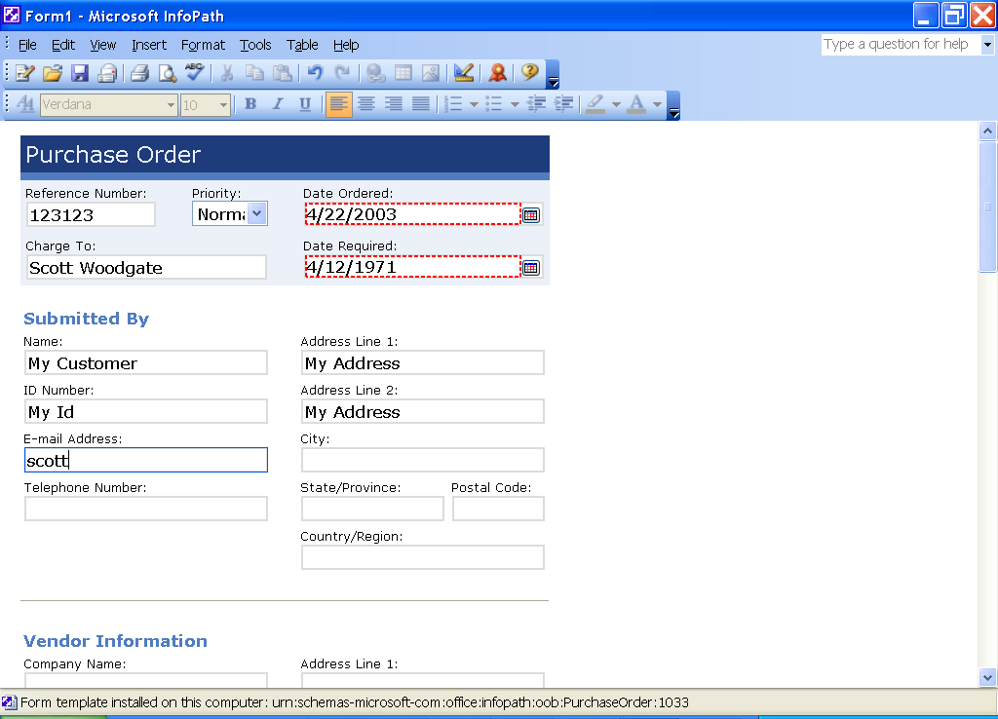
Office and InfoPath Integration
Scenarios
  Route InfoPath documents through the enterprise
  Input data from InfoPath
  documents into
  enterprise systems
Capabilities
  Open XML Schema directly inside BizTalk
  Send from InfoPath through XML Web services to BizTalk

Slide 30
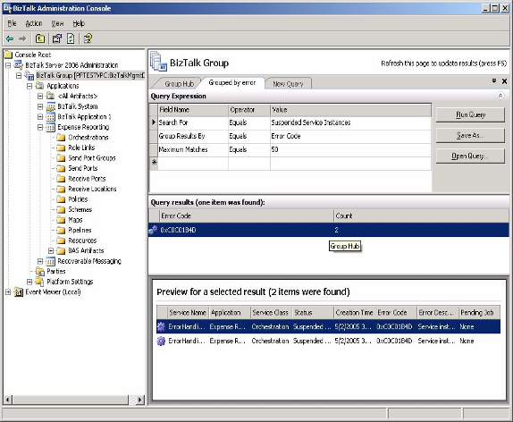
Monitoring & Tracking
  Scalable management of runtime instances
  Hub summarized farm health
  Resubmit capability
  MOM support
  Messaging Tracking for BAM

Slide 31
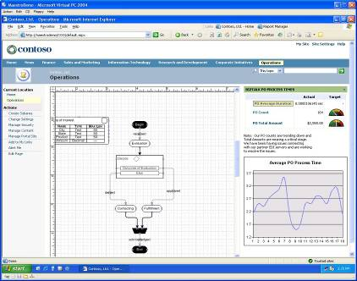

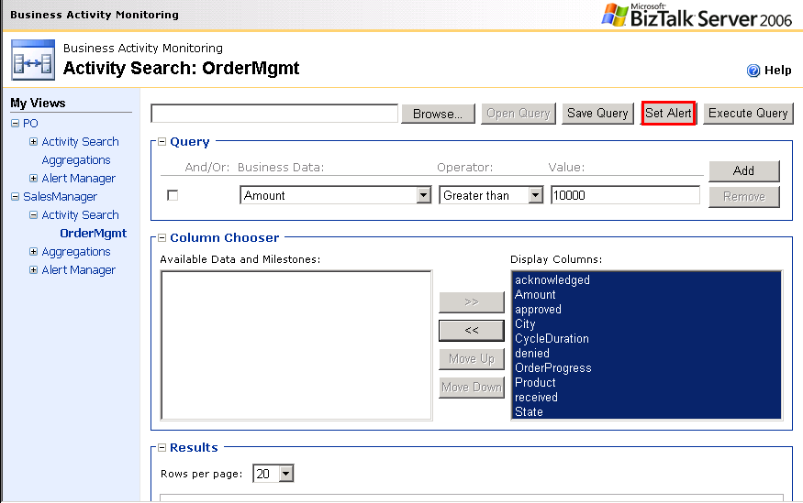
Business Activity Monitoring
Ask real-time questions
  How many units are waiting to
  be shipped right now?
  What is the total value of my finished goods inventory today?
Ask aggregation questions
  How much does it cost to produce
  one unit today?
Intercepts events from heterogeneous applications
Easy access through SPS/ASP.NET or Maestro
Business users can set alerts and drill into data

Slide 32
Updated & New Adapters
New adapters out-of-box
  MSMQ adapter
  MQSeries adapter
  POP3 receive adapter NEW
  SharePoint Adapter NEW (sort of)
Enhancements in existing adapters
  More granular perf counters
  Enhanced email composing in SMTP adapter
  Usability improvements

Slide 33
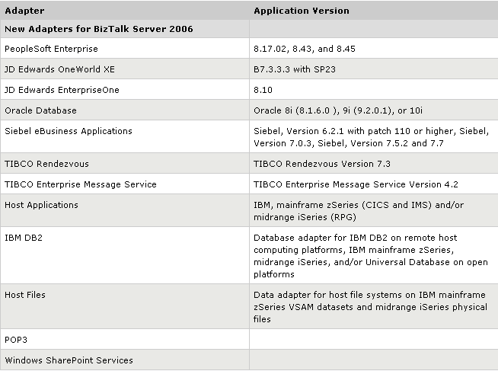
New Adapters in BizTalk 2006

Slide 34
Agenda
The Workflow Spectrum
The Integration Problem
Integration Architectures
BizTalk 2006 Overview
Bringing it All Together
Demo
Discussion

Slide 35




MOSS,WF and BizTalk Together
SharePoint Portal 2007
Synopsis
InfoPath Document is passed around from various users and approval sites using WF.
Once final approval is adopted the message is passed to BizTalk
BizTalk update backend applications with predefined orchestration leveraging transformation services to deliver message in LOB system native form.
Information Worker
Committees
Committees
Committees
1
InfoPath Doc
Committee Review
Windows Workflow Foundation
2
Backend Systems
BizTalk
3
Orchestration
Transformations
IBM Mainframe
Accounting System
Business Rules
External System

Slide 36

BizTalk Server 2006 R2 Investments
Platform Alignment
People_Ready Processes
WCF support enables WS-* standards
Monitoring of WF workflows through
Business Activity Monitoring
WCF Adapter Framework and WCF based adapters
BizTalk Adapter Pack enables Office Servers access to LOB data
Microsoft Office SharePoint Server Integration
Partner solutions enable modeling, simulation and rules definition within Office
Federated Process
EDI and AS2
Federated Process
RFID
Native EDI engine (X12, EDIFACT) + AS2 Support
B2B vertical standards support (HIPAA, HL7, SWIFT, RosettaNet)
Global supply-chain collaboration networks through GXS partnership
Device abstraction and management tools
Event processing for filters, alerts and transforms
Design, runtime and management APIs
Back-office integration

Slide 37












Microsoft BPMS
Roadmap
Radical gains in productivity thru advances in model-driven development and management
Rich business process modeling and simulation for the business analyst
Further advance and integrate the use of Windows Workflow Foundation
Continued commoditization of low-level integration
R2
Human-centric workflow delivered in SharePoint and accessible across Microsoft Office System
Common workflow solutions and activities out of the box; customizable through
SharePoint Designer
Windows Workflow Foundation
Native interoperability with WinFX applications
Integration with Microsoft Office SharePoint Server
Federated processes across trading partners and devices
Third foundational WinFX technology for Windows Vista
Support for Windows XP and Windows Server 2003
Microsoft Office integration thru SharePoint Adapter
Adapters expose processes contained within LOB applications
Visibility to end-to-end processes through Business Activity Monitoring

Slide 38




Gartner Magic Quadrant
Integration Backbone Software
Challengers
Leaders
Microsoft
Fujitsu
IBM
TIBCO
Oracle
Ability
to
Execute
SAP
BEA
Sterling
Commerce
SeeBeyond
webMethods
Novell
NEC
Sonic
SoftwareAG
Intersystems
Axway
Iona
Hitachi
iWay
Magic
EXTOL
CapeClear
Cordys
Vitria
Fiorano
Polarlake
Niche Players
Visionaries
Completeness of Vision
Gartner Research (April 2005)

Slide 39
Agenda
The Workflow Spectrum
The Integration Problem
Integration Architectures
BizTalk 2006 Overview
Bringing it All Together
Demo
Discussion

Slide 40


Demo Scenario
Customer
Sales Manager
InfoPath & Outlook
SharePoint &
InfoPath
Purchase Order
PO Review
Systems
BizTalk
ERP - Database
Orchestration
Supplier – Web Service
Business Rules
Shipper – Flat File / FTP

Slide 41

© 2005 Microsoft Corporation. All rights reserved.
This presentation is for informational purposes only. Microsoft makes no warranties, express or implied, in this summary.

Slide 42
Contrasting BizTalk with WWF
BizTalk:
  Workflow across applications
  Targeted toward Agencies or Enterprises that need a robust platform for integrating applications on disparate platforms
  Includes value added features such as BAM, adapters, BAS..
  Changes in workflow forces a recompile which implies Developers will be responsible for this.
WF (Windows Workflow Foundation)
  Workflow within applications
  Targeted toward ISV or strong .NET shops that want to roll their own workflow solutions.
  Also targeted toward Office workers who want to create and control their own H2H workflows through SharePoint.
  Changes in workflows can be done without Developer’s necessarily being involved.
  WF must have an application that exposes it to the end user such as SharePoint 2007.

Slide 43
Contrasting WF and BizTalk (2)
Feature | BizTalk Server | Windows Workflow Foundation
Hosting | Server-side in the BizTalk process | Hosted in a custom application (client-side execution, but the client could be an ASP.NET application)
Designer | Included in Visual Studio | Included in Visual Studio, or custom designers can be written
Scalability | Well-proven, highly scalable | Developer must implement
Transactional integrity | Long running and atomic (ACID) transactions | Developer must implement
Tracking infrastructure | Comprehensive Business Activity Monitoring infrastructure provided | Simple framework pieces provided that allow you to build the tracking infrastructure
Runtime modification of “in-flight” workflows | No, workflows are defined at design time | Yes, but developer must implement
Cross-platform integration capabilities | Extensive adapters available | Not supported natively
Composability | A BizTalk process could invoke a WF process via Web service call, or from a helper class or expression shape | WF processes cannot directly invoke a BizTalk application, although you could indirectly by calling an orchestration that had been exposed as a Web service (for example), or perhaps by API usage

Slide 44
Contrasting WF and BizTalk (3)
Feature | BizTalk Server | Windows Workflow Foundation
Management and administration | Extensive set of tools provided for IT pros to administer and track execution | Developer must implement
Windows Communications Framework (formerly “Indigo”) support | Through an adapter, or could be called from an expression shape or helper class | Natively supported
Rules engine support | Yes | Yes
Extensible activities | No | Yes
Transformation capabilities | Yes | Only those already available in .NET
Programmability | BizTalk Server exposes APIs for most parts, and has numerous extensibility points such as pipeline components, adapters and “functoids” (out-of-the box and custom mapper components) | WF is a framework. You must implement applications to use it.

Slide 45
Some Questions to Decide Which to Use
Question: Are you and ISV needing to incorporate workflow into your application?
Answer: Yes, then use WF
Question: Are you an Agency needing to integrate applications on disparate platforms (i.e. Mainframe, LOB)?
Answer: Yes, then use BizTalk
Question: Do you want Information workers to control and create their own workflows (primarily human to human)?
Answer: Answer yes, then use WF preferrably through MOSS
Do you want to link applications and possibly end users in mostly static workflows (i.e. changing every couple of months)
Answer: Yes, then use BizTalk
Question: Do you have a Integration Needs and a Development Staff skilled in .NET development that can leverage WF?
Answer If Yes, look at WF if No consider BizTalk
Question: Do you Need BPM capabilities such as BAM or adapters?
Answer: Yes, then use BizTalk

Slide 46
Flat-File Import Wizard
Legacy application produces data in the following format:
To enable processing of this format in BizTalk Server developer needs to define a flat file schema
  Flat file schema is an xsd with additional flat file annotations
PO1999-10-20
US Alice Smith 123 Maple Street Mill Valley CA 90952
US Robert Smith 8 Oak Avenue Old Town PA 95819
Hurry, my lawn is going wild!
ITEMS,ITEM872-AA|Lawnmower|1|148.95|Confirm this is electric,ITEM926-AA|Baby Monitor|1|39.98|Confirm this is electric|1999-05-21

