Slide 1
ADFS v2 and SharePoint 2010 DEMO
22/04/2010
Bert Jansen
Microsoft Corporation

Slide 2
About
About the demo
ADFS v2 working together with SharePoint 2010
About me
Bert Jansen (bert.jansen@microsoft.com)
MCS Architect inside Microsoft Consulting Services (MCS)
Focus on Architecture, SharePoint and everything related ☺

Slide 3
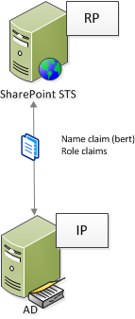
Claims versus SharePoint 2010

Slide 4
Demo time

Slide 5
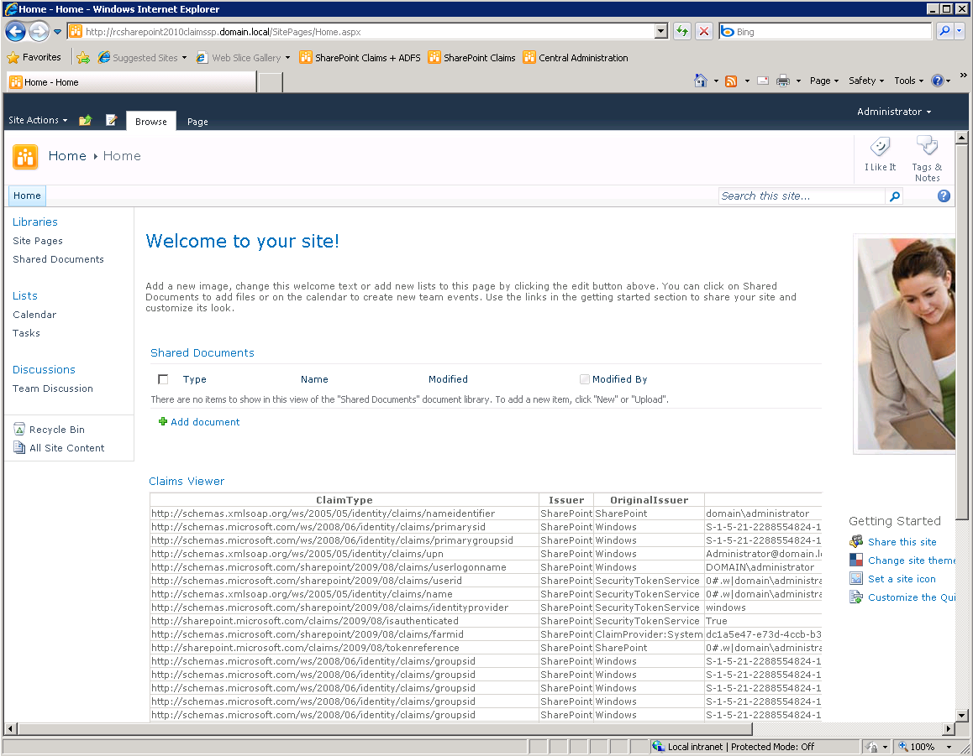
http://schemas.microsoft.com/sharepoint/2009/08/claims/userid = 0#.w|domain\administrator

Slide 6
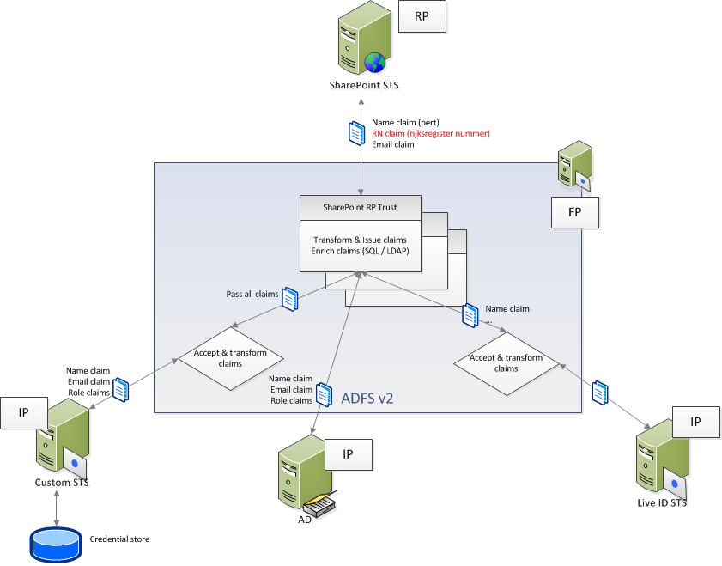
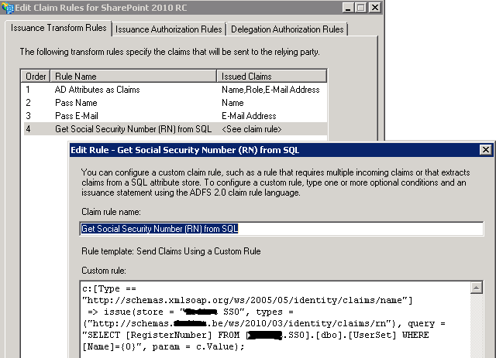
SharePoint 2010 versus ADFS v2

Slide 7
Demo time

Slide 8
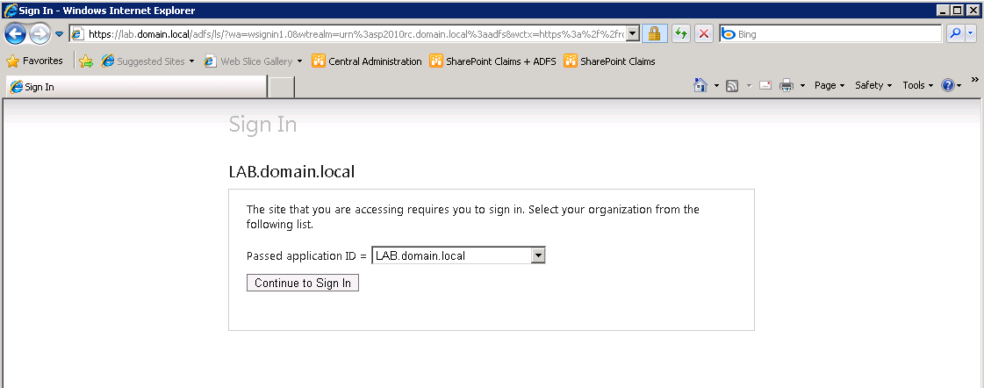

Slide 9
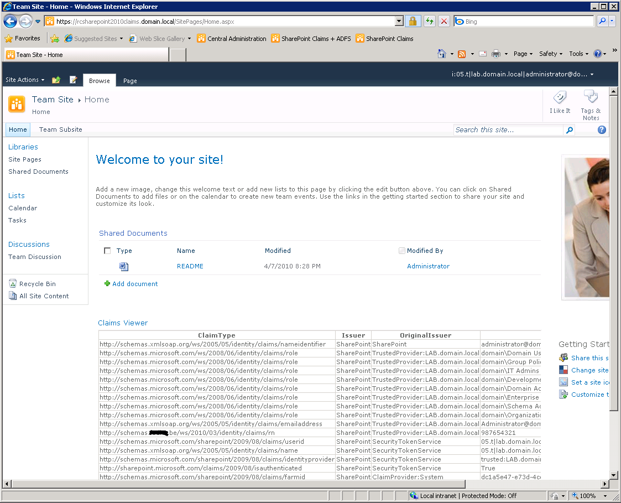
http://schemas.microsoft.com/sharepoint/2009/08/claims/userid = 05.t|lab.domain.local|administrator@domain.local
http://schemas.xxx.be/ws/2010/03/identity/claims/rn = 987654321

Slide 10
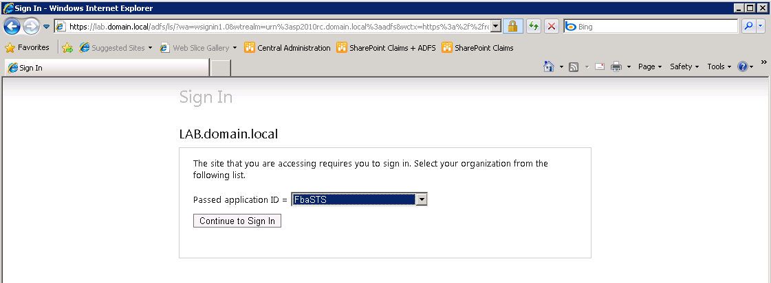

Slide 11
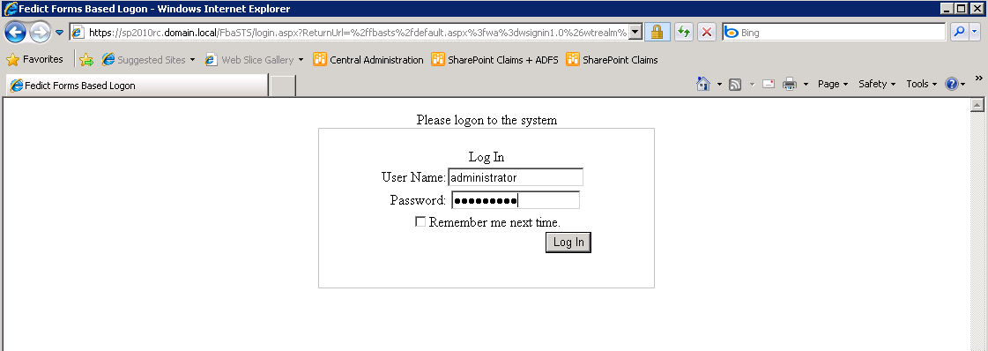

Slide 12
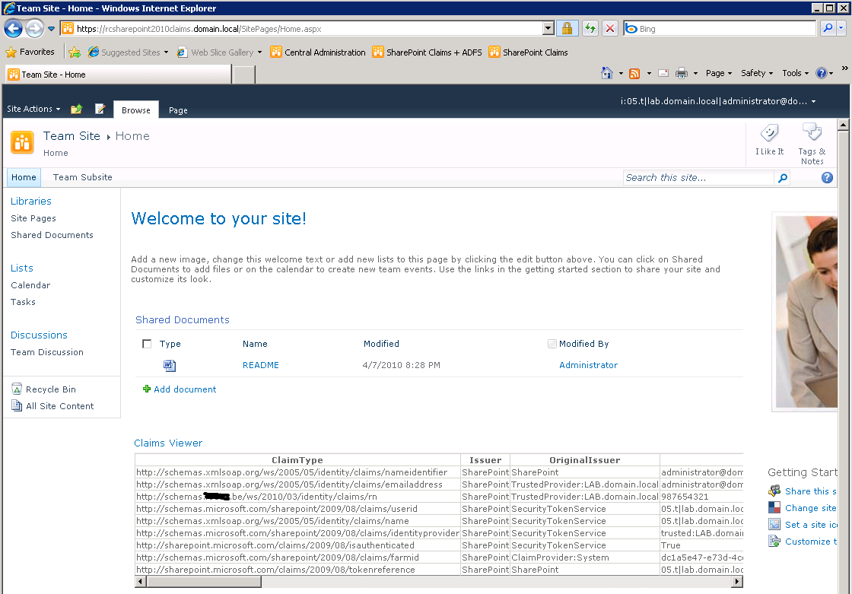
http://schemas.microsoft.com/sharepoint/2009/08/claims/userid = 05.t|lab.domain.local|administrator@domain.local
http://schemas.xxx.be/ws/2010/03/identity/claims/rn = 987654321

Slide 13
Questions ??

Slide 14
© 2008 Microsoft Corporation. All rights reserved. Microsoft, Windows, Windows Vista and other product names are or may be registered trademarks and/or trademarks in the U.S. and/or other countries.
The information herein is for informational purposes only and represents the current view of Microsoft Corporation as of the date of this presentation. Because Microsoft must respond to changing market conditions, it should not be interpreted to be a commitment on the part of Microsoft, and Microsoft cannot guarantee the accuracy of any information provided after the date of this presentation. MICROSOFT MAKES NO WARRANTIES, EXPRESS, IMPLIED OR STATUTORY, AS TO THE INFORMATION IN THIS PRESENTATION.

