Slide 1


Hosting Websites and Web Applications with
Microsoft® SQL Server® 2008
Notes:
.

Slide 2
Agenda
SQL Server and the Microsoft Web Platform
Reducing Costs with SQL Server
Increasing Revenue with SQL Server
Additional Resources
Notes:
This is what we’ll cover in this presentation.

Slide 3
SQL Server and the Microsoft Web Platform
Notes:
Talk about pervasiveness of the Web.
Talk about changes to the Web.
Increasingly dynamic, more functional.
Need same levels of functionality as line-of-business applications.

Slide 4












The Microsoft Web Platform
Tools
Presentation Technologies
Web Application Platforms
Web Development Technologies
Database Services
Content Hosting services
Operating System
Notes:
Highlight strength of Windows Server 2008 and IIS 7.0.
Highlight versatility of the Microsoft Web platform.
Build rich applications with ASP.NET, Ajax, Silverlight, Windows Communication Foundation (WCF), and popular Web development technologies such as PHP.
Includes SQL Server and its extensive feature set.
Highlight additional services such as Office SharePoint Server and Commerce Server.

Slide 5
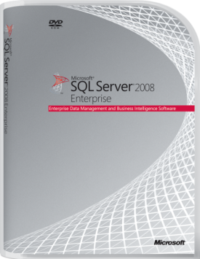

Why SQL Server?
Pay for only what you need
Range of editions, from free to enterprise-scale
  Express, Web, and Enterprise fit most hosting scenarios
Fidelity across all editions
  Seamless growth path for customers that need to increase scale
  Consistent scripting and management for all SQL Server instances
Give Web developers what they want
Tight integration with Visual Studio and Visual Web Developer Express
  The database of choice for ASP.NET developers
PHP drivers
  A broad-reach, scalable, manageable alternative to MySQL
Notes:
Highlight the wide range of editions and the seamless upgrade process between editions. Particularly highlight Express, because it is free, Web, because it is designed specifically for Web hosting, and Enterprise, because it is functionally rich.
Highlight the power of ASP.NET and that ASP.NET developers prefer SQL Server.
Highlight the maturity, scalability, and manageability compared to MYSQL.

Slide 6







SQL Server Editions
Key Editions
For Web Scenarios
Core Editions
Specialized Editions
Free Editions
Notes:
Highlight the choices of edition, particularly Express, Web, and Enterprise.
SQL Server 2008 Express Edition – Free edition, but with some scalability restrictions. Now available with a graphical management tool, reporting capabilities and full-text indexing.
SQL Server Compact 3.5 – A free, lightweight database designed to be used for embedded databases in desktop applications and mobile devices. Not relevant for Web hosting.
SQL Server 2008 Web Edition – An edition of SQL Server that is designed specifically for use as a database server in a Web hosting scenario. SQL Server Web Edition offers the same levels of scalability as Standard Edition, but for approximately 40% less cost. SQL Server Web Edition also includes self-management capabilities and reporting capabilities.
SQL Server 2008 Workgroup Edition – An edition of SQL Server designed for departmental or branch office applications that require a local data store.
SQL Server 2008 Standard Edition – A scalable database platform for corporate data stores that includes self-management features, and Business Intelligence (BI) capabilities through SQL Server Integration Services, SQL Server Reporting Services, and SQL Server Analysis Services.
SQL Server 2008 Enterprise Edition – An enterprise-class database platform that extends the features of Standard Edition to include hardware support for massively scalable database solutions and enterprise-class data encryption capabilities.
SQL Server 2008 Developer Edition – An edition of SQL Server that includes the same functionality as Enterprise Edition, but which is licensed for software development purposes only.

Slide 7
SQL Server Editions
Feature | Enterprise Edition | Web Edition | Express Edition
Maximum number of CPUs | OS Maximum | 4 | 1
Maximum memory | OS Maximum | OS Maximum | 1 GB
Maximum database size | Unlimited | Unlimited | 4 GB
Maximum instances per server | 50 | 16 | 16
x32 support | ✓ | ✓ | ✓
x64 support | ✓ | ✓ | ✓
I64 support | ✓
Dynamic AWE management | ✓
Data compression | ✓
Backup compression | ✓
Hypervisor support | ✓ | ✓ | ✓
Clustering support | ✓
Database Mirroring | ✓
Resource Governor | ✓
C2-compliant tracing | ✓ | ✓ | ✓
SQL auditing foundation | ✓ | ✓ | ✓
Fine-grained auditing | ✓
Transparent database encryption | ✓
Extensible key management | ✓
Policy-based management | ✓ | ✓ | ✓
Performance data collection | ✓ | ✓
SQL Server Agent | ✓ | ✓
SQL Server Integration Services | ✓
SQL Server Analysis Services | ✓
SQL Server Reporting Services | ✓ | ✓(Express) | ✓(Express)
Relational data structures and Transact-SQL | ✓ | ✓ | ✓
Native XML data support | ✓ | ✓ | ✓
Spatial data support | ✓ | ✓ | ✓
Notes:
Highlight the value for money of Express edition, extended capabilities of Web edition, and full enterprise capabilities of Enterprise edition.
Express edition has several features that would typically only be found on expensive products:
64-bit support
Policy-based management
Reporting Services (Express edition)
Spatial data support
Web edition is appropriate for most Web hosting deployments. Includes functionality of Express plus some key features at very competitive price-point:
Unlimited memory and database size
SQL Server Agent for automated administration and monitoring
Enterprise edition has many scalability enhancements:
Up to 50 instances per server
High availability
Business Intelligence
Data and backup compression
Key based encryption
Resource Governor to ring-fence workload resources
SSIS, SSAS, and full version of SSRS

Slide 8












Hosting Scenarios
Dedicated Hosting
Hosted Server
Virtual Server
VM
VM
Each customer gets their own Web server
Each customer gets their own database server and one or more instances of SQL Server
Each customer gets their own Web server virtual machine
Each customer gets their own database server virtual machine and one or more instances of SQL Server
Notes:
Discuss the different options for hosting on a dedicated server.
A large deployment can have a dedicated physical server for a single client with the database edition of choice.
SQL Server Web edition is ideal for most dedicated hosted servers, but Enterprise edition can be deployed for increased scalability and availability.
Typically there is either one physical server for the Web server and one physical server for the database server.
Typical deployments now share physical servers using virtualization.
This limits physical servers and power consumption while still providing full isolation to customers.
Customers can still separate the Web server from the database server by using multiple virtual machines.
Customers still have a full choice of database editions.
Virtualization enables new servers to come online very quickly, can enable live migration between physical boxes, and simplifies backups.

Slide 9









Hosting Scenarios
Shared Hosting
Single SQL Instance
Multiple SQL Instances
Shared Virtual Servers
VM
VM
Multiple customers share the Web server
Each customer gets a limited number of databases in the SQL Server instance
Multiple customers share the Web server
Each customer gets their own instance of SQL Server
Multiple customers share a Web server virtual machine
Each customer gets a limited number of databases, or one SQL Server instance, on the database virtual machine
Notes:
When a dedicated server or virtual machine is not required, it is also possible to share server resources between customers, but keep a level of isolation. When a SQL Server instance is shared, the choice of SQL Server edition is dependant upon the hoster. To support large numbers of clients they are likely to install SQL Server Web edition at a minimum, or, for even more clients, and additional functionality, they might choose SQL Server Enterprise edition. When customers have a dedicated instance of SQL Server, they have more control over the choice of SQL Server edition, but hosters should consider that SQL Server Express edition supports a maximum of 16 instances on one server.
The three most common shared hosting scenarios are as follows:
Multiple customers can share a Web server and share a database instance.
There is isolation at the database level, but customers do not have full administration rights over their data.
Customers are typically limited to one database.
Multiple customers can share the Web server, but each customer has a separate instance of SQL Server.
Customers have full administration rights over their data.
Customers can have many databases.
Multiple customers can share a virtual Web server and a virtual database server.
Web server and database server are logically separated.
Web server and database server are on the same physical machine.
As there are multiple customers on the database server it is likely that hosters will deploy the Web edition of SQL Server at a minimum.

Slide 10
Hosting Scenarios
Choosing the Edition of SQL Server
Dedicated Hosting
Hosted server
    Typically Enterprise edition
Virtual server
    Typically Web edition or Enterprise edition
Shared Hosting
Single SQL instance
    Typically Enterprise edition
Multiple SQL instances
    Typically Web edition
Shared virtual servers
    Typically Web edition or Enterprise edition
Notes:
Recommended editions for hosting scenarios depend both on the requirements of the customer and the ability of the hoster to deliver service levels to each of the customers databases. It should be highlighted that there is no truly typical system and every system is different.
These are common solutions for the scenarios:
Hosted server scenarios are typically mission critical systems that benefit from the high availability and scalability features of Enterprise edition.
Virtual server scenarios use a database edition to fit customer needs. This is typically Web edition as it offers very good value for money, but, if the systems are large, or mission critical, Enterprise edition could be used. Similarly, if the database is little used, Express edition might be the most suitable.
Single SQL instance shared scenarios typically use Enterprise edition as many databases could be hosted on one instance and resources might need to be ring fenced.
Multiple SQL instances shared scenarios typically use Web edition, as it offers very good value for money, however, if more than 16 instances are deployed, Express edition is required.
Shared virtual servers typically use Web edition if the customer has their own SQL Server instance, or Enterprise edition if instances are shared between customers.

Slide 11
Reducing Costs with SQL Server
Notes:
Highlight the reduced initial investment through free and low cost editions, and through virtualization.
Highlight the lower total cost of ownership through automated maintenance, proactive management, and resource optimization.

Slide 12
Future-Proof Your Database Platform Investment
Seamless upgrade
Use edition that best fits needs and budget
Take advantage of full edition compatibility to upgrade if needs change
  Upgrade from Express edition to SQL Server Web Edition, or even SQL Server Enterprise Edition without any changes
Save administration and development costs
Use same tools and scripts to provision, configure, and manage instances
Take advantage of cost savings in multi-edition environments with a single set of tools
Notes:
Highlight the advantages of seamlessly upgrading databases.
There is no need to future-proof by over specifying the database edition.
Buy what is right now and upgrade as required.
Save costs.
As each edition has the same architecture and language save administration and development costs.
Use the same tools across multiple servers and multiple editions.
Save staff and training costs.
Use the same scripts across multiple servers and multiple editions.
Save development costs.

Slide 13





Reduce the Total Cost of Ownership
Automate maintenance
Manage by intent
Optimize resources
Create scheduled tasks
Receive operator alerts
Centrally manage tasks and alerts
  Ensure all tasks are performed across the data center
Use PowerShell to automate administrative tasks for Microsoft Windows, IIS, and SQL Server
Use Policy-Based Management to proactively manage servers
  Apply policies to multiple servers
  Restrict configuration settings that customers can change
Use data compression in Enterprise edition to reduce storage and improve I/O
  Large cost savings on systems with many customer databases
Use Resource Governor in Enterprise edition to control resource usage
  In shared instances prevents individual customers from monopolizing resources
  Provides predictable performance
Notes:
Discuss the tools to reduce TCO.
Automated maintenance can perform scheduled tasks such as backups automatically.
Operators can be notified of outcome to ensure tasks are completed.
Multi-server tasks can reduce administrator workload.
Reactive tasks can run automatically in response to events on the server.
Policy-Based Management ensures that business rules are followed.
Apply policies to one or more servers.
Apply policies are applied proactively to prevent a policy infringement or reactively to check for policy infringements.
Optimize resources with Enterprise edition tools.
Data compression not only reduces storage, but also increases I/O as less physical data is being moved.
Data compression does increase processor load.
Backup compression reduces storage and backup times, but increases processor load.
Sparce columns decrease storage where many null values are present, but increase it if there are no null values.
Resource governor prevents individual workloads from overusing resources.
Workloads are grouped and limits are placed on the group.
Limits are only applied where necessary.
Workloads can exceed the limit if there is no conflict.
Provides predictable performance to customers to meet SLAs.

Slide 14
Increasing Revenue with SQL Server
Notes:
Revenues can be increased by providing value add features to increase the hosters appeal.

Slide 15
Attract Web Developers
If you are not using SQL Server…
Grow market opportunity to ASP.NET developers
Visual Studio: best developer tool
Full power of SQL Server available (e.g. Spatial)
If already using SQL Server?
Move to SQL Server 2008
Spatial data type, XML type, extended precision date/time
Offer PHP developers a more robust DB
New SQL Server Driver (for SQL Server 2005 & 2008)
PHP developers looking for better database
Offer PHP developers new capabilities
Quickly build business intelligent features
Utilize advanced data types
Serve customers with single platform
Windows + IIS + SQL Server + PHP
PHP apps using SQL Server: e.g. ADOdb platform, Coppermine Gallery, TUTOS,…
Notes:
Few people change Web development technology to match a hoster. Instead, they will find a hoster who matched their technology. The Microsoft Web platform supports the Web technologies that developers want.
ASP.NET enables developers to use the same .NET languages that they use for desktop and line of business applications in their Web applications.
SQL Server is closely integrated with ASP.NET, Visual Studio, and Visual Web Developer Express.
Developers can create databases and debug stored procedures and functions from within Visual Studio.
Deployment to the hosted SQL Server database is through a straightforward wizard.
PHP is a very popular Web scripting language and Microsoft now provides full support for this.
Microsoft Expression Web 2 has a full set of PHP development tools including code-coloring, snippets, IntelliSense, and a PHP development server that lets you test your PHP pages without any other external Web server dependencies.
The Microsoft Web platform includes PHP drivers for SQL Server to make it straightforward for PHP developers to take advantage of the relational database capabilities of SQL Server.

Slide 16
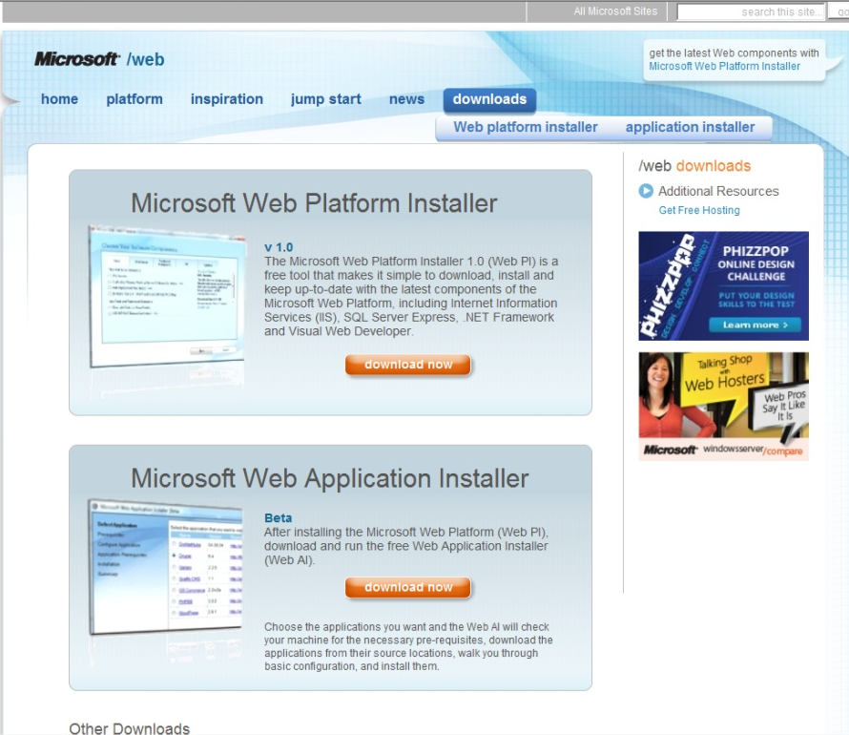
Web Platform Installer
Free download manager for Web Platform
Quick and easy download
Thousands downloading and adopting weekly
Microsoft.com/web
Notes:
The Microsoft Web Platform Installer is a free tool to download, install, and keep up-to-date with Microsoft Web Platform components.
Components include:
.NET Framework
Install the latest version of the .NET Framework. This includes everything you need to work with ASP.NET.
IIS and Extensions
Install the latest version of IIS, including latest IIS Web extensions like IIS Media Services.
SQL Server
Install the latest version of SQL Server 2008 Express. This includes both the database engine and tools.
Visual Web Developer
Install the latest version of Visual Web Developer Express, the fully featured free web development tool.

Slide 17













Differentiate with Value-Add Capabilities
Database server management
Enterprise level security
Replication
Geographic data
High availability and data recovery
Business Intelligence
Notes:
Discuss the additional functionality of SQL Server that can be used to differentiate the hoster offering.
Automated administration and policy-based management enable maintenance to be performed automatically to reduce customer overheads.
Replication services enables the provision of geographically dispersed Web solutions.
High availability and data recovery enables hosters to offer attractive SLAs to customers who have mission-critical systems.
Hosters can offer high levels of security including complete database encryption, key based security, and comprehensive auditing.
Hosters can support the increasing numbers of spatially aware applications and plug geographic data into online mapping systems, such as Microsoft Virtual Earth.
To improve data insight hosters can offer Business intelligence solutions using SQL Server 2008 Reporting Services and SQL Server 2008 Analysis Services.

Slide 18
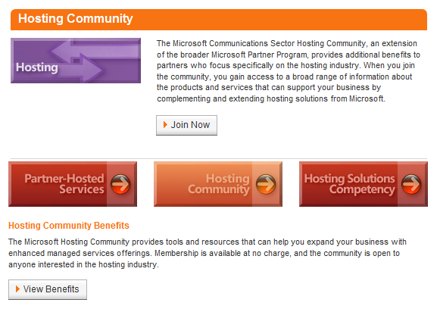
Call to Action
Join Microsoft Partner Program
Hosting Deployment Accelerator
  Plan and implement a solution
Customizable marketing Web sites
  Drive interest in your services
Web Hosting Sales Kit
  Includes sales guidance,
  e-mail templates, and presentations
partner.microsoft.com/hostingcommunity
Notes:
Microsoft provides a number of resources to help hosters offer solutions based on the Microsoft Web platform, including SQL Server 2008. To maximize the effectiveness of your Microsoft hosting services:
Become a Registered Member of the Microsoft Partner Program and review the many resources available at: http://partner.microsoft.com/hostingcommunity.
Review the Hosting Deployment Accelerator for business guidance and technical resources to help you plan and implement a hosting solution.
Use the set of easily customizable marketing Web sites provided by Microsoft to reduce the overhead of creating marketing collateral and attracting customers.
Make use of the Web Hosting Sales Kit, which provides a customizable set of documents that you can use to create campaigns and drive demand for your Windows-based hosting services.
Review the licensing information at http://www.microsoft.com/serviceproviders/licensing/default.mspx for details about how to purchase SQL Server 2008 licenses.

Slide 19
Additional Resources

Slide 20

© 2009 Microsoft Corporation. All rights reserved.
This presentation is for informational purposes only. Microsoft makes no warranties, express or implied, in this summary.

Slide 21
Appendix: Security Enhancements Over SQL Server 2005
Security Challenge
Security Feature
Weak passwords
Password policy enforcement
Lack of audit information
Capture and audit DDL activities
Data confidentiality
Built-in encryption and key management
Metadata protection
Catalog security
Schema level permission
User-schema separation
Granular permission to execute statements in a module
Execution context and module signing
Protect access to the DB
Encrypted login credentials and connection end-points

