Slide 1
PHP on Windows: Why Care?
Pandurang Nayak
Developer Evangelist
Microsoft Corporation

Slide 2
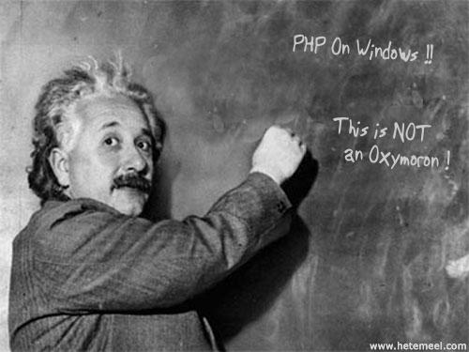

Slide 3
<?php ?>

Slide 4
What is php?
Written as Common Gateway Interface (CGI)
Released first as “Personal Home Page Tools”
PHP: Hypertext Preprocessor
Current release PHP 5.2.4 Aug 30 2007
Actively managed by Zend Technologies
Producers of Zend Engine (PHP 4 onwards)

Slide 5
php
<?php
echo “hello world”;
?>
<html>
<head><title>
<?php echo $page_title; ?>
<title></head>
…..

Slide 6
PHP: Object Oriented Programming
class foo extends bar
{
function __construct()
{
}
public static function mystaticfunc()
{
}
}
….
foo::mystaticfunc()

Slide 7
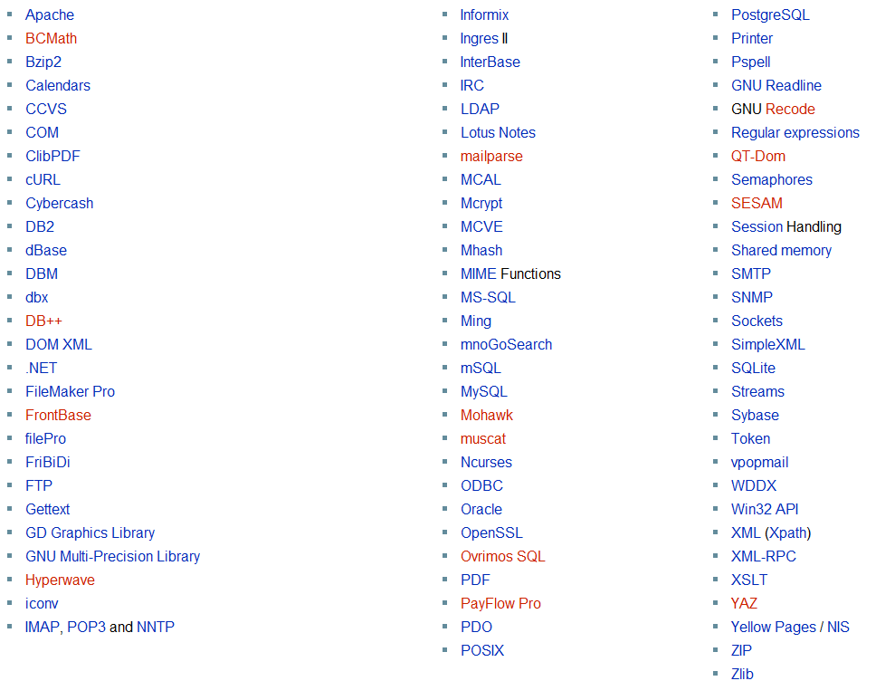
PHP Libraries

Slide 8
CGI

Slide 9
CGI Drawbacks
Single process per request
Multiple requests spawn multiple processes
Script engines suffer performance and scability losses

Slide 10
FastCGI

Slide 11
FastCGI
First developed by OpenMarket in 1990s
Single persistent process to handle multiple requests over lifetime
Internal multiplexing
Multiple connections
Thread pool
Web server to process interaction through TCP connection (remote) or domain sockets (local)

Slide 12
IIS 7.0

Slide 13
IIS 7
Modules! Modules! Modules!
Managed and Native Modules
Custom Modules
Integrated Pipeline Architecture
Goodbye Metabase!
Intuitive Management Console
Reduced Attack Surface
FastCGI built-in module!!
Great performance for PHP, Ruby on Rails, Perl

Slide 14
DEMO
Running PHP on IIS 7

Slide 15
Why Care?
Great performance!!
Leverage core IIS/.NET features such as Forms Authentication, Output Caching, etc.
ASP.NET and PHP environments running on same box
Interop with .NET, Active Directory, COM+, Web Services, etc.
Seamless development to deployment experience

Slide 16
Notably..
Phalanger
Managed Code PHP version
www.codeplex.com/phalanger
Several third-party tools and libraries
.NET Integration
ADSI Integration
SQL Server and ODBC Integration

Slide 17
IIS Community Site
www.iis.net

Slide 18
QUESTIONS
www.thinkingMS.com/pandurang

Slide 19
© 2007 Microsoft Corporation. All rights reserved.
This presentation is for informational purposes only. Microsoft makes no warranties, express or implied, in this summary.
Notes:
19

