Slide 2
用双手改变生活 - Windows7和WPF中的多点触摸（Multi-Touch）应用开发及案例展示
WUX320

Slide 3
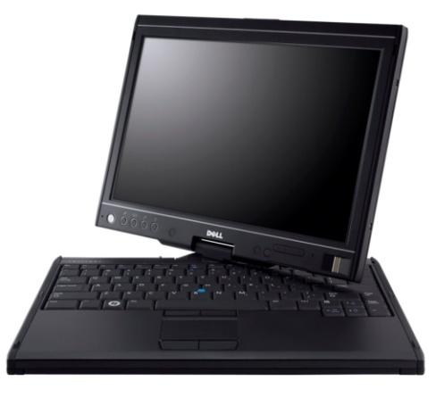
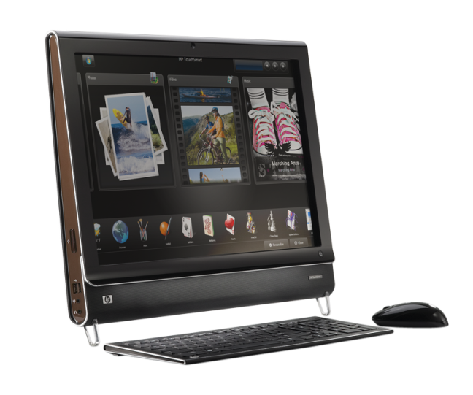
Multi-Touch已经就绪！
硬件
如今具备Multi-touch能力的电脑已经上市
多种形式的Multi-touch设备
软件
Windows 7, .NET Framework 4.0
消费者
新应用场景
更丰富的用户体验

Slide 4
Windows Photo Viewer Paint
Demo
Windows 7 built-in multi-touch

Slide 5
议程
Multi-touch简介
控制面板设置
Touch场景：“Good, Better, Best”模式
平台架构
触摸(Touch) - WM_TOUCH
手势(Gesture) - WM_GESTURE
多触操作(Manipulations)和惯性(Inertia)
Windows Presentation Foundation (WPF)的支持
Touch应用程序的用户体验(UX)指南
小结

Slide 6
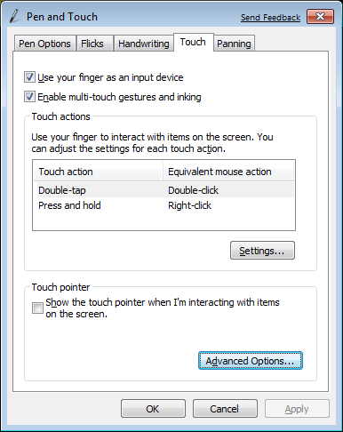
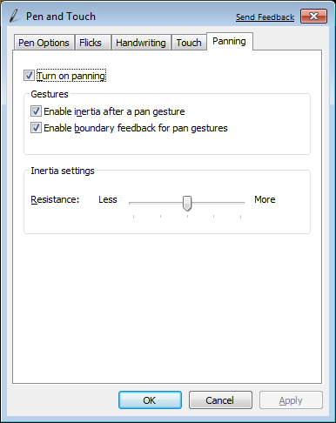
控制面板 Control Panel 触笔(Pen)和触摸(Touch)

Slide 7
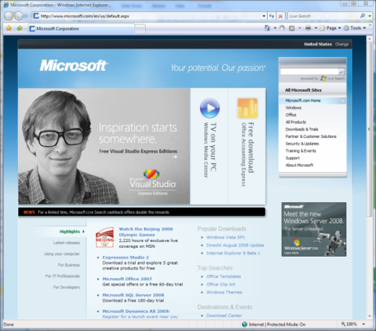
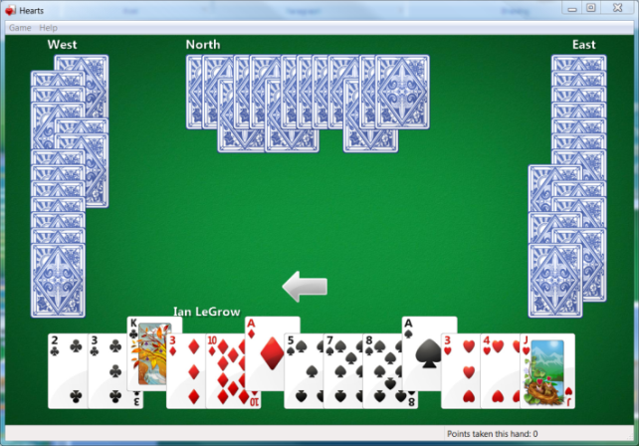
Touch场景和Windows 7
开发平台: At the root is the touch developer platform that exposes touch APIs for any application
界面的增强: Focusing on the core scenarios, many parts of the core UI have been optimized for touch experiences
手势(Gestures): Multi-touch gestures have been added to enable consistent panning and zooming in most applications.
应用程序(Applications): A set of multi-touch focused applications that demonstrate the power of touch will ship separately from Windows 7
There are several key scenarios for multi-touch
Navigating and consuming the Web
Reading and sorting email
Viewing photos
Playing casual games
Consuming music and video
Navigating files and arranging windows
Using Microsoft Office applications
All focused on consumption

Slide 8
Multi-Touch开发的不同模式 Good – Better – Best
Windows应用程序选择三个级别的Touch集成
Good：无需使用Touch API，但是应用程序的界面能够正确响应内建的手势(gestures)
Better：支持手势(Gesture) API，能够自然流畅的交互
Best：完全针对触摸(Touch)而设计的用户体验，使用了多点触摸(Multi-touch)的特性

Slide 9
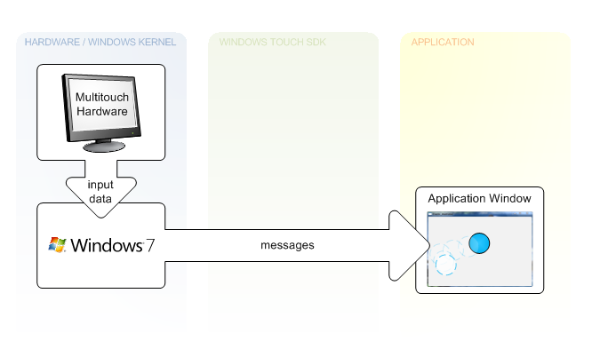
架构概览 Windows消息
WM_TOUCH
TOUCHEVENTF_MOVE
TOUCHEVENTF_DOWN
TOUCHEVENTF_UP
…
WM_GESTURE
GID_ZOOM
GID_PAN
GID_ROTATE
GID_TWOFINGERTAP
GID_PRESSANDTAP

Slide 10
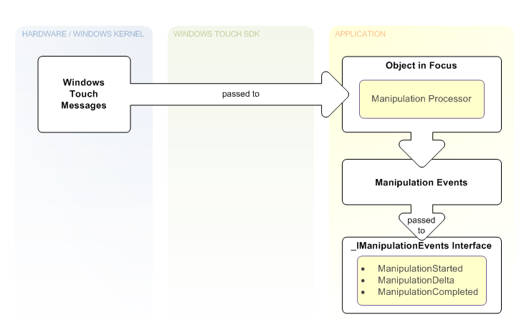
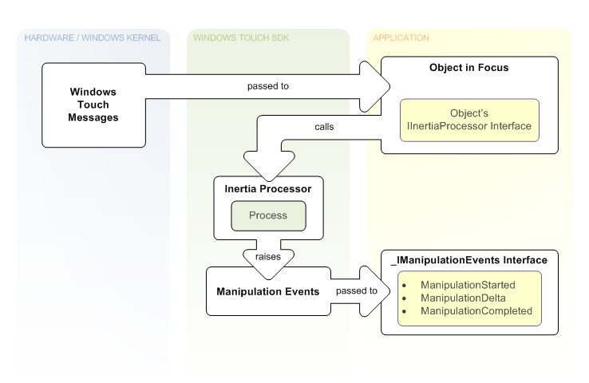
架构概览 多出操作（Manipulations）和惯性（Inertia）

Slide 11
Touch 开发路线图
Windows 7 Release
NET 4.0 / Surface 2.0 Release
Native
Win32
application
WinForms application
WPF application
Surface application
Surface SDK
1.0
Surface SDK 2.0
Surface
multi-touch controls and API
Multi-touch controls
Multi-touch API
Managed wrapper and interoperability
WPF 3.5 SP1
WPF 4.0
Managed wrapper and interoperability
WPF 3.5
Multi-touch API and controls
Surface Hardware
Windows 7
Windows 7
Surface hardware
Windows Vista
Multi-touch API

Slide 12
Multi-Touch开发的不同模式 Good – Better – Best
 | Good
APIs | For Free! 平移/缩放手势 右键手势
Native Win32 | 标准scrollbars控件
WPF | WPF 3.5 SP1 API代码库 WPF 4.0 完全支持 + 控件
WinForms | 标准scrollbars控件
Better
Gesture notifications 平移/缩放/旋转 其他…
WM_GESTURE消息
手势(Gesture)事件 惯性(Inertia)配置
通过互操作处理WM_GESTURE消息
Best
原始的触摸数据 多出操作(Manipulation)和惯性(Inertia)处理器
WM_TOUCH消息 基于COM的多出操作(Manipulation)和惯性(Inertia)处理器
触摸(Touch)事件 多出操作(Manipulation)和惯性(Inertia)处理器
通过与COM互操作使用多触操作(Manipulation)和惯性(Inertia)处理器

Slide 13
检测数位板（Digitizer）的能力
Passing SM_DIGITIZER to GetSystemMetrics() returns a bit field:
0x01 | 0x02 | 0x04 | 0x08 | 0x10 | 0x20 | 0x40 | 0x80 | Bit
Integrated Touch | External Touch | Integrated Pen | External Pen | Reserved | Reserved | Multi input | Stack Ready | Value
// test for touch
int value = GetSystemMetrics(SM_DIGITIZER));
if (value & 0x80){ /* stack ready */}
if (value & 0x40)
{
bMutiTouch = TRUE;/* digitizer is multitouch */
MessageBox(L"Multitouch found", L"IsMulti!", MB_OK);
}
if (value & 0x01){ /* Integrated touch */}

Slide 14
注册Touch XOR Gesture消息
BOOL InitInstance(HINSTANCE hInstance, intnCmdShow)
{
HWND hWnd;
hWnd = CreateWindow(…)
if (!hWnd) return FALSE;
//We will receive WM_GESTURE messages by default
//Calling RegisterTouchWindow stops gesture message
if (bTouchMessages && bMultiTouch)
RegisterTouchWindow(hWnd, 0);
ShowWindow(hWnd, nCmdShow);
UpdateWindow(hWnd);
return TRUE;
}

Slide 15
Win32 Samples
Demo
Windows 7 gesture and touch

Slide 16
WM_TOUCH

Slide 17
WM_TOUCH
类似鼠标消息
将原始的Touch数据传递给Win32应用
使用场景
手指绘图
自定义手势
转送给更高级的控件

Slide 18
处理WM_TOUCH消息
UINT cInputs = LOWORD(wParam);
PTOUCHINPUT pInputs = new TOUCHINPUT[cInputs];
if (pInputs != NULL)
{
if (GetTouchInputInfo((HTOUCHINPUT)lParam, cInputs, pInputs,
sizeof(TOUCHINPUT)))
{
// process pInputs
}
else { … } // error handling
}
else { … } // error handling, presumably out of memory
if (!CloseTouchInputHandle((HTOUCHINPUT)lParam))
{
// error handling
}

Slide 19
TOUCHINPUT消息结构
typedef struct _TOUCHINPUT {
LONG x;
LONG y;
HANDLE hSource; //Device Handle
DWORD dwID; //区分特定TouchInput的ID
DWORD dwFlags; //TOUCHEVENTF_* (DOWN, UP, MOVE, INRANGE, PALM)
DWORD dwMask; //TOUCHINPUTMASKF_* (CONTACTAREA, EXTRAINFO, TIMEFROMSYSTEM)
DWORD dwTime;
ULONG_PTR dwExtraInfo;
DWORD cxContact;
DWORD cyContact;
}TOUCHINPUT, *PTOUCHINPUT;

Slide 20
在.NET中使用TouchHandler
public MainForm()
{
InitializeComponent();
_touchHandler =
Factory.CreateHandler<TouchHandler>(this);
_touchHandler.TouchDown += OnTouchDownHandler;
_touchHandler.TouchMove += OnTouchMoveHandler;
_touchHandler.TouchUp += OnTouchUpHandler;
Paint += new PaintEventHandler(this.OnPaintHandler);
}

Slide 21
MTScratchPad
Demo
TouchBridge.TouchHandler

Slide 22
WM_GESTURE

Slide 23
预定义的手势（Gesture） Translate
Two Finger Pan - 两指平移：
SFP – 单指平移
SetGestureConfig() for GC_PAN
Specify GC_PAN_WITH_SINGLE_FINGER_VERTICALLY and/or GC_PAN_WITH_SINGLE_FINGER_HORIZONTALLY

Slide 24
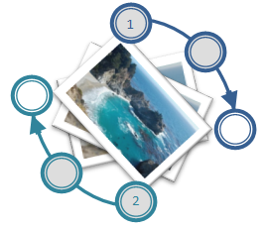
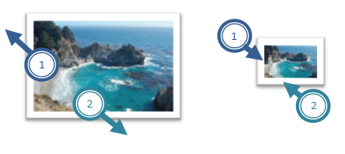
缩放（Zoom）和旋转（Rotate）
旋转（Rotate）
Touch the image with two fingers and turn fingers in a circle
缩放（Zoom）
Touch the image with two fingers and move them closer or further apart

Slide 25
Two Finger Tap and PressAndTap
Two Finger Tap
Tap once with both fingers
Press and Tap
Place one finger on the screen, place second finger on the screen, lift the second finger, and then lift the first finger

Slide 26
手势（Gesture）配置
应用程序默认接受所有的手势（Gesture）消息
你可以配置发送的手势（Gesture）类型:
BOOL WINAPI SetGestureConfig(HWND hWnd, DWORD dwReserved, UINT cIDs, PGESTURECONFIG pGestureConfig, UINT cbSize)
This API gets an array of GESTURECONFIG structures
cbSizeis the size of the array, cIDs is the length
dwReserved保留参数应该是0

Slide 27
GESTURECONFIG结构
typedefstruct _GESTURECONFIG { DWORD dwID; //One of GID_* (0, ZOOM, PAN, // ROTATE, TWOFINGERTAP, ROLLOVER DWORD dwWant; //One of GC_* (ALLGESTURES, // ZOOM, PAN, PAN_*, ROTATE, // TWOFINGERTAP, ROLLOVER
DWORD dwBlock; //Same arguments as dwWant // but block the message
} GESTURECONFIG, *PGESTURECONFIG;

Slide 28
配置hWnd接受所有的手势(Gestures)
GESTURECONFIG gestureConfig;
gestureConfig.dwID = 0;
gestureConfig.dwBlock = 0;
gestureConfig.dwWant = GC_ALLGESTURES;
SetGestureConfig(hWnd, 0, 1,
&gestureConfig,
sizeof(gestureConfig));

Slide 29
动态的改变手势（Gesture）配置
WM_GESTURENOTIFY消息表示：将要接收一个手势消息
case WM_GESTURENOTIFY:
{
GESTURECONFIG gc = {0,GC_ALLGESTURES,0};
SetGestureConfig(hWnd, 0, 1, &gc,
sizeof(GESTURECONFIG));
}
break;

Slide 30
WM_GESTURE消息
GESTUREINFO gi;
gi.cbSize = sizeof(GESTUREINFO);
gi.dwFlags = 0; gi.ptsLocation.x = 0; …
GetGestureInfo((HGESTUREINFO)lParam, &gi);
// now interpret the gesture
switch (gi.dwID){
case GID_ZOOM:
// Code for zooming goes here
break;
case GID_PAN:
// Code for panning goes here
break;
case GID_ROTATE: …
}
CloseGestureInfoHandle((HGESTUREINFO)lParam);

Slide 31
GESTUREINFO结构
typedefstruct _GESTUREINFO
{
UINT cbSize;
DWORD dwFlags; //GF_* (BEGIN, INERTIA, END)
DWORD dwID; //GID_* (BEGIN, END, ZOOM, PAN,
//ROTATE, TWOFINGERTAP, ROLLOVER)
HWND hwndTarget;
POINTS ptsLocation;
DWORD dwInstanceID;
DWORD dwSequenceID;
ULONGLONG ullArguments; //8 Bytes Gesture Arg
UINT cbExtraArgs;
} GESTUREINFO, *PGESTUREINFO;

Slide 32
处理Gesture消息
(dwFlags & GF_BEGIN) != 0
Indicates that this is a new gesture
If dwFlags is 0 (or GF_INERTIA)
For Pan:
We have to calculate the translation delta since last message
For Rotate:
We have to calculate the angle delta since last message
For Zoom:
We have to calculate the zoom factor delta since last message

Slide 33
WM_GESTURE消息的顺序

Slide 34
Multi-Touch与.NET Framework
WPF
Interop sample library for .NET Framework 3.5
Multi-touch, gesture, Inertia, Manipulation
.NET Framework 4.0 release
新的控件将支持Multi-touch
WinForms (Windows 7 launch)
Interoperability to native Win32 APIs – TouchWrapper

Slide 35
The Windows Integration Library
Windows7.Multitouch.Handler
A base class for Touch and Gesture handlers
Use Factory to create one of the handlers
For WinForm, managed Win32 hWnd, and WPF gesture support the handler subclass the Window (hWnd)
For WPF touch support, use stylus event with the help of the Factory.EnableStylusEvents() method

Slide 36
Using the GestureHandler
public MainForm()
{
InitializeComponent();
…
_gestureHandler = TouchBridge.Handler.
CreateHandler<TouchBridge.GestureHandler>(this);
_gestureHandler.Pan += ProcessPan;
_gestureHandler.PanBegin += ProcessPan;
_gestureHandler.PanEnd += ProcessPan;
_gestureHandler.Rotate += ProcessRotate;
_gestureHandler.RollOver += ProcessRollOver;
_gestureHandler.TwoFingerTap += ProcessTwoFingerTap;
_gestureHandler.Zoom += ProcessZoom;
}

Slide 37
MTGesture
Demo
Windows7.Multitouch.GestureHandler

Slide 38
Manipulations Inertia

Slide 39
多触操作 Manipulations
Manipulations are a great foundation for touch-optimized experiences. They are
2D affine transformations (translate, scale, rotate)
Superset of supported gestures
Supports multiple concurrent manipulations
Need a source of raw data: WM_TOUCH
Similar to Surface APIs
Interfaces
IManipulationProcessor
IManipulationEvents

Slide 40
惯性 Inertia
Provides basic physics
Works hand in hand with manipulations
Interfaces
IInertiaProcessor
IManipulationEvents – Same event interface as manipulations

Slide 41
Windows7 Integration Library Manipulation
A .NET wrapper
You need to forward touch events
You get back manipulation events
Be ready to process translation, rotation and expansion all together
If there are many objects on the screen
Find a good heuristic to decide which object to move

Slide 42
Using Manipulation
public MainForm()
{
InitializeComponent();
_touchHandler = Factory.CreateHandler<TouchHandler>(this);
_processor = new
ManipulationProcessor(ProcessorManipulations.ALL);
_objectList = new List<DrawingObject> { … };
_touchHandler.TouchDown += (s,e ) =>
{ _processor.ProcessDown((uint)e.Id, e.Location); };
_touchHandler.TouchUp += (s, e) =>
{ _processor.ProcessUp((uint)e.Id, e.Location); };
_touchHandler.TouchMove += (s, e) =>
{ _processor.ProcessMove((uint)e.Id, e.Location); };
_processor.ManipulationDelta += ProcessManipulationDelta;
_processor.PivotRadius = 2;
}

Slide 43
Using Manipulation
private void ProcessManipulationDelta(object sender,
ManipulationDeltaEventArgs e)
{
DrawingObjectobj = FindObject(Point.Round(e.Location));
if (obj == null) return;
obj.Move(e.TranslationDelta.ToSize());
obj.Rotate(e.RotationDelta, Point.Round(e.Location));
obj.Zoom(e.ScaleDelta, Point.Round(e.Location));
Invalidate();
}

Slide 44
Manipulation
Demo
mtManipulation

Slide 45
Windows7 Integration Library Inertia
The integration library offers a Manipulation Processor with Inertia capabilities
It is derived from the ManipulationProcessor
It has the InertiaProcessor property that returns the inner inertia processor
You should find good values as an input to the inertia processor
Initial Translation, Rotation and Expansion Velocities
Deceleration velocity for each of them

Slide 46
惯性（Inertia）
Demo
mtInertia

Slide 47
WPF对Multi-Touch的支持
UIElement和UIElement3D的改善
手势（Gesture）事件 (tracking)
Touch system gesture events (single)
原始的触点（Touch）事件
控件对多点触摸（Multi-touch）的支持
ScrollViewer升级后接收平移手势（Pan Gestures）
基本控件升级后Multi-touch aware
支持Multi-capture
新的多点触摸（multi-touch）特定控件
与Surface SDK 2.0兼容

Slide 48
演 示
TOUCH PACK

