Slide 2
微软必应Bing与AdCenter平台概览
WUX220

Slide 3
议题
必应Bing介绍
必应Bing API 介绍

Slide 4
关于必应 Bing
微软对搜索服务进行了大规模的更新
今年六月份首次推出
在中国叫“必应”
由在北京的亚洲搜索技术中心开发
包含了微软亚洲研究院和微软全球开发团队的贡献
还在试用阶段

Slide 5
用户更依赖于搜索
但满意度并没有提高
人们大量地依靠搜索来完成每天工作…
…数量在不断增长
8%
Growth
in Users
March 2009
202 Million
March 2008
188 Million
% who do this on a typical day
…越来越多地使用搜索
…可是对搜索的满意度有待提高
30%
Growth
in Visits
March 2009
30 visits per searcher
68%
65%
March 2008
2005
2008
23 visits per searcher
Sources: Pew Research Center; ComScore; Harris Poll

Slide 6
每次搜索都有要做决定的倾向
用户更依赖搜索
做决定的搜索时间长
Q. In the past six months have you used a search engine to help inform your decisions for the following tasks?
Length of Sessions by Type
66%
of people are using search more frequently to make decisions
用户在完成任务和做决定时需要帮助
复杂任务和做决定的搜索可以更容易一些
Sources: Microsoft Internal Research conducted by iPos 2009:; Live Search Session Analysis

Slide 7
搜索结果应该更好
四个查询中只有一个给出成功的结果
Abandonment 15%
Algorithmic Not Sat, 14%
2
3
Algo Partial Sat, 10%
重复查询和提炼
完全放弃
快速往回点击
Requery
14%
1
Pagination
10%
Algo Sat
23%
Others
8%
Answer Sat
2%
Ad Sat
4%
Source: Microsoft Analysis of Industry Data

Slide 8

创新的机会
搜索挑战
机会
用户不满意
结果不能满足意图
很多点击浪费了
重复的去搜
更好的结果
用户想要在搜索中得到帮助
用法在搜索过程中不在查询里
一半的时间花在长时间搜索里
提炼或重复查询占相当多的时间
有序的体验
越来越多的搜索着重于任务和做决定
更多用户依靠搜索来做决定
用户专心于完成任务
搜索没有被优化成任务和做决定的工具
做决定的工具

Slide 9
我们的目标
更好地理解用户意图
帮助搜索者在完成任务和做决定上取得更大成功
Your Benefit (Webmaster & Publishers)
让更多的搜索流量有意义
大多数查询也能得到小范围特殊内容

Slide 10
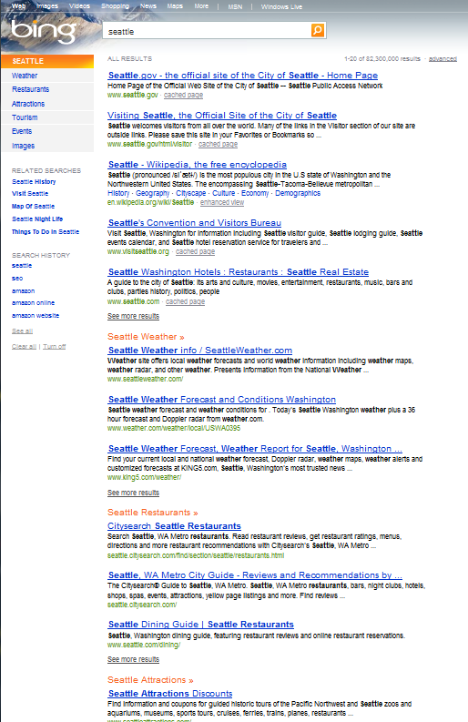
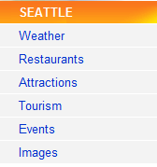
分类的结果
覆盖20% 的查询
从最常用的20%查询开始
根据对查询意图的分析定期更新类别
每个查询的类别是独特的但相近的实体的类别也相似（例如：城市，篮球名星）
分类的结果的点击率高于一般算法结果

Slide 11
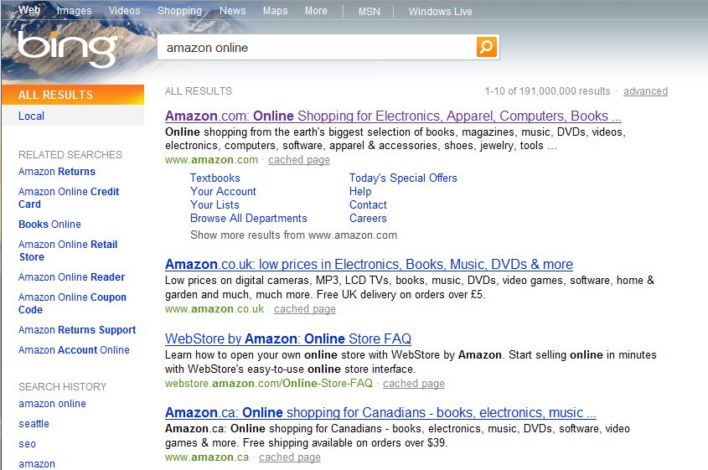
最好的结果 – 有一些确定

Slide 12
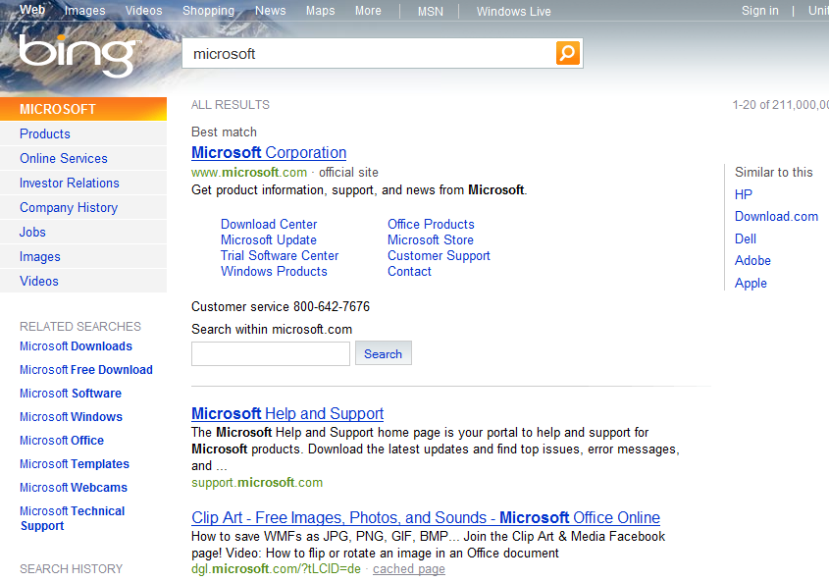
最好的结果 – 比较确定

Slide 13
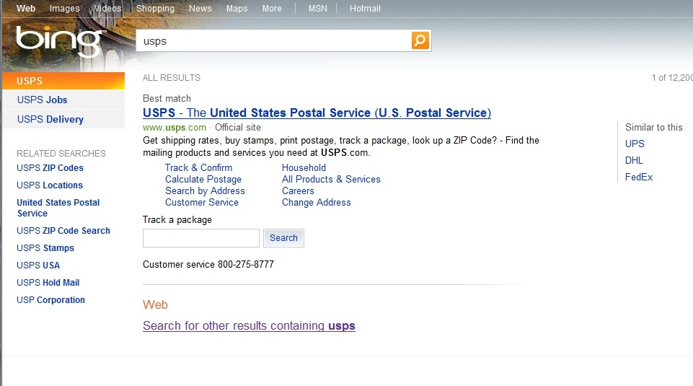
超好的结果 – 很确定

Slide 14
演 示
必应Bing

Slide 15
必应Bing API: 扩大你的网站潜力
提高互动性
强大、灵活、免费的 API 把新的内容拉入你的网站并让你根据你的站点来定制
可以作为可定制组件来嵌入
可接触到新的内容来源和类型
可根据需要来调整搜索结果的风格
包括XML、JSON、RSS 格式和 SOAP API
和查询相关的内容，例如图片、新闻、和网络结果
使用灵活，查询没有每天的上限，搜索结果的排序及格式也没有限制

Slide 16


把必应Bing API 作为内容服务
Finance Data
Many, many more…
Finance Data
Reference data index
Many, many more…
Reference data index
Web Index
Weather data
Weather data
Web Index
News Index
Image Index
Video Index
Image Index
News Index
Video Index

Slide 17












哪些合作伙伴在使用必应Bing API

Slide 18
演 示
必应Bing API

Slide 19
Introduction to adCenter

Slide 20
World Wide Online Ad Market Sizing, FY07 – FY13

Slide 21
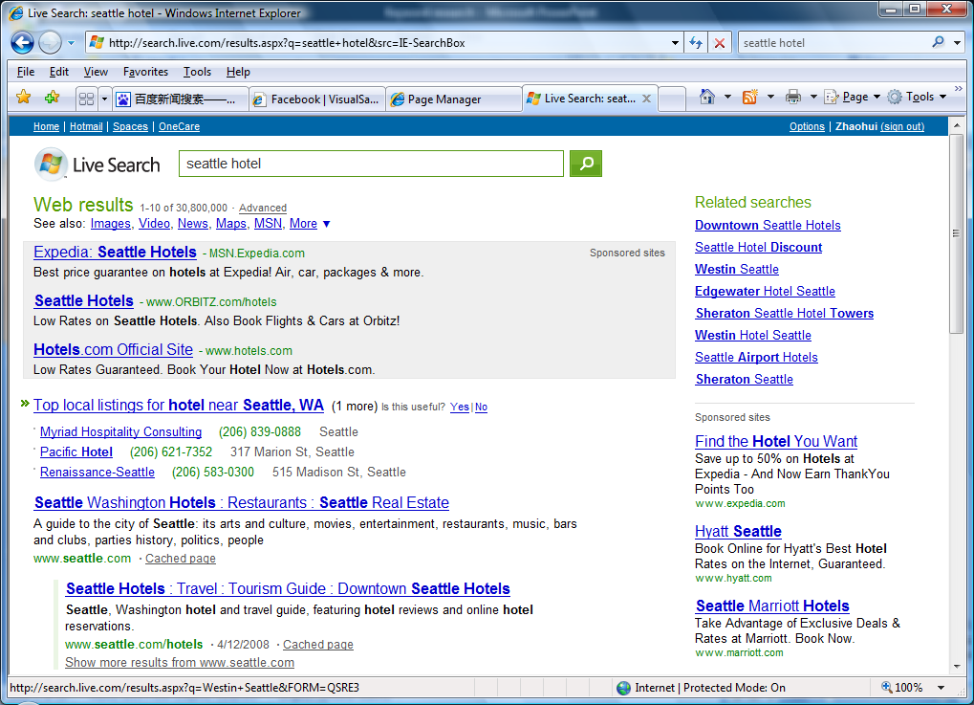
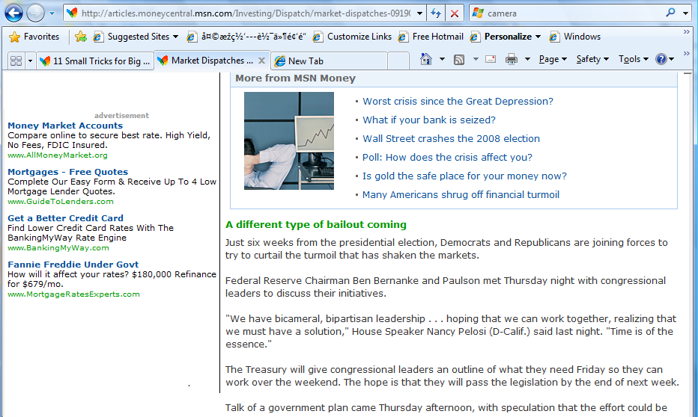
From Query to Search Ads
Estimated
CTR
Seattle, Hotel
Seattle hotel
Quality
Score
Seattle Hotel
Bidding
database
Targeting
Expansion
Price
…

Slide 22



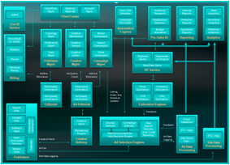



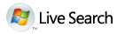




Who are the parties involved in the Ad Ecosystem?
Publishers Sell Ads, via
  Online content
    CNN, Wall Street Journal, MSN
    Bloggers
  Online Applications
    Search, Email, Calendars…
  Non-Browser Applications
    Windows Live Messenger
Advertisers Buy Ads
  Businesses of all sizes
    Big businesses: Ford, Proctor & Gamble, Toyota
    Small businesses: Local Florist, Travel Agent, Real Estate Agent
  Many customers use Agencies to optimize campaigns
Customers
Ad Platforms connect buyers & sellers
IM

Slide 23
Who are the parties involved in the Ad Ecosystem?
Publishers Sell Ads, via
  Online content
    CNN, Wall Street Journal, MSN
    Bloggers
  Online Applications
    Search, Email, Calendars…
  Non-Browser Applications
    Windows Live Messenger
Advertisers Buy Ads
  Businesses of all sizes
    Big businesses: Ford, Proctor & Gamble, Toyota
    Small businesses: Local Florist, Travel Agent, Real Estate Agent
  Many customers use Agencies to optimize campaigns
Customers
Ad Platforms connect buyers & sellers
IM

Slide 24
Who are the parties involved in the Ad Ecosystem?
Publishers Sell Ads, via
  Online content
    CNN, Wall Street Journal, MSN
    Bloggers
  Online Applications
    Search, Email, Calendars…
  Non-Browser Applications
    Windows Live Messenger
Advertisers Buy Ads
  Businesses of all sizes
    Big businesses: Ford, Proctor & Gamble, Toyota
    Small businesses: Local Florist, Travel Agent, Real Estate Agent
  Many customers use Agencies to optimize campaigns
Customers
Ad Platforms connect buyers & sellers
IM

Slide 25
Who are the parties involved in the Ad Ecosystem?
Publishers Sell Ads, via
  Online content
    CNN, Wall Street Journal, MSN
    Bloggers
  Online Applications
    Search, Email, Calendars…
  Non-Browser Applications
    Windows Live Messenger
Advertisers Buy Ads
  Businesses of all sizes
    Big businesses: Ford, Proctor & Gamble, Toyota
    Small businesses: Local Florist, Travel Agent, Real Estate Agent
  Many customers use Agencies to optimize campaigns
Customers
Ad Platforms connect buyers & sellers
IM

Slide 26
Who are the parties involved in the Ad Ecosystem?
Publishers Sell Ads, via
  Online content
    CNN, Wall Street Journal, MSN
    Bloggers
  Online Applications
    Search, Email, Calendars…
  Non-Browser Applications
    Windows Live Messenger
Advertisers Buy Ads
  Businesses of all sizes
    Big businesses: Ford, Proctor & Gamble, Toyota
    Small businesses: Local Florist, Travel Agent, Real Estate Agent
  Many customers use Agencies to optimize campaigns
Customers
Ad Platforms connect buyers & sellers
IM

Slide 27
Who are the parties involved in the Ad Ecosystem?
Publishers Sell Ads, via
  Online content
    CNN, Wall Street Journal, MSN
    Bloggers
  Online Applications
    Search, Email, Calendars…
  Non-Browser Applications
    Windows Live Messenger
Advertisers Buy Ads
  Businesses of all sizes
    Big businesses: Ford, Proctor & Gamble, Toyota
    Small businesses: Local Florist, Travel Agent, Real Estate Agent
  Many customers use Agencies to optimize campaigns
Customers
Ad Platforms connect buyers & sellers
IM

Slide 28
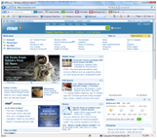

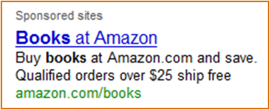



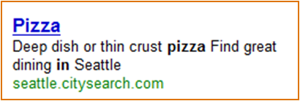
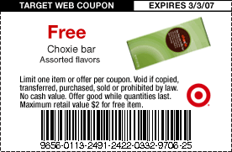
Types of Ads for Sale
“Banner Ads” “Rich Media”
Ad Types
Online
  Display
  Search
  Content
  Local / Mobile
Offline
  Print
  TV / Radio (mostly)
  Newspaper
“Books”
“Relevance”
“Pizza in Seattle”
Joe’s Pizza
$5.00 off any Large Pizza

Slide 29
Types of Ads for Sale
“Banner Ads” “Rich Media”
Ad Types
Online
  Display
  Search
  Content
  Local / Mobile
Offline
  Print
  TV / Radio (mostly)
  Newspaper
“Books”
“Relevance”
“Pizza in Seattle”
Joe’s Pizza
$5.00 off any Large Pizza

Slide 30
Types of Ads for Sale
“Banner Ads” “Rich Media”
Ad Types
Online
  Display
  Search
  Content
  Local / Mobile
Offline
  Print
  TV / Radio (mostly)
  Newspaper
“Books”
“Relevance”
“Pizza in Seattle”
Joe’s Pizza
$5.00 off any Large Pizza

Slide 31
Types of Ads for Sale
“Banner Ads” “Rich Media”
Ad Types
Online
  Display
  Search
  Content
  Local / Mobile
Offline
  Print
  TV / Radio (mostly)
  Newspaper
“Books”
“Relevance”
“Pizza in Seattle”
Joe’s Pizza
$5.00 off any Large Pizza

Slide 32
Types of Ads for Sale
“Banner Ads” “Rich Media”
Ad Types
Online
  Display
  Search
  Content
  Local / Mobile
Offline
  Print
  TV / Radio (mostly)
  Newspaper
“Books”
“Relevance”
“Pizza in Seattle”
Joe’s Pizza
$5.00 off any Large Pizza

Slide 33
Types of Ads for Sale
“Banner Ads” “Rich Media”
Ad Types
Online
  Display
  Search
  Content
  Local / Mobile
Offline
  Print
  TV / Radio (mostly)
  Newspaper
“Books”
“Relevance”
“Pizza in Seattle”
Joe’s Pizza
$5.00 off any Large Pizza

Slide 34
How do Advertisers pay for ads?
Pricing Model | Description | Common Values
CPM | Cost per Mille, or Thousand Impressions, often negotiated. Commonplace in Display Ads. | $0.10 to $20, depending on the value of the targeting
CPC | Cost per Click, often sold via auction. Commonplace in Search and Content Ads. | $0.05 to a few dollars, depending on the keywords (auction)
CPA | Cost per Action [also Acquisition] Actions could be web form completion, click to call, mouse-over, video playback, product purchase on advertiser’s site, print a coupon for in-person purchase | High value (often dollars), depends on what was purchased or action taken

Slide 35
What is a Click worth?
Here are some example values by keyword(s) on our network. Average CPC represents actual clicks against auctioned keywords. Many advertisers may have bid higher – the top ranked position isn’t always the one that gets clicked.
Keyword(s) | Average CPC
Hilton Hotel | $ 0.40
Pizza | $ 0.90
Books | $ 0.96
Sports | $ 1.06
Diamond Ring | $ 1.24
Washington Mortgage | $ 1.31
Autos | $ 1.32
Hotel | $ 1.44
Diamond Engagement Ring | $ 1.53
Dating | $ 1.67
HDTV | $ 1.67
Tokyo Hotel | $ 1.97
California Mortgage | $ 3.92

Slide 36
What is a Click worth?
Sometimes being more specific is more valuable since it tells more about your search intent.
Keyword(s) | Average CPC
Hilton Hotel | $ 0.40
Pizza | $ 0.90
Books | $ 0.96
Sports | $ 1.06
Diamond Ring | $ 1.24
Washington Mortgage | $ 1.31
Autos | $ 1.32
Hotel | $ 1.44
Diamond Engagement Ring | $ 1.53
Dating | $ 1.67
HDTV | $ 1.67
Tokyo Hotel | $ 1.97
California Mortgage | $ 3.92
Specific
More Specific

Slide 37
What is a Click worth?
On other occasions a very specific search may be cheaper if it lowers bid density – the number of advertisers willing to bid on those keywords.
Keyword(s) | Average CPC
Hilton Hotel | $ 0.40
Pizza | $ 0.90
Books | $ 0.96
Sports | $ 1.06
Diamond Ring | $ 1.24
Washington Mortgage | $ 1.31
Autos | $ 1.32
Hotel | $ 1.44
Diamond Engagement Ring | $ 1.53
Dating | $ 1.67
HDTV | $ 1.67
Tokyo Hotel | $ 1.97
California Mortgage | $ 3.92
Lower Bid Density
Higher Bid Density

Slide 38
What is a Click worth?
Keyword(s) | Average CPC
Hilton Hotel | $ 0.40
Pizza | $ 0.90
Books | $ 0.96
Sports | $ 1.06
Diamond Ring | $ 1.24
Washington Mortgage | $ 1.31
Autos | $ 1.32
Hotel | $ 1.44
Diamond Engagement Ring | $ 1.53
Dating | $ 1.67
HDTV | $ 1.67
Tokyo Hotel | $ 1.97
California Mortgage | $ 3.92
In addition to bid density some keywords also have their worth influenced by the value of the prospective transaction.

Slide 39
A Day in the Life of a Click
A Data Flow Perspective

Slide 40
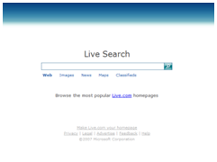
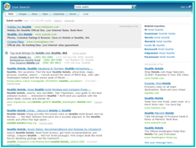
Search Ads, aka "Paid Search"
Advertisers
User enters Campaign, Budget, Keywords, Bids, Ads, Etc.
Customer Mgmt
Campaign Mgmt
Editorial Validation
Publisher
Cust
CM
Budget Pause
EV
Feed
Ad call
Delivery Engine
Budget Pause
Auction
Click!
adCenter BI Reports
Valid Clicks
Auction Billing
dr
Invoicing
Card Swipes
Revenue Feeds
dr
dr
dr
Pipelines
Bill
Redirect Servers
cr
Aggregations
Fraud Credits
[ Pub Acct, Adv Acct, Order, AdUnit, Medium]
To Advertiser’s Site

Slide 41
Customer Sign Up
Customer Mgmt
Campaign Mgmt
Editorial Validation
Publisher
Cust
CM
Budget Pause
EV
Feed
Perform Customer Sign Up, provide:
Address, Credit Card, User ID
Ad call
Delivery Engine
Budget Pause
Auction
Click!
adCenter BI Reports
Valid Clicks
Auction Billing
dr
Invoicing
Card Swipes
Revenue Feeds
dr
dr
dr
Pipelines
Bill
Redirect Servers
cr
Aggregations
Fraud Credits
[ Pub Acct, Adv Acct, Order, AdUnit, Medium]
To Advertiser’s Site

Slide 42
Campaign Management
Advertiser
Campaign Mgmt
Customer Mgmt
Editorial Validation
Publisher
Cust
CM
CM
EV
CM
CM
Budget Pause
CM
CM
CM
CM
Feed
User enters Campaign, Budget, Keywords, Bids, Ads, Ad Text, Destination URLs, Targeting, etc.
Ad call
Delivery Engine
Budget Pause
Auction
Click!
adCenter BI Reports
Valid Clicks
Auction Billing
dr
Invoicing
Card Swipes
Revenue Feeds
dr
dr
dr
Pipelines
Bill
Redirect Servers
cr
Aggregations
Fraud Credits
[ Pub Acct, Adv Acct, Order, AdUnit, Medium]
To Advertiser’s Site
Billions of Keywords exist in our databases. Consider all the permutations of book titles, CDs, product names, ISBNs, SKUs, …

Slide 43
Editorial Validation
Editorial Validation
Customer Mgmt
Campaign Mgmt
Publisher
Cust
CM
Budget Pause
EV
Feed
Ad call
Delivery Engine
Risk Management
Relevance
Appropriate use
Legal
Budget Pause
Auction
Click!
adCenter BI Reports
Valid Clicks
Auction Billing
dr
Invoicing
Card Swipes
Revenue Feeds
dr
dr
dr
Pipelines
Bill
Redirect Servers
cr
Aggregations
Fraud Credits
[ Pub Acct, Adv Acct, Order, AdUnit, Medium]
To Advertiser’s Site

Slide 44
Ad Delivery via "Delivery Engines"
Advertisers
User enters Campaign, Budget, Keywords, Bids, Ads, Etc.
Real Time Auction
<10 ms Response Time
Partitioned structures, entirely in memory
Relevance & Ranking
Impression & CTR History
Many 9’s of uptime
Budget Pause
Algorithms from adLabs researchers
Auction currency, common units of measure to handle CPM, CPC, CPA bids
Customer Mgmt
Campaign Mgmt
Editorial Validation
Publisher
Cust
CM
Budget Pause
EV
Feed
Ad call
Delivery Engines
Budget Pause
Auction
Click!
adCenter BI Reports
Valid Clicks
Auction Billing
dr
dr
dr
dr
Pipelines
Bill
Redirect Servers
cr
Aggregations
Fraud Credits
[ Pub Acct, Adv Acct, Order, AdUnit, Medium]
To Advertiser’s Site

Slide 45
Click, Redirection and Logging
Advertisers
User enters Campaign, Budget, Keywords, Bids, Ads, Etc.
Customer Mgmt
Campaign Mgmt
Editorial Validation
Publisher
Cust
CM
Budget Pause
EV
Feed
Delivery Engine
Redirection required to record the click
Terabytes of logs every day
Ad call
Budget Pause
Auction
Click!
adCenter BI Reports
Valid Clicks
Auction Billing
dr
dr
dr
Logs
Invoicing
Card Swipes
Revenue Feeds
Pipelines
Bill
Redirect Servers
Fraud Credits
Aggregations
[ Pub Acct, Adv Acct, Order, AdUnit, Medium]
To Advertiser’s Site

Slide 46
What's in a Log?
Here is an excerpt from a paid search impression log, schema & data
1 Full Row of Data (scrubbed)
Schema (partial)
Name | Type
ClientIP | StringA(16)
CDate | DBDate
CTime | DBTime
ClientTimeZoneId | Int16
UserAgent | StringA(1024)
PUID | StringA(16)
AnonymousId | StringA(32)
CID | StringA(32)
GUID | StringA(32)
RGUID | StringA(32)
PassportGenderId | StringA(3)
PassportAgeGroupId | StringA(3)
PassportZipCode | StringA(15)
CleanKeyword | String(256)
StartPosition | Int32
ReturnedAdCnt | Int16
ListingIds | StringA(256)
AdIds | StringA(256)
AmountCharged | StringA(256)
MatchTypeIds | StringA(128)
ProbablityOfClicks | StringA(128)
IXRoundTripTime | StringA(20)
[…]
127.0.0.1,09/12/2008,19:00:10,62,71;70;71;71,Mozilla/5.0 (Windows; U; Windows NT 5.1; en-US) AppleWebKit/525.13 (KHTML; like Gecko) Chrome/0.2.149.27 Safari/525.13,-,-,-,-,c6c10f07dd237d4994116d43bce66bce,-,-,-,-,-,-,-,-,190;4090;4862;0;0,unsecured loans;financial news;business;oil;loan;social security;wall street;funds;accounting;stocks,0,4,4,1065526695;425312479;1394567127;640208783,24245260;7556395;38332794;10074130,200;225;800;372,140;146;339;241,1;1;1;1,5;5;5;5,223;214;40;52,&adunitid=936&v=pubm8&w=300&h=250&url=http%3A//www.foo.com/public/us%3Frefresh%3Don&ref=http%3A//www.foo.com/public/us%3Frefresh%3Don&tz=240&cc=2633&dt=1221246008598&uh=1600&uw=2560&uah=1570&uaw=2560&cd=32&npl=15&nmime=68&ja=true&app=Netscape&his=2&plf=Win32,12140,10579,166300,cpc;cpc;cpc;cpc,49,0,-,-,-,-,-,-,1788,1798,190900;20990;269497;32042,59,3,0;0;0;0,FOO_NoBT_NoCrawl,stocks;accounting;stocks;accounting,204461,132729110;58100242;151127140;69746278,0,163;165;187;196,658;769;831;912,-;-;-;-,37548;2300990;37548;2300990,1000;1000;1000;1000,300000;0,2,996,233313,71,329;336,3598,4460;4815;3200;1934,0;0;0;0,0;0;0;0,0;0;0;0,4;4;4;4,1|171|4|46;2|888888|2|254,1;2;3;4,1,0;0;0;0,1;1;1;1,-,4cd2f69083364d123a3a238fe68e0332;d4c143f004d88b7286e6f999dea9d0d7;4cd2f69083364d323a3a238fe68e0332;d4c143f004d88j87k6e6f999dea9d0d7,0;0;0;0,

Slide 47
Click Fraud Analysis
Advertisers
User enters Campaign, Budget, Keywords, Bids, Ads, Etc.
Customer Mgmt
Campaign Mgmt
Editorial Validation
Publisher
Cust
CM
Budget Pause
EV
Feed
Ad call
Delivery Engine
Budget Pause
Auction
Valid Clicks
Click!
dr
adCenter BI Reports
dr
dr
Debits
Auction Billing
Credits
Bill
Invoicing
Card Swipes
Revenue Feeds
Pipelines
Redirect Servers
Aggregations
[ Pub Acct, Adv Acct, Order, AdUnit, Medium]
Fraud Logic
To Advertiser’s Site
Click Fraud analysis seeks to reduce harmful impacts from botnets and other non-human traffic

Slide 48
Aggregation and Reporting
Advertisers
User enters Campaign, Budget, Keywords, Bids, Ads, Etc.
Customer Mgmt
Campaign Mgmt
Editorial Validation
Publisher
Cust
CM
Budget Pause
EV
Feed
Performance Reporting
Granularity is down to the Keyword
Partitioned for scale
Ad call
Delivery Engine
Budget Pause
Auction
BI / Reports
Click!
Valid Clicks
Auction Billing
dr
Invoicing
Card Swipes
Revenue Feeds
dr
dr
dr
Pipelines
Bill
Redirect Servers
cr
Fraud Credits
Aggregations
[ Pub Acct, Adv Acct, Order, AdUnit, Medium]
To Advertiser’s Site
[ Pub Acct, Adv Acct, Order, AdUnit, Medium, Keyword]

Slide 49
Billing
Advertisers
User enters Campaign, Budget, Keywords, Bids, Ads, Etc.
Customer Mgmt
Campaign Mgmt
Transactions are ‘Rated’ at Auction
Billing calculates commission splits & recognizes revenue
Invoice Presentment
Fine Grained budget pause
Editorial Validation
Publisher
Cust
CM
Budget Pause
EV
Feed
Ad call
Delivery Engine
Budget Pause
Auction
Click!
adCenter BI Reports
Auction Billing
Valid Clicks
dr
Bill
Invoicing
Card Swipes
Revenue Feeds
dr
dr
dr
Pipelines
Redirect Servers
cr
Aggregations
Fraud Credits
[ Pub Acct, Adv Acct, Order, AdUnit, Medium]
To Advertiser’s Site

Slide 50
Search Ads, aka "Paid Search"
Advertisers
User enters Campaign, Budget, Keywords, Bids, Ads, Etc.
Customer Mgmt
Campaign Mgmt
Editorial Validation
Publisher
Cust
CM
Budget Pause
EV
Feed
Ad call
Delivery Engine
Budget Pause
Auction
Click!
adCenter BI Reports
Valid Clicks
Auction Billing
dr
Invoicing
Card Swipes
Revenue Feeds
dr
dr
dr
Pipelines
Bill
Redirect Servers
cr
Aggregations
Fraud Credits
[ Pub Acct, Adv Acct, Order, AdUnit, Medium]
To Advertiser’s Site

Slide 51
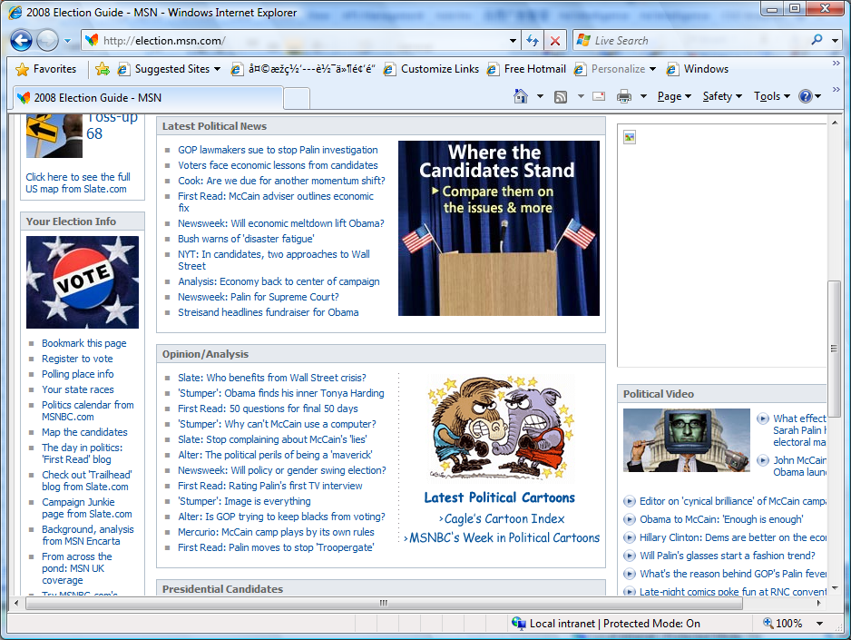
Keyword Extraction
Term | Relevance
obama | 0.772
john mccain | 0.611
presidential candidate | 0.322
election | 0.307
hillary clinton | 0.224
election systems | 0.224
political parties | 0.222
candidates | 0.208
palin | 0.13
campaign | 0.12
white house | 0.119
wall street | 0.114
latest political news | 0.11
…

Slide 52
Expansion “car” from different angles
User Search association
Advertiser Campaign association
Contained query
Suggestion | Relevance
Honda | 0.90
Toyota | 0.88
Ford | 075
Camera | 0.74
Honda Accord | 0.70
…
Suggestion | Relevance
Auto | 0.98
Automobile | 0.92
SUV | 0.90
Auto reviews | 0.88
Truck | 0.80
…
Suggestion | Relevance
Cars | 0.90
Rent a car | 0.88
Buy a car | 075
New car | 0.74
Car insurance | 0.70
…
From vertical, from performance (CTR, CPC), from semantic, combination…

Slide 53
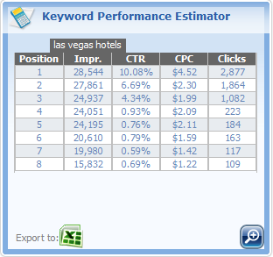
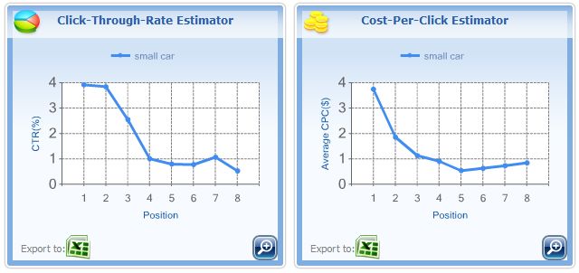
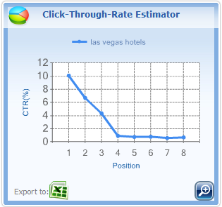
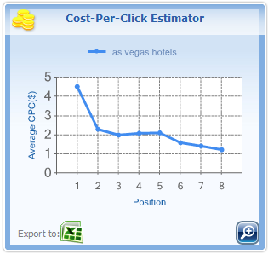
Keyword Monetization, Performance and Traffic
Query: “Las Vegas Hotels”

Slide 54
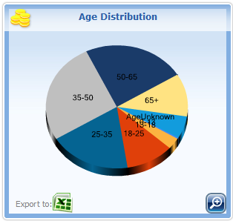
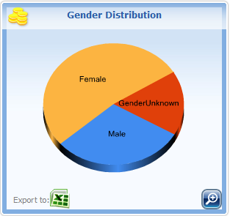
Keyword Demographics
Query “Minivan”:

Slide 55
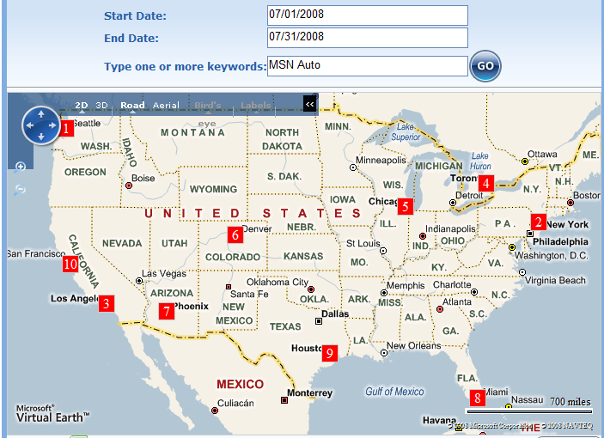
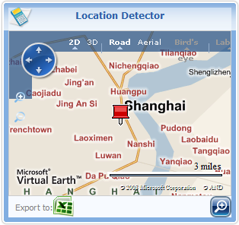
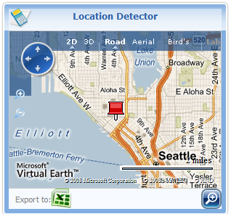
Geography
Query location detection
“Oriental Pearl”
Query distribution: “MSN Auto”
Query location detection
“Restaurants near Space Needle”

Slide 56

Keyword Commercial Intension
Term | Intension
Credit card | 0.90
Digital camera | 0.88
Map | 0.11
Microsoft | 0.48
Laptop | 0.86
Flower | 0.91
Nanjing International Conference Center | 0.06
…

Slide 57
Demo – adCenter Keyword Services Platform

Slide 58
如何开始…
先注册再来使用必应Bing API
报名使用Webmaster Tools
审查我们的使用条例
连接支持内容如 adCenter
加入我们的论坛和博客
在 http://bing.com/toolbox/developers 上拿到AppID
提交你的网址并得到 SEO tools http://bing.com/toolbox/webmasters
接受Bing API 和 Ad-serving 要遵循我们的 Terms of Use
取得支持内容, adCenter 在 Bing Toolbox 网站有更多
注意: Ad-serving 只在美国有，还在试行

Slide 59
参考资源
Bing工具箱：http://www.bing.com/toolbox/
Bing开发者: http://bing.com/toolbox/developers
Bing社区: http://www.bing.com/community/

Slide 60
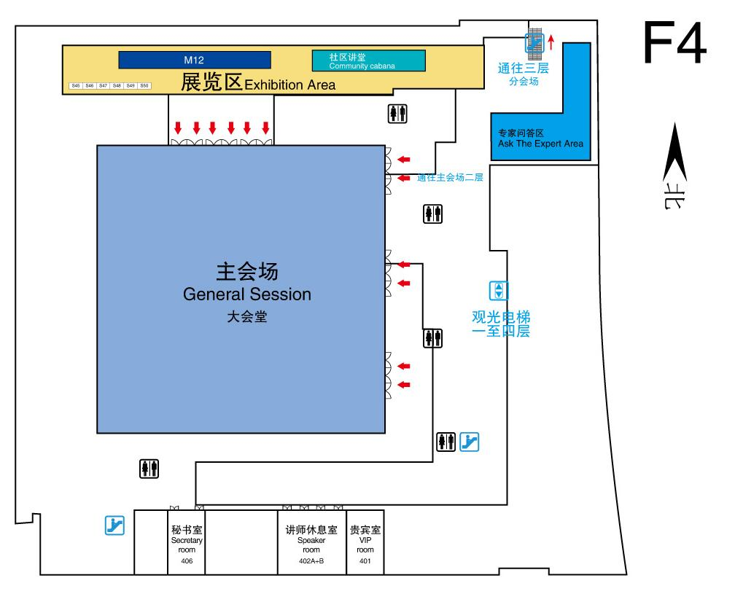
专家问答区 (F4)
本课程结束后，我将在接下来的70分钟内于4层专家问答区与您交流答疑

Slide 62
疑问和解答

