Slide 2
Windows Virtual PC, Windows 7 XP Compatibility mode and Native VHD Support in Windows 7
VIR212

Slide 3
Windows Virtual PC

Slide 4
Virtual PC History
1997 – Virtual PC for Mac 1.0
Focused on running Windows apps on Mac
2001 – Virtual PC 4.0 for Windows
Focused on running legacy applications on Windows 2000 / XP
2003 – Microsoft Virtual PC 2004
Two primary markets: Legacy application compatibility in the Enterprise and Development / Testing
2007 – Microsoft Virtual PC 2007
Add support for 64-bit hosts, hardware virtualization

Slide 5
Key Customer Challenges
“If it doesn’t work with the software I have then it doesn’t work for me.”
“Time is money. I can’t have a slow or unreliable computer. I just can’t have it.”
“I need to know that I’m safe when I go online.”

Slide 6
Windows 7 need to address Windows XP application compatibility concerns…
“When Windows 7 is released later this year or in early 2010, many PC users who upgrade will be coming from Windows XP”
“ … one of the major complaints against Vista aside from the lack of drivers and its significantly higher hardware requirements is its Windows XP compatibility…”
“But what if Windows 7 had perfect Windows XP compatibility?”
“So XP users, unite: Are you going to clamor for extended support? Plan for a Windows 7 migration now?”

Slide 7
Windows Virtual PC Goals
Provide a seamless solution for running Windows XP applications on Windows 7 using virtualization
Maintain existing Virtual PC functionality

Slide 8
Windows Virtual PC Features
Windows XP mode
Select Windows 7 SKUs will include the right to run a Windows XP virtual machine
USB support
Finally!
Seamless Application Mode
Single login
User does not need to know about a virtual machine being present

Slide 9
Windows Virtual PC Features
High levels of integration with Windows 7
Jump list support
Etc…
Smartcard / printer redirection
Scripting interface
Similar to the Virtual Server interface

Slide 10
Windows XP Mode
Business Continuity
Cost Management
Easy to Use
Run many Windows XP productivity applications
Support many Windows XP devices via USB connections
Extend the life of existing Windows XP applications and devices
Reduce learning curve by using familiar applications and devices
Windows XP applications appears on Windows 7 desktop after install
Launch Windows XP applications directly from Windows 7 desktop
Don’t wait and get a PC with Windows 7 Pro now!
With Windows XP Mode and Windows Virtual PC features, it will provide you the flexibility to run many older productivity applications in a virtual Windows XP environment on a Windows 7-based PC

Slide 11
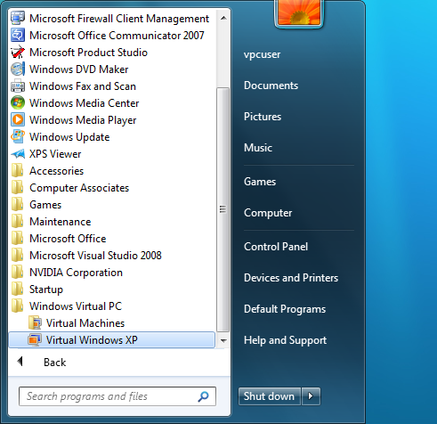
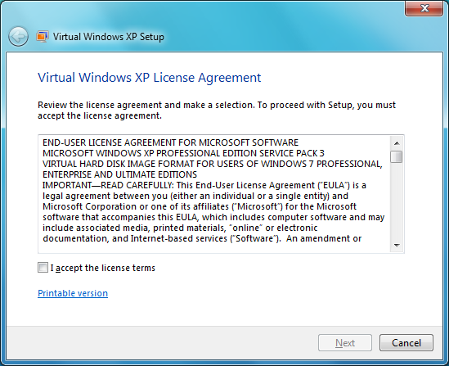
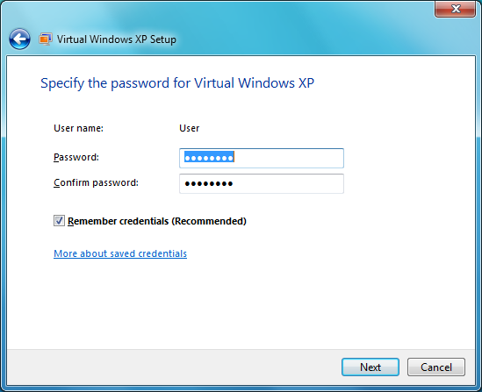
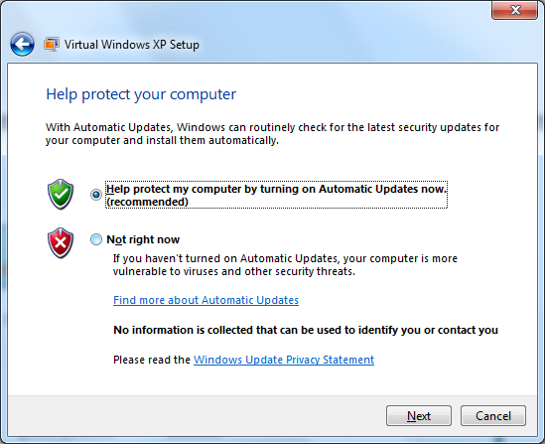
Easy to setup from the Windows 7 Desktop

Slide 12
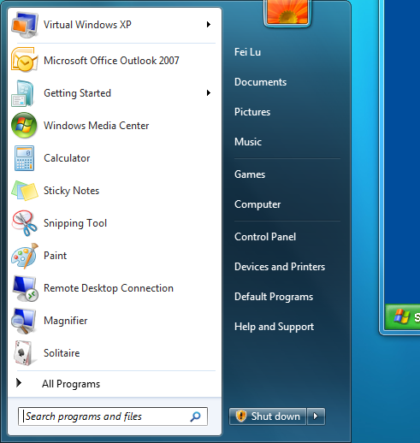
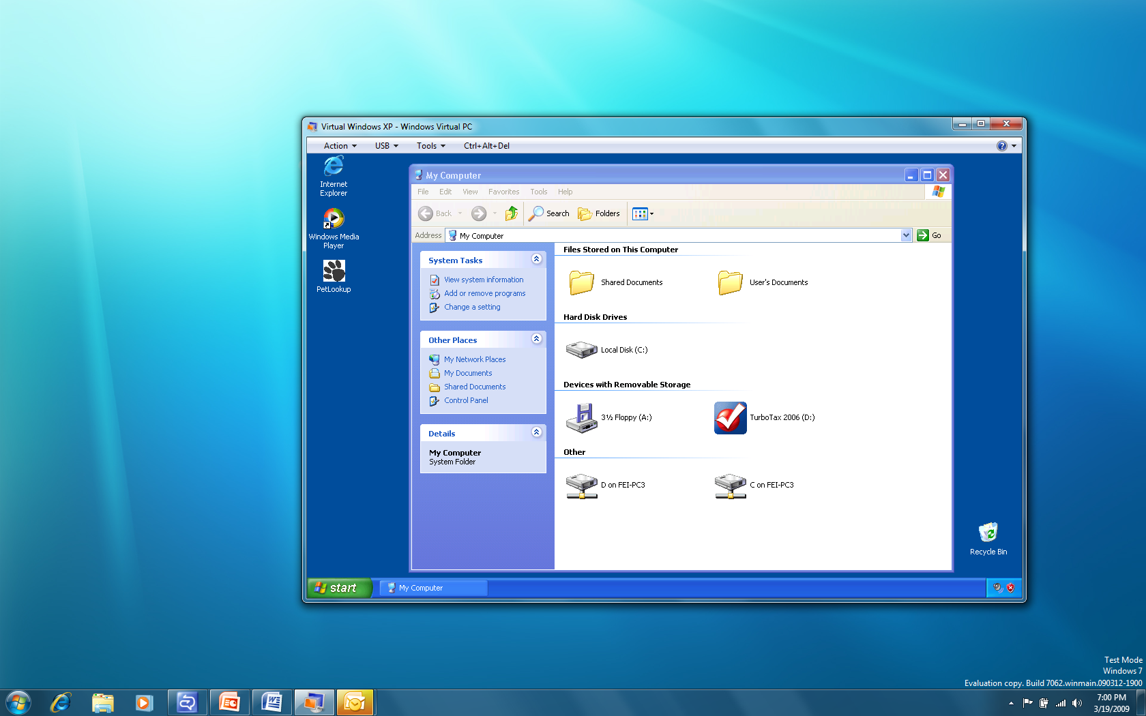
Install Applications in Virtual Windows XP
Open Virtual Windows XP from Windows 7 Start Menu
Install Windows XP applications like you normally do

Slide 13
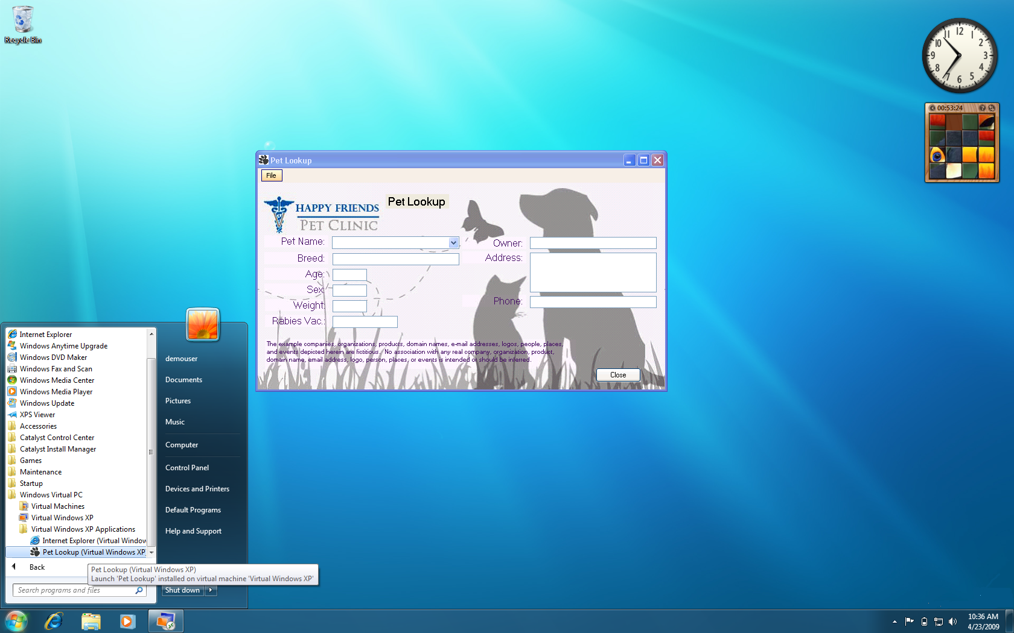
Windows 7 exp for Windows XP Apps

Slide 14
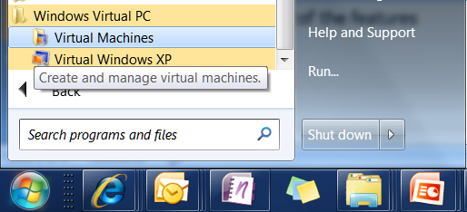
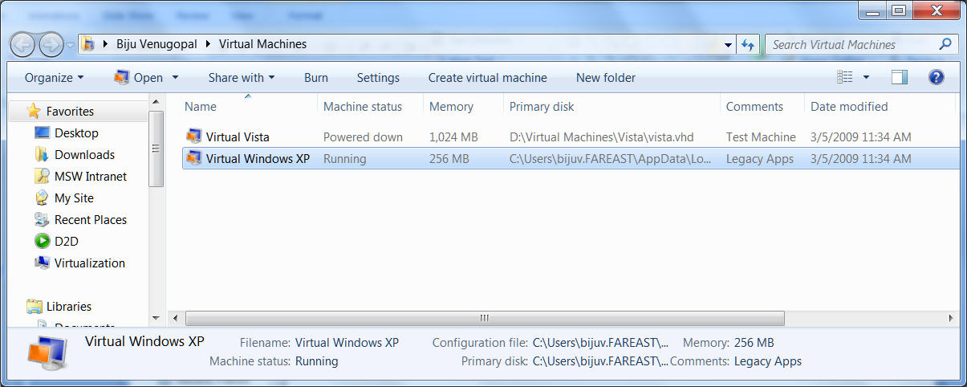
Integrated with Windows 7
Intuitive interface to discover all registered virtual machines.
Launching point to start the VM’s, view settings and create new VM’s

Slide 15
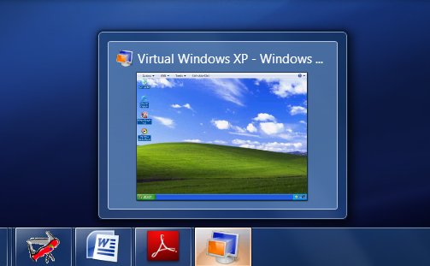
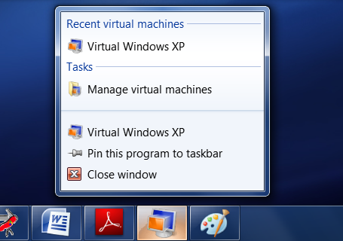
Superbar Integration
Integrated with the Windows 7 Superbar

Slide 16
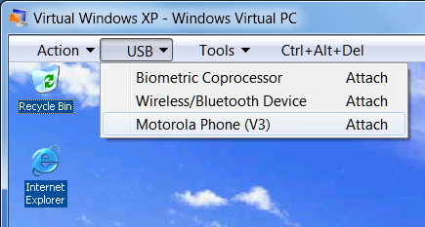
Device redirection / USB Support
Just plug in and use the following devices in the guest*
Mass Storage
Printers / Scanners
Smart Cards
Redirect USB devices to Guest
Use USB devices for which Windows 7 drivers are not available.
* Requires Host and Guest drivers

Slide 17
Limitations of Windows Virtual PC
Windows Virtual PC is designed to address business and productivity application compatibility concerns for small business / home users
Key Known Limitations:*
Does not support 3D Graphics
Does not support bi-directional audio
Does not support 64-bit guest operating systems
It is not designed to run demanding applications such as high-end games.
Antivirus running Virtual Windows XP does not protect Windows 7
* While these are key known limitations, other limitations may exist which could affect performance of your applications.

Slide 18
Windows Virtual PC Environment
Windows 7 is only supported Host Operating system
Windows XP, Windows Vista and Windows 7 are supported guest operating systems
Maintains Virtual PCs level of compatibility with non-supported operating systems
Hardware virtualization required

Slide 19
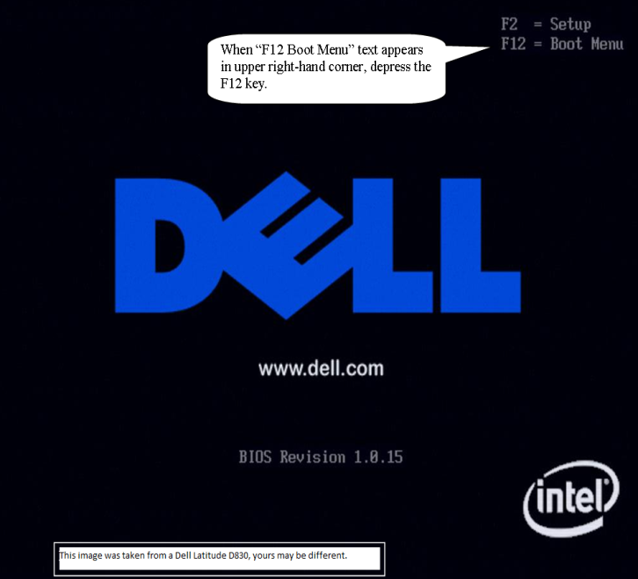
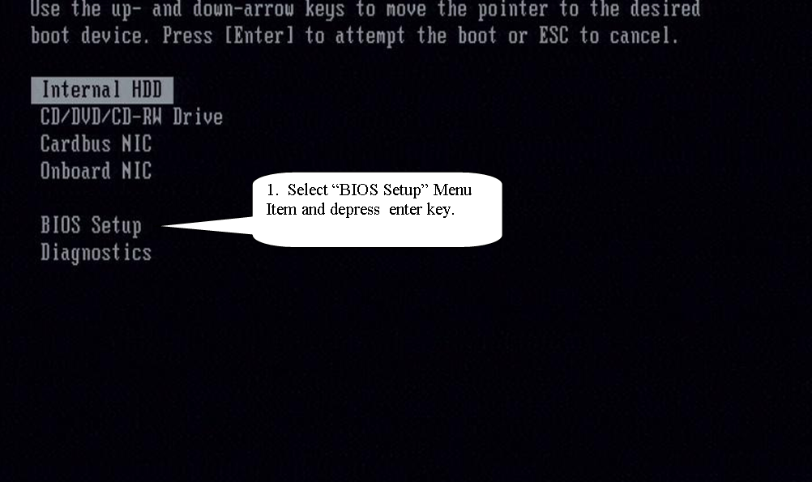
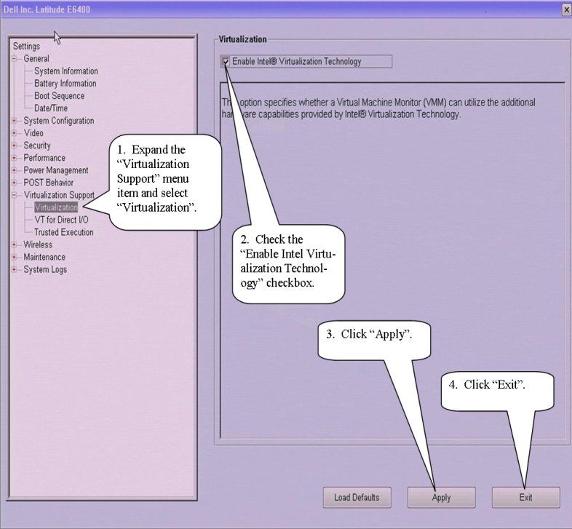
Enabling Hardware Virtualization

Slide 20
Microsoft Enterprise Desktop Virtualization (MED-V)
MED-V* centrally manages virtual Windows environments
Deploy – deliver virtual Windows images and customize per user and device settings
Provision – define which applications and websites are available to different user groups
Control – assign and expire usage permissions and Virtual PC settings
Maintain and Support - update images, centrally monitor users and remotely troubleshoot
*Available post Windows 7 GA as part of Microsoft Desktop Optimization Pack (MDOP)
Windows Virtual PC provides the ease of use for end users
Run Windows XP or other Windows environments on Windows 7
Install and launch Windows XP applications from Windows 7 Desktop
IT Pros: Use MED-V when deploying Windows Virtual PCs, to reduce complexity, maintain control and keep costs low

Slide 21
Demo
Windows Virtual PC

Slide 22
Windows Virtual PC Architecture
Built on Virtual Server engine
Modified for end user envionment
Terminal Services technology used for:
Seamless applications
Advanced integration (smartcards, drives, etc…)
Hyper-V technology used for new devices
USB built on VMBus style architecture (VPCBus)

Slide 23
Windows Virtual PC High Level Architecture
User Mode
Host
Guest
Kernel Mode
VMX
Windows
VM Window
VM SAL
RAIL
TS ActiveX
TS ActiveX
ICs
RDP Stack
App Pub
VPC
RDP ET
COM
App Pub
Mouse Int
Arb. Res.
Devices
NAT
ICs
Time Sync
Stub
USB VSP
USB VSC
RPM
NDIS Stack
USB Stack
VPC BUS
VPC BUS
Switch
VMM.SYS
VMX Kernel

Slide 24
Native Virtual Hard Disk Support

Slide 25
Current VHD uses
In Microsoft products:
Container for virtual machine image (e.g. Hyper-V, Virtual Server, Virtual PC)
Container for backups (e.g. Windows Server Backup, Vista/Windows 7 Complete PC Backup)
Backing store for iSCSI LUNs (e.g. Windows Unified Data and Storage Server)
SCVMM management support
Partners have adopted it as well
Citrix XenServer
Dozens of ISVs using it for evaluation redistribution

Slide 26
Why VHD?
Reduce format explosion
ISVs focus on domain vertical (like A/V) over building container expertise
Leverage existing OS technologies and tools
Security, compression, FS management tools, etc
Consistent and compatible experience for partners
Image management, OS and App virtualization, deployment
VHD stacks exist today
Native support improves reliability and consistency

Slide 27
Native VHD Support
Foundational support for booting from VHD and for Surface/Removal of VHDs
Orderly shutdown of volumes
Support for nested volumes (2 levels)
Servicing for mounted (offline) VHD volumes
VHD operations
Create / Attach/ Detach
Meta-operations: Merge, Expand, Compact
Tools and APIs:
Win32 APIs
VDS APIs (DCOM Remotable)
Hyper-V WMI for management operations
Performance goal: within 10% of native

Slide 28
Native VHD Architecture
User / Management Application
Win32 xxxVirtualDisk()
[Create, Surface, Remove, Merge, Compact, Convert]
Diskmgmt.msc
Diskpart.exe
VDS APIs
*HYPER-V WMI
Virtual Volume Stack
Physical Volume Stack
FS Depends
FS Depends
Partmgr
FS
FS
Disk
Volmgr
Volmgr
VHD Driver
*Requires installation of Hyper-V role

Slide 29
Native VHD Performance

Slide 30
VHD Boot
Strategic direction for Windows in the Data Center
Image consolidation
Single image format for generalized and specialized physical images
Single generalized master image for virtual and physical environments
Reduced management TCO
Single toolset and process for management and deployment
Enables other compelling scenarios
Rapid provisioning and repurposing
Rapid, reliable patching and rollback

Slide 31
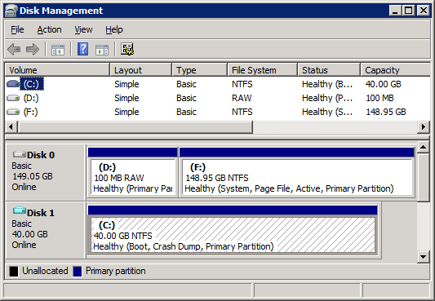
VHD Boot in Windows
Windows
C:\
D:\
VHD

Slide 32
Boot from VHD Policies
Differencing chain must reside on a single partition
Same LUN for iSCSI boot case
Dynamic VHDs pre-expanded by default
User sets max size at Create
Nested VHDs strongly discouraged
Nesting depth >2 not supported
Non-boot VHDs are not auto-mounted
Pagefile and boot loader/boot store reside outside VHD
No support for hibernation or BitLocker

Slide 33
Demo
Native Virtual Hard Disk

Slide 34
Summary
Microsoft is continuing to invest in desktop virtualization
Application compatibility is scenario number one for Windows 7 virtualization
Native Virtual Hard Disk support enables new and interesting scenarios
Evaluate Virtual PC and MED-V for addressing application compatibility in your environment
Evaluate Native Virtual Hard Disk support

Slide 35
Q & A

Slide 36
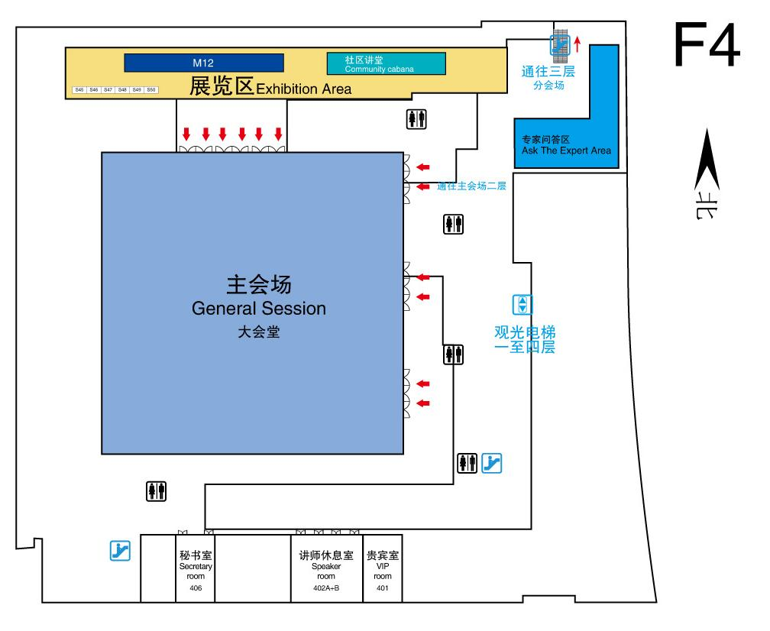
Ask the Expert (F4) In next 70 minutes, I will be available at the “Ask the Expert” area to answer your questions

