Slide 2
Records Management Strategies and Compliance in SharePoint 2010
OFC223

Slide 3

Session Objectives & Takeaways
Session Flow:
  Approach & Tools: Learn what’s different about SharePoint Records Management.
  Demos and Best Practices: Let’s solve real business problems with 2010 RM
Takeaways:
  New customers: 2010 expands on the 2007 RM vision by removing significant roadblocks to RM deployments.
  Limits: There are still RM scenarios beyond what we target for SharePoint.

Slide 4
SharePoint 2010: Smart RM
Key tenants of RM in the 2010 release:
Integrated Governance
Tightly bound to collaboration experiences.
Familiar and Easy to Use
Right trade off between feature richness and end user freedom
Flexible
Configurable to the organization’s needs
Works on a variety of SharePoint objects

Slide 5
The SharePoint RM Toolbox
RM Feature Area
What’s new in O14
Recordization
In place records management
Metadata-driven, hierarchal file plan in the archive
eDiscovery and Hold
eDiscovery searches over any SharePoint content.
Auditing and Reporting
File Plan Report shows overview of content management policies
Per item audit log reports
Retention and Expiration
Retention schedules with multiple stages
Archive results or leave on an in place hold.
Seven out of the box retention actions

Slide 6

Business Problem #1
How do I prepare for litigation and eDiscovery?

Slide 7
Litigation and eDiscovery
Primary focus should be on up front preparation
  Appropriately enforced retention policies
  Configure the system to track appropriate actions (auditing)
Leverage existing search technology during discovery process.
  “Custodian based approach” to eDiscovery doesn’t work in a collaborative environment.

Slide 8
演 示
Litigation Preparedness
Retention, auditing, eDiscovery search

Slide 9
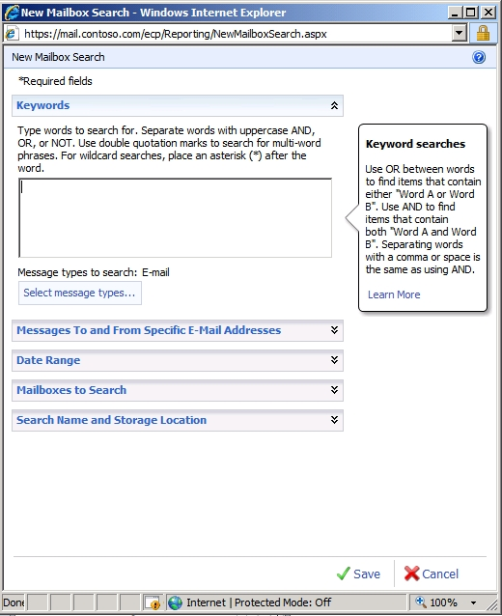
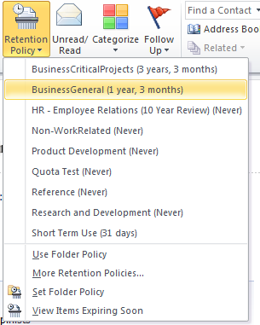
Managing E-mail Discovery

Slide 10
Business Problem #2
How do I protect the most important data in my enterprise?

Slide 11
演 示
In Place Records Management
Record lock down, record retention polices

Slide 12
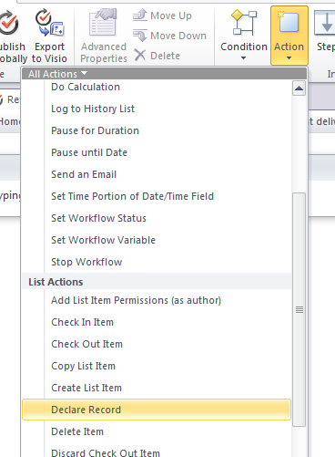
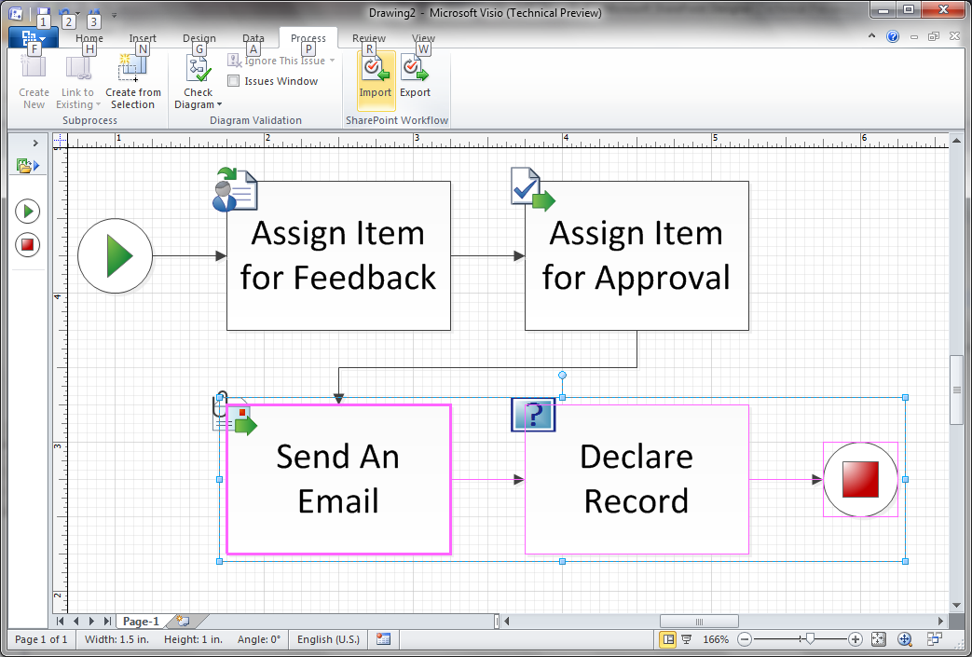
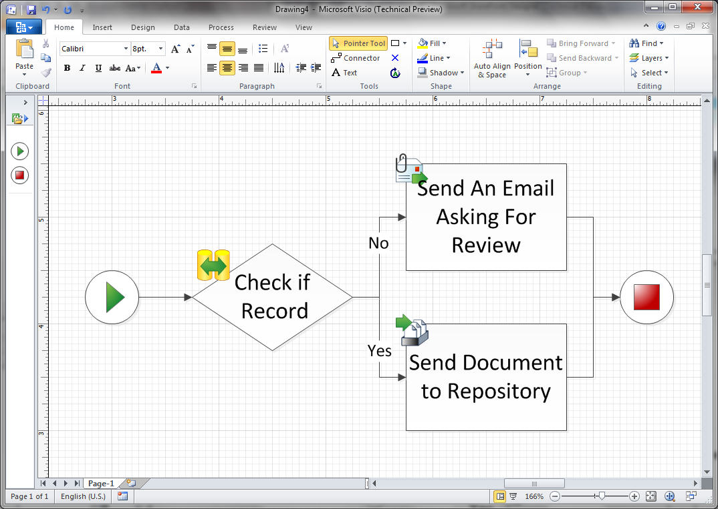
Workflow and Records
Declare Record action in SPD
Policy on the blog posts
Workflow creating records
Record status driving business decisions

Slide 13
演 示
SharePoint 2010 Records Center
File Plan Builder, File Plan Report, Metadata Based Submittal and Navigation, Stubbing

Slide 14
Record in 2010
Choosing between In Place vs. Archive
In Place
Works best in well established sites (e.g. knowledge management repositories).
Requires tight integration between RM team, IT, and content stewards.
Archive
Centralized storage of less managed content
More traditional; easier to implement hierarchal file plan
Records are actively used and sit alongside non-records.
Provides one centralized view and location for all records across enterprise
Necessary for DoD 5015 compliance

Slide 15
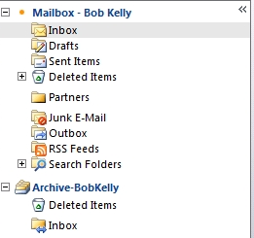
E-Mail Archiving
Exchange 14 offers alternatives to PSTs via an online archive of e-mail.
Allows cheaper storage for the less frequently used content
Policies can drive e-mail to the archive.

Slide 16
Business Problem #3
How do I scale my compliance solution to the enterprise?

Slide 17

Content Type Syncing and Compliance Coordination
Collaborative Space
(In progress content)
* Content gets created using enterprise content type.
* Corporate policy gets applied, regardless of where content is created
* Records Center subscribes the service
* Incoming content already has correct metadata and policy.
-Enterprise Content Type & Policy Sharing Service
-Enterprise Metadata
Record Center
(Highly managed
Repository)

Slide 18
演 示
Policy on the blog posts, Content Type Syncing

Slide 19
Scale and Distributed Architecture
To scale to 100s of millions of records, we’ll need to distribute the data to several databases and sites.
O14 includes features to ensure centralized management of this distributed data:
  The content organizer distributes submissions across the sites.
  Content types are shared across site collections.
  Centralized eDiscovery searches across all sites.
FAST Search ensures a unified retrieval experience.
Hub
SC1
SC2
…

Slide 20
疑问和解答

