Slide 2
SQL Server 2008 R2 自助式商务智能 Self-service Business Intelligence
BAP302

Slide 3
微软中国研发集团服务器与开发工具事业部
商用平台
开发工具
管理与服务
Windows Server解决方案
协议工程
商业在线服务
团队博客：
http://blogs.msdn.com/stbcblog/
我们关注的论坛
http://social.microsoft.com/Forums/zh-CN/categories/

Slide 4
我们的精彩五年

Slide 5
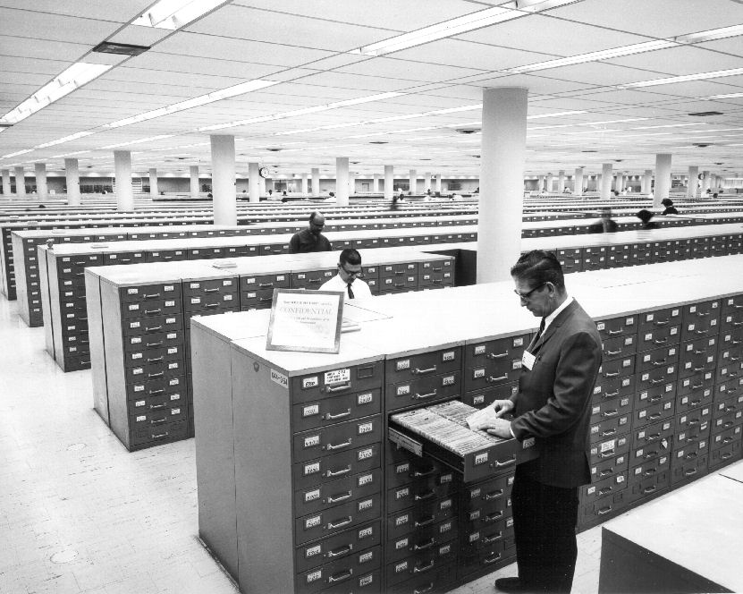

Slide 6
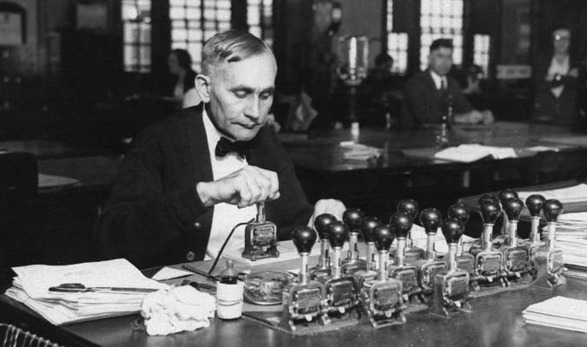

Slide 7
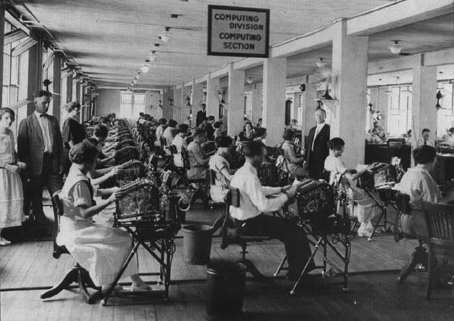
计算机分区

Slide 8
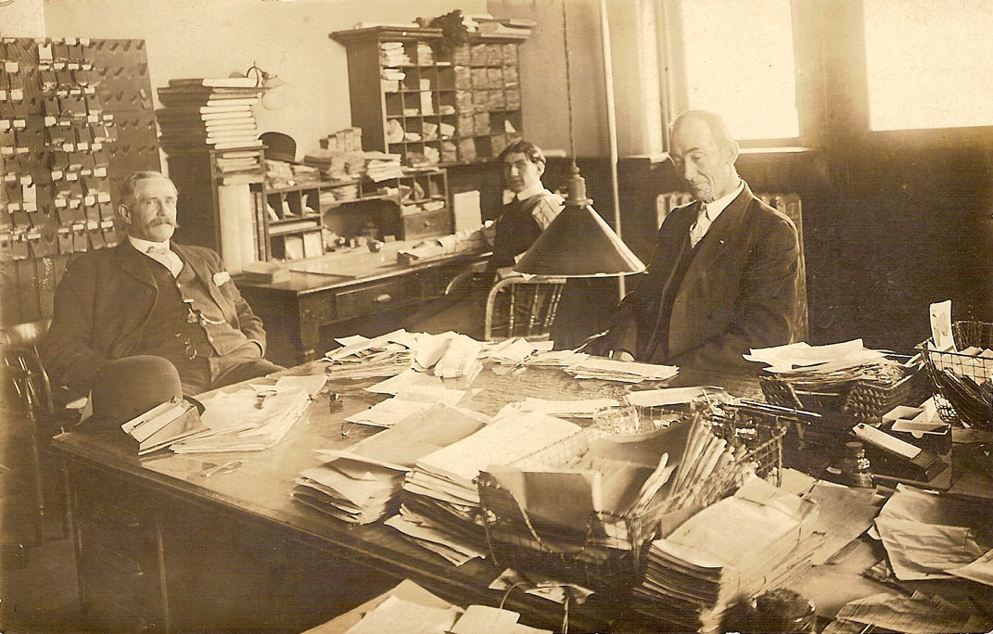

Slide 10
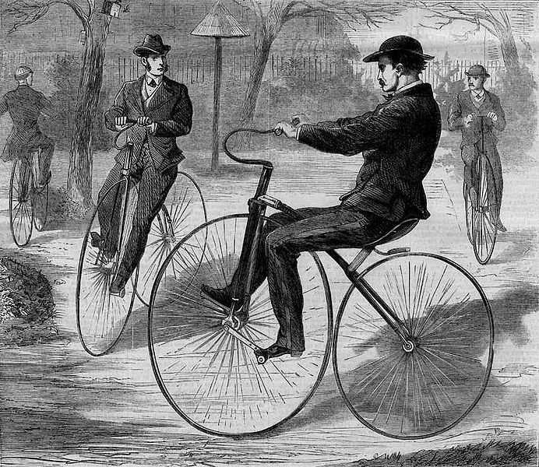

Slide 11
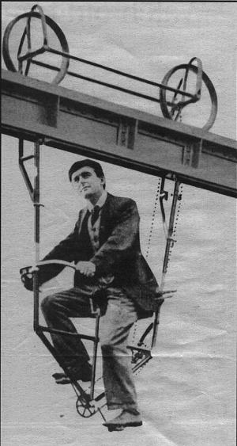

Slide 12
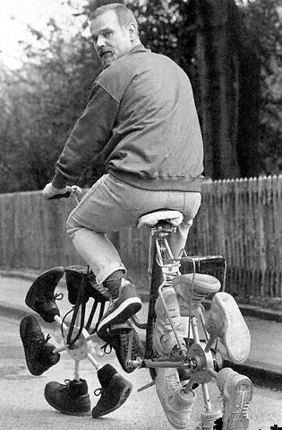

Slide 13
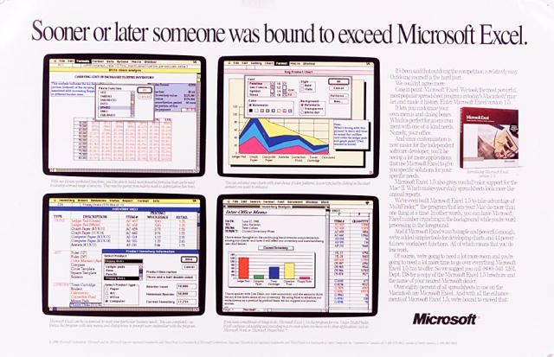
有人迟早会超越 Microsoft Excel

Slide 14
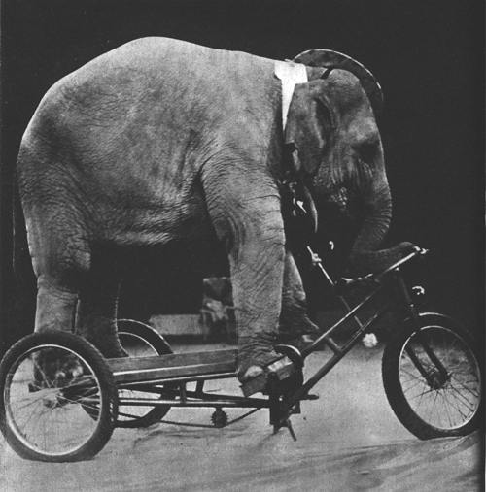

Slide 15
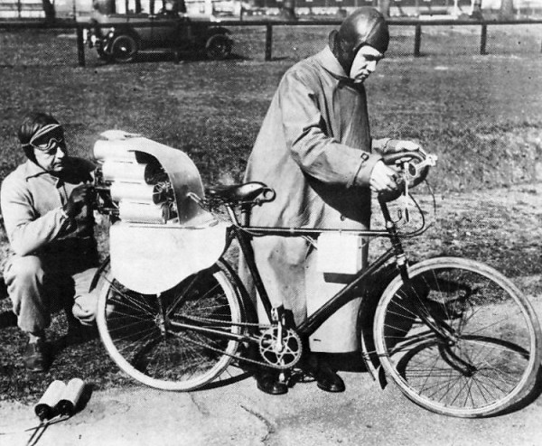

Slide 16
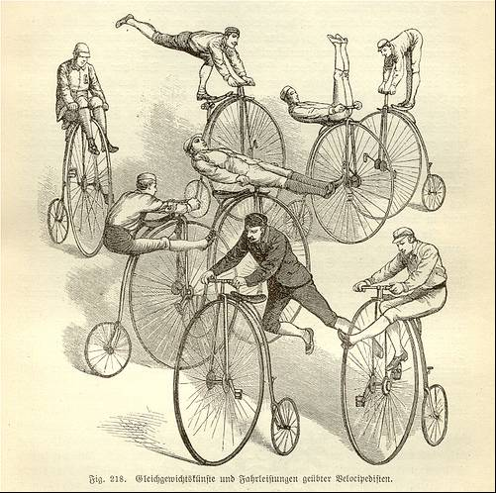

Slide 19
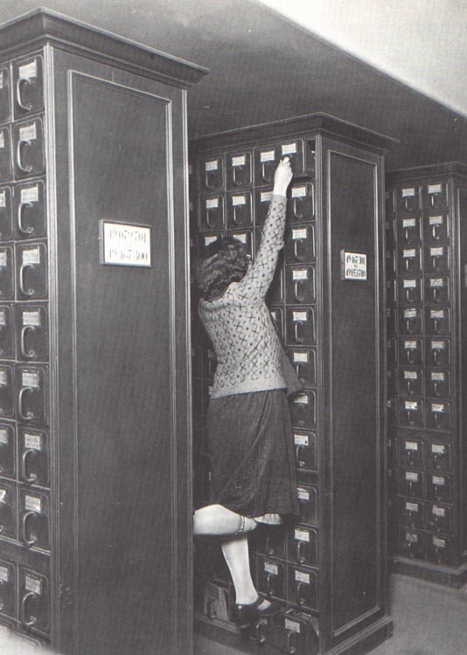

Slide 20
令人震惊的记忆功能 – 你也可以办得到

Slide 21
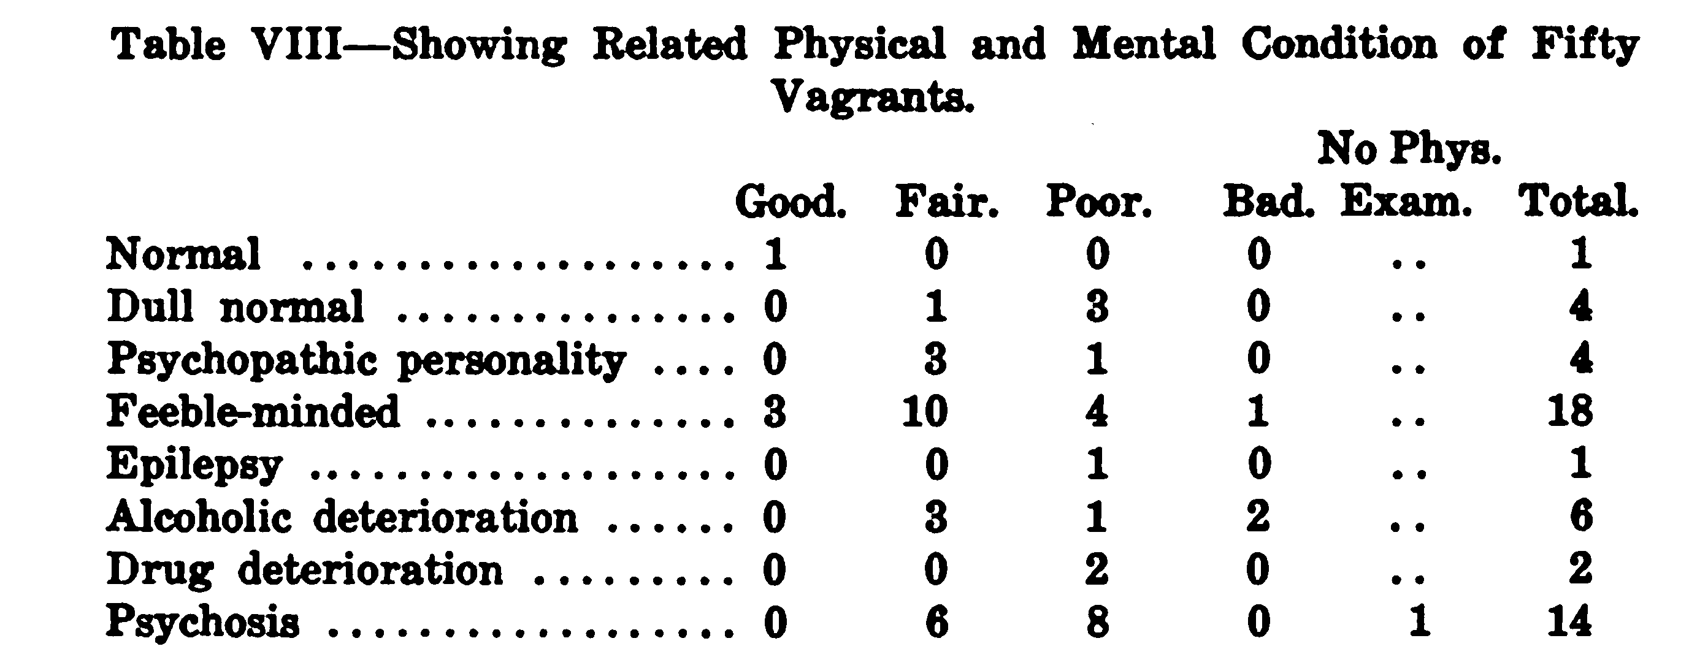

Slide 24
大忙人- 你收到 “脑盒”了吗？

Slide 28
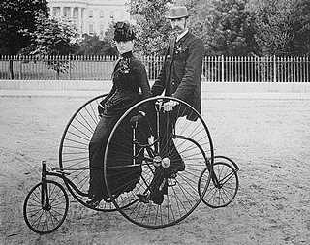

Slide 29
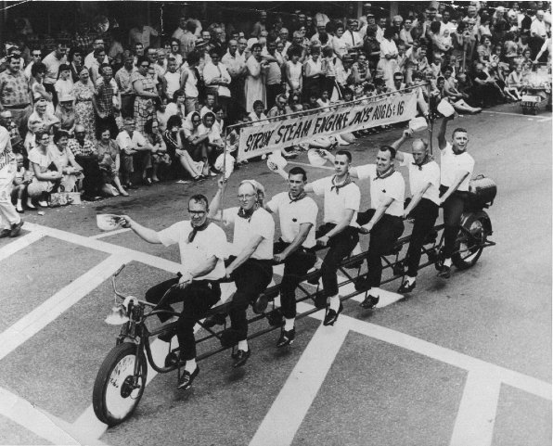

Slide 30
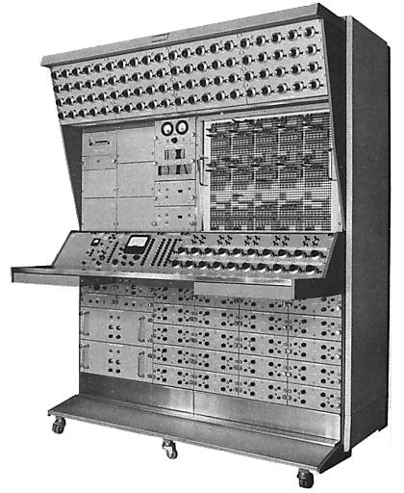

Slide 31
Gemini 的Excel函数
Date and Time | Information | Math and Trig | Statistical | Text
DATE | ISBLANK | ABS | AVERAGE | CHAR
DATEVALUE | ISERROR | CEILING, ISO.CEILING | AVERAGEA | CODE
DAY | ISLOGICAL | EXP | COUNT | CONCATENATE
EDATE | ISNONTEXT | FACT | COUNTA | EXACT
EOMONTH | ISNUMBER | FLOOR | COUNTBLANK | FIND
HOUR | ISTEXT | INT | MAX | FIXED
MINUTE |  | LN | MAXA | LEFT
MONTH | Logical | LOG | MIN | LEN
NETWORKDAYS | AND | LOG10 | MINA | LOWER
NETWORKDAYS.INTL | IF | MOD | STDEV.S | MID
NOW | IFERROR | MROUND | STDEVA | REPLACE
SECOND | NOT | PI | STDEV.P | REPT
TIME | OR | POWER | STDEVPA | RIGHT
TIMEVALUE | FALSE | QUOTIENT | VAR.S | SEARCH
TODAY | TRUE | RAND | VARA | SUBSTITUTE
WEEKDAY |  | RANDBETWEEN | VAR.P | TEXT
WEEKNUM |  | ROUND | VARPA | TRIM
WORKDAY |  | ROUNDDOWN |  | UPPER
WORKDAY.INTL |  | ROUNDUP |  | VALUE
YEAR |  | SIGN
YEARFRAC |  | SQRT
 |  | SUM
 |  | SUMSQ
 |  | TRUNC

Slide 32
查找函数
LookupValue (ResultColumn, SearchColumn, SearchValue...)
Related (Column)
RelatedTable (Table)

Slide 33
聚合函数
SUMX (Table, Expression)
AVERAGEX (Table, Expression)
COUNTAX (Table, Expression)
MINX (Table, Expression)
MAXX (Table, Expression)
EARLIER(Column)
EARLIEST(Column)

Slide 34
表函数
RelatedTable (Table)
Filter (Table, Condition)
Distinct (Column)
Values (Column)
All (Table), All(Column)
AllExcept (Table, Col1, Col2,...)

Slide 35
Calculate() 的不同方式
Scalar functions
Calculate
CalculateAll
CalculateAllRows
Table Functions
CalculateTable
CalculateTableAll
CalculateTableAllRows
Supporting Functions
All
AllExcept
AllNoBlankRow

Slide 36
时间智能函数
FirstDate
LastDate
FirstNonBlank
LastNonBlank
StartofMonth
StartofYear
EndofMonth
EndofQuarter
EndofYear
DateAdd
DatesBetween
DatesInPeriod
ParallelPeriod
PreviousDay
PreviousMonth
PreviousQuarter
PreviousYear
NextDay
NextMonth
NextQuarter
NextYear
DatesMTD
DatesQTD
DatesYTD
SamePeriodLastYear
TotalMTD
TotalQTD
TotalYTD
OpeningBalanceMonth
OpeningBalanceQuarter
OpeningBalanceYear
ClosingBalanceMonth
ClosingBalanceQuarter
ClosingBalanceYear

Slide 37
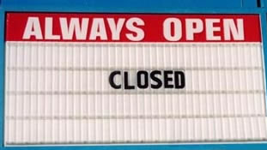

Slide 38
Q & A

