Slide 2
SQL Server 2008 R2
的自助式商务智能
Self-service Business Intelligence
BAP302

Slide 3
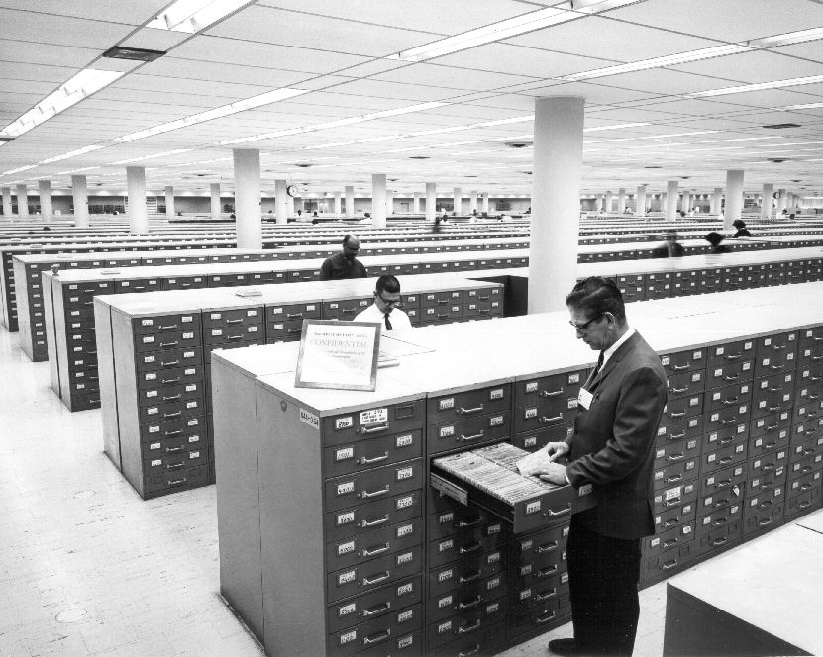

Slide 4
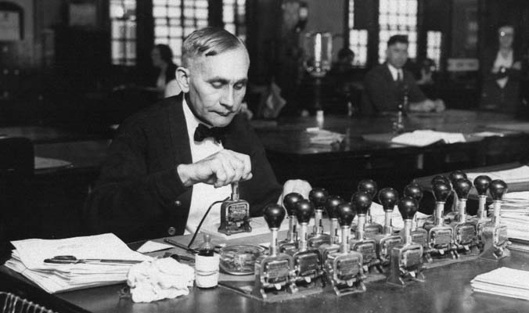

Slide 5
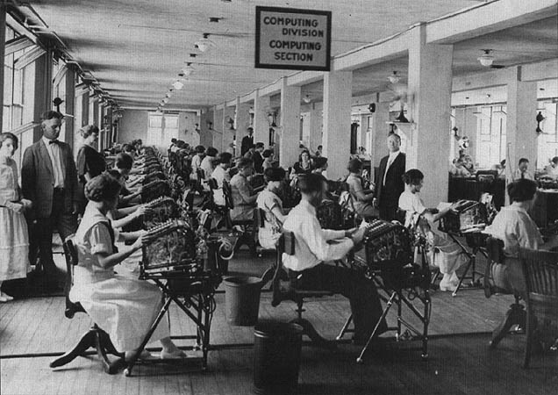
Please translate the sign

Slide 6
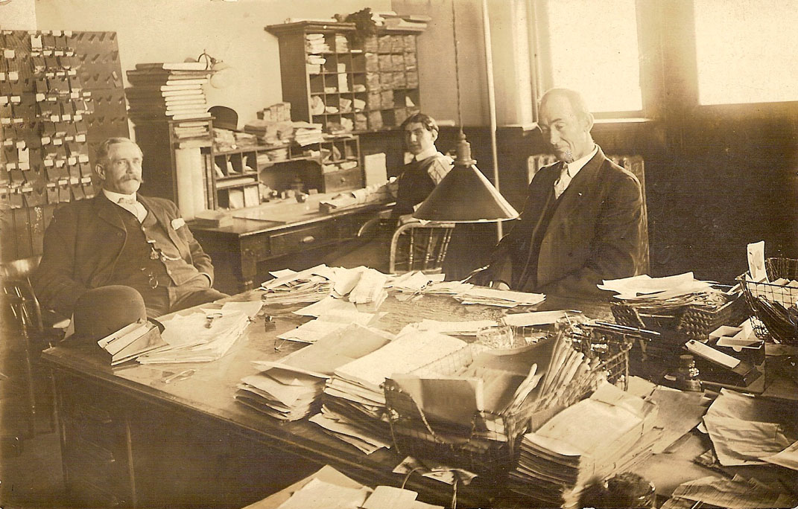

Slide 8
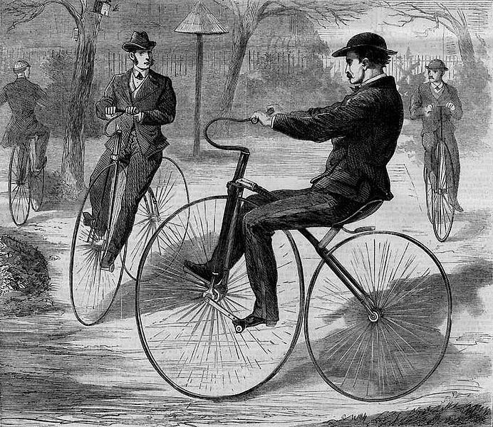

Slide 9
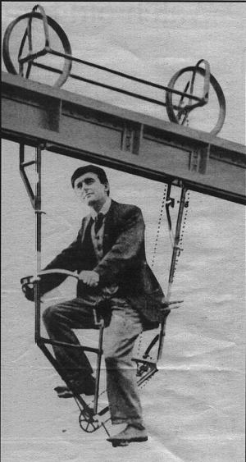

Slide 10
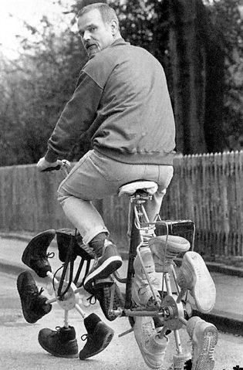

Slide 11
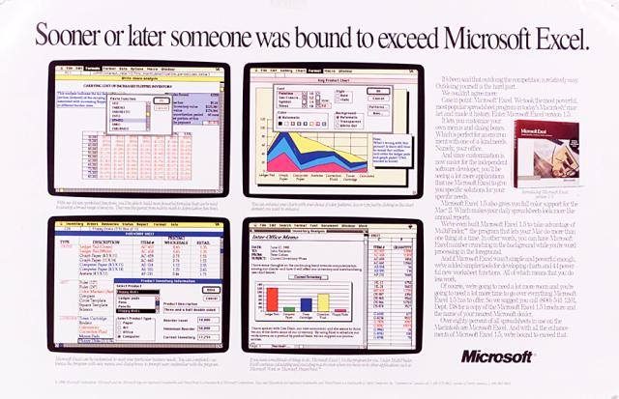
Please translate the headline

Slide 12
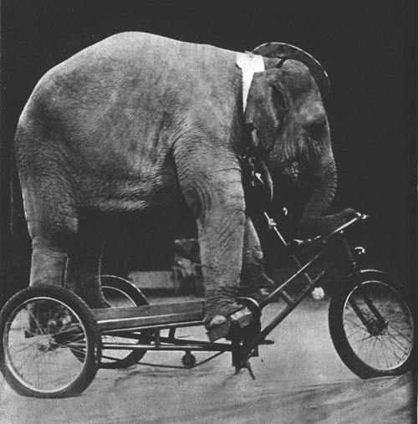

Slide 13
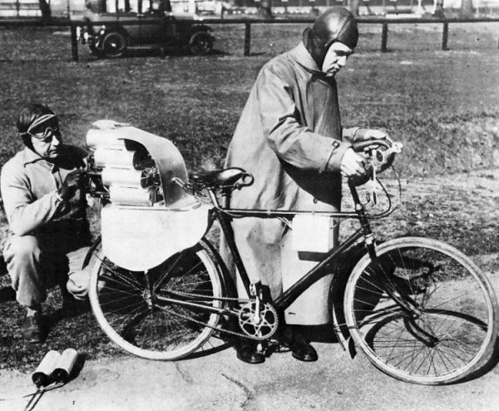

Slide 14
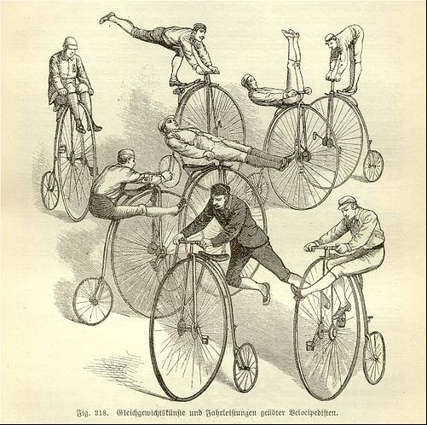

Slide 17
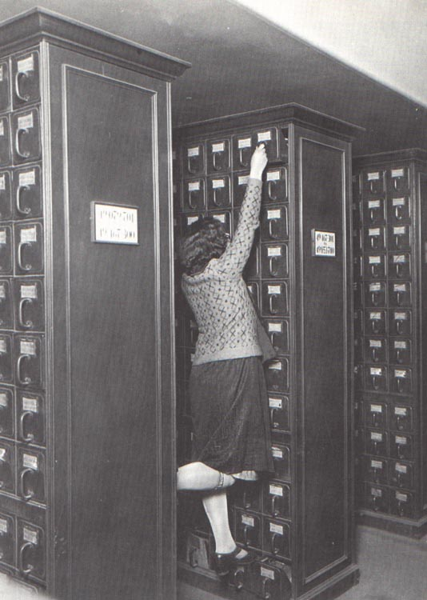

Slide 18


Please translate the headline

Slide 19
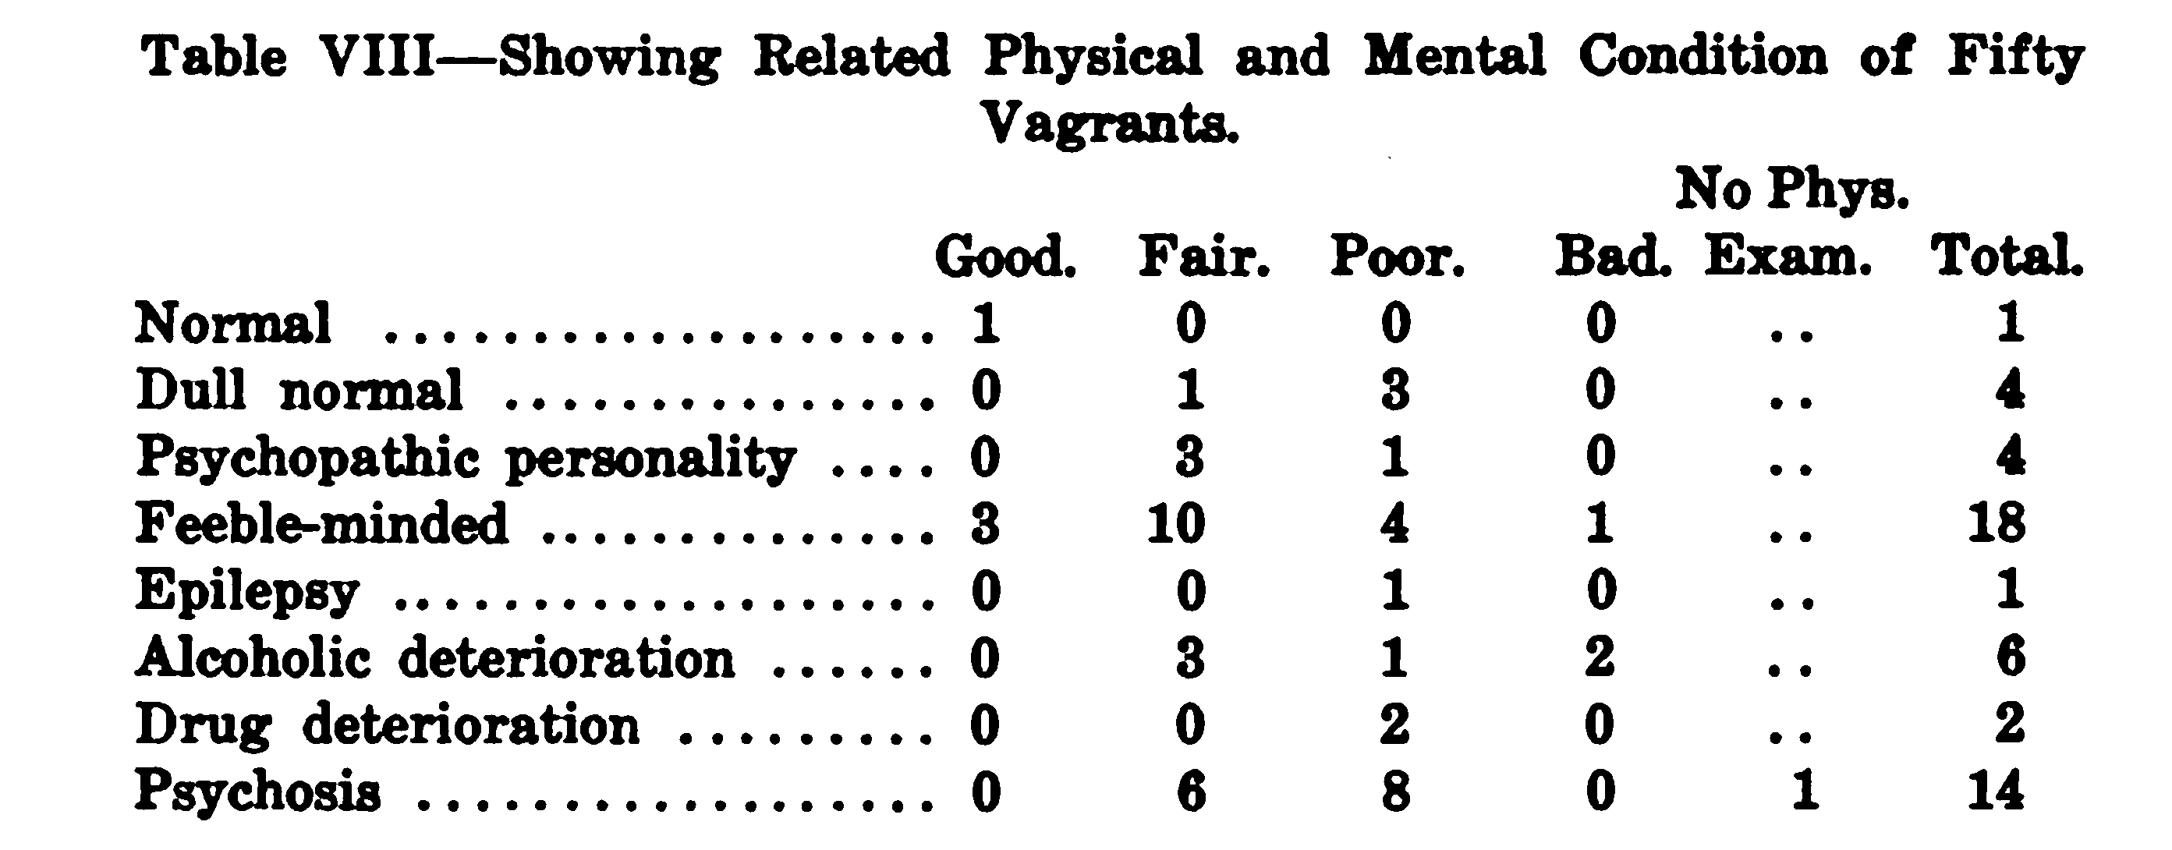

Slide 22
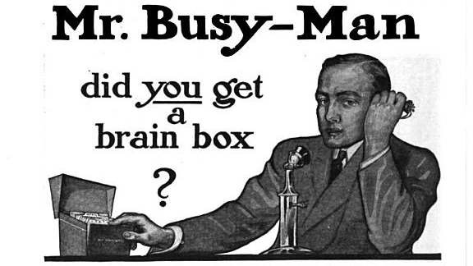
Can this be translated and still be fun? If not, you can delete.

Slide 24
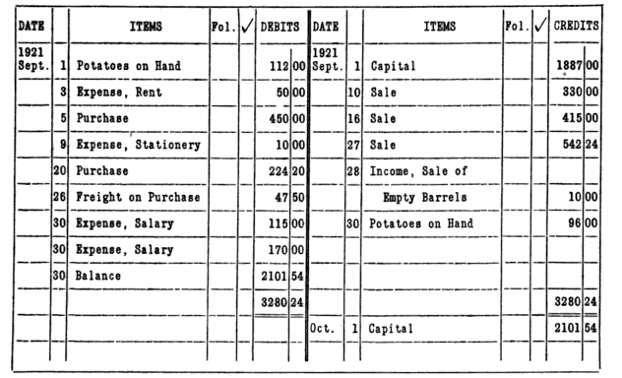

Slide 25
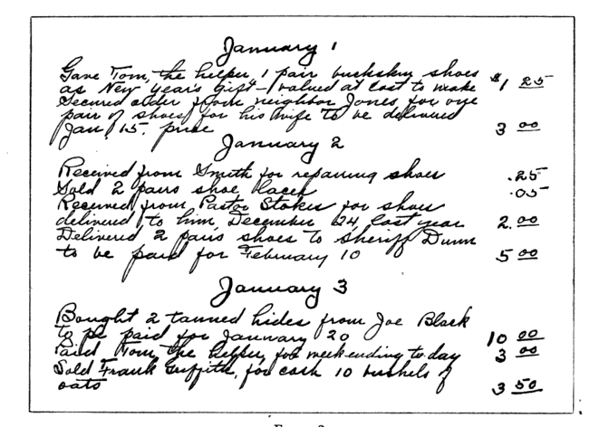

Slide 26
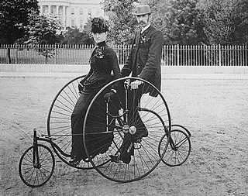

Slide 27
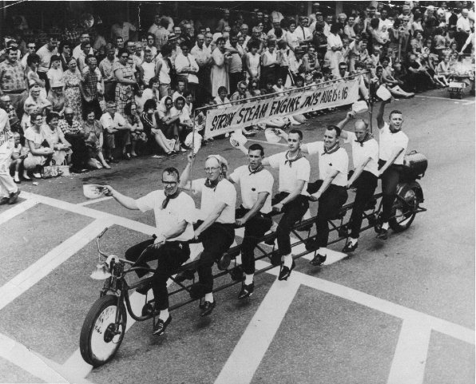
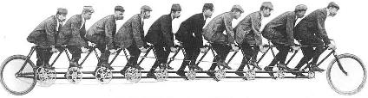

Slide 28
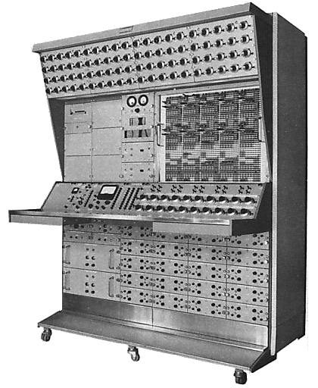

Slide 29
Excel Functions in Gemini
Date and Time | Information | Math and Trig | Statistical | Text
DATE | ISBLANK | ABS | AVERAGE | CHAR
DATEVALUE | ISERROR | CEILING, ISO.CEILING | AVERAGEA | CODE
DAY | ISLOGICAL | EXP | COUNT | CONCATENATE
EDATE | ISNONTEXT | FACT | COUNTA | EXACT
EOMONTH | ISNUMBER | FLOOR | COUNTBLANK | FIND
HOUR | ISTEXT | INT | MAX | FIXED
MINUTE |  | LN | MAXA | LEFT
MONTH | Logical | LOG | MIN | LEN
NETWORKDAYS | AND | LOG10 | MINA | LOWER
NETWORKDAYS.INTL | IF | MOD | STDEV.S | MID
NOW | IFERROR | MROUND | STDEVA | REPLACE
SECOND | NOT | PI | STDEV.P | REPT
TIME | OR | POWER | STDEVPA | RIGHT
TIMEVALUE | FALSE | QUOTIENT | VAR.S | SEARCH
TODAY | TRUE | RAND | VARA | SUBSTITUTE
WEEKDAY |  | RANDBETWEEN | VAR.P | TEXT
WEEKNUM |  | ROUND | VARPA | TRIM
WORKDAY |  | ROUNDDOWN |  | UPPER
WORKDAY.INTL |  | ROUNDUP |  | VALUE
YEAR |  | SIGN
YEARFRAC |  | SQRT
 |  | SUM
 |  | SUMSQ
 |  | TRUNC

Slide 30
Lookup Functions
LookupValue (ResultColumn, SearchColumn, SearchValue...)
Related (Column)
RelatedTable (Table)

Slide 31
Aggregation Functions
SUMX (Table, Expression)
AVERAGEX (Table, Expression)
COUNTAX (Table, Expression)
MINX (Table, Expression)
MAXX (Table, Expression)
EARLIER(Column)
EARLIEST(Column)

Slide 32
Table Functions
RelatedTable (Table)
Filter (Table, Condition)
Distinct (Column)
Values (Column)
All (Table), All(Column)
AllExcept (Table, Col1, Col2,...)

Slide 33
Variants of Calculate()
Scalar functions
Calculate
CalculateAll
CalculateAllRows
Table Functions
CalculateTable
CalculateTableAll
CalculateTableAllRows
Supporting Functions
All
AllExcept
AllNoBlankRow

Slide 34
Time Intelligence Functions
FirstDate
LastDate
FirstNonBlank
LastNonBlank
StartofMonth
StartofYear
EndofMonth
EndofQuarter
EndofYear
DateAdd
DatesBetween
DatesInPeriod
ParallelPeriod
PreviousDay
PreviousMonth
PreviousQuarter
PreviousYear
NextDay
NextMonth
NextQuarter
NextYear
DatesMTD
DatesQTD
DatesYTD
SamePeriodLastYear
TotalMTD
TotalQTD
TotalYTD
OpeningBalanceMonth
OpeningBalanceQuarter
OpeningBalanceYear
ClosingBalanceMonth
ClosingBalanceQuarter
ClosingBalanceYear

Slide 35
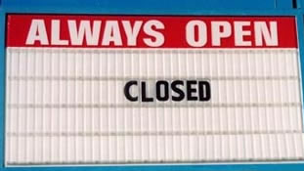

Slide 36
Q & A

