Slide 1

Visual Studio 2010
和
.NET Framework 4
培训研讨会

Slide 2
演示文稿概述（隐藏幻灯片）：
技术水平：300
目标受众：开发人员和架构师
目标 （您希望受众得到哪些收获）：
  务必理解围绕新客户端控件和模板功能的主要目标
  帮助促进 ASP.NET AJAX 的使用，作为一个客户端 JavaScript 平台，可以支持丰富的 web 开发，甚至能超出 ASP.NET 环境。
演示文稿概述：
  客户端模板
  客户端控制
  声明性安装
  Command Bubbling
  实时绑定

Slide 3

ASP.NET AJAX 4 中的新功能
姓名
职务
组织
电子邮件
Notes:
ESTIMATED TIME:
60 minutes

Slide 4
议程
  客户端模板
  客户端控件
  声明性安装
  Command Bubbling
  实时绑定
Notes:
Estimated Time: < 1 minute
In this presentation we’re going to take an introductory look at ASP.NET AJAX 4.0. This will include explanations and demos of the following items:
Client-Side Templates
Client Controls
Declarative Instantiation
Command Bubbling
Live Bindings

Slide 5
“ASP.NET AJAX 还不错，但是对于客户端开发而言，它太以服务器为中心了……”
- 不明真相的某人
Notes:
Estimated Time: 2 minutes
One of the more common misconceptions with ASP.NET AJAX is that it has always been a server-centric framework and offered little to no value for purely client-side JavaScript development. One of the primary objectives of this presentation is to show how ASP.NET AJAX as a JavaScript library has always been useable without server constraints, as well as how ASP.NET AJAX 4.0 makes that even more of a reality by adding additional support.

Slide 6
常见误解
ASP.NET AJAX 绑定 ASP.NET，即 WebForms……
您必须使用 ScriptManager 和 UpdatePanels 才能完成任务……
它需要 Visual Studio 才能工作……
Notes:
Estimated Time: 2 minutes
When some developers think of ASP.NET AJAX they implicitly associate it with WebForms, and feel like it’s very coupled to the ScriptManager and UpdatePanel server controls. While this style of development (partial rendering) in WebForms is an available option, it’s important to keep in mind that that is simply an integration point between ASP.NET AJAX and ASP.NET WebForms. If you’re already using WebForms, partial rendering provides a very easy starting point for introducing AJAX-like functionality to a web application.
That said, ASP.NET AJAX can be used outside of the context of WebForms, because it is ultimately just a collection of JavaScript files that can be referenced within a web page. It’s true that Visual Studio provides rich support for using ASP.NET AJAX, but there is no reason to treat ASP.NET AJAX any differently than any other JavaScript library (i.e. jQuery, Prototype, etc.)

Slide 7
要求
为了使用 ASP.NET AJAX，需要……
客户端控件
数据绑定
UI 模板
轻松服务通信
模块功能
Notes:
Estimated Time: 2 minutes
Taking a pragmatic look at the existing ASP.NET AJAX release, we recognize that there are some things missing from it that are really necessary to begin doing any serious client-side web development with it.
There needs to be a stronger offering in terms of client-side controls, which ideally would also provide the same level of templating and data binding that the server controls in WebForms provide. In addition, because JavaScript is a client technology, communication between the server needs to be extremely easy, such that developing with JavaScript, and taking on the tax of an additional tier, becomes simple enough to warrant the benefits it provides without overloading the time it takes to create.
Finally, ASP.NET AJAX really needs to become modular in the sense that developers can pick and choose what pieces of the framework they want to use, or need for that matter.

Slide 8
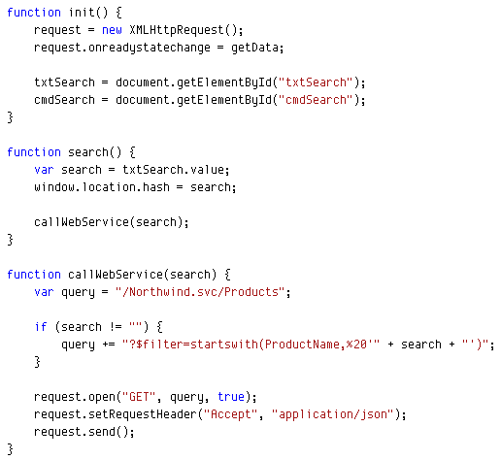
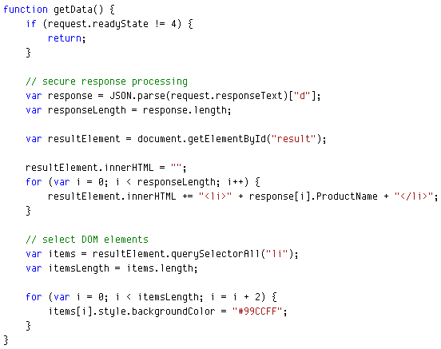
为什么有些人觉得 JavaScript 很让人痛苦？
Notes:
Estimated Time: 2 minutes
JavaScript in general hasn’t been the most popular language to write amongst web developers. The IDE support hasn’t always been strong, and common tasks haven’t been as easy to accomplish as they should be.
Working with server-side logic using the XMLHttpRequest class isn’t exactly the most intuitive programming model and it leads to a load of boilerplate code. [Advance Animation]
Creating dynamic UI on the client-side can require a lot of HTML generation, which is very fragile, and tedious to write.

Slide 9
哪个正常的人希望手动执行 XMLHttpRequest 任务、HTML 生成或数据传输？
Notes:
Estimated Time: < 1 minute
If developing client-side web applications required the use of practices such as manual server-communication and HTML generation, there is no surprise why most developers have strayed away from that type of application and continue creating very server-heavy web sites.

Slide 10

服务器 vs. 客户端 AJAX
服务器 AJAX
呈现
初始请求：HTML
形成 POST
HTML
客户端 AJAX
HTML + JSON
JSON
JSON
呈现
Notes:
Estimated Time: 2 minutes
It’s important to understand the difference between server-centric “AJAX” and client “pure” AJAX.
In server-centric AJAX applications, even though the application leverages asynchronous calls between client and server, the server is the one that is actually responsible for generating the necessary HTML content before providing it to the client. This leads to heavy bandwidth usage, and lack of responsiveness. In addition, the client application becomes far too reliant on the functionality of the server, and its ability to provide good markup, as opposed to simply requiring data and simple interaction.
In client AJAX applications, the communication with the server is purely for passing data back and forth. All of the rendering and state is maintained within the client environment, and the server is only brought into the picture as needed.

Slide 11
服务器应该只关注数据而不是展示
Notes:
Estimated Time: < 1 minute
As we move closer to “pure” AJAX applications, it becomes more important that we place as little burden on the server as possible.

Slide 12
客户端模板
服务器端(WebForms)：
<ItemTemplate>
<li><%# Eval("Name") %></li>
</ItemTemplate>
客户端：
<ul class="sys-template">
<li>{{ Name }}</li>
</ul>
Notes:
Estimated Time: 3 minutes
In order to enable our ability to easily create dynamic UI and place the rendering process on the client, we need a way to define templates of markup that represent the UI we wish to create, and allow the runtime to instantiate them for us. This alleviates the need to write a bunch of DOM code or depend on server-rendering.
If you’ve used WebForms before, you’re already familiar with the approach many of its server controls take. You have access to a set of properties that allow you to define arbitrary templates of content, complete with HTML, server controls, and data binding expressions. This model makes it very easy to create dynamic UI that is rendered server-side [Advance Animation].
ASP.NET AJAX 4.0 introduces the ability to define templates as well, but purely client-side. Now you can create the HTML markup you want to use for representing your template, complete with HTML and data binding expressions. In this example, we’ve created an unordered list template whose content is a list item whose content is the value of the Name property of the JSON object that is bound to it. The data binding expression resembles that of WPF.

Slide 13
客户端控件
DataView | DataContext
动态 UI Master/Detail DataContext 集成 选择 command bubbling 其他 | 服务器通信 WCF ASMX ADO.NET 数据服务 其他 更改跟踪 其他
Notes:
Estimated Time: 2 minutes
In addition to just templates, ASP.NET AJAX 4.0 also introduces two new client controls: DataView and DataContext.
DataView can be thought of as the JavaScript equivalent to a Repeater/ListView and a DetailsView. It allows you to use a client template and then bind data to it. It the data is a collection, then the DataView will replicate an instance of the template for each item in the collection. If the data is a single JSON object, then the DataView will display only a single template. This gives you the ability to use the DataView for both master and detail scenarios.
The DataContext class is a general-purpose proxy for communicating with services for performing data-centric operations. It will work with any service that knows how to communicate via JSON data, such as WCF, ASMX, and ADO.NET Data Services. The DataContext class also provides change tracking functionality, which makes the end-to-end scenario of CRUD-based apps really simple to build.

Slide 14
DataContext
ASMX
1. 请求
WCF
数据上下文
ADO.NET
数据服务
2. JSON 数据
ASP.NET MVC
JsonResult
3. 修改数据
4. 保存数据
其他
* DataContext 包括自动更改跟踪
Notes:
Estimated Time: 2 minutes
The DataContext control essentially provides a connection between your client application and the server. The server component can be represented by any JSON compatible service, such as ASMX, WCF, and ADO.NET Data Services.
The DataContext handles requesting data from the server [Advance Animation], as well as retrieving the returned JSON data. On the client, any JSON objects that were retrieved via a DataContext are participating in change tracking [Advance Animation]. This means that you can go about making any modifications you need, and can then simply save changes back to the server via the DataContext [Advance Animation] without having to worry about determining what changes have occurred.

Slide 15


客户端模板
DataView
DataContext
Notes:
Estimated Time: 15 minutes
This demo should show off a simple example of defining/creating client templates. Highlight the basic options of using the DataView control and how easy it makes creating dynamic UI. Show the use of the DataContext in association with the DataView control for read-only scenarios. Show using a DataContext to retreive data from both a WCF service and an ADO.NET Data Service.

Slide 16
也许您希望 JavaScript 的编写越少越好……
Notes:
Estimated Time: < 1 minute
The reasoning behind this approach is that it allows you to achieve the declarative instantiation functionality while still maintaining XHTML compliance.

Slide 17
声明性安装
映射：
xmlns:dataview="javascript:Sys.UI.DataView“
2. 联系：
<div sys:attach="dataview"></div>
3. 使用：
<div … dataview:serviceuri="myService.svc"…>
Notes:
Estimated Time: 2 minutes
In the previous demo we saw how to take advantage of the new client templates and controls from a purely imperative standpoint. While the amount of code required to do client-side AJAX applications has drastically been reduced, some developers might prefer to achieve the same functionality using a declarative approach, effectively removing the need to use JavaScript for common scenarios.
ASP.NET AJAX 4.0 introduces the ability to declaratively instantiate controls and behaviors. This works using three simple steps:
You first have to map the control or behavior to an XML namespace in your HTML document. The value of the XMLNS is simply the fully qualified name of the control/behavior you wish to target declaratively [Advance Animation].
Then you have to attach your control/behavior to an element that will represent the control/behavior. Notice that you attach the control/behavior using the sys:attach attribute (which is imported through the sys namespace). The value of the attach namespace is the name of the XMLNS that you assigned to the control/behavior that you’re looking to declaratively instantiate [Advance Animation].
Once a control/behavior is attached to an element, you can then access any of its properties declaratively as well.
The use of declarative controls and behaviors somewhat resembles WPF’s attached properties.
Note: The sys namespace is a standard namespace that is configured to “javascript:Sys”. It contains a bunch of system-wide utility attributes that aid in the development of ASP.NET AJAX 4.0 application (i.e. attach).

Slide 18
我有没有提到它是遵从 XHTML 的？
Notes:
Estimated Time: < 1 minute
The reasoning behind this approach is that it allows you to achieve the declarative instantiation functionality while still maintaining XHTML compliance.

Slide 19
声明性安装
Notes:
Estimated Time: 10 minutes
The purpose of this demo is to show how to achieve the exact same functionality as the previous demo, but purely declaratively. Show how to “import” the DataView and DataContext classes and then declaratively attach them to elements in the page. Highlight how all of that functionality is achievable without the use of any custom JavaScript.

Slide 20
Command Bubbling
服务器端 (WebForms)：
<asp:Button runat=“server” CommandName=“Select" … />
客户端：
<button sys:command="select" … />
Notes:
Estimated Time: 2 minutes
In WebForms you can associate arbitrary commands with certain server controls such as Button and LinkButton. This allows you to watch for an event that has a higher semantic meaning that just a click. In addition, parent controls can be developed that are aware of certain types of commands, and can respond to them regardless what it was that triggered the command. This is especially useful in templated scenarios where the template host is only interested in certain commands, and doesn’t care who fires them, or if they’re fired at all.
ASP.NET AJAX 4.0 allows you to achieve the same behavior in JavaScript. You can apply the sys:command attribute to any element, and when clicked, it will bubble that command up its DOM tree. Parent controls can then be developed to watch for certain command types and respond to them appropriately.
The DataView control is aware of the “select” command, which allows you to associate any element in your template as being your “click handler”.

Slide 21
实时绑定
源
目标
对象 #1
属性 #1
属性 #2
属性 #3
对象 #2
属性 #1
属性 #2
属性 #3
一次性
单向
双向
Notes:
Estimated Time: 2 minutes
Aside from just doing simple data binding, there are many times where it’s valuable to bind two objects together, for syncronization purposes. Those two objects can be client controls, behaviors, UI elements, or just arbitrary JSON objects.
Bindings allow you to perform multiple types of synchronization. In fact, bindings in ASP.NET AJAX 4.0 provide the same options as WPF bindings do [Advance Animation].
The default binding type is one-time, in which the source object will synchronize a property value with the target only at the time that the binding occurred. Any subsequent changes to either the source or the target won’t affect the binding [Advance Animation].
The one-way binding allows you to keep the target object constantly up-to-date with the source whenever it changes [Advanced Animation].
Finally, two-way binding forms a tight-coupling between the source and target objects such that a change on either end automatically reflects the other.

Slide 22
Command Bubbling
实时绑定
更改跟踪
Notes:
Estimated Time: 10 minutes
This demo should build upon the previous demo by adding a simple example of command bubbling. Show off how to add a select command to an element within the master template which allows easy item selection. Highlight how live binding works by connecting a detail view to the master view, and show how the changes made to the detail view automatically update the master view by means of the two-way bindings. Finally, show off how the DataContext was tracking the changes made to the client-side data and that because of live bindings, the changes can be easily pushed back to the server with very little effort.

Slide 23
总结
客户端模板
  客户端控件
  声明性安装
  Command Bubbling
  实时绑定
Notes:
Estimated Time: 1 minute
In summary, we took a look at how ASP.NET AJAX 4.0 provides a substantial amount of new functionality that makes client-side web applications much simpler. Between client-side templates and the new DataView and DataContext controls, building a data-centric application becomes very simple. With command bubbling and live bindings, developing responsible and rich UIs is easier. Finally, thanks to the new modular separation of scripts, leveraging just the functionality you need from ASP.NET AJAX is possible.

