Slide 1

Your Data Any Place, Any Time
Anunciando!
Lanzamiento: Febrero, 2008
Migre hoy a SQL Server 2005 para estar preparado y tener una actualizacion mas transparente!
Notes:
The general acceptance and growth of database usage has grown phenomenally over the past 20 years. The drops in storage and technology costs have led to large amounts of storage growth and database proliferation. Because of this readily available technology, embedded databases come with many products, companies are storing more data for longer periods of time, and companies are consolidating servers.

Slide 2









SQL Server 2008
Capacidades OLTP
Escalabilidad a todo tamano de negocios
Seguridad
Reduccion overhead administrativo
Baja dramatica de downtime
Notes:
SQL Server addresses each of these challenges:
Scale for any buisness– SQL Server 2008 enables companies to build a database solution with the performance and scalability capabilities required by today’s applications.
Dramatically reduce downtime– SQL Server 2008 provides a database application with always-on capabilities, while minimizing the management and performance overhead of your high-availability solution.
Secure business-critical data – SQL Server 2008 provides an enhanced secure data platform by encrypting your valuable data, auditing changes to your data and metadata, incorporating external cryptographic keys, and encrypting and signing data in backup files.
Reduce administrative overhead– SQL Server 2008 allows companies to reduce the time and cost of managing their data infrastructure by providing innovative and automated policy-based administration and improved tools for performance monitoring, troubleshooting, and tuning.

Slide 3

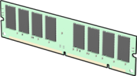




Escalabilidad y Rendimiento
Escalabilidad para todo negocio
Almacenamiento eficiente
Utilizacion eficiente de memoria
Rendimiento balanceado
Concurrencia optima
Notes:
[This slide provides a high-level overview of SQL Server’s capabilities in this area. The next slide drills into them in more detail]
The recent trend towards data center and server consolidation as well as a proliferation of remote and embedded databases, makes it important for a database server to be scalable and to perform well for a wide variety of applications. SQL Server 2008 provides a rich database environment that is capable of scaling to your data needs.
Fundamental to SQL Server 2008’s ability to provide enterprise-level scalability and performance are:
Efficient data storage through comprehensive support for different kinds of data, optimizations in the way numerical data and nulls are stored, and native data compression.
Effective memory utilization through automatic management of memory resources and the ability to scale to huge, data-center levels of memory.
Balanced workload performance through Resource Governor – a new tool in SQL Server 2008 that enables you to proactively manage workload resource utilization.
Optimal concurrency through efficient lock management and isolation configuration options.

Slide 4






Alta Disponibilidad
Reduccion dramatica de downtime
Database Mirroring
Failover Clustering
Replicacion
Operaciones en linea
Notes:
[This slide provides a high-level overview of SQL Server’s capabilities in this area. The next slide drills into them in more detail]
SQL Server 2008 delivers always-on data operations for today’s mission-critical line of business applications through:
Database mirroring, which includes enhanced reliability and performance in this release.
Failover clustering
Replication of data throughout the enterprise, including enhancements to peer-to-peer replication in this release.
Online operations for database operations and server maintenance.

Slide 5





Seguridad
Asegurando la data critica del negocio
Autenticacion y autorizacion
Reduccion de area expuesta
Auditoria completa
Encripcion nativa
Notes:
[This slide provides a high-level overview of SQL Server’s capabilities in this area. The next slide drills into them in more detail]
SQL Server 2008 delivers a secure data platform through:
A comprehensive authentication and authorization model.
Surface area configuration capabilities, and a “secure by default” configuration.
Full event auditing of all SQL Server events throughout the enterprise.
Native support for transparent encryption of data.

Slide 6
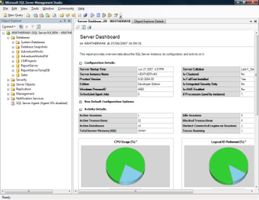



Administracion
Reduciendo overhead administrativo
Administracion centralizada
Operaciones automatizadas
Administracion con politicas
Monitoreo consolidado
Notes:
[This slide provides a high-level overview of SQL Server’s capabilities in this area. The next slide drills into them in more detail]
SQL Server 2008 provides management automation and consolidation to help reduce the overhead of database server administration, and release administrators to focus on high-value activities: Key to SQL Server’s manageability are:
Centralized administration through a single, consistent management interface.
Automated operations to perform database maintenance tasks and respond proactively to system issues.
Policy-based management through the new Declarative Management Framework (DMF).
Consolidated monitoring across the enterprise through the new Performance Studio.

Slide 7
SQL Server 2008
Plataforma de BI
Integracion
Analisis
Reportes
Almacenamiento
Motor de BD SQL Server
SQL Server Integration Services
SQL Server Analysis Services
SQL Server Reporting Services
Notes:
SQL Server 2008 provides a full, end-to-end platform for Business Intelligence solutions.
Store - The SQL Server 2008 Database Engine provides a high-performance, scalable storage solution for enterprise-scale data warehouses.
Integrate – SQL Server Integration Services provides a comprehensive set of ETL capabilities that you can use to build and maintain a data warehouse that consolidates business data from across the enterprise.
Analyze – SQL Server Analysis Services provides powerful OLAP analysis and data mining functionality to help your users gain deep insights into your business data.
Report – SQL Server Reporting Services is an enterprise-scale reporting solution that you can use to create and deliver reports throughout the organization and to external partners and customers.

Slide 8



SQL Server 2008
Almacenamiento Uniforme de la data
Consolide analisis y reporte de data
Optimice Rendimiento del DW
Alcance analiticos de alto rendimiento
Implemente reporteo escalable
Notes:
[This slide provides a high-level overview of SQL Server’s capabilities in this area. The Key Points slide in the appendix drills into them in more detail]
Most organizations have multiple business systems, each with its own dedicated data store. While you can often generate reports from individual applications, and perform analysis on the data they contain, you can only achieve a complete and consistent insight into the business by consolidating the disparate data throughout the enterprise to create a central source of business data for reporting and analysis.
Consolidate data for analysis and reporting
SQL Server 2008 supports the building of data warehouses as well as the utilization of data source abstraction.
Data warehouse performance
SQL Server 2008 provides a comprehensive and scalable data warehouse platform that enables your organization to integrate data into the data warehouse faster thus allowing you to better scale and manage growing volumes of data and users.
Analytics performance
Increasingly, organizations need to perform highly complex analysis with a large number of dimensions and aggregations. To facilitate the process, SQL Server 2008 includes Analysis Services, enabling you to drive broader analysis with enhanced capabilities including complex computations and aggregations.
Scalable Reporting
For many organizations, a significant challenge is getting the right information to the right people at the right time. SQL Server 2008 provides a high performance reporting engine for processing and formatting reports along with a complete set of tools for creating, managing, and viewing reports. An extensible architecture and open interfaces enable easy integration of reporting solutions in diverse IT environments.

Slide 9
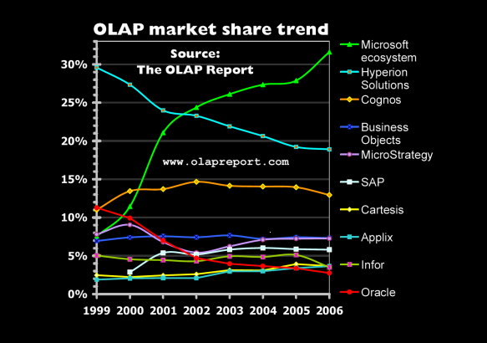
SQL Server 2008
Momento en Mercado
3r anio como lider en la industria de BI
Mayor crecimiento en la industria
http://www.olapreport.com

Slide 10

© 2004 Microsoft Corporation. All rights reserved.
This presentation is for informational purposes only. Microsoft makes no warranties, express or implied, in this summary.

