Slide 1
Microsoft Dynamics CRM 4.0
Deployment and system management
[NAME]
[TITLE]
[YOUR COMPANY]

Slide 2
Caveats & Disclaimer
Dates and capabilities are subject to change
Screen shots are prototypes only
Disclaimer
This presentation contains preliminary information that may be changed substantially prior to final commercial release of the software described herein. The information contained in this presentation represents the current view of Microsoft Corporation on the issues discussed as of the date of the presentation. Because Microsoft must respond to changing market conditions, it should not be interpreted to be a commitment on the part of Microsoft, and Microsoft cannot guarantee the accuracy of any information presented after the date of the presentation. This presentation is for informational purposes only. MICROSOFT MAKES NO WARRANTIES, EXPRESS, IMPLIED OR STATUTORY, AS TO THE INFORMATION IN THIS PRESENTATION. Microsoft may have patents, patent applications, trademarks, copyrights, or other intellectual property rights covering subject matter in this presentation. Except as expressly provided in any written license agreement from Microsoft, the furnishing of this information does not give you any license to these patents, trademarks, copyrights, or other intellectual property. © 2008 Microsoft Corporation. All rights reserved.

Slide 3
Agenda
Email Router
Deployment Scenarios and Scaling
Writing your own setup
Lab

Slide 4
Email Router
Configuring inbound and outbound email

Slide 5
Email / Exchange Router
Complete re-write for CRM 4.0
Stand-alone service and configuration tool that can run on any machine in any domain that can communicate with the required services
Support for POP3, SMTP and Exchange for both sending and receiving
Works against On Premise, Online and Partner Hosted

Slide 6
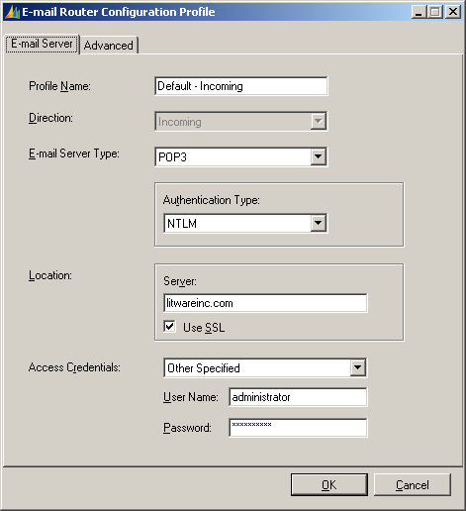
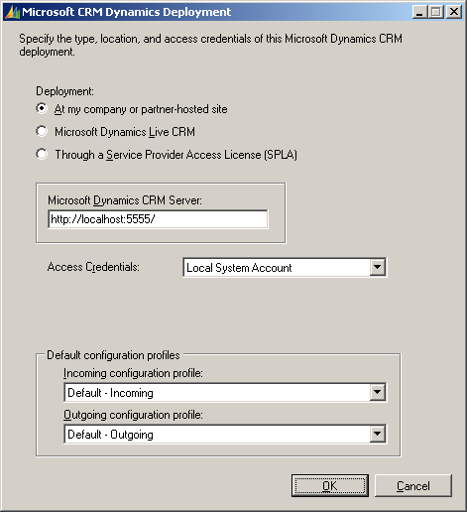
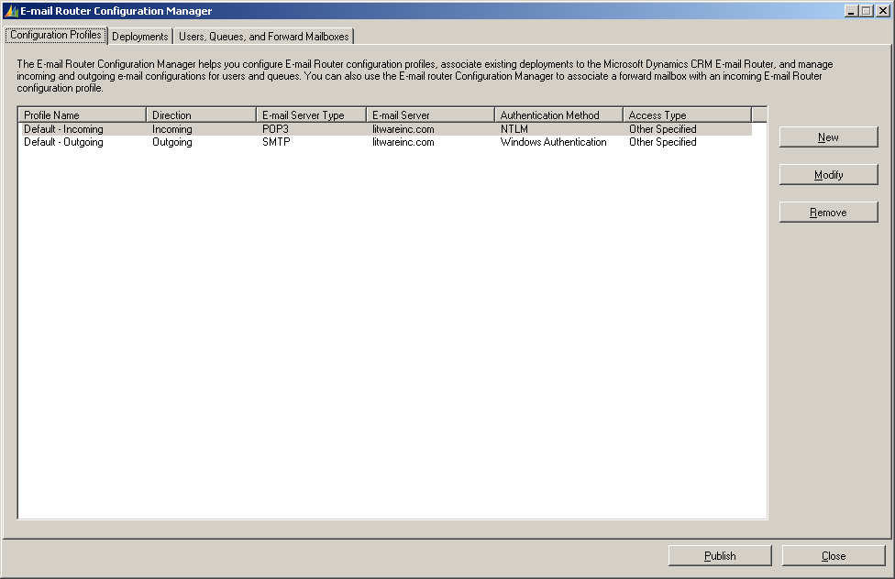
Email / Exchange Router
Configured via WinForm application.
Configuration consists of Inbound and Outbound “Profiles” as well as “Deployments”.
Profiles store connection information for mail servers
Deployments connect the profiles to a CRM server.
Rule Deployment Wizard still exists for Exchange-based email deployments

Slide 7
Writing your own Setup
Getting your add-ons installed

Slide 8
Writing your own setups
Several approaches are available and the “right” approach depends on your solution and the amount of time and budget you can dedicate to setup.
The solution can be as complex as a custom MSI package that provides a wizard-driven interface to fully install and uninstall your add-in. Or it can be as simple as instructions on how to manually deploy your solution.

Slide 9
Writing your own setup - Considerations
Design your setup – What do you need to deploy?
Customizations (Adding entities or attributes)
ISV.config / Site Map
Custom database
Custom files (ASPX, JS, Etc)
Workflows
Plug-ins
Virtual Directory and IIS Configuration
Backups
Recommend or automate the backup of the users customizations, site map, system settings and ISV.config prior to installing anything

Slide 10
Writing your own setup - Considerations
Don’t “stomp” on a users installation
Don’t import your ISV.config, Site Map, form customizations over their current one, instead “merge” them.
When uninstalling, be conscious of whether or not you should remove attributes or entities you added. Does the user really want to lose that data?

Slide 11
Writing your own setup - Considerations
Both the CRM Server and CRM client have known and documented registry keys that your setup can use to “detect” information about the installation.
Important keys include:
HKLM\Software\Microsoft\MSCRM\
HKCU\Software\Microsoft\MSCRM\
Key | Purpose
ConfigSku | The SKU of CRM installed - Ex: “OnPremise”
CRM_Server_Version | The version of CRM installed
CRM_Server_InstallDir | Where CRM is installed
ServerUrl | The URL to the CRM web services, use this so that your setup can call the CRM web services.
website | The IIS Metabase path to the CRM website, useful if you need to create a VDIR

Slide 12
Managing Deployments
Post installation management

Slide 13
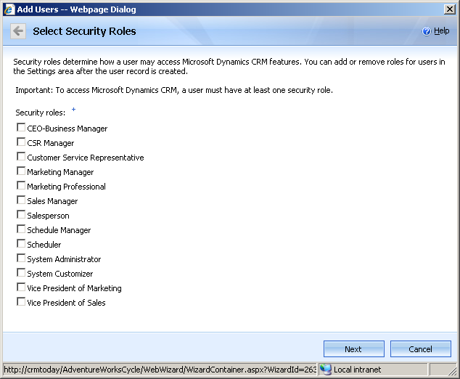
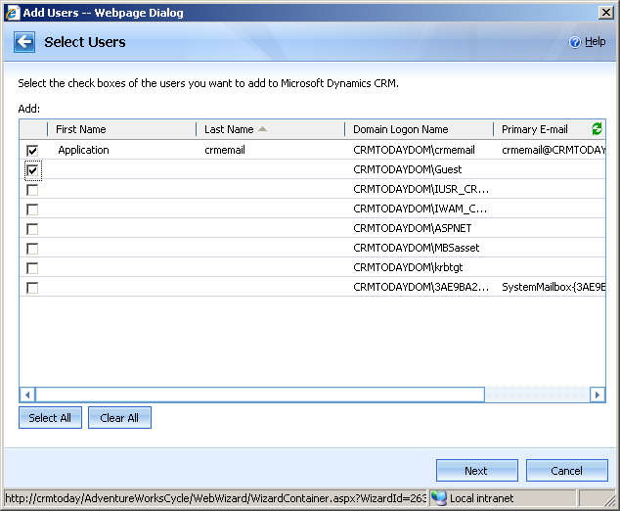
Managing Deployments
Add User Tool moved from Deployment manager to a new web-based Wizard
New “Deployment Administrator” Role
Deployment Manager adds:
Organization Manager
Deployment Administrator Manager
Notes:
Takeaway: The Add Users Wizard is much improved version of the old user manager.
Is accessible everywhere from the browser.
Requires no knowledge of Win32 MMC.
Uses modern, consistent web UI framework.
Performant
Can handle any number of Active Directory users via pagination.
Queries only portions of Active Directory in layers.
Automatically supports multiple orgs.
Supports specification of license type.
Supports application of multiple CRM roles.
Practical
Returns domain and group specific Active Directory users.
Allows drilling down to manageable number of users.

Slide 14
Lab - Overview
In this lab you will:
Use CRM Tools to provision a new CRM Organization
Use CRM registration web services to programmatically register the plug-in you developed in previous lab
Test your work
Finished Early? Already done this lab?
Explore the CRM Office Client Diagnostic Wizard. This tool is used to find and fix common issues, allows enabling of tracing and creation of a troubleshooting file. Start | All Programs | Microsoft Dynamics CRM 4.0 | CRM Office Client Diagnostic Wizard
Try connecting the Outlook Client to the organization you just created.
Explore the register.xml schema in the CRM SDK.

Slide 15
© 2008 Microsoft Corporation. All rights reserved.
This presentation is for informational purposes only. Microsoft makes no warranties, express or implied, in this summary.

