Slide 1
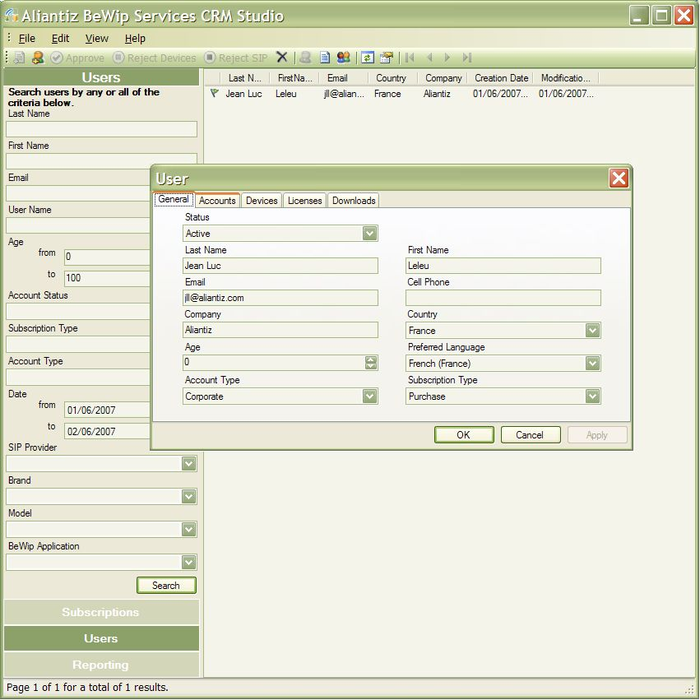
be Wireless Internet phone
Aliantiz, leader de la Convergence Fixe Mobile
avec sa plateforme logicielle BeWip
APPLICATION
BeWip apporte aux terminaux Windows Mobile la richesse de l’Internet :
- Communications et messageries unifiées,
- Web Services 2.0 mobiles
TECHNOLOGIES
SIP, VoIP WiFi, SMS/IP, User Presence, VideoTones
MS Windows Mobile 5 and 6
MS Windows 2008 Server
MS SQL Server 2008
www.bewip.com
www.aliantiz.com
The information contained in this document relates to prerelease software product which may be substantially modified before its first commercial release. Accordingly, the information may not accurately describe or reflect the software product when first commercially released. This document is provided for informational purposes only and Microsoft makes no warranties, express or implied, with respect to this document or th information contained in it.
Notes:
You just made the first step towards mobile Internet and voice over IP via any WiFi access point.
Indeed, you may not be aware of it, but as soon as you have a mobile phone with WiFi connectivity, you can access Internet-based online services such as VoIP, wherever you are: at home or friends, in the street, at the coffee shop, in the airport, or in the office.
BeWip relies on standard services and protocols provided by telecommunications operators. This software gives you the ability to use on your mobile, the services you normally use at home. For example, it is possible to call your contacts over landlines or cellular telephony, and thus on your mobile at a price close to what you would pay if you were at home on your own landline, as defined by your SIP operator.

